Slide 1

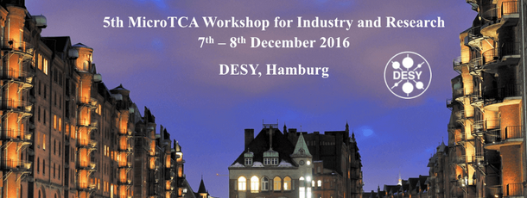
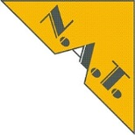
High Voltage Power Module
pluggable to
NAT RTM Power Supply Carrier
Konrad Przygoda
Michael Fenner,
DESY
Helmut Lauftkoetter,
NAT

Slide 2
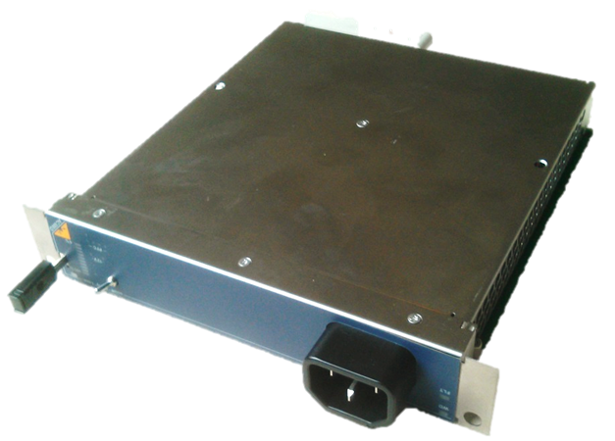
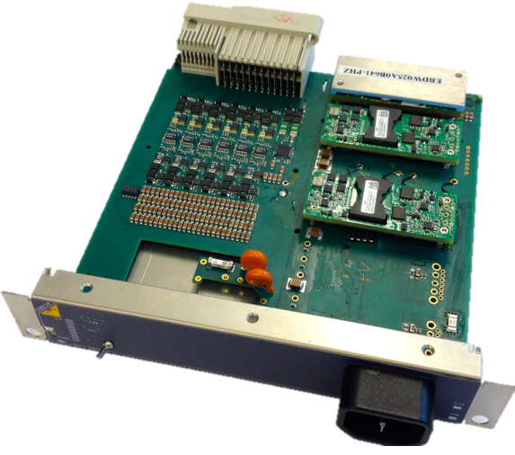
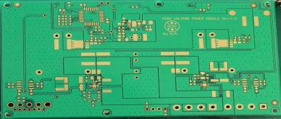
Outline
Motivation
Hardware
Firmware
Software
Results
Possible applications

Slide 3
Motivation
DESY introduced an RF-Backplane for MicroTCA.4 Crates
  The RF-Backplane is located behind the AMC backplane of the MicroTCA.4 Crate.
  Three types of RTMs used: µRTMs with only a Zone-3 connection to the front AMCs, µRTMs with a connector to the RF-Backplane and optionally a Zone-3 connection to the front AMCs and extended RTMs
eRTMs are not covered by MicroTCA.4 Specification, a standard Power Modules does not provide power to them
µRTMs used together with the RF-Backplane might be powered from the RF-Backplane instead of corresponding to a given AMC board
In many cased sensitive analog signal conditioning elements are installed on RTMs and there is a need to provide clean power supply to these RTMs
For specific applications there is a need to deliver high voltage, high current power supply which is not covered by MicroTCA.4 Specification

Slide 4
Hardware (RF-Backplane)
Courtesy by H. Lauftkoetter
Rear PM
Rear PM

Slide 5
Hardware (Example Setup)
+/-100V
Courtesy by H. Lauftkoetter

Slide 6
Hardware (NAT RTM Power Supply Carrier)
High quality ±VV for µRTMs, adjustable 5-12V
+12V PP, +3.3V MP for eRTMs
Contention protection against standard PMs
Modular design
Optional ±100V output at front panel
AC frontend
Courtesy by H. Lauftkoetter

Slide 7
Hardware (High Voltage Power Module)
Accept low voltage input (up to
+48 VDC) and deliver stable, high voltage (up to ±100 VDC – bipolar or unipolar) and high current (up to 500 mA) outputs
PMBus standard communication bus
Temperature, output voltage, current and power sensors
Allow supplying up to 4x RTM cards
High voltage output indicated by front panel LEDs
Built in: short circuit protection, input filter
Inputs/outputs isolated with possible line, load regulation
Closed inside housing (Nickel Plated Copper),
Cooled using free air convection (no additional heat sink needed)

Slide 8
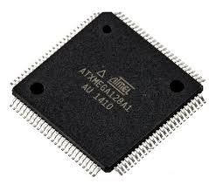
Firmware (ATXMEGA128A1U)
hvpm.c
  void HVPM_DriverInit(); void HVPM_ActivateHVPos(); void HVPM_DeactivateHVPos();
  void HVPM_ActivateHVNeg(); void HVPM_DeActivateHVNeg();
  void HVPM_ActivateHVPosNeg(); void HVPM_DeActivateHVPosNeg();
  void HVPM_TemperatureSenseHVPos(); void HVPM_TemperatureSenseHVNeg();
  void HVPM_VoltageSenseHVPos(); void HVPM_CurrentSenseHVPos();
  void HVPM_PowerSenseHVPos(); void HVPM_VoltageSenseHVNeg();
  void HVPM_CurrentSenseHVNeg(); void HVPM_PowerSenseHVNeg();
hvpm.h
  #define MAX6626A_ADDR (0x48)
  #define MAX6626B_ADDR (0x49)
  #define LTC2945A_ADDR (0xD8>>1)
  #define LTC2945B_ADDR (0xDE>>1)
  …

Slide 9
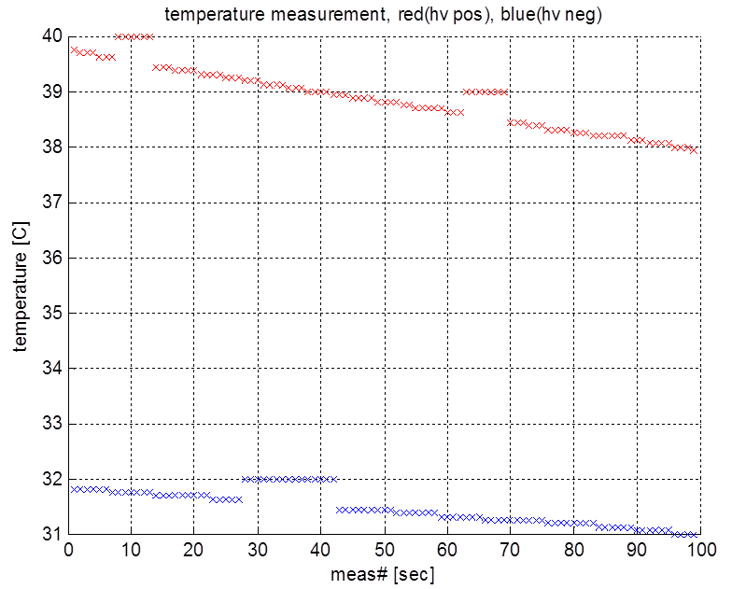
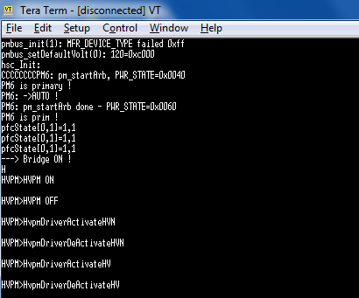
Software
NAT RTM PSC menu
HVPM submenu

Slide 10
Results

Slide 11



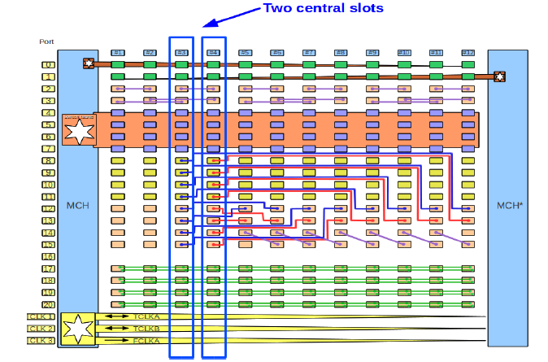
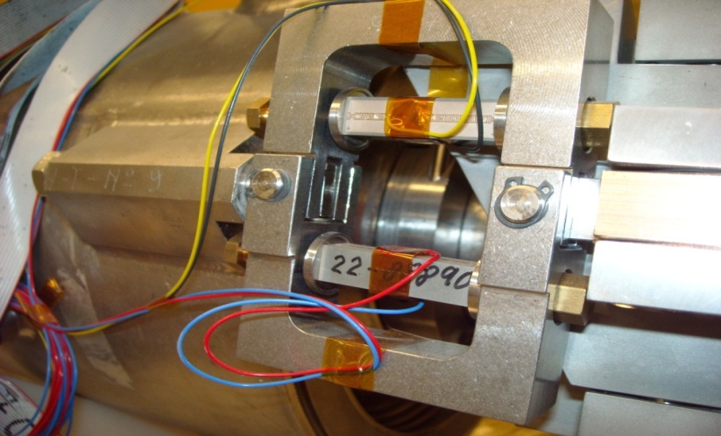

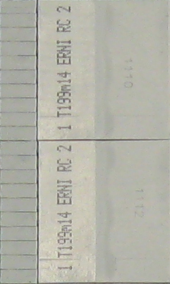
Possible Applications (XFEL RF Station – 32 cavities)
1x KLY
FPGA
4x V_{piezo}
PZD
FPGA
2x12
Slot
Crate
1x
2x
8x
8x
DRTM-VM2
DAMC-TCK7
DRTM-PZT4
DAMC-FMC25/20/TCK7
8x RF in
(probe)
FPGA
1x12
Slot
Crate
2x
FPGA
2x
2x
1x
RTM-DWC10
AMC-SIS8300
DAMC-FMC25/20/TCK7
SFP
8x RF in
(forward)
FPGA
32x cavities = 64x piezos
Cavity tuner control – pulse or cw modes
2x
2x
RTM-DWC10
AMC-SIS8300
8x RF in
(reflected)
FPGA
2x
2x
RTM-DWC10
AMC-SIS8300

Slide 12
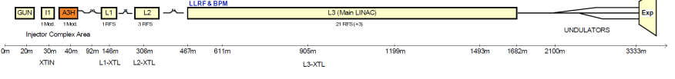

Possible Applications (XFEL link stabilization)
1x12
Slot
Crate
FPGA
4x V_{piezo}
PZD
FPGA
1x
6x
6x
DAMC-FMC25
DRTM-PZT4
DAMC-FMC25/20/TCK7
4x OXC
FPGA
1x12
Slot
Crate
2x
FPGA
6x
6x
1x
RTM-AD84
DAMC-FMC25
DAMC-FMC25/20/TCK7
SFP
Link Stabilization
24x links = 24x piezo fiber stretchers
RF Master Oscillator
Master Laser Oscillator
Synch Hutch
10-12 Links
12 RF Links
Sub-Synch Hutch
? Links
? RF Links
RF
Links
Links
2x
Master Laser Oscillator
Links
2x
Courtesy by C. Sydlo
2x
2x
1-6x
2x
3x
INJL
REFM
REFM
BAM
REFM
2x
BAM
3x
REFM
2x
BAM
REFM
REFM
REFM
REFM
SEED
2x
BAM
SEED
BAM
PPL
INJL
REFM
REFM
BAM

Slide 13
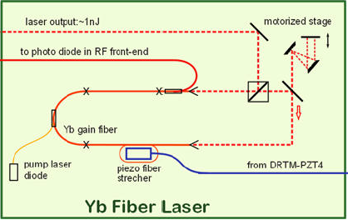
Possible Applications (XFEL Master Laser Oscillator Sync)
1x12
Slot
Crate
1x V_{piezo}
PZD
FPGA
Laser Synchronization
2x
1x
DRTM-PZT4
Redundant
solution
DAMC-FMC25
2x RF in
FPGA
2x
2x
RTM-DWC10
DAMC-SIS8300
Courtesy by U. Mavric
1x
Before connecting your AMCs with serial links over the AMC backplane study its show_fruinfo 253

Slide 14
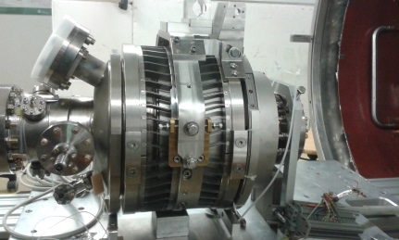
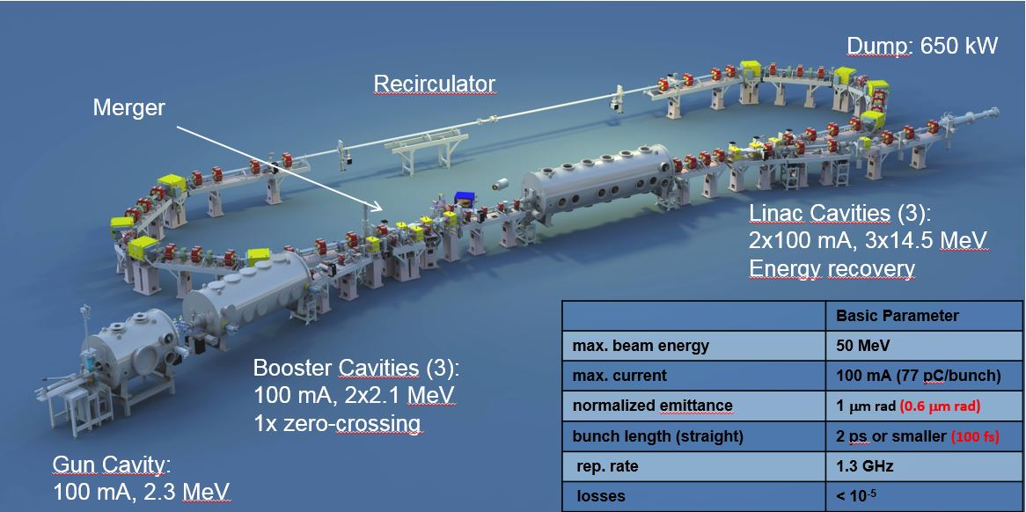
Possible Applications (many more)
bERLinPro at HZB
TARLA in Ankara
ESS?
Courtesy by P. Echeverria

Slide 15
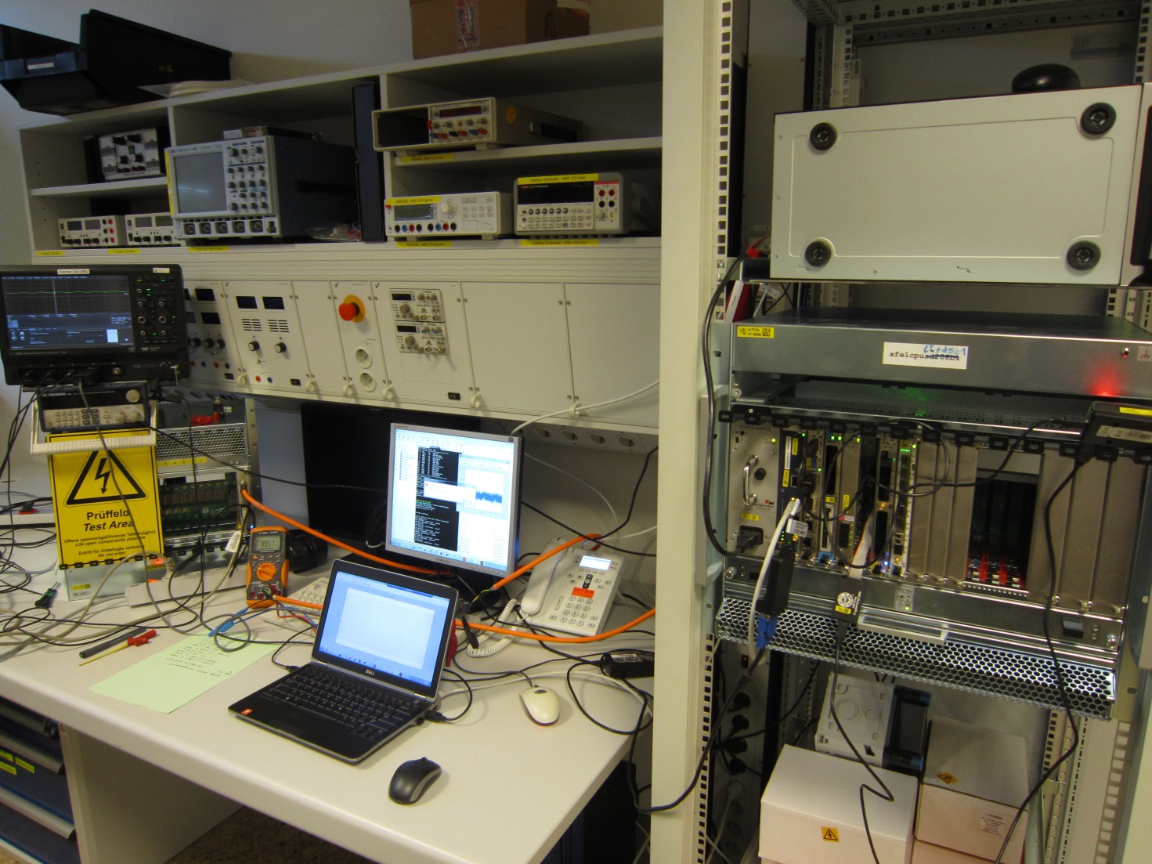
Thank You for Attention

