Slide 1
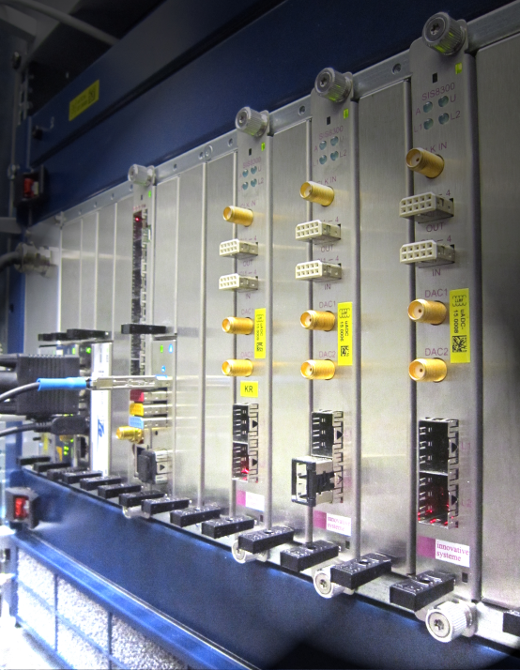
Introduction: 5th MicroTCA.4 Workshop 2016
Dr. Holger Schlarb
MSK, DESY
DESY, 07.12.2016

Slide 2

History of MicroTCA@DESY
2
Nov. 2005: Reliability Workshop in Grömitz, Germany
  Joint meeting with ILC (intern. linear collider, 33km, 500GeV)
Dec. 2007: European XFEL Crate-Standard Workshop
  MicroTCA and ATCA was defined to be used
Mar. 2009: First PICMG Meeting “xTCA for Physics”
  Hardware group: rear I/O and timing
  Software group: standardization of interfaces for FPGAs…OPsys
Oct. 2011: Official announcement of PICMG Specification
  “MTCA.4 Enhancements for Rear I/O and Precision Timing“
Jul. 2012: Start of Helmholtz Validation Fund till Dec. 2014
  „MicroTCA.4 for Industry“
Jan. 2014: Reestablish HW/SW PICMG working groups ➔ R. Larsen, SLAC
Sep. 2016: MicroTCA controls for European XFEL ➔ Talk K.Rehlich/J.Branlard
Oct. 2016: Start of MicroTCA TechLab (HGF Innovation Lab) ➔T. Walter, DESY
Notes:
Before you start editing the slides of your talk change to the Master Slide view:
Menu button “View”, Master, Slide Master:
Edit the following 2 items in the 1st slide:
1) 1st row in the violet header:
Delete the existent text and write the title of your talk into this text field
2) The 2 rows in the footer area: Delete the text and write the information
regarding your talk (same as on the Title Slide) into this text field.
If you want to use more partner logos position them left
beside the DESY logo in the footer area
Close Master View

Slide 3
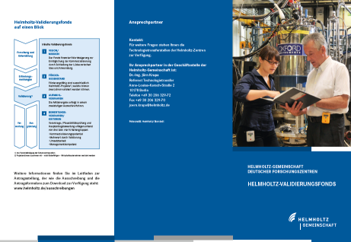
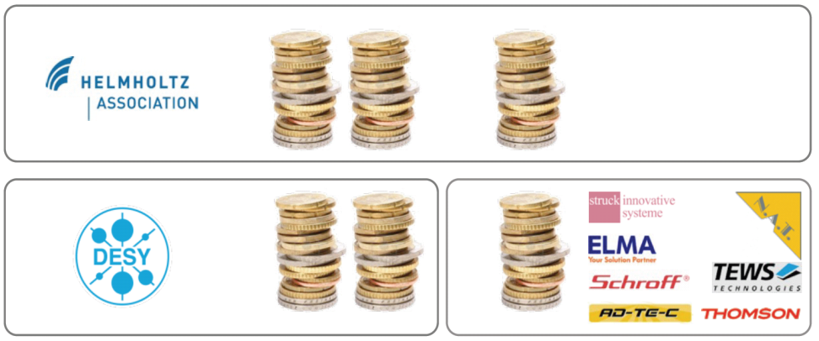






Helmholtz Validation Fund “MicroTCA for Industry”
3
What is the HGF validation fund?
Finance instrument to support the spin-off and technology transfer from scientific, technical inventions or developments from HGF centers to the industry and society
Main objectives of “MicroTCA for Industry” project:
Establish MicroTCA.4 electron crate system
  In accelerator community
  Industrial branches
  Scientific community
by reducing the market entry barriers and foster MicroTCA.4 to industry
Boundaries: 4 Mio (50% HGF) max 2 years, HVF0016: 07/2012 – 12/2014
successfully
50%
7 partners
+ 6 new partners
30%
20%
Notes:
Before you start editing the slides of your talk change to the Master Slide view:
Menu button “View”, Master, Slide Master:
Edit the following 2 items in the 1st slide:
1) 1st row in the violet header:
Delete the existent text and write the title of your talk into this text field
2) The 2 rows in the footer area: Delete the text and write the information
regarding your talk (same as on the Title Slide) into this text field.
If you want to use more partner logos position them left
beside the DESY logo in the footer area
Close Master View

Slide 4
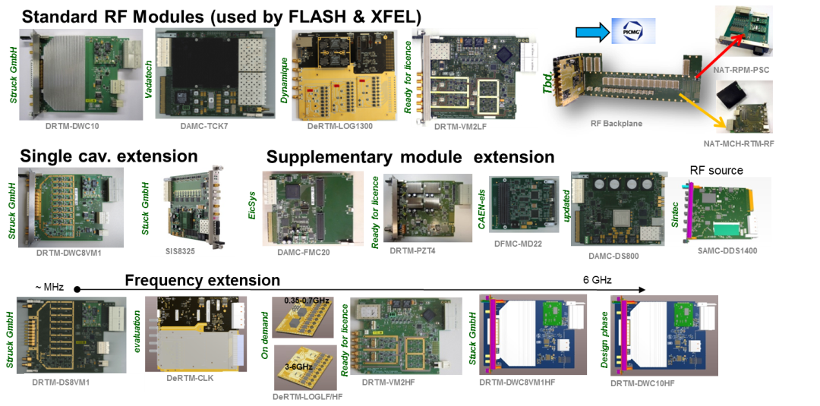
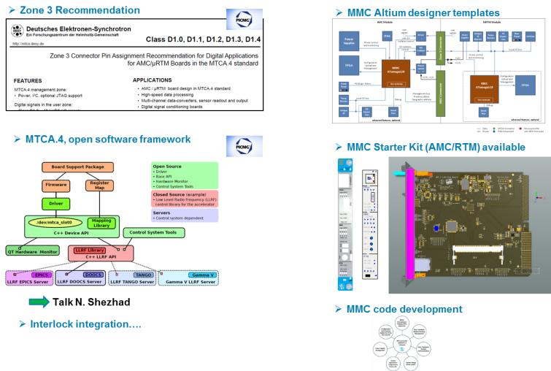
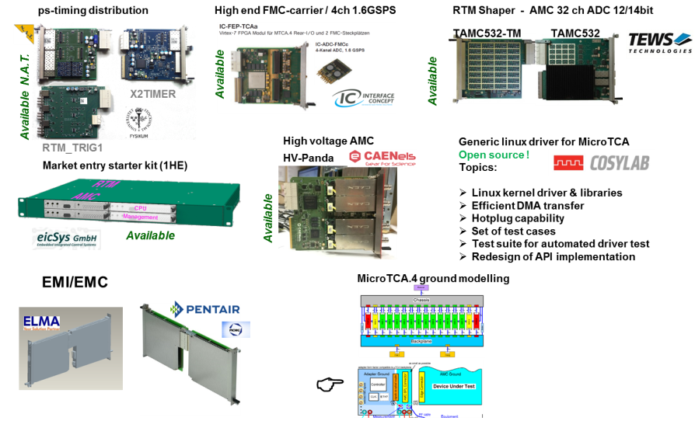
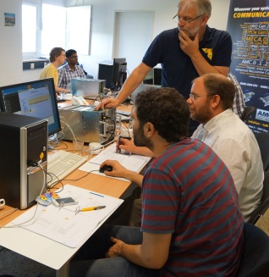
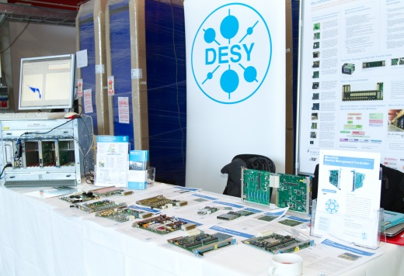
Helmholtz Validation Fund “MicroTCA for Industry”
4
Boards for RF controls & other appl.
Developments on standard & solutions
> 50 sub-projects were carried out and completed
> 25 new products on the market
Extending product portfolio on market & EMI
Support & Distribution & Marketing
www.mtca.desy.de

Slide 5
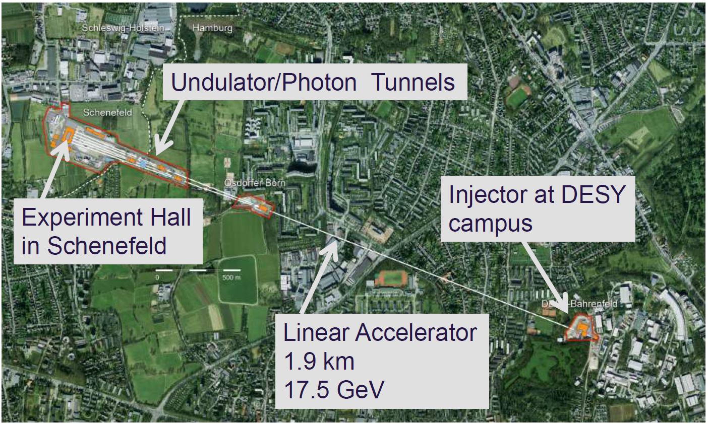

Construction of European XFEL kept us busy …
5

Slide 6
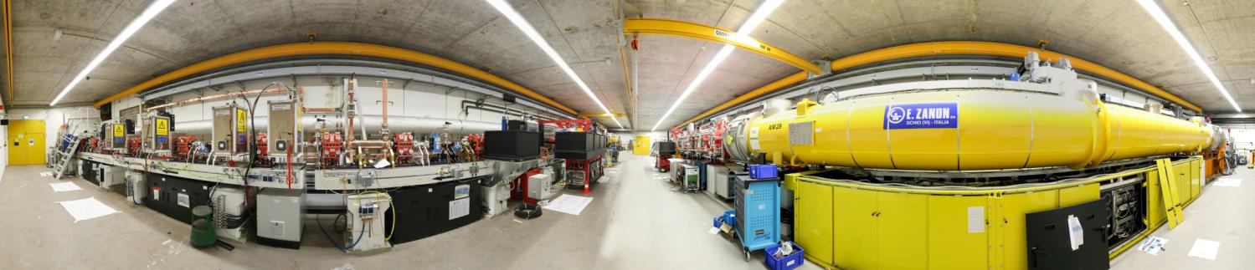
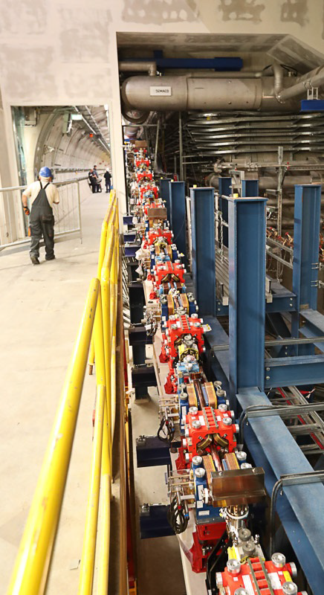
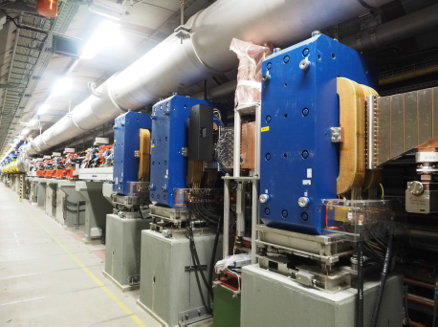
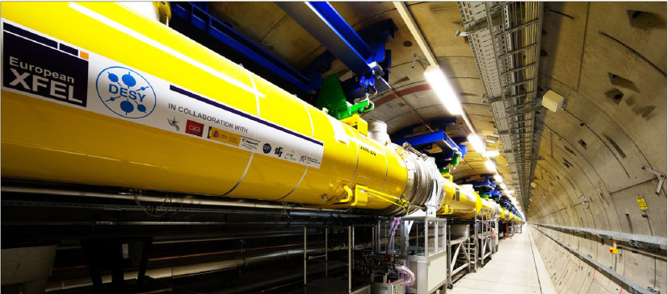
Impressions of European XFEL
6
Injector section
Transport to linac
Bunch compressor
beginning of cryo-linac

Slide 7
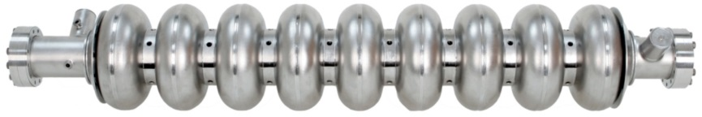
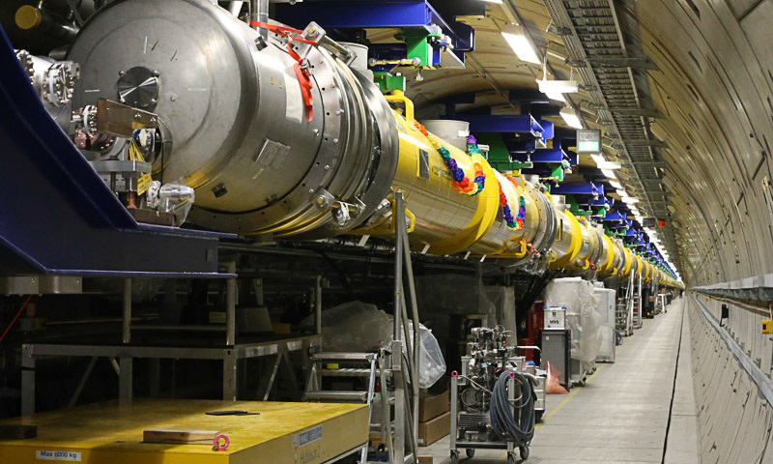
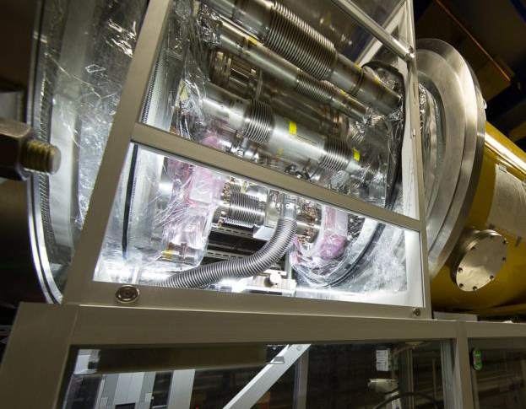
Impressions of European XFEL
7
End of cryo-linac (T=2K, 800 superconducting cavities)
Last connection of cryo-module: 9. Sep 2016

Slide 8
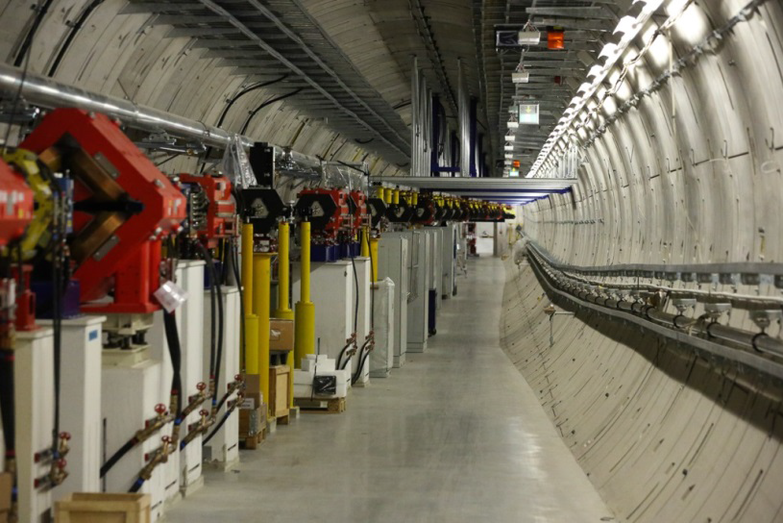
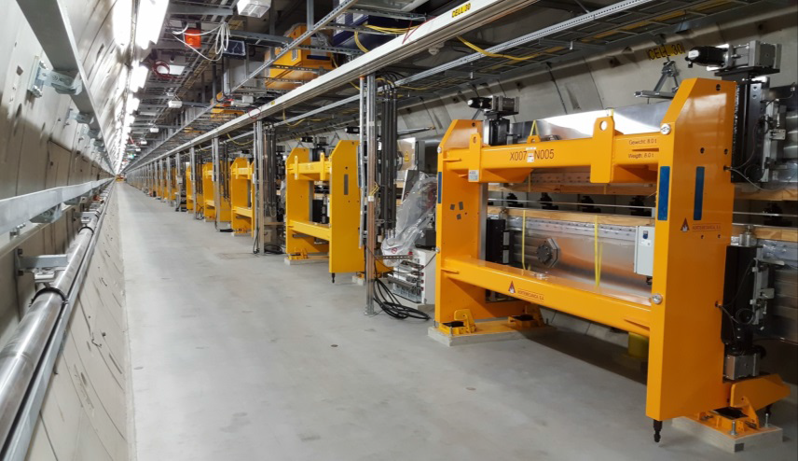
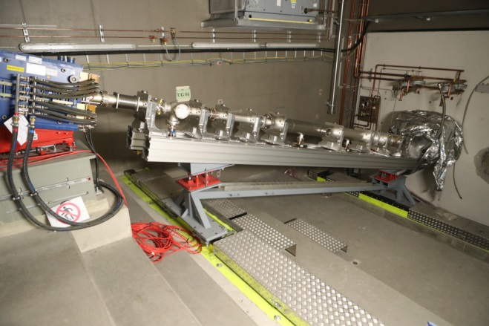
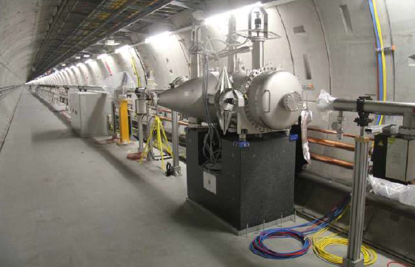
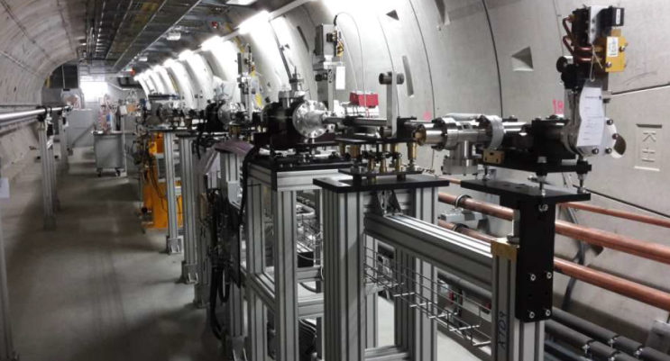
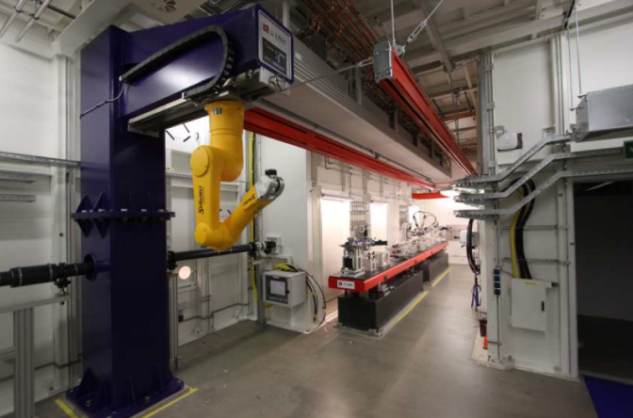
Impressions of European XFEL
8
Collimation system
Undulators
Electron Dump
e⁻
Photon transport
Photon diagnostics
Exp. End-station
X-rays
Tunnel closed for cool down 05. Dec 2016!!!

Slide 9

Helmholtz Innovation Lab…
9
2015 DESY Directorate approved funding to continue “MicroTCA” @ DESY
Activities (strongly reduced compared to HVF):
  Future enlarge MicroTCA product portfolio through licensing
  Continuation PICMG efforts (HW/SW)
  Marketing / support / consultancy
  Investigate future funding options
From last years workshop
Most promising: Application for „Helmholtz Innovation Labs”
Interface between industrial and research centers
Close interaction between Scientists and Industry & users/customer
Funding: 5 Mio total (50%/50%) for 5 years!
Target of submit application:
Service & Support
Creation of set of turn key system
Decision taking: Q1-Q2/2016
Notes:
Before you start editing the slides of your talk change to the Master Slide view:
Menu button “View”, Master, Slide Master:
Edit the following 2 items in the 1st slide:
1) 1st row in the violet header:
Delete the existent text and write the title of your talk into this text field
2) The 2 rows in the footer area: Delete the text and write the information
regarding your talk (same as on the Title Slide) into this text field.
If you want to use more partner logos position them left
beside the DESY logo in the footer area
Close Master View

Slide 10
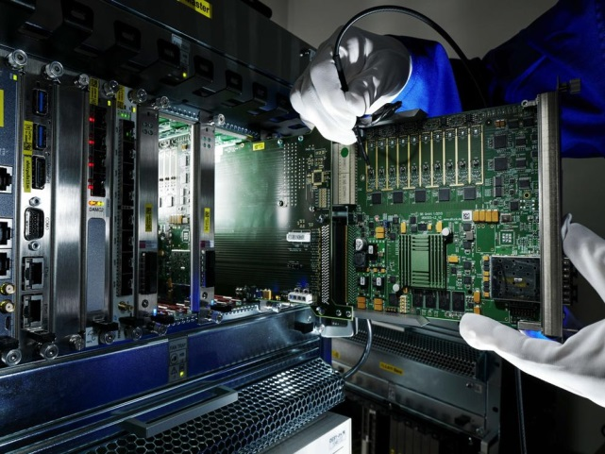
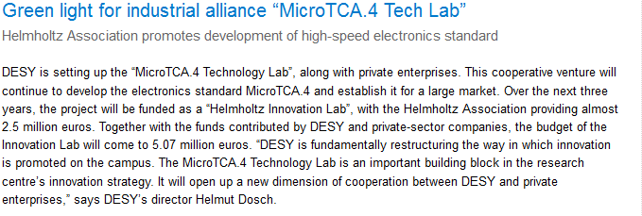
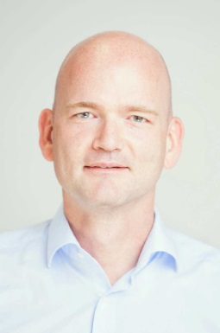
MicroTCA TechLab – a HGF Innovation Laboratory (HIL)
DESY press lease: 10.05.2016
7 proposals out auf 27 where selected by HGF
Received full funding (2.5 Mio from HGF 50%)
Duration 5 years
Start 10.16: Construction of Labs/Hiring personnel/Equipment …
Talk today
Thomas Walter
HIL Manager
Notes:
Before you start editing the slides of your talk change to the Master Slide view:
Menu button “View”, Master, Slide Master:
Edit the following 2 items in the 1st slide:
1) 1st row in the violet header:
Delete the existent text and write the title of your talk into this text field
2) The 2 rows in the footer area: Delete the text and write the information
regarding your talk (same as on the Title Slide) into this text field.
If you want to use more partner logos position them left
beside the DESY logo in the footer area
Close Master View

Slide 11
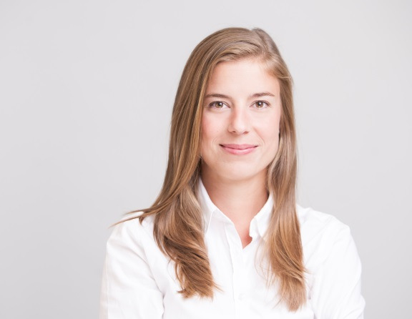
11
Workshop organization
Katharina Kull
Notes:
Before you start editing the slides of your talk change to the Master Slide view:
Menu button “View”, Master, Slide Master:
Edit the following 2 items in the 1st slide:
1) 1st row in the violet header:
Delete the existent text and write the title of your talk into this text field
2) The 2 rows in the footer area: Delete the text and write the information
regarding your talk (same as on the Title Slide) into this text field.
If you want to use more partner logos position them left
beside the DESY logo in the footer area
Close Master View

Slide 12
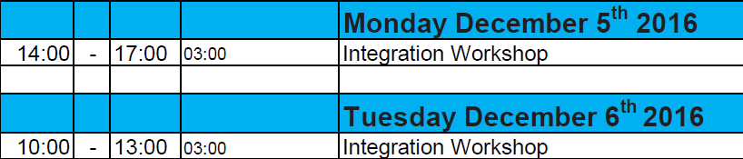
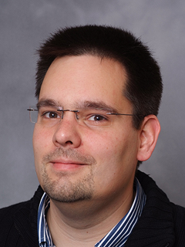
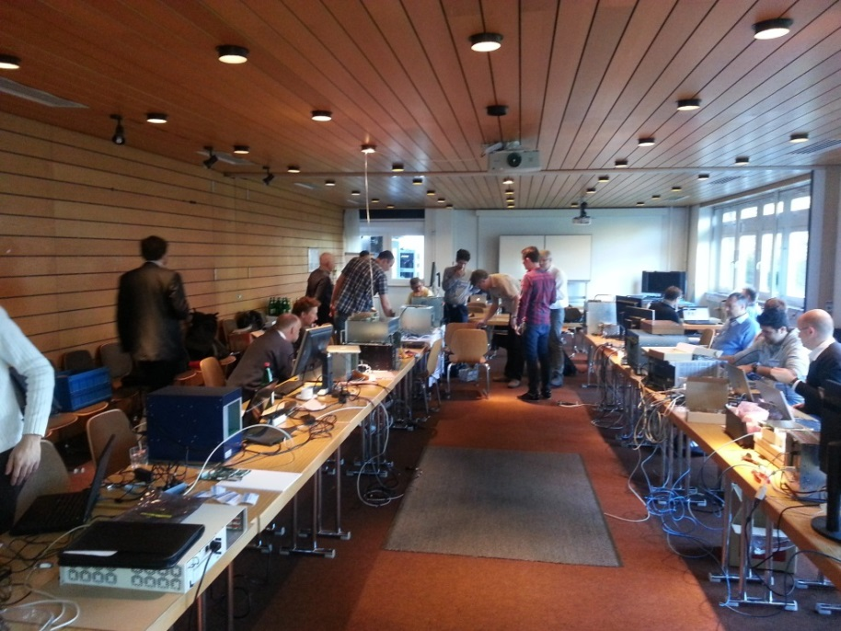
Workshop program: Integration Workshop
12
Michael Fenner
Goal:
Opportunity to test your application with vendors on different platform configurations
Well received, 18 participants
Notes:
Before you start editing the slides of your talk change to the Master Slide view:
Menu button “View”, Master, Slide Master:
Edit the following 2 items in the 1st slide:
1) 1st row in the violet header:
Delete the existent text and write the title of your talk into this text field
2) The 2 rows in the footer area: Delete the text and write the information
regarding your talk (same as on the Title Slide) into this text field.
If you want to use more partner logos position them left
beside the DESY logo in the footer area
Close Master View

Slide 13
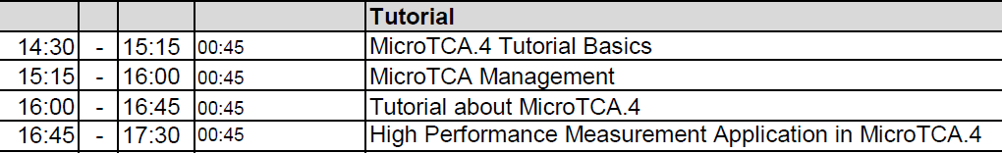
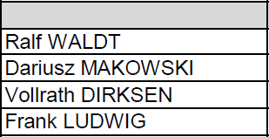
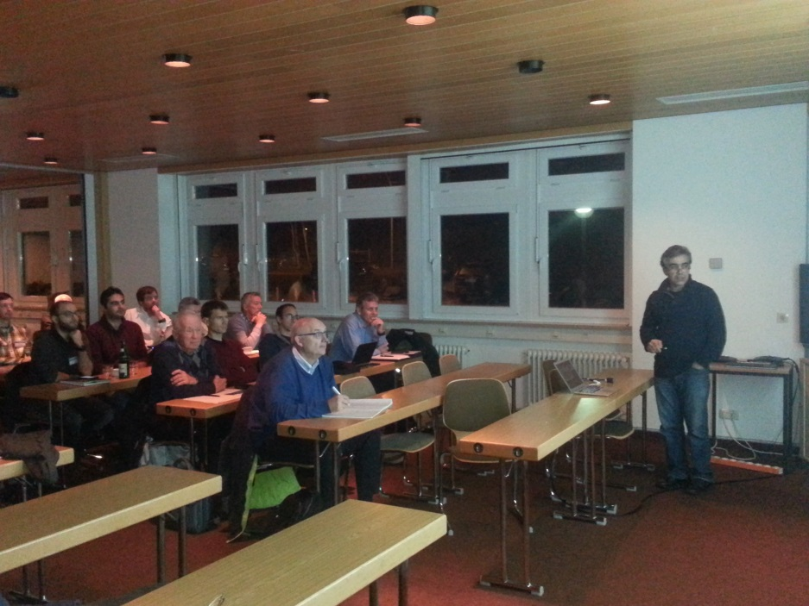
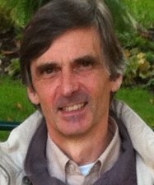
Workshop program: Tutorials
13
Tuesday 06 December 2016
Pentair
Uni Lodz
N.A.T.
DESY
Target audience:
Part 1:
Newcomers to MicroTCA.4 standard
Part 2:
Advanced users
Well received, > 50 participants
Kay Rehlich
Notes:
Before you start editing the slides of your talk change to the Master Slide view:
Menu button “View”, Master, Slide Master:
Edit the following 2 items in the 1st slide:
1) 1st row in the violet header:
Delete the existent text and write the title of your talk into this text field
2) The 2 rows in the footer area: Delete the text and write the information
regarding your talk (same as on the Title Slide) into this text field.
If you want to use more partner logos position them left
beside the DESY logo in the footer area
Close Master View

Slide 14
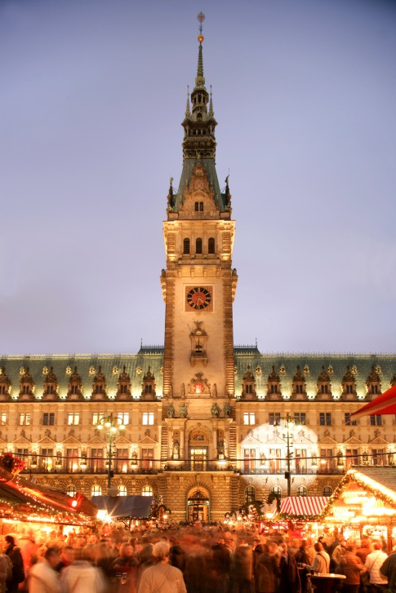
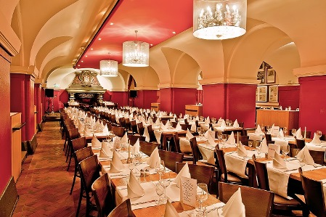
Workshop Dinner
Wednesday, December 7th restaurant “Parlament”
Shuttle busses starting from 18:55 at the DESY
main gate, returning 22:30 to DESY
More information in abstract book
Please inform registration desk if you can not attend
=> free spot for other interested participants

Slide 15
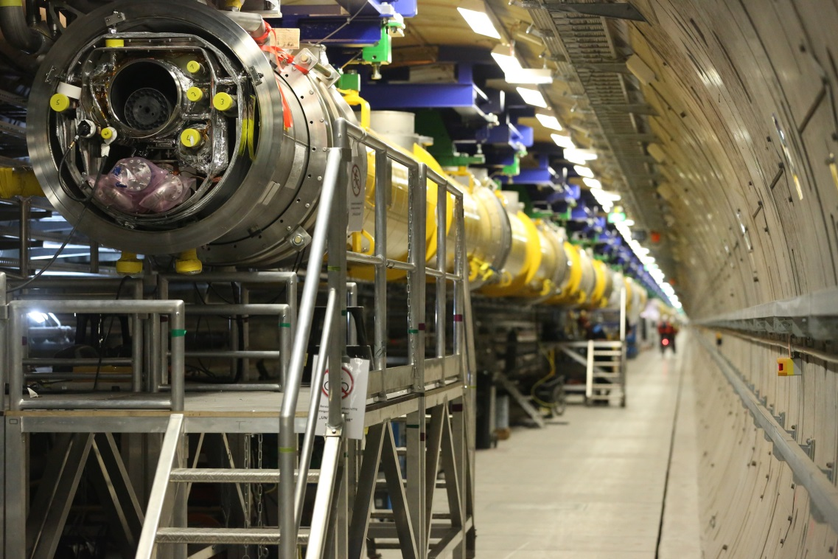
General Information
DESY tour
Meeting point ➔ in front of the registration desk
Takes about an hour
Lunch will be offered before and after the tour

Slide 16
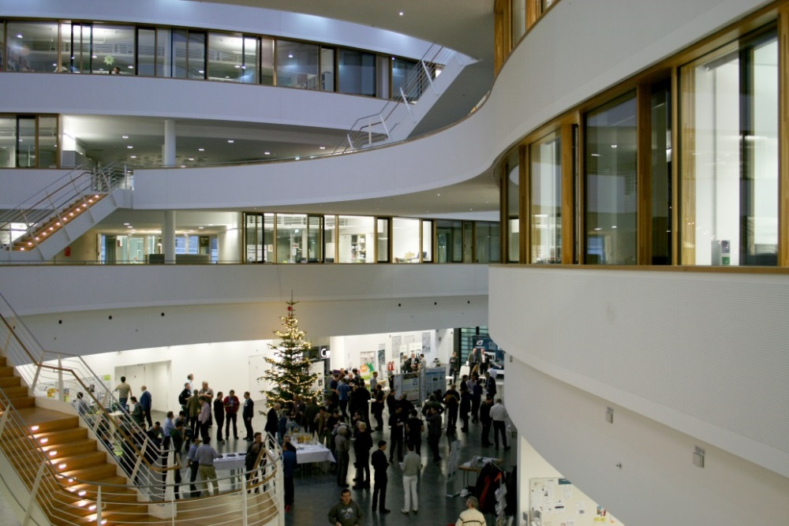
General Information
Speaker info
Presentations need to be handed to the organization team before the session starts
Magic presenter (please do not use your own laptop)
WLAN
Name: MTCA-Workshop
Password: MTCA_2016

Slide 17
17
We wish you an informative
and pleasant
5th MicroTCA Workshop
Thank you for your attention!
Notes:
Before you start editing the slides of your talk change to the Master Slide view:
Menu button “View”, Master, Slide Master:
Edit the following 2 items in the 1st slide:
1) 1st row in the violet header:
Delete the existent text and write the title of your talk into this text field
2) The 2 rows in the footer area: Delete the text and write the information
regarding your talk (same as on the Title Slide) into this text field.
If you want to use more partner logos position them left
beside the DESY logo in the footer area
Close Master View

Slide 18
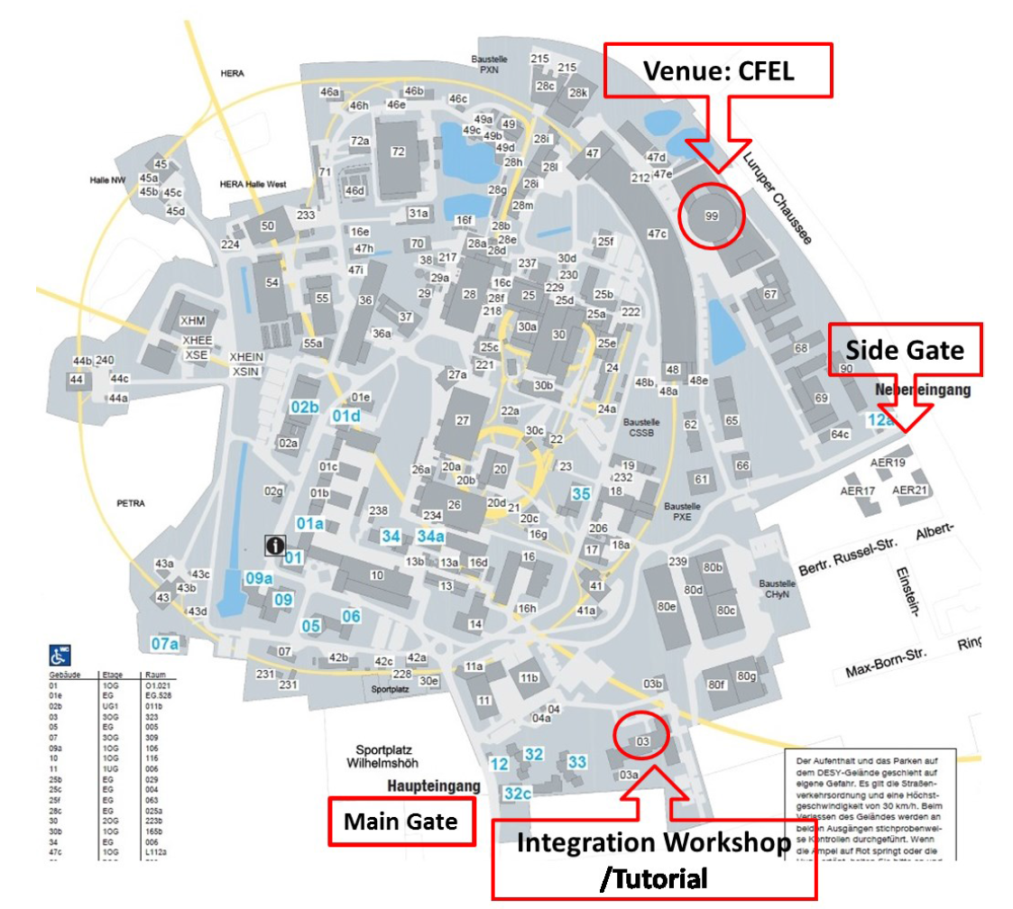
Workshop locations
18
XFEL
Notes:
Before you start editing the slides of your talk change to the Master Slide view:
Menu button “View”, Master, Slide Master:
Edit the following 2 items in the 1st slide:
1) 1st row in the violet header:
Delete the existent text and write the title of your talk into this text field
2) The 2 rows in the footer area: Delete the text and write the information
regarding your talk (same as on the Title Slide) into this text field.
If you want to use more partner logos position them left
beside the DESY logo in the footer area
Close Master View

