Slide 1
MicroTCA systems at ESS
Simone Farina
Integrated Control System Division
www.europeanspallationsource.se
2016 December 07

Slide 2
Outline
The European Spallation Source Facility;
MicroTCA components selection;
Systems for beam control and instrumentation;

Slide 3
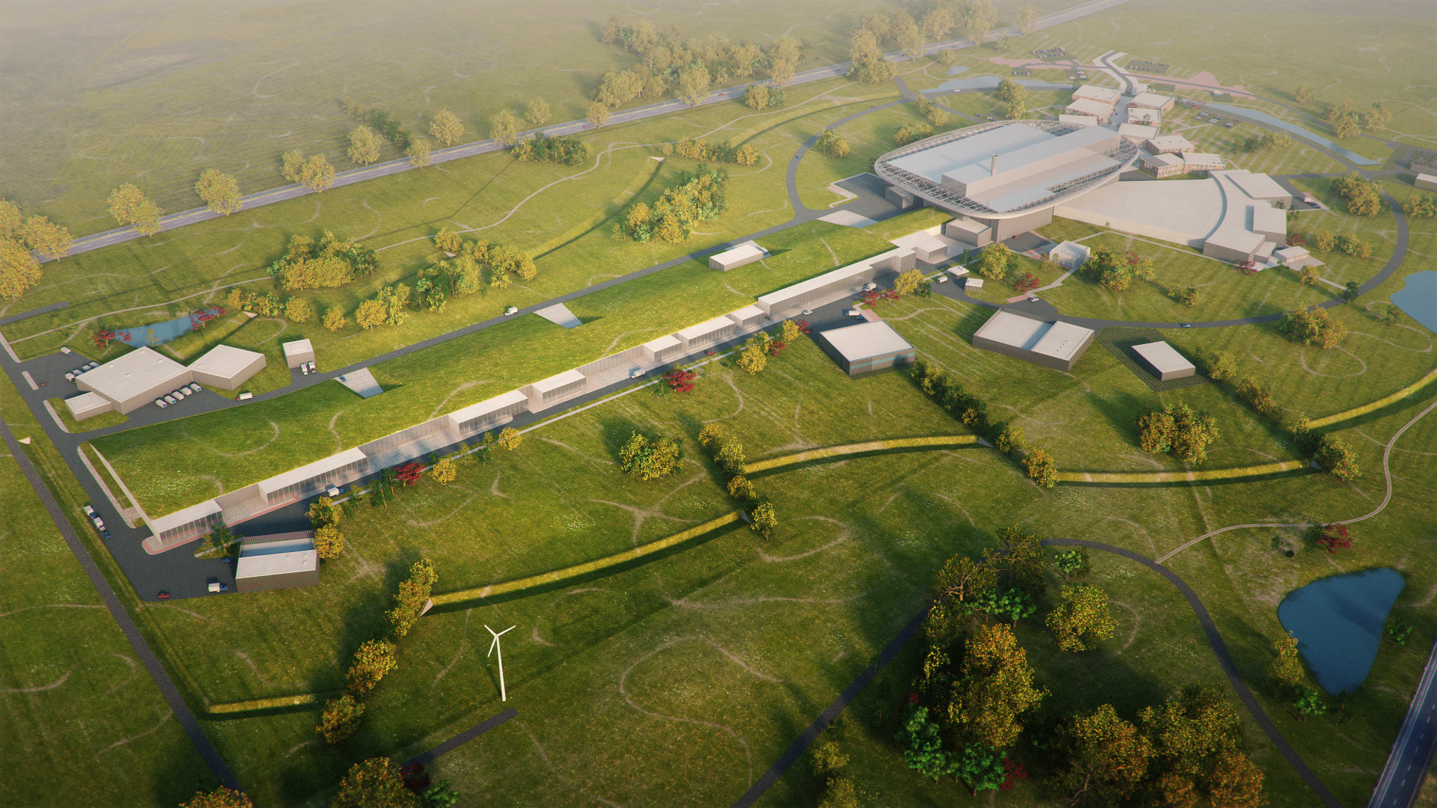
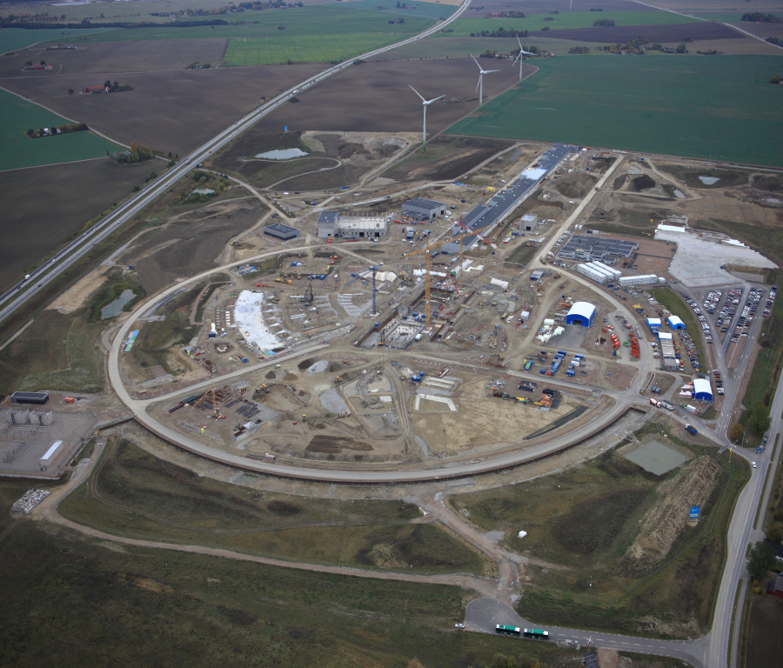
Facility Overview
The European Spallation Source is a Partnership of 17 European Nations committed to the goal of collectively building and operating the world's leading facility for research by use of neutrons
Facility located in Lund in southern Sweden and Data Management and Software Centre situated in Copenhagen
First protons delivered on a rotating tungsten target in 2019 and fully operational (22 instruments) in the second quarter of the 21st century
Around 35% of the construction budget is provided through In-Kind Contributions

Slide 4
Accelerator Overview
Key Parameters:
Energy 2 GeV
Current 62,5 mA
Pulse Lenght 2,86 ms
Pulse Repetition Frequency 14 Hz
Average Power 5 MW

Slide 5
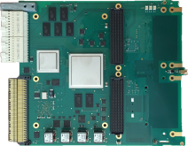
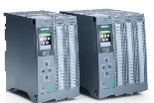
Three layer strategy - control systems at ESS
Signal speed
A custom made microTCA board with a powerful FPGA. A FPGA framework constitutes the development environment. The CPU board runs EPICS
ICS has adopted a three layer strategy for implementing the control system based on signal speed
A custom made platform based on microTCA for applications with data acquisition exceeding 100 kHz
The CPU will run EPICS and the FPGA will have a complete application development environment
For slower signals, EtherCAT will be used as a real-time fieldbus with good price/performance ratio
Synchronization and event information are key for applications where a full custom platform solution would be too costly
Low speed signals are handled with commercially available PLC systems from Siemens
This is a cost-effective solution that addresses ESS reliability and maintainability requirements
The PLCs will be connected to EPICS for further integration into the control system
10 MHz
1 MHz
100 kHz
Digital controls platform
10 kHz
1 kHz
EtherCAT I/O modules that are connected to commercial or open-source EtherCAT master controllers which are in turn connected to the EPICS based control system
100 Hz
EtherCAT
10 Hz
Slower signals are handled by industrial automation (PLC) for reliability and cost reasons. The standardized platform for ESS applications comes from Siemens
1 Hz
0.1 Hz
Industrial automation (PLC)

Slide 6
Beam Instrumentation
18 Beam Current Monitor Systems
99 Beam Position Monitor Systems
1 Doppler Shift Measurement System
4 Emittance Meter Units
4 Farady Cup Systems
3 Insertable Beam Stops
4 Longitudinal Brunch Profile Monitor Systems
10 Non-invasive Profile Monitor Systems
14 Wire Scanner Systems
273 Beam Loss Monitor Systems
2 Target Imaging Systems
3 Aperture Monitor Systems
1 Grid System

Slide 7
Beam Instrumentation
Three system architectures selected depending on performance and cost optimization:
Signal speed
10 MHz
1 MHz
uTCA
100 kHz
PLC
Industrial, process I/O
Safety systems, high reliability
10 kHz
1 kHz
100 Hz
EtherCAT
EtherCAT
mid-range, beam synchronised I/O
Used mainly as a fieldbus
10 Hz
MTCA
High-speed front-end processing
Digital Frontend Platform
1 Hz
Industrial automation (PLC)
0.1 Hz

Slide 8
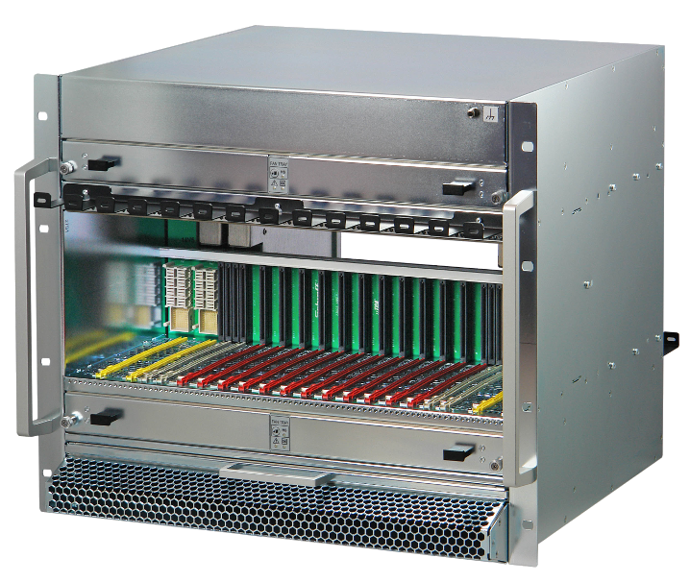
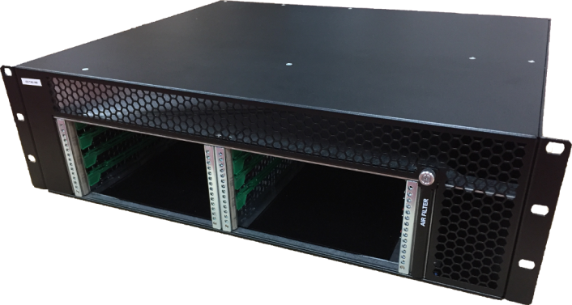
µTCA Infrastructure: crates
Plans to support two crate variants :
12 slots 9U for systems requiring more than 6 AMCs and/or more than 4 RTMs;
6 slots 3U to reduce the number of racks deployed.
Constraints:
Cooling scheme: front to rear, defined by rack ventilation;
Triggers and Interlocks: signals conveyed to all AMCs, M-LVDS lines availability;
ISSUE: very few options for 3U crates with front to rear cooling

Slide 9
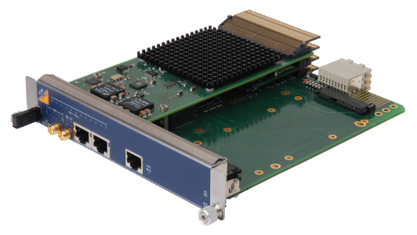
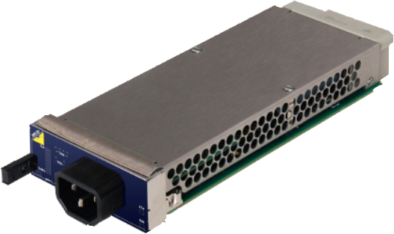
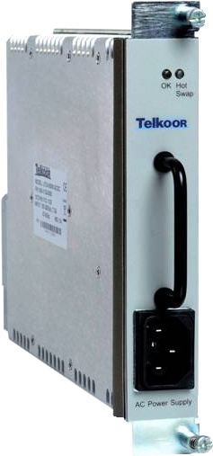
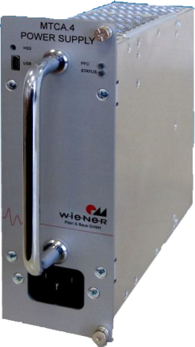
µTCA Infrastructure: MCH & PM
MicroTCA Carrier Hub :
N.A.T. selected, less interoperability issues found up to now.
Power Modules:
Many products under review:
Telkoor
Wiener
N.A.T.
Final choice made according to instrument requirements and space constraints.
More than one product might be selected.

Slide 10
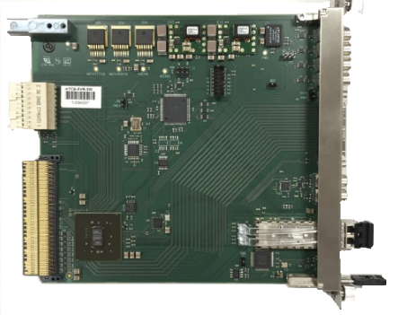
AMC boards: EVR
ESS Timing system based on Micro-Research Finland products:
clocks from/to TCLKA/TCLKB
driving/receiving differential triggers AMCRX/TX 17 through 20
24 differential lanes to RTM (no RTM designed yet)
front panel 4 x TTL outputs, 2 x TTL inputs (LEMO)
VHDCI front panel connector for IFB-300 interface box
Delay compensation and feedback
Segmented data buffer
Event masking in sequencer (event master/generator)

Slide 11
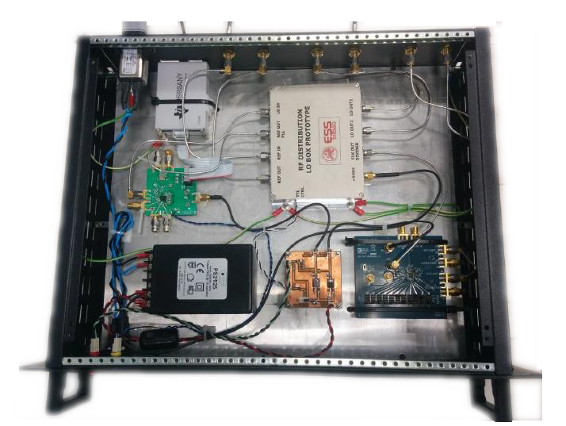
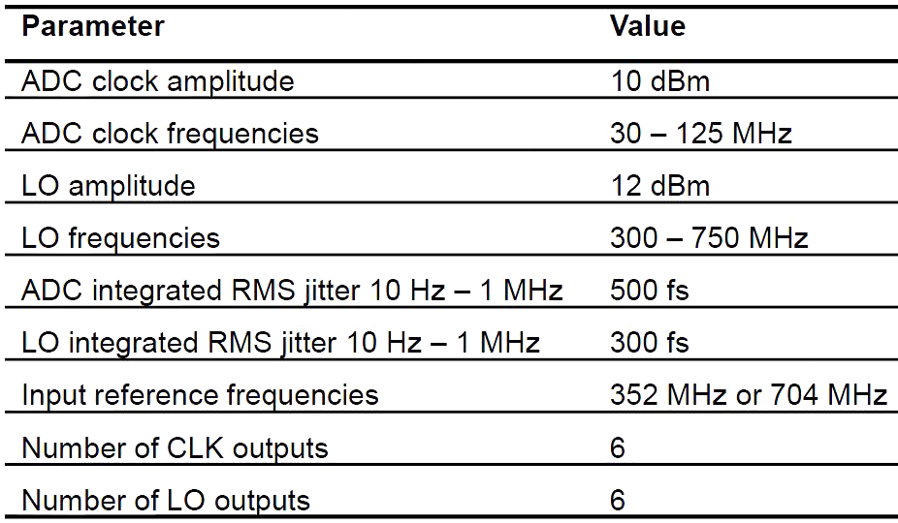
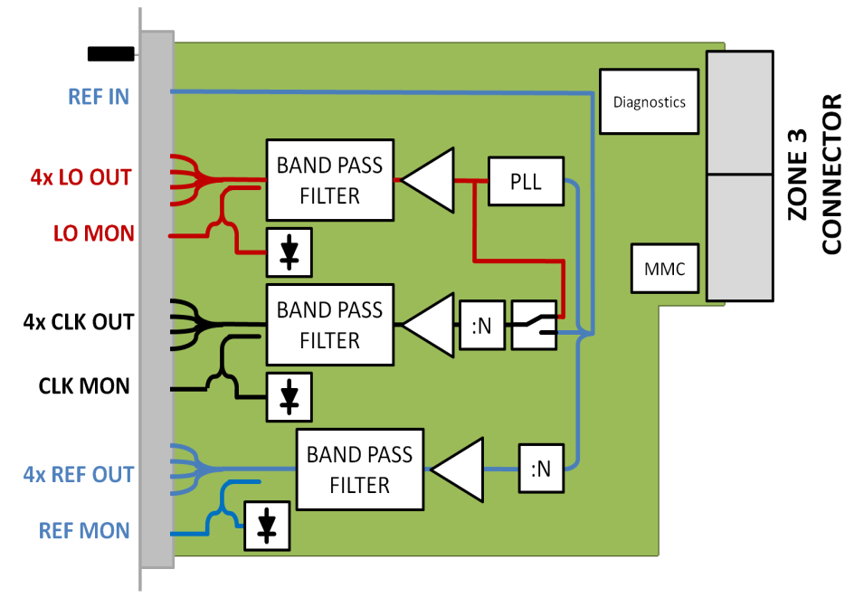
AMC boards: LO & CLK
Local Oscillator (LO) and ADC Clock generation/distribution
ESS Bilbao LO generation (pizza-box solution)
ISE – Polish Electronics Group Warsaw University – MicroTCA.4 AMC+RTM solution
Both solutions work for 352 MHz and 704 MHz

Slide 12
AMC boards: ICS supported
Beam Instrumentation will be built using 2 types of AMC boards provided by PSI through an in-kind collaboration:
AMC FMC (HPC) Carrier:
Ultrascale FPGA family to cover also high demanding applications
Support for 2 HPC FMC cards
Zone 3 assignment according to DESY recommendation for digital applications to promote standardization
AMC Digitizer board:
Similar digital architecture to FMC Carrier
Zone 3 assignment according to DESY Class A1 recommendation for analog applications
FMC slot LPC or HPC to interface to non-MTCA systems would be a nice feature

Slide 13
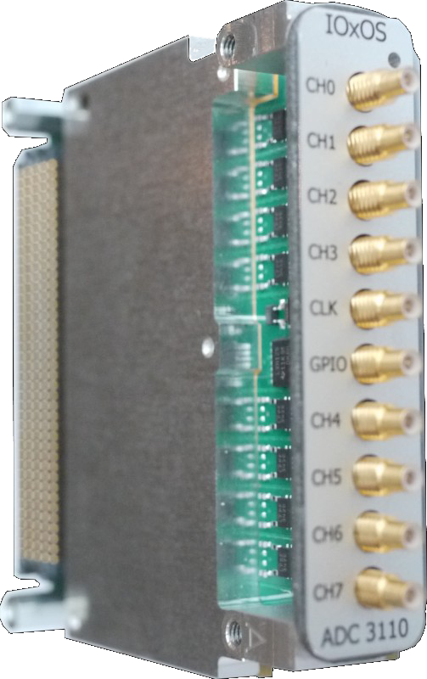
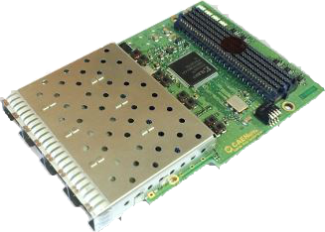
FMC cards: ICS supported
AD/DA Converter boards:
ACQ420 (4 channel 16-bit 500 to 2000 ksps)
ADC 3110/3111 (8 channel 16-bit 250Msps)
ADC 3112 (4 channels 12-bit/900(1000) Msps
or 2 channels 12-bit/1800(2000) Msps)
DAC 3113 (dual channel 16-bit/500 Msps DAC and 2 channels 16-bit/250 Msps ADC
High speed interface cards:
FM-S14 (Quad-SFP/SFP+ up to 10Gbps)
FMC-4SFP+ (Quad/Dual-SFP/SFP+)
EtherCAT slave, in-kind project (Estonia)
Additional FMC cards might be supported according to BI requirements

Slide 14
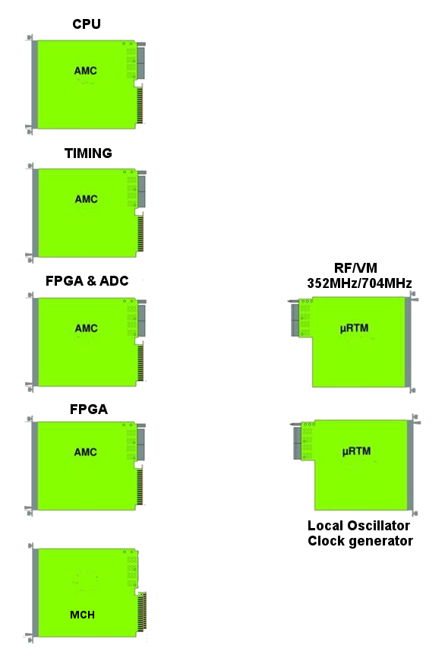
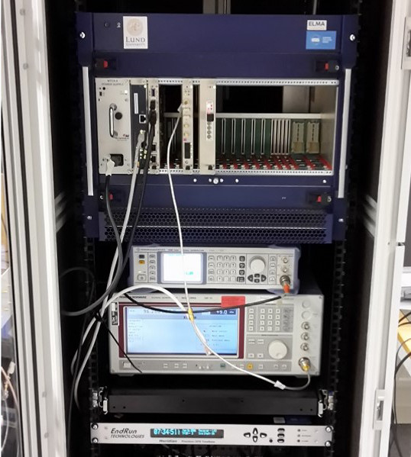
AMC boards: LLRF
Ethernet (port 0/1)
Control (PCIe)
Current firmware implementation based on Struck SIS8300-L2 but designed to allow easy porting to an In-Kind contributed digitizer
Triggers (ports 17-20)
Signals from:
PowerAmp
Cavity
PreAmp
VM
Timing
Currently evaluating option to embed a CPU in the FPGA & ADC board
Interlock
Timing board provides:
Pulse coming
Pulse start
Pulse End
LO
RTM board with piezo drivers currently under development by in-kind contributor (Poland)
LAN
Phase reference

Slide 15
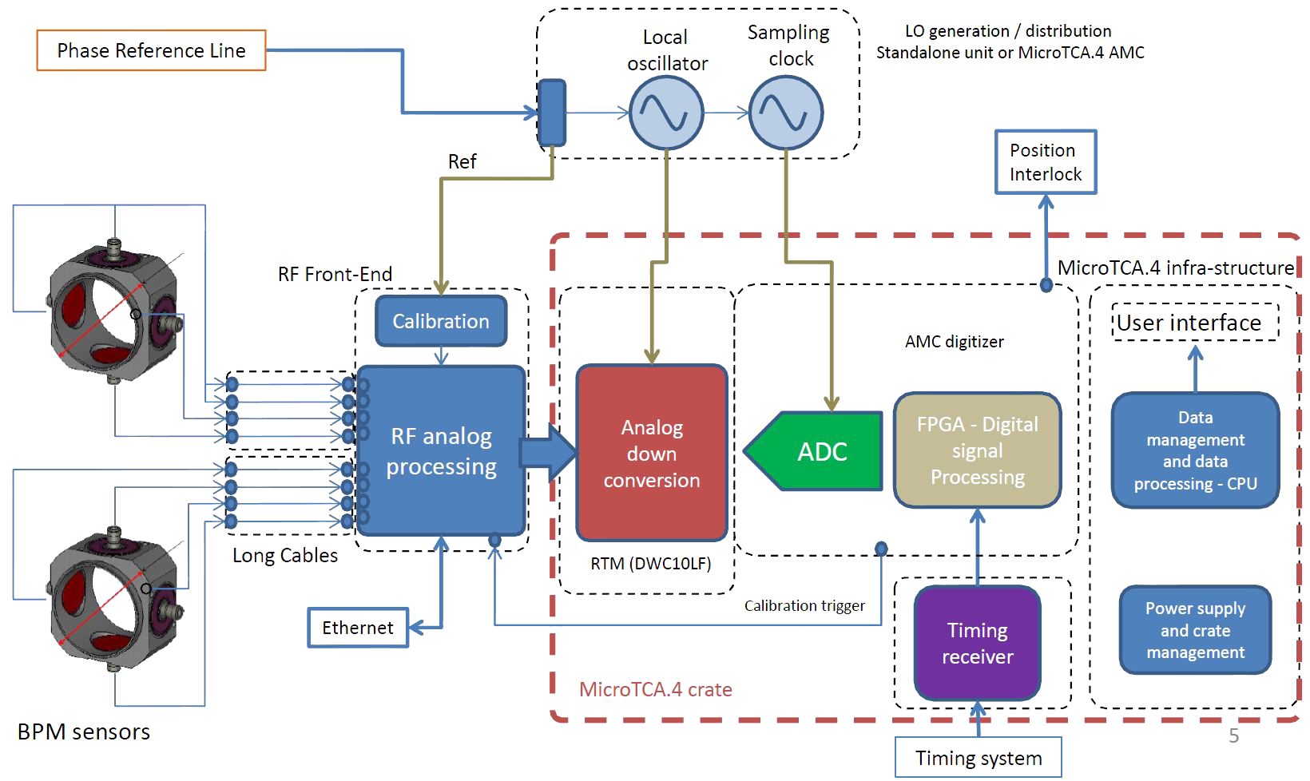
AMC boards: BPM
Reuse as much as possible the LLRF hardware and firmware
Custom RF front-end needed due to:
Bandwidth
Input dynamic range
Two solutions under test (RTM)
External filters + Custom RTM (design by SLAC + ESS)
COTS RTM + custom external RF Front-End

Slide 16
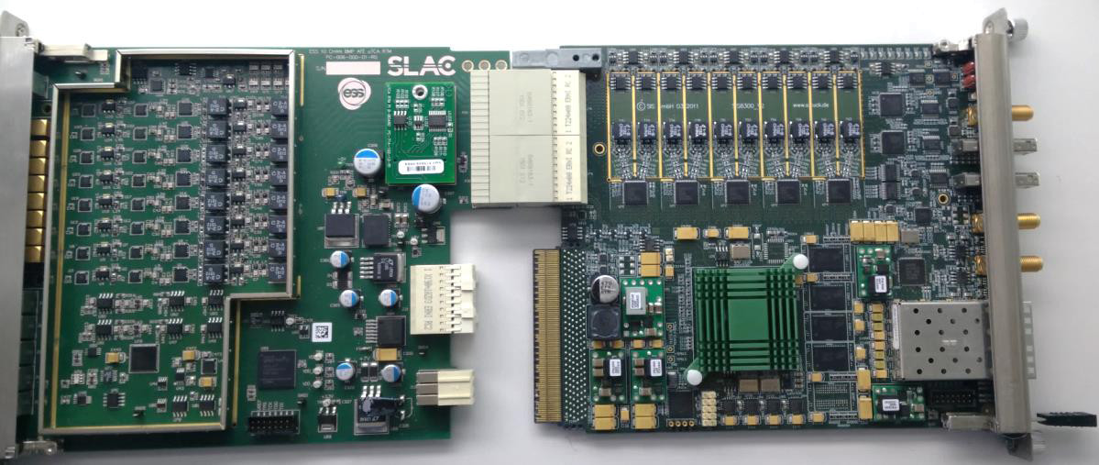
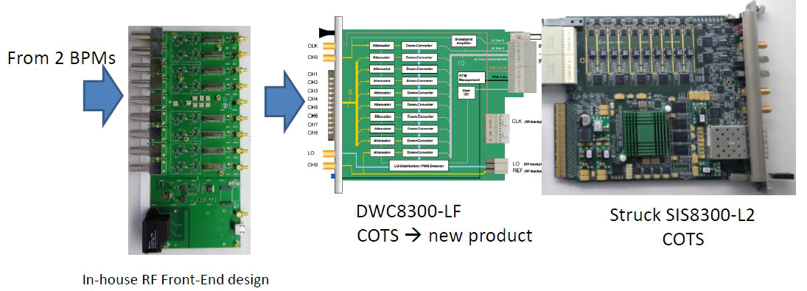
AMC boards: BPM
From BPM
External BPF
352 MHz or 704 MHz
10 MHz bandwidth
...
From BPM

Slide 17
Summary
ESS will use MTCA platform as base for complex Beam Instrumentation and LLRF
In-Kind budget type pushes towards development of new components by partner nations companies
Many instruments already under test using COTS hardware
Vielen Dank für Ihre Aufmerksamkeit

