Slide 1
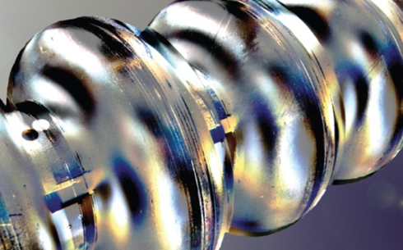
DESY SRF Infrastructure – Post XFEL Improvements and Upgrades
Hans Weise + Detlef Reschke
3. Annual MT Meeting, 31.1. – 02.02.2017
Cavity Team
A. Matheisen, J. Schaffran, M. Wenskat, B. Foster, N. Walker, A. Prudnikava, A. Dangwal-Pandey, W.-D. Möller, J. Eschke, D. Kostin, B. van der Horst, L. Lilje, H. Remde, G. Semione, L. Steder, A. Muhs, A. Ermakov, A. Stierle, L. Steder, J. Iversen, …
Technical support by several DESY groups

Slide 2
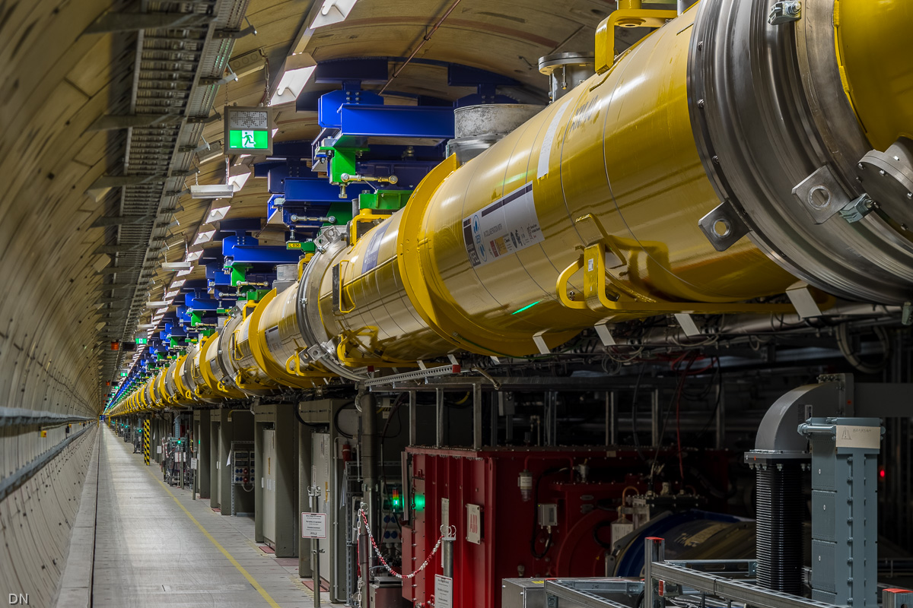
European XFEL Linear Accelerator

Slide 3
Linac commissioning status
L1
L2
L3
injector
0m 30m 230m 480m 1430m 2100m 3200m
Sequential commissioning of accelerator modules and beam lines Injector at 130 MeV (=> performance of 2015/2016 run restored)
pass on to BC1 beam dump
L1 commissioning (1 RF station until Feb 1st)
L1 at E_{final} = 600 MeV (10 bunches with 0.5 nC)
Next steps:
pass on to BC2 beam dump for L2 commissioning
L2 commissioning (3 RF stations until Feb 15th)
L2 at E_{final} = 2.4 GeV
pass on to XTL dump for L3 commissioning
L3 up to E_{final} = 17.5 GeV (15-18 RF stations, April 15th)
Set-up bunch compression in parallel to linac commissioning

Slide 4
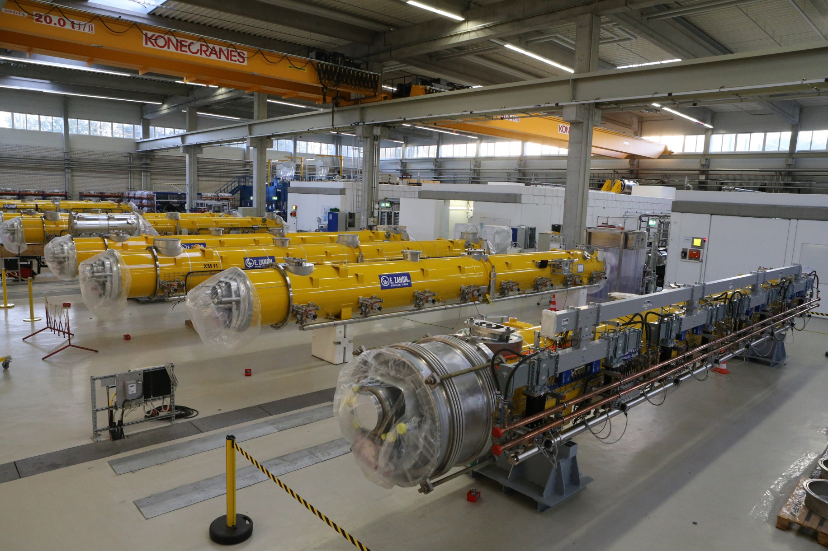
After European XFEL module series production …

Slide 5
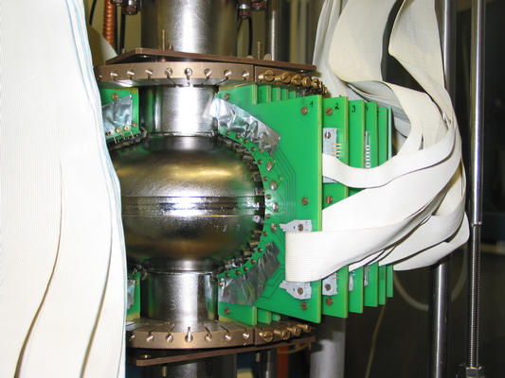
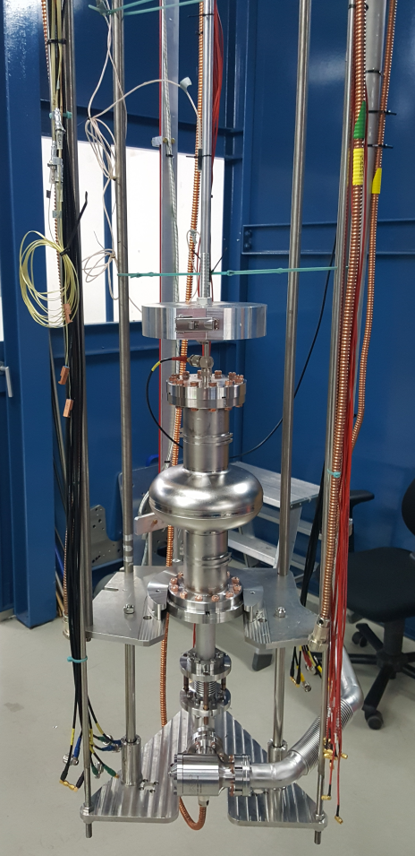
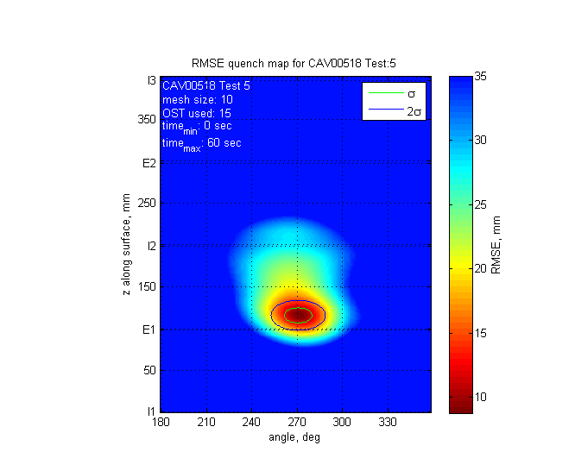
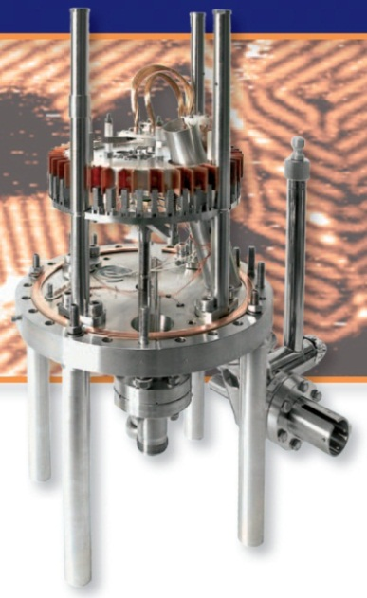
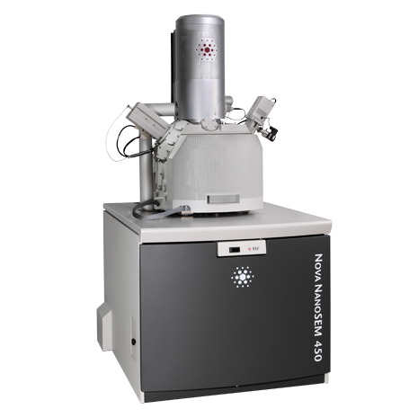
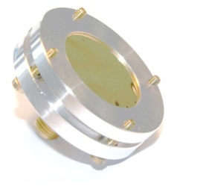
… back to R&D:
Different nitride and oxide phases formed
σ_{z}=8.9mm
σ_{ϕ}=9.0°
Nb

Slide 6
SRF: Enabling technology for future accelerators
SRF technology is well-established since many years
The 832 cavities of the European XFEL production gave a unique statistics for the applied mechanical fabrication and surface preparation techniques. => for both accelerating gradient E_{acc} and quality factor Q₀ we know very well typical performances and limitations
Both, FLASH and European XFEL are operated in pulsed mode (RF pulse length 1.4ms; Rep.rate 10 Hz => duty factor 1.4%)
Having additional cw and long pulse operation will allow for more flexibility in the time structure of the photon beams and will make both facilities more attractive to the users. (new facilities LCLS-II, ESS, FRIB are based on cw-operation)
Goal for DESY R&D: Improve the Q-value and keep high gradient performance

Slide 7
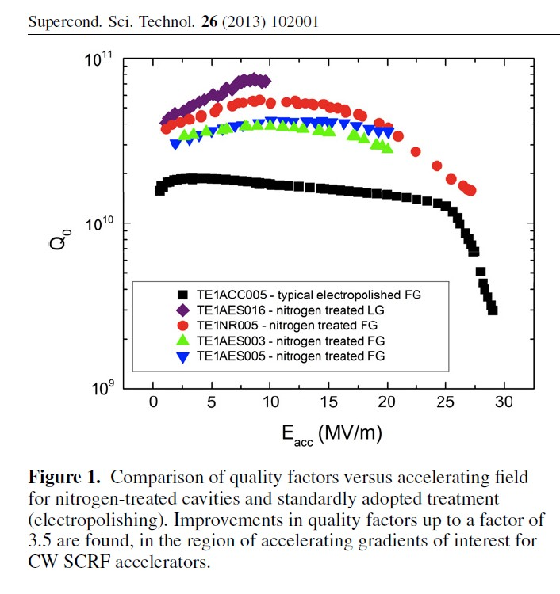
SRF: New surface preparation techniques
After freezing the surface preparation strategy (2009) for the European XFEL new developments were published
In 2013 a new surface treatment recipe based on a modified thermal treatment (well-defined low pressure of nitrogen during 800°C furnace treatment + surface removal by electropolishing) was published by Fermilab: “Nitrogen-doping”
Applied for LCLS-II cavities
Higher Q-value than XFEL, but reduced gradient (typically ~ 20MV/m)
A. Grasselino et al.

Slide 8
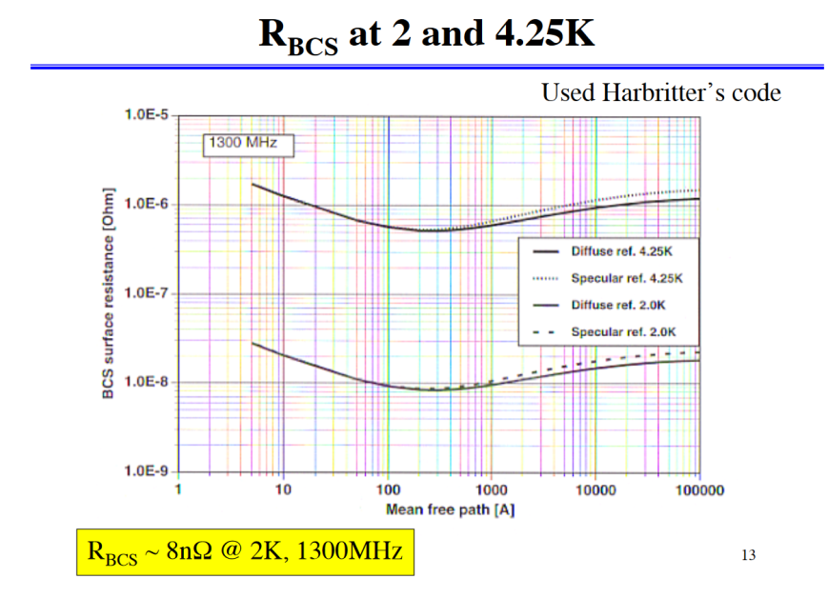
The idea …
Recent development (again Fermilab): Nitrogen Infusion
Similar thermal treatment, but no subsequent surface removal
High Q-value and high gradients
Minimizing the BCS surface resistance by using the dependence on the mean free path: Optimal mean free path by interstitial nitrogen atoms => “dirty layer” on high purity bulk Nb
l
Courtesy K.Saito

Slide 9
“N infusion” for high Q-values and high gradients

Slide 10
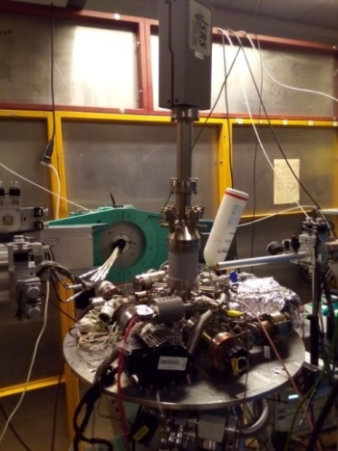
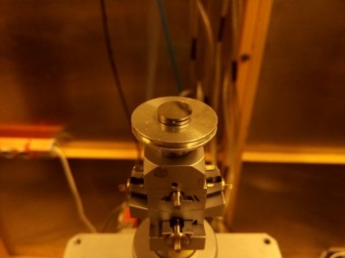
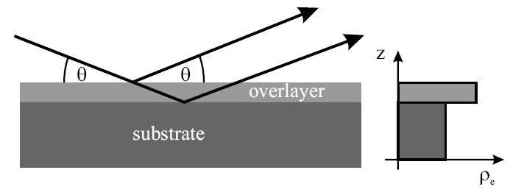
First nitrogen infusion on samples at DESY NanoLab
‘Nitrogen infusion’ experiment on a model sample
Nb (100) Single-Crystal
UHV Mobile Chamber
Cu Kα source
800°C annealing / 2 hours
Cooldown to 120°C, insert 25mTorr of N₂
Hold for 23 hours
In-situ x-ray reflectivity (XRR) measurements
Ir film/ sapphire
Courtesy A. Stierle, A. Dangwal-Pandey
Surface sensitive technique

Slide 11
First nitrogen infusion on samples at DESY NanoLab
‘Nitrogen infusion’ experiment on Nb(100): preliminary results
Nb₂O₅
Room temperature
NbO₂
Natural oxide layers
Intensity (ct)
NbO
Nb
q_{z} (A⁻¹)
NbO
During/After 800°C anneal
Intensity (ct)
Intensity (ct)
Nb
q_{z} (A⁻¹)
q_{z} (A⁻¹)
Different nitride and oxide phases formed
During infusion
at 120°C
25mTorr N₂
Intensity (ct)
Nb
q_{z} (A⁻¹)
q_{z} (A⁻¹)

Slide 12
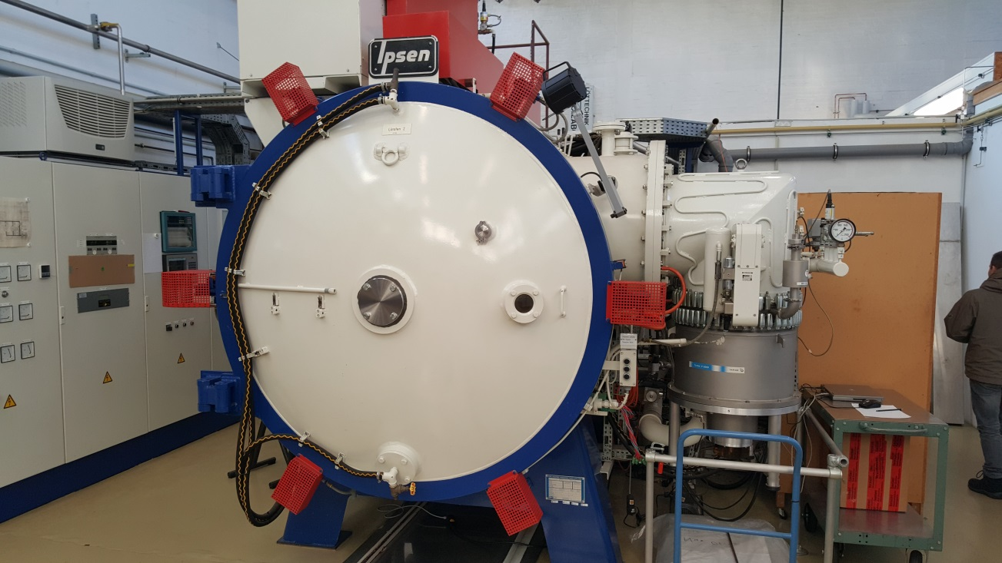
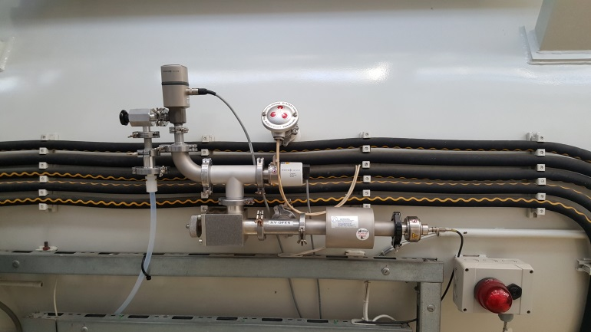
The realization for cavities…
Modification of the existing 800 ºC furnace at DESY for nitrogen infusion: Controlled nitrogen inlet (under improvement)
“Nitrogen doping” is no option for DESY: FLASH and European XFEL require high gradients for both, pulsed and cw operation.

Slide 13
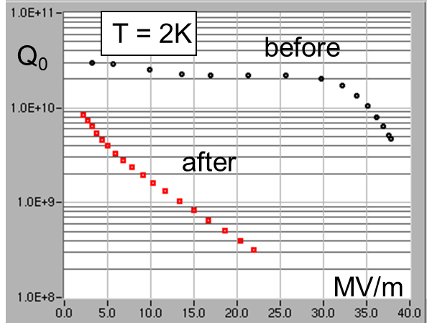
First results – single cell 1DE18
“Nitrogen Infusion” => Process: {800C, 2h, UHV + 120C, 48h, 10⁻² mbar N₂ } => High Pressure Water Rinse + assembly in ISO4
First single-cell cavity treated and tested (to low nitrogen pressure)
No field emission! No quench!

Slide 14
More results and activities around N-infusion
Surface analysis on samples in parallel to cavity tests
DESY Nanolab XRR studies
Nb samples analysed by SEM/EDX
Next cavities and samples under preparation
Furnace process control to be improved
Achieve reproducible (9-cell!) and robust process
Improve the recipe
Many open questions to understand:
Substitute nitrogen by other (C, O) interstitial impurities possible?
Why is the gradient affected (N-doping)?
Explanations of “Q-rise” and “Q-drop”?
physics unclear

Slide 15
Surface Preparation Infrastructure
Maintain and improve existing SRF infrastructure
Cleanroom, UPW system, High Pressure Water Rinse, EP & BCP incl. sub-systems maintained and partially refurbished
Nb-material properties: RRR; mechanical properties; interstitial and metallic impurities; eddy current scanning; X-ray fluorescence; optical microscopie
Cavity surface inspection (OBACHT); Replica; CPB; Profilometrie
Dry-ice cleaning of 9-cells

Slide 16
Modify AMTF vertical test infrastructure
We are now in the process to change over the vertical test stands in AMTF:
Vertical test stands: adaptive for different cavity types, adjustable antenna, T-map, second sound, magnetic flux, different frequencies, …
Supplement vertical measurement software for: Rs (T), T-map, field emission-map, second sound, magnetic measurement etc.

Slide 17
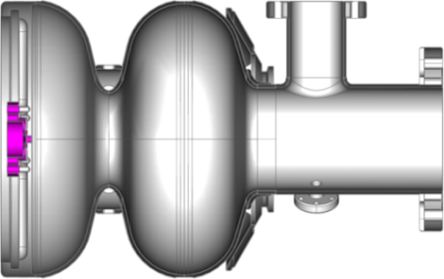
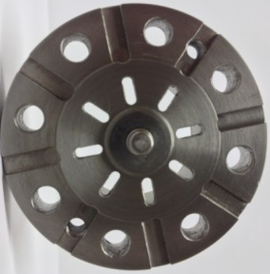
SRF Photoinjectors
DESY approach: All superconducting gun with Pb cathode in Nb cavity
Test attempts in 2016 with one existing gun failed due to mechanical instability after many chemical treatments
Construction and ordering of two additional gun cavities with improved end plate design started
Examination of lead cathodes in collaboration with HZDR
Preparation of horizontal “gun test stand” (HZDR cryostat)
Closer collaboration with HZB
Improvement of cleaning esp. HPR for choke and half cell
Beam dynamical studies and simulations on SRF gun, SC solenoid and booster cavity arrangements
Nb plug
Pb coated cathode tip
Nb cavity
Nb/Pb
cathode

Slide 18
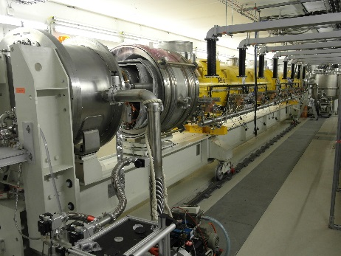
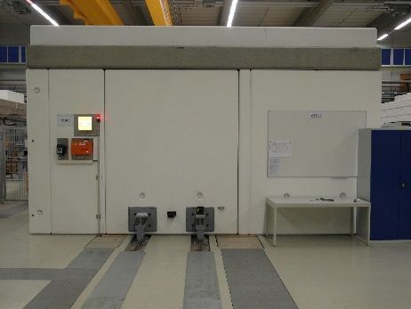
AMTF Cryomodule Test Stands
Improved flexibility of test benches
XATB1 for 1.3 GHz and 3.9 GHz modules; (incl. CW / long pulse)
XATB2 unchanged
XATB3 for planned horizontal SRF gun cryostat and tbd: CHECHIA for horizontal nine-cell cavities with power coupler
New test stand for power coupler conditioning

Slide 19
AMTF Infrastructure: Accelerator module repair (+ some R&D)
Few European XFEL cryomodules could not be repaired within the schedule and show some open technical issues
heating of 70K window of power coupler
repair of 4 modules
XM8 (leaky cryogenic line)
XM46 & XM50 (inacceptable cavity performance)
XM99 (leaky beam line)
Open technical issues
identification of leaks
improved thermal coupling
application of new surface preparation schemes for a full module
extensive testing of repaired modules incl. cw at AMTF or CMTB
XM-3 (7 LG cavities) to be retested…

Slide 20
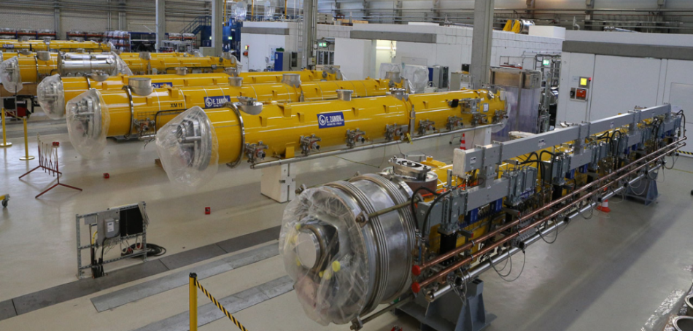
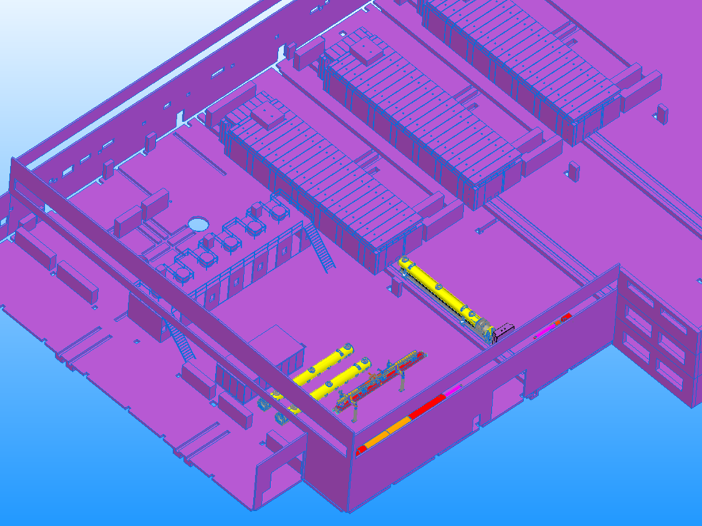
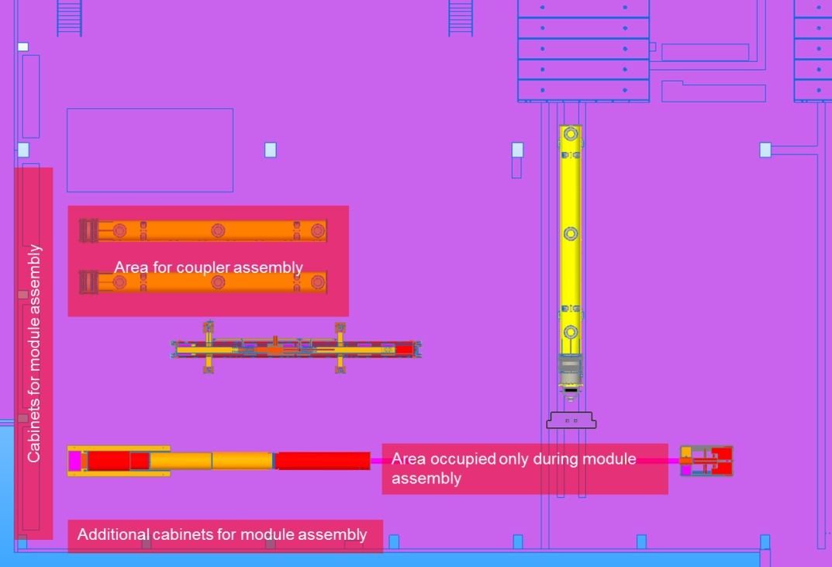
AMTF infrastructure: Accelerator module repair and assembly
Optimized module assembly at AMTF (before “hall 3”) for repair of few XFEL modules
Relocation of Cantilever System
Transport Frames necessary

Slide 21
Summary
Goal for FLASH and European XFEL cw upgrade: High Q / low loss Cavities with high (≥ 30MV/m) gradients
Close link between surface studies and cavity activities
Adapt and understand new surface treatment recipes for large-scale production
SRF infrastructure under modification and upgrade
SRF photoinjector activities will be intensified

Slide 22
Back-up

Slide 23
Accelerator Modules
100 accelerator modules
800 accelerating cavities
1.3 GHz / 23.6 MV/m
The accelerator tunnel (XTL) houses three cold linac sections separated by bunch compressors.
Down to approx. 50 m behind the last module the complete beam vacuum system is particle free.
4 modules / 32 s.c. cavities are connected to one 10 MW klystron.
12 modules form a cryogenic string.
At the XTL end a collimation and separation system is installed.

Slide 24
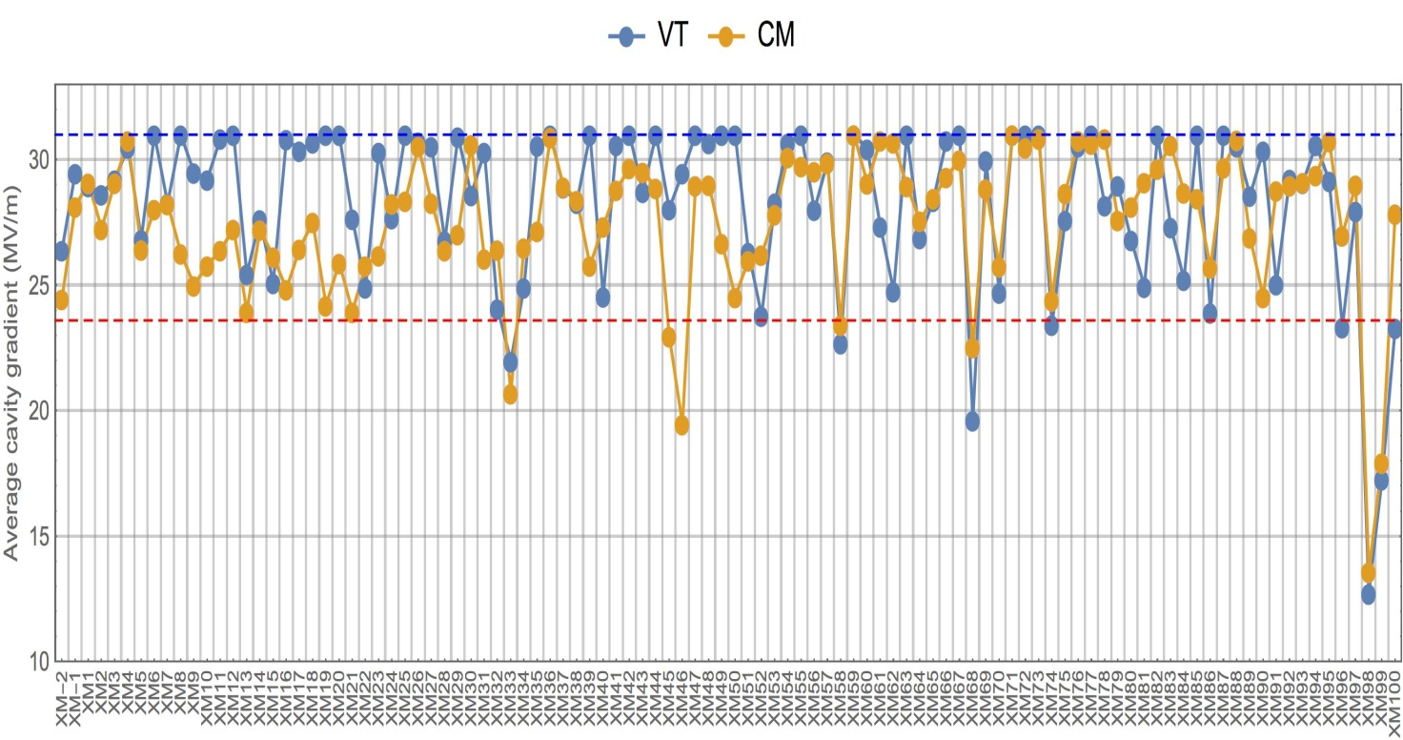
Ausgezeichnete Performance der Cavities und Module
Module performance well above specs. and visible improvement with time
Tunnel installation used sorting of modules based on AMTF performance
XFEL Spec
23.6 MV/m
vertical test (clipped at 31 MV/m)
module performance
 | N_{cavs} | Average | RMS
VT | 815 | 28.3 MV/m | 3.5
CM | 815 | 27.5 MV/m | 4.8
Remark:
Clipping at 31 MV/m is done due to max. available RF power; limit given by waveguide distribution.
Disclaimer: Das sollte eigentlich noch besser gehen, nur wie???

Slide 25
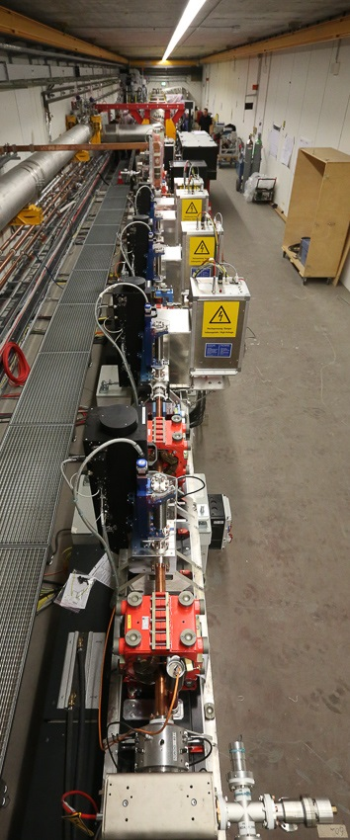
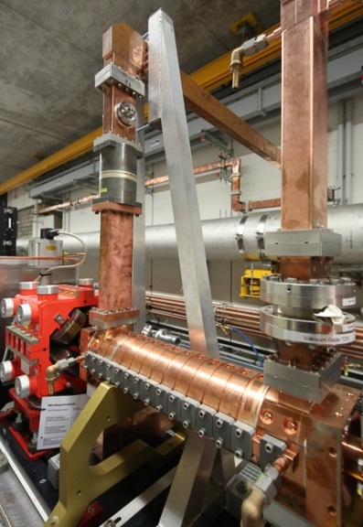
XFEL Injector Status as of 6/2016 (end of commissioning run)
Injector installation finalized in Q4/2015
3.9 GHz module installed in 9/2015
Injector cool-down started beginning of 12/2015
First Beam on December 18th , 2015
Successful commissioning during Q1/2016
Emittance measurements done on a routine basis;
Projected emittance as expected (1...1.5 mm mrad)
Full bunch train length (2700 bunches) reached and beam stopped in injector beam dump
Transverse Deflecting System operated
Slice emittance measurements give 0.5 mm mrad for 500 pC; also over bunch train
Laser heater commissioning started
Notes:
Before you start editing the slides of your talk change to the Master Slide view: Menu button “View”, Master, Slide Master:
Edit the following 2 items in the 1st slide: 1) 1st row in the violet header: Delete the existent text and write the title of your talk into this text field 2) The 2 rows in the footer area: Delete the text and write the information regarding your talk (same as on the Title Slide) into this text field.
If you want to use more partner logos position them left beside the DESY logo in the footer area Close Master View

