Slide 1
HV Maps

Slide 2
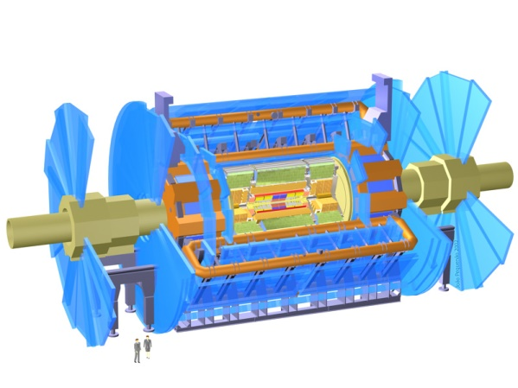
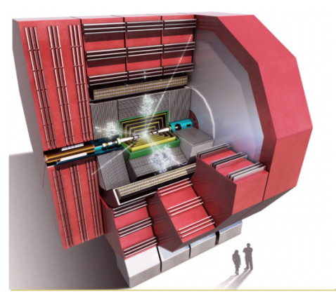
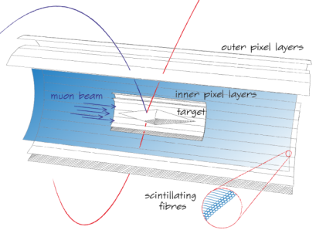
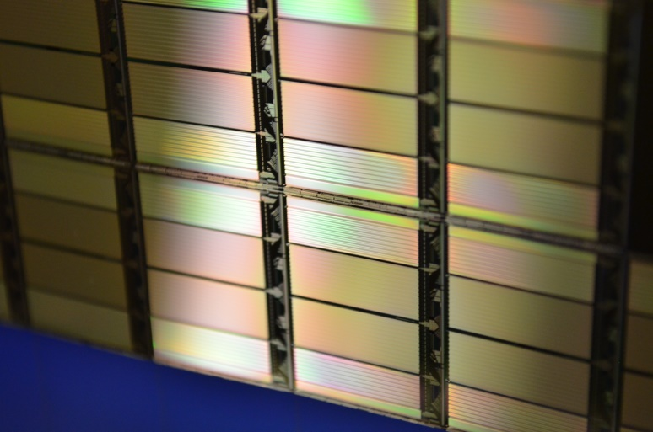
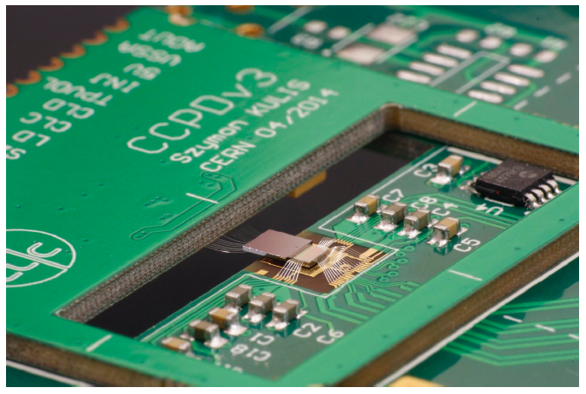
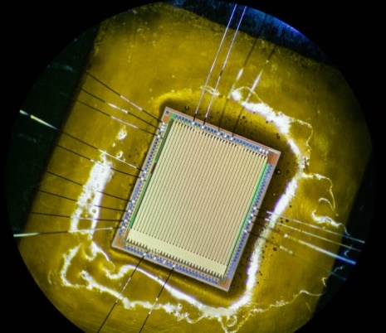
HVCMOS
…
ATLAS detector
CLIC
Mu3e detector at PSI
ATLAS pixel HVCMOS prototype
CLICPIX CCPD
Mu3e-pixel prototype

Slide 3
HVCMOS Pixel
Isolated PMOS
Isolated NMOS
NW
PW
NW
PW
NW
PW
NW
Deep n-well
Collection electrode
P-Substrate

Slide 4
HVCMOS Pixel 2
Isolated PMOS
Isolated NMOS
Isolated PMOS
Isolated NMOS
NW
PW
NW
PW
NW
PW
NW
NW
PW
NW
PW
NW
PW
NW
P-implant
P-implant
Deep n-well
Collection electrodes
Collection electrode
P-Substrate
P-Substrate

Slide 5
HVCMOS for ATLAS HL Upgrade
ATLAS HVCMOS and HVMAPS collaborations of Universities of Bern, Geneva, Heidelberg, Karlsruhe (KIT), Liverpool, Tsukuba, Brookhaven National Laboratory and IFAE Barcelona
Bonn
Stanford (SLAC)
CPPM Marseille
CERN
HVR_CCPD
HVSTRIP collaboration

Slide 6
HVCMOS for ATLAS HL Upgrade
CCPD vs. Monolithic
Passive sensor
(can be in “CMOS” techno.)
HVCMOS sensor
Standard
CCPD
Low cost, fast readout of small pixels possible, no need for development of readout with CMOS project
HVCMOS sensor
Monolithic
One chip

Slide 7
Specifications
Specifications for ATLAS
Particle flux:
Layer 1 (4cm) 50 hits/cm²/BC (BC = 25ns)
Layer 3 (14cm) 5 hits/cm²/BC
Layer 5 (30cm) 1 hits/cm²/BC
Radiation tolerance ~ 0.7 to 2 x 10¹⁵ neq/cm2, ~ 30 to 100MRad (3rd /5th layer)
Pixel size 50um x 50um for 3rd layer, may be larger for outer layers and smaller for inner layers
Power consumption < 500mW/cm²
Present goal: 99% of the hits must be detected with timing better than 50ns, later 25ns
Noise level 10⁻⁴hits/BC

Slide 8
HVCMOS for ATLAS HL Upgrade
Recent results:
Beam tests on irradiated small CCPDs and monolithic sensors in AMS H18 (standard) process
Beam test on reticle area (5 cm²) CCPD/monolithic sensor in AMS H35 process on HiRes substrates
Submission of large-area monolithic sensors in AMS aH18 and LFoundry LFA15 processes on high resistivity substrates

Slide 9

CCPD Sensor in H18 Technology
HVCMOS CCPD sensors implemented in AMS H18 technology on standard 10 Ω cm substrate (CCPDv4) have been irradiated to fluences between 1.3 x 10¹⁴ and 5·x 10¹⁵ n_{eq}/cm² and tested in beam (full matrix test). The average hit eﬃciencies of from 97.6 % (highest fluence) to 99.7% have been measured. These values are comparable to hit eﬃciencies of planar pixel sensors.
CCPDv4: Measured detection efficiencies in the beam test versus applied bias voltage.

Slide 10
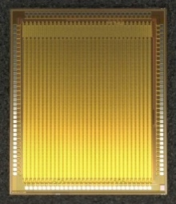
CCPD Sensor in H18 Technology
HVCMOS monolithic sensors implemented in AMS H18 technology on standard 10 Ω cm substrate (MuPix7) have been irradiated to fluence 10¹⁵ n_{eq}/cm² and tested in beam.
The layout or transistors is not radiation tolerant -> the average hit eﬃciency of ~ 95 % has been measured

Slide 11
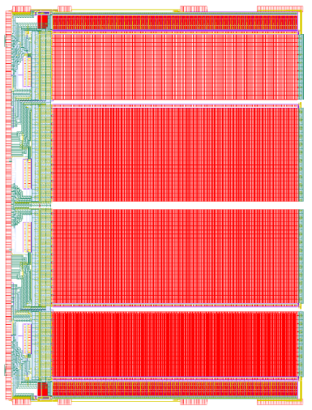
The Large Area Sensor H35DEMO
The Large Area Sensor H35DEMO
2.5cm
CCPD
MuPixel
H35DEMO

Slide 12
The Large Area Sensor H35DEMO
Sensor in AMS H35 Technology
The first beam test of the first large area HVCMOS sensor H35DEMO was done. The sensor was capacitively coupled to the pixel readout ASIC FEI4. More than 99% detection efficiency have been measured. Within a time window of 50ns the efficiency is still 99% - in terms of time resolution the HVCMOS sensor performed nearly as good as the reference detector based on the planar sensors and FEI4
Spatial resolution measured in beam
Detection efficiency of H35DEMO vs. bias voltage
Time resolution of H35DEMO (blue histogram) compared with the time resolution of the reference detector – planar sensors with FEI4 (red histogram). One “bunch crossing” BC corresponds to 25ns.

Slide 13
The Large Area Sensor H35DEMO
The H35DEMO has the possibility that external signals are applied to the pixel pads used for the capacitive signal transmission. In this way, the coupling capacitance can be measured for every pixel.
The coupling capacitive on a large area is quite uniform. The coupling capacitance varies from 2.05fF to 2.4fF, which is a suitable value for signal transmission.
Coupling capacitance between HVCMOS pixel pads and FEI4 amplifier pads have been measured (Bonn) along a pixel row of 1.5 cm length.

Slide 14
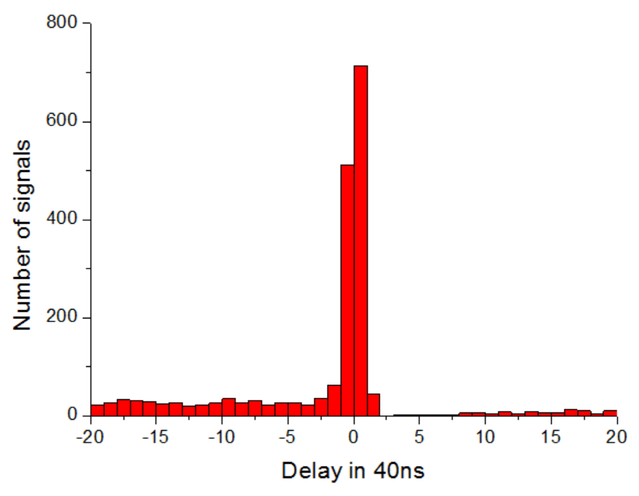
The Large Area Sensor H35DEMO
The H35DEMO has the possibility can be readout as a monolithic sensor
Zero suppression and time measurement on chip
Time resolution – difference between the time stamp and the trigger momen

Slide 15
Submission of large area monolithic sensors in AMS aH18 process on HiRes substrates
Name: ATLASPIX

Slide 16
…
Project cost > 200k – supported by Bern, BNL, CERN, CPPM Marseille, Geneva, IFAE Barcelona, INFN Milano, Heidelberg, KIT, Liverpool
Technology aH18 produced in Austrian AMS factory – 180nm HVCMOS
Additional production step – isolated PMOS
The chips will be produced on 80 and 200 Ohm cm wafers
Reticle Size about 21mm x 23mm
Submission: January 2017

Slide 17
Sensor Technology
Additional production step – isolated PMOS
TCAD simulations and test structures done by AMS
2 matrices use isolated PMOS
Active digital circuits
Analog circuits
Active digital circuits
Analog circuits
NMOS
NMOS
PMOS
NMOS
PMOS
pwell
nwell
Deep nwell
Deep nwell

Slide 18
Sensor Types
M Matrix
Triggered readout, digital pixels
50um x 60um

Slide 19
Working Principle
Monolithic Readout
8
A
B
A
C+E
C
D
E
F
25ns

Slide 20
Working Principle
Monolithic Readout
A
C+E
8
25ns
1
2
3
12
TS
Addr
Flag
TS
Addr
Flag
TS
Addr
Flag

Slide 21
Working Principle
Monolithic Readout
2
A
Hit
TS
Addr
Empt
TS
Addr
Empt

Slide 22
Working Principle
Monolithic Readout
2
A
Hit
12
C+E
Hit
TS
Addr
Empt

Slide 23
Working Principle
Monolithic Readout
1
2
3
12
Match
Match
TS-Delay
2-Delay
TS-Delay
TS
CMP
Addr
Flag

Slide 24
Working Principle
Monolithic Readout
1
2
3
12
Match
Match
TS-Delay
Trigger
2-Delay
TS-Delay
Trigger
TS
CMP
Addr
Flag

Slide 25
Working Principle
Monolithic Readout
2
A
Empt
12
C+E
Hit
Match
Match
TS
Addr
Empt
Trigger
Empty

Slide 26
Working Principle
Monolithic Readout
Empt
12
C+E
TrigH
Match
Match
TS
Addr
Empt
Trigger
Triggered Hit

Slide 27
Working Principle
Monolithic Readout
Fast OR
State Machine

Slide 28
Working Principle
Monolithic Readout
Data
State Machine

Slide 29
Working Principle
Monolithic Readout
Data
State Machine

Slide 30
Working Principle
Monolithic Readout
PLL + Oscillator
Data
State Machine
Gbit Transmitter

Slide 31
Sensor Types
HVMAPS Matrix
Untriggered readout, anlog pixels
Time stamp, threshold, 2 thresholds, amplitude measurement (ramp ADC), time over threshold measurement
80um x 80um

Slide 32
Sensor Types
Simple Matrix
Untriggered readout, digital pixels
Time stamp, time over threshold measurement
40um x 130um

Slide 33
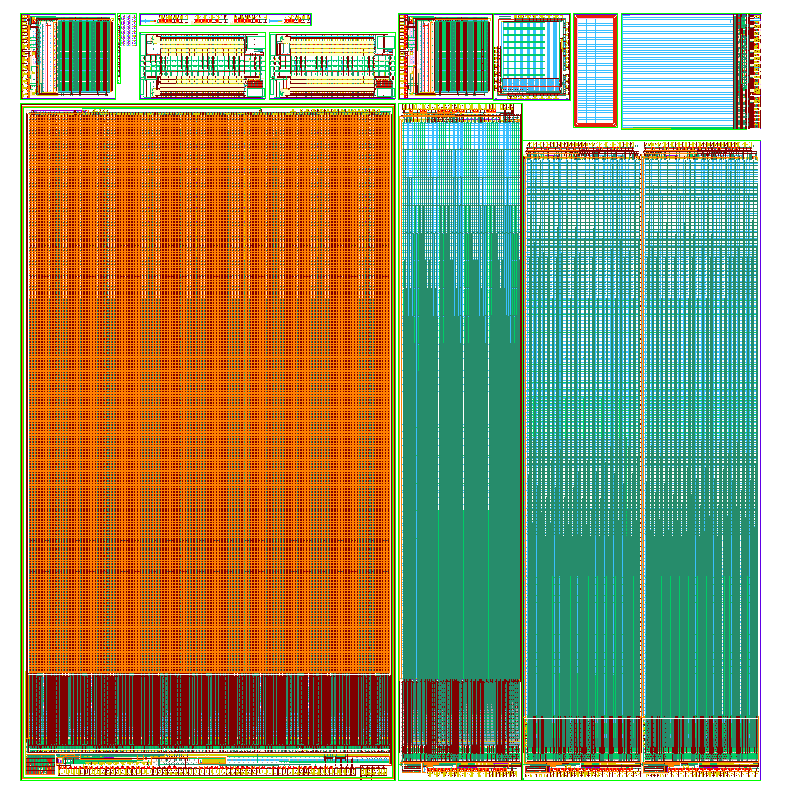
…

Slide 34
Summary
Beam test: Small sensor in standard AMS H18 process fulfuls ATLAS specs after irradiation
Beam test: Large not irradiated sensor in H35 process on HiRes substrate fulfils specs

Slide 35
…
Plans for 2016
Measurements with the new sensors in aH18 and with H35DEMO
Desing of large CCPD and monolithic prototypes
  aH18 process
CCPD – development of interconnection process
  Current issues -> gluing process too slow (needs curing)
  Need of two side wide bonding
  Solutions: TSV and/or standard bumps/RDL for power
CCPD as now
CCPD with a few standard bumps
CCPD with TSVs

Slide 36
…
Cost estimation:
Production cost of 10m² silicon modules that consist of the CMOS sensor chips flipped to the readout AICSs (RD53), that do not use TSVs and are wire bonded to the staves:1.2M€.
Production cost of 10m² silicon modules that consist of the CMOS sensor chips flipped to the readout AICSs that use TSVs and can be bump bonded or glued to staves 1.5M€.
Cost for 100m² would be 9M€ for the silicon modules without TSVs and 11M€ for the silicon modules with TSVs
CCPD as now
CCPD with a few standard bumps
CCPD with TSVs

