Slide 1
Large-Scale Laser-Microwave Synchronization for Attosecond Photon Science Facilities
Kemal Şafak^{1,2}, Ming Xin^{1,3}, Michael Y. Peng³, Aram Kalaydzhyan^{1,2}, Wenting Wang¹, Oliver D. Mücke¹, and Franz X. Kärtner^{1,2,3}
¹Center for Free-Electron Laser Science, DESY, Hamburg, Germany
²Physics Department, University of Hamburg, Hamburg, Germany
³Research Laboratory of Electronics, MIT, Cambridge, MA, USA
3rd Annual MT Meeting
February 01, 2017

Slide 2






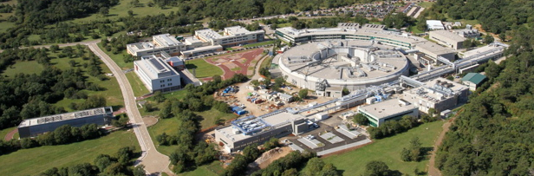


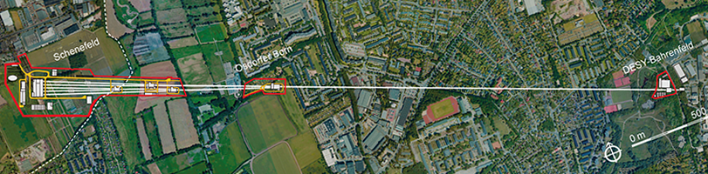


New generation XFELs:
T. Ishikawa, et al., Nature Photon. 6: 540 (2012).
Coherent X-ray pulses with:
Unprecedented brightness: up to 10¹³ photon per pulse
Atomic level spatial resolution: wavelengths < 1 Å
When combined with sub-fs temporal resolution:
super 4D microscopes for ultrafast molecular dynamics
P. Emma, et al.,” Nature Photon. 4: 641 (2010).
E. Allaria, et al. Nature Photon. 6: 699 (2012).
M. Altarelli, et al., Technical Design Report, DESY 97 (2006).

Slide 3
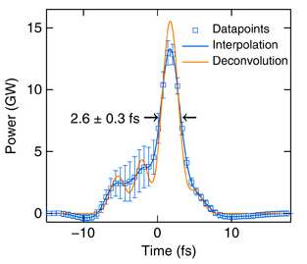

Timing distribution for next generation FELs
Current XFELs can produce few-fs X-ray pulses
New FEL designs predict X-ray pulses shorter than 1 fs.
Obstacles:
  Overall sub-fs synchronization of the complete XFEL
  Synchronization of secondary laser sources
C. Behrens et al., Nature Communications 5:3762.
Probe laser
Linacs,
Compressors
Injector
laser
Fiber link
~3.5 km
Master
laser
  Target: facility-wide sub-fs precision synchronization
      Sub-μm stability for a 3.5-km fiber link
J. Kim et al., Proc. of FEL Conference (2004);
J. Kim et al., Opt. Lett. 32, 9 (2007).

Slide 4
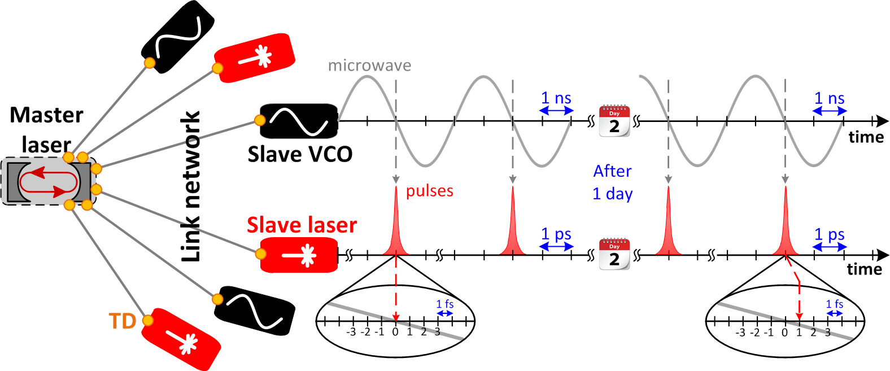
How to make a synchronous laser-microwave network with sub-fs precision?
Outline:
Timing detector
Drift-free fiber network
Remote synchronization

Slide 5
1. Timing detector: Direct photodetection
Femtosecond laser
Much broader electronic pulses (ps-regime)
Exact shape highly dependent on the pulse train and photodetector
Clean sinusoidal signal in-phase with the optical pulse train
Low timing sensitivity

Slide 6

1. Timing detector: Optical cross-correlation
Sum-frequency
Amount of SF light depends on the pulse timing
  No overlap – no signal
  Ability to detect timing fluctuations significantly smaller than the pulse duration
Big disadvantage: Amount of SF light is also influenced by the intensity noise
  Amplitude modulation of the optical cross correlation curve

Slide 7
1. Timing detector: Balanced optical cross-correlation
Sum-frequency
>1mV/fs
Sum-frequency
Another SFG with relatively time-delayed input pulses
Second cross-correlation curve
  Exact shape, but time delayed with respect to the first one
Around zero-crossing
  Difference in the SF light cancels the optical intensity fluctuations
  Timing sensitivity larger than 1 mV/fs

Slide 8
1. Timing detector: Phase detector vs. BOC

Slide 9
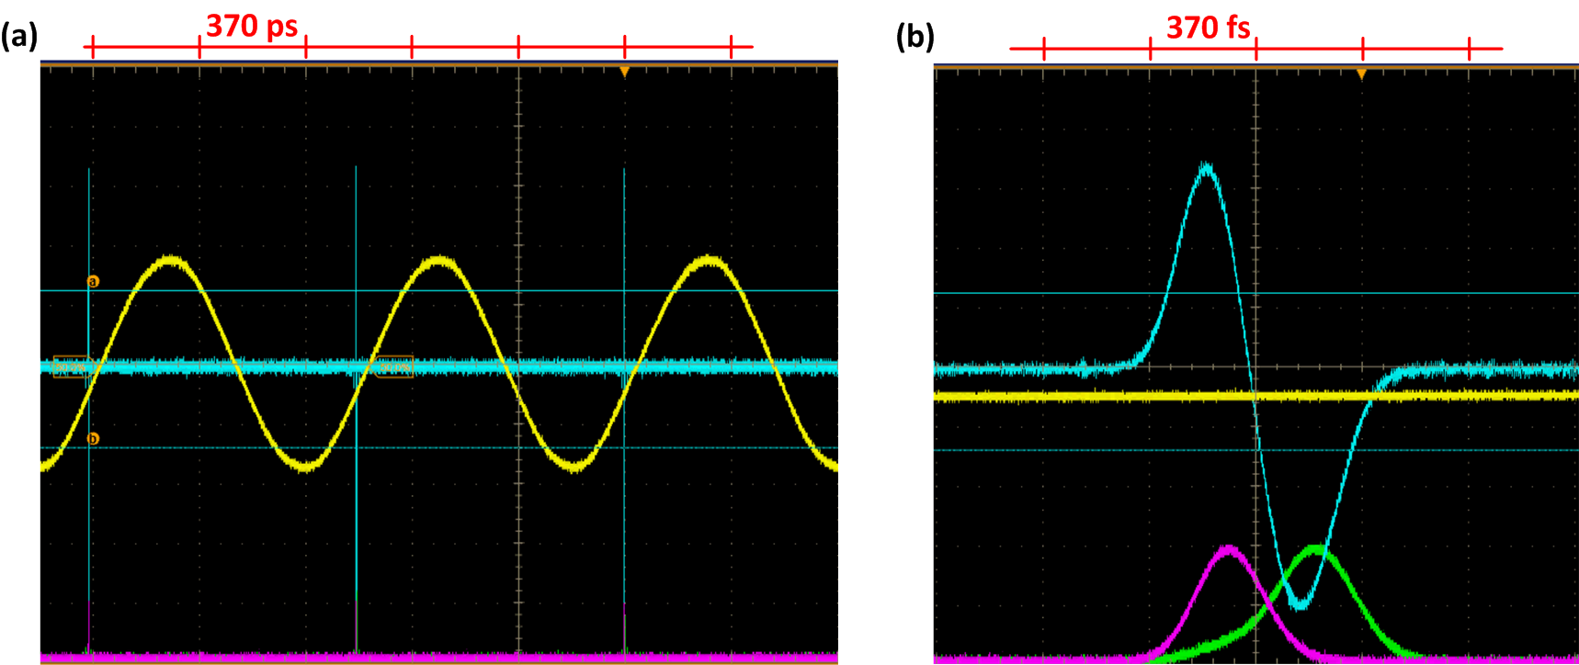
1. Timing detector: Phase detector vs. BOC

Slide 10
2. Drift-free fiber link transmission
In-loop BOC
Feedback
Long-term drift
compensation
Fast jitter compensation
~ 100ps
Coupler
Master Laser
Motorized
Delay
Fiber
Stretcher
PM-DC
Fiber Link
Fiber
Amplifier
Partial
Reflector
Free Space
Fiber
Electrical Path
PM-DC: Polarization-maintaining dispersion-compensated
J. Kim et al., Nat. Phot., 2, 12 (2008).

Slide 11
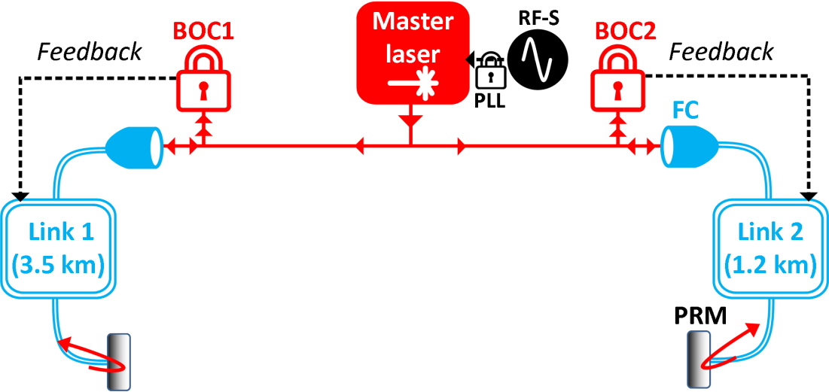

Fiber link network stabilization
RF-S: RF synthesizer
PLL: phase-locked loop
BOC: balanced optical cross-correlator
FC: fiber collimator
PRM: partially reflecting mirror
0.7-fs RMS

Slide 12





Nonlinear pulse propagation in fibers
COG_{t}
∆COG_{t}
Fiber: a nonlinear medium
$$ΔCOG_{t}∝ΔP_{peak}$$
$$×nonlinearities$$
Fiber input
Second-order dispersion
Third-order dispersion
Self-phase modulation
Raman effect
Self steepening
Fiber output
BOC Output
BOC Output
Amplitude
Modulation
COG
Shifts
$$T_{0}=0$$
$$T_{0}≠0$$
$$τ$$
$τ$

Slide 13
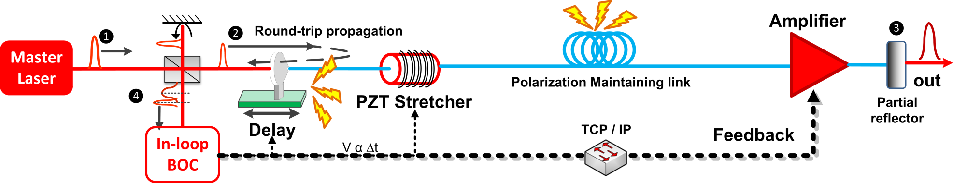
Nonlinear pulse propagation in fibers
$$ΔCOG_{t}∝ΔP_{peak}×nonlinearities$$
Out-of-loop timing error: 200 as RMS
Xin et al., Light Sci. App., 6, e16187 (2017).

Slide 14
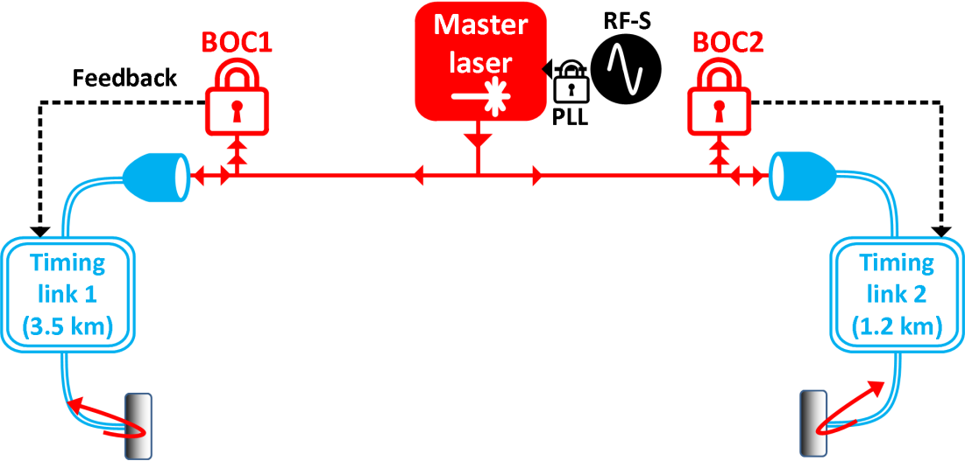
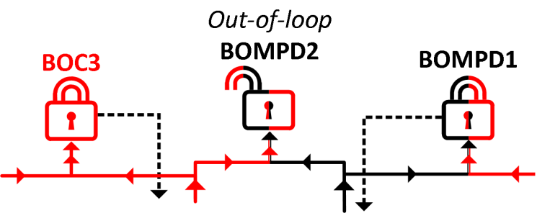

3. Remote Synchronization: Laser-microwave network
BOMPD: Balanced optical-microwave phase detector
VCO: voltage-controlled-oscillator
Balanced optical-microwave phase detector:
∆t ≠ 0
∆t = 0

Slide 15
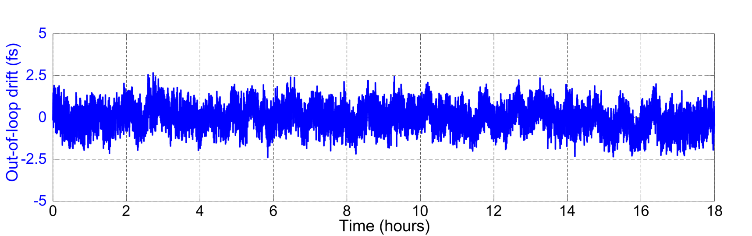
4. Remote Synchronization: Laser-microwave network
BOMPD: Balanced optical-microwave phase detector
VCO: voltage-controlled-oscillator
Out-of-loop timing error: 670 as RMS
Xin et al., Light Sci. App., 6, e16187 (2017).

Slide 16
Conclusion & outlook
Observation of sub-fs timing jitter due to fiber nonlinearities
Correction via link power modulation
Link network: 200 as RMS drift (< 1Hz) over 2 days
Laser-microwave network: 670 as RMS drift (<1Hz) over 18 hours
First demonstration of remote laser-microwave synchronization with long-term sub-fs precision

Slide 17

THE END

