Slide 1










Status Report ARD-ST4
Novel Acceleration Concepts
Ulrich Schramm, HZDR
Florian Grüner, UHH
January 31st, 2017
3rd Annual MT Meeting
GSI, Darmstadt

Slide 2
ARD – ST4: Novel Acceleration Concepts
Mission: develop from proof-of-principle experiments to
stable application oriented machines, i.e.,
from advanced accelerator research to advanced accelerators
-> dedicated novel lab infrastructure combining state-of-the-art high
power lasers with latest accelerator technology and diagnostics
coming online @ HZDR, DESY, HI-Jena / GSI
-> innovative open source simulation tools (like PIConGPU) providing
predictive simulation capabilities
-> novel approaches for femto-scale diagnostics funded on-top by
Impuls- und Vernetzungsfont Zukunftsthemen

Slide 3
ARD – ST4: Novel Acceleration Concepts
Mission: develop from proof-of-principle experiments to
stable application oriented machines, i.e.,
from advanced accelerator research to advanced accelerators
Karl Zeil, HZDR, First PW Experiments in Dresden
Malte Kaluza, HI-Jena, News from Jena Laser Development
Udo Eisenbarth, GSI, Operation of PHELIX under Thermal Load: Upgrade of the
Preamplifier and Active Wavefront Control
Arie Irman, HZDR, Highest Charges in Laser Wakefield Acceleration
Jan-Hendrik Röckemann, DESY, Mapping Plasma Lenses
Dennis Schumacher, GSI, Reaching for Highest Beam Intensities using Laser Accelerated
Ions together with Conventional Accelerator Components –
The Light Project
Plus remarks on first “user (test) experiment” at a laser driven accelerator based source

Slide 4
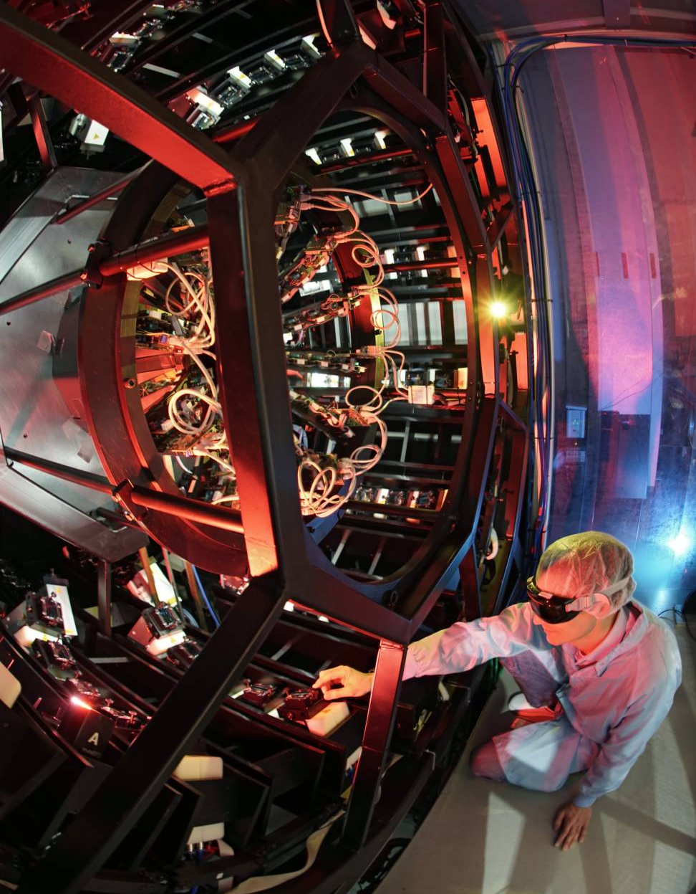
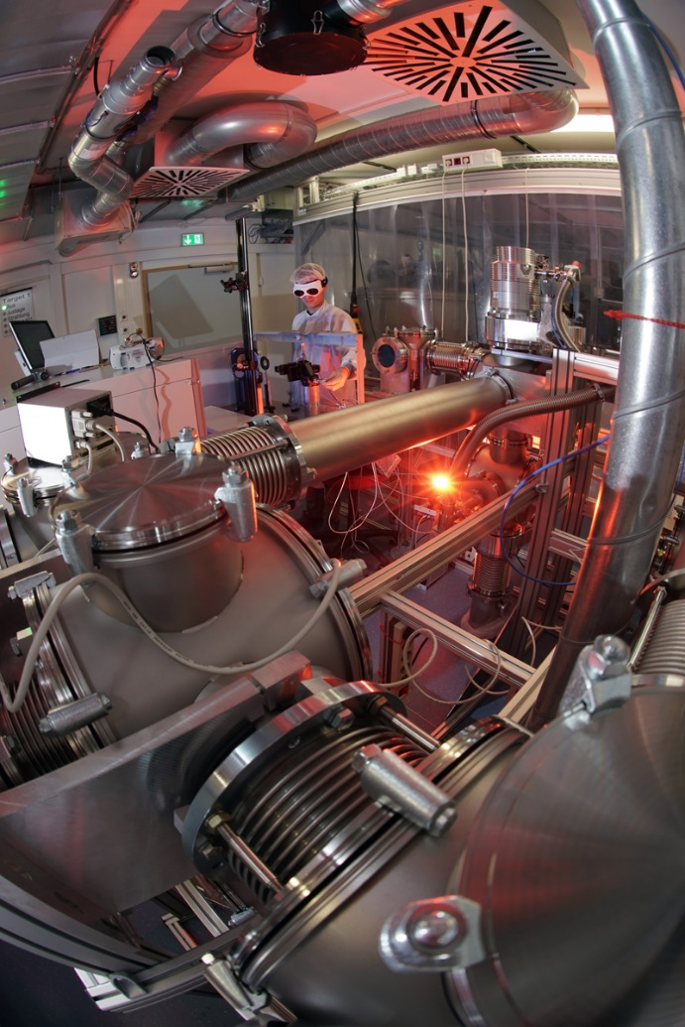
High-Power Laser Infrastructure @ HI-Jena
POLARIS:
Diode-pumped Yb:Glass/Yb:CaF₂ laser
pulses amplified to > 54 J
> 17 J on target in 98 fs: P_{max} > 170 TW
max. intensity: 1.3×10²¹ W/cm²
ultra high ASE-contrast: <2x10⁻¹³
Hornung et al., Opt. Lett. (2016)
Liebetrau et al., Opt. Lett. (2016)
Keppler et al., Opt. Lett. (2016)
Keppler et al., Laser&Phot. Rev. (2016)
JETI 200:
Ti:Sapphire laser
> 4 J on target in 17 fs: P_{max} > 250 TW
max. intensity: > 10²¹ W/cm²
First experiments on SHHG running

Slide 5

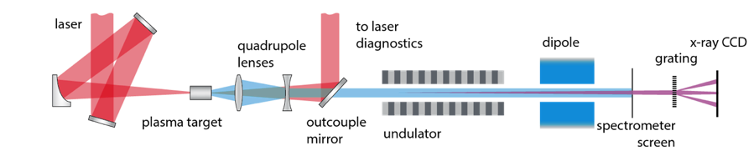
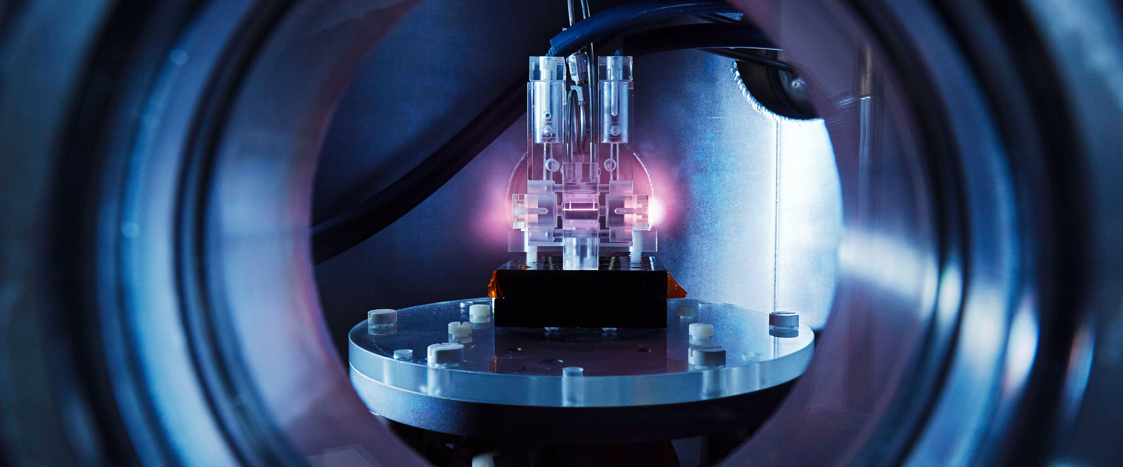
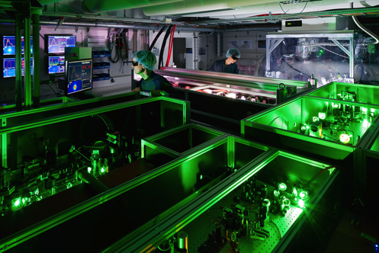
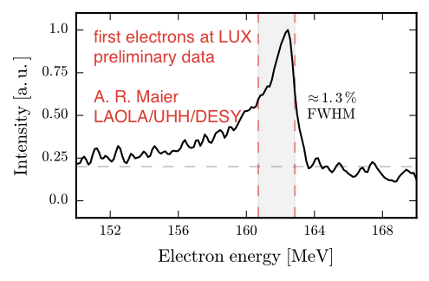


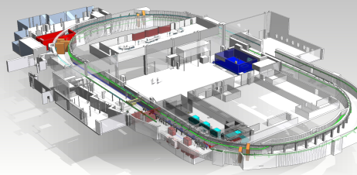
Advanced Electron Acceleration in Hamburg
FLASHForward
First electrons accelerated (~100 MeV)
and PWFA beamline installation started
Laser, diagnostic and target test lab in operation
Preparation for first PWFA experiments in 2017
Succesful test of active plasma lens
LUX Beamline
First electrons 2016
5 Hz rep-rate, up to 400 MeV
Undulator currently being commissioned
strategic partner Univ. Hamburg
SINBAD facility
research on ultra-short electron bunches and high gradient accelerator structures
Currently under construction
100MeV linac for fs-bunches
THz driven acceleration in dielectric waveeguides and DLA experiments
EuPRAXIA
Design study for
„European Plasma Research Accelerator with eXcellence In Applications”
Goal: stable multi GeV electron beam
16 European labs & 22 associated partners
Horizon2020

Slide 6

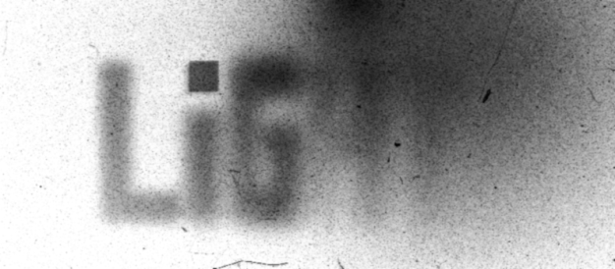
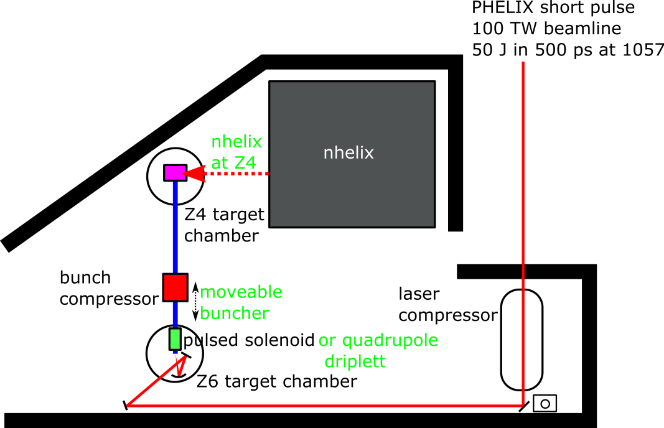
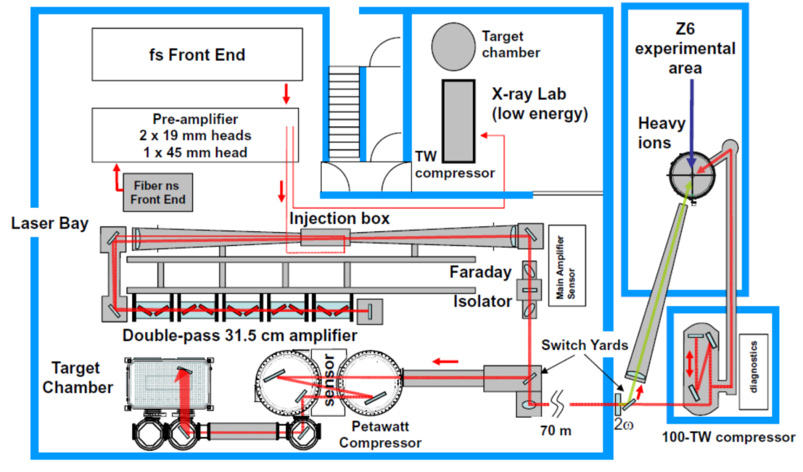
Status of the (GSI based) Light project
first transport of laser acc. heavy ions
shortest proton bunch with 209 ps and 400 mA current
first proton imaging experiments with transported protons
improved ion beamline transport
plan for pump-probe experiments

Slide 7
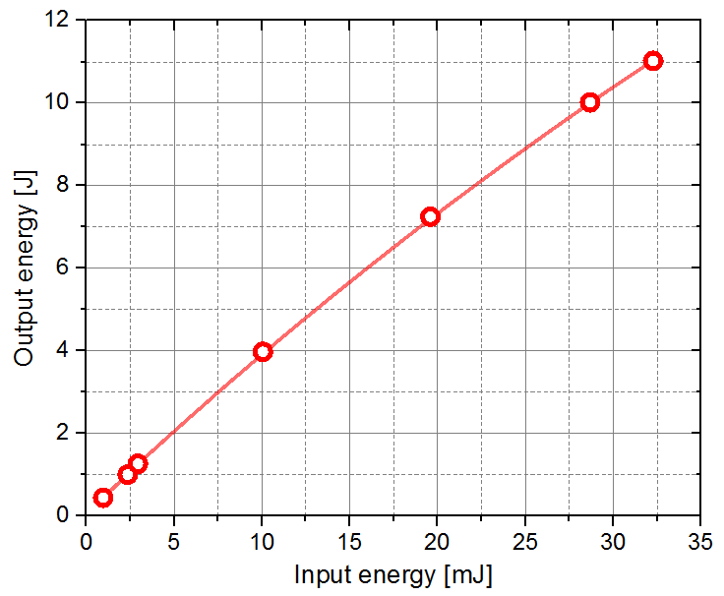
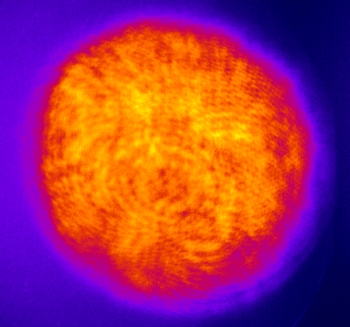
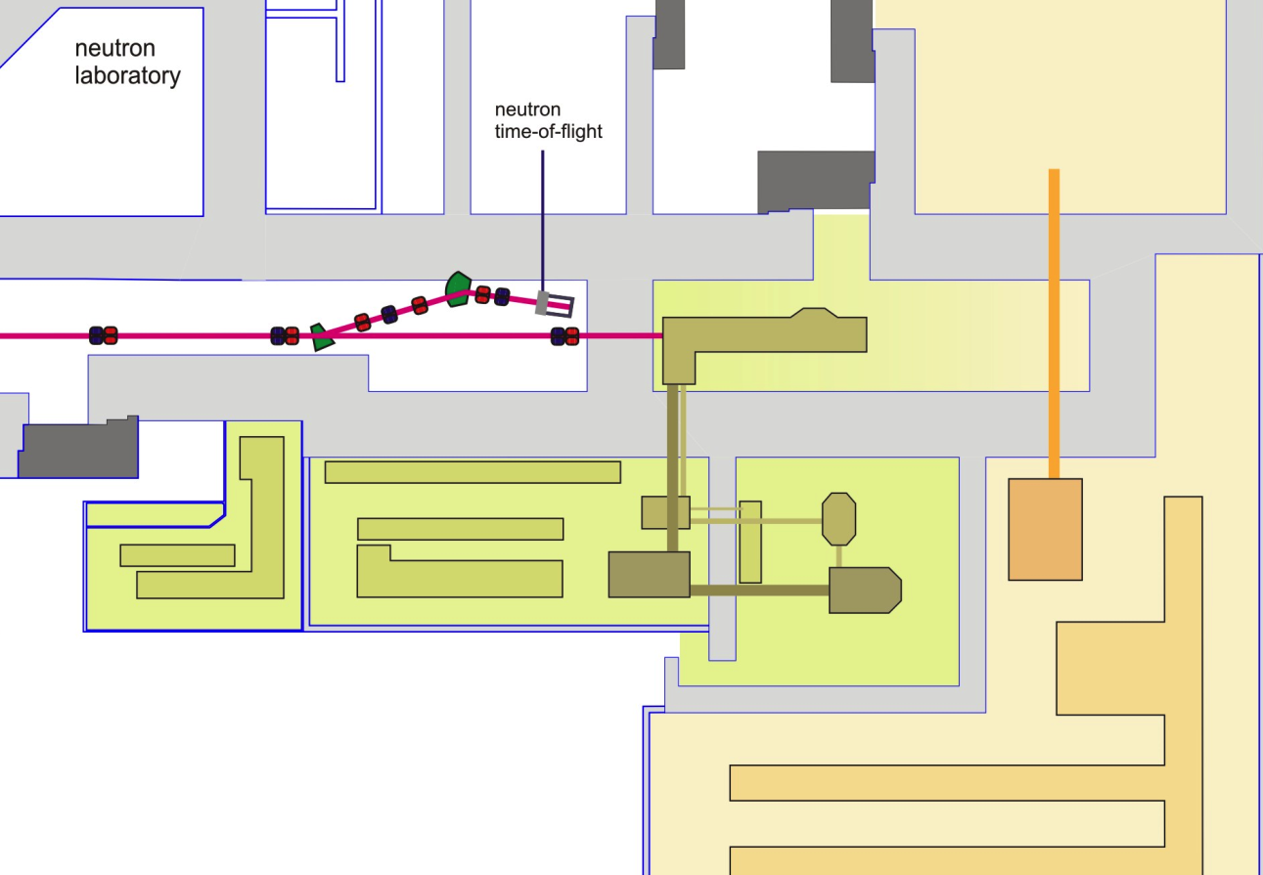

HZDR Draco-PW and Penelope laser infrastructure @ ELBE
Draco Ti:Sapphire laser dual-beam:
150TW (4J in 30fs routinely back on target)
PW (30J on target in 30fs, 20J on target)
Penelope (diode pumped PW)
>10 J amplification demonstrated
30 J amplified
ELBE
Electron / X-ray lab
Focus 3-4 µm FWHM
(F/2.5 90deg), ~35fs
150TW
Draco PW
Ion acc. lab
→ I ≈ 6·10²¹ W/cm²
Penelope diode pumped PW

Slide 8
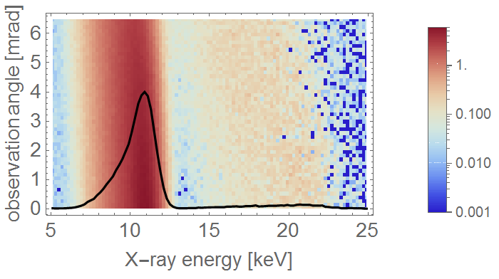
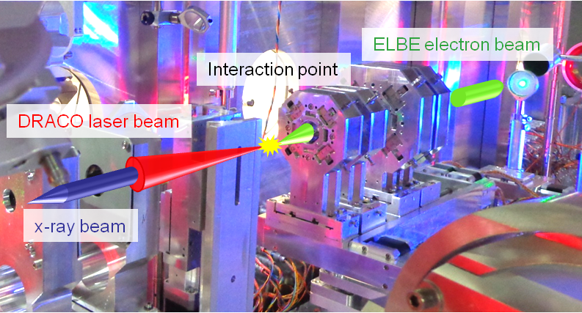
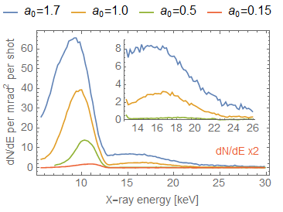
First application tests at the Thomson source Phoenix
ELBE
Electron / X-ray lab
150TW
Draco PW
red-shift and broadening of the
fundamental
harmonics (pile up corrected) with
increasing laser intensity a₀
Ion acc. lab
Penelope diode pumped PW
-> above 10⁶ per shot in 1/γ cone (a₀~1.5)

Slide 9


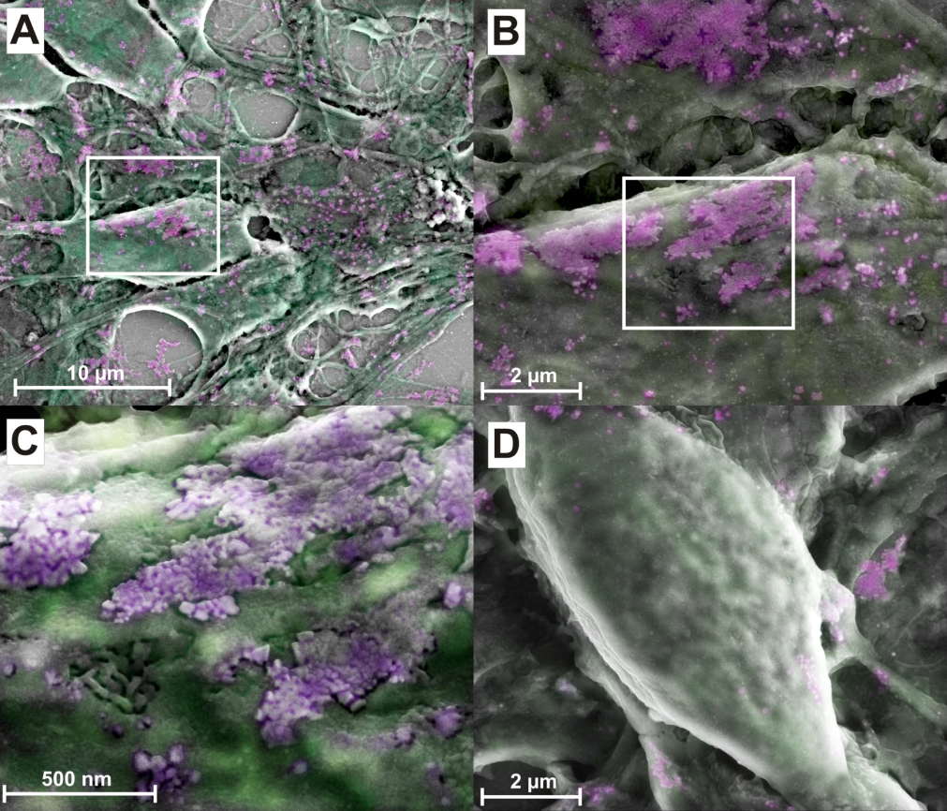
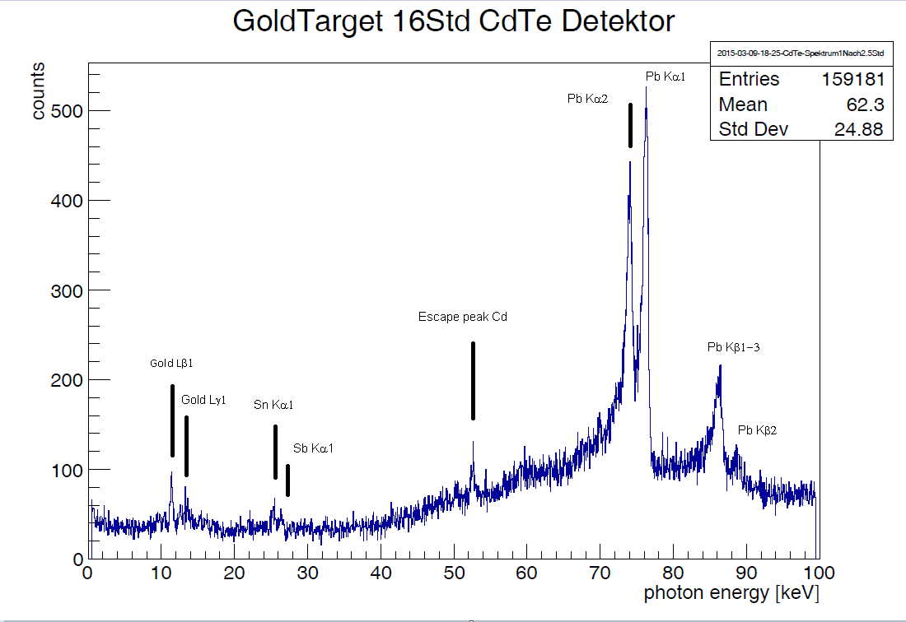
Medical imaging with x-ray fluoreschence
Marking cells with
gold nanoparticles (Au NPs)
X-ray detector in shielded area
X-ray laser thomson
Non-functionalized Au NPs
Au solution
B
L-edge Au-fluorescence
Functionalized Au NPs
A
Microscopy images of neurons

Slide 10
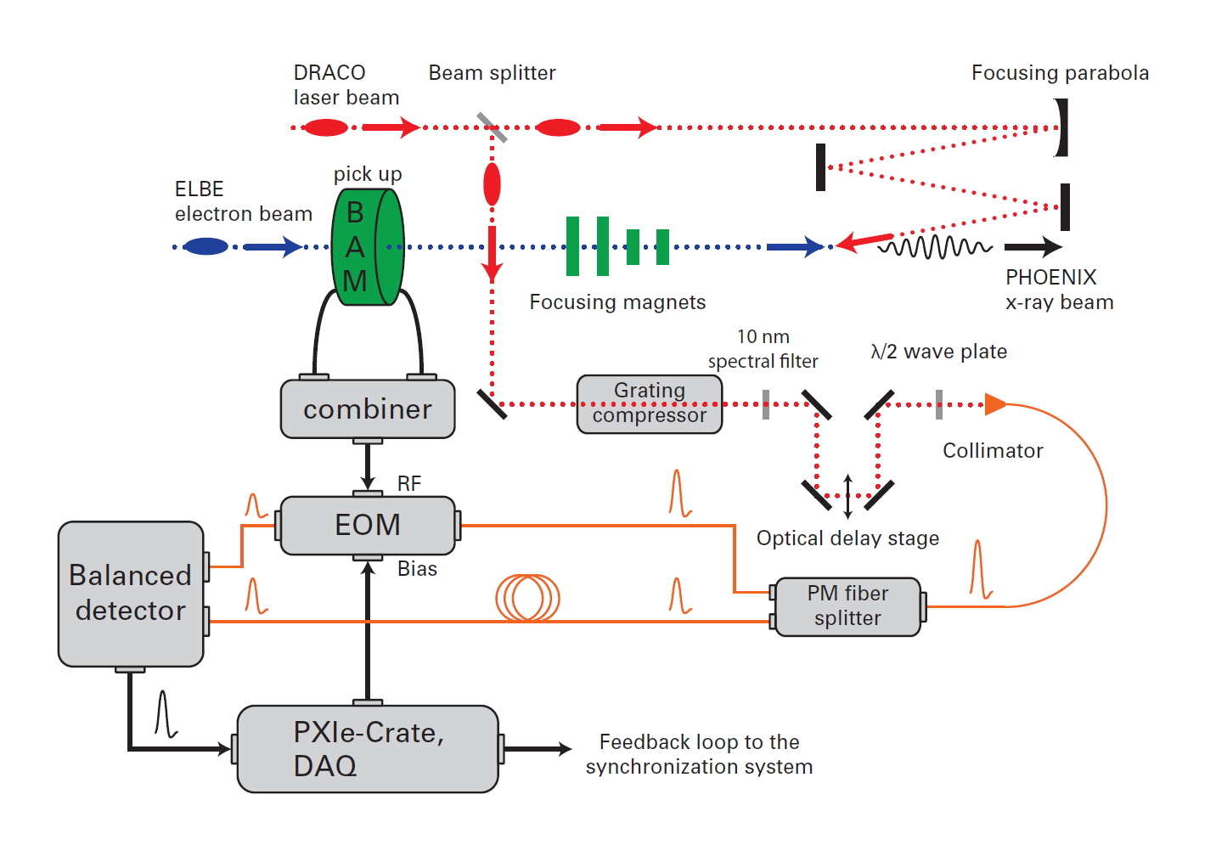

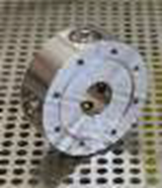
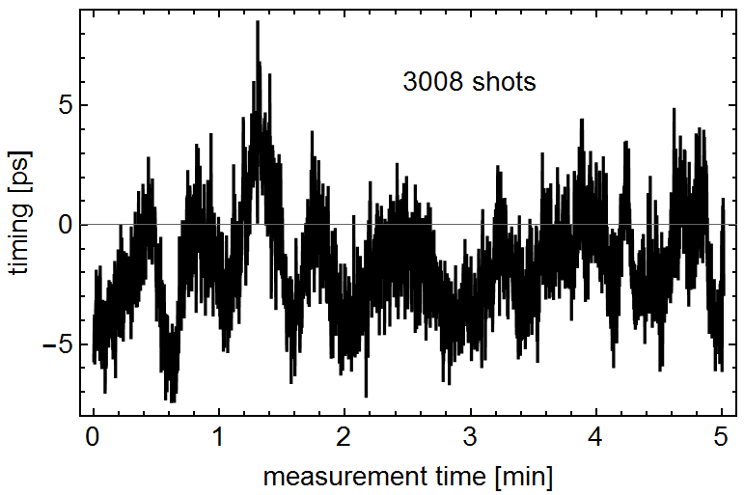
Single-shot beam arrival monitor (ST3 / ST4)
Resolution <200fs
Arrival time jitter: 2.2 ps RMS
Mean shot to shot jitter: 1.4 ps
Single shot diagnostic

Slide 11
Advanced plasma accelerators

