Slide 1


First Draco PW measurements – Preparation of radiobiological experiments
K. Zeil, L. Obst, M. Rehwald, H.-P. Schlenvoigt, F. Brack, F. Kroll, J. Metzkes, I. Prencipe, T. Kluge, S. Kraft, U. Schramm
E. Beyreuther, L. Karsch, J. Pawelke
P. Poole, G. Cochran, D. Schumacher

Slide 2
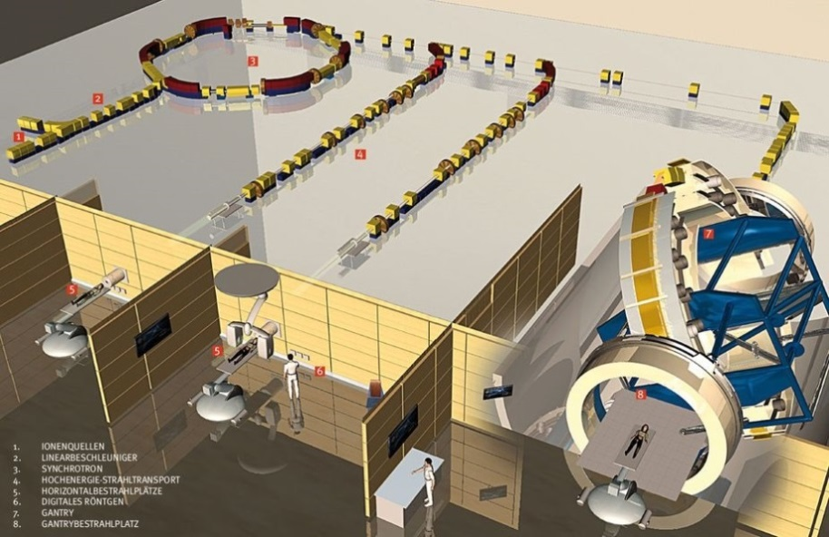
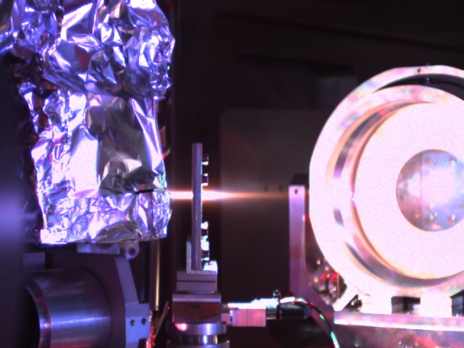

Advanced ion accelerator for medical application
Ion therapy center HIT
Normal tissue
tumor
Photons
Normalized dose
Protons
(175-190 MeV)
Protons
≈ µm
Depth in water [cm]
Proton energies of 250 MeV required
dose rate of Gy/min necessary
stability and precision
laser development
optimization of laser plasma interaction

Slide 3
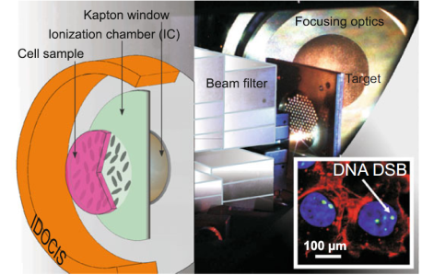
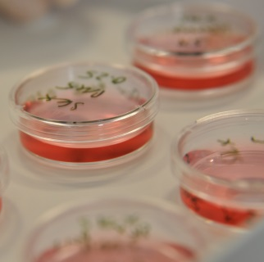
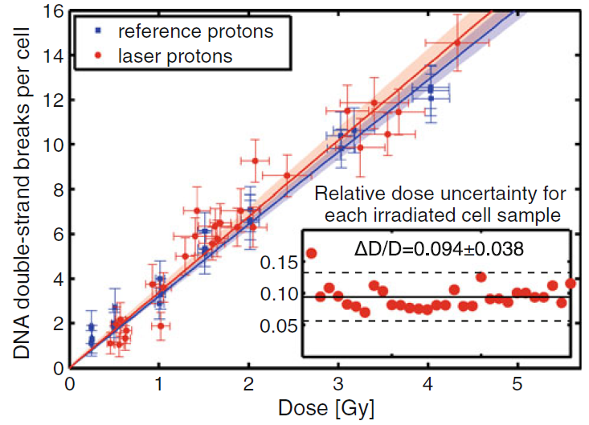
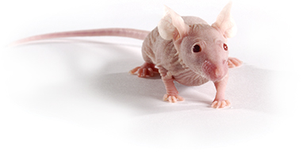
Compact ion accelerator for radiation therapy
Feasibility of ultra-short pulse laser-driven proton & ion sources for applications
In vitro cell irradiation with laser-accelerated protons
→ relative dose uncertainty of below 10 %
In vivo cell irradiation
criver.com

Slide 4
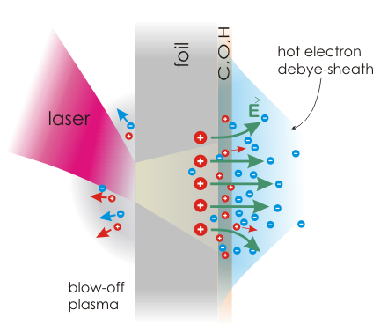
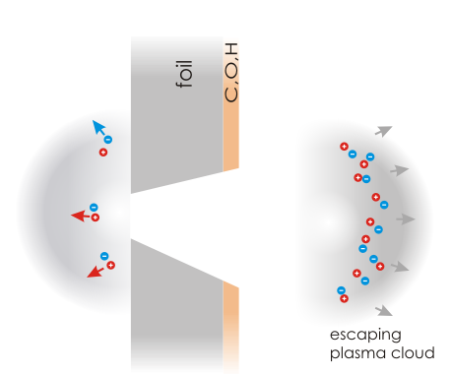
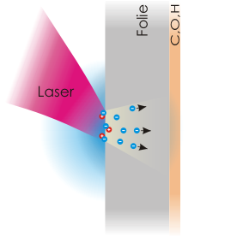
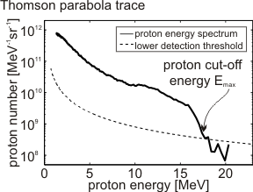
TNSA – Target normal sheath acceleration
Absorption and
electron acceleration
fs - time scale
Electron transport and forming of Debye sheath
Expansion of electron-proton plasmas into vacuum
ps – time scale
> 20°
E ~ TV/m
Notes:
Kern des Vortrages ist das Wechselspiel zwischen quasi-statischer Beschleunigung (prethermal, kurzer Puls) und Expansion (RMT, Targerphysik)
Nach eindander aufbauen, aber nicht zu kompliziert
Topics of thesis
bevor ich die physikalischen Prozesse beleuchte, möchte ich ein paar worte zur anwendung sagen, damit gleichzeitig Experimentaufbau eingeführt wird
was bringt Zellbestrahlung: Nachweis eines funktionierenden Proton dose delivery systems enabling dose control and measurement with sufficient presicision das kann man schon bei geringeren Energien validieren

Slide 5
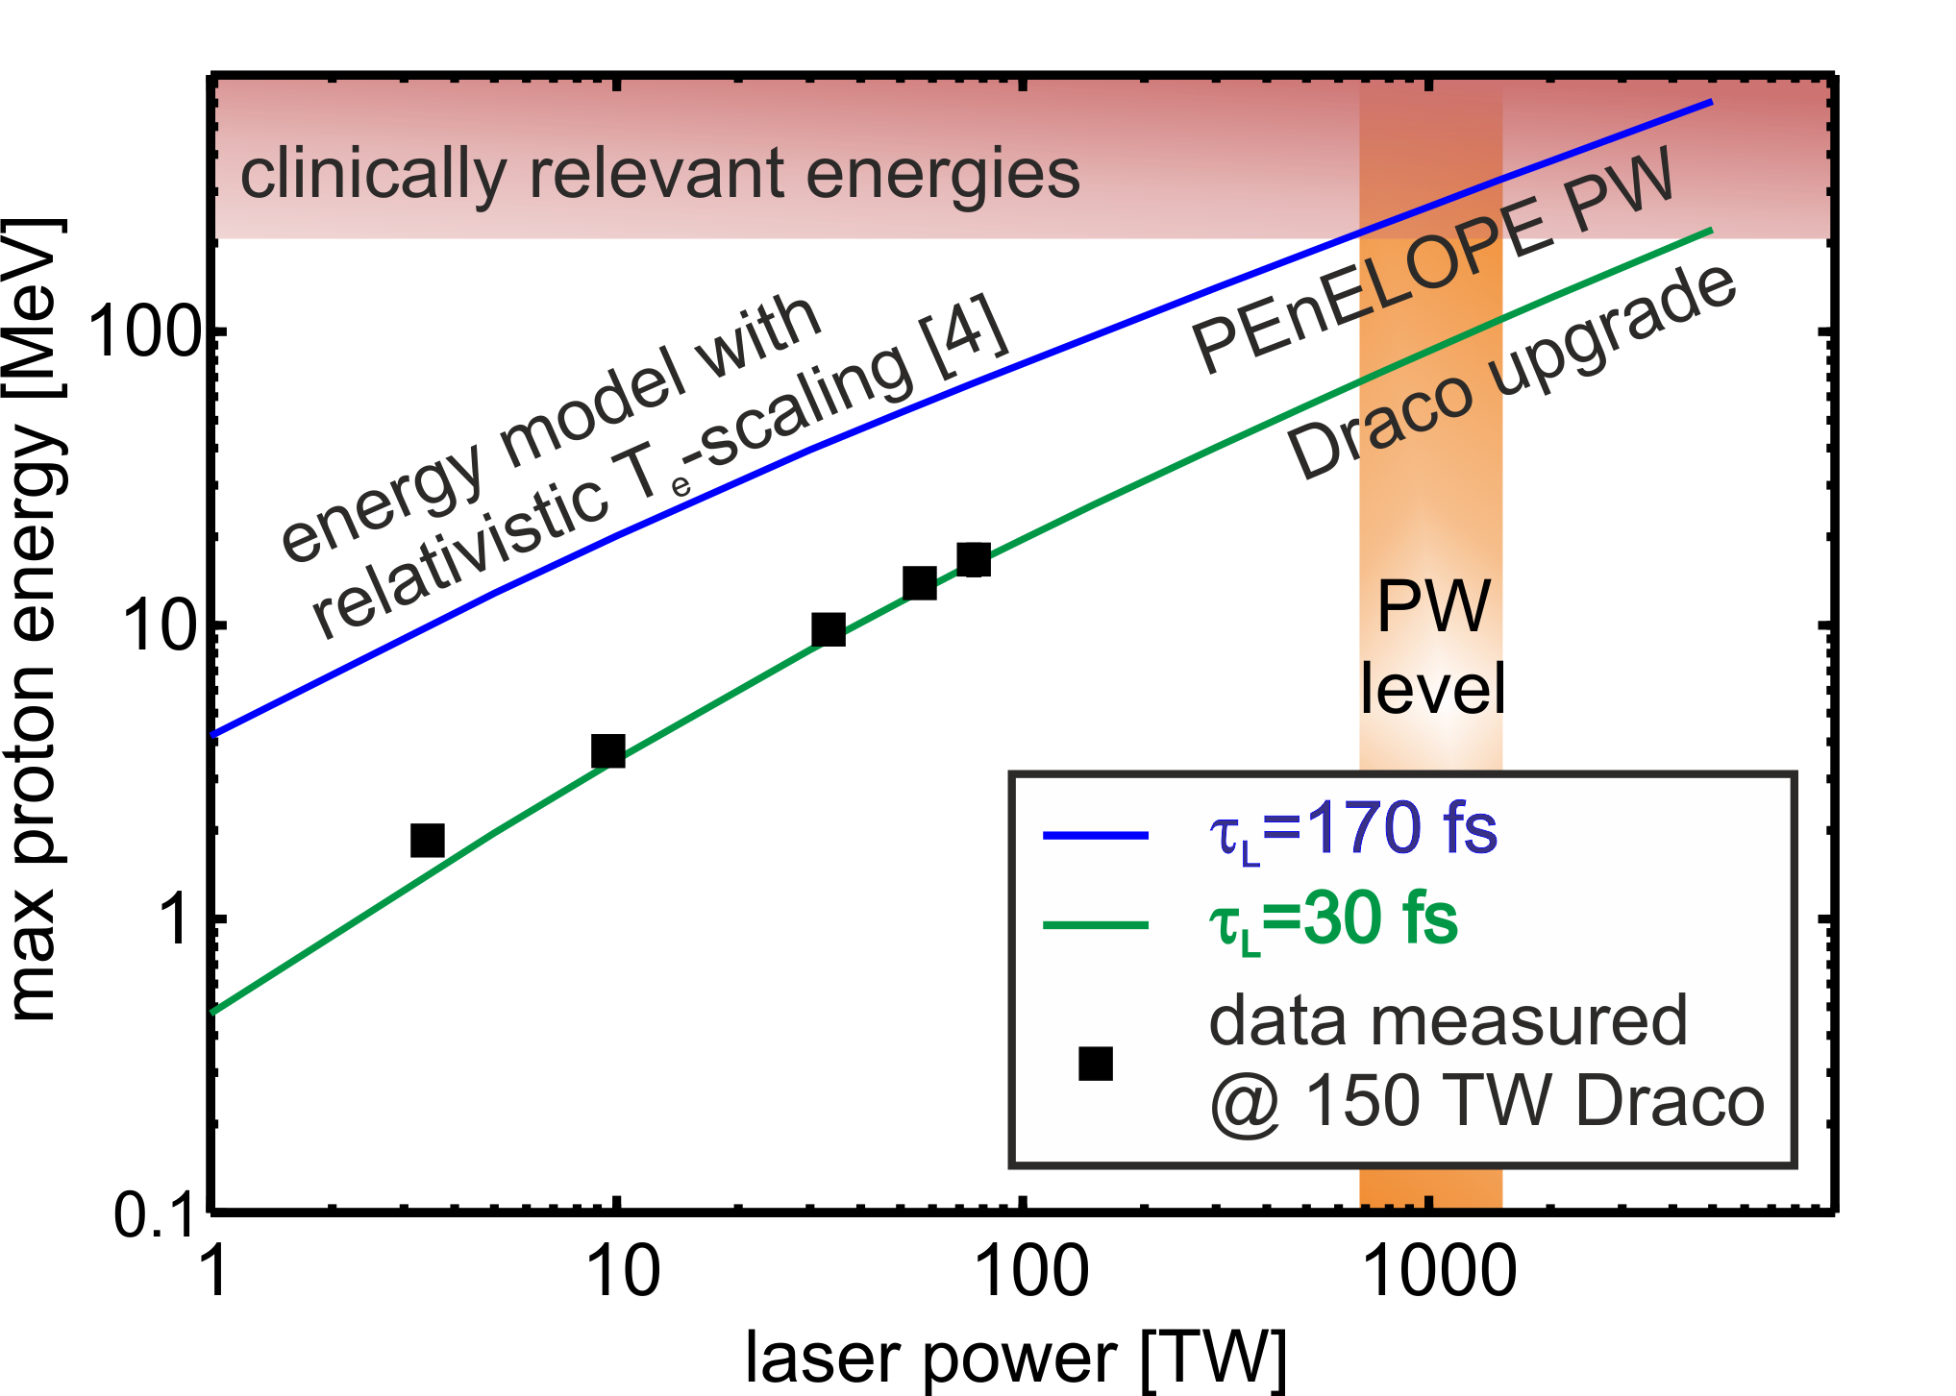
Proton energy scaling
[1]
[2,3,4]
Development of PW class lasers – complementary technology
[1] Kluge et al. PRL 107, 205003 (2011), [2] Ogura et al., OPT. LETT. , 37 (2012),
[3] Jong Kim et al., PRL 111, 165003 (2013), [4] Wagner et al., PRL 116, 205002 (2016)

Slide 6
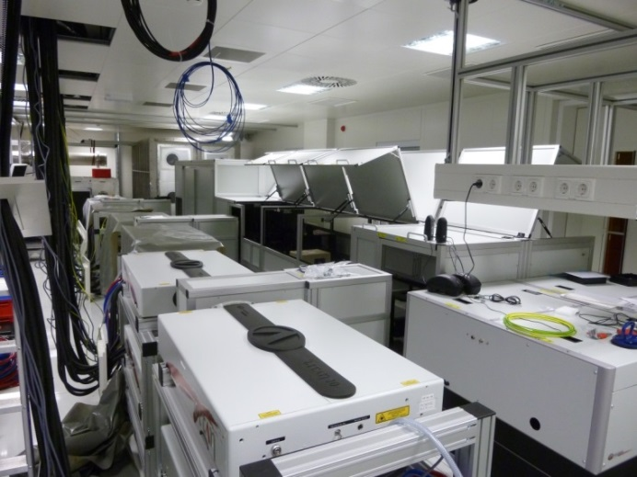
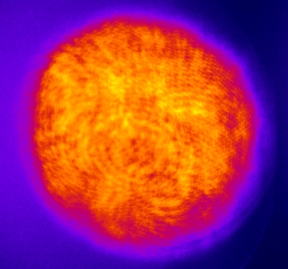
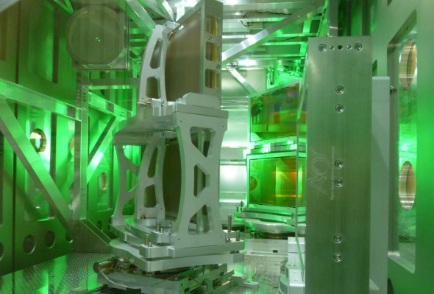

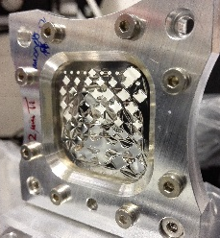
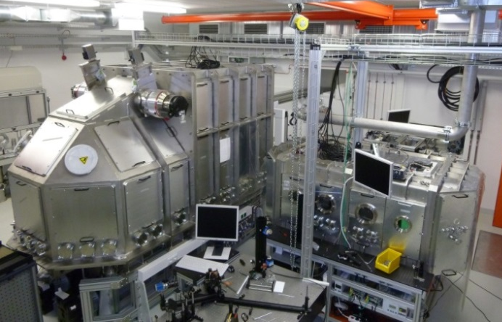
Draco PW Upgrade – First shots
  Draco Ti:Sa Laser System (September 2016)
150 TW (4J Pulse mit 30fs)
650 TW demonstriert (20J Pulse mit 30fs)
30 J amplified
Focus 3-4 µm FWHM
(F/2.5 90deg), ~35fs
→ I ≈ 6·10²¹ W/cm²

Slide 7
Draco PW Upgrade – First shots
*
ca. 40 MeV p from
1 µm Ti-foil
Demonstration of 600 TW operation on target

Slide 8
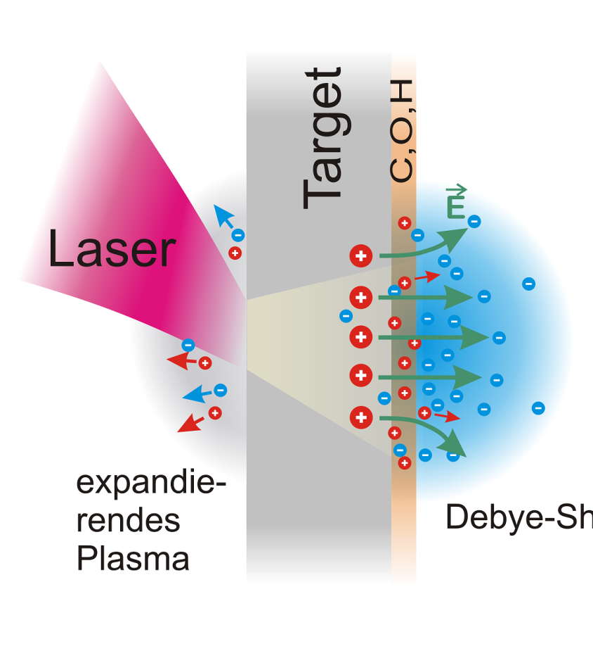
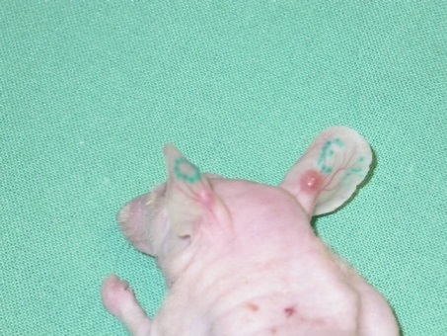
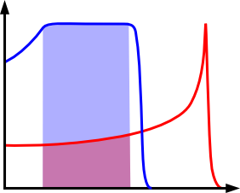
Animal irradiation - requirements
HF-Solenoid
25 MeV
40 MeV
dose
Homogeneous depth dose profile (5x5x5 mm³)
precise dose application of Gy/min
stabile operation for several weeks
proton energy of 25 – 40 MeV
depth

Slide 9

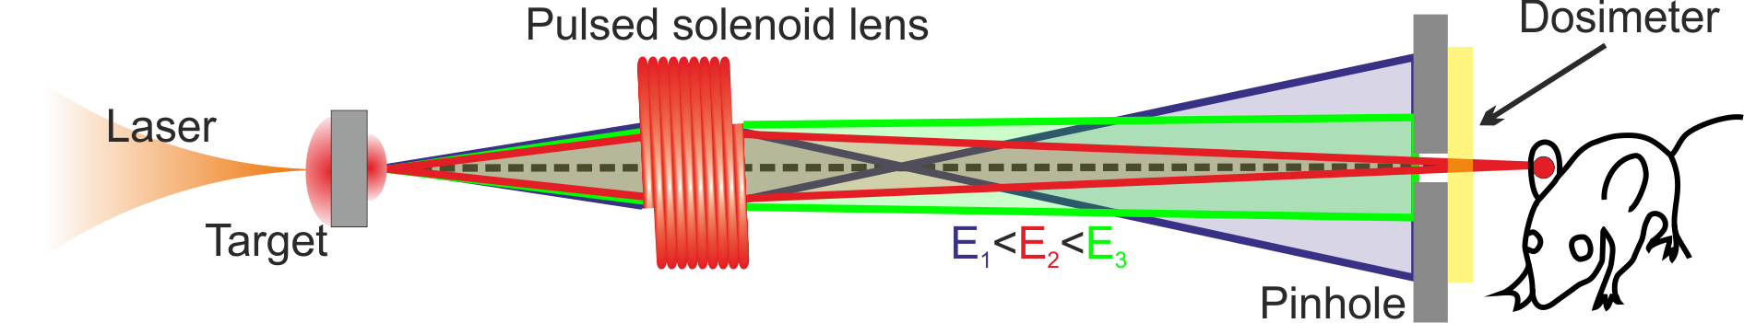
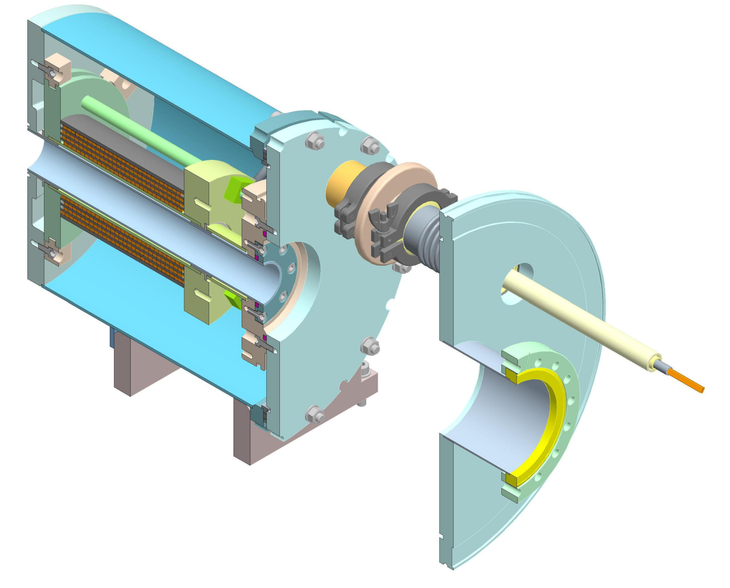
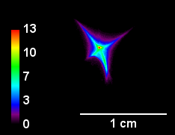
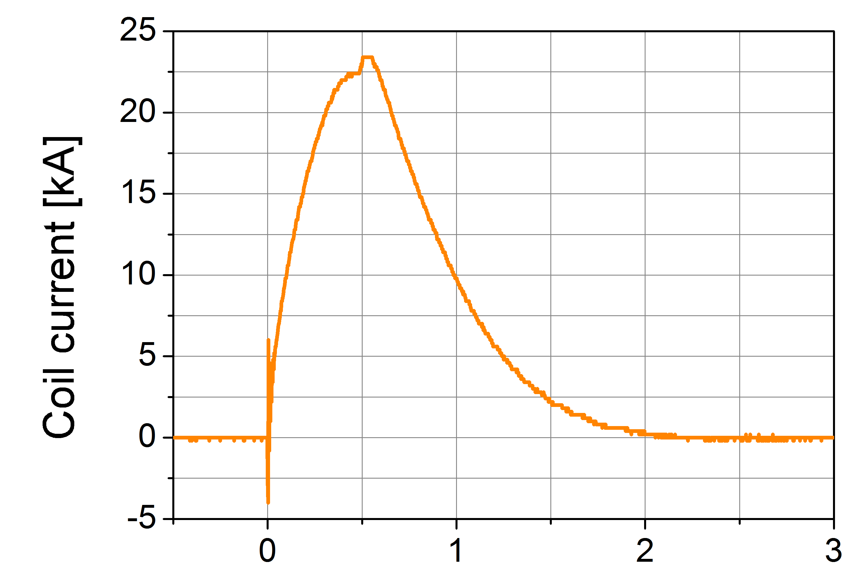
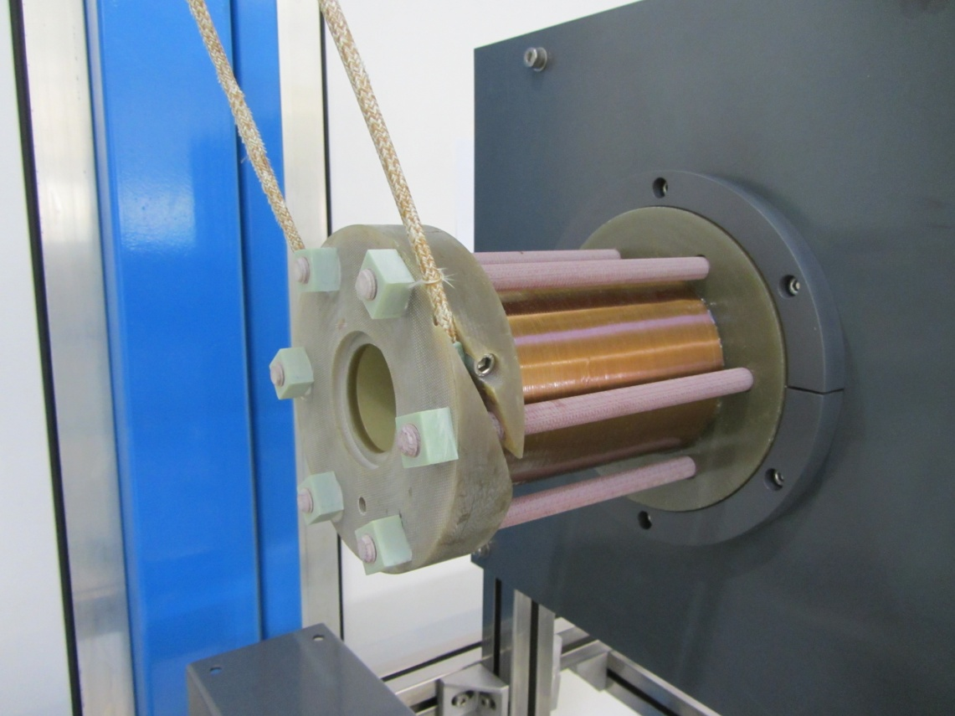
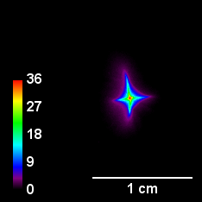
Animal irradiation – pulsed beam line
Proton focus single solenoid
18,6 MeV
solenoid current [kA]
time[ms]
B_{max} = 20 T (I_{max} = 24 kA)
collimation of 70 MeV
few years operation (hundreds of pulses)
number /a.u.
proton energy /MeV
18,6 MeV

Slide 10
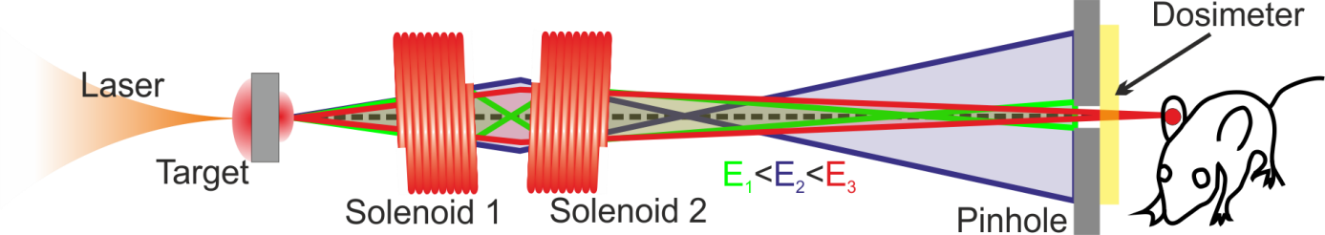
Animal irradiation – pulsed beam line
Proton focus single solenoid
18,6 MeV
solenoid current [kA]
time[ms]
B_{max} = 20 T (I_{max} = 24 kA)
collimation of 70 MeV
few years operation (hundreds of pulses)
double
solenoid
18,6 MeV

Slide 11
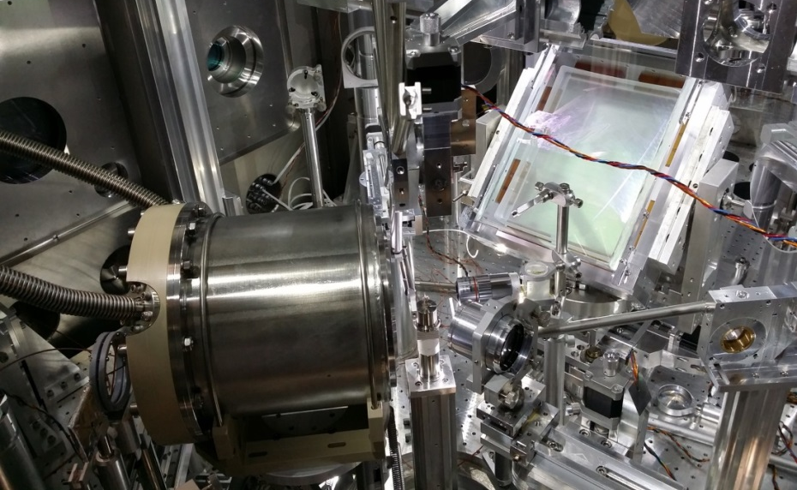
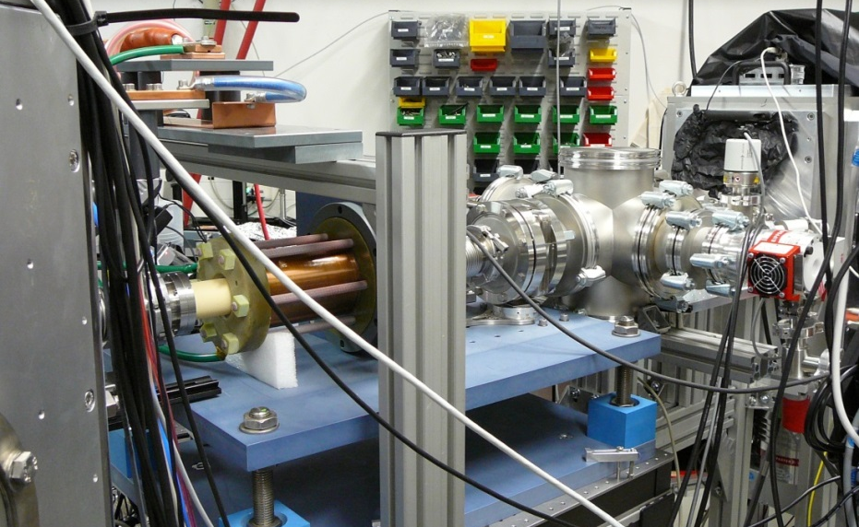
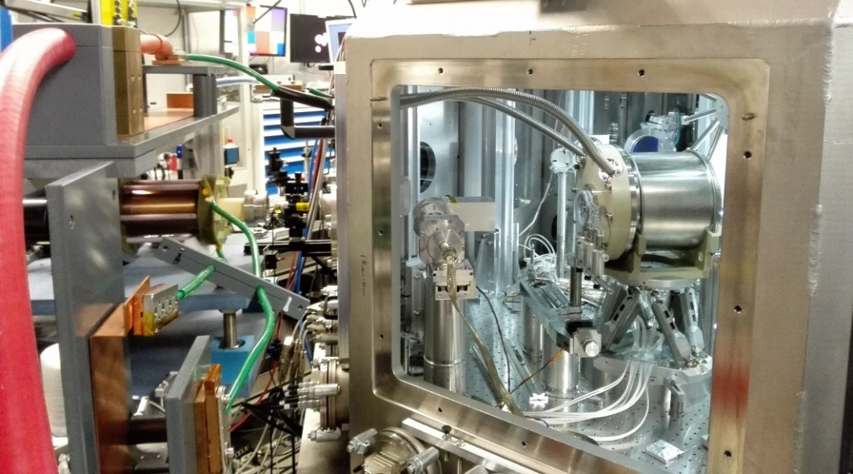
Animal irradiation – setup in target chamber
Off-Axis Parabola
Irradiation site
Solenoid 2
Solenoid 1
Target
Solenoid 2
Solenoid 1

Slide 12
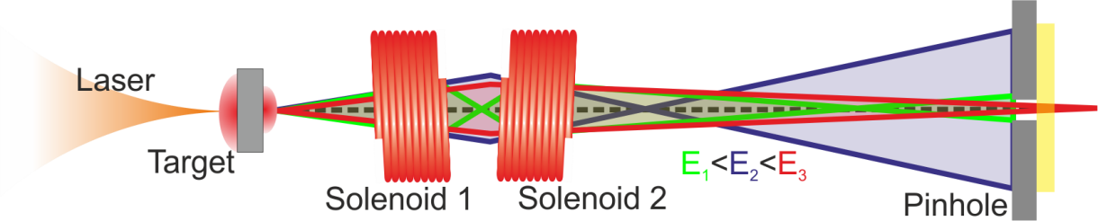
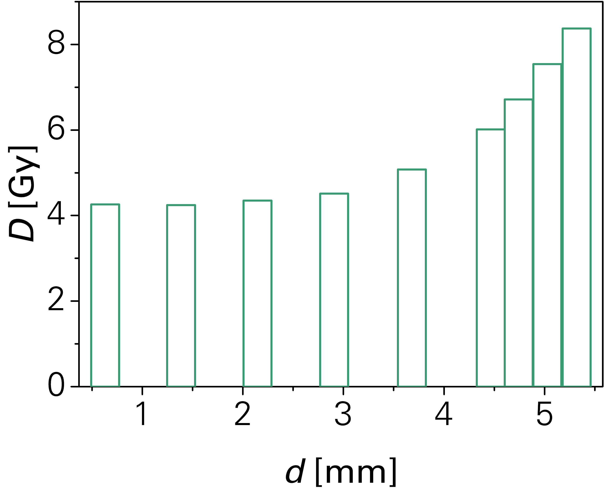
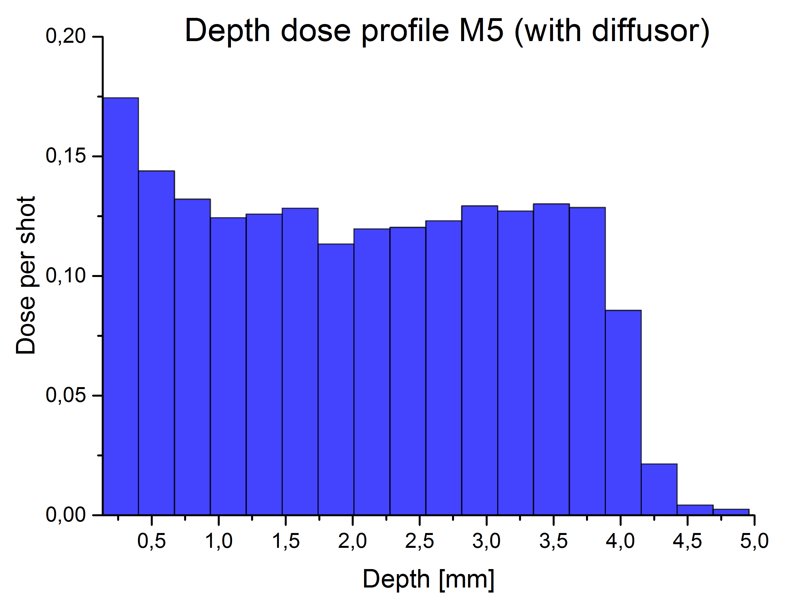
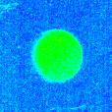
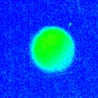
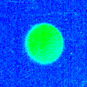
Animal irradiation – conclusion
scatter foil
RCF-Stack
homogenization ✓
BUT: reproducibility ☹
Depth dose
5 mm penetration depth ✓
sufficient dose per shot ✓
Notes:
noch scatterer foils in Grafik

Slide 13
Animal irradiation – conclusion
RCF-Stack
homogenization ✓
BUT: reproducibility ☹
day-to-day change , or during one day can be significant
Notes:
noch scatterer foils in Grafik

Slide 14
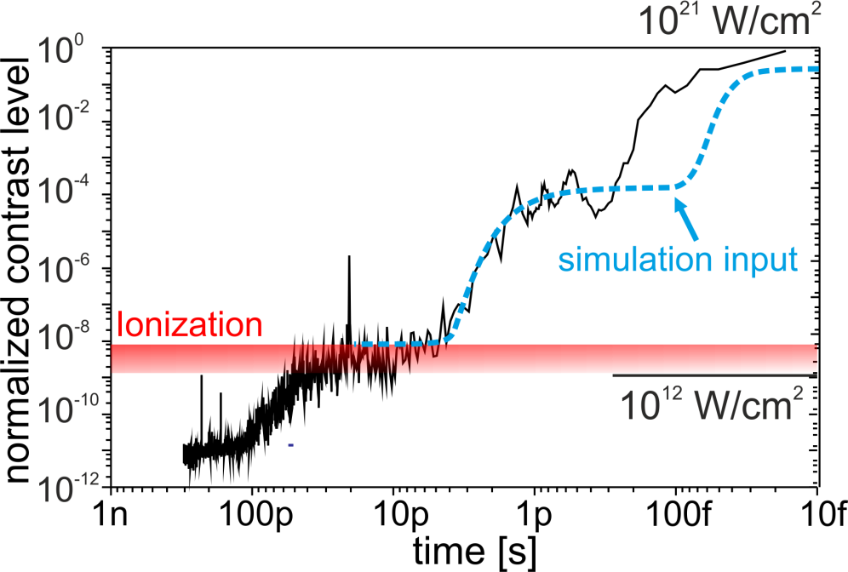
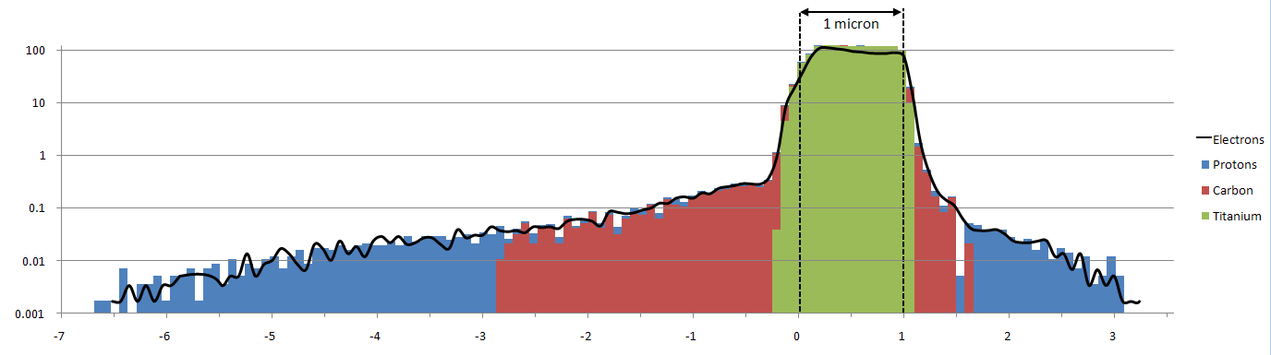
Temporal contrast and preplasma
Large
1 µm Ti
30 nm CH - Layer
30 nm CH - Layer
10²¹ W/cm² @ oblique incidence
100
electrons
10
protons
critical density
n (n_{c})
1
carbon
0.1
titanium
0.01
0.001
-7 -6 -5 -4 -3 -2 -1 0 1 2 3
x (µm)
front side → bulk expansion
increased interaction length at critical
density - enhanced absorption
rear side → proton plasma expansion
reduced (different) field gradient for both species
Notes:
14
sublte changes in particular at the ramp have strong influence, becomes obviously more severe for PW

Slide 15
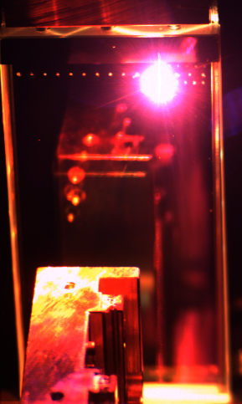
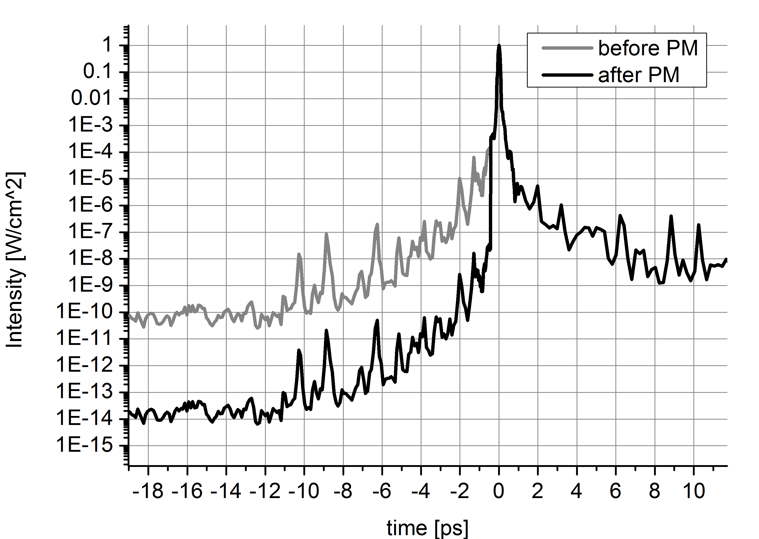
Laser Temporal Contrast Improvement
Single Plasma Mirror Setup
OAP_{PM} = F/100
substrate 8 mm behind focus
  I_{PM} ~ 10¹⁶ W/cm² (p – pol.)
AR coating R_{AR} = 0.001
T_{PM} = 80 %
10¹⁰
Temporal contrast before PM
Temporal contrast after PM
Draco 3.3 J / 30 fs
Draco 2.6 J / 25 fs
Notes:
nice for contrast, but characterization of the pulse afterwards much harder

Slide 16
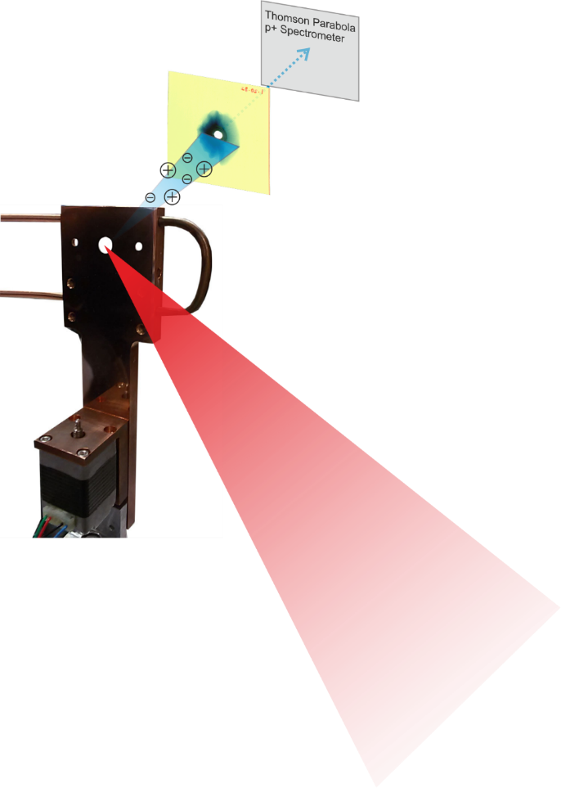
Thickness scan using foil targets
Proton cut-off energies in target normal direction using 100 TW Draco
shots with plasma mirror
shots at intrinsic laser contrast
reference shots on 2µm Ti at intrinsic laser contrast
25 MeV @ 2.5 J laser energy
→ scaling to PW??

Slide 17
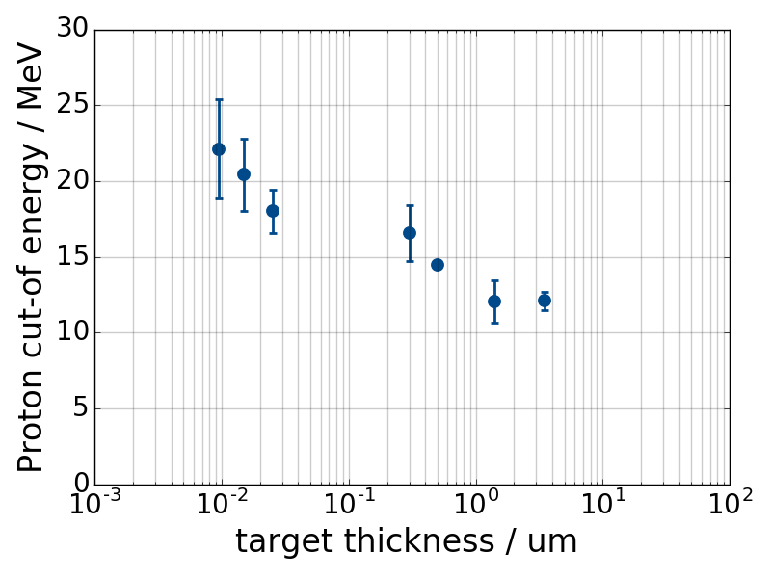
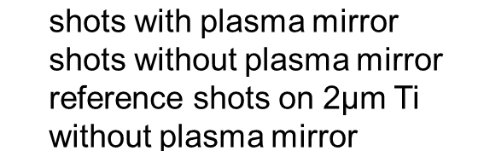
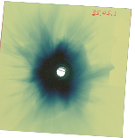
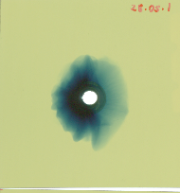
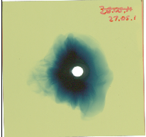
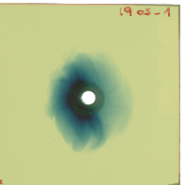
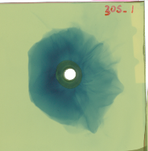
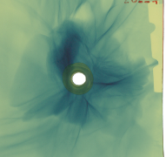
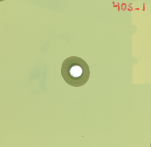
Thickness scan using foil targets
Proton beam profiles in target normal direction using 100 TW Draco
shots with plasma mirror
shots at intrinsic laser contrast
15nm
4,5 MeV
430nm
24nm
1270nm
10° half angle
10mm
6500nm
1500nm
190nm
15° half angle

Slide 18
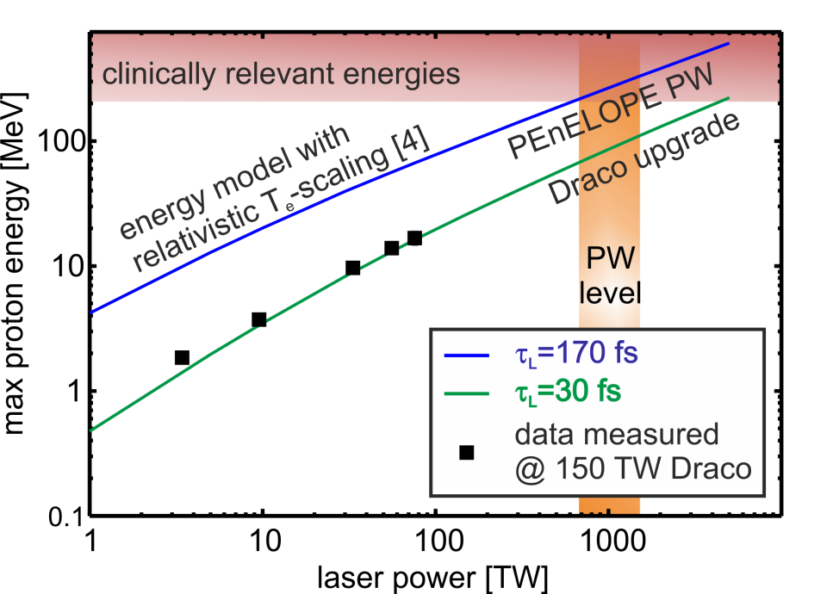






Conclusion
*
demonstration of 600 TW operation on target
30 J amplified
18,6 MeV
dose
40 MeV
pulsed beam line for in-vivo irradiation
25 MeV
shots with plasma mirror
shots at intrinsic laser contrast
depth
15nm
4,5 MeV
24nm
430nm
1270nm
10° half angle
enhanced beam quality at high contrast → scaling to PW
10mm
1500nm
6500nm
190nm
15° half angle

Slide 19

Thank you for your attention
multiple filamentation of freely
propagating 100 TW beam in air

Slide 21






Laser-proton acceleration using hydrogen jets
Cryogenic Hydrogen Jet
Pure proton near critical density target (30 $n_{c}$ ) Cooled with liquid He to 16 - 20 K
high rep rate, debris free
cylindrical and planar geometries (~ µm)
Study dynamics with optical probing at different laser contrast
Facilitate comparison with PIC
Longitudinal probe
Transversal probe
Ti:Sapphir Draco
temporal resolution of picoseconds
spatial resolution of micrometers
Focus spot
5 µm
Notes:
First: In Addition a optical probe setup was used due to the fact, that the Hydrogen jet is transparent
Cruidal point: characterisation of plasma with ps and um resolution possible.
Als eine der Hauptdiagnostiken (über die ich jetzt vorallem reden möchte) wurde longitudinaler und transversaler Probe verwendet.
D.h. der H2 Jet konnte in Laserrichtung und senkrecht dazu abgebildet werden.
Dabei frequenzverdoppleder Probe, aus einem kleinen Teil des DRACO lasers generiert und eine phasen gekoppelter ps-Laser verwendet.
Damit war eine ps und um auflösung möglich.

Slide 22






Laser contrast and beam profiles
Intrinsic contrast
Bubble-like modulations of proton beam profile
~ 4cm
~ 4 cm
TNSA protons are deflected by filamented rearside field structure
(3)
(1)
Laser
(2)
̴µm scale
length
6.7 MeV
8.7 MeV
10.3 MeV
plasma mirror contrast
smooth beam profile
plasma mirror contrast with tailored prepulse (50 ps)
more dose, and potentially more directed beam

