Slide 1
Development of CsK₂Sb Photocathodes for High-Current SRF Electron Injectors
Martin Schmeißer M&T annual meeting
01.02.2017

Slide 2
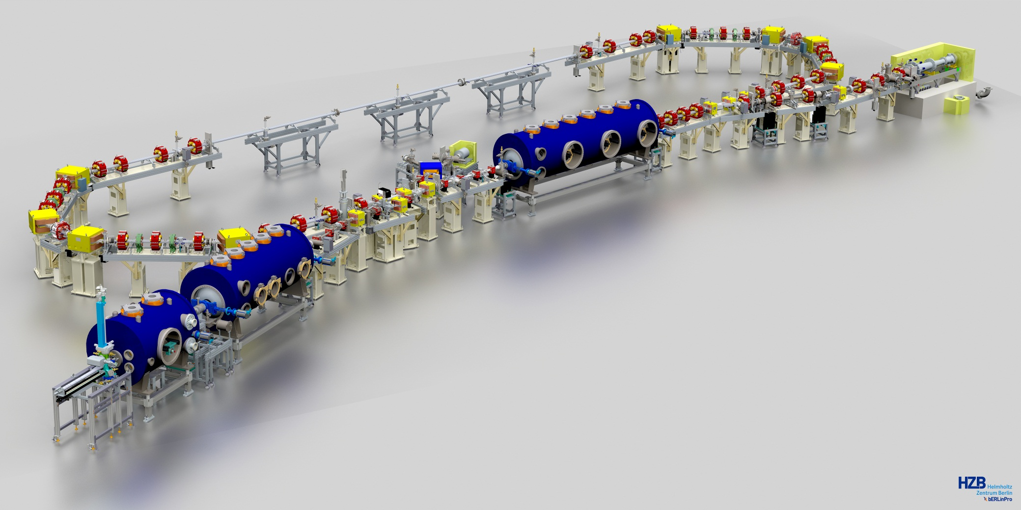
high-current Photoinjectors
Photoinjectors for new accelerators require
High brightness
High average current
Photocathode QE > 1% allows mA current
SRF technology allows high gradient and cw operation
SRF photoinjector with normal conducting cathode
Photocathode exchange system

Slide 3
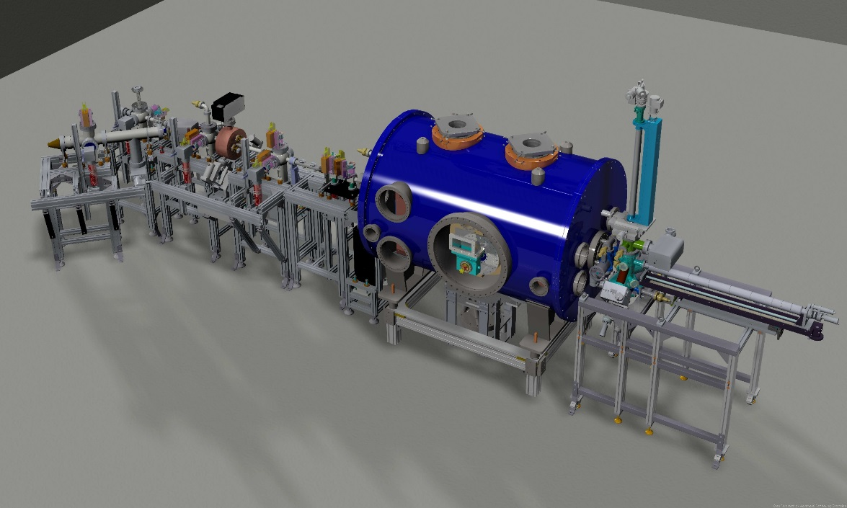
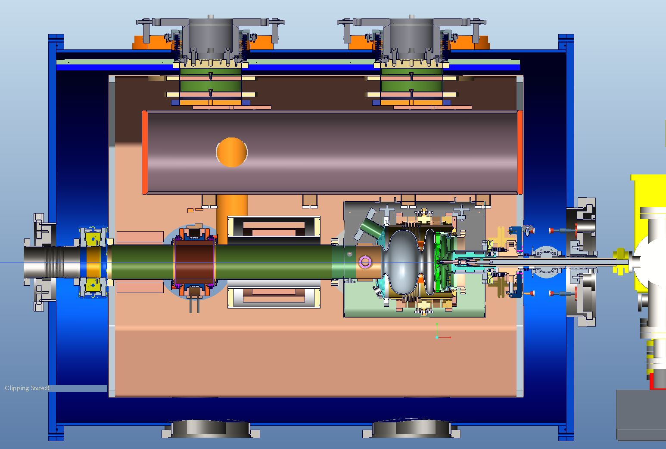
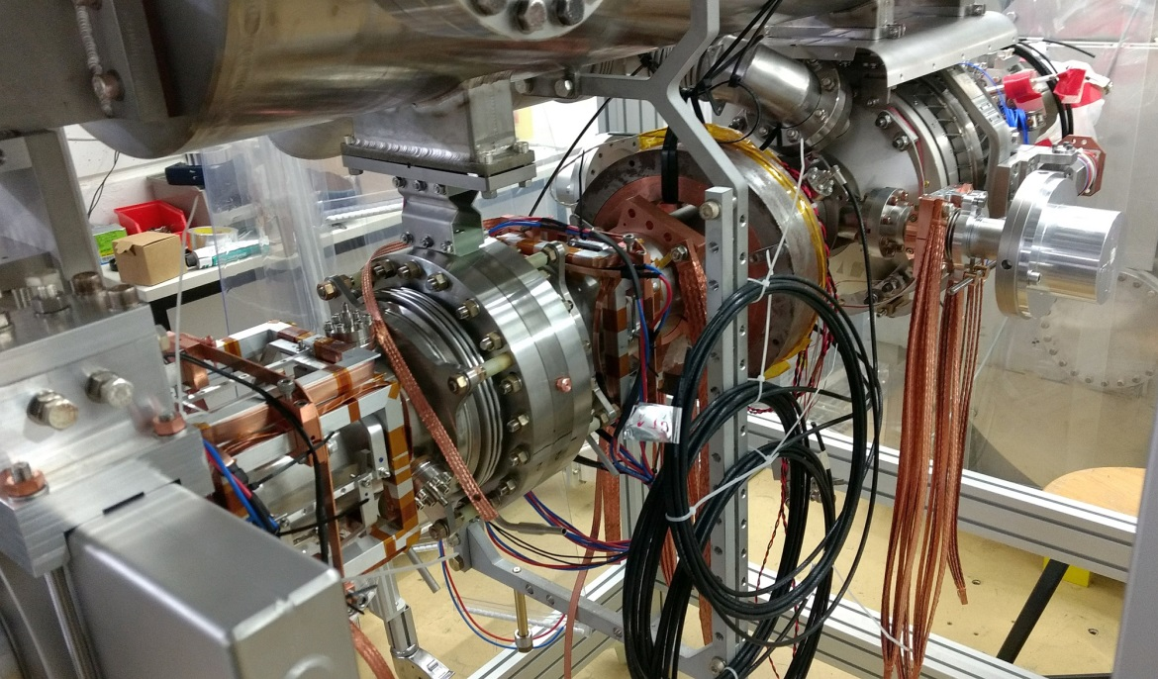
high-current Photoinjectors
beam energy | < 3.5 MeV
bunch length | < 6 ps rms
bunch charge | < 100 pC
repetition rate | < 30 kHz
Spectrometer dipole
Wirescanner, Screens
TCAV
Faraday Cup,
Screen, BPM
Photocathode
Transfer System
slit scanner
Image D. Böhlick

Slide 4
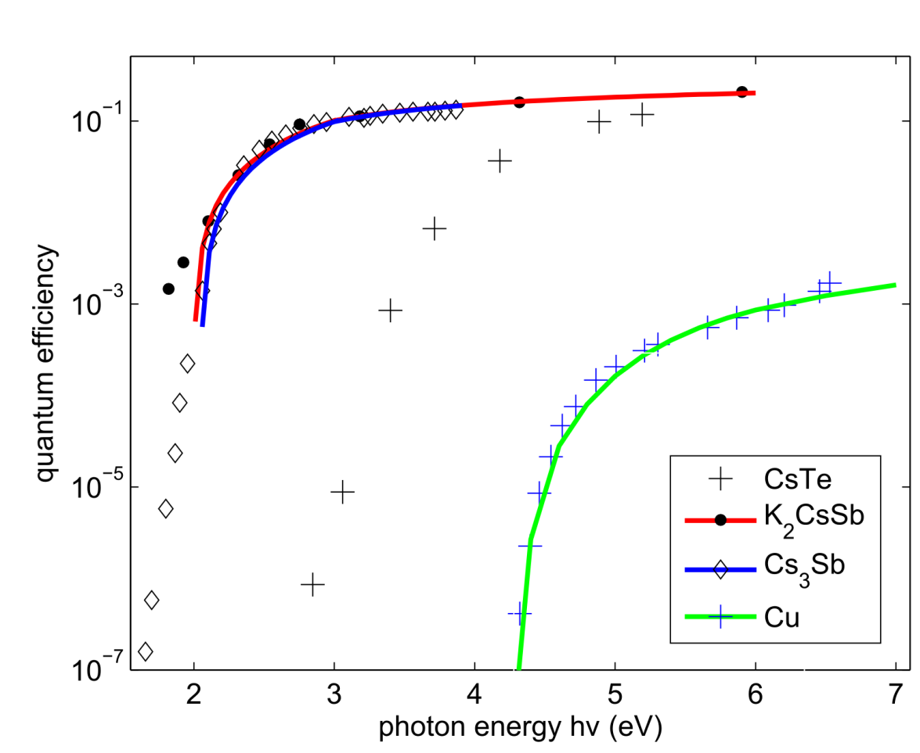
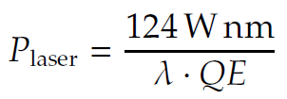
PhotoCathodes
Aim:
0.5 mm mrad emittance from gun
100mA in cw operation
2ps rms bunch length
Boundary conditions:
1% QE at 515nm req‘s 23W avg laser power on the cathode
High-QE semiconductors are highly reactive, survive only in 10⁻¹⁰ mbar vacuum
10ps rms Gaussian bunch with 77pC has 3A peak current
515nm available as 2. harmonic of Nd or Yb lasers

Slide 5
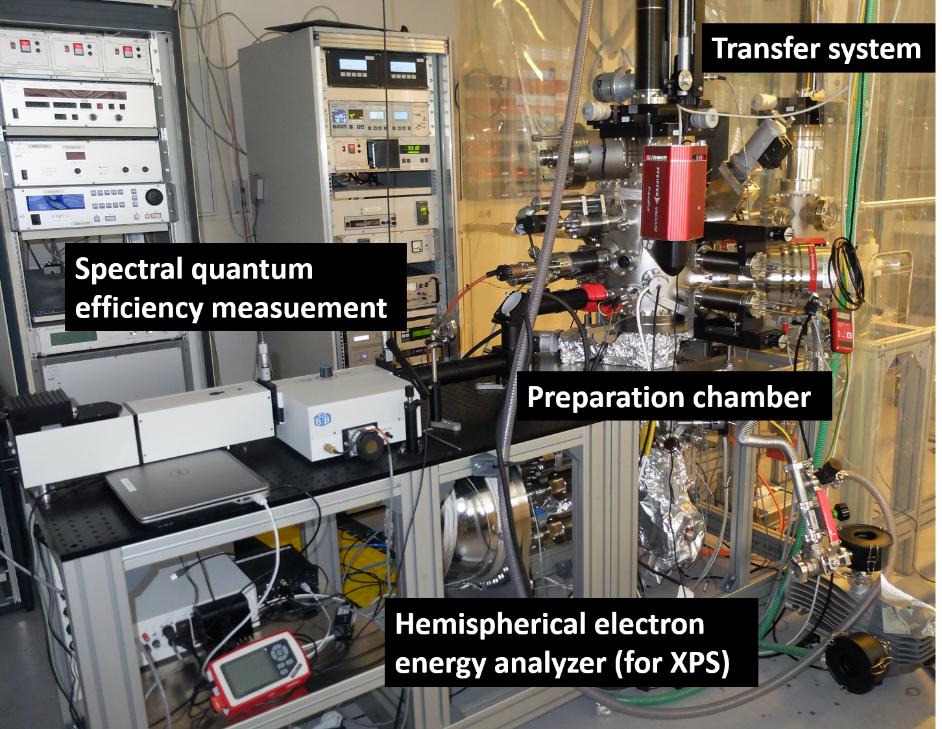
Alkali Co-Deposition Process
Momentatron
p = 8x10⁻¹⁰ mbar
Spectral quantum
efficiency measurement
p = 8x10⁻¹¹ mbar
Vacuum suitcase
p < 1x10⁻¹¹ mbar
p = 6x10⁻¹¹ mbar

Slide 6
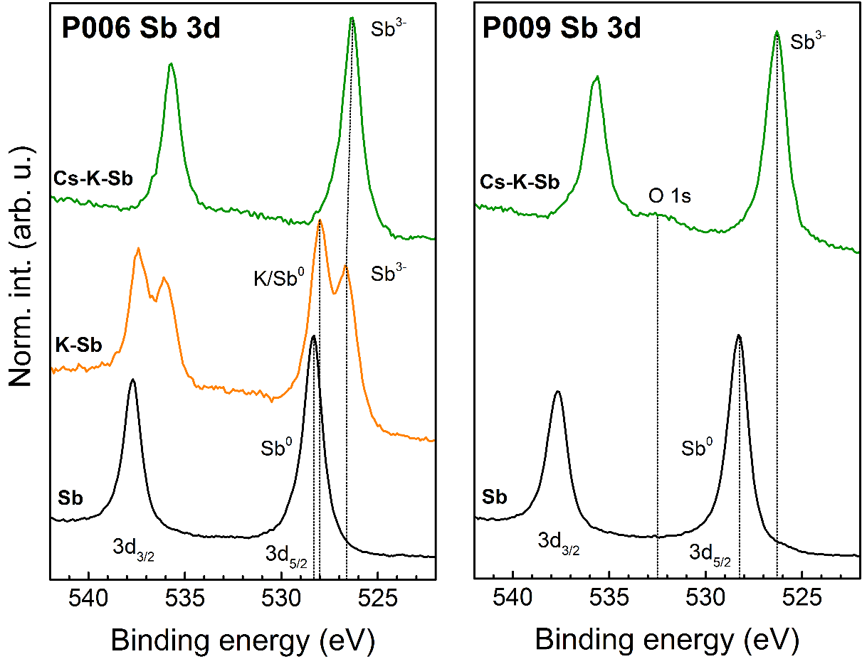
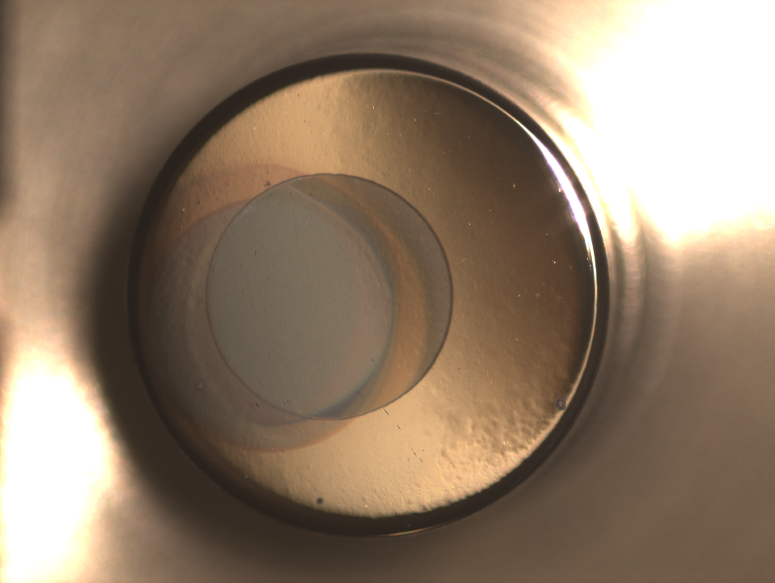
Alkali Co-Deposition Process
Conventional process (sequential growth of Sb, K, Cs) leads to good results when K-Sb material has only partially reacted
Alkali co-deposition (K+Cs on Sb) yields good sample performance and is easier to reproduce

Slide 7
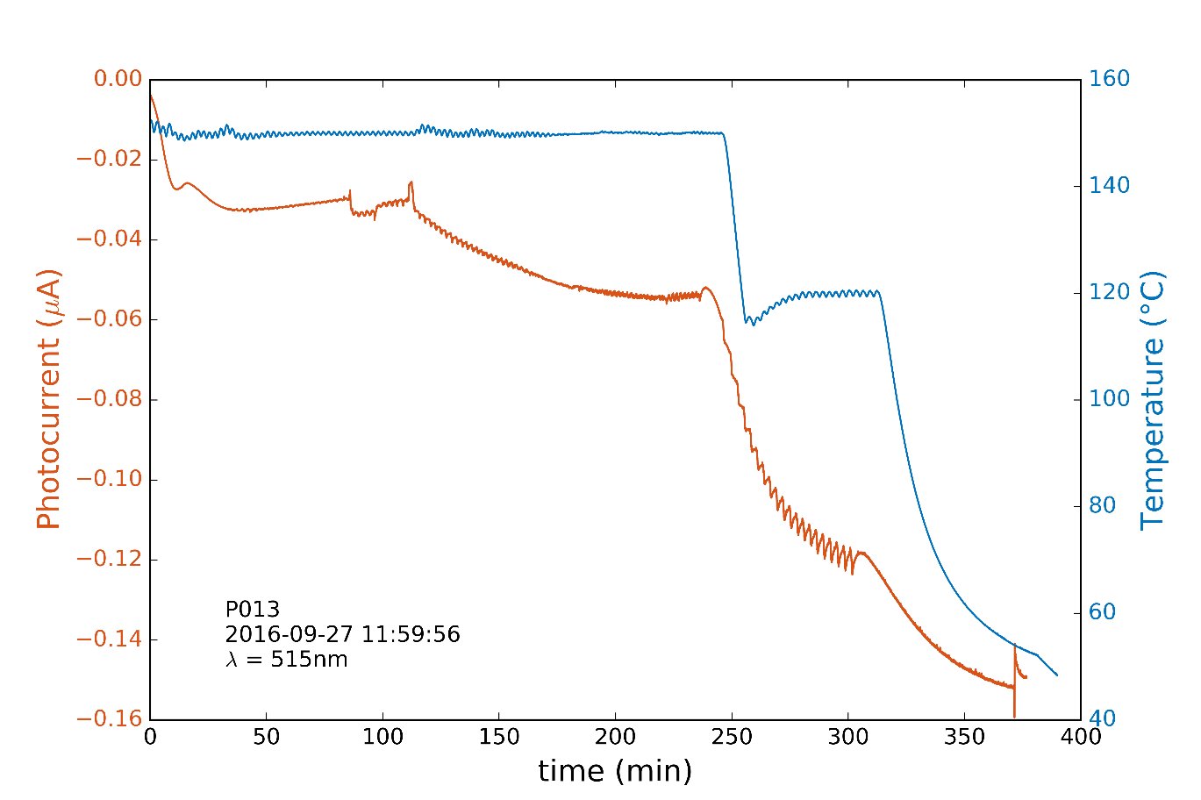
Recent results (P013)
Photocathode P013 grown on a Mo substrate:
30nm Sb deposition at 150°C
K + Cs co-deposition at 150°C, reduce to 120° after 250min, finally let cool

Slide 8
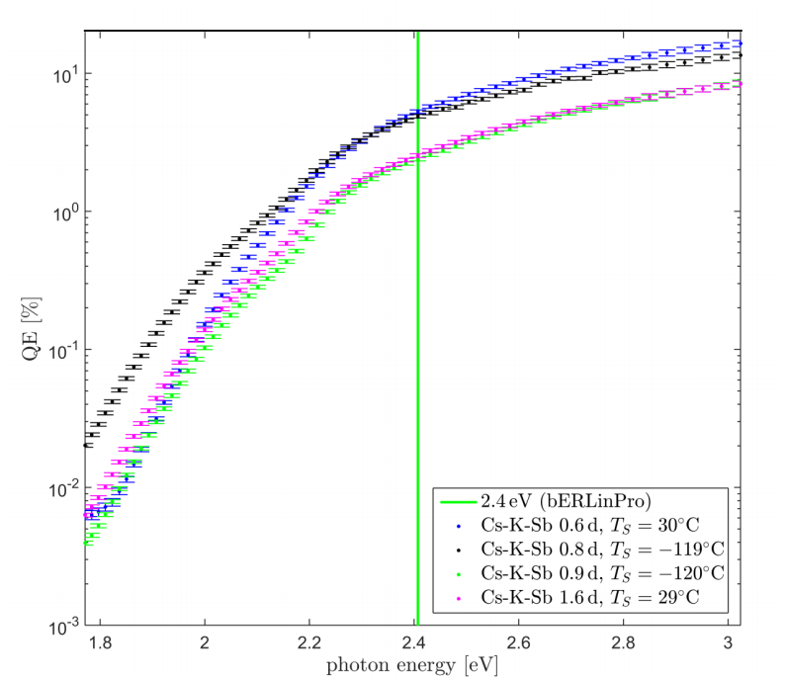
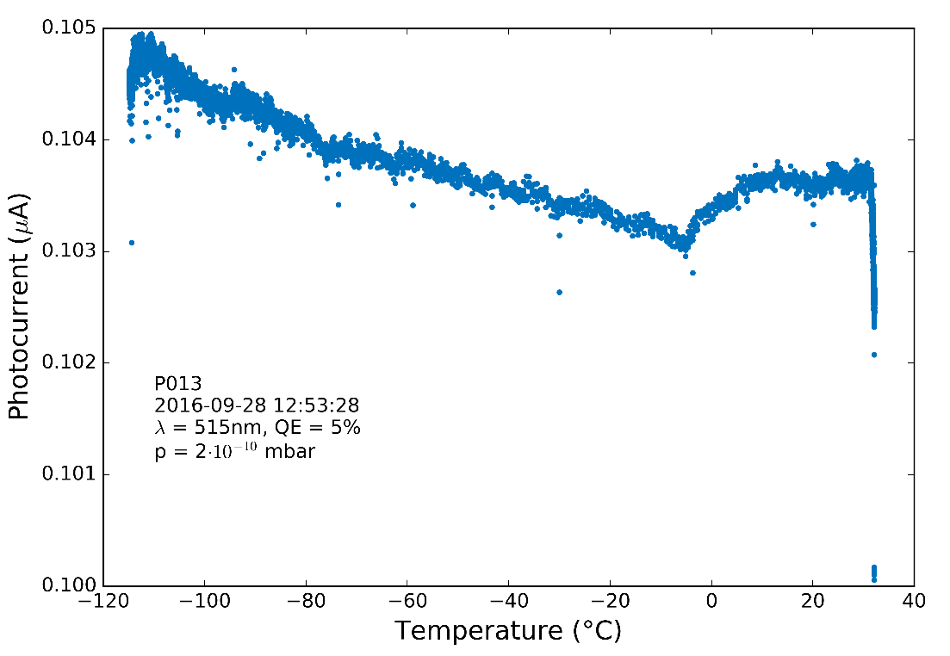
Recent results (P013)
← time
No degradation of the performance was observed during cooling to -120°C.
Movement of the cold sample (exposure to p > 10⁻⁹ mbar) results in loss of QE.

Slide 9
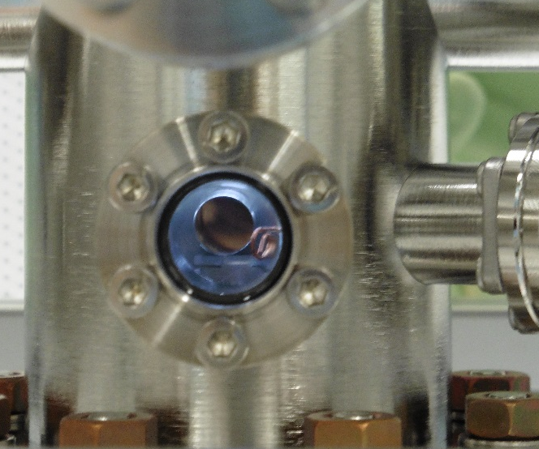
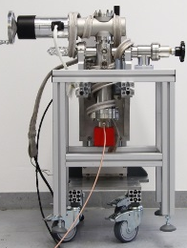
Cathode Transfer system
Cathodes must be stored and handled in < 10⁻¹⁰ mbar UHV
Vacuum suitcase is available. Vacuum ~ 1*10⁻¹¹ mbar
Suitcase and plug design are compatible to HZDR gun
Stability with NEG + getter pump is good for >3 months
All parts : cleaning and assembly in ISO 5 cleanroom conditions
Transfer system 1 is in use
Transfer system 2 ready for final testing, still in the cleanroom
Engineering Design: Petr Murcek (HZDR), Kerstin Martin, Markus Bürger, Andre Frahm
Transfer System #1 at Prep Chamber
Transfer System #2 at Gun Module

Slide 10
Goals - outlook
GunLab commissioning
Installation of transfer system 2
Preparation and Characterization of Cu cathode for GunLab commissioning
Learn about cathode transfer with a less sensitive sample
Commissioning of beam diagnostics
Investigate beam dynamics at low bunch charge
Operation of GunLab with CsK₂Sb photocathodes
Further R&D projects
Manufacturing and photoemission experiments with single crystal metals
Cu 100 and Mo 100
Set up of a scientific cathode preparation chamber for EMIL endstation
Unique methods compination of hard & soft x-ray analytics

Slide 11
Acknowledgement
Hans Kirschner, Julius Kühn, Guido Klemz, Georgios Kourkafas, Jens Völker, Eva Panofski , Thorsten Kamps, Andreas Jankowiak
GunLab and bERLinPro project teams
Engineering:
Markus Bürger, André Frahm, Daniel Böhlick, Kerstin Martin
Sven Lederer
Rong Xiang, Petr Murcek, Jochen Teichert
Susanne Schubert, Jared Wang, Howard Padmore
John Smedley, Zihao Ding, Menjia Gaowei
Thank you for your attention!

Slide 12
cross-section of the gun module
Support posts
80 K shield
Helium gas return pipe
Cold steerer
Cathode transfer system #2
HOM
absorber
SC Solenoid
Warm→
Cold transition
2 layer magnetic
shielding
Cathode
Insert
w/ Plug
Coupler
with courtesy of A. Neumann (HZB)

Slide 13
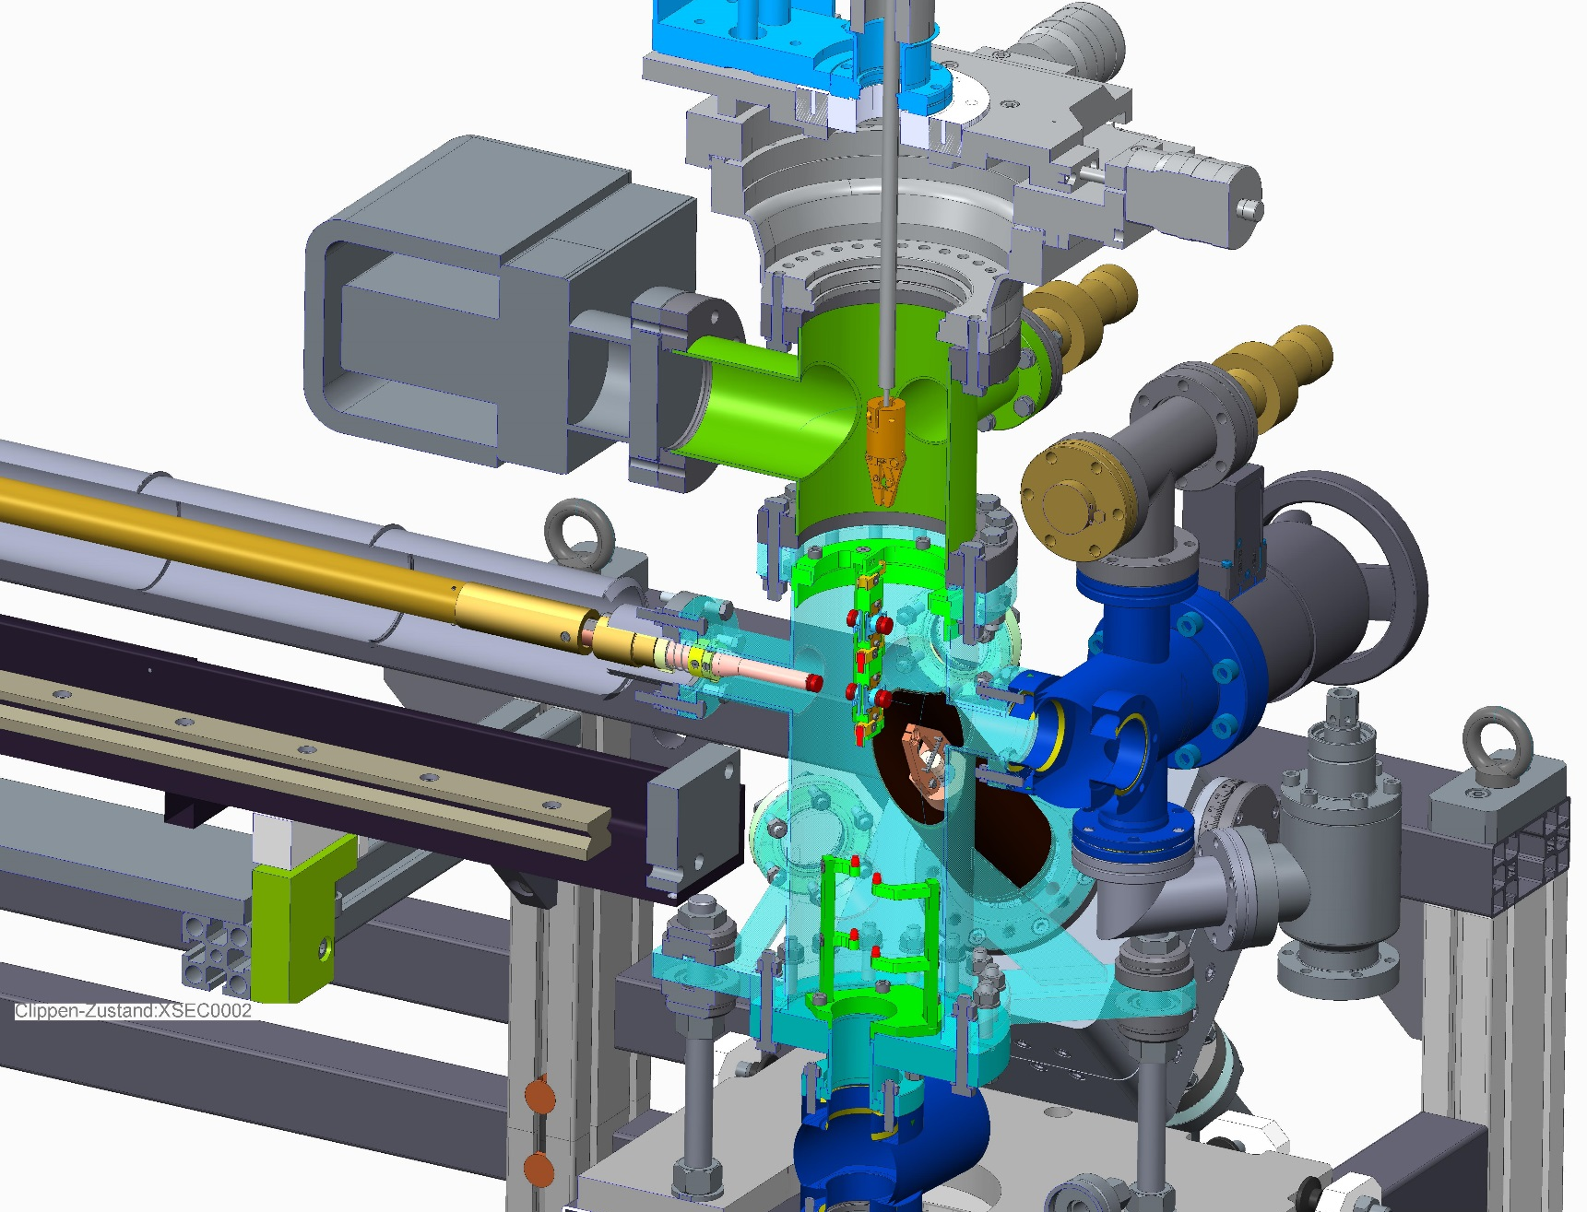
cross-section transfer system #2
Plug transport
cart
Manipulator to take the plugs off the sample holder
Gun Module
Cathode insert w/ plug
Vacuum suitcase

Slide 14
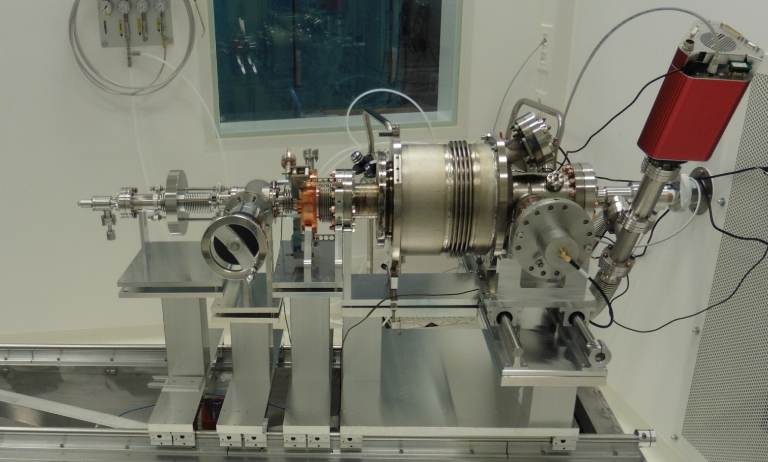
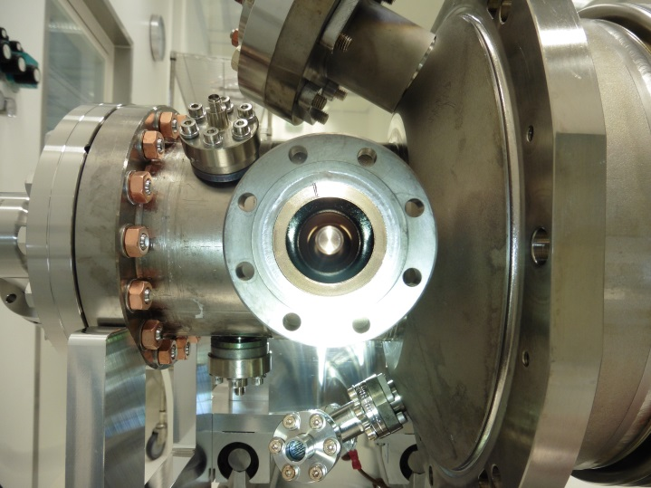
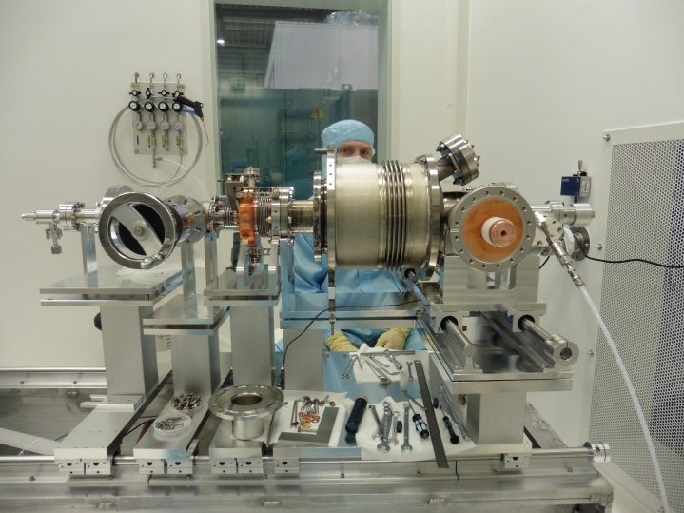
Cold string assembly
Cavity with helium
vessel
Gate valve
Valve
Cathode beam tube
Coupler assembly
Cathode cooler
Cold part
of TTF-III
coupler

