Slide 1
SRF Implementation in BESSY VSR for Picosecond X-ray Pulse Production
Andranik Tsakanian
Helmholtz-Zentrum Berlin, Albert-Einstein-Str. 15, 12489 Berlin
Annual Matter & Technology Meeting
31 Jan. - 2 Feb. 2017
GSI, Darmstadt, Germany

Slide 2
Outline
Introduction to BESSY II storage ring
SRF Upgrade - BESSY VSR & Highlights
SRF Cavity Specific Designs
HOM Power Levels in SRF Module
Summary
2

Slide 3
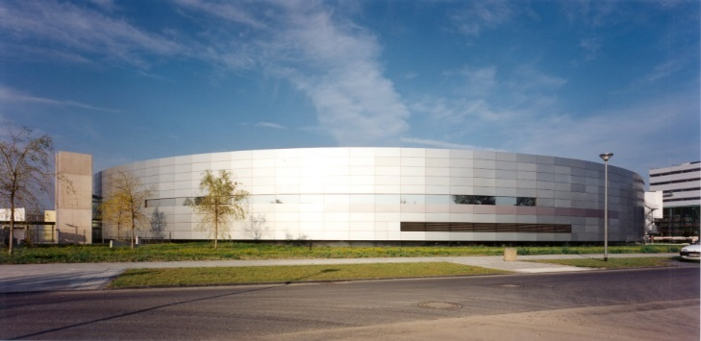
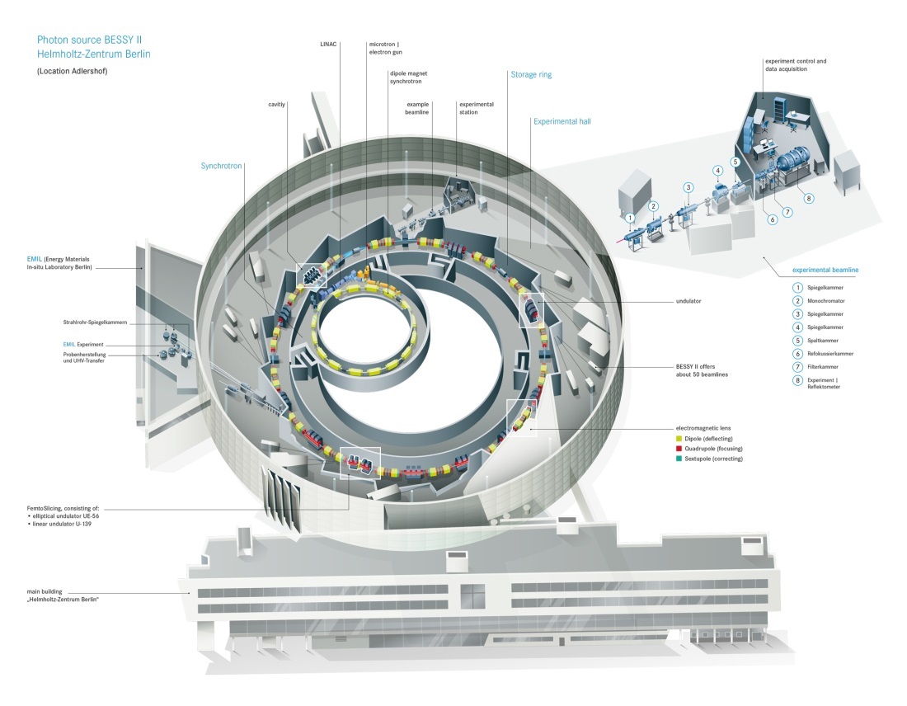
BESSY II Storage Ring
BESSY II is a 1.7 GeV synchrotron radiation source operating for 20 years in Berlin
Core wavelength in the range from Terahertz region to hard X rays
BESSY II Parameters
Lattice | DBA
Circumference | 240 m
Energy | 1.7 GeV
Current | 300 mA
RF Frequency | 500 MHz
RF Voltage | 1.5 MV
Bunch Length | 15 ps
Emmitance | 6 nm rad
2

Slide 4
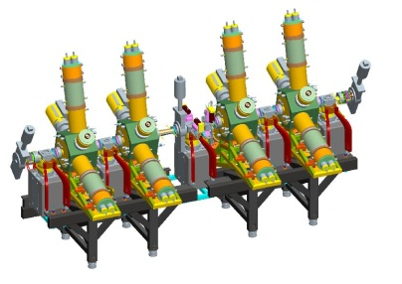
The Concept of BESSY VSR
BESSY II @ present
Limited pulse length in storage ring
Normal conducting cavity system
Machine optics
Hardware (RF cavities)
At high current beam becomes unstable
For ps pulses, flux is reduced by nearly 100
Bursting mode begins
User optics
10
Low alfa operation only 12 days/year
(all beamlines) ------- Low flux
Femtoslicing is continuously operated ( only 1 beamline) -- Low flux
Low alpha optics
RMS bunch length (ps)
1
0.1
10⁻⁴
10⁻³
10⁻²
10⁻¹
1
10
Bunch current (mA)
4

Slide 5
The Concept of BESSY VSR
BESSY II @ present
Limited pulse length in storage ring
Normal conducting cavity system
Machine optics
Hardware (RF cavities)
At high current beam becomes unstable
For ps pulses, flux is reduced by nearly 100
Bursting mode begins
User optics
10
Low alfa operation only 12 days/year
(all beamlines) ------- Low flux
Femtoslicing is continuously operated ( only 1 beamline) -- Low flux
Low alpha optics
RMS bunch length (ps)
1
Can we design a system offering both possibilities simultaneously?
0.1
10⁻⁴
10⁻³
10⁻²
10⁻¹
1
10
Bunch current (mA)
4

Slide 6
The Concept of BESSY VSR
BESSY II @ present
Limited pulse length in storage ring
Normal conducting cavity system
Machine optics
Hardware (RF cavities)
At high current beam becomes unstable
For ps pulses, flux is reduced by nearly 100
User optics
10
Low alpha optics
I_{th} roughly proportional to V´_{rf} σ²
Supply short pulses down to 1.5 ps
(100 × more bunch current )
Low α permits few 100 fs pulses
Configure BESSY^{VSR} so 1.5 ps and 15 ps bunches can be supplied simultaneously for maximum flexibility and flux!
User optics
RMS bunch length (ps)
1
80 × more voltage gradient
Low alpha
0.1
10⁻⁴
10⁻³
10⁻²
10⁻¹
1
10
Bunch current (mA)
5

Slide 7
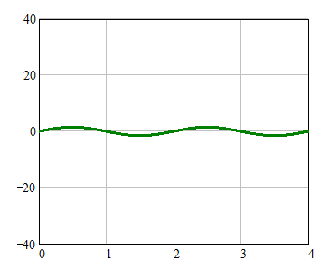
BESSY II, SC Upgrade – BESSY VSR
G.Wüstefeld et al. „Simultaneous long and short electron bunches in the BESSY II storage ring“ , IPAC2011
Present
Voltage: 1.5 MV @ 0.5 GHz
15 ps bunch
Voltage / MV
Time [ ns ]
6

Slide 8
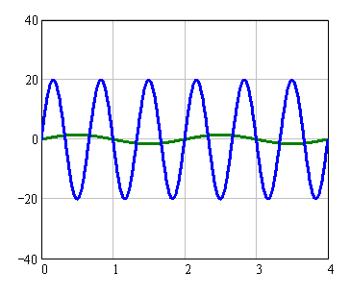
BESSY II, SC Upgrade – BESSY VSR
G.Wüstefeld et al. „Simultaneous long and short electron bunches in the BESSY II storage ring“ , IPAC2011
SC Upgrade
Present
Voltage: 1.5 MV @ 0.5 GHz
1.5 ps bunch
15 ps bunch
Voltage / MV
Voltage / MV
Time [ ns ]
Time [ ns ]
6

Slide 9
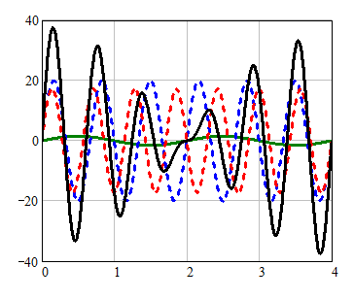
BESSY II, SC Upgrade – BESSY VSR
G.Wüstefeld et al. „Simultaneous long and short electron bunches in the BESSY II storage ring“ , IPAC2011
SC Upgrade
Present
BESSY VSR
Voltage: 1.5 MV @ 0.5 GHz
1.5 ps bunch
Long Bunch
15 ps bunch
Voltage / MV
Voltage / MV
Voltage / MV
Short Bunch
Time [ ns ]
Time [ ns ]
Time [ ns ]
1.5GHz and 1.75GHz ---- RF beating
(modulate RF focusing)
Odd (voltage cancelation, 15 ps bunches)
Even (voltage addition, 1.1 ps)
6

Slide 10
BESSY II, SC Upgrade – BESSY VSR
Baseline
BESSY VSR Filling Patterns
High concentration of long bunches populated with high current
(flux hungry users)
Few high current - short bunches
(slicing bunches …)
7

Slide 11
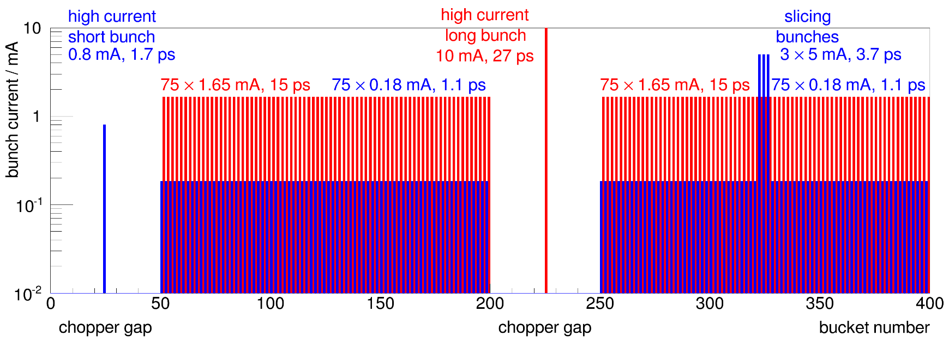
BESSY II, SC Upgrade – BESSY VSR
Baseline
BESSY VSR Filling Patterns
High concentration of long bunches populated with high current
(flux hungry users)
Few high current - short bunches
(slicing bunches …)
More short bunches ( Extended )
High Population of long & short bunches at the same time
Extended
7

Slide 12
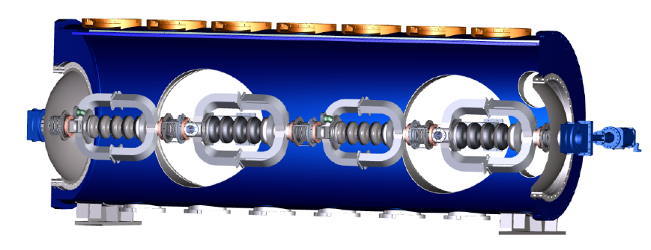
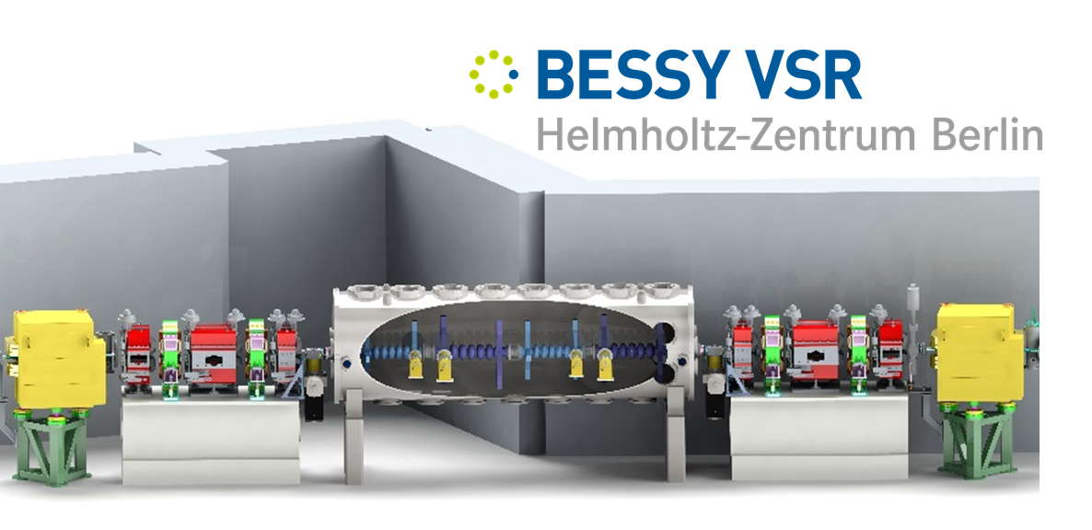
BESSY II SC Upgrade – BESSY VSR
Simultaneous Store of long & short bunches
SC Upgrade
SRF SYSTEM: 2@1.5 GHz & 2@1.75 GHz
Variable pulse length Storage Ring
8

Slide 13
BESSY II SC Upgrade – BESSY VSR
Simultaneous Store of long & short bunches
SRF SYSTEM: 2@1.5 GHz & 2@1.75 GHz
SC Upgrade
Variable pulse length Storage Ring
CHALLENGES
CW operation @ high field levels E=20MV/m
Peak fields on surface (discharges, quenching)
High beam current (Ib=300mA),
Cavity HOMs must be highly damped (CBIs)
Exotic cavity design (damping end-groups)
Integrating in existing storage ring
Transparent Parking of SRF Module.
8

Slide 14
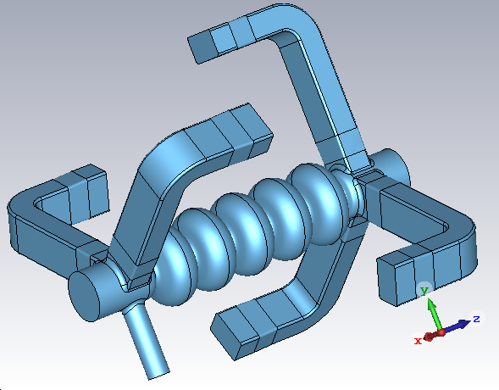
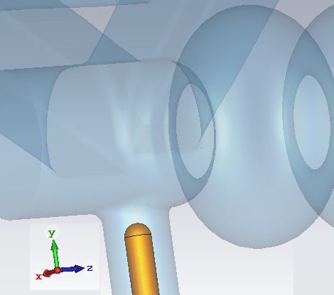
BESSY VSR SRF Cavity Designs
Tune fundamental mode: field flatness, R/Q …
Control cavity HOM spectrum (off-resonance condition) during the design.
Strong HOM damping concept
5 x Waveguide dampers, HOM loads (warm)
Large beampipe radius – better HOM propagation
Waveguides are below cutoff for fundamental → can be moved close to the cavity for heavy damping.
FPC

Slide 15
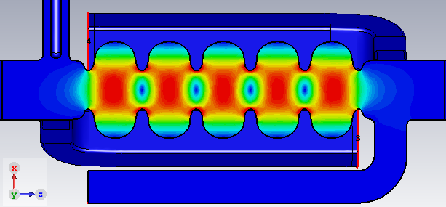
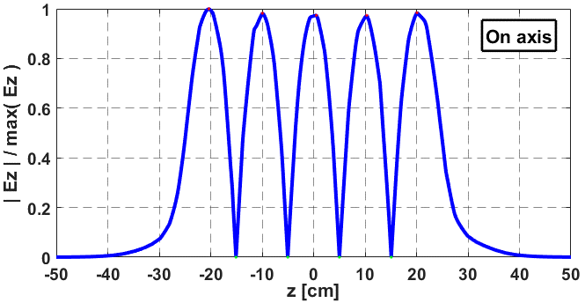
BESSY VSR SRF Cavity Designs
L_{active}
Simulation Results – for both Cavity (TM₀₁₀)
 | 1.5GHz | 1.75GHz | Design goal
L_{active} | 0.5 m | 0.43 m
Frequency [GHz] | 1.4990 | 1.748887 | 3th & 3.5th harm. of 499.65 MHz
Q_{ext} | 4.997*10⁷ | 4.266*10⁷
G [Ω] | 277.8 | 280.04
E_{pk} / E_{acc} | 2.313 | 2.407 | ≤ 2.4
B_{pk} / E_{acc} [mT / (MV/m)] | 4.96 | 5.023 | ≤ 5.3
R/Q₀ [Ω] | 487.17.34 | 479.86 | ≥ 90 per cell
R/Q₀ (Active) [Ω] | 531.83 | 524.07
µ_{ff} | 97.56% | 98.43 % | ≥ 95%
10

Slide 16
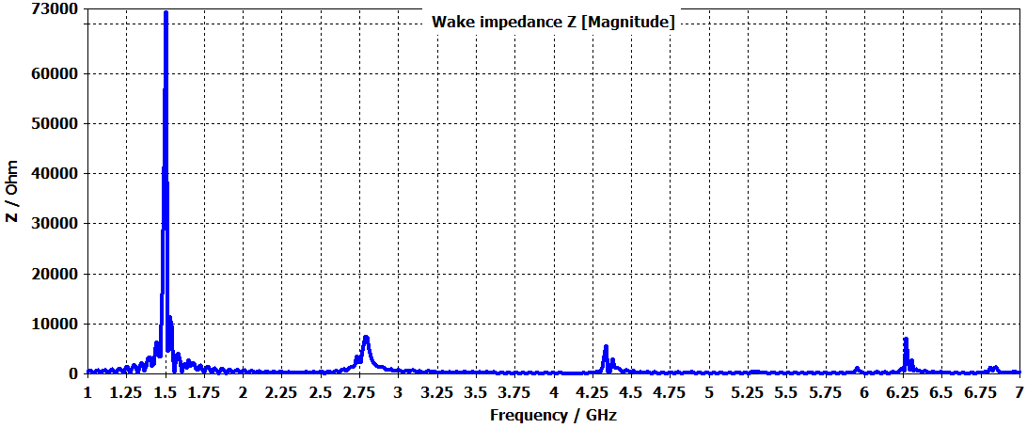
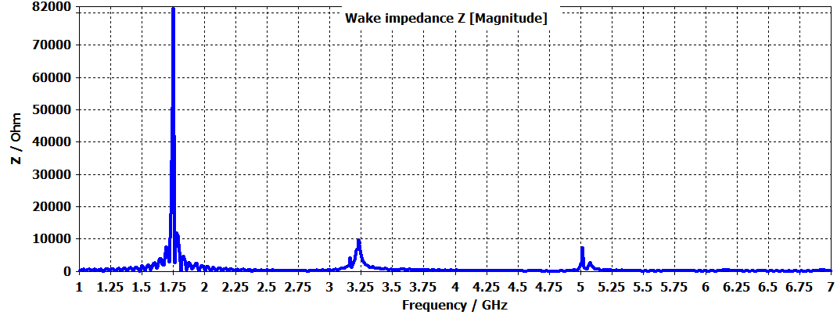
HOM Power of Single Cavity – VSR Baseline beam
Spectrally Weighted with “Baseline” pattern
1.5GHz Design-FA
Port Num. | Coherent Power [W]
 | 1.5 GHz | 1.75GHz
1-FPC | 27.11 | 22.88
2 | 120.18 | 174.14
3 | 120.03 | 174.52
4 | 100.86 | 127.86
5 | 102.15 | 128.00
6 | 103.28 | 140.42
7-BmP | 257.69 | 267.92
8-BmP | 305.88 | 248.55
Sum Coh. None-Coh. | 1137.19 1289.91 | 1284.28 1408.18
1.75GHz Design-A4
Both cavities are not hitting any of beam resonances that are multiple of 250MHz (Coherent and none-coherent powers are at the same level).
Cornell‘s ERL cavities are designed to run at about 100-200W HOM Power.

Slide 17
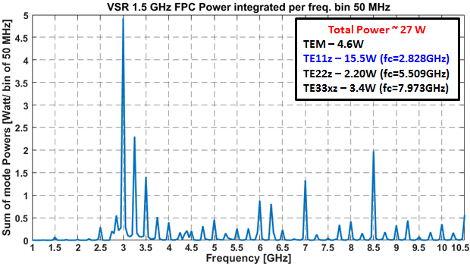
HOM Power of Single Cavity – VSR Baseline beam
HOM Spectrum in Fundamental Power Coupler

Slide 18
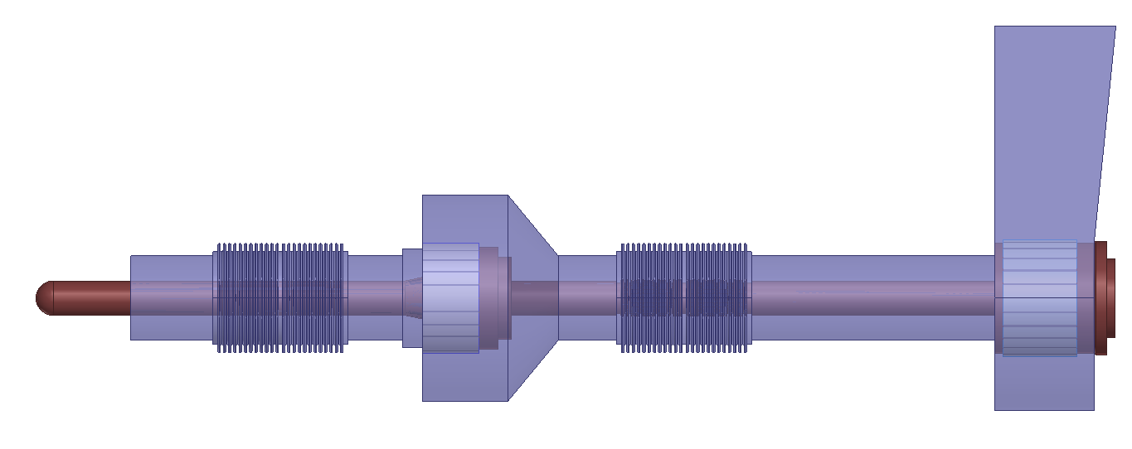
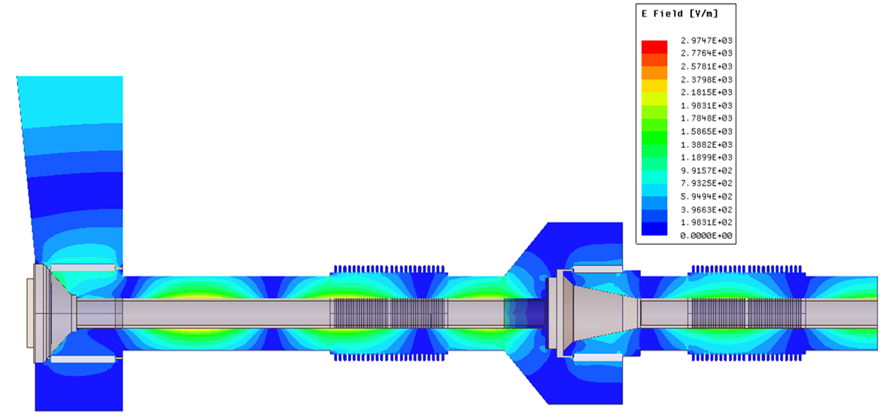
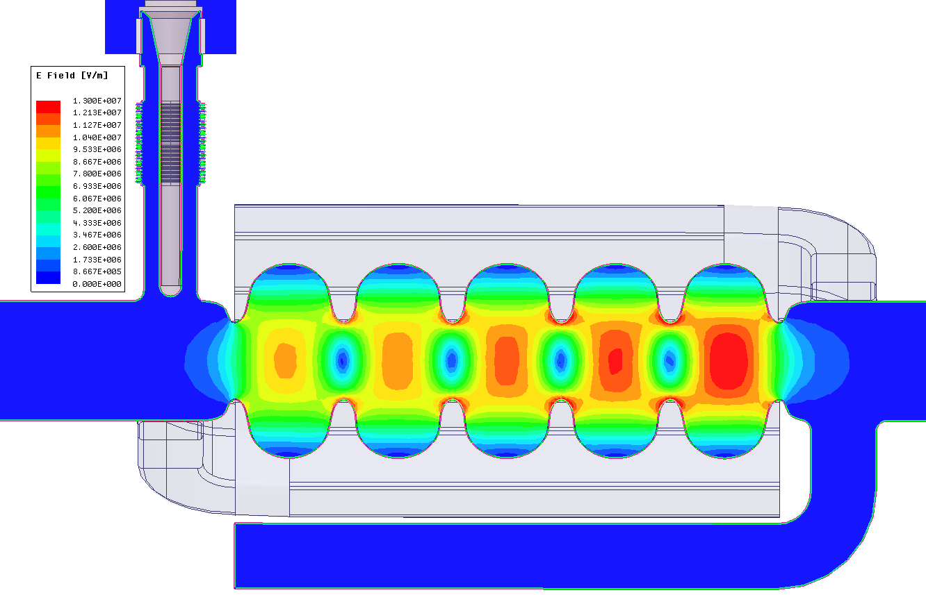
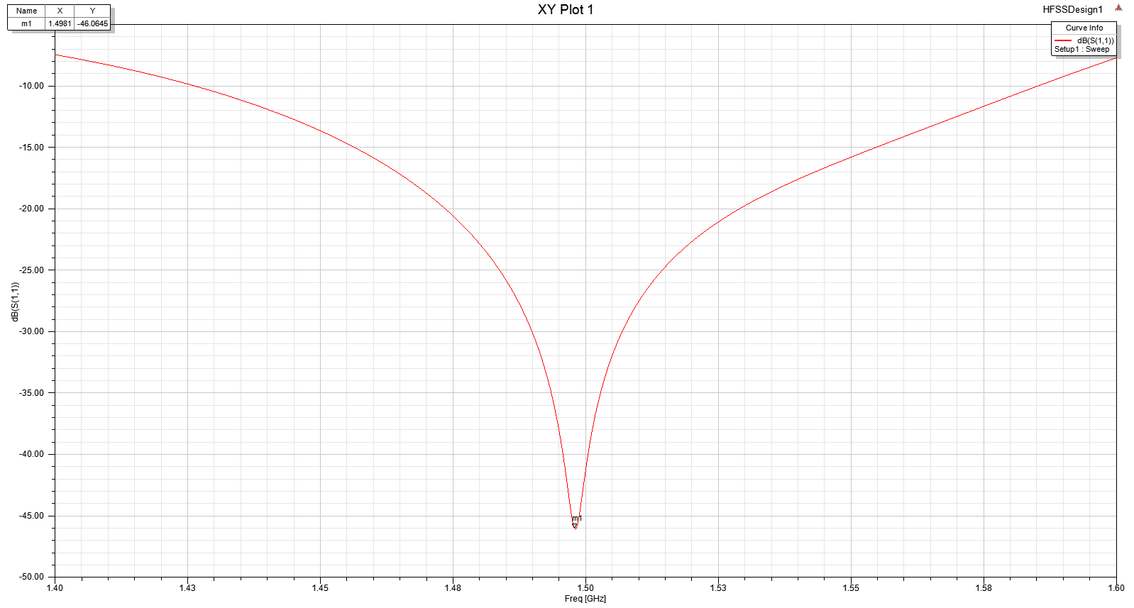
Design of the 1.5 GHz BESSY VSR coupler
Coax coupler diameters: 49 mm x 20 mm.
Two ceramic windows to maintain vacuum.
Inner an outer coax bellows provide a tuning mechanism to allow for variable coupling with a Q_{ext} of 6x10⁶ to 6x10⁷
Rounded antenna tip
Magnitude plot of E-field in coupler
S11 Plot
Magnitude of -46 dB at 1.498 GHz
Magnitude plot of E-field at 1.5 GHz
Courtesy of Dr Emmy Sharples (HZB)
13
Notes:
Un even field due to meshing of the cavity

Slide 19
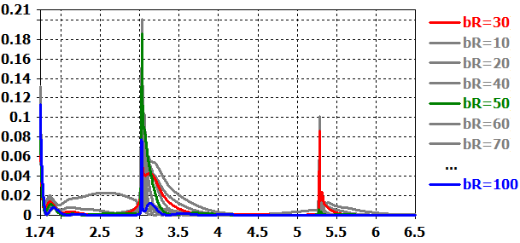
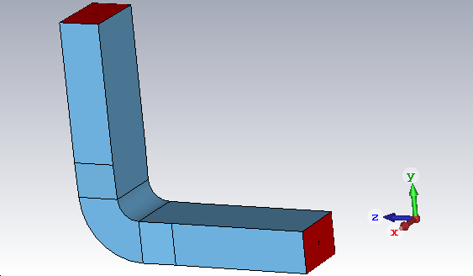
Waveguide Bend Broadband Characteristics
Reflection Broadband Behavior for TE10 Mode
WG Tapered 60 x 88_91_95mm
Port modes -18
60x95mm
Incident (TE10) Port,
60x88mm
Taper 91-95
$$\sum_{m}{{\left|S_{1,m}\right|}^{2}}$$
Taper 88-91
R_{bend}=30mm
Frequency [ GHz ]
TE10 - 6.25 GHz
R_{bend}=30mm
Low reflection (broadband) from the WG bend is for bending radius = 30mm or bR ≥ 100mm.
TE10 mode couples into different modes after bend: TE10, TE11, TM11…, depending on excitation frequency & the cutoff of each WG mode !
At high frequencies the TE10 is scattered from the bend into several modes, i.e. acts as mode mixer.
At optimized 30mm inner bending radius the reflection is minimal in broadband frequency sense.

Slide 20
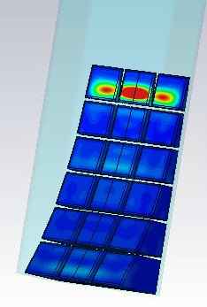
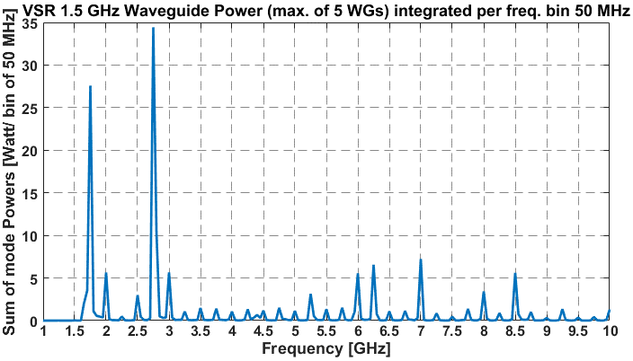
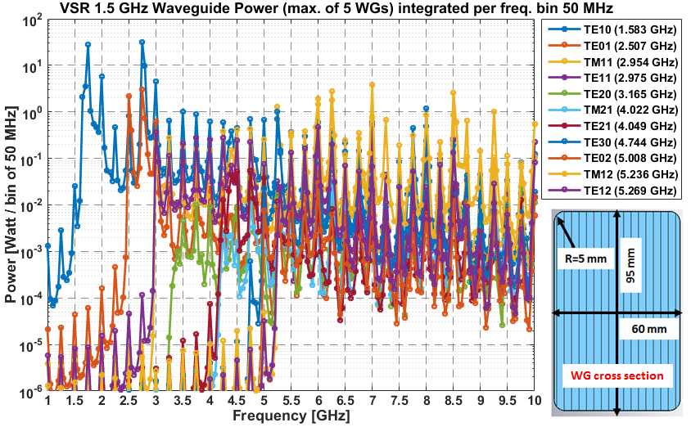
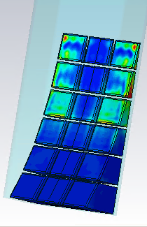
Broadband RF Load Design
HOM Load Requirements
Broadband – Multimode
Max. HOM Power 460W
TE10, 2.75GHz
TM12, 6.25GHz
Load EM design is optimised for 1.5GHz system
(For most of the WG modes the reflection is bellow -15dB)
Cooling system design
Fabrication and Testing
1.75GHz system load design is foreseen.
Courtesy of J. Guo (JLAB)
15

Slide 21
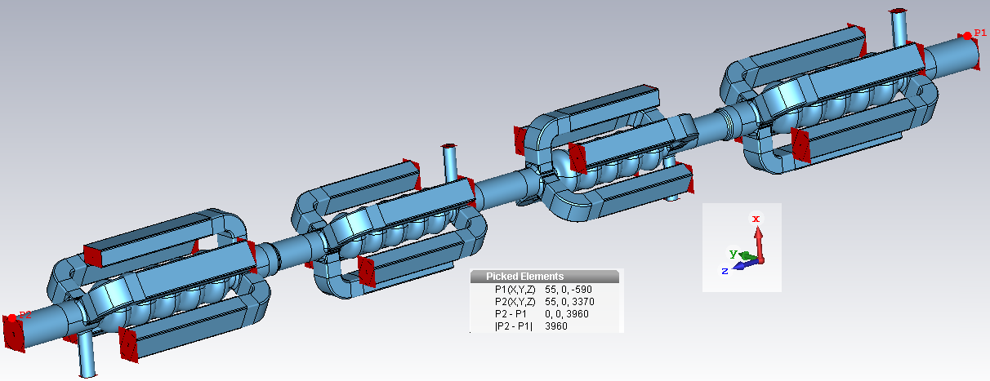
HOM Power Levels in SRF Module
Wakefield Simulations
Setup 1: no Bellows
Long Range Wakes~ 20m
Spectral Weighting of all Port Signals with Beam Spectrum
Expected HOM Power Levels & Spectrum
Efficiency of HOM Damping
Setup 2: with Bellows

Slide 22
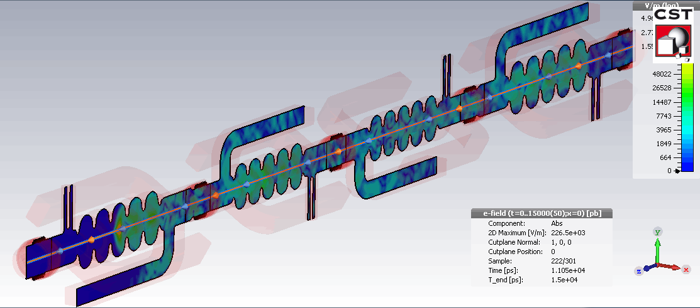
HOM Power Levels in SRF Module
Wakefield Simulations
Setup 1: no Bellows
Long Range Wakes~ 20m
Spectral Weighting of all Port Signals with Beam Spectrum
Expected HOM Power Levels & Spectrum
Efficiency of HOM Damping
Setup 2: with Bellows

Slide 23
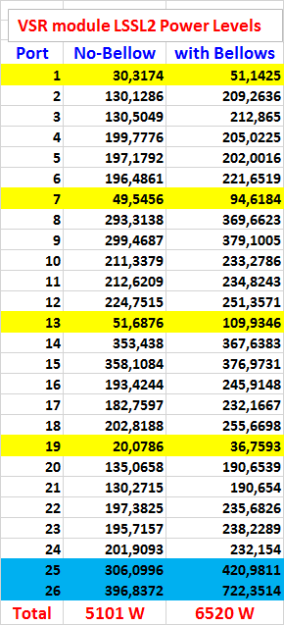
HOM Power Levels in SRF Module
1.5 GHz
1.75 GHz Cavities
HOM Power [ W ]
1.5 GHz
Beam pipes
18

Slide 24
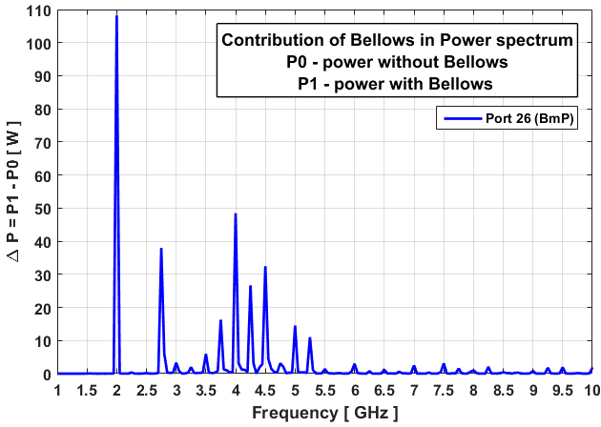
HOM Power Levels in SRF Module
1.5 GHz
1.75 GHz Cavities
Bellows increases HOM power by ~28%
Corresponding spectrum is up to 5.5GHz
HOM Power [ W ]
1.5 GHz
Beam pipes
18

Slide 25
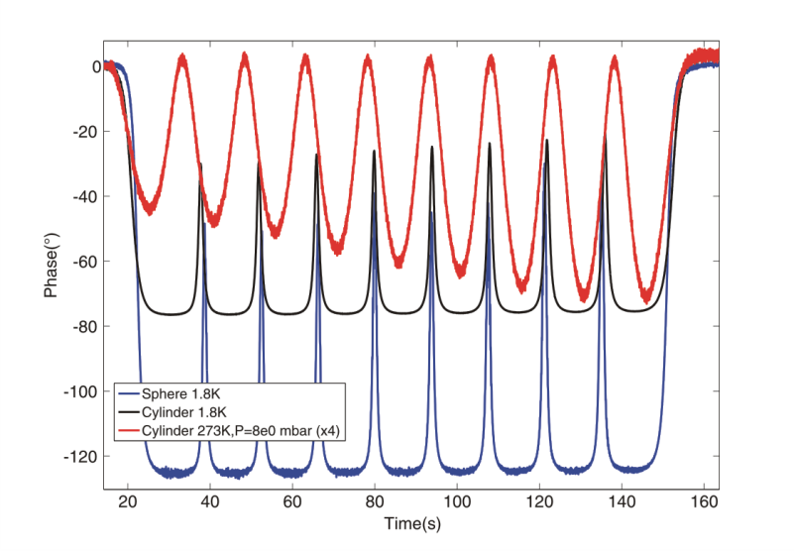
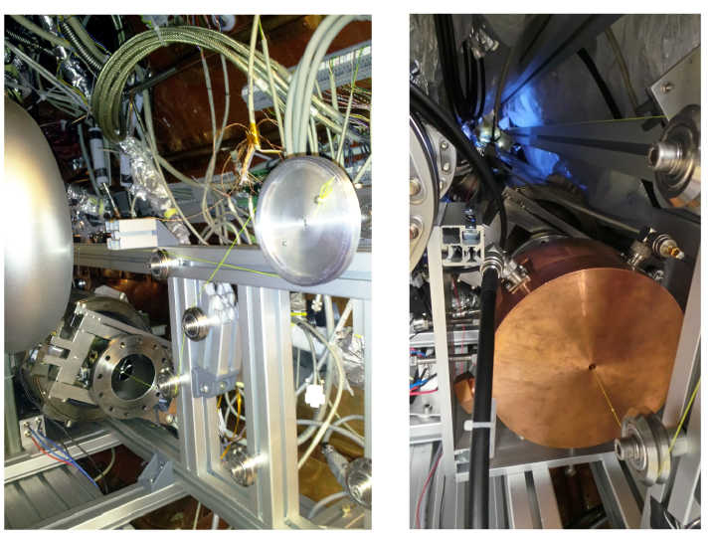
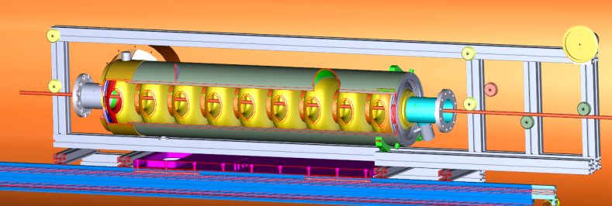
A COLD BEAD-PULL TEST-STAND FOR SRF CAVITIES
Fundamental -mode
Cold Test-Stand
1st Cold bead-pull test stand commisioned and in operation
Form factor of the bead extracted by means of a copper pillbox at 1.8 K
Experimental study of the effects created by cooldown process and tuner actuation on field profile
Sucessfully commisioned a 1.3GHz 9-cell Tesla cavity for the fundamental passband. Characteristic parameters such as R/Q can be experimentally determined.
Study of the field profile and R/Q for different HOM modes
9-cell Tesla cavity mounted on the test-stand before the installation of the pillbox (a). Pill-box cavity mounted with the wire system inside the HobiCat cryomodule (Niobium 9-cell cavity hidden behind) (b).
Layout of the 9-cell Tesla cavity mounted within HoBiCaT test cryomodule [1,2].
Courtesy of A. Velez (HZB)
[1] A. Vélez, A. Frahm, J. Knobloch, A. Neumann “Developments on a cold-bead-pull test stand for SRF cavities”. Proceedings of SRF2015, Whistler, BC, Canada. TUPB078.
[2] O. Kugeler, A. Neumann, W. Anders, and J. Knobloch, Review of Scientific Instruments 81, 074701 (2010).

Slide 26
Summary
Challenges in Cavity Designs
( Off-Resonance with the Beam )
Strong HOM Waveguide Damping
HOM Power Levels & Spectrum in Single Cavities.
(Can be double by hitting single beam resonance)
Special HOM Load Design (Broadband, Multimode)
Power Ballance in Complete Modul.

Slide 27
Summary
Challenges in Cavity Designs
( Off-Resonance with the Beam )
Strong HOM Waveguide Damping
HOM Power Levels & Spectrum in Single Cavities.
(Can be double by hitting single beam resonance)
Special HOM Load Design (Broadband, Multimode)
Power Ballance in Complete Modul.
Study effects of undamped energy propagated throug the beam-pipes to the ring. Heating issues.
Concatenation studies . Cavity-cavity coupling, energy damping and impedances.
Sensitivity analyses on Cavity Deformations
(Fabrication Tolorances)
Thermal studies (waveguides, flanges...).
Engineering challanges & solutons.

Slide 28
Summary
Challenges in Cavity Designs
( Off-Resonance with the Beam )
Strong HOM Waveguide Damping
HOM Power Levels & Spectrum in Single Cavities.
(Can be double by hitting single beam resonance)
Special HOM Load Design (Broadband, Multimode)
Power Ballance in Complete Modul.
Study effects of undamped energy propagated throug the beam-pipes to the ring. Heating issues.
Concatenation studies . Cavity-cavity coupling, energy damping and impedances.
Sensitivity analyses on Cavity Deformations
(Fabrication Tolorances)
Thermal studies (waveguides, flanges...).
Engineering challanges & solutons.
$$⋯$$
And much more ongoing R&D.

Slide 29
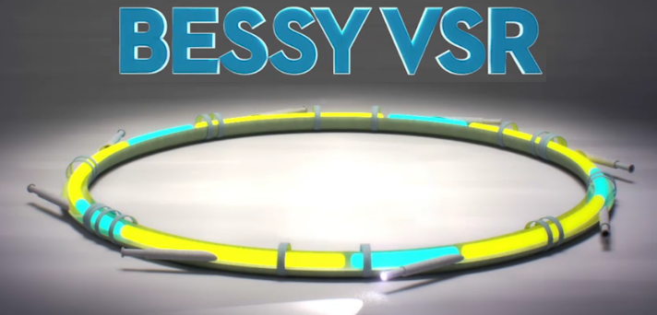
Summary
Challenges in Cavity Designs
( Off-Resonance with the Beam )
Strong HOM Waveguide Damping
HOM Power Levels & Spectrum in Single Cavities.
(Can be double by hitting single beam resonance)
Special HOM Load Design (Broadband, Multimode)
Power Ballance in Complete Modul.
Study effects of undamped energy propagated throug the beam-pipes to the ring. Heating issues.
Concatenation studies . Cavity-cavity coupling, energy damping and impedances.
Sensitivity analyses on Cavity Deformations
(Fabrication Tolorances)
Thermal studies (waveguides, flanges...).
Engineering challanges & solutons.
$$⋯$$
And much more ongoing R&D.
Let this Brilliant Light to be …
Thank You for Your Attention !

Slide 30
Backup Slides

Slide 31
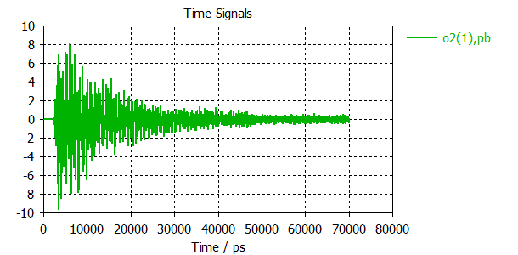
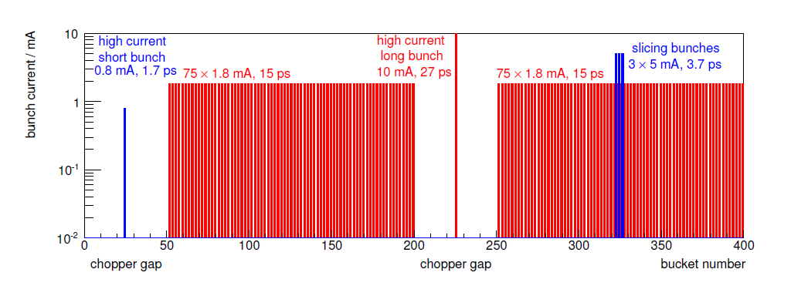
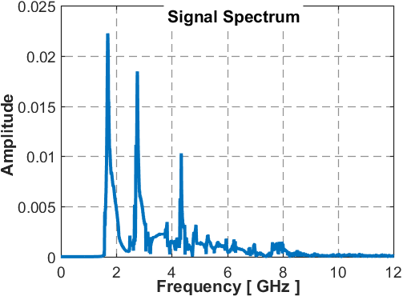
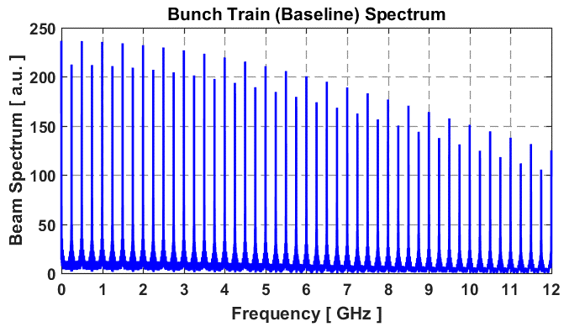
Signal Spectral Weighting Technique
Bunch Train - Baseline
Bunch Current [ mA ]
Bucket Number
$${\tilde{I}}_{b}\left(ω\right)=f_{rev}\sum_{n}{q_{n}{∙e}^{−0.5∙ω^{2}σ_{n}^{2}}∙}e^{j ω t_{0,n}}$$
FFT
Spectral weighting of port signal & Power per freq. bins (FFT)
∆f =250 MHz
$$P\left(ω\right)={\left|\frac{{\tilde{I}}_{b}}{{\tilde{I}}_{0}}𝓕(ω)\right|}^{2}$$
${\tilde{I}}_{0}$ - Simulated single bunch

Slide 32
Waveguide Bend Broadband Characteristics
Bending Radius Optimization for WG-Bend Low Reflection
WG Tapered 60 x 88_91_95mm
Port modes -18
$$\sum_{m}{{\left|S_{1,m}\right|}^{2}}$$
TE10 - 3.05 GHz
R_{bend}=50mm
Frequency [ GHz ]
Low reflection (broadband) from the WG bend is for bending radius = 30mm or bR ≥ 100mm.

Slide 33
BESSY VSR 1.5GHz SRF Cavity
HOM Spectrum in Waveguide Dampers

Slide 34
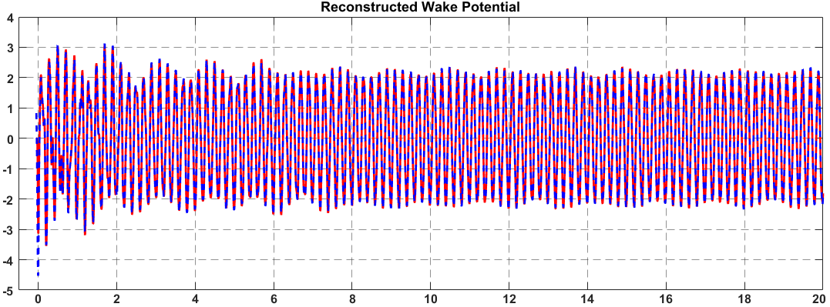
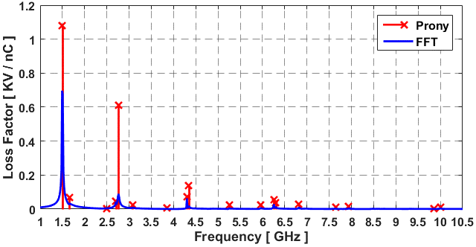
Resonant Mode Extraction from Wake Potential
Prony-Pisarenko Fit
Wake Potential – Long Range
$$W\left(s\right)=\sum_{ν}{2 K_{ν }cos⁡(\frac{ω_{ν }}{c}s)e^{−α_{ν }s}}$$
$α_{ν }$= $ω_{ν }$/(2 Q_{loaded})
Freq. [GHz] | K_{loss} [KV/nC] | Q_{loaded}
1.5006 | 1.078 | 8.43e5
1.6561 | 0.069 | 60.2
2.4968 | 0.0025 | 63.02
2.7035 | 0.045 | 620.9
2.7613 | 0.61 | 82.3
3.0751 | 0.024 | 100.35
3.853 | 0.005 | 108.8
4.3024 | 0.729 | 3.15e3
4.3403 | 0.137 | 124.8
5.2508 | 0.025 | 173.96
5.9606 | 0.026 | 219
6.2534 | 0.0536 | 1.23e3
6.2958 | 0.0379 | 253.8
6.8204 | 0.0274 | 289.6
7.6459 | 0.0129 | 152
7.9392 | 0.0175 | 315.9
9.8534 | 0.0034 | 202.6
10.003 | 0.0131 | 400
Bunch Gauss 1nC, σ = 9mm, on axis
W// [ KV/nC ]
K_{loss}~2.266 KV/nC
Energy ~ 2.266µJ
Simulated
Prony- Fit
s [m]
Modes with
K_{loss} / K_{loss}(1.5GHz) > 0.1%
Presented loss factors are corresponding to point charge.

Slide 35
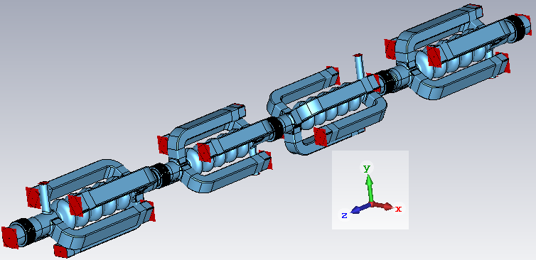
BESSY VSR Module
Setup 1: no Bellows
Setup 2: with Bellows

