Slide 1
High Level Applications for commissioning & operation
Beschleuniger-Betriebsseminar 2016
Travemünde, 03.11.2016
Raimund Kammering
on behalf of the HLC team

Slide 2
Outline
Intro/Motivation
High Level Applications – what’s meant
Control Systems and High Level Applications
Brief refresher of Control System Architecture
High Level Applications – some examples
A topological view
The Virtual XFEL
Latest status
Outlook
AI & Big Data
Summary

Slide 4
Refresher – last Betriebsseminar

Slide 5
Intro/Motivation – the dream

Slide 6
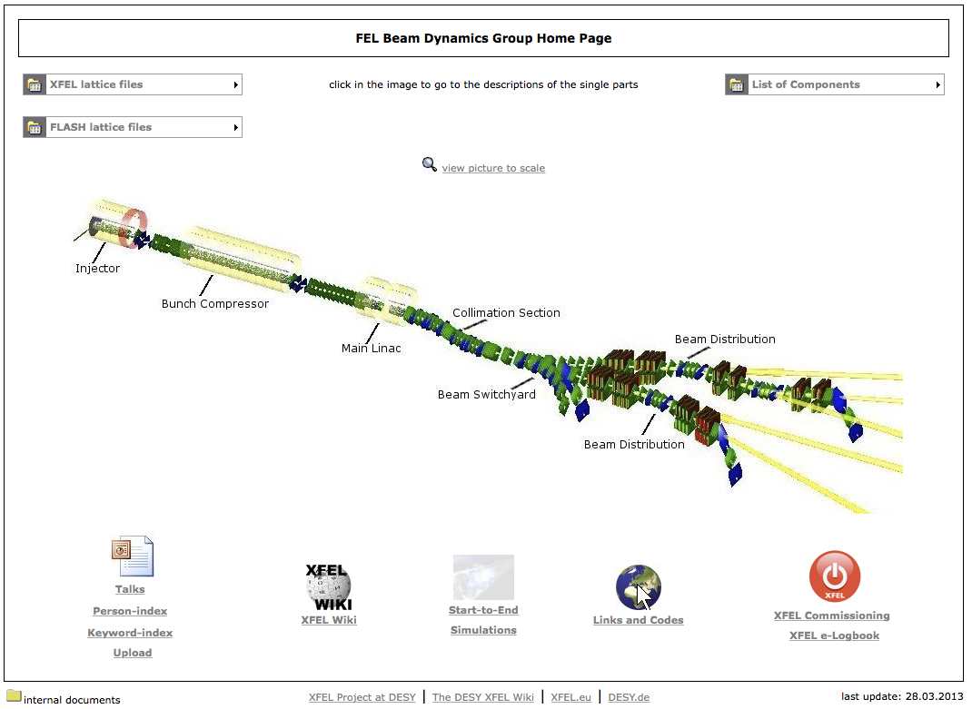
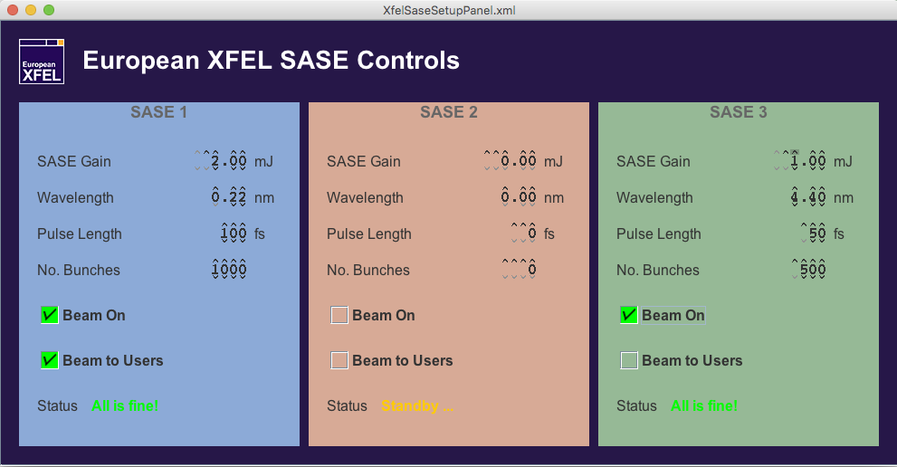
Intro/Motivation – the task
High Level Applications should
hide complexity
automate well understood procedures
offer physical and “smart knobs”
evaluate and monitor key performance parameter
minimize setup times and though ensure maximum availability
…
Notes:
4.10.2016:
Total number of properties = 2 620 739
Total number of locations = 20 843
Total number of devices = 556
Total number of histories = 186 528
Error count = 9202
In:
XFEL.VAC, XFEL.DIAG, XFEL.SDIAG, XFEL.SYNC, XFEL.MAGNETS, XFEL.UTIL, XFEL.DAQ, XFEL.SYSTEM, XFEL.CRATE, XFEL.CRYO, XFEL.FEEDBACK, XFEL.FEL, XFEL.RF
~ 2 600 QIP entries in controls network

Slide 7
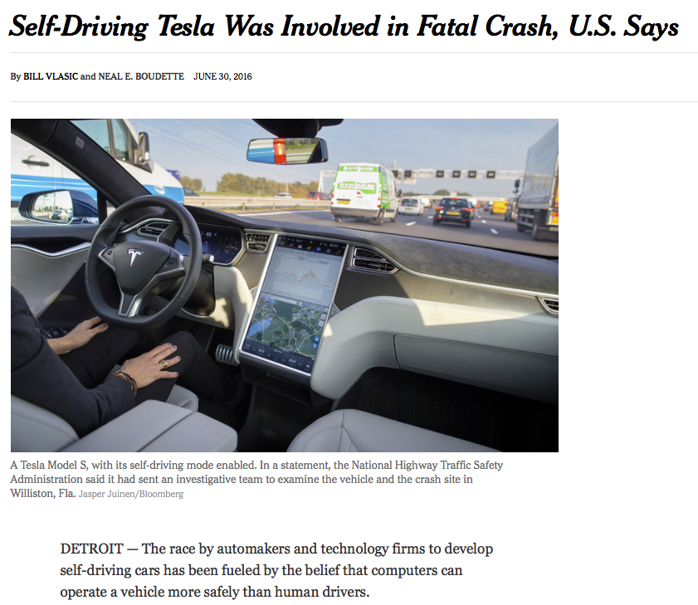
Intro/Motivation – the reality
" … belief that computers can operate a vehicle more safely than human drivers."
Notes:
Safety at the EU-XFEL is ensured by the machine protection system – MPS

Slide 8
Control System and High Level Applications
jddd / Karabo-GUI
Generic user interface builders/engines
jddd: Java
Karabo-GUI: Python 3.4 / QT
Applications
(Rich Clients)
Matlab
Python 3.4 / QT
Java
Control Systems / Protocols
DOOCS, TINE, EPICS, Karabo
Middle Layer Servers
C++ (03, 11, 14)
Frontend Servers
C++ (03)
Notes:
heterogeneous
interfaces between all CS exist

Slide 9
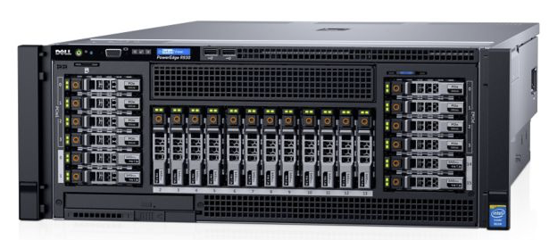
Control System and High Level Applications
Architecture unchanged since years
Throughput proven to be working
2 big server machines installed
Courtesy: T. Wilksen (DESY)
Notes:
Key role of (DAQ based) middle layer servers

Slide 10
High Level Controls
HLC group got going
Group has extended
Concentrated on:
Concepts
Architecture
Algorithms
Developed interfaces, libraries and tool boxes
C++ Libraries
Matlab Toolboxes
Python (pydoocs, PyTINE) and Matlab (xcomm)
Guidelines, coding styles, documentation, …

Slide 11
High Level Controls – a topological view
Injector
Bunch Compression
Main Linac
Timing, MPS
Bunch Pattern Server
…
Orbit displays, ORM
Laser heater
Feedbacks
...
Emmitance ...
Undulators
Energy Management
Interfaces to cryogenic
...
Energy measurements
Chicane setup
Longitudinal Diagnostics
TDS
RF Tweak
…
Kicker control
Wavelength control, tappering, ...
GMDs
...

Slide 12
High Level Controls – (just) two examples
Injector
Bunch Compression
Main Linac
Timing, MPS
Bunch Pattern Server
…
Orbit displays, ORM
Laser heater
Feedbacks
...
Emittance ...
Undulators
Energy Management
Interfaces to cryogenic
...
Energy measurements
Chicane setup
Longitudinal Diagnostics
TDS
RF Tweak
…
Kicker control
Wavelength control, tappering, ...
GMDs
...

Slide 13
High Level Controls – emittance
User Application Layer
DAQ Data Access Framework
Other Applications
Data
GUI
JDDD/ JDAQ
MATLAB/Octave
C/C++ Interface
Middle Layer
dCache
RAID Cluster
Event Builder
Distributor
Middle Layer Server
Run Controller
Central Shared Memory
Fast Collector
Slow Collector
File I/O
TCP
Device Layer
Fast ADC, Camera
Fast ADC, Camera
Fast ADC, Camera
PLC, slow ADC
PLC, slow ADC
PLC, slow ADC
Shared Memory
Multicast
RPC
Fast, bunch-synchronous data
Slow data (fixed rate or event-based)

Slide 14
High Level Controls – emittance
‘Online’ Emittance Measurement
Matlab
Emittance Measurement
GUI
Console layer
Optics
server
Middle layer
Ethernet
Image Analysis
Server
0-MQ
Screen
Server
Kicker
Server
Generic Camera
Server
Hardware
Front end

Slide 15
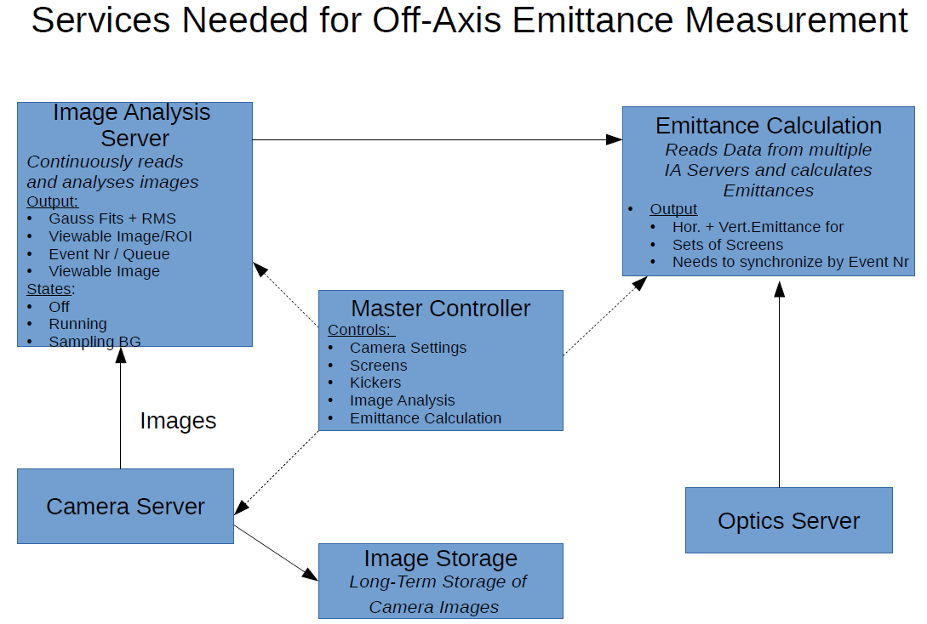
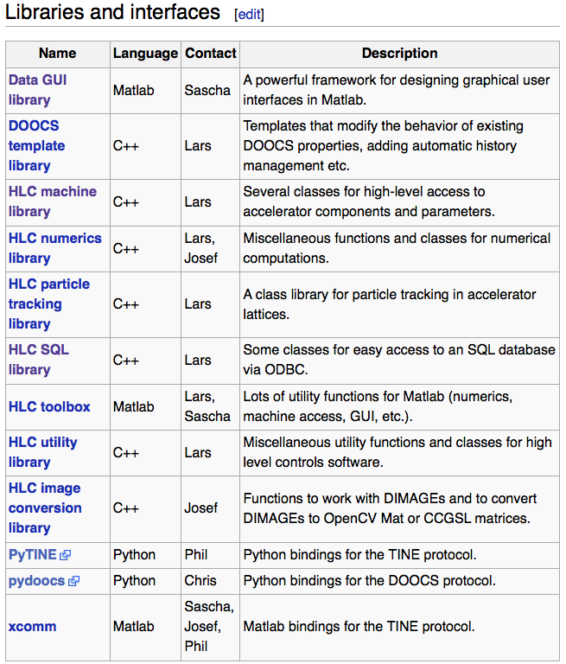
High Level Controls – emittance
Server
Matlab
Courtesy: J.Wilgen

Slide 16
High Level Controls – (just) two examples
Injector
Bunch Compression
Main Linac
Timing, MPS
Bunch Pattern Server
…
Orbit displays, ORM
Laser heater
Feedbacks
...
Emmitance ...
Undulators
Energy Management
Interfaces to cryogenic
...
Energy measurements
Chicane setup
Longitudinal Diagnostics
TDS
RF Tweak
…
Kicker control
Wavelength control, tappering, ...
GMDs
...

Slide 17
HLS examples – Linac Energy Control
No energy management in Injector and L1 (no spare klystron)
Energy setup using sum voltage server (“physical knob”)
No spare klystron in L2 …
but dedicated modules → some headroom
One klystron as spare in L3
Investigate impact off different usage scenarios
L1
L2
L3
1x1x8
1x1x8
1x4x8
3x4x8
20 (21) x4x8

Slide 18
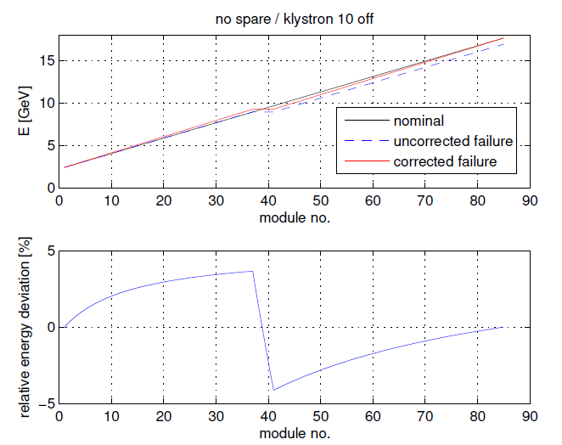
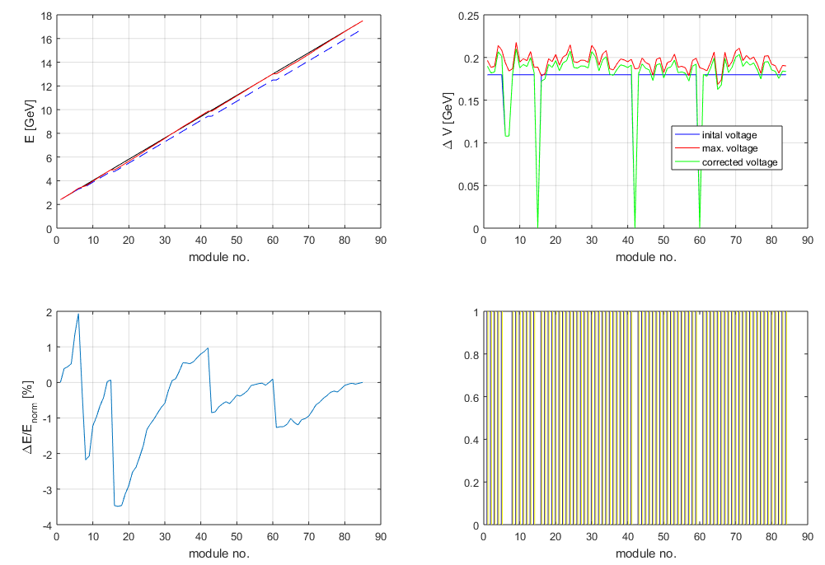
HLS examples – Linac Energy Control
Iterative adjustment of voltage per station respecting individual station capacity
Courtesy: B. Beutner

Slide 19
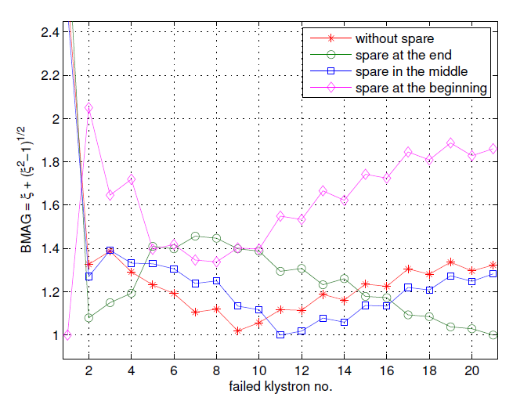
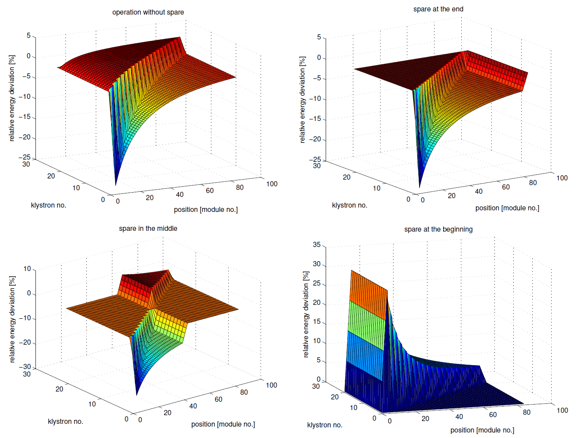
HLS examples – Linac Energy Control
Optics mismatch at end of Linac vs. failed RF station no.
A configuration with all stations in operation at reduced voltage (red) is most favorable in terms of:
Optics mismatch for random station failure
Reduced average power per station
Courtesy: B. Beutner

Slide 20
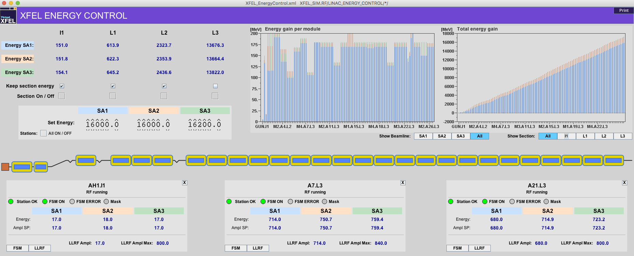
HLS examples – Linac Energy Control
This recipe has been implemented in C++ based middle layer server: Linac Energy Control
First tests in Virtual XFEL worked out well

Slide 21
The virtual XFEL
Orbit display, bumps
1. calculate orbit for given optic
4. Display orbit
+
modify by bump program
Optic
6. new currents to
optic server
5. write new currents
Orbit
DAQ
Magnet Server
3. send orbit data
to DAQ/orbit server
2. write orbit to BPM server
BPM

Slide 22
The virtual XFEL

Slide 23
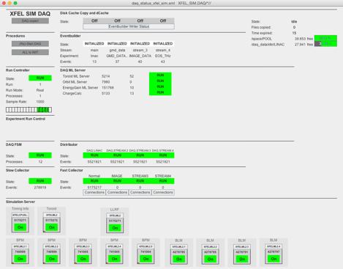
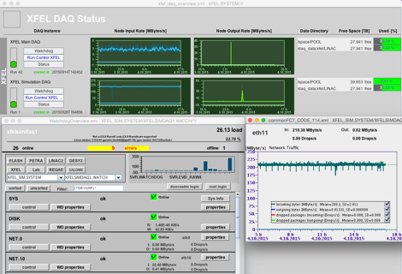
The virtual XFEL – Data throughput

Slide 24
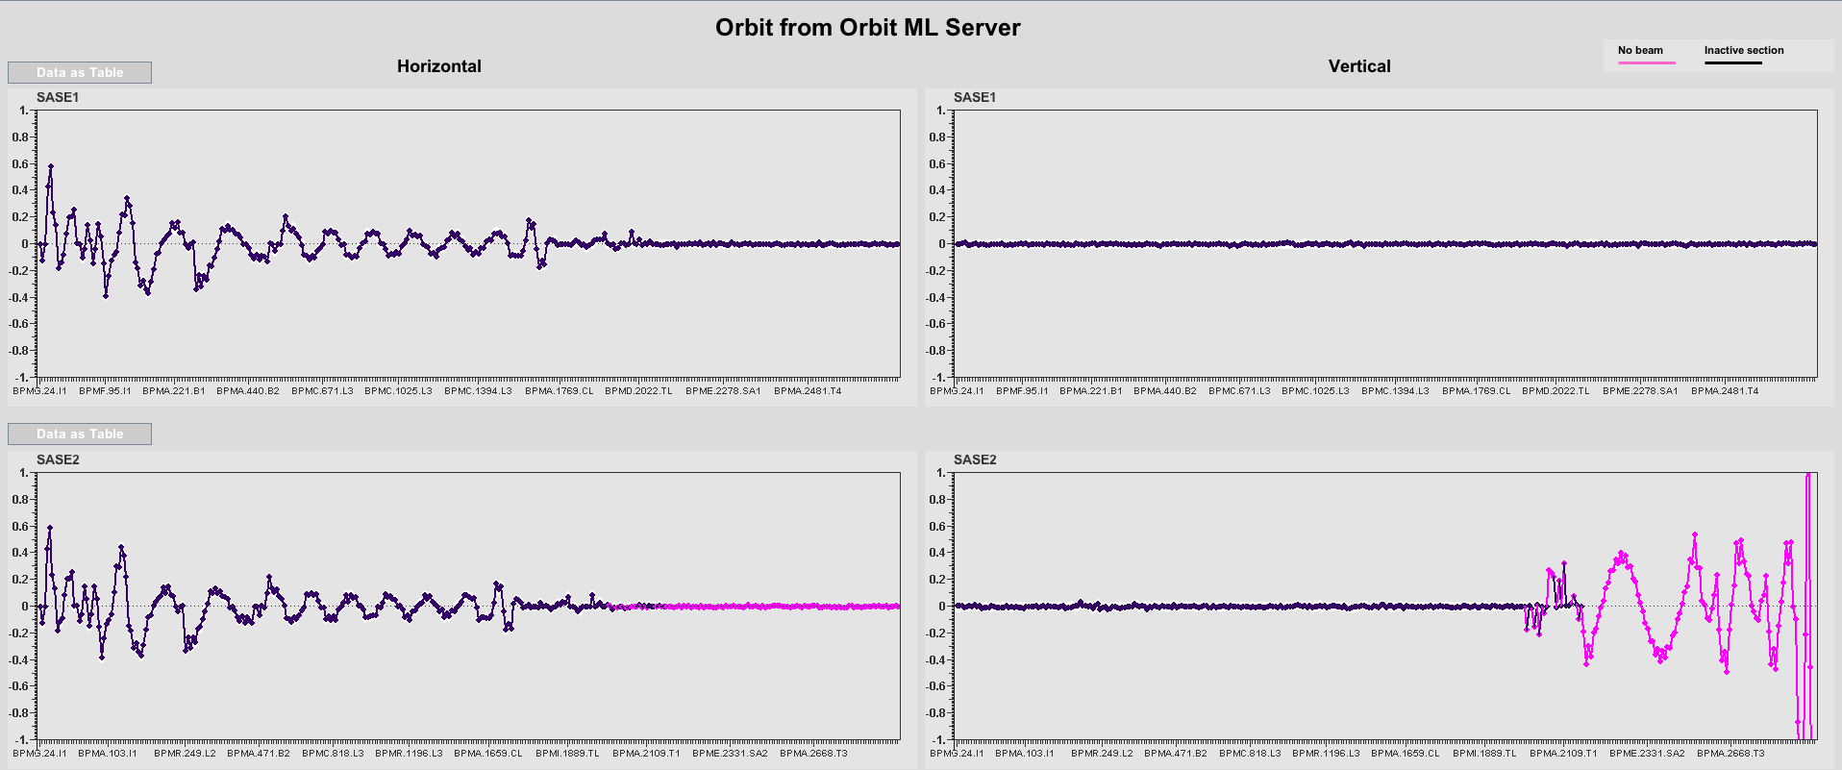
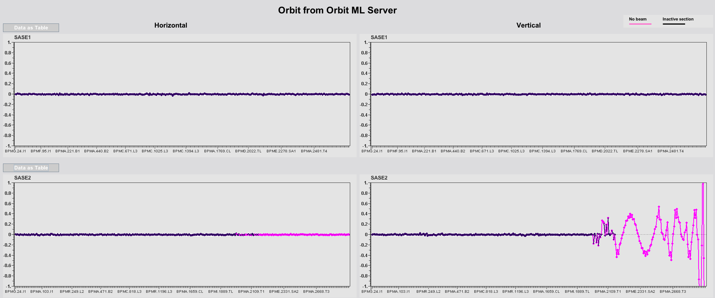
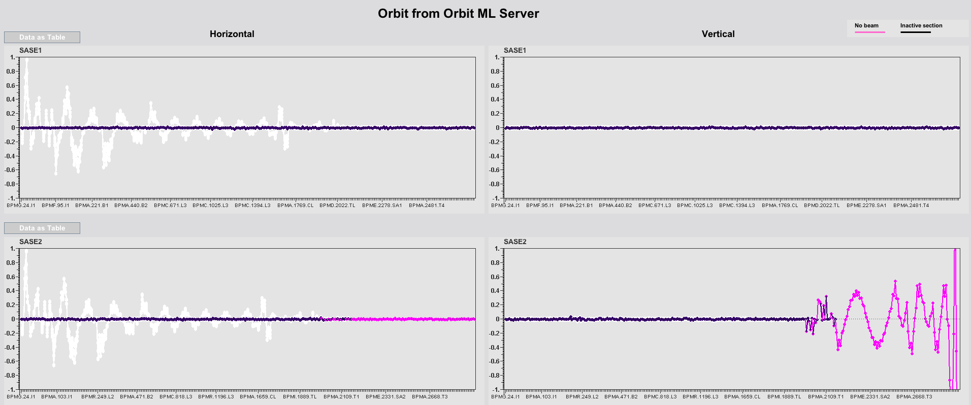
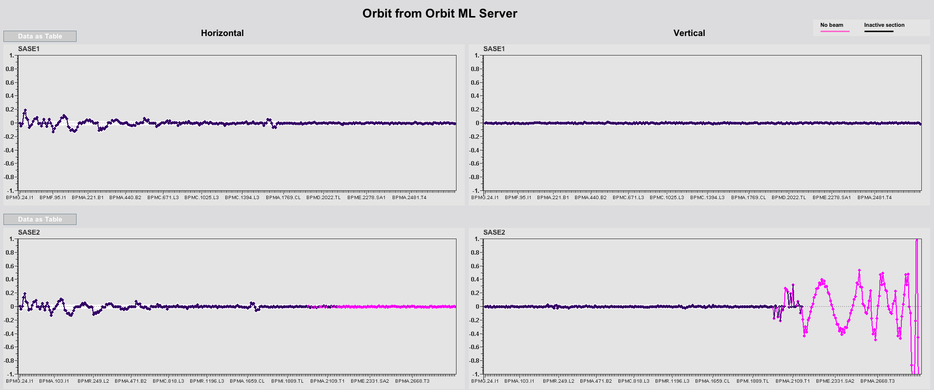
The virtual XFEL – Orbit

Slide 25
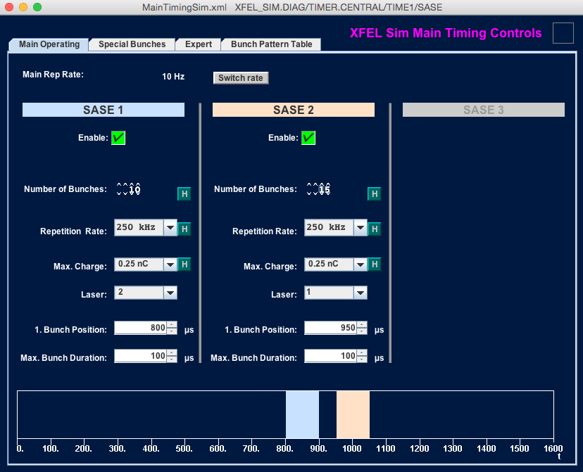
The virtual XFEL – Timing

Slide 26
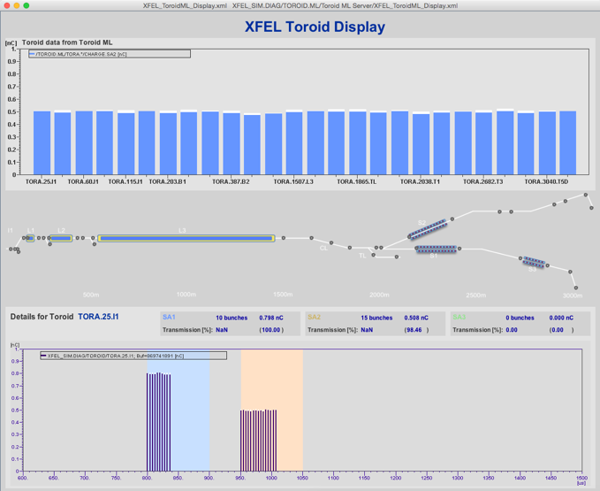
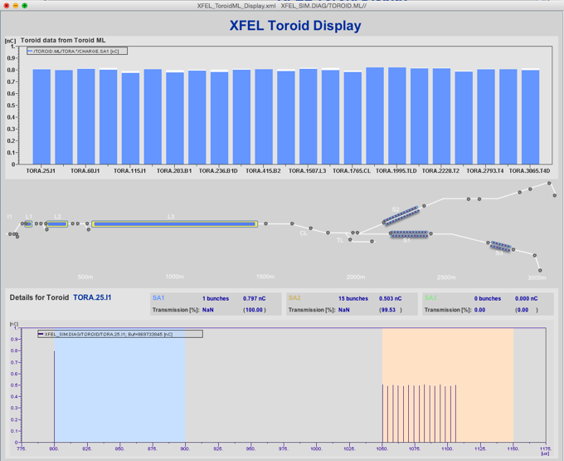
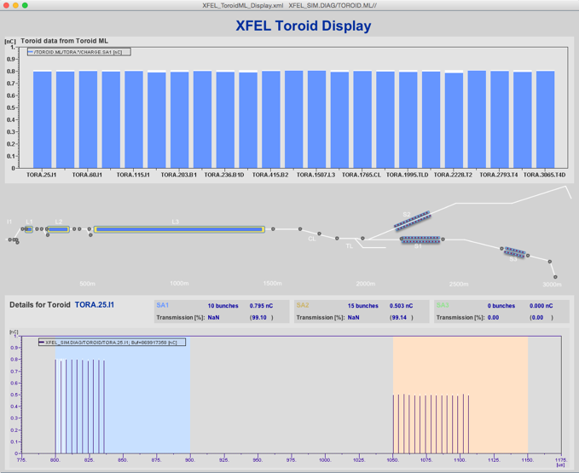
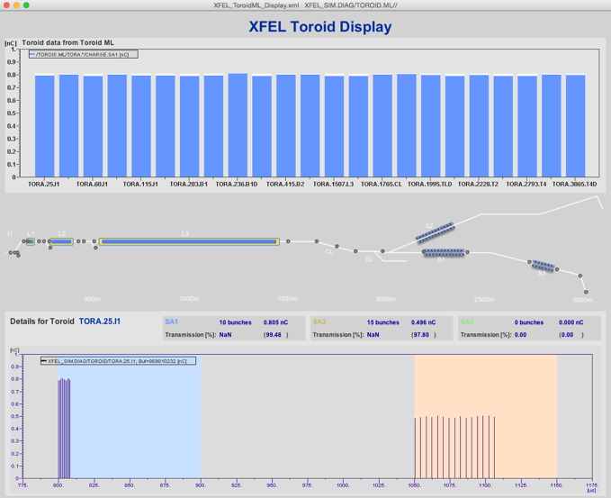
The virtual XFEL – Bunch pattern handling

Slide 27
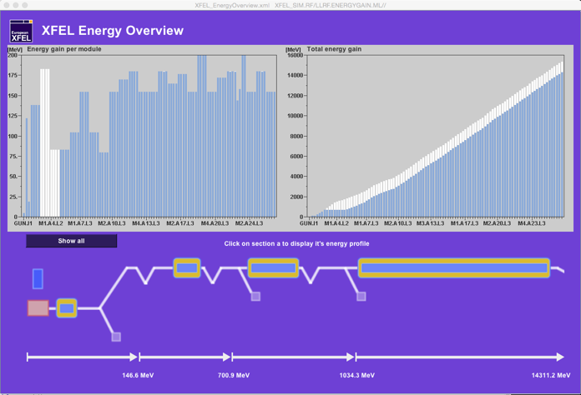
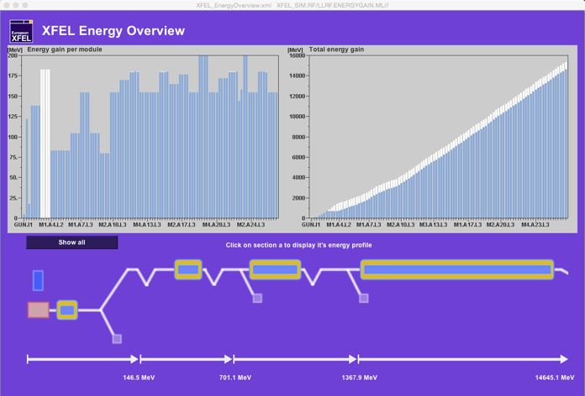
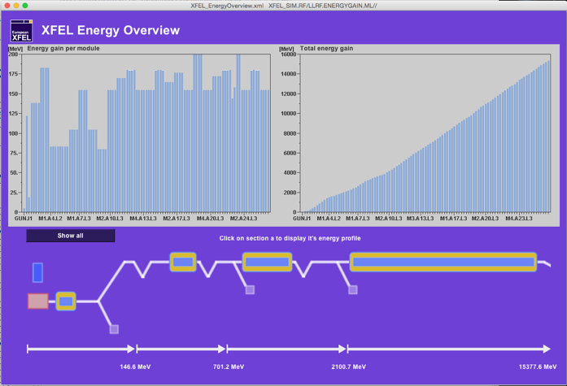
The virtual XFEL – LLRF

Slide 28
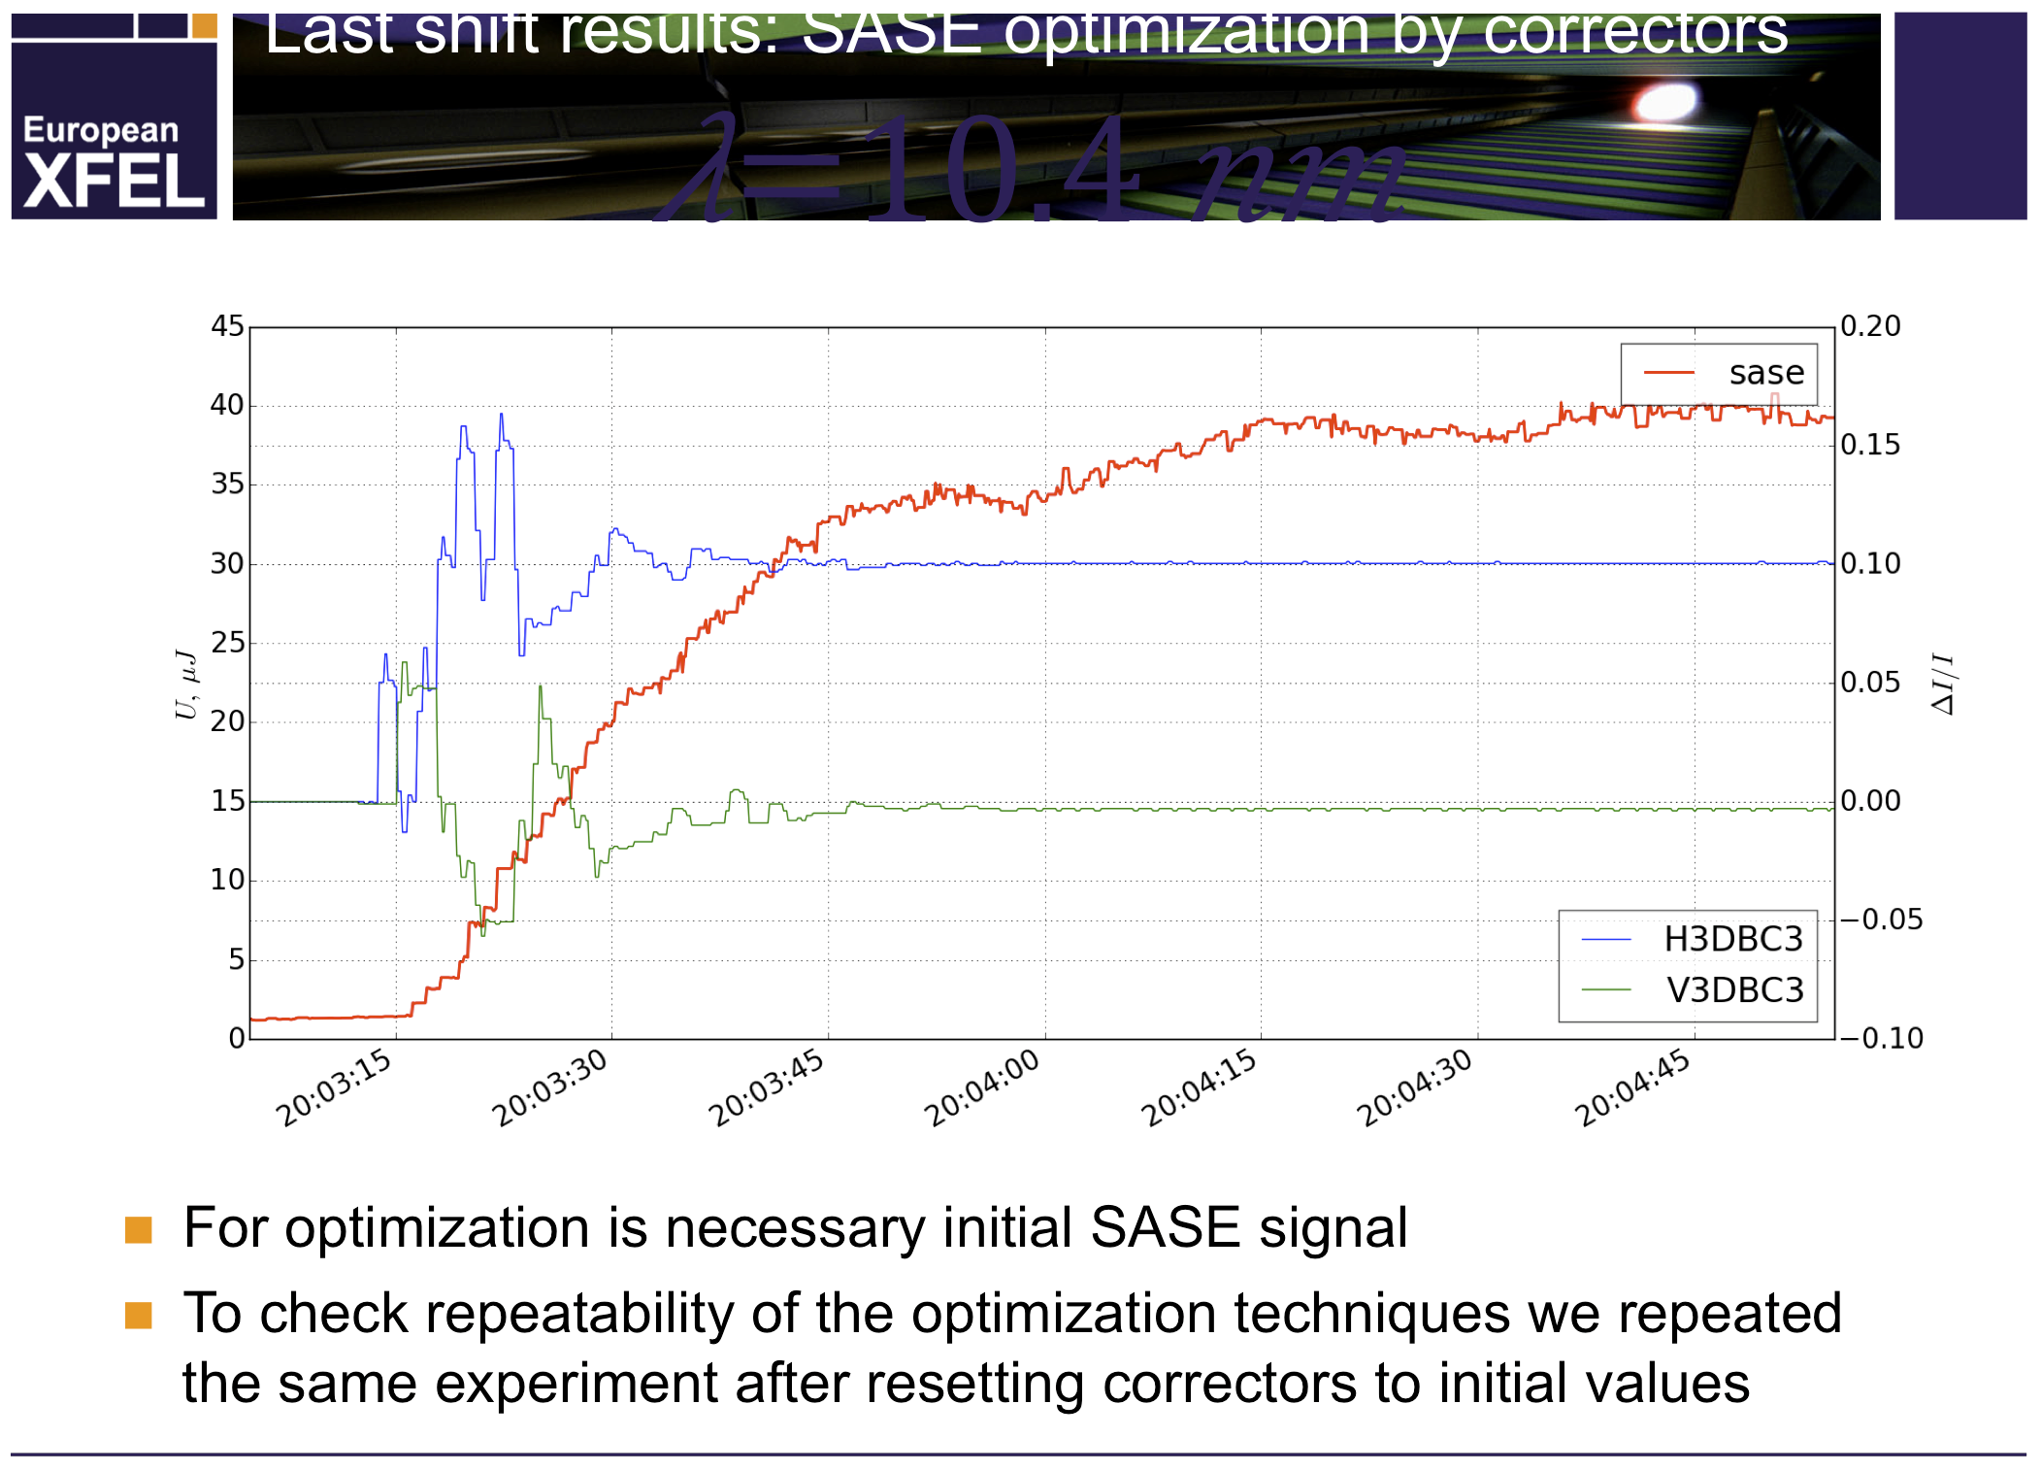
Outlook – Machine Optimization using HLS
At FLASH a SASE optimization is done by operators
To get optimal performance within shortest time machine driven procedures might be faster
First tests using OCELOT have been done at FLASH
Courtesy: S. Tomin (European XFEL)

Slide 29
Outlook – Machine Optimization using HLS
Needed interfaces (DOOCS) for EU-XFEL already exist
Integration in existing HLS landscape should be easy
OCELOT developers started to work in close collaboration with HLS team
A generic optimizer has still been missing on our shopping list!

Slide 30
Outlook – Big Data
EU-XFEL will produce TB per day of pure machine data
A good part of this is available via the DAQ
But also the CS infrastructure itself will provide a very large amount of diagnostic data (e.g. TBs of log files)
Use 'Big Data' tools to get insides
We evaluated Apache Spark on several data sets
First results look promising

Slide 31
Outlook – Big Data
An example: Search and fix missing meta data
Courtesy: K. Rehlich (DESY)

Slide 32
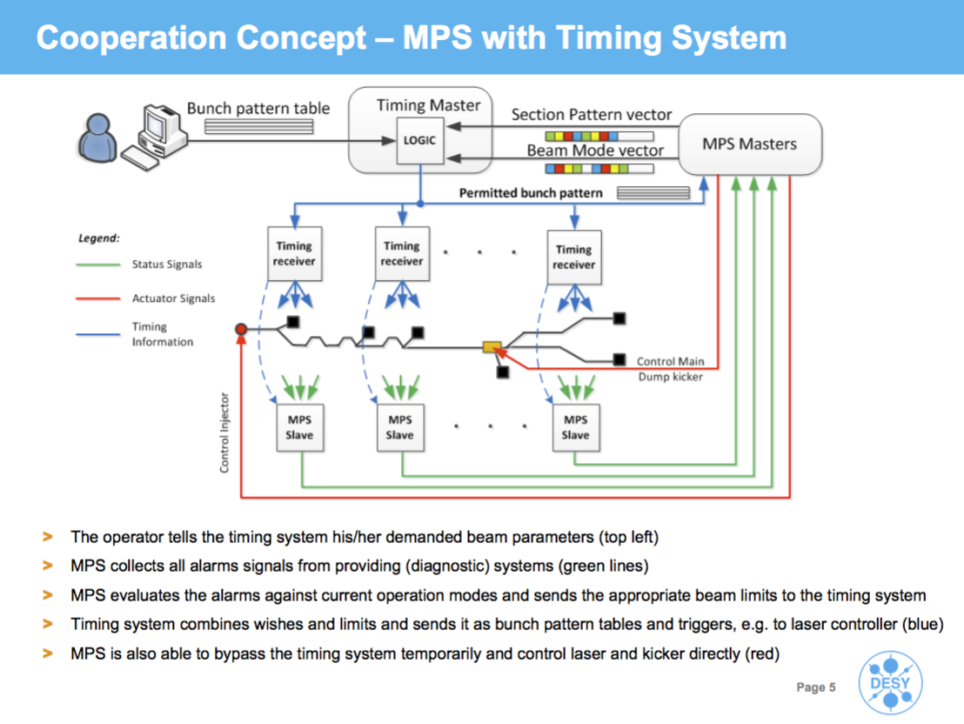
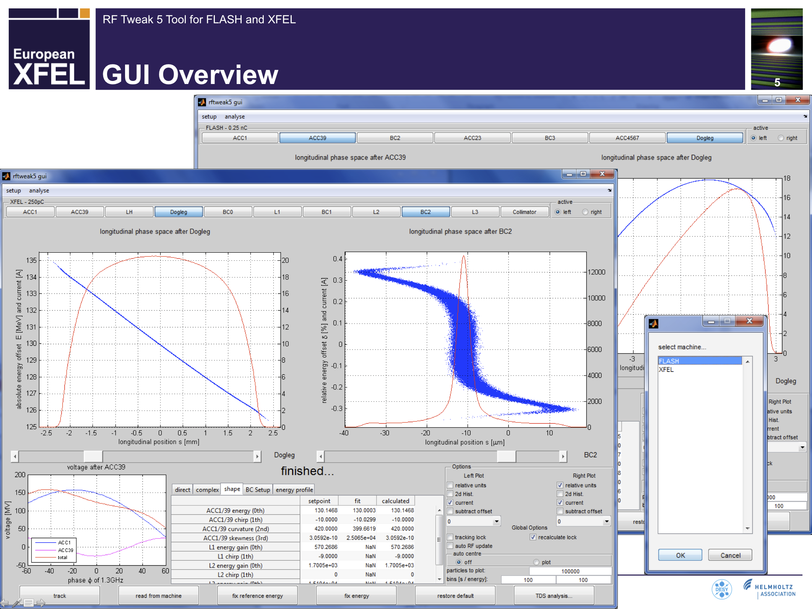
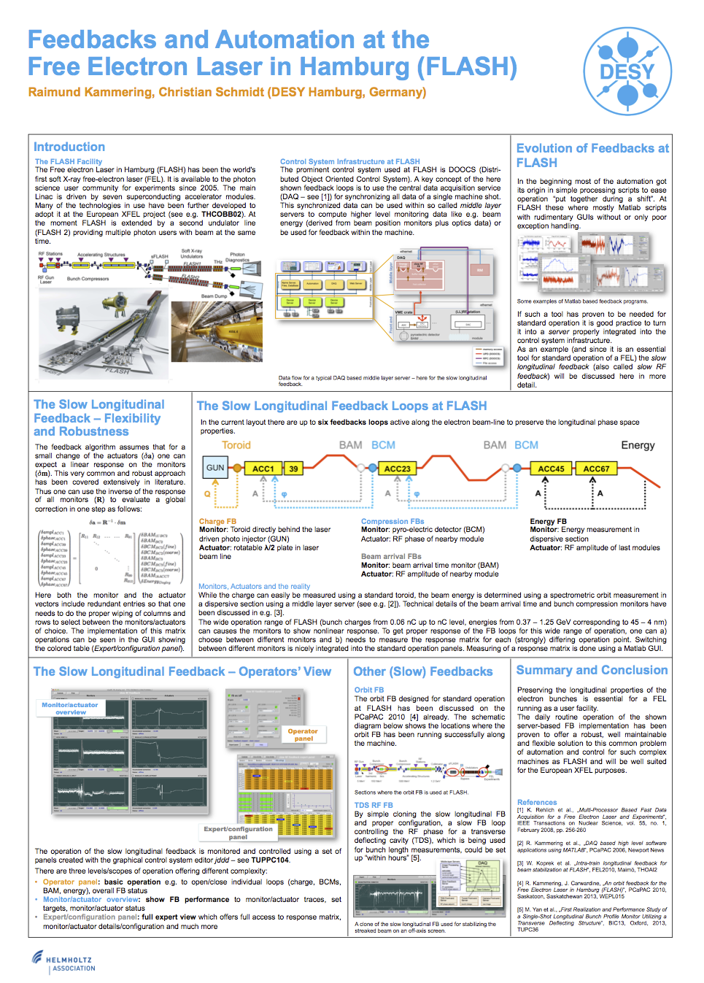
Summary
Much hasn’t been covered in detail
Timing system, multi-beam line operation
see e.g. http://doocs.desy.de → µTCA Development
Machine Protection System
see e.g. ICALEPCS 2013 TUCOCA01
Matlab tools
see e.g. www.desy.de/fel-beam → Talks
Libraries
http://xfel-wiki.desy.de/Control_system
Feedbacks
see e.g. ICALEPCS 2013 THPPC121
...
Courtesy: T. Tschentscher (European XFEL)
Courtesy: J. Jaeger (DESY)
Courtesy: B. Beutner (DESY)

Slide 33
Summary
We got a good team focusing exclusively on the high level view
This focused on architecture, concepts and common algorithms
to develop, test and implement libraries with common high level functionality
With the Virtual XFEL we have a great environment to do prior test and debug high level applications
Many servers and tools have been created this way and we:
think we are well prepared – let’s get started!
Thank you for your attention!

Slide 34
Backup: The need for a High Level View
Classic controls
physically
meaningful data
µTCA crate
0 | 0.205 mm
1 | 0.198 mm
2 | 0.194 mm
3 | 0.207 mm
4 | 0.210 mm
… | …
+
Server Code
→
→
→
typically DOOCS
C++ based server
display/work with
data

Slide 35
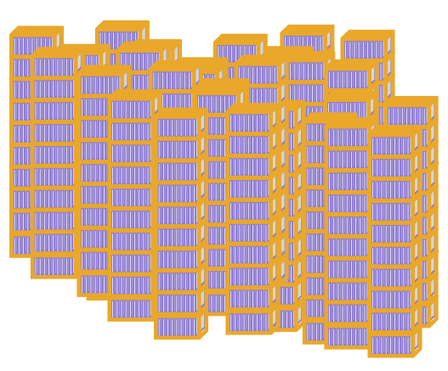
Backup: The need for a High Level View
0 | 0.205 mm
1 | 0.198 mm
2 | 0.194 mm
3 | 0.207 mm
4 | 0.210 mm
… | …
+
Server Code
→
→
→
O(kB/s)
x 200
…
0 | 0.215 mm
1 | 0.199 mm
2 | 0.198 mm
3 | 0.201 mm
4 | 0.209 mm
… | …
0 | 0.195 mm
1 | 0.196 mm
2 | 0.184 mm
3 | 0.187 mm
4 | 0.201 mm
… | …
0 | 0.205 mm
1 | 0.198 mm
2 | 0.194 mm
3 | 0.207 mm
4 | 0.210 mm
… | …
+
Server Code
→
→
O(GB/s)

Slide 36
Backup: Physical Knobs

Slide 37
Backup: Physical Knobs

Slide 38
Backup: Physical Knobs

Slide 39
Backup: Karabo Interfaces (1/3): Native Python Bindings
Direct Karabo integration for Python tools
Complete support for all Karabo features
Coexists with PyDOOCS, PyTINE interfaces
Control room demo: Not yet, to be scheduled soon.
Python Tool
Karabo Bindings
Karabo
Photon Beamlines
Courtesy: L. Froehlich (DESY)

Slide 40
Backup: Karabo Interfaces (2/3): C++ Client Library
Under development
Can be integrated into DOOCS C++ client library
Provides Karabo access for
DOOCS middle layer servers
Matlab tools (via Matlab DOOCS interface)
Python tools (via PyDOOCS interface)
Initial tests successful, but experimental code, not in standard build yet.
Matlab Tool
Python Tool
DOOCS Matlab Bindings
PyDOOCS
DOOCS Client Lib w/ Karabo
DOOCS Client Lib w/ Karabo
DOOCS ML Server
DOOCS Client Lib w/ Karabo
Karabo
Photon Beamlines
Courtesy: L. Froehlich (DESY)

Slide 41
Backup: Karabo Interfaces (3/3): jddd / Java
jddd uses Java jDOOCS instead of DOOCS C++ ClientLib
Java bindings for Karabo: Only conceptual implementation available, to be evaluated
Alternative: Create DOOCS middle layer servers
jddd
jDOOCS Library
DOOCS ML Server
DOOCS Client Lib w/ Karabo
Karabo
Photon Beamlines
Courtesy: L. Froehlich (DESY)

