Slide 1
Status and Commissioning Strategy for the Undulator Systems of the European XFEL
J. Pflüger,
representing WP71: S. Abeghyan, M. Bagha-Shanjani, U. Englisch, S. Karabekyan, F. Preisskorn, F. Wolff-Fabris, P. Li, Y. Li T. Wei, M. Wünschel, M. Yakopov
Betriebseminar 2016
Notes:
How to edit the title slide
Upper area: Title of your talk, max. 2 rows of the defined size (55 pt)
Lower area (subtitle): Conference/meeting/workshop, location, date, your name and affiliation, max. 4 rows of the defined size (32 pt)

Slide 2
Overview
The Undulator Systems of the European XFEL
Representative Magnetic Measurements, Re-measurement Campaign
→ Startup Strategy for Commissioning
Status of Undulator Control System
Status & Plan of Tunnel Installation: SASE1, SASE2, SASE3

Slide 3
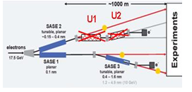
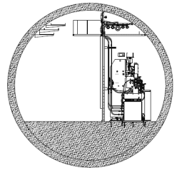
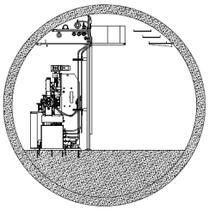
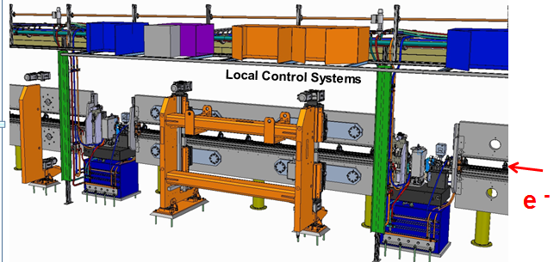
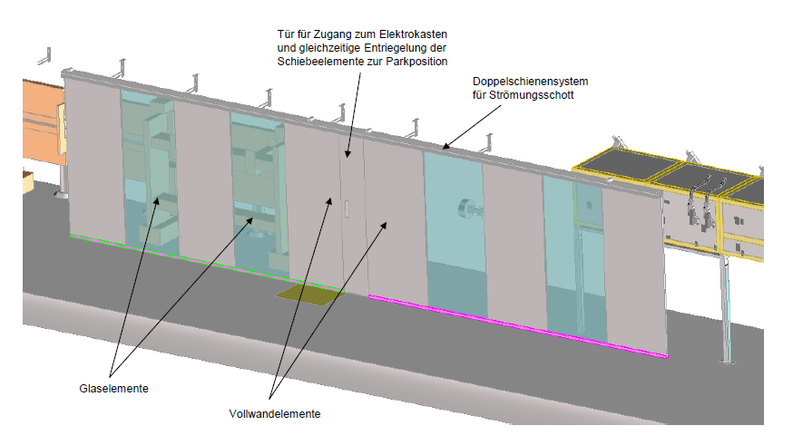
The XFEL Undulator Systems in Tunnels XTD1, XTD2 and XTD4
 | SASE1/2 | SASE3
λ₀ [mm] | 40 | 68
Operational Gap Range [mm] | 10-20 | 10-25
K-Range | 3.9–1.65 | 9.3-4
Radiation Wavelength Range [nm]
@ 17.5 GeV | 0.147-0.040 | 1.22-0.27
@ 14.0 GeV | 0.230-0.063 | 1.90-0.42
@ 8.5 GeV | 0.625-0.171 | 5.17-1.15
# of Segments | 35 | 21
System Length [m] | 213.5 | 128.1
SASE2 SASE1/3
Downstream View
With Air Conditioning Enclosures
“Naked“ Undulator System
WP71 Scope & Responsibility:
Organization , production either in house or through numerous IKCs & installation of the Undulator Systems

Slide 4
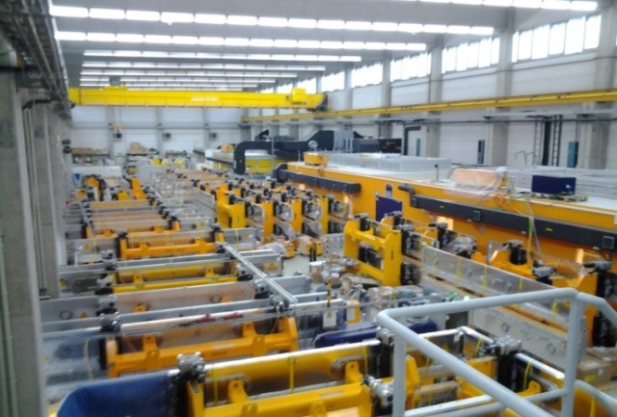
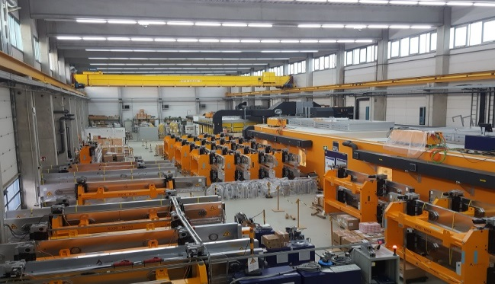
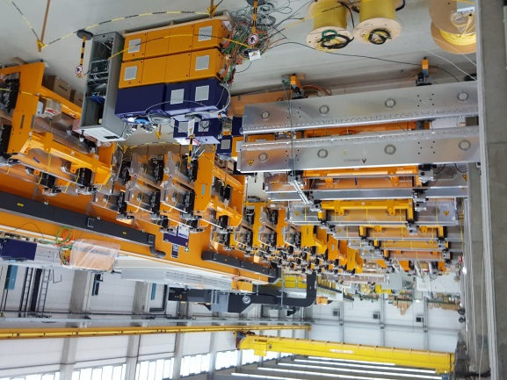
WP71 Hardware Status November 2016
WP71 Status of Hardware Production
92 Undulator Segments produced, tuned & commissioned
92 Undulator Segments for SASE1-SASE3 re-measured
56 undulator segments for SASE1+3 installed, 35 for SASE2 RFI
100 Pillars, Granite Bases for SASE1-3 installed
96 Phase Shifters in house; 56 (SASE1+3) installed, rest RFI
91 Quadrupole Movers (CIEMAT IKC) 56 (SASE1-3) installed
91 Intersection Control Racks (CIEMAT IKC) SASE1-3 installed
200 Air Coils, produced, tested, RFI
Air Condition: SASE1 operational, SASE3 in commissioning, SASE2 March 2017
Hall 36
Dec 2014
Contributions from Accelerator Consortium
XQA Quadrupoles
Cavity BPMs , DESY WP17, PSI; 97 RFI; 60 SASE1+3 installed, Rest RFI
BLMs, DESY WP17, IHEP Protvino; 97 RFI; 60 SASE1+3 installed, Rest RFI
Vacuum Supports SASE1-3 installed
Intersection Vacuum, DESY WP19, BINP 60 installed SASE1+3 installed, Rest RFI
Undulator Vacuum Chambers, DESY WP19: 62 SASE1+3 installed, Rest RFI
Feb 2016
Message:
All WP71 Hardware is either installed or Ready for Installation (RFI)
Oct 2016

Slide 5
Undulators: Representative magnetic Results: U40-X046
XFEL Specs | U40 | U68
Operational Gap Range [mm] | 10-20 | 10-25
B₀ @ 10mm Gap [T] | 1.14 | 1.66
K @ 10mm Gap | 3.9 | 9.0
RMS I2_{Y} [Tmm²] | < 100 | < 210
RMS I2_{Z} [Tmm²] | < 100 | < 100
Phase Jitter [°] | ≤ 8 | ≤ 8
Documentation Data Base in EDMS
Drawings
Tender Material
Production data of all WP71 components
Acceptance Tests
Magnetic data of all Undulator Segments, Phase Shifters, Air Coils
Installation

Slide 6
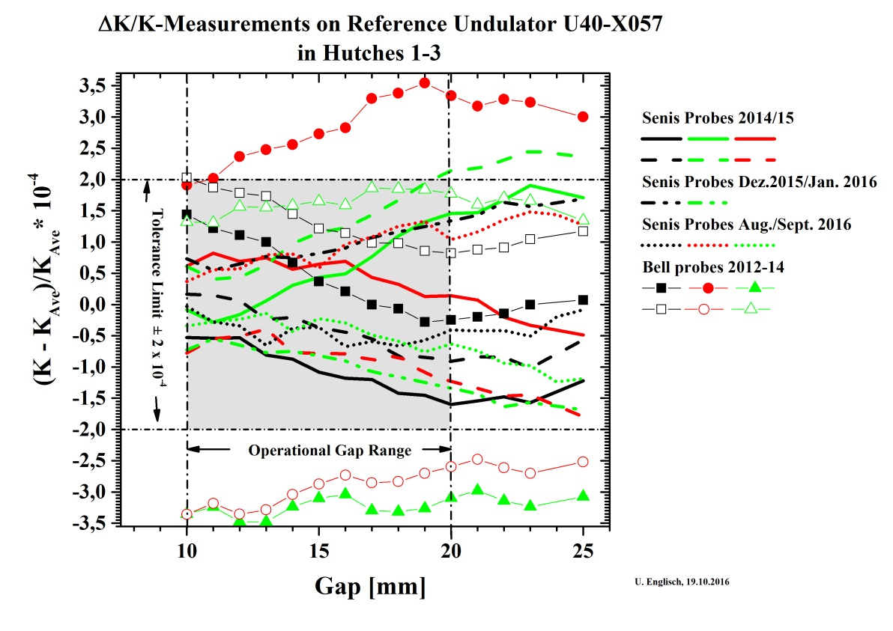
Re-Measurement Campaign
Reasons:
60% of the Undulator Segments were stored outside up to 2 ½ years with no temperature control (8-30°C) Check prior to installation requested!
Improve accuracy of Hall Probe measurements to ΔK/K =2 x 10⁻⁴ using new high stability, low drift, low noise probes (SENIS H3A-0YJ02F-B02T0K5K)
Apply exactly the same specs and procedures to all segments.
Precision Air Coil settings for Entrance/Exit Kicks using the Long Moving Wire Method rather than Hall Probes.
Results:
Only minor changes observed (entrance/exit kicks)
Phase Jitter, straightness unchanged
Probe data are much more stable
Message: Accuracy Limit, ΔK/K ≤ ±2.0x10⁻⁴ during the whole re-measurement campaign Fall 2014 – September 2016

Slide 7
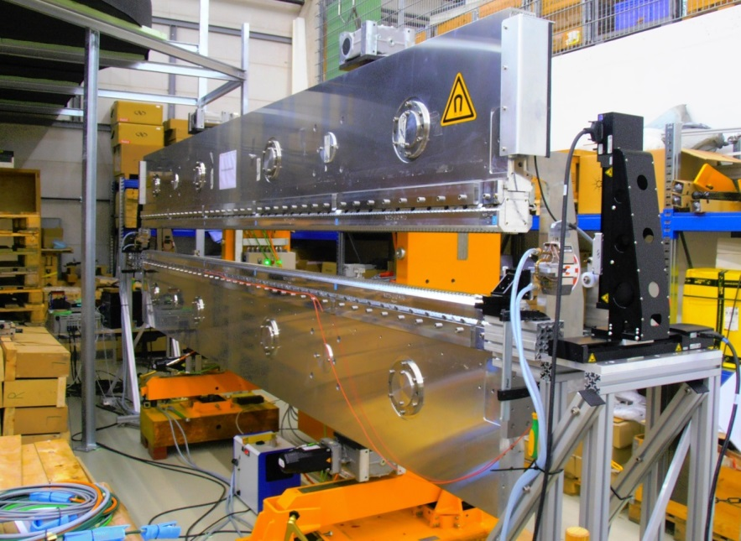
Precision Measurement of Entrance &Exit Kick using the Moving Wire
Results on U40-X001, X042, X057
1st Field Integrals
2nd Field Integrals
Moveable stages
Undulator
Air coil
0.1mmØ CuBe Wire
Paralell “P“
Anti-Paralell “A“
Accuracy: ΔI1≤±5μTm; ΔI2≤±20 μTm²;
For Comparison: 1μm ^ 68 μTm²
$${I1}_{}=\frac{{Δφ}_{P}}{N Δy,z}; {I2}_{B}=\frac{L/2}{N Δy,z}\left\{{Δφ}_{P}−{Δφ}_{AP}\right\}$$
D. Zangrando, R.P. Walker, Nucl. Instr. And Meth, A376 (1996), 275
F. Wolff-Fabris

Slide 8
Global Orbit Control in Undulator Systems
Orbit inside each Undulator segment is straight within specs → Accuracy of Hall probe sufficient
Hall measurements insufficient for End Corrector (Air Coils) setting
Long Moving wire measurements provide accurate data for a straight global orbit
Corrector & BPMs Positions
Without
6.1m
With MW

Slide 9
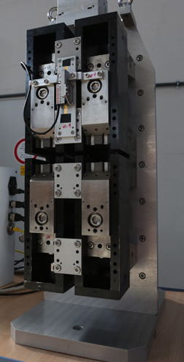
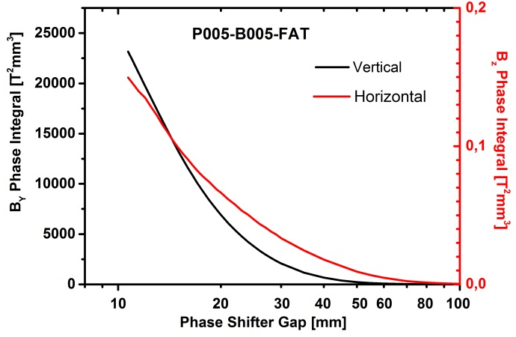
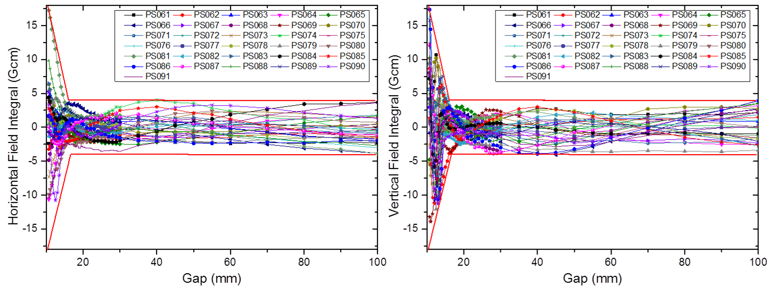
Phase Shifters with very low 1st Field Intergral errors: Representative Results
Period length: 55mm
Gap range: 10.5 to ≈>100mm
Max. Phase Integral @ gap 10.5mm : ≥23400 T²mm³
1st Hor/Ver Field Integral
Tolerance: ±0.004 Tmm
Dynamic Operation without retuning!
2nd Hor/Ver Field Integral Tolerance: ±67 Tmm²
Min. Gap precision for 5° SASE1/2 ±15µm
Phase Integrals: Adjust Phase delay
1st Field Integrals: Important for independent operation,
no corrections required (31 Phase Shifters , Huihua Lu, Lingling Gong, Yajun Sun, IHEP)
Y. Li, J. Pflueger, Phys. Rev. STAB 18, 030703 (2015)
Horizontal 1st Field Integral
Vertical 1st Field Integral

Slide 10
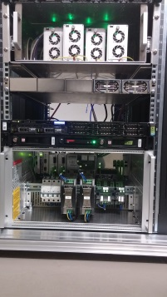
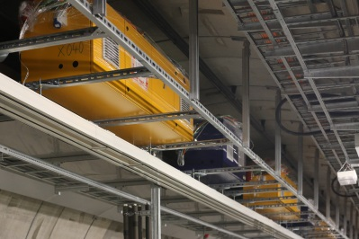
Control System Architecture
Based on industrial Beckhoff Hardware using TwinCAT Software and fast EtherCAT Fieldbus
Machine Control
DOOCS client
Experiment Control
DOOCS client
Client Layer
Ethernet
DOOCS server
Central Control Node
Beckhoff Programmable Logic Controller (PLC)
x 1
TwinCAT System Manager
Middle Layer
CCN in Balcony
Room in XHEXP
Virtual axis #1; 2 QM axes; PS axis; AMFC; 3-way valve; ACC
Virtual axis #N; 2 QM axes; PS axis; AMFC; 3-way valve; ACC
…
EtherCAT
Undulator Cell #1
Undulator Cell #N
Axes and parameters that are coupled to a virtual axis
Local Drive
Motion
Control of
undulator
cell #1
Axes and parameters that are coupled to a virtual axis
Local Drive
Motion
Control of
undulator
cell #N
x 35
Front-end
4 undulator axes
2 quadrupole
mover axes
4 undulator axes
2 quadrupole
mover axes
1 phase shiftrer axis
4 air coil correctors
AMFC
3-way valve
1 phase shiftrer axis
4 air coil correctors
AMFC
3-way valve
LCN in SASE1
…
S. Karabekyan

Slide 11
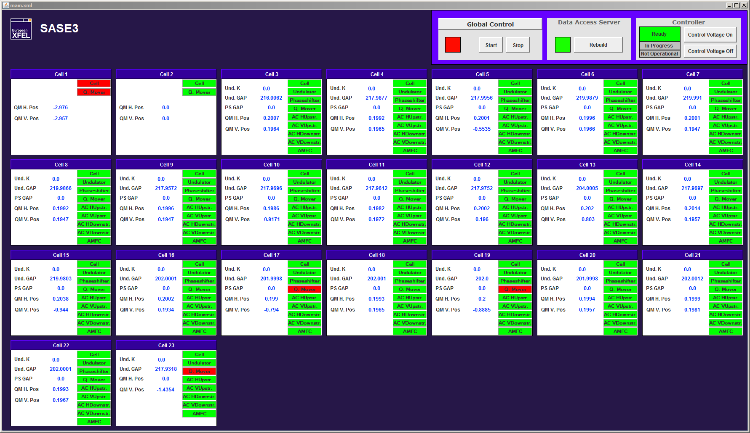
Main user interface (S. Abeghyan)

Slide 12
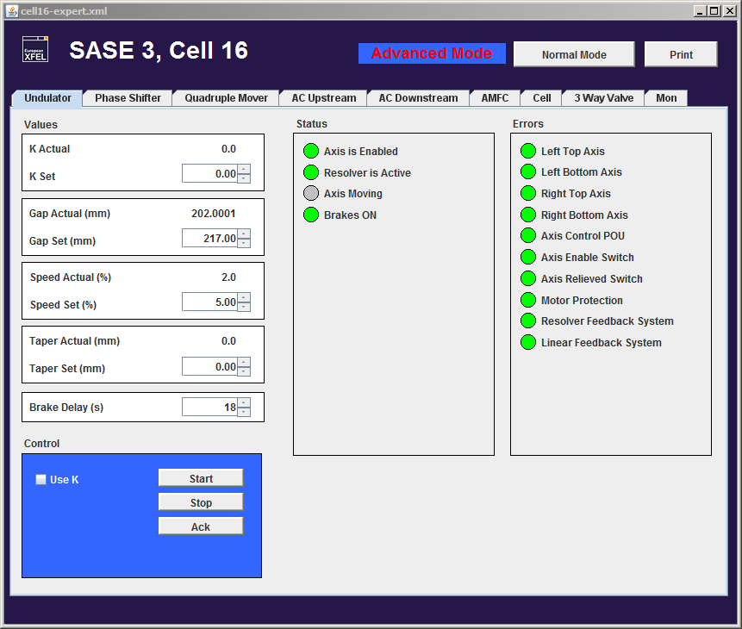
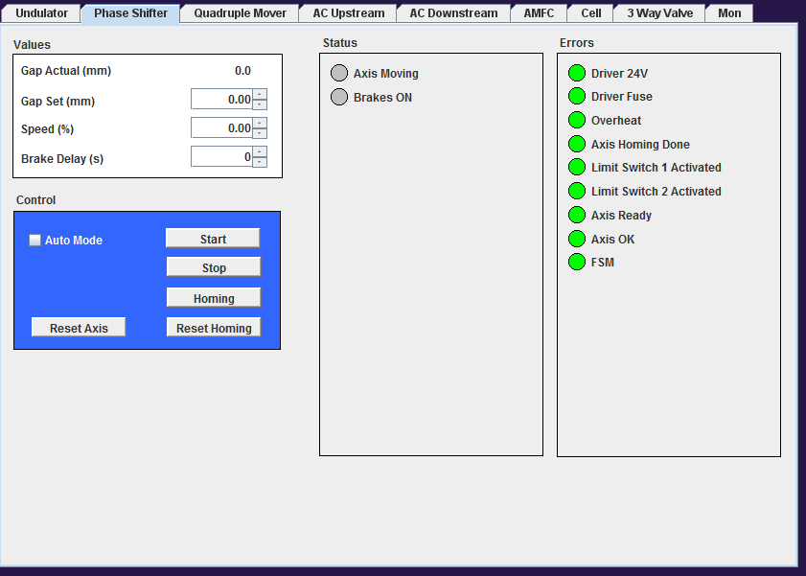
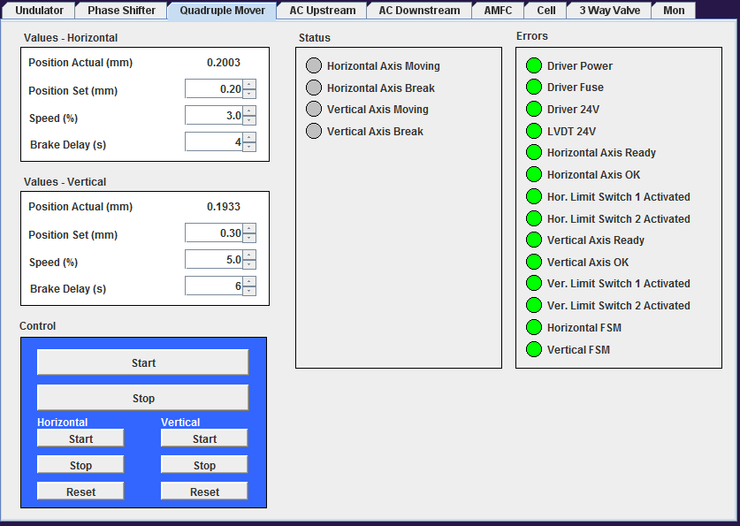
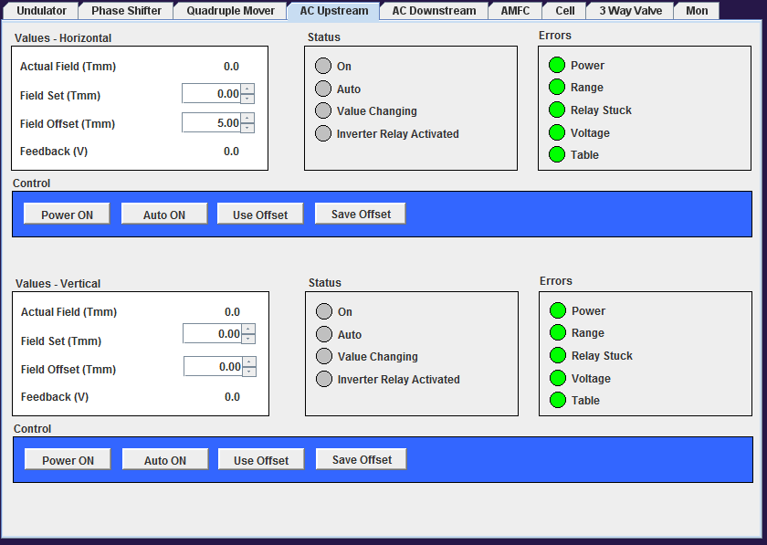
Undulator Control
Phase Shifter Control
S. Abeghyan
Quadrupole Mover Control
Air Coil Control

Slide 13
Undulator Control System: Properties
Local Control Node (LCN); Controls an individual cell
Synchronization of Gap-Motors, Operational Safety, Phase Shifters, Quadrupole Movers, Synchronization with Air Coils, Phase Shifters, Vacuum Chamber Temperature Control, Temperature Monitoring
Well tested during magnetic measurements
Central Control Node (CCN); Controls all cells of a SASE System :
Based on TwinCAT
Controls 35/21 LCNs using redundant ring architecture with optical fibers, length ≈2km
Manages/archives Hardware specific data: Lookup tables, operational parameters, offset bias values
Centralized data storage in Oracle Database, Backups
Automated procedures
IDA (Image Deployment Automation): Software Version control, updates, parameter uploads.
Functional tests of Hard/Software
Interface with DOOCS: Control of all system properties
CCN of SASE1 + SASE3 fully operational and under remote control
User Interface with JDDD (Java Doocs Data Display)
Future upgrades: Global synchronization of all undulators (Lasing on the Fly, synchronization with monochromators) → Make full use of hardware capabilities – Only new software needed.
S. Karabekyan, S. Abeghyan, M. Yakopov

Slide 14
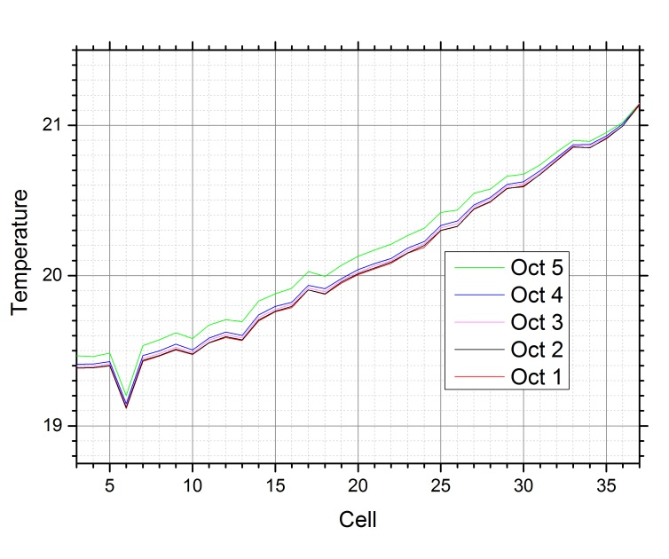
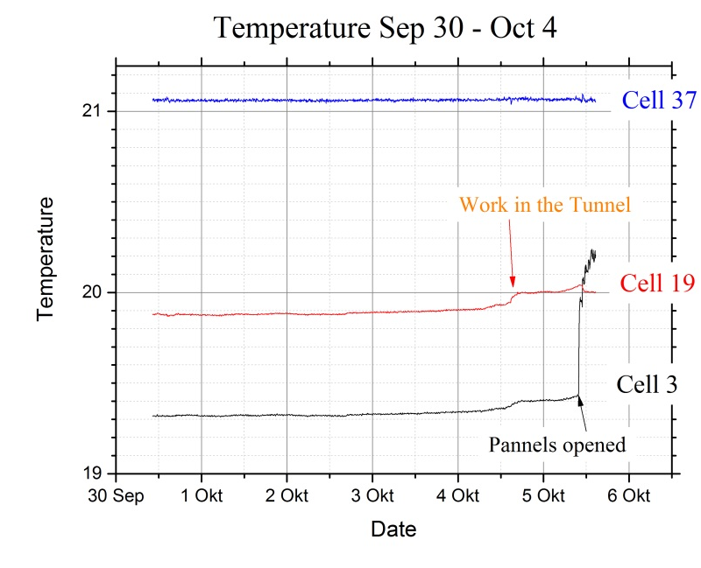
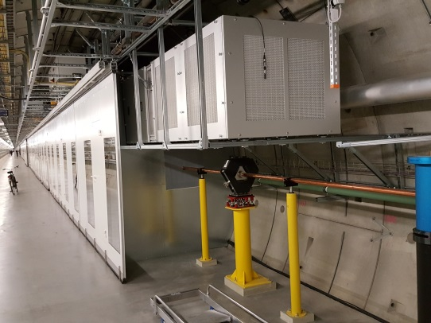
Temperature Distribution in SASE1 System measured Sep.3 – Oct. 3 (Holidays)
SASE1 PKG
Temperature along SASE 1
Time Dependence at Cells 3, 19,37
Air
e⁻

Slide 15
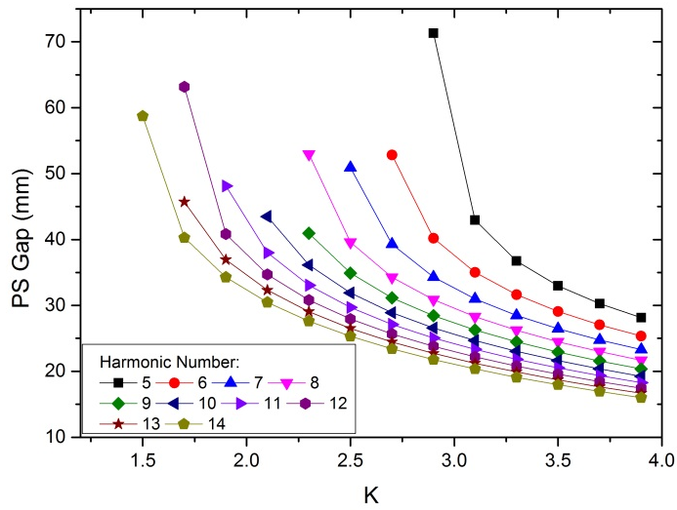
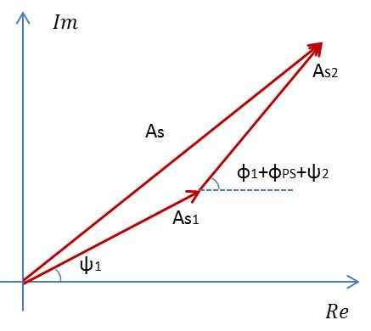
Phase Matching --- Look up table for Und & PS
ϕ_{Und, 1}
ϕ_{Und, 2}
Complex On-Axis vector potential
from magnetic measurements: $A_{s}=\int_{0}^{z}{I_{1y}(z_{1})e^{iφ\left(z_{1}\right)}dz_{1}}$
$$A_{sum 1,2}=\left|A_{s,1}\right|e^{iψ_{1}}+\left|A_{s,2}\right|e^{iψ_{2}}∙e^{i{{(φ}_{Und,1+}φ}_{PS})}$$
$ψ_{1}={φ_{und,1}+φ}_{PS}+ψ_{2}+2nπ$
Phase Shifter Gap vs. Undulator K
U40-X005 PS073 U40-X006
Pairing Needed for Undulator Phase Shifter combination → Lookup Table in control system
Y. Li
Notes:
Before you start editing the slides of your talk change to the Master Slide view: Menu button “View”, Master, Slide Master:
Edit the following 2 items in the 1st slide: 1) 1st row in the violet header: Delete the existent text and write the title of your talk into this text field 2) The 2 rows in the footer area: Delete the text and write the information regarding your talk (same as on the Title Slide) into this text field.
If you want to use more partner logos position them left beside the DESY logo in the footer area Close Master View

Slide 16
SPECTRA results using measured field data
Phase Matching: On axis intensity from two Undulators is 4 times that of one.
Rough ΔK Estimate:
$$E_{1}=8442eV; ∆E=10eV$$
$$\frac{ΔK}{K}=0.566∙\frac{ΔE_{1}}{E_{1}}$$
$$\frac{ΔK}{K}=6.7E−4$$
All six undulators within this limit
Message: Undulators behave perfect, Phase Matching works
Y. Li

Slide 17
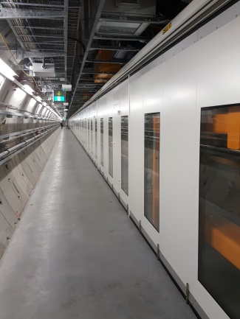
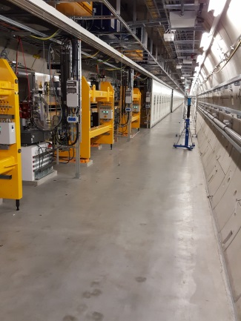
SASE1 Status & Plans November 2016
Status
Undulator Hardware installed, including XQAs, Magnet Power, Cooling Water, QMs, Phase Shifters,
Undulator Control System commissioned, operational
Interlock installed
Air Conditioning System installed & commissioned
SLRS installed & commissioned
Enclosure closed
Sep 2016
Plan
Re-alignment of Undulator System using SLRS: Total 6 weeks End: Dec 9
Commissioning of 35 Undulator Segments: Removal of Safety covers, Safety Precautions
Fine alignment of the vacuum chambers, closing the gap to 10.000mm, Fine adjustment of limit switches, CALs, Hardstop, Installation of Radfets, Air Coils: 8 weeks; End: Feb 8, 2017
Ready For Beam: Beginning of February 2017
Re-opened for SLRS alignment 22.10.2016

Slide 18
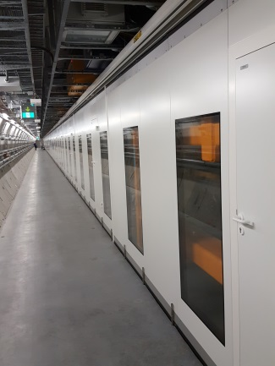
SASE3 Status & Plans November 2016
Status
Undulator Hardware installed, including XQAs, Magnet Power, Cooling Water, QMs, Phase Shifters,
Undulator Control System commissioned, operational
Air Conditioning System installed, commissioning in progress
Interlock not yet installed
SLRS in installation
Plan
Commissioning of SLRS
Re-alignment of Undulator System using SLRS: Total 6 weeks End: Jan 31, 2017
Commissioning of 35 Undulator Segments: Removal of Safety covers, Safety Precautions:
Fine alignment of the vacuum chambers, closing the gap to 10.000mm, Fine adjustment of limit switches, CALs, Hardstop, Installation of Radfets, Air Coils: 8 weeks; End: March 21,, 2017
Ready For Beam: End of March 2017
Enclosure closed

Slide 19
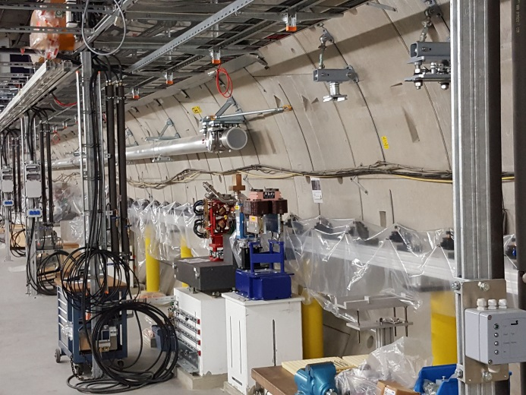
SASE2 Status & Plans November 2016
Status
SASE2 has low priority
Pillars, Granites, Floor Mounts installed
Air Conditioning: Enclosure + Unit installed
25 out of 35 undulator control units installed
Posts and adjustors for vacuum system installed
QMs and XQAs mounted
Plan
Instal & align vacuum system, BPMs, BLMs undulator chambers : Pre-Condition: Baustromversorgung needs to be removed first
SLRS installation and commissioning
Installation/Completion of Infrastructure (Interlock, cooling water, magnet power)
Phase Shifter Installation(1 week)
Undulator Installation (3 weeks)
Cabling and connecting of 35 cells, first commissioning of undulator controls (3 weeks)
Final alignment using SLRS (3 weeks)
Install panels for Air Conditioning Enclosure (3weeks)
Commissioning of Air Conditioning System (2 weeks)
Commissioning of Undulator System guarantee safe operation for Gap 10.000mm (8weeks)
Ready For Beam: June 2017
SASE2 26.10.2016

Slide 20
The End

