Slide 1
Current Status of Vibration Monitoring in XHEXP
XHEXP Section Coordination Meeting
8:30 Friday 12th August
XHQ-E1.173
Notes:
How to edit the title slide
Upper area: Title of your talk, max. 2 rows of the defined size (55 pt)
Lower area (subtitle): Conference/meeting/workshop, location, date, your name and affiliation, max. 4 rows of the defined size (32 pt)

Slide 2

New Report has been released
Report on measurements from Jan 2015 to June 2016
It is in alfresco, XHEXP1 site (link in minutes)
Summary: Comparison of quiet time measurements on Sundays did not show any change
The main vertical (z-direction) excitations were at 2,5 Hz and 10 Hz
The main horizontal (x- and y-direction) excitation was slightly below 2,5 Hz and a smaller exitation is at 10 Hz as well.
These are so called “cultural noise“.
No new additional influence from technical infrastructure and the completed office building can be ovserved.

Slide 3
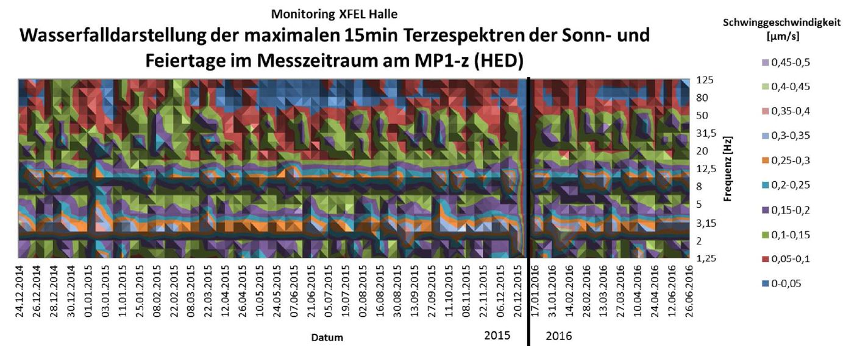
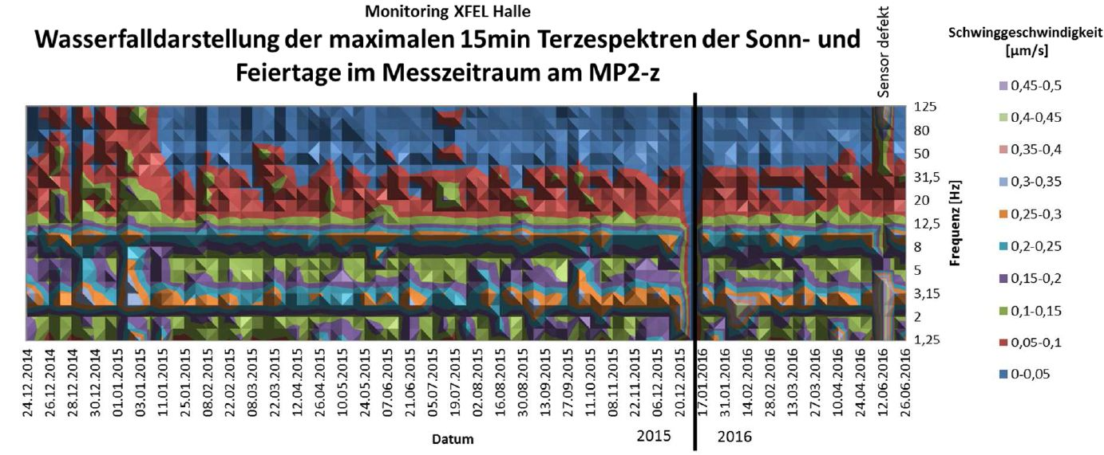

Slide 4
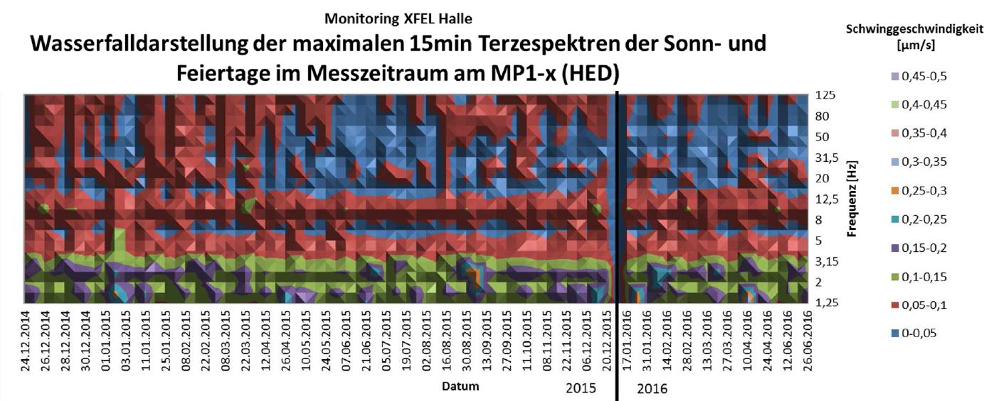
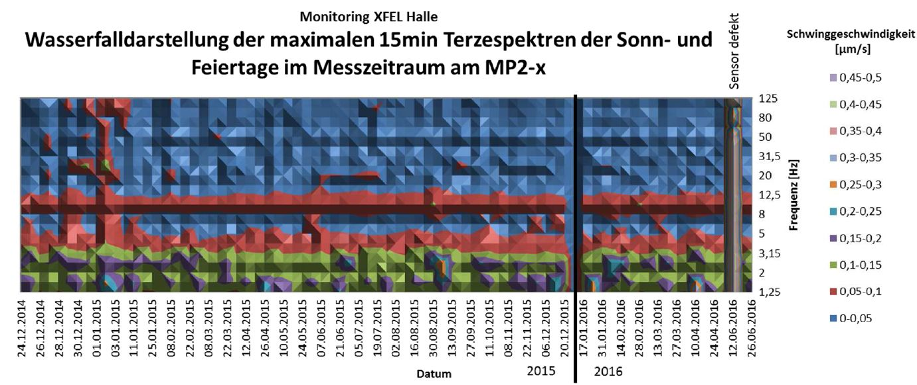

Slide 5
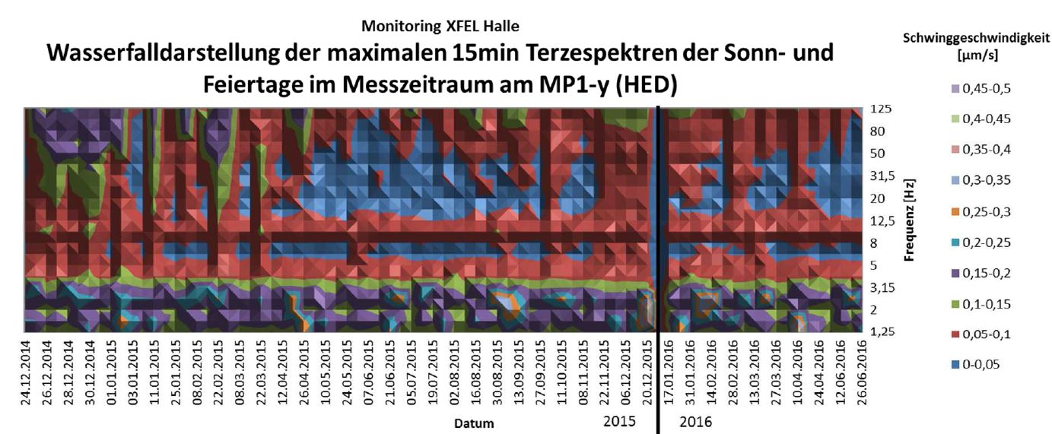
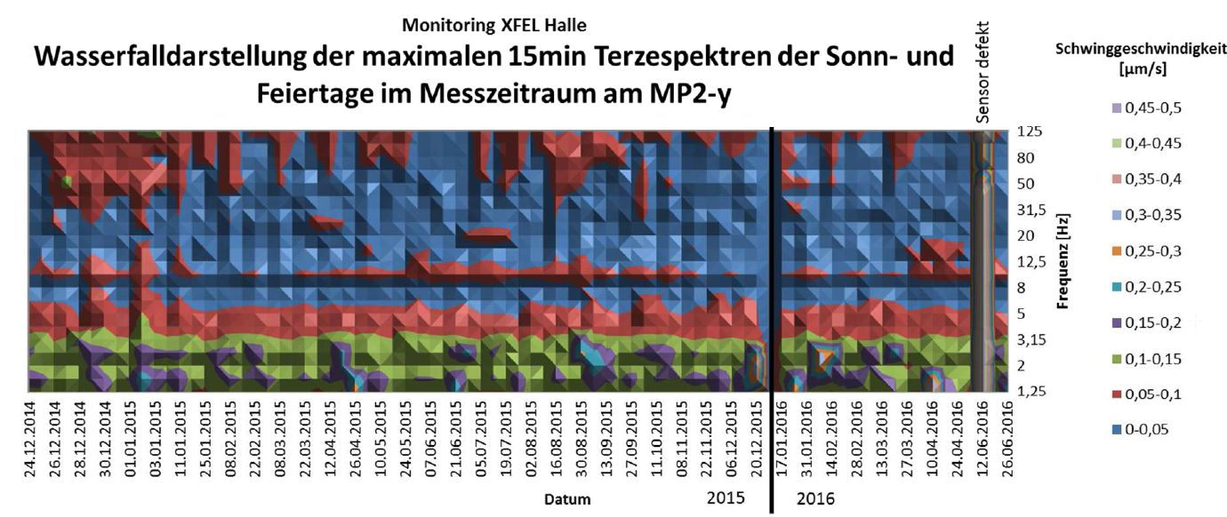

Slide 6
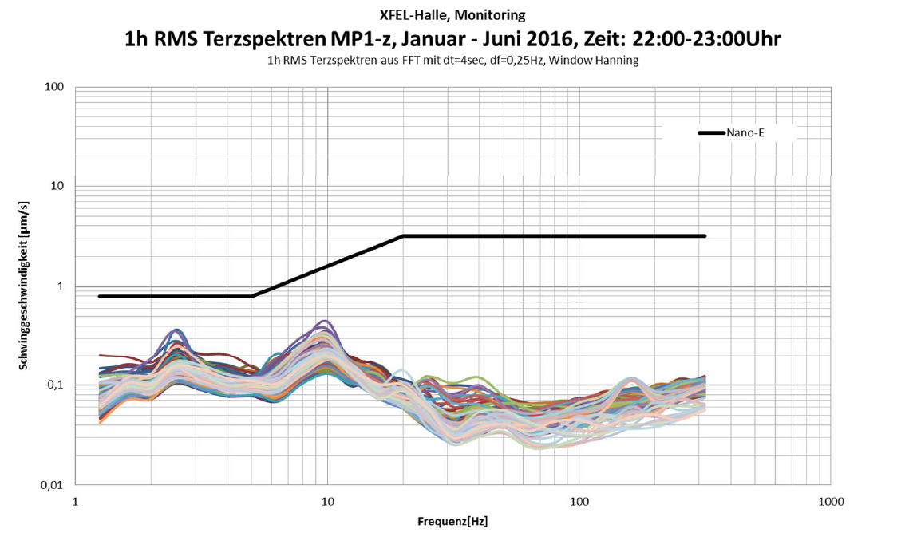
Evaluation according to strucural dynamics criteria (as in the report)
From a structural dynamics point of view the experiment hall still is well qualified for Nano-E criteria

Slide 7
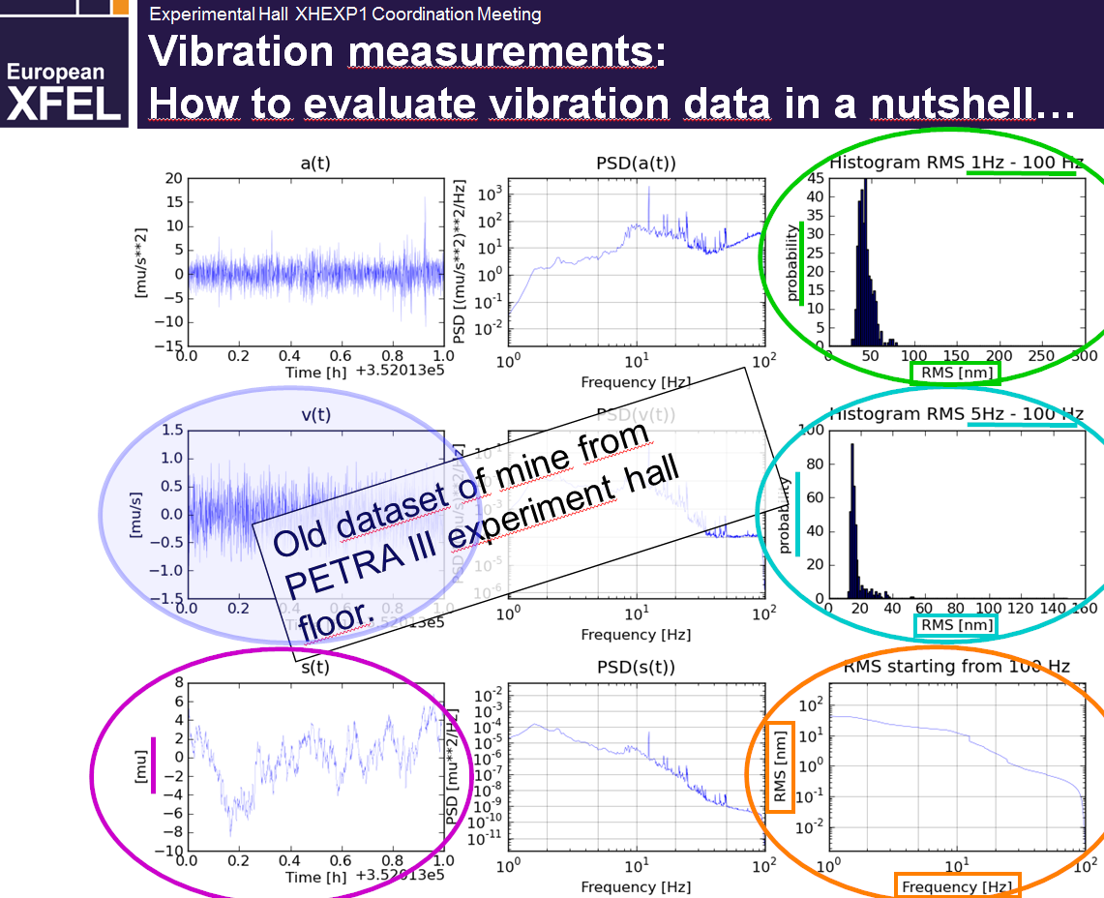
now: looking at displacements …
from the talk given by
G. Wellenreuther

Slide 8
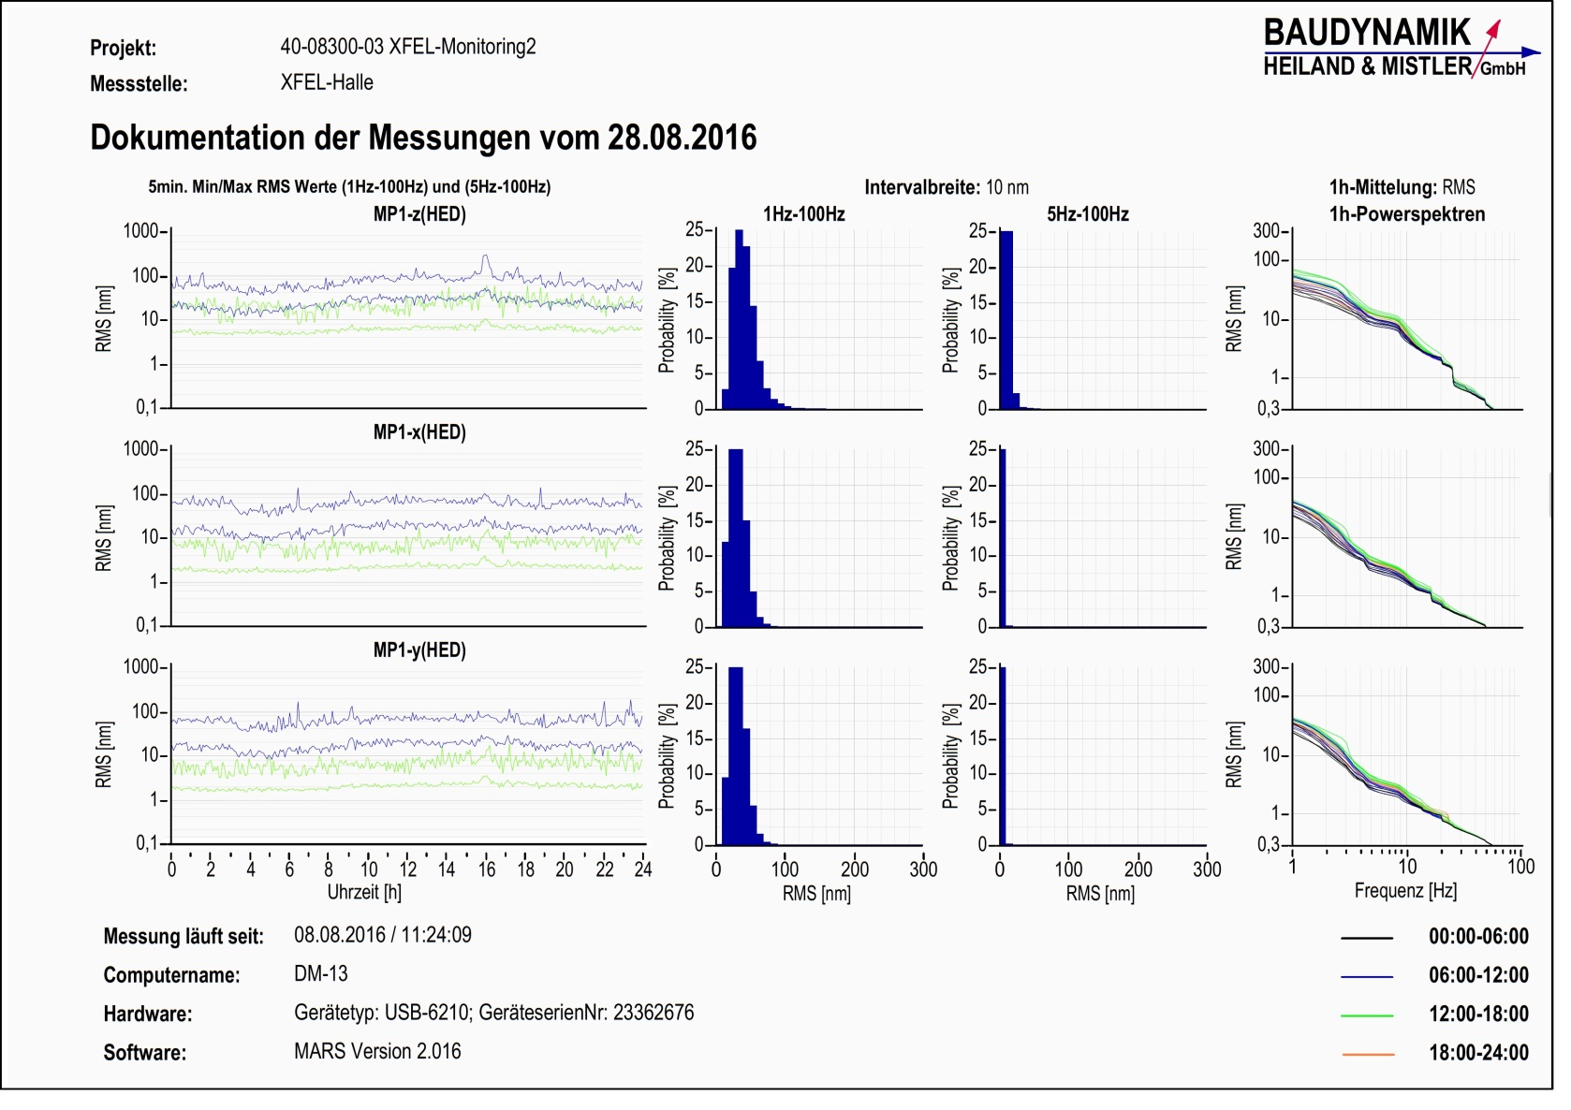
A Sunday inside HED
20
5
40

Slide 9
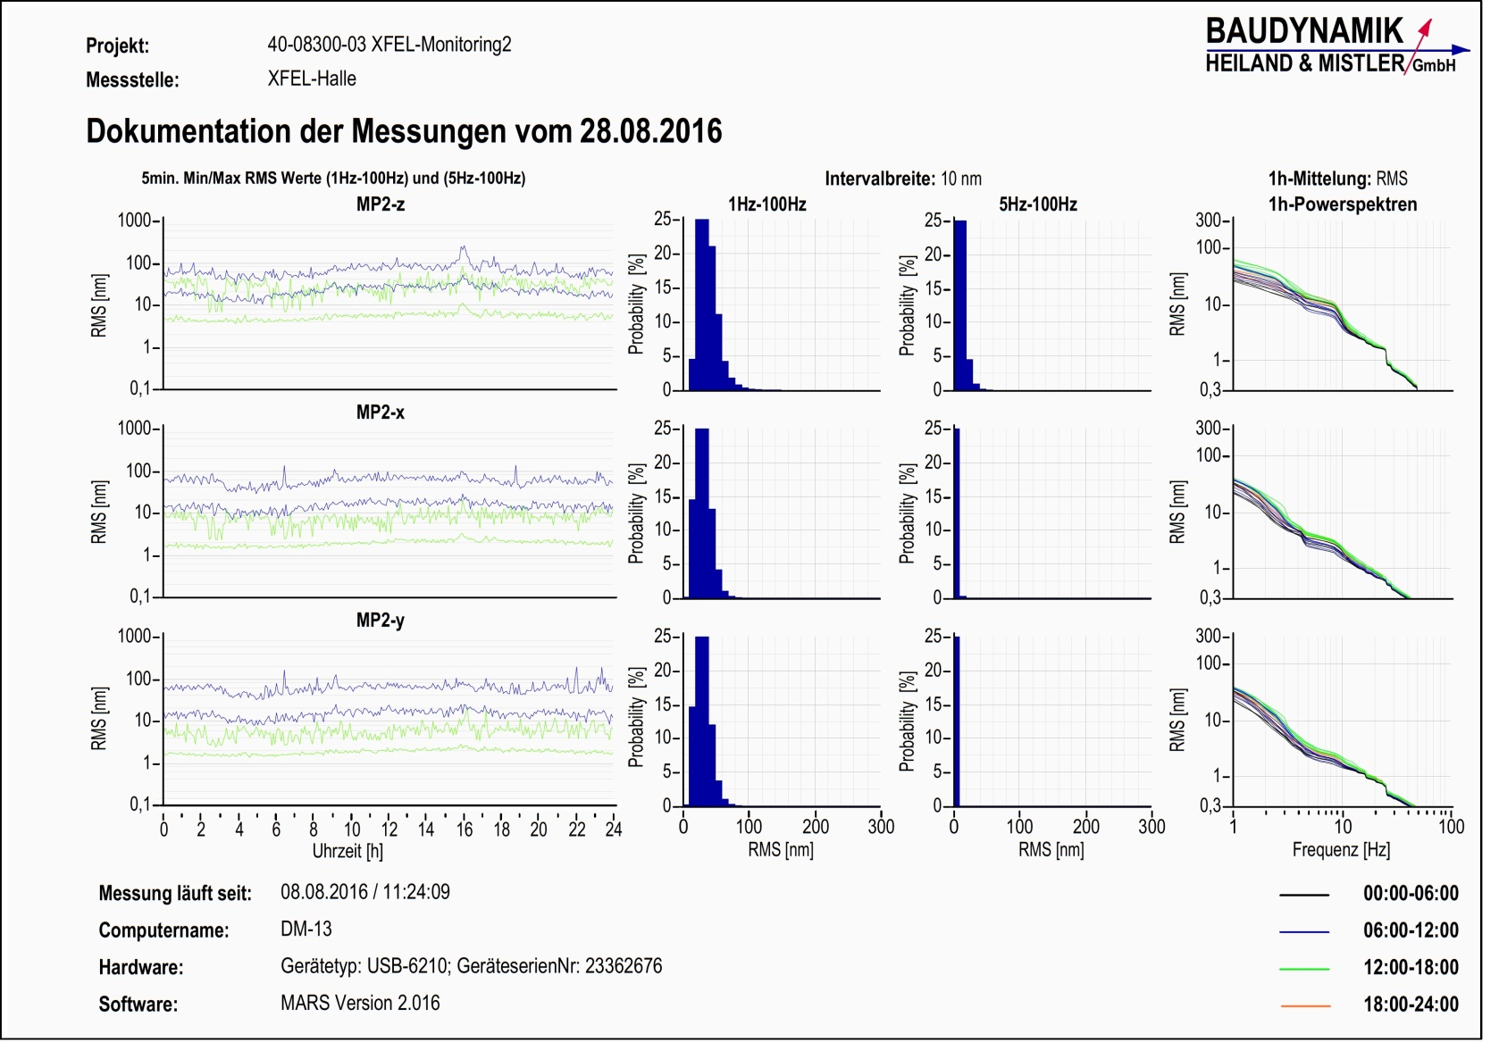
A Sunday at the pillar at SPB
20
5
40

Slide 10
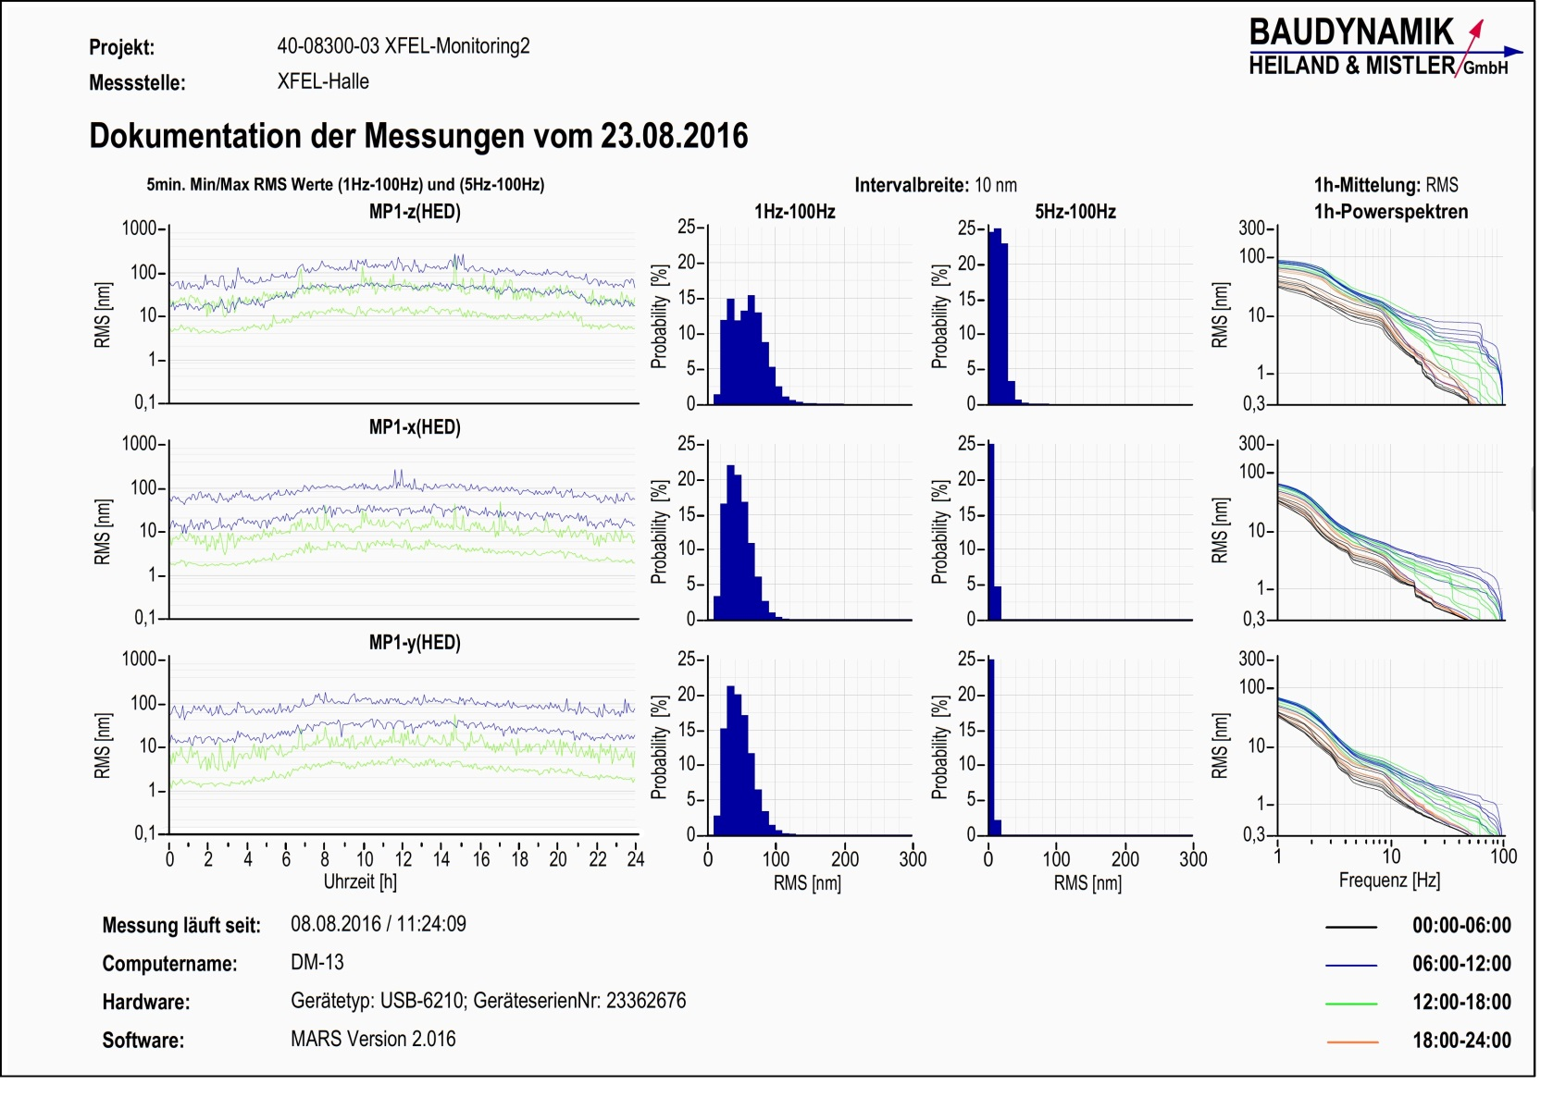
… a work day …
20
5
40

Slide 11

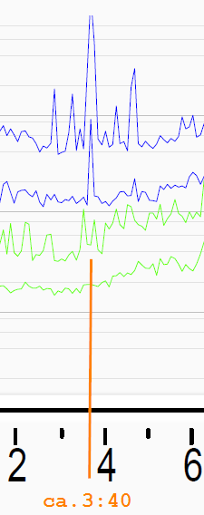
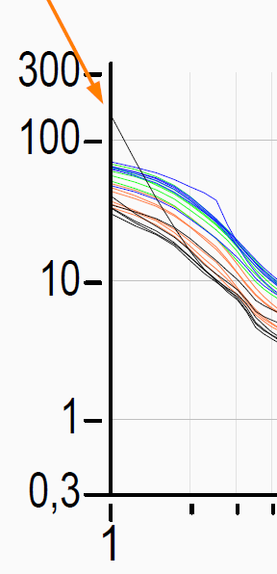
… a current work day (including the Italy quake)
20
5
40

Slide 12
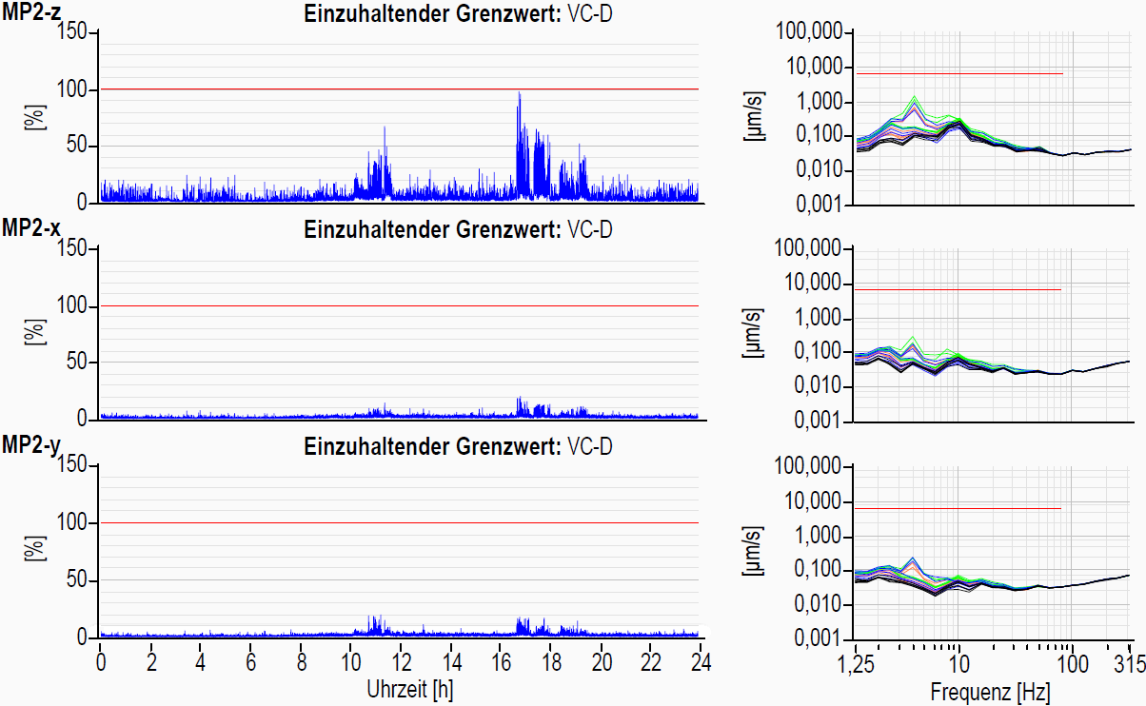
Sunday 21st Aug.

Slide 13
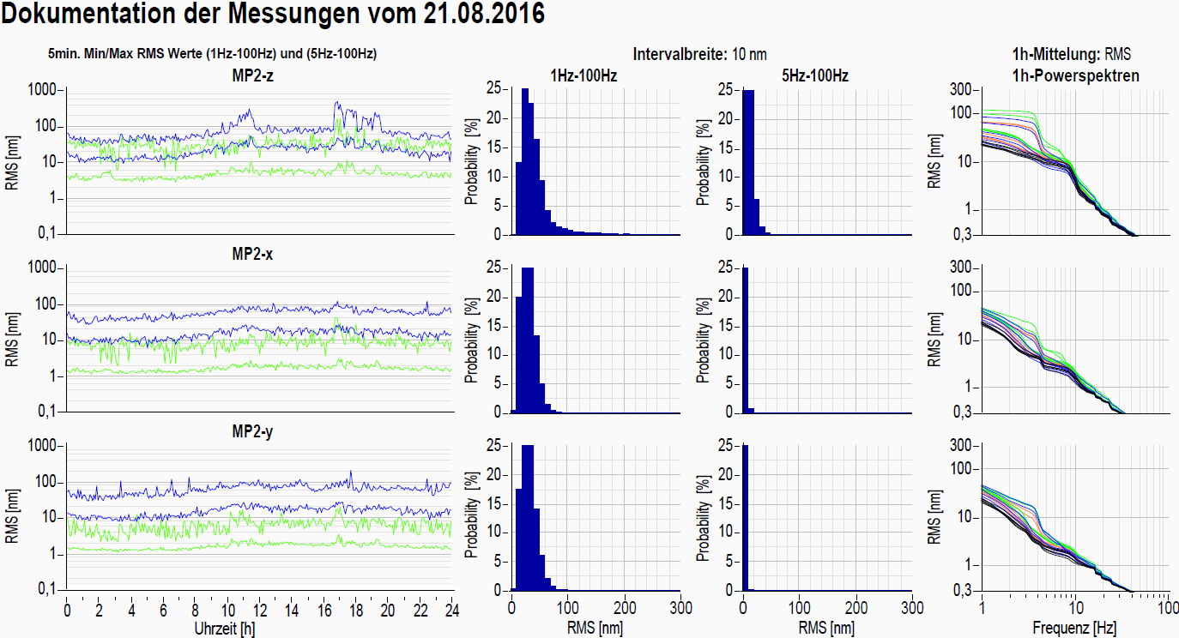
Sunday 21st Aug.

Slide 14
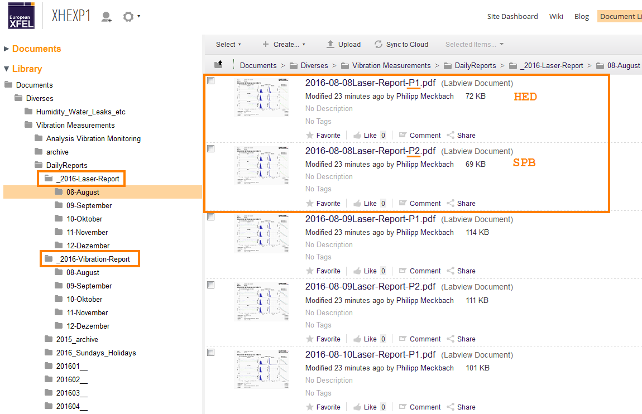
Data storage on alfresco …

