Slide 1


Publish or Perish
@ DESY
DESY Libraries
Dr. Martin Köhler
ORCiD: 0000-0003-0617-3319
If I have seen further it
is by standing on the
shoulders of giants.
Sir Isaac Newton
Text:

Slide 2



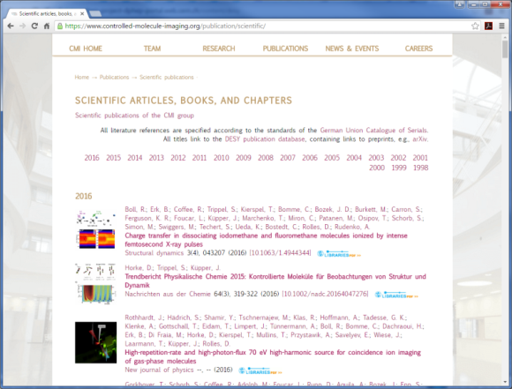
Options?
How to make your research visible
DESY Publications
  Reports
  Thesis
  Books
  Proceedings
Journal publications
  Open Access (Gold & Green)
  Hybrid
  Closed Access
Institutional Repository
  Collaboration, publication lists, Websites
  http://pubdb.desy.de
More Information from the library:
l.publishing@desy.de
Hybrid

Slide 3
DESY Publications
DESY is an (Open Access) publisher since 2001 and has the right to assign ISB-Numbers (ISBN)
Red Report (Preprint), Thesis
  Contact the library l.publishing@desy.de for the corresponding number
  Fill out and send permission form (See http://library.desy.de/publicationsdesy/)
  Submit fulltext to the DESY publication database (http://pubdb.desy.de) and to http://arXiv.org
  Use a CC-BY license for best re-usability (NOT CC-BY-NC!) if possible
  Questions: l.publishing@desy.de
  → Open Access Publication
  You can additionally submit your publication to a journal
Books, Proceedings
  Contact the library l.publishing@desy.de

Slide 4
Journal Publications
You must ask for permission before submitting to a journal
(DESY Publication rules: Link at http://library.desy.de/publicationsdesy/)
The DESY Directorate asks all scientists to preferable publish in Open Access Journals (http://library.desy.de/open_access/)
Open Access Publications in hybrid journals are not encouraged
For subscription journals (Closed access)
  Do not simply sign the copyright transfer agreement !
  Make sure to keep your rights for your own figures, pictures, … by using a CC-BY license.
  State this explicitly in your paper: „All figures, … by the author under a CC BY license”
  Elsevier has a „short license agreement“ that they provide on request
  (contact oxfordcopyrights@elsevier.com or the library l.publishing@desy.de)
  Use your right to make your own version(s) e.g. the „Post-referee version“ publicitly available in the publication database
Submit your publication to the DESY publication database (http://pubdb.desy.de) including fulltexts (your own for the public and the publisher version for internal use only)

Slide 5
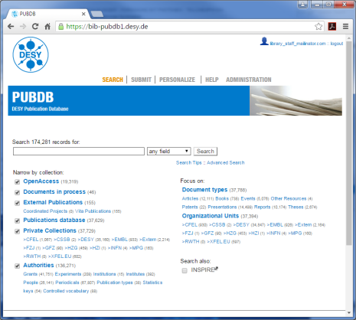


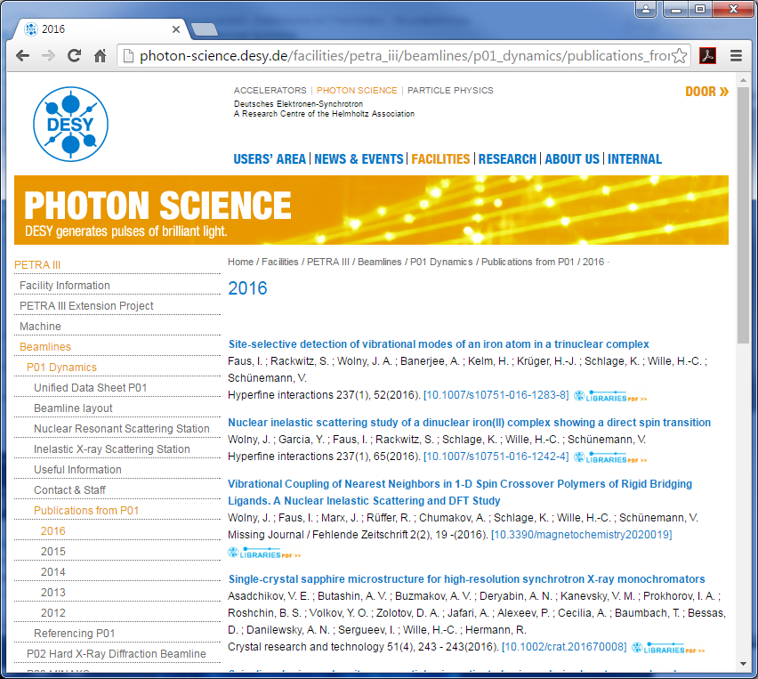
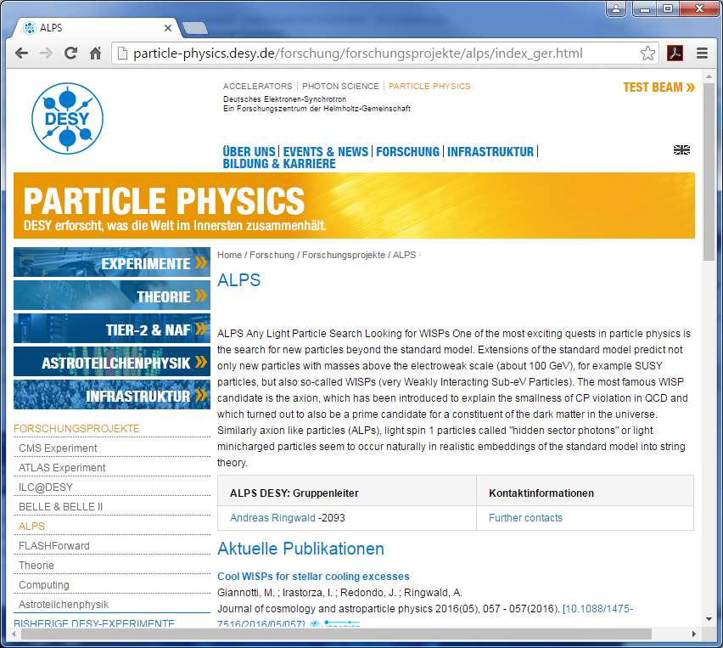
Institutional Repository
Preserve your scientific research output and make it visible
  DESY Publication Database (PUBDB http://pubdb.desy.de)
  OpenAire Validated
  Indexed in Base
  ORCiD for authors
  HGF Reporting
  Plug-In for web pages
  Part of JOIN², a collaboration of
  DESY, DKFZ, FZJ, GSI, MLZ, RWTH (http://join2.de)
ORCiD

Slide 6

Need more Information?
Do not hesitate to contact the library for further information or in case of questions
Maren Stein
l.publishing@desy.de
Martin Köhler
Kirsten Sachs
Robert Thiele
Alexander Wagner

Slide 7

Thank You

