Slide 1
Particle Physics @ DESY
DESY FH Fellow Day
Thomas Schörner-Sadenius
29 November 2016

Slide 2
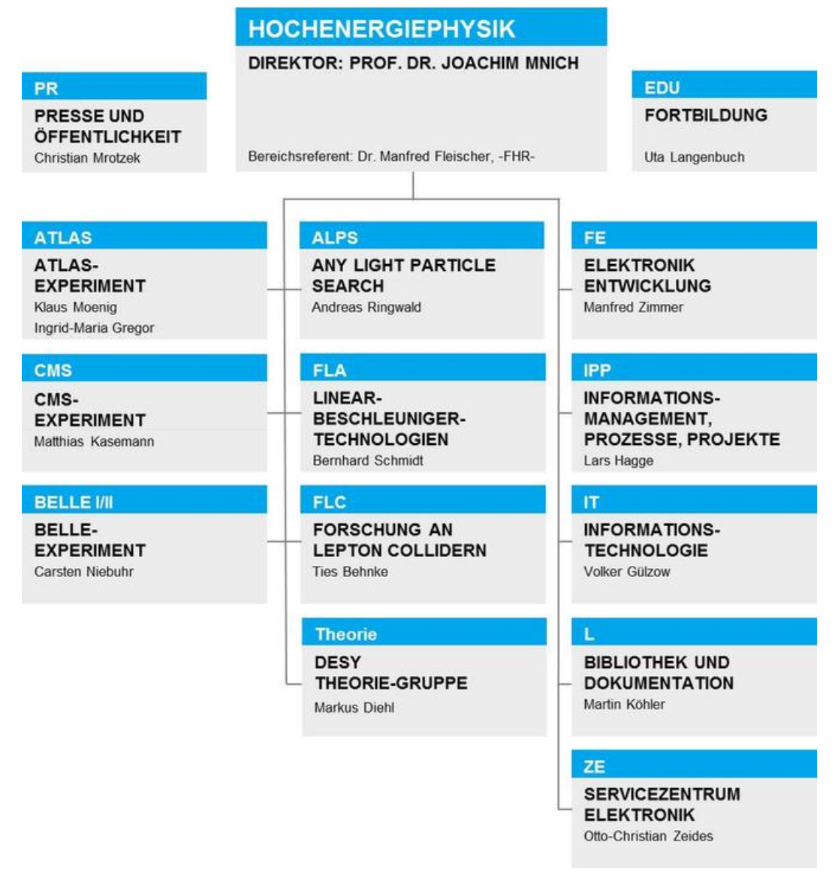
DESY FH
> 400 heads
> About 25 MEUR / year
> + 3. party funds

Slide 3

DESY FH in Helmholtz
GEOMAR | Helmholtz-Zentrum für Ozeanforschung Kiel
Deutsches Elektronen-Synchrotron DESY
> 18 research centers
> 33600 staff
> 2,4 Bn €
Alfred-Wegener-Institut Helmholtz-Zentrum für
Polar- und Meeresforschung
Helmholtz-Zentrum Geesthacht Zentrum für Material- und Küstenforschung (HZG)
Max-Delbrück-Centrum für Molekulare Medizin (MDC)
Helmholtz-Zentrum für Infektionsforschung
Helmholtz-Zentrum
Potsdam - Deutsches GeoForschungsZentrum GFZ
Helmholtz-Zentrum Berlin für Materialien und Energie
Forschungszentrum
Jülich (FZJ)
Helmholtz-Zentrum für Umweltforschung – UFZ
Deutsches Zentrum für
Luft - und Raumfahrt (DLR)
Helmholtz-Zentrum
Dresden-Rossendorf (HZDR)
Deutsches Zentrum für Neurodegenerative Erkrankungen (DZNE)
GSI Helmholtzzentrum für Schwerionenforschung
Deutsches Krebsforschungszentrum
Karlsruher Institut für Technologie (KIT)
Max-Planck-Institut für Plasmaphysik
Helmholtz Zentrum München – Deutsches Forschungszentrum für Gesundheit und Umwelt

Slide 4
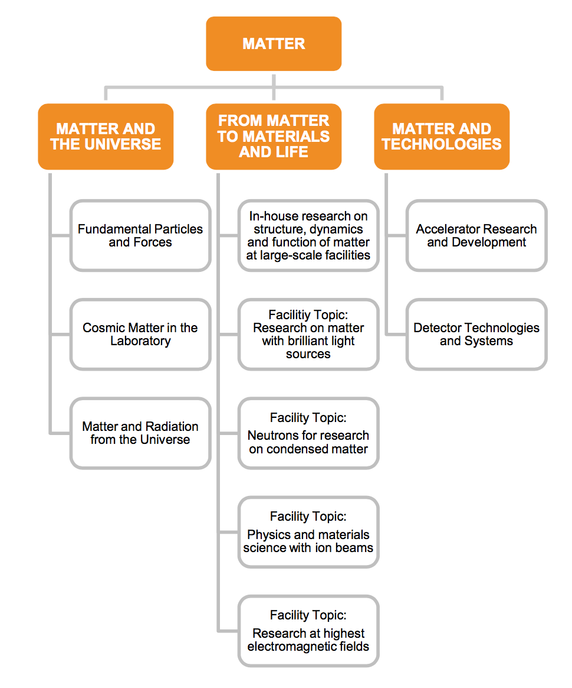
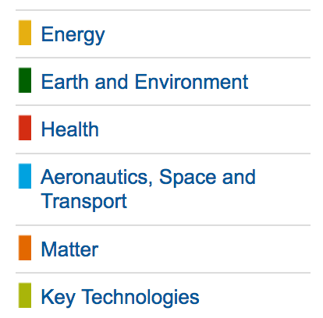
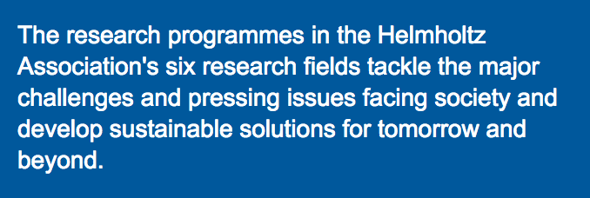
DESY FH in Helmholtz

Slide 5
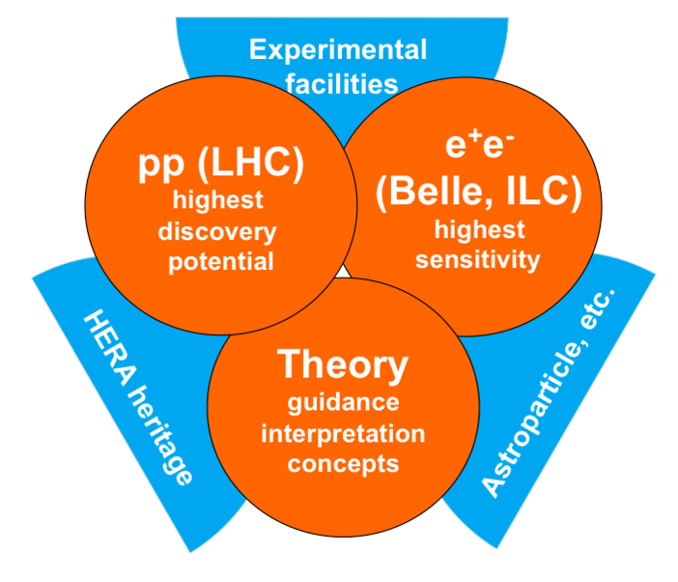

DESY Particle Physics Strategy: POF 3
DESY Strategy in line with national and European roadmaps, and building on core competencies. Topic structure:
Close interaction with many universities –
role as national lab (e.g. Terascale alliance)
We live in (currently) 5-year funding periods (POF – programme-oriented funding)

Slide 6
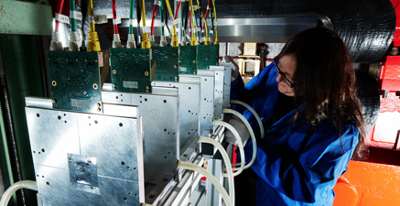
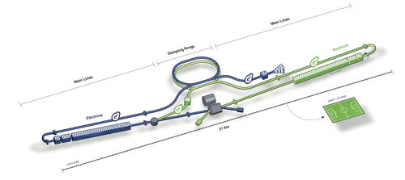
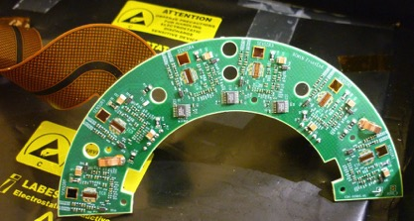

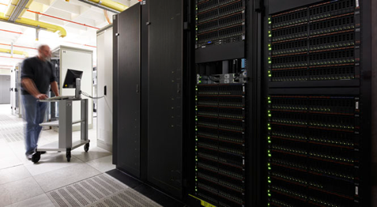
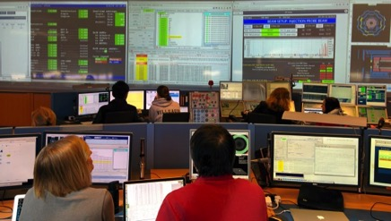
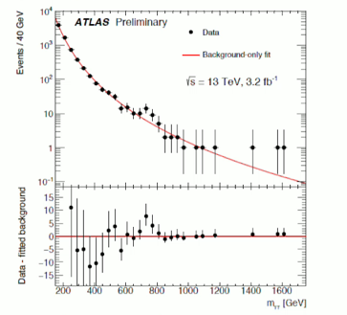
FULL LIFECYCLE COMPETENCE
Development
Conception
Design
Construction
Data
Preservation
Operation
Physics
analysis
Interpretation

Slide 7
DESY FH Fellow Programme
Experimental:
  Two rounds per year (31 March, 30 September)
  Each round 50-75 applications
  (~25% female scientists)
  Typically 7-8 accepted per round
  (larger fraction of female scientists)
  Free choice of groups and activities
  Theoretical:
  One round per year (deadline 1 December)
  About 500 applications (10% female scientists)
  Typically up to 10 accepted (currently high level
  because of third-party funding);
  typically about 20% female scientists
  Both experimental and theoretical:
  Wide mixture of nationalities
  Almost unique opportunity to round off CV
  Excellent career “boost”
My guess: altogether
about 50-60 fellows at
DESY at a given time.

Slide 8
Aim of the Meeting
> Get to know each other
> Get an overview of experimental + theoretical activities at DESY
> Prepare for future common activities
> Start forming a supportive network
Veeeery strict time limit: 12 minutes!

Slide 9
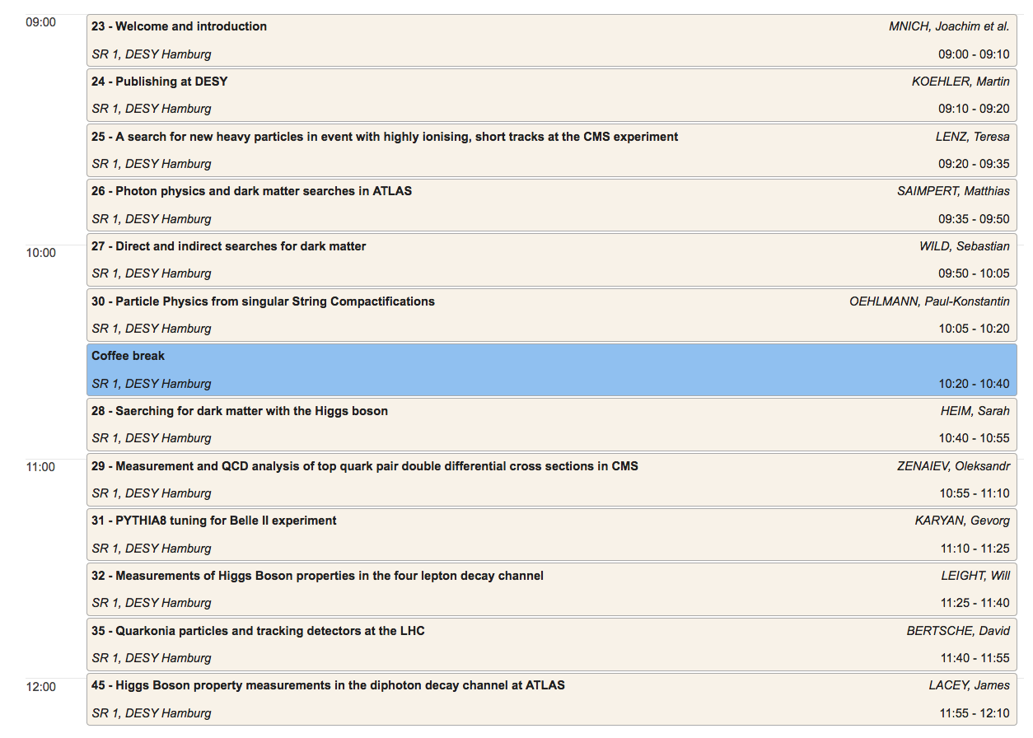
Agenda (1)

Slide 10
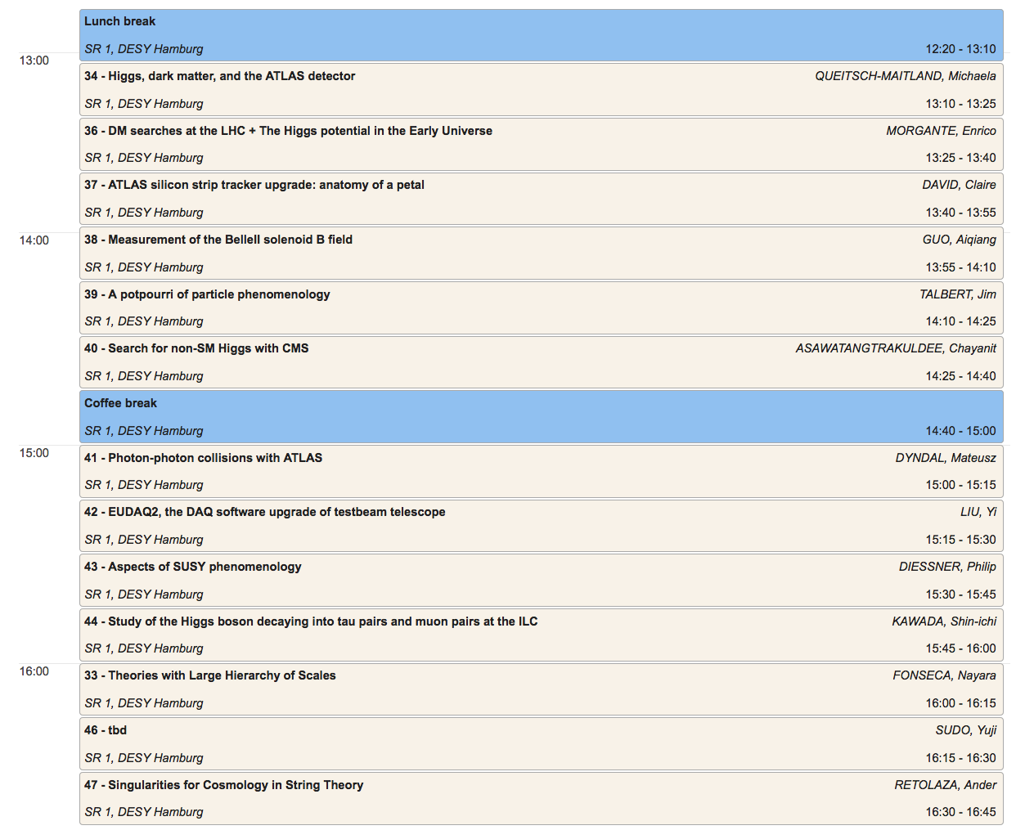
Agenda (2)

