Slide 1
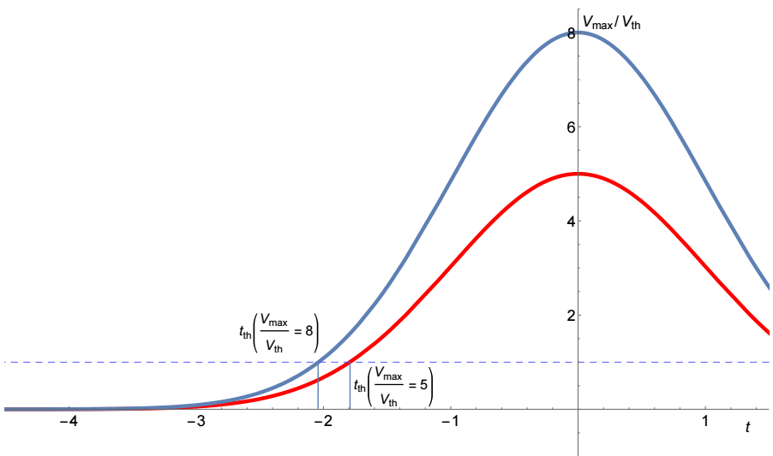
Hands-on tutorial:
Measurement of time of arrival
Requirments:
Bring your laptop!
Basic knowledge of C / C++
Working installation of root (any OS)
Comparison between different algorithms to compute the arrival time using sampled signals.
Starting from a simple threshold crossing, the time precision can be improved implementing a smarter discriminator (hysteresis, peak selection, interpolation, ... ) and time walk corrections (Constant Fraction, ... )
Real data acquired in a beam test will be used.
nicola@cern.ch
Nicola Minafra, University of Kansas
5th Beam Telescopes and Test Beams Workshop 2017, Barcelona
24-27 January 2017

Slide 2
http://nminafra.web.cern.ch/nminafra/barcelonahandson/
Barcelona_HandsOnTiming.root
Barcelona_HandsOnTiming_start.C
Barcelona_HandsOnTiming_out.root
Barcelona_HandsOnTiming.C
Data file
Starting point: opens the root file and create histograms with various algorithms <- empty!
Example of output file
Example of complete code (don’t cheat!)

Slide 3
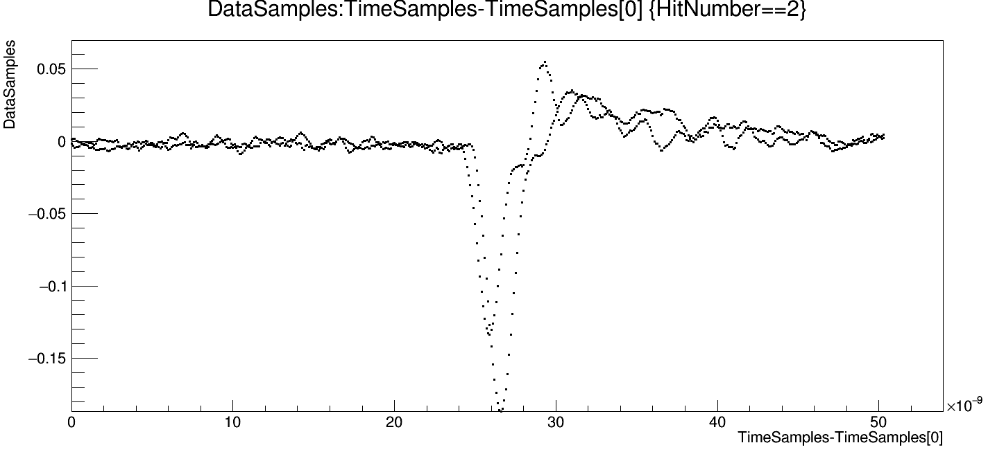
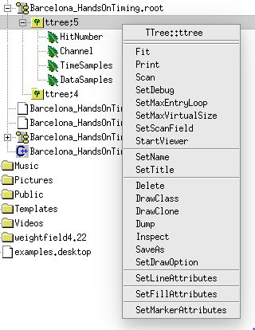
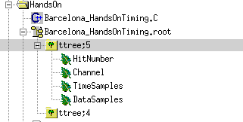
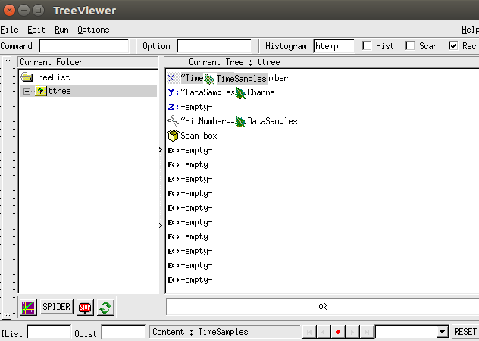
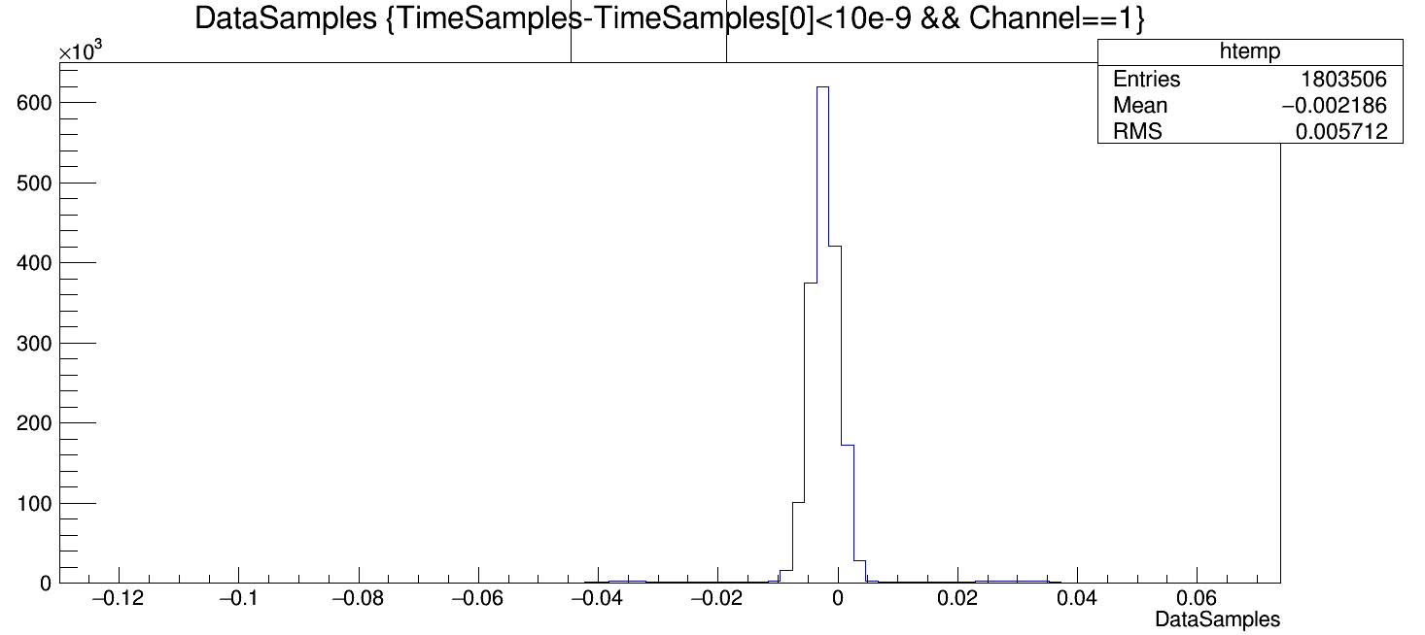
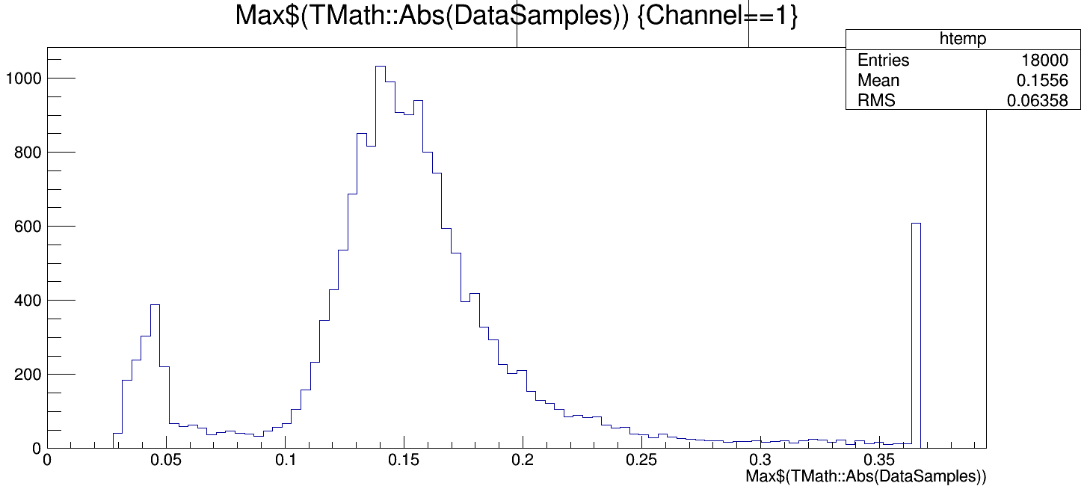
Barcelona_HandsOnTiming.root

