Slide 1
High-resolution tracking and timing based on HADES scCVD diamond sensors for detector tests - test of PADI for straw tube readout
J. Pietraszkoª, T. Galatyuk ^{b}, W. Koenigª, M. Trägerª, M. Kisª, C.J.Schmidtª
ª GSI Helmholtz Centre for Heavy Ion Research GmbH Planckstrasse 1, D-64291 Darmstadt, GERMANY
^{b} Technische Universität Darmstadt, Darmstadt, Germany
Outline
A short introduction to the HADES experiment
ScCVD diamond detectors used for MIPs in HADES
Performance of a segmented scCVD diamond utilized as a reference detector
in a straw tube test setup

Slide 2
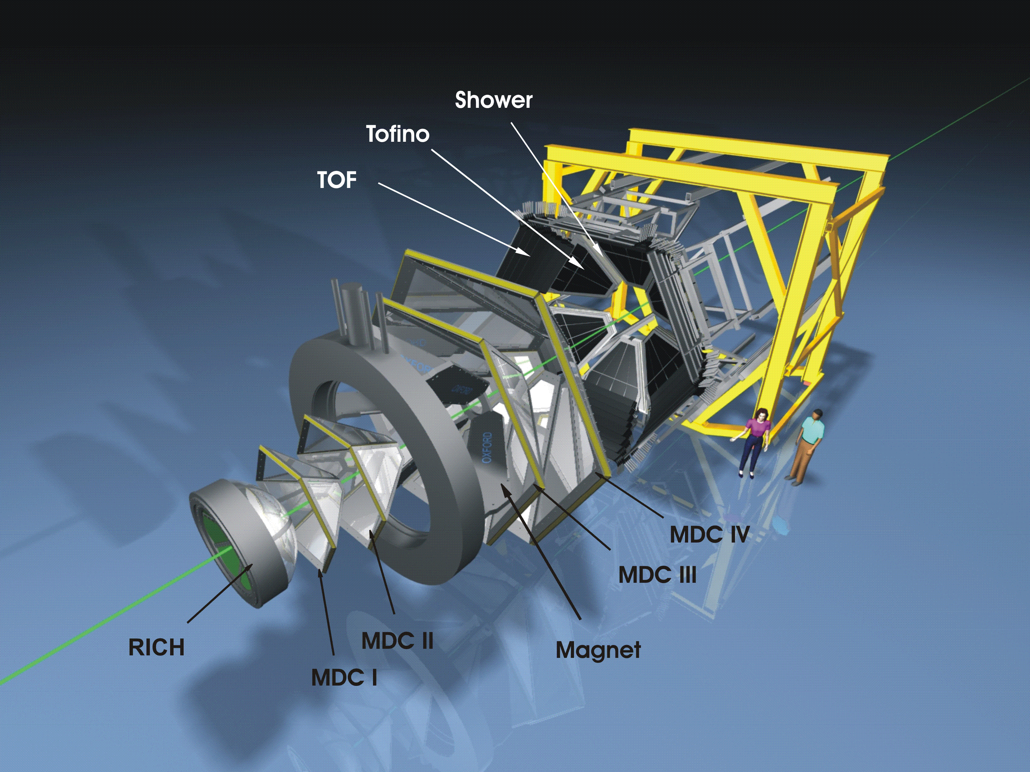
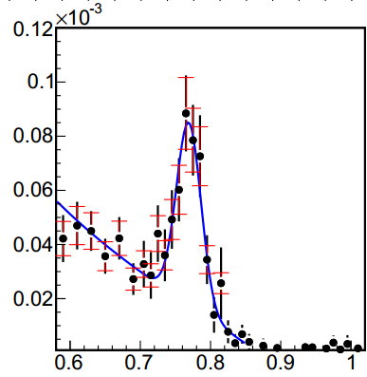
Experimental apparatus: HADES (The High-Acceptance Di-Electron Spectrometer)
Eur.Phys.J. A48 (2012) 64
p(3.5 GeV) + p
σ/M_{ω}≈2%
Diamond T0 detector
ω→e⁺e–
Geometrical acceptance: 2π in φ; 18 ⁰ < θ < 85 ⁰
Di-electron pair acceptance ≈ 35 %
low mass spectrometer
─ RICH: X/X₀ < 1%
─ MDC: X/X₀ ≈ 0.42%
σ_{M}(ω) ≅ 2.0%
Systematic di-electron and strangeness measurements in heavy ion, proton and pion induced reactions. Beams from SIS18 and SIS100 at FAIR (GSI Darmstadt, Germany)
Notes:
2

Slide 3
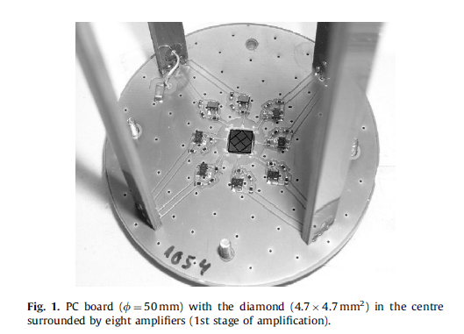
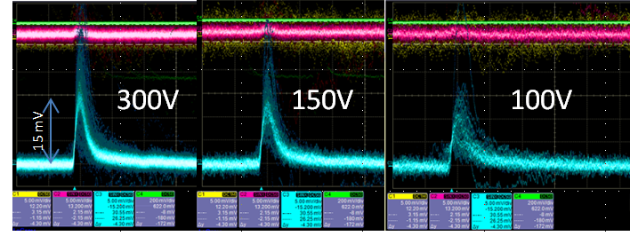
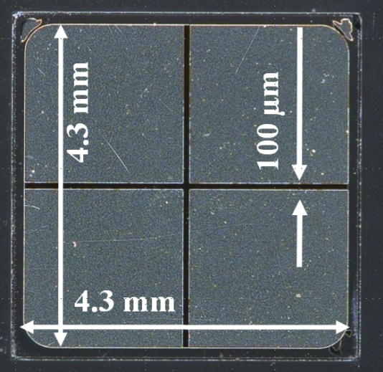
scCVD diamond start detector for MIPs
The key features:
4.5 mm x 4.5 mm x 0.3 mm scCVD high purity diamond material
Thickness of 300 µm , low Z
In vacuum operation, without cooling, noise free ...
Superposition of about 50 waveforms
Jülich (COSY), p@2.95 GeV
→ excellent ADC capabilities and S/N ratio
Diamond T0 detector for pion beam – active area 1.2 cm x 1.2 cm
single plate of scCVD diamond
Notes:
3
nucleus

Slide 4
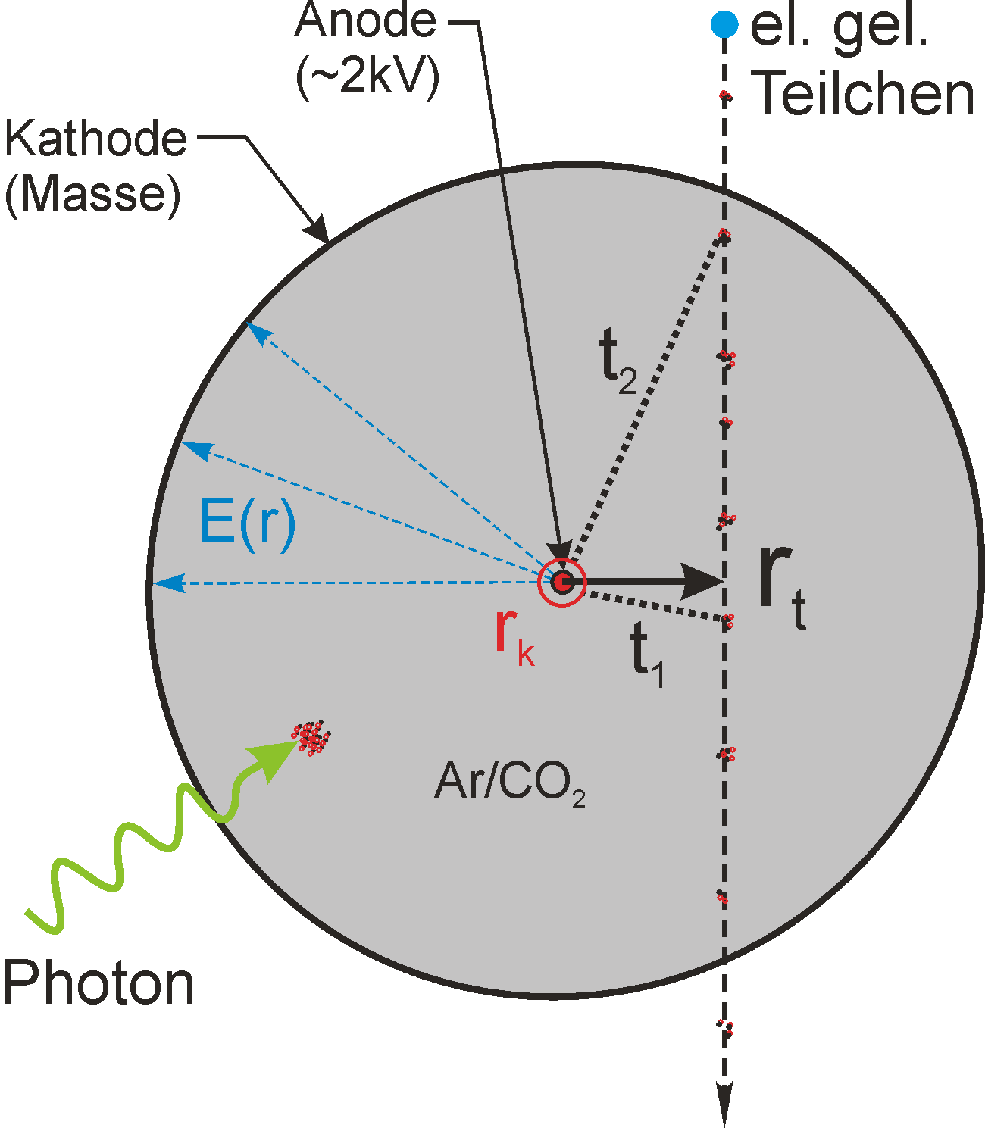
Aim of the test: can the PADI chip be used for straw tube readout ?
PADI6 ASIC for straw tube readout
(M. Ciobanu, m.ciobanu @ gsi.de)
4 channel per ASIC, differential inputs 8 channel on FEET-PADI6_Hda
conversion gain: 35(17.5*)mV/fC
voltage gain: 244
BW: 416MHz
time constant in setup: ~20ns
Straw tube detector
CBM MUCH prototype 6mm diameter, ~22cm length
detector gas: Ar/CO₂ (70/30)
gas pressure: 1bar
HV: 1800V
AC coupling to PADI input: 400pF(straw), 2.2nF(PCB)
Needed a reference detector:
Position resolution below 50 µm
Time resolution better 100 ps
Single particle mode for MIPs
scCVD diamond utilized as a reference detector

Slide 5
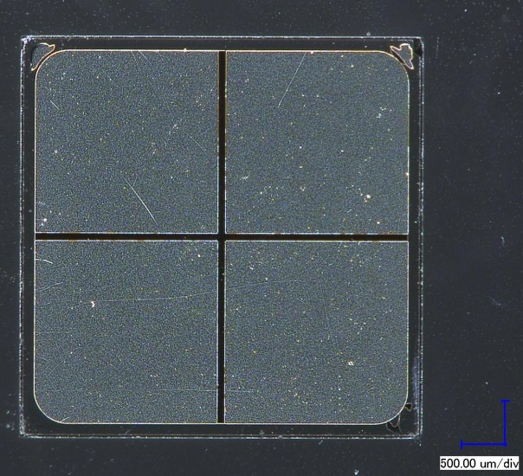
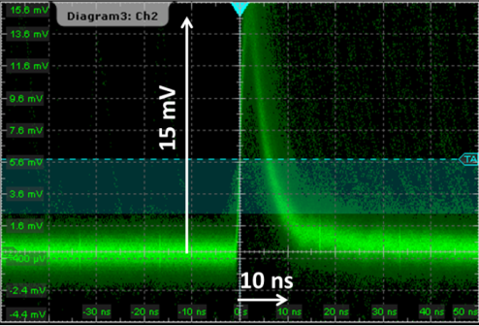
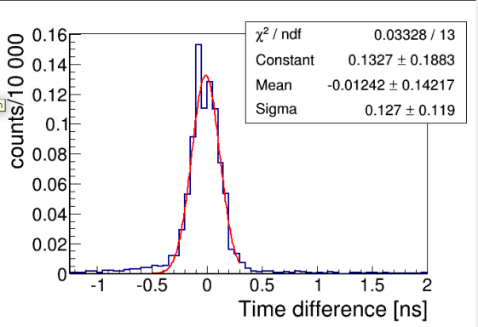
Experimental setup – reference detector
Reference, tracking, scCVD detector
scCVD diamond signal for MIPs
4.3 mm
100 µm
4.3 mm
four channels – metallization
100µm space between electrodes
time resolution below 100 ps
p@ 2.95 GeV
Used threshold: 7mV on each channel
AND condition between 2 channels
→ position resolution better than 50µm
σ ≈ 90 ps

Slide 6
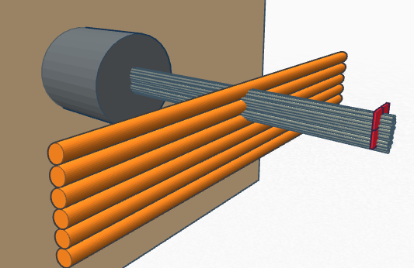
Experimental setup
www.tinkercad.com
Reference, tracking, scCVD detector
beam pipe
p@2.95GeV
4.3 mm
100 µm
Straw tubes,
Φ = 6mm
p beam
Straw tubes
4.3 mm
scCVD diamond
Diamond detector
Four channels – metallization
100µm space between electrodes
Time resolution below 100 ps
Attached to a movable table,
(µm step precision)
Straw tubes connected to the PADI v6
Straw diameter: 6 mm
Ar/CO₂: 70%/30%
HV: 1800 V
DAQ /Trigger:
Oscilloscope used as a DAQ (R&S 1044)
Correlated signal in two diamond electrodes used as a trigger
Trigger: protons in the 100µm gap between electrodes.

Slide 7
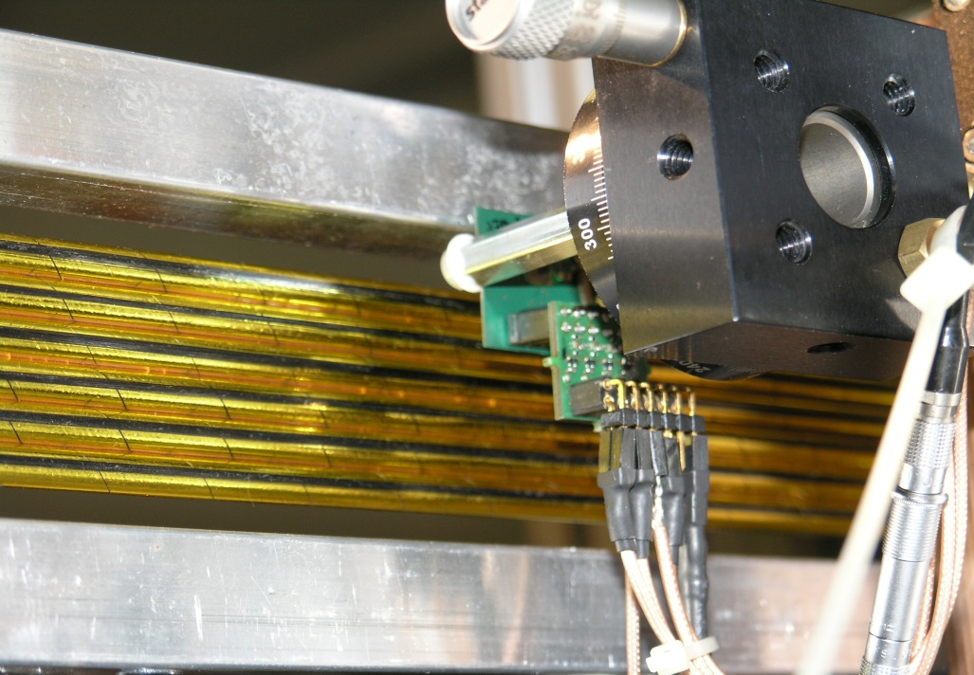
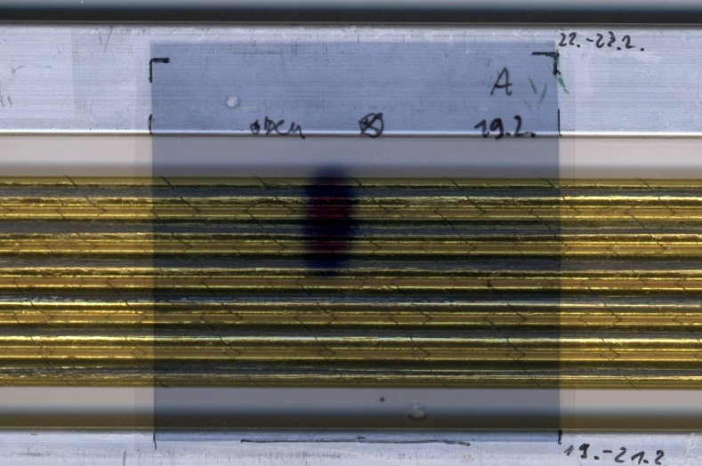
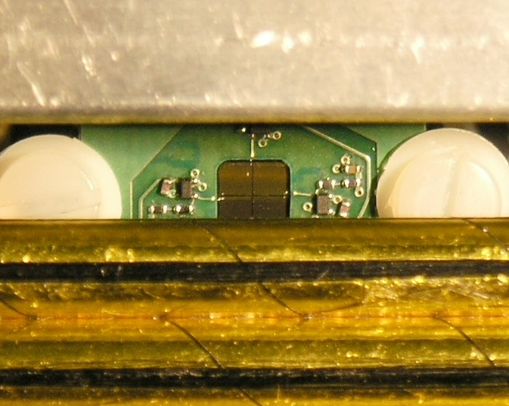
Experimental setup
www.tinkercad.com
beam pipe
p@2.95GeV
p beam
Straw tubes,
Φ = 6mm
p beam
Straw tubes, Φ=6 mm
scCVD diamond
scCVD diamond detector
mounted on movable table (±1µm)
www.tinkercad.com
Real beam spot – Jülich beam time

Slide 8
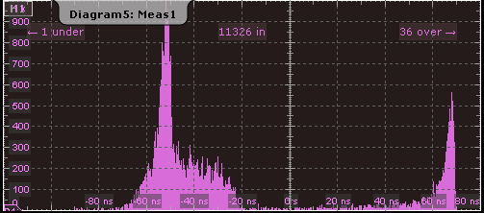
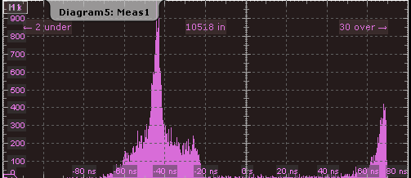
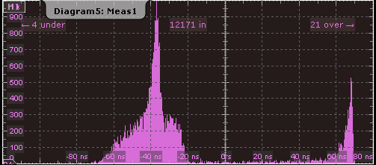
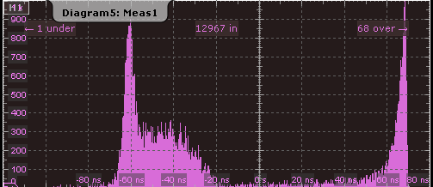
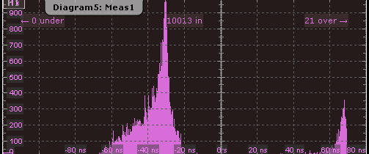
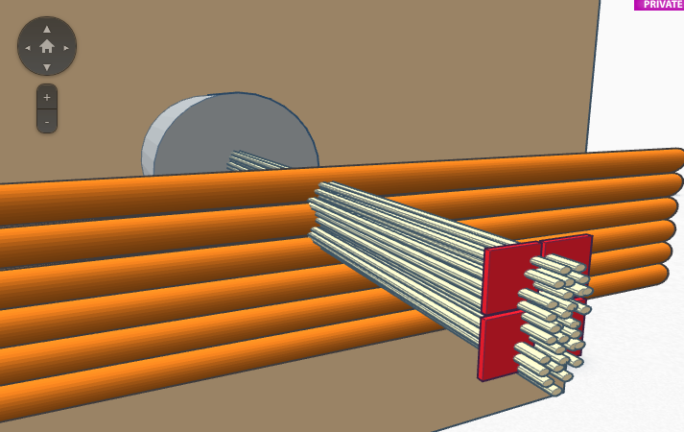
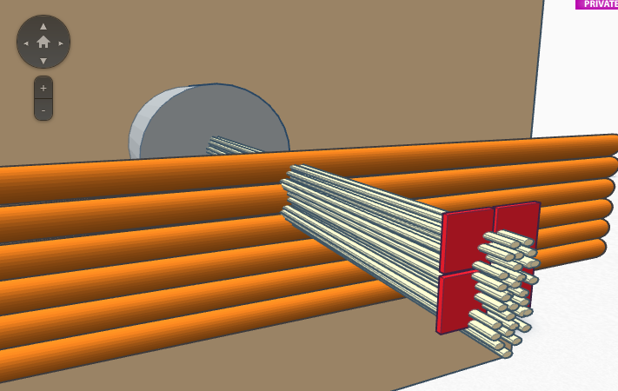
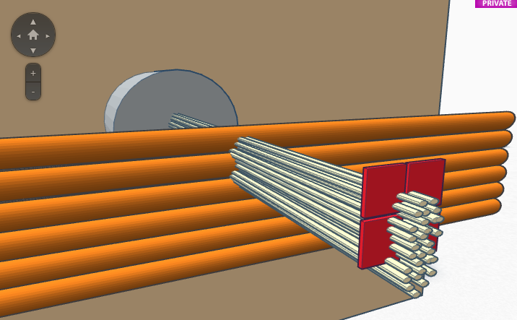
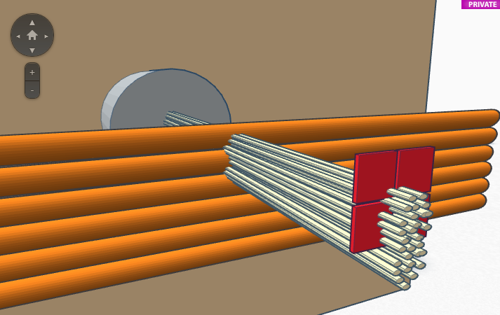
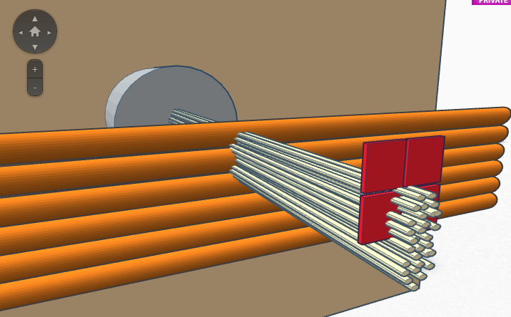
Drift time measurement
Time difference between the scCVD diamond detector
and Straw Signal from the PADI discriminator.
→ Drift time spectra (example for 5 positions)
+0.0mm
+1.0mm
+0.5mm
+1.5mm
+2.0mm
www.tinkercad.com
Straw tube
beam particles

Slide 9
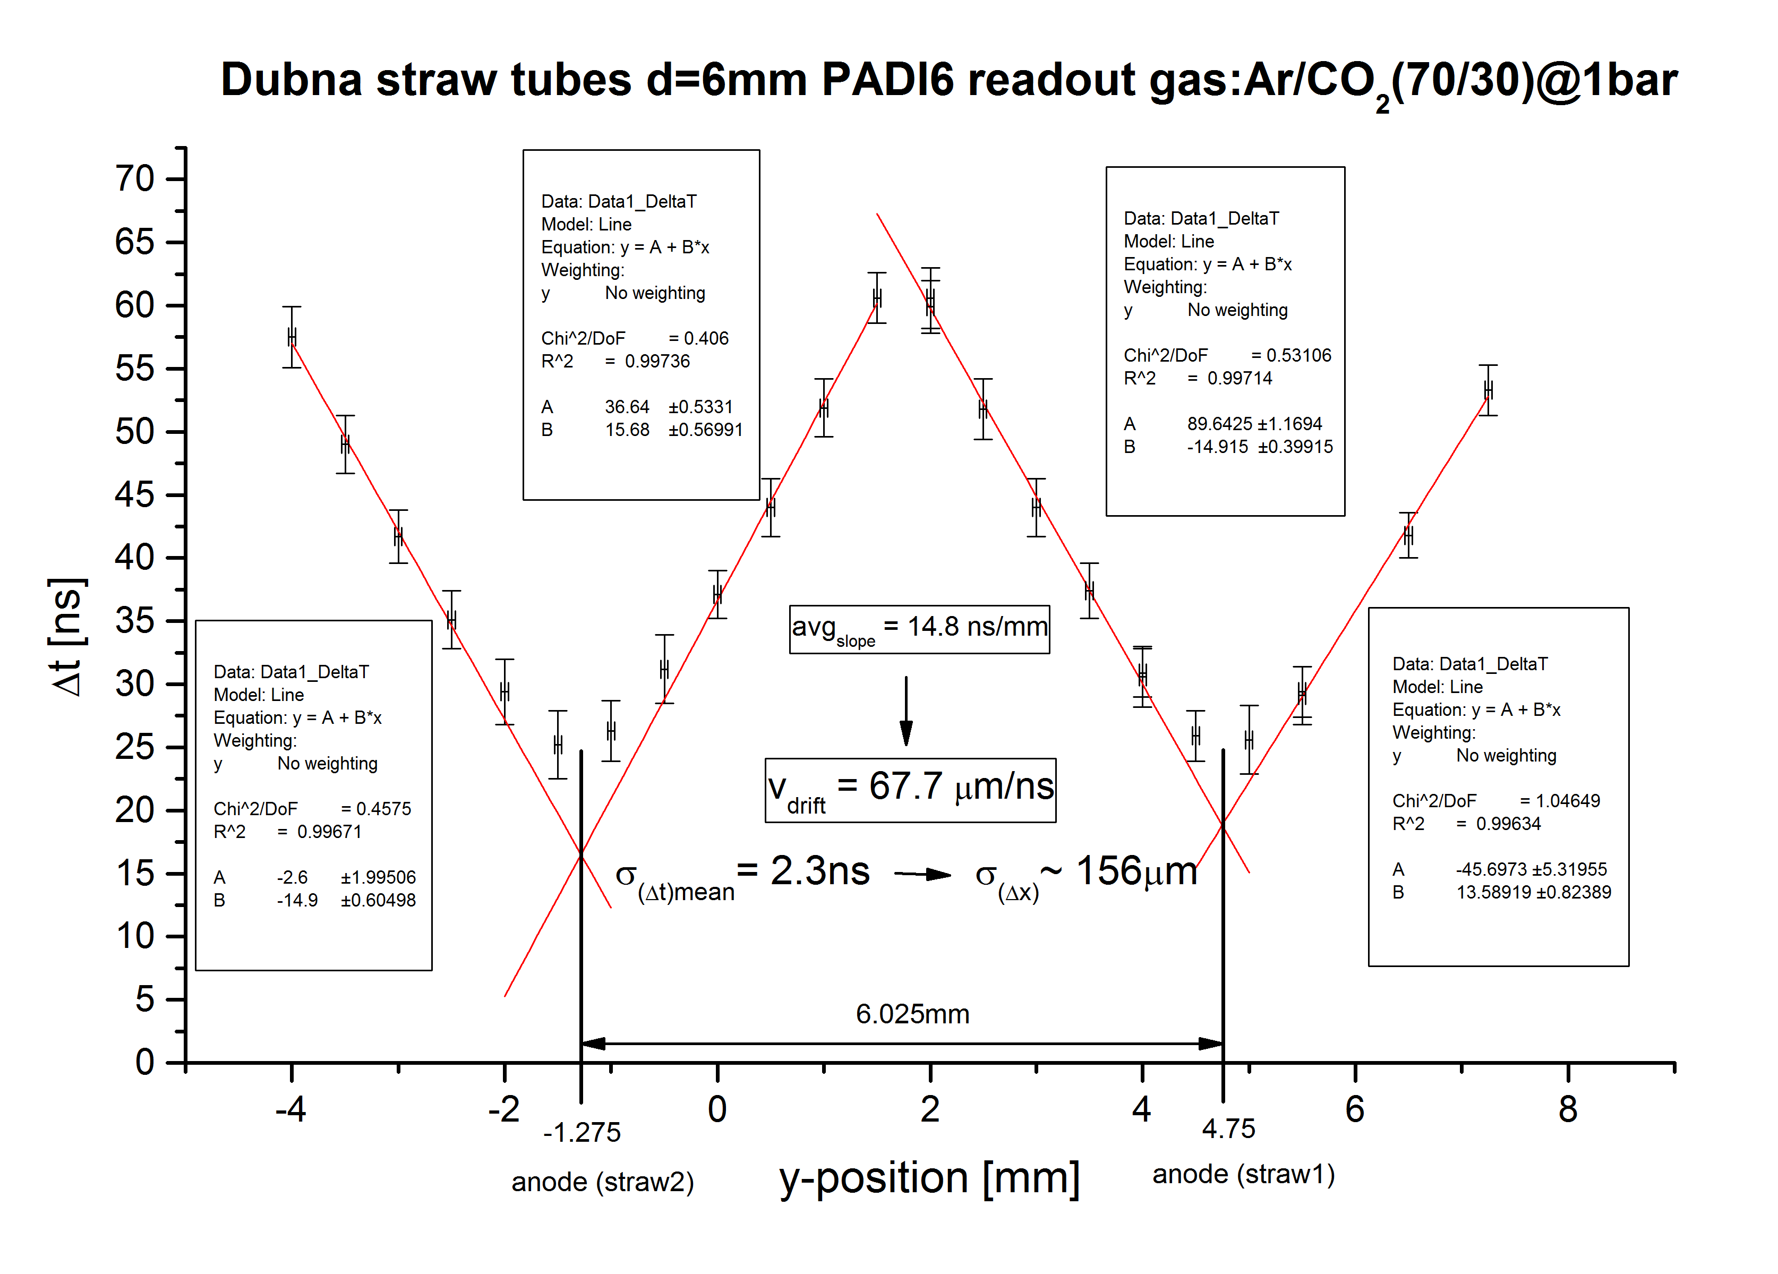
Drift velocity estimation

Slide 10
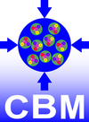
Summary
Simple, segmented scCVD diamond with precise timing and positioning of MIPs
Rate capability up to 10 ⁷ particles / s
Time precision < 100 ps (sigma) for both MIPs and HI
Position information better then 50 µm, can be improved by increasing the bias voltage
Simple construction and robust device
Powerful device for detector tests – timing and tracking

Slide 11
Thank you

