Slide 1
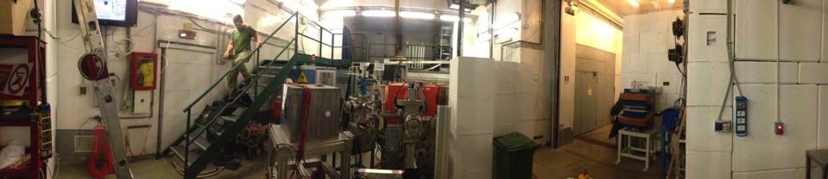
DAΦNE BTF improvements of the transverse beam diagnostics
http://www.lnf.infn.it/acceleratori/btf/
Bruno Buonomo¹, Luca Foggetta¹, Claudio Di Giulio¹, Paolo Valente²
1 INFN Laboratori Nazionali di Frascati
2 INFN Sezione di Roma

Slide 2
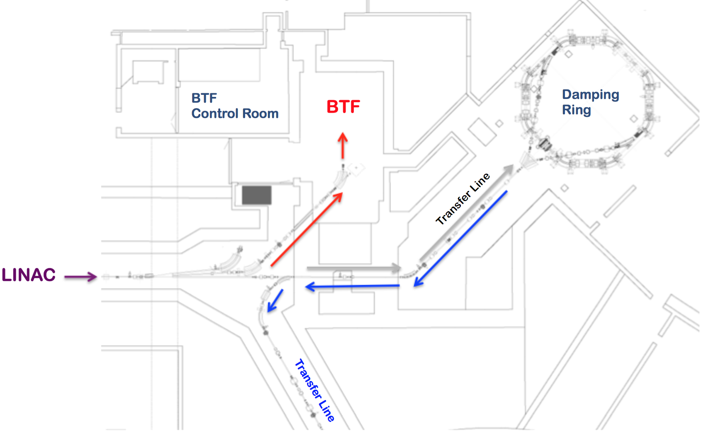
BTF in the DAΦNE
The BTF (Beam Test Facility) is part of the DAΦNE accelerator complex:
it is composed of a transfer line driven by a pulsed magnet allowing the diversion of electrons or positrons

Slide 3
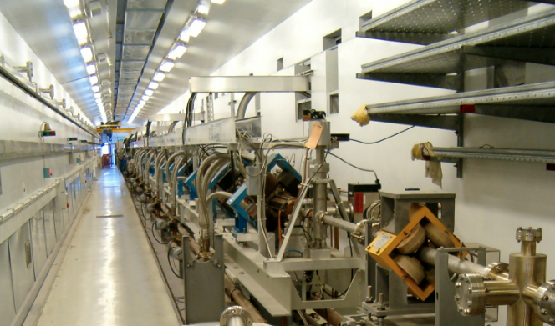
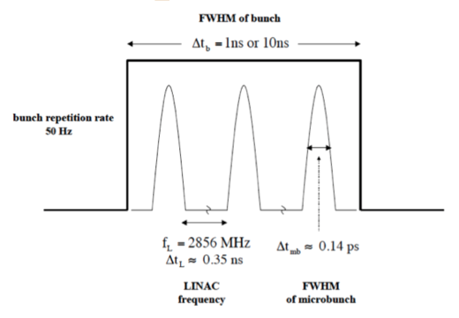
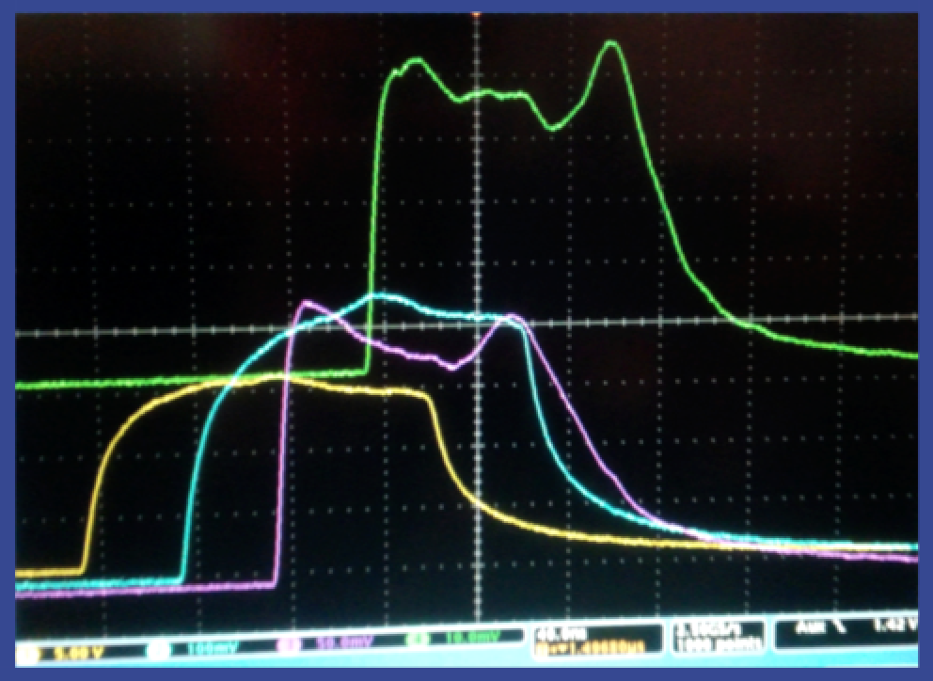
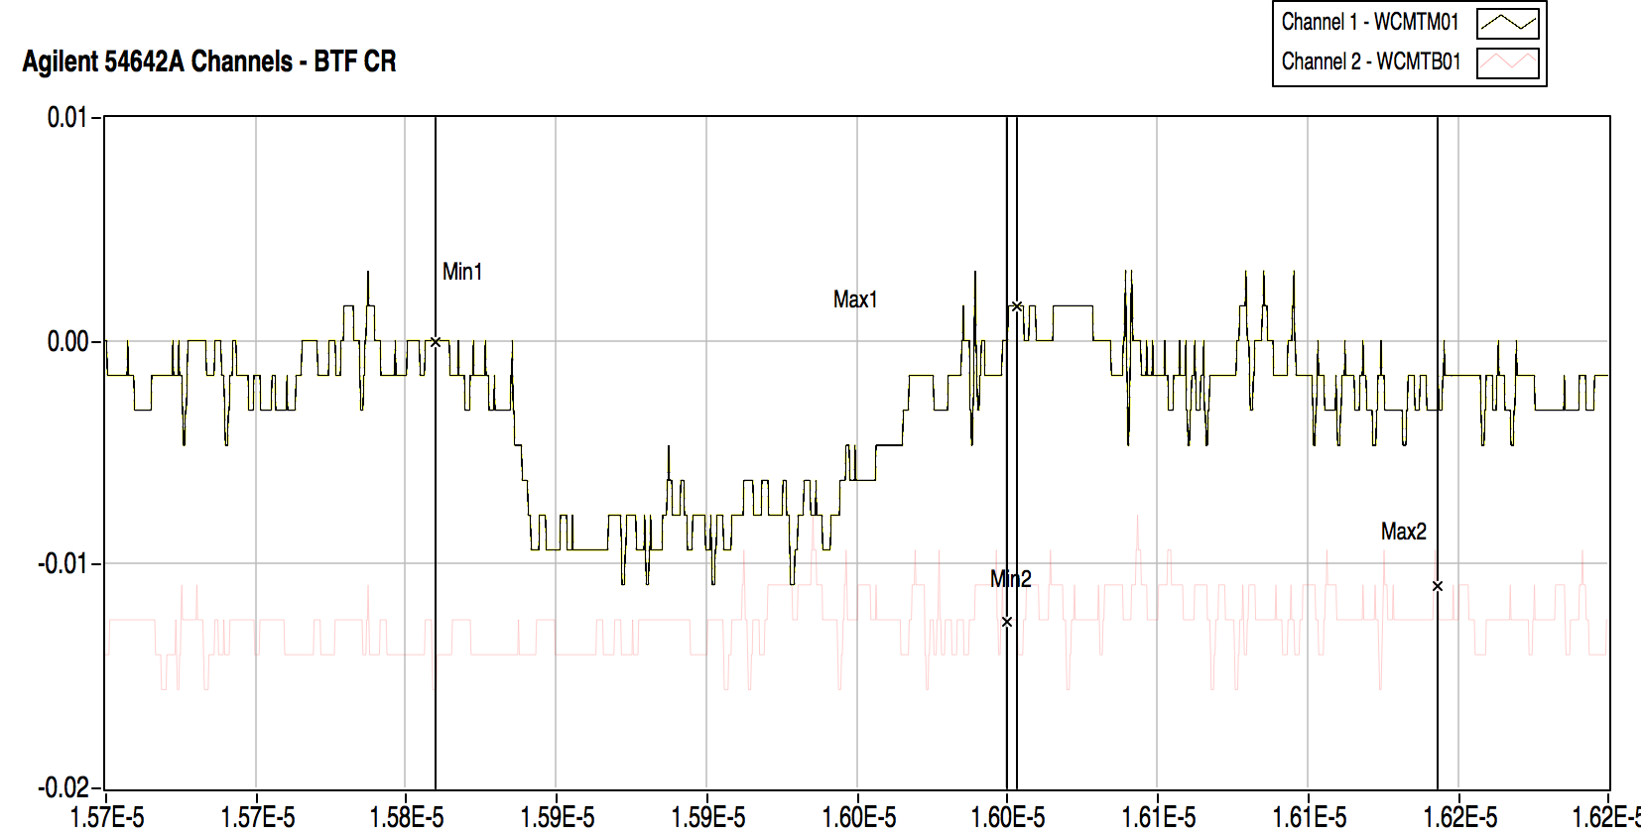
LINAC
 | Design | Operational
Electron beam final energy | 800 MeV | 510 MeV
Positron beam final energy | 550 MeV | 510 MeV
RF frequency | 2856 MHz
Positron conversion energy | 250 MeV | 220 MeV
Beam pulse rep. rate | 1 to 50 Hz | 1 to 50 Hz
Beam macropulse length | 10 nsec | 1.4 to 40 nsec
Gun current | 8 A | 8 A
Beam spot on positron converter | 1 mm | 1 mm
norm. Emittance (mm. mrad) | 1 (electron) 10 (positron) | < 1.5
rms Energy spread | 0.5% (electron) 1.0% (positron) | 0.5% (electron) 1.0% (positron)
electron current on positron converter | 5 A | 5.2 A
Max output electron current | >150 mA | 500 mA
Max output positron current | 36 mA | 85 mA
Trasport efficiency from capture section to linac end | 90% | 90%
Accelerating structure | SLAC-type, CG, 2π/3
RF source | 4 x 45 MWp sledded klystrons TH2128C
TITAN Beta (Ca,USA) 1995
S band LINear ACcelerator ~60 m long
Termoionic gun, 4x45 MW klystrons SLED 15 waveguide 2/3π SLAC type section 3m long.
Upgrade pulse width: ~ 150 ns

Slide 4
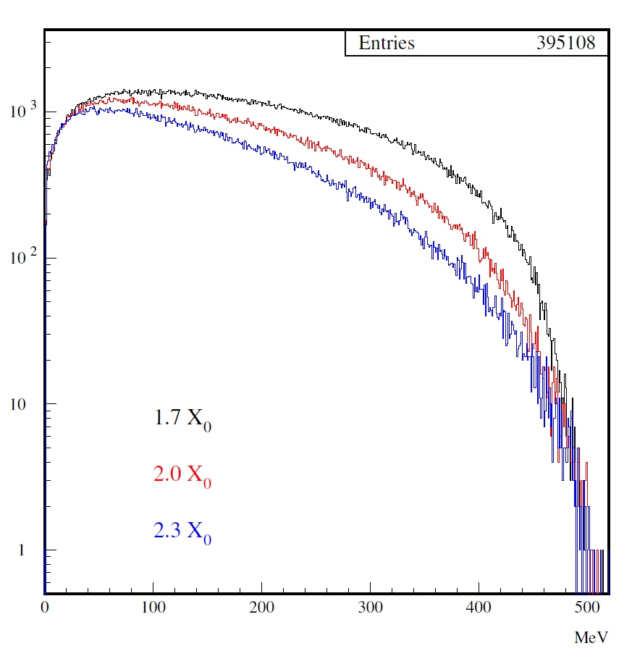
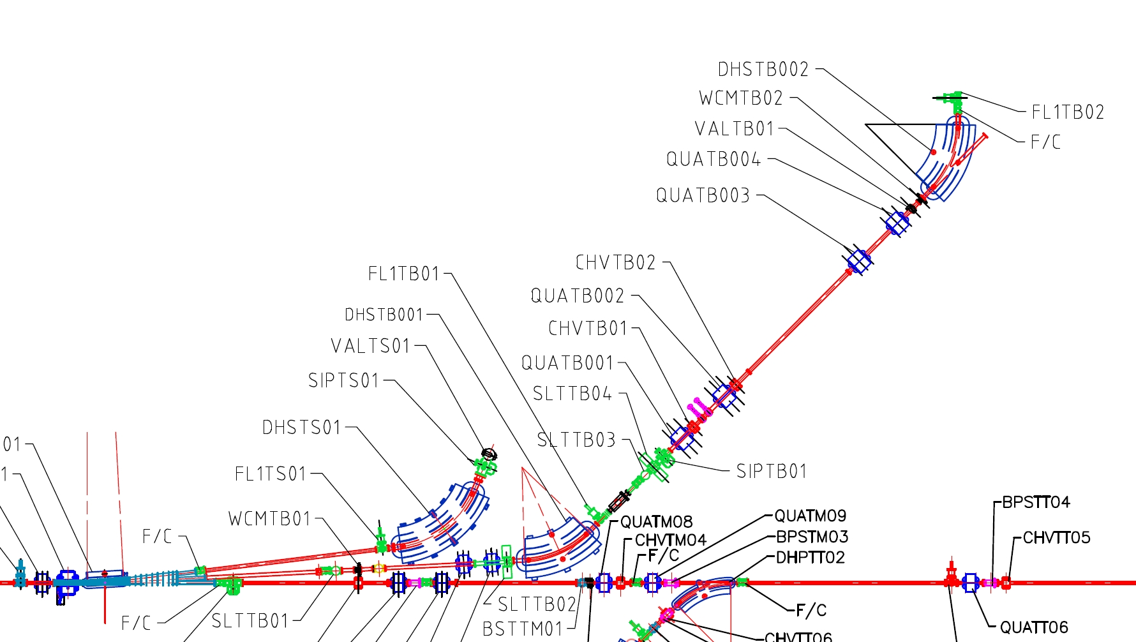
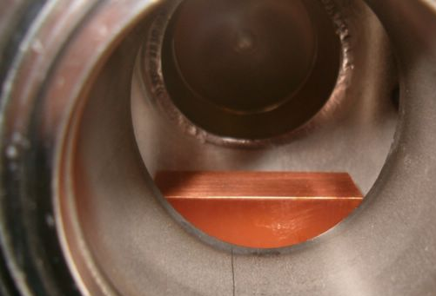
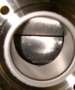
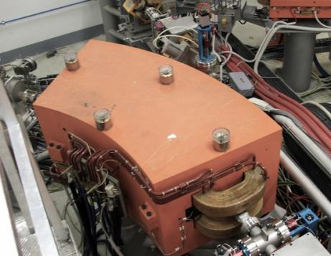
How the BTF works:
The primary beam collide ≈2x₀, Cu produce a secondary beam
#
10¹⁰
Sim. 10⁸
∫∫
BTF
Exp. Hall
510
Energy [MeV]
e⁻/e+
Linac

Slide 5
The Beam-Test Facility
  The users in BTF are able to know in real time the beam parameter (type of particle, energy, intensity, dimension and position).
  They have the accelerator complex services available for their setup: power supply, network, gas, DAQ, Vacuum staff, cryogenic.
Usually BTF works in parasitic way respect to DAΦNE collider.
Parametri | Parasitic |  | Dedicated
 | With Cu target | Without Cu target | With Cu target | Without Cu target
Particle | e⁺ or e⁻ (User ) | e⁺ or e⁻ (Dafne status) | e⁺ or e⁻ (User )
Energy (MeV) | 30–500 | 510 | 25–700 (e⁻/e⁺) | 250–730 (e⁻) 250–530 (e⁺)
Energy Resolution | 1% at 500 MeV | 0.5% | 0.5%
Repetition rate (Hz) | Variable from 10 to 49 (DAFNE status) |  | 1–49 (User)
Pulse lenght (ns) | 10 |  | 1.5–40 (150) (User)
Intensity (particle/bunch) | 1–10⁵ (Energy dependence) | 10⁷–1.5 10¹⁰ | 1–10⁵ Energy dependence | 10³–3 10¹⁰
Max # of partic. | 3.125 10¹⁰ part./s
Beam size σ(mm) | 0.5–25 (y) × 0.6–55 (x)
Divergence (mrad) | 1–1.5

Slide 6


BTF products:
Electron o positron:
  Single particle
  High Intensity
“Tagged” photon
Neutrons
BTF
γ
e⁻
n
e⁺
E

Slide 7
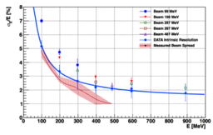
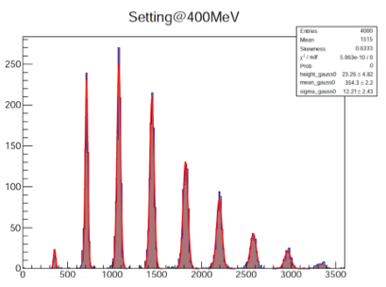
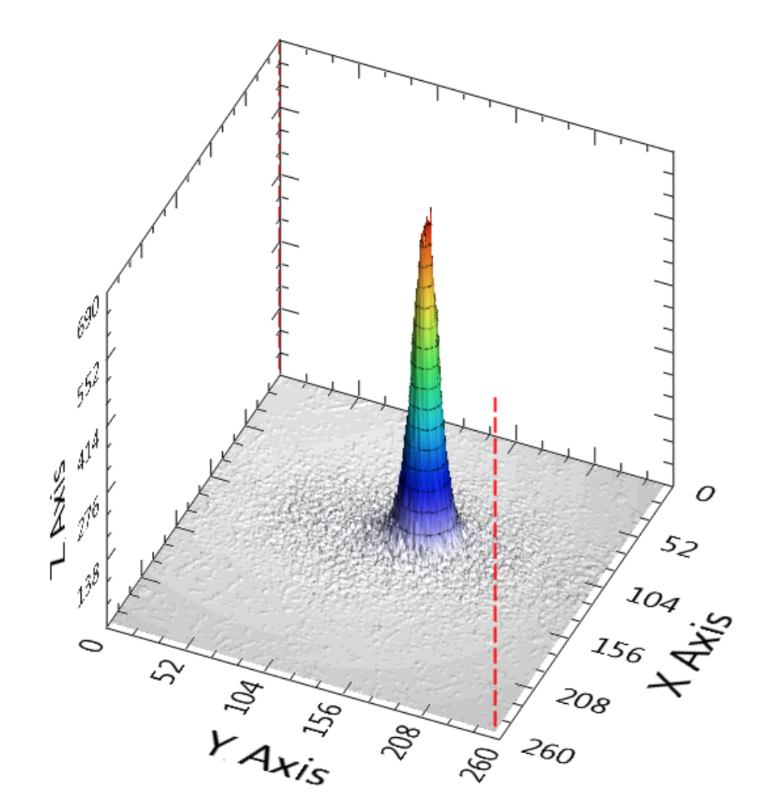
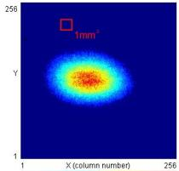
BTF: Low Intensity
Single particle
Primary beam attenuated by a Copper target
Energy of Secondary beam from 500 up to 30MeV
The multiplicity follow the Poisson distribution and user can select the mean value.
Positron and electrons independent from the primary beam.
Energy spread mesured by(LYSO Calorimeter)
Best beam
(σ_{x} x σ_{y}):
440x420μm²
Transverse beam monitoring
[Mambo BGO]
Secondary beam
2cm² MEDIPIX

Slide 8
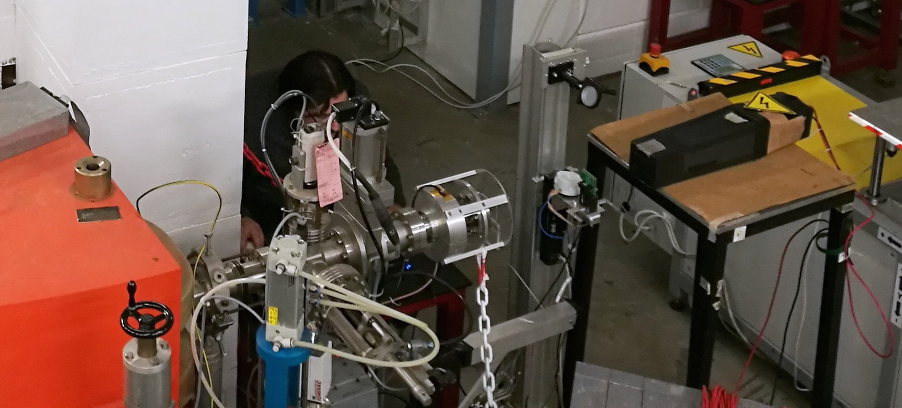
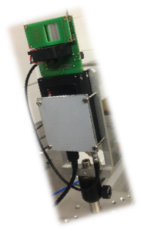

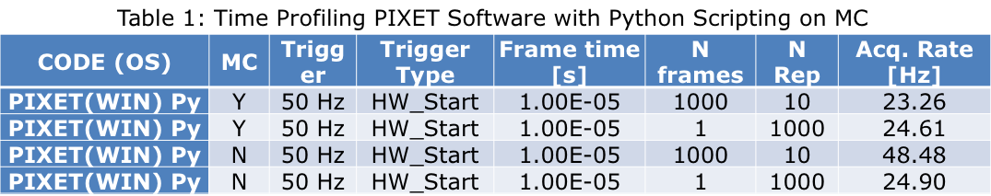
Transverse Monitoring
FITPIX Kit Detectors: sensors have a square pixel of 55 µm side in a 256×256 pixels (overall side length 1.4 mm) layout
for a square sensitive
area of about 2 cm²
and 300 µm of
Thickness.
Programming solutions:
starting with the python scripting capability of the provided software kit;
low-level programming, which required some interaction with ADVACAM® for a full exploitation of the Linux libraries;

Slide 9


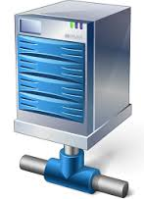


Transverse Monitoring Data Access
access to live data at the maximum frame-rate within the BTF duty cycle.
software architecture with a typical producer-consumers layout.
data caching on MEMCACHED server, to allow more than one different consumers at the same time.
Cross Check Multiplicity with calorimeter or user detectors.
User
Expermental
DAQ

Slide 10

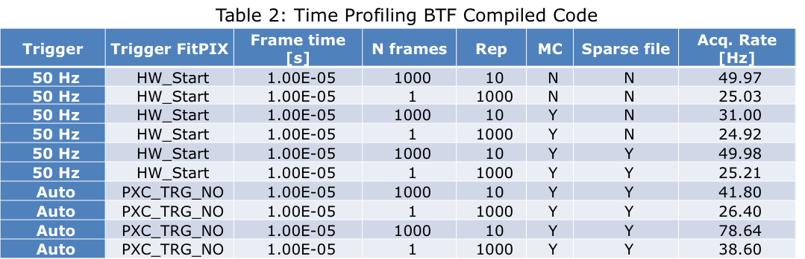
Low-Level programming
Develop of three possible data structures:
Array, sparse, ultra sparse mode
All of these cases are headed by the following values:
Case and FitPIX configuration identifier;
Time tag (resolution 0.1 ms);
number of fired pixel;
frame number;
Callback
frame by frame
on dev interrupt N

Slide 11
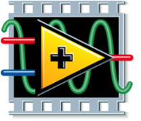
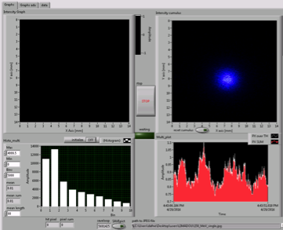
Transverse Monitoring
Consumer Code in LabView allow:
Beam spot bunch per bunch
Cumulative spot image
Multiplicity distribution from FitPIX.
Multiplicity vs time

Slide 12
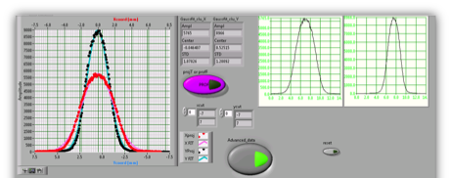
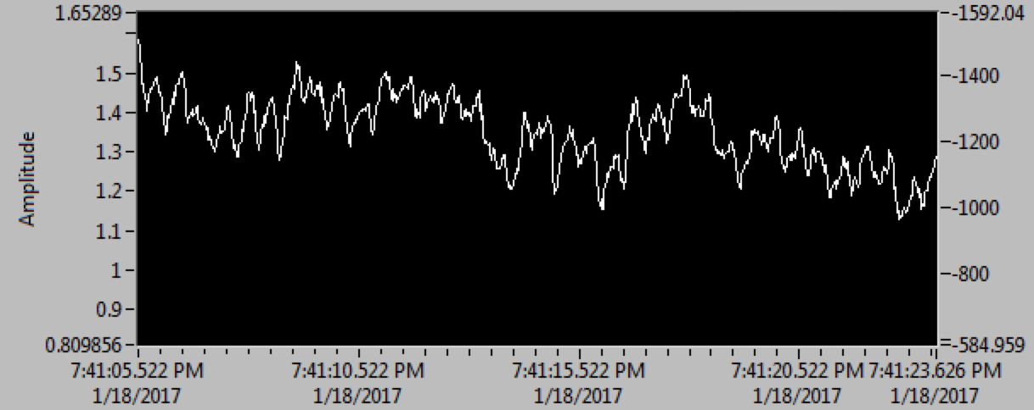
Transverse Monitoring
Consumer Code in LabView allow:
Beam position monitoring bunch per bunch
Beam size monitoring bunch per bunch.
Bunch position vs time

Slide 13

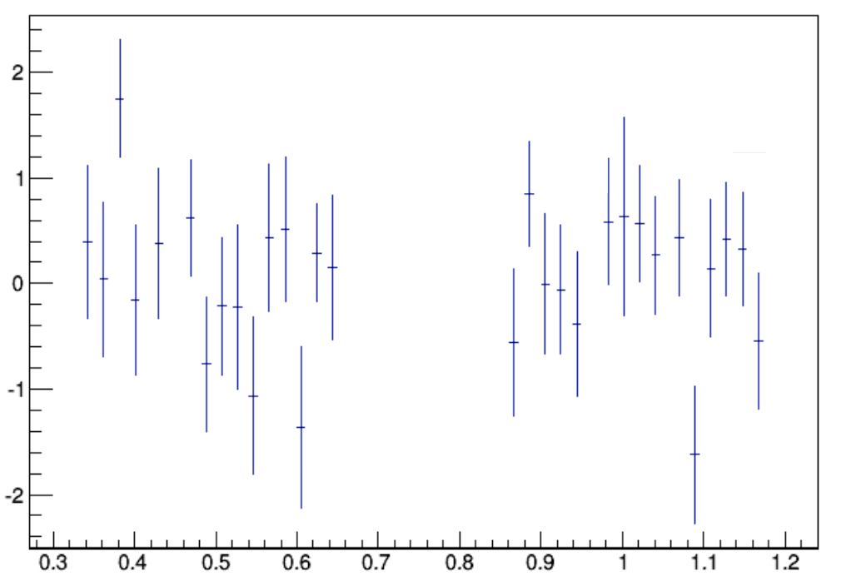
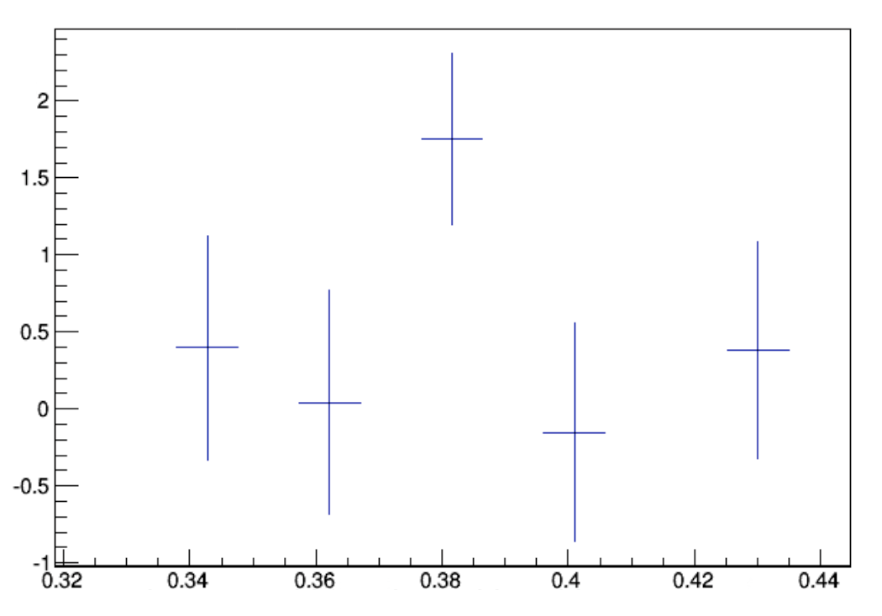
Transverse Monitoring
e⁻ for Dafne
Bunch X position [mm]
Consumer Code in C++ allow:
Root Data Files
  (UTC time, pix, count, frame)
Cross Check with User detectors
Client code available for the users by svn.
(UTC time – ref. Time) [s]
20 ms -> 50Hz
Bunch X position [mm]
40 ms:
Bunch in the spectrometer transfer line.
(UTC time – ref. Time) [s]

Slide 14
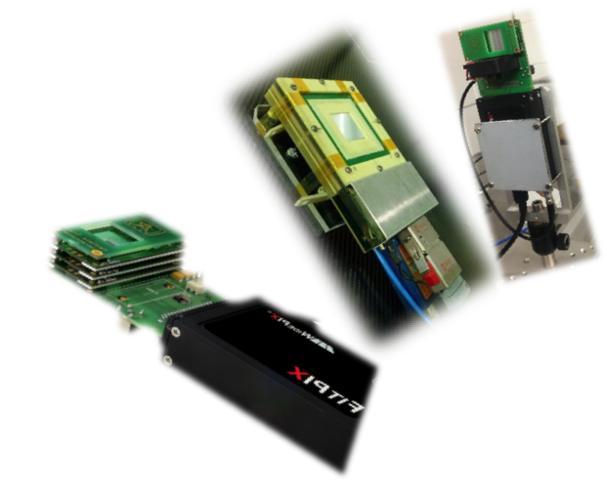
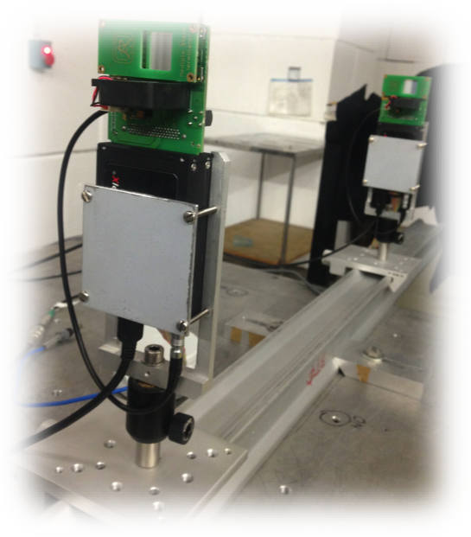
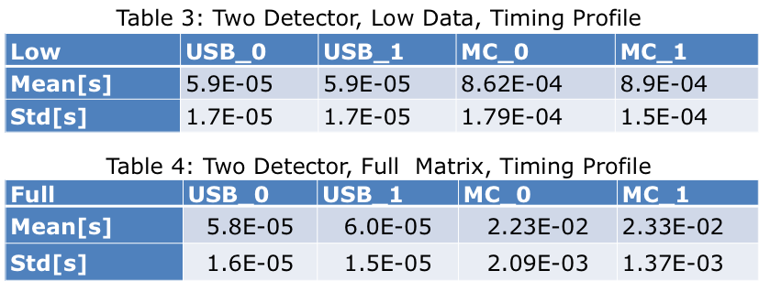
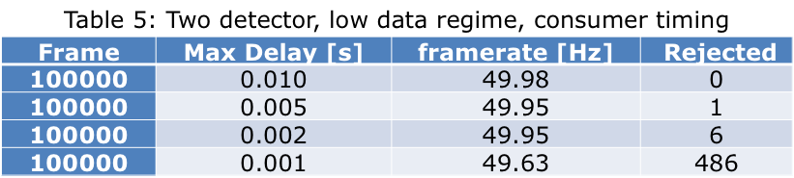
Low-Level programming
The software architecture is tested for:
GEMPIX
Multiple FITPIX
Tracker with 2 FitPIX
A consumer software rejection function senses a single event jitter delay of 5ms (the minimum time-tag difference between two synchronized FitPIX MC keys) after 100000 calls, mainly due to producer thread time jitter.
This guarantees a complete software data alignment within the user DAQ cycle, even for the data coming for two FitPIX devices in the BTF typical tracking setup

Slide 15
Conclusions
The transverse monitoring bunch per bunch allow a more precise beam characterization.
BTF Users requires precise beam information to test their devices to reduce the uncertainty in their measurements and reducing the time-to-problem solution during their tests.
BTF staff will follow to develop the improvements following the requirements identified by the user.

Slide 16
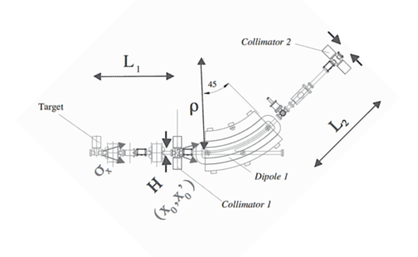
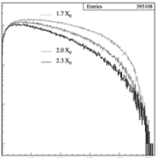



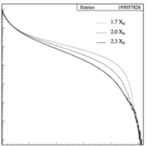

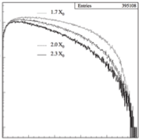

BTF: Single particle
Cu 2X0 target
10⁻⁵
10⁻⁶
Target
10⁻⁷
10⁻⁸
0
0.2
0.4
0.6
0.8
1 (E₀)
10⁻¹
Energy resolution:
10⁻³
10⁻⁵
10⁻⁵
Out of target
10⁻⁶
Energy spread misurato
(Calorimetro LYSO)
10⁻⁷
10⁻⁷
< 4 mrad
0
0.2
0.4
0.6
0.8
1 (E₀)
10⁻⁸
0
0.2
0.4
0.6
0.8
1 (E₀)
Maximum input divergence:
d≈0.25 mm
D=60 mm

Slide 17

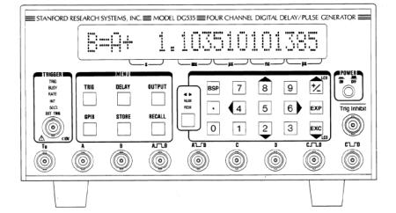
Timing
DAFNE reference Ø₄ for the injection systems
Conditioned Ø₄ -> DELAYED LINAC SYS SIGNAL moves all the LINAC stuff together to match ACCUMULATOR phase)
  DELAYED GUN SIGNAL -> LINAC SYS REFERENCE (once optimized, not moved for months)
  BTF REFERENCE -> USER needs DELAYED LINAC SYS
  → WE ARE WORKING in STATIC LINAC+BTF TRIGGERING SCHEME
Some Jitter contribution (see also AMY and UA9 experiences)
LINAC SYS reference jitter (rms, 10ps, our best measure)
LINAC GUN jitter (100ps)
BTF STANFORD DDG535m single channel jitter (rms, 60ps + 0.01ppm of the channel delay) .

Slide 18
n@BTF
With 1.1×10¹¹ n in the target:
8.8×10⁸ n/cm²/s exiting from the target
1.87×10¹⁰ γ/cm²/s exiting from the target
d (m) | ×10⁻⁷ n/cm²/pr
0.5 | 58
1 | 15
1.5 | 8
At 1.5 m distance:
Total neutron flux: 8×10⁻⁷ n/cm²/pr ±3%
Flux = 4.5×10⁵ n/cm²/s @ full beam
Equivalente dose = 45 mSv/h
d (m) | ×10⁻⁵ γ/cm²/pr
0.5 | 63
1 | 5.7
1.5 | 1
At 1.5 m distance
Total photon flux = 1×10⁶ γ/cm²/s

Slide 19
Neutron electro-production
Tungsten target
At full linac power: 10¹³ e/s
  to be compared e.g. with nELBE, N=6·10¹⁵ e/s
Swanson estimate
  9.3·10¹⁰ Z^{(0.73±0.05)} n/s kW⁻¹
  2.15 ·10¹² n/s kW⁻¹ for Tungsten
Optimizing the target configuration can (slightly) improve the yield:
  n@BTF optimized target: 2.75 ·10¹² n/s kW⁻¹
  0.218 n/pr (over 4π and all spectrum)
In our case the main limitation will always be the intensity delivered onto the target
Evaporation peak + fast neutrons shoulder

