Slide 1
Irradiation at Birmingham
K. Kanisauskas, R. Bates, C. Buttar, T. Huffman, J.J John, D. Maneuski, R. Plackett, L. Vigani
Special thanks to L. Gonella, P.P. Allport, D.L. Briglin, P. Dervan, I. Iqbal
ATLAS Strip CMOS Regular Meeting
October 11, 2016

Slide 2
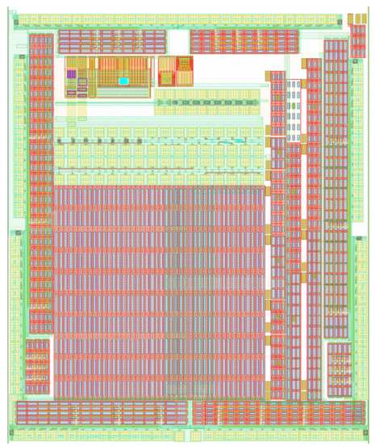
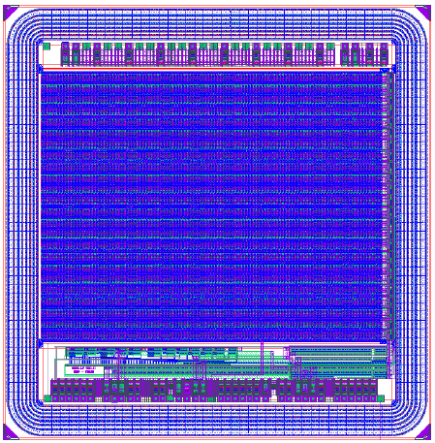
Irradiated Devices
AMS-Chess1
CCPD L-Foundry (Ver A)
Two HV-CMOS test chips were chosen for the irradiation campaign
1 × AMS-Chess1 (strips) and 1 × CCPD_LF (pixels)
X-ray and MIP measurements were performed for both devices beforehand

Slide 3
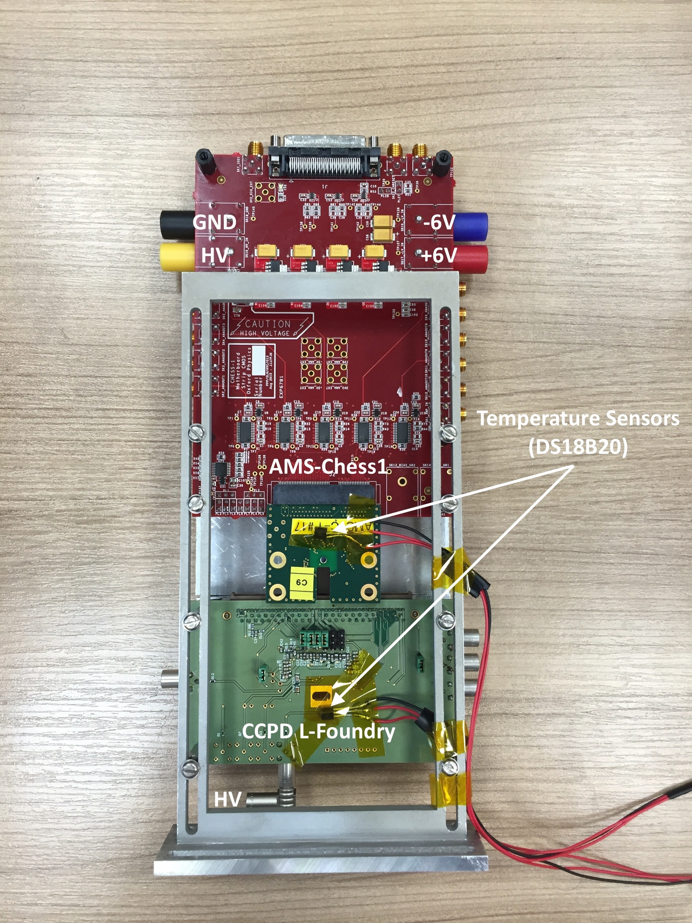
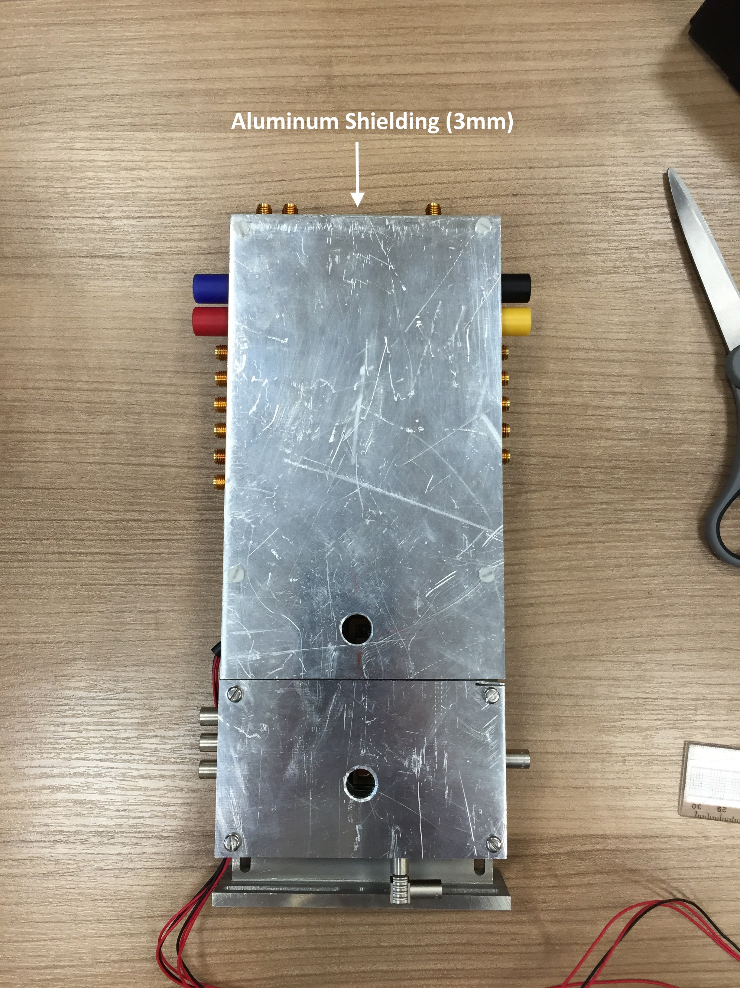
Irradiation Procedure (1)
The irradiation took place at MC40 cyclotron facility at the University of Birmingham (27 MeV proton beam) on 28th of September
Target fluence was set to 1 × 10¹⁵ n_{eq}/cm²

Slide 4
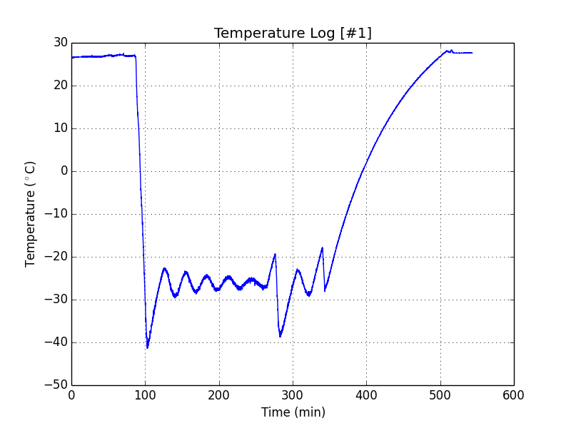
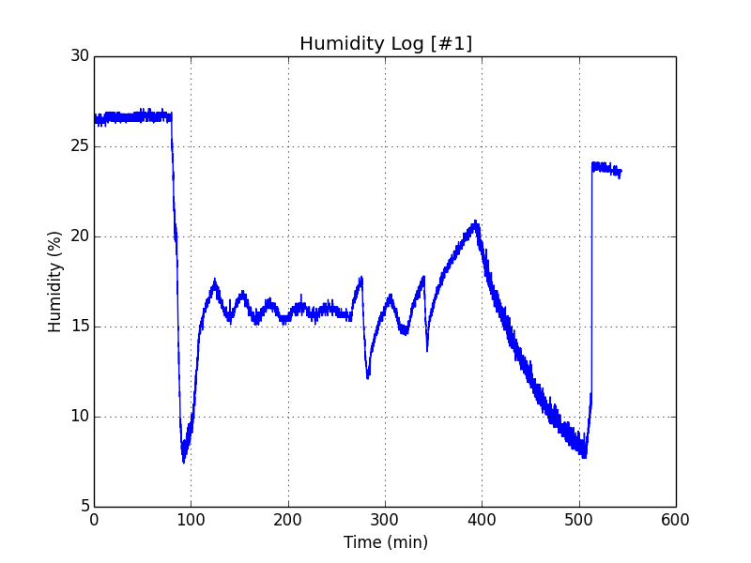
Irradiation Procedure (2)
Both chips were biased to -50V, whereas LV was only supplied to AMS-Chess1
The chips were cooled down to -25℃ during the irradiation
LabView program was written to monitor temperatures and leakage currents
Unfortunately Arduino based temperature monitoring system failed during the irradiation (also preventing to further log the leakage currents)
Instead the temperature monitoring data was obtained from the facility

Slide 5
Irradiation Procedure (3)
Measured fluences
AMS-Chess1: 0.62 × 10¹⁵ n_{eq}/cm²
CCPD_LF: 1.2 × 10¹⁵ n_{eq}/cm²
During the irradiation issues were encountered with translational stages which prevented to achieve the target fluence for AMS-Chess1
The devices are still being stored at the facility

