Slide 1
First results with passive devices on CHESS2 chip
I. Mandić, et al., JSI Ljubljana

Slide 2
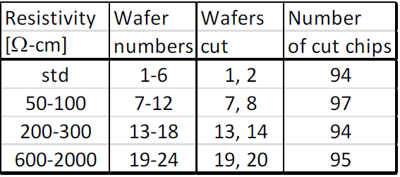
Detector
Chip from wafer 13: 200-300 Ohm-cm

Slide 3
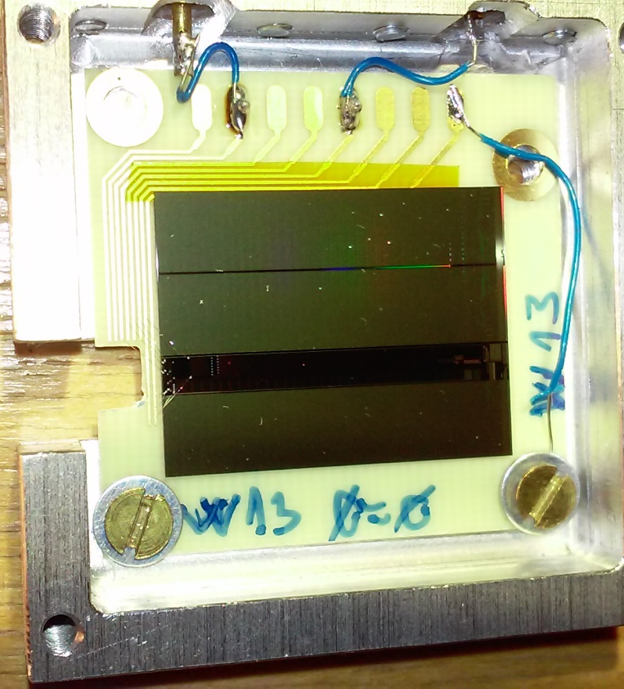
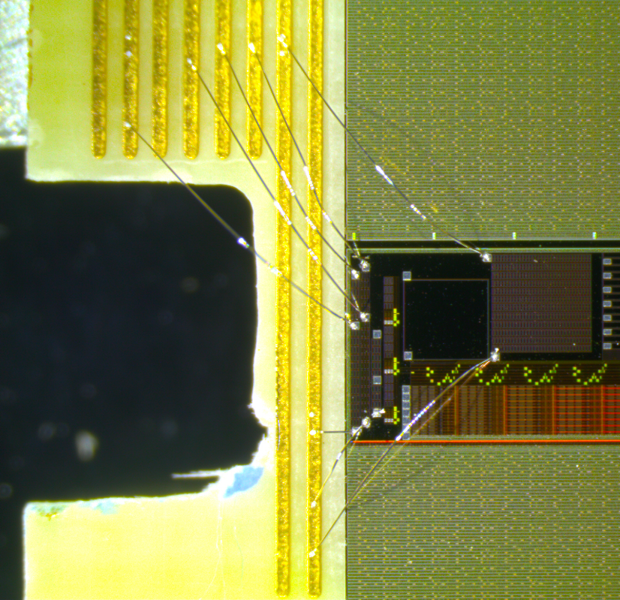
Chip mounted on a simple PCB:
E-TCT:
regular passive pixel array:
3x3 630 um x 40 um pixels
Sr90:
arge passive array
2x32 630 um x 40 um pixels
E-tct
➔ bias up to 120 V, currents very low (few nA)

Slide 4
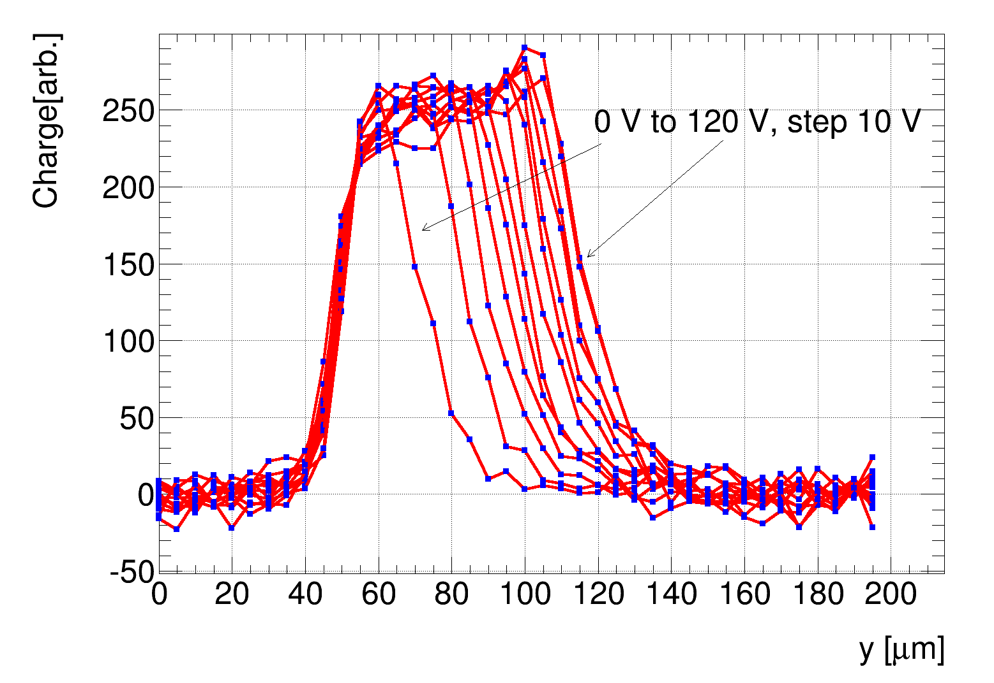
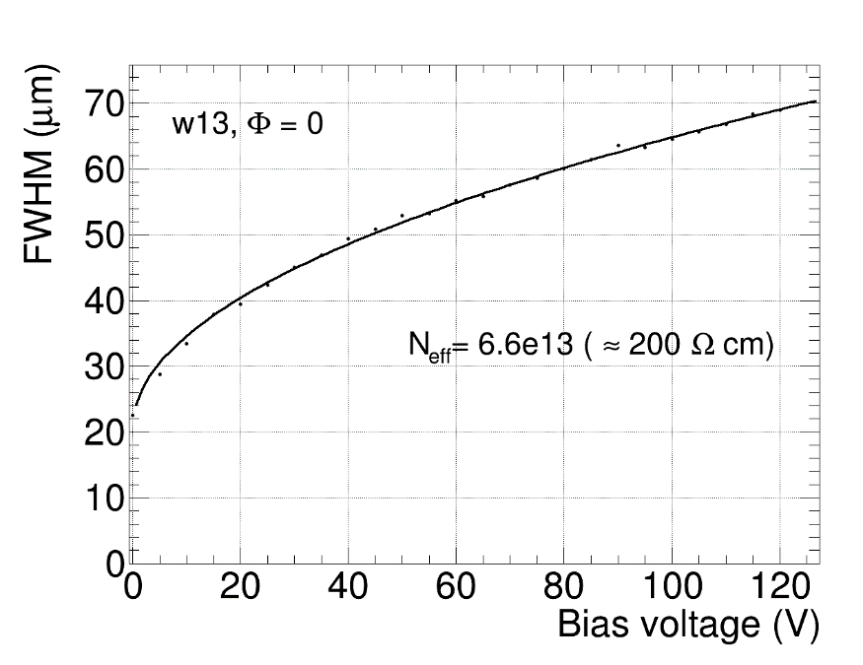
E-TCT
measured charge collection profile across the central pixel
Fit FWHM of the profile with:
➔ good fit
➔ extracted N_{eff} corresponds to 200 Ohm-cm
➔ measured charge collection width about 70 um at 120 V → but large offset at 0 V
→ depleted depth probably less than 70 µm :
→ for N_{eff} = 6.6 e13 cm-3 and V_{eff} = 120 V:

Slide 5
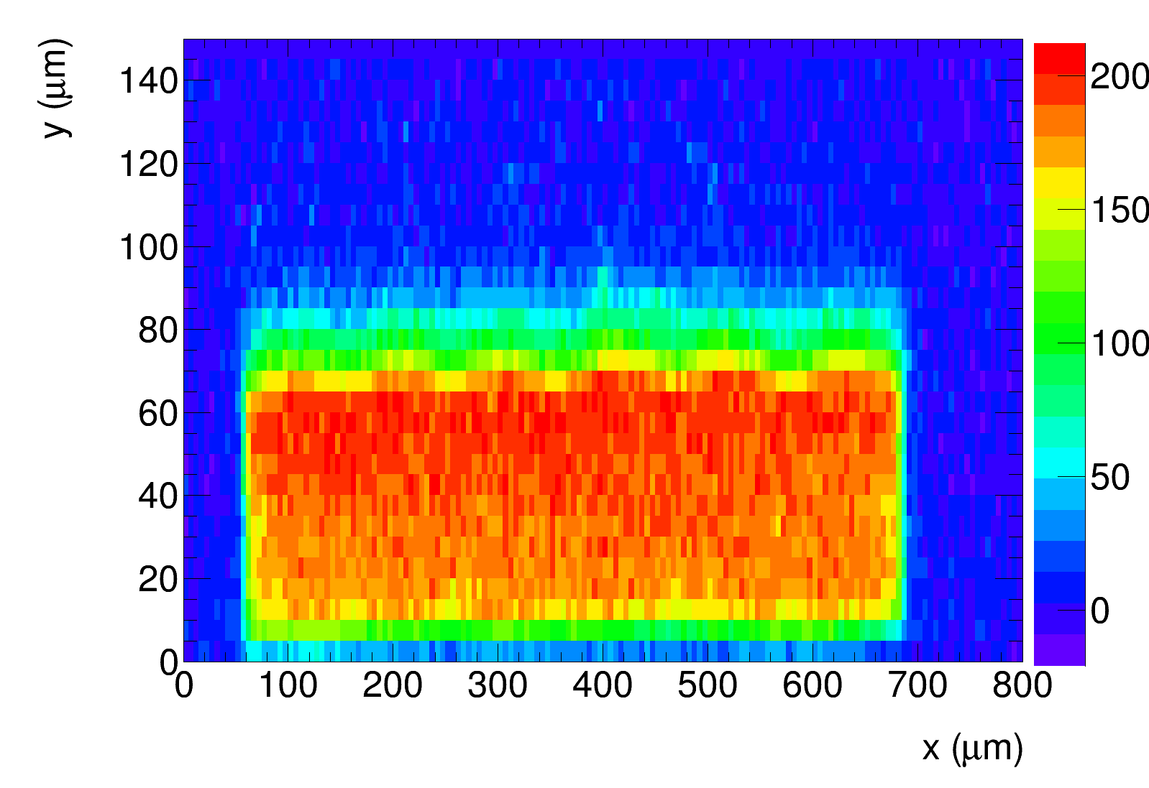
E-TCT
charge
depth
surface
2d charge collection profile of the central pixel
six pixel segments can be seen
no efficiency gaps between segments

Slide 6
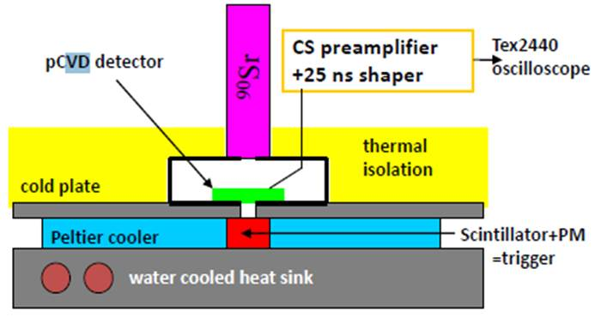
Source measurements
ORTEC 142 charge sensitive amplifier + custom made shaper +
digital oscilloscope
detector
HV-CMOS: small signals, large noise → S/N very bad
➔ must have clean sample of events
➔ need large detector for reasonable trigger rate
and good collimation, small scintillator
Measurement:
1) Record N waveforms
2) average over all waveforms and determine signal peak
3) sample waveforms at the peak
4) Fill spectrum
5) measure at different shaping times: 25 ns, 80 ns, 200 ns and 500 ns

Slide 7
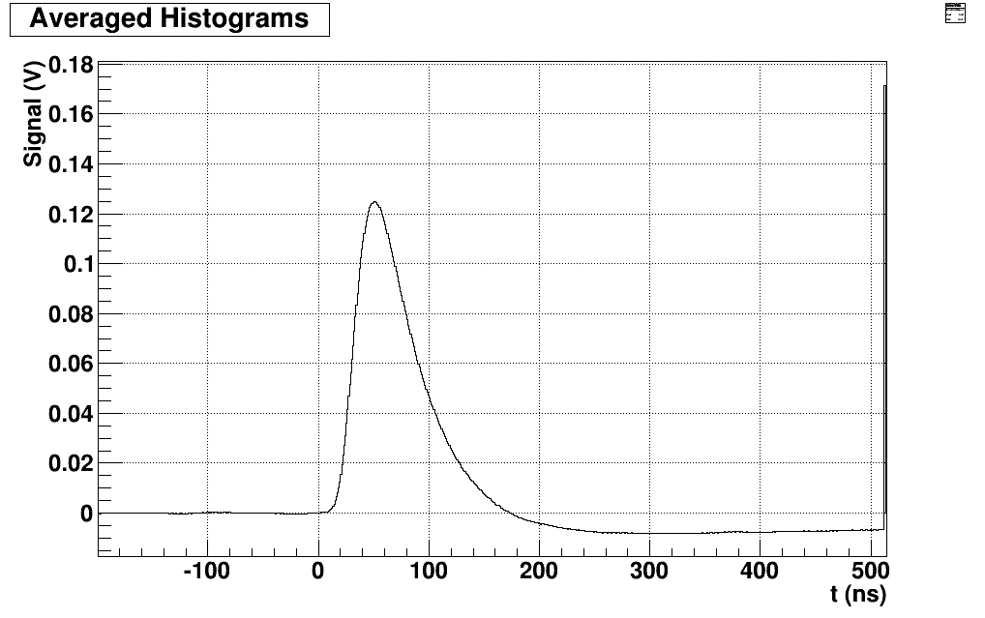
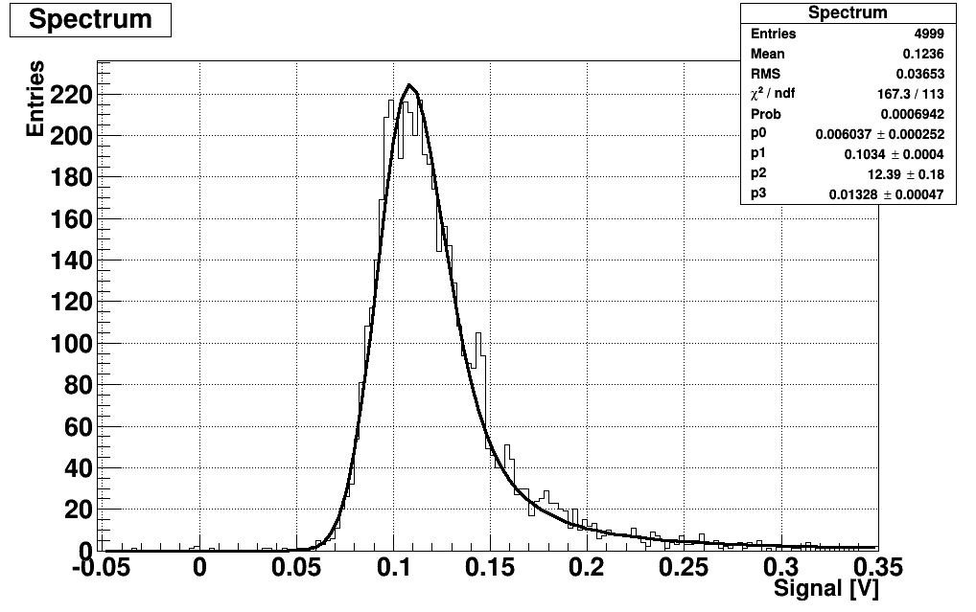
Calibration
Am241 source, 59.5 keV photon peak in 300 µm thick FZ detector
Sr90 with 300 µm thick FZ p-type silicon diode
➔ calibration at 25 ns shaping time : 230 electrons/mV
FZ p-type silicon diode, 300 µm thick , V_{fd} = 70 V:
Averaged waveforms
Spectrum of amplitudes at sampling time
Bias = 300 V
Shaping time 25 ns
Bias = 300 V
Shaping 25 ns
Sampling time

Slide 8
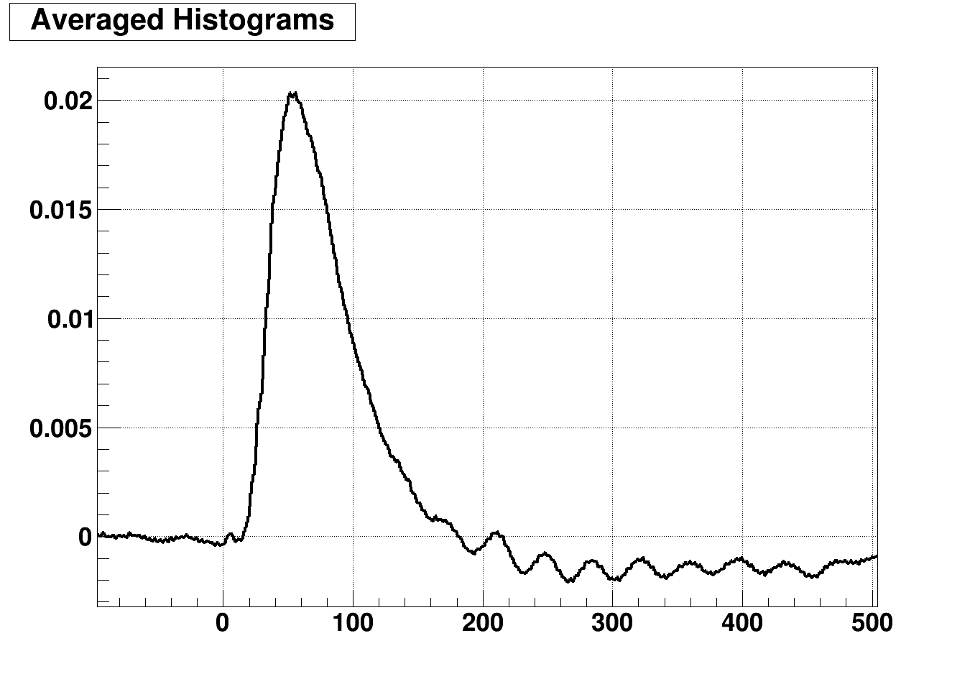
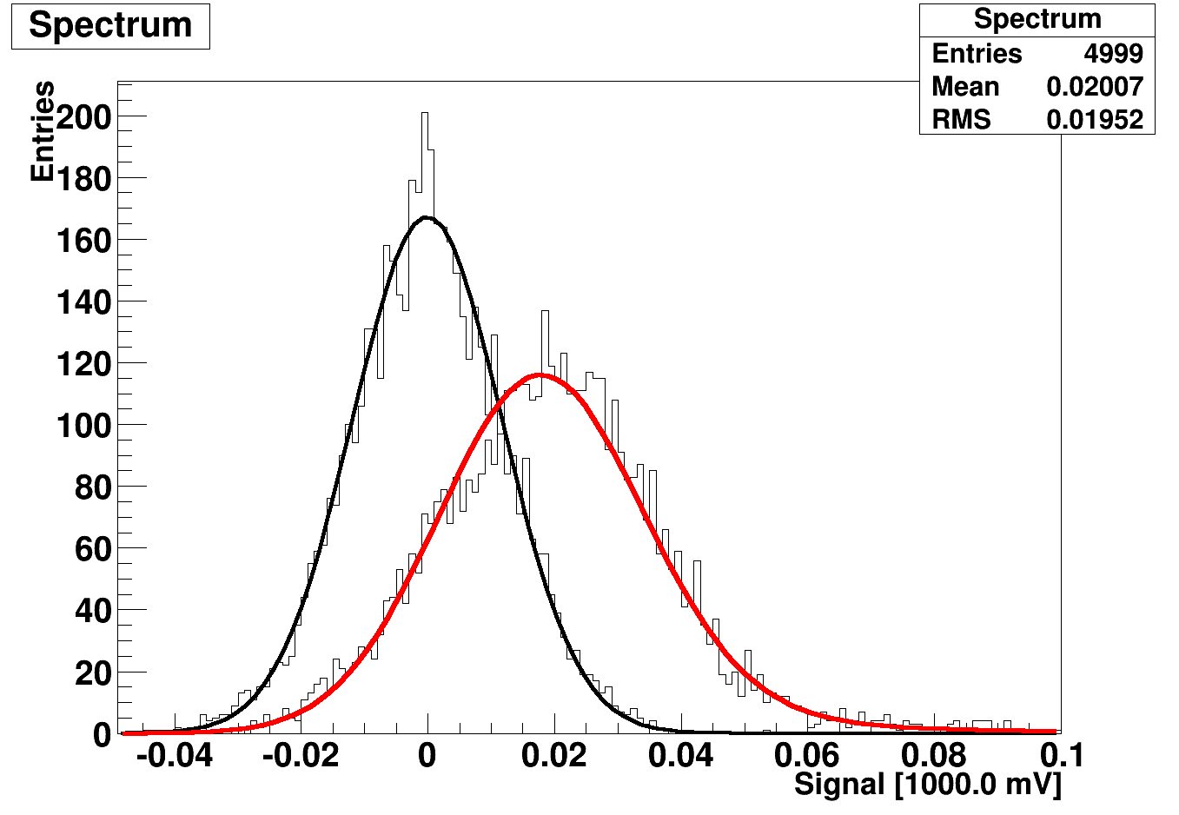
Measurement with CHESS2, W13, big array
Shaping time: 25 ns
Average waveform:
Spectrum of values sampled at peak
noise
120 V
120 V
signal
t (ns)
Sampling point for signal
sampling point for noise

Slide 9
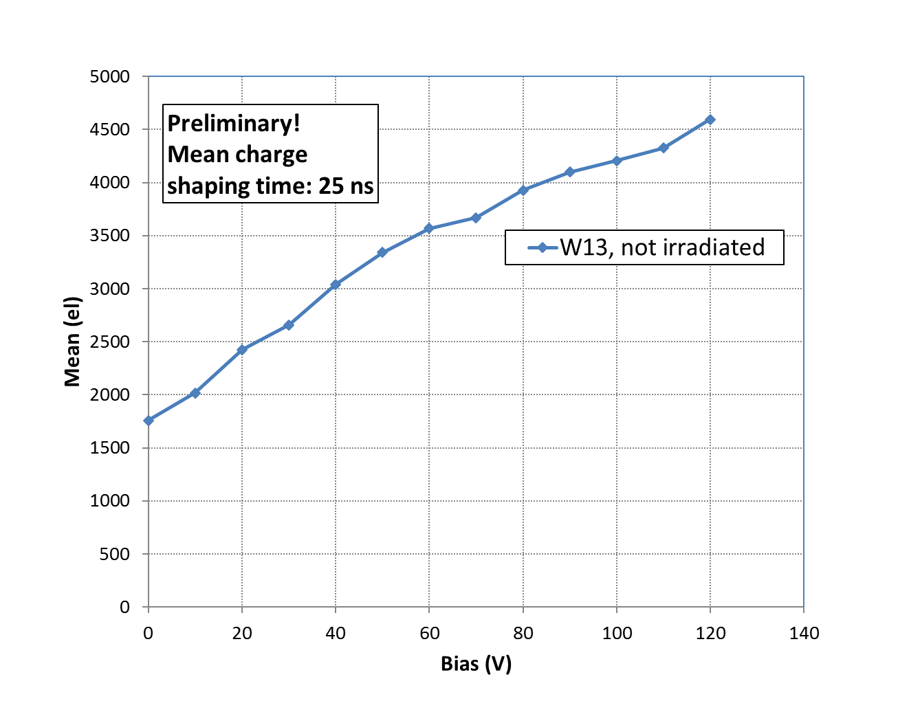
Measurement with CHESS2, W13
depleted depth for 200 Ohm-cm at 120 V: 48 µm
➔ expected mean charge from depleted region: ~ 48 um x 100 el/um ~ 4800 el
➔ in total would expect ~ 1500 el more from diffusion?
  ➔ maybe alignment between the collimator and the structure not perfect,
  will see with more samples

Slide 10
Summary and outlook:
First E-TCT and Sr90 measurements with CHESS2
chip from W13 200-300 Ohm-cm resistivity
measurement with passive structures
  3x3 array for E-TCT
  big array for Sr90
Bias up to 120 V, currents low (nA)
resistivity estimated from E-TCT: 200 Ohm-cm
Sr90: 4500 electrons at 120 V
continue with other resistivities
chips were irradiated with neutrons: 1e14, 3e14,5e14,1e15 and 2e15,
one chip per resistivity
  irradiated chips ready to be measured

