Slide 1
Chess1 MIP Measurements
K. Kanisauskas, R. Bates, C. Buttar, D. Maneuski
ATLAS Strip CMOS Regular Meeting
October 25, 2016

Slide 2
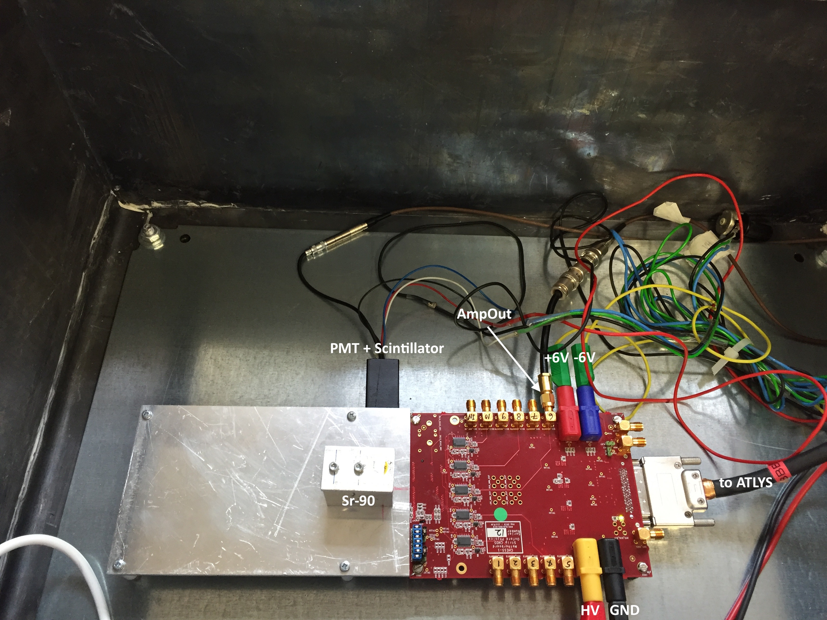
MIP Setup (1)
The MIP setup was arranged inside the box shielded with lead
190 MBq Sr-90 source was used
2 level triggering – scope trigger at 20mV on AmpOut line and software trigger looking for PMT signal within 300ns timeframe
Test structures of interest were APA5 (CH75) and APA8 (CH36, CH38, CH40)
Note that edge-TCT cut version of AMS-Chess1 was used for MIP measurements (thus CH35-43 correspond to APA8)

Slide 3
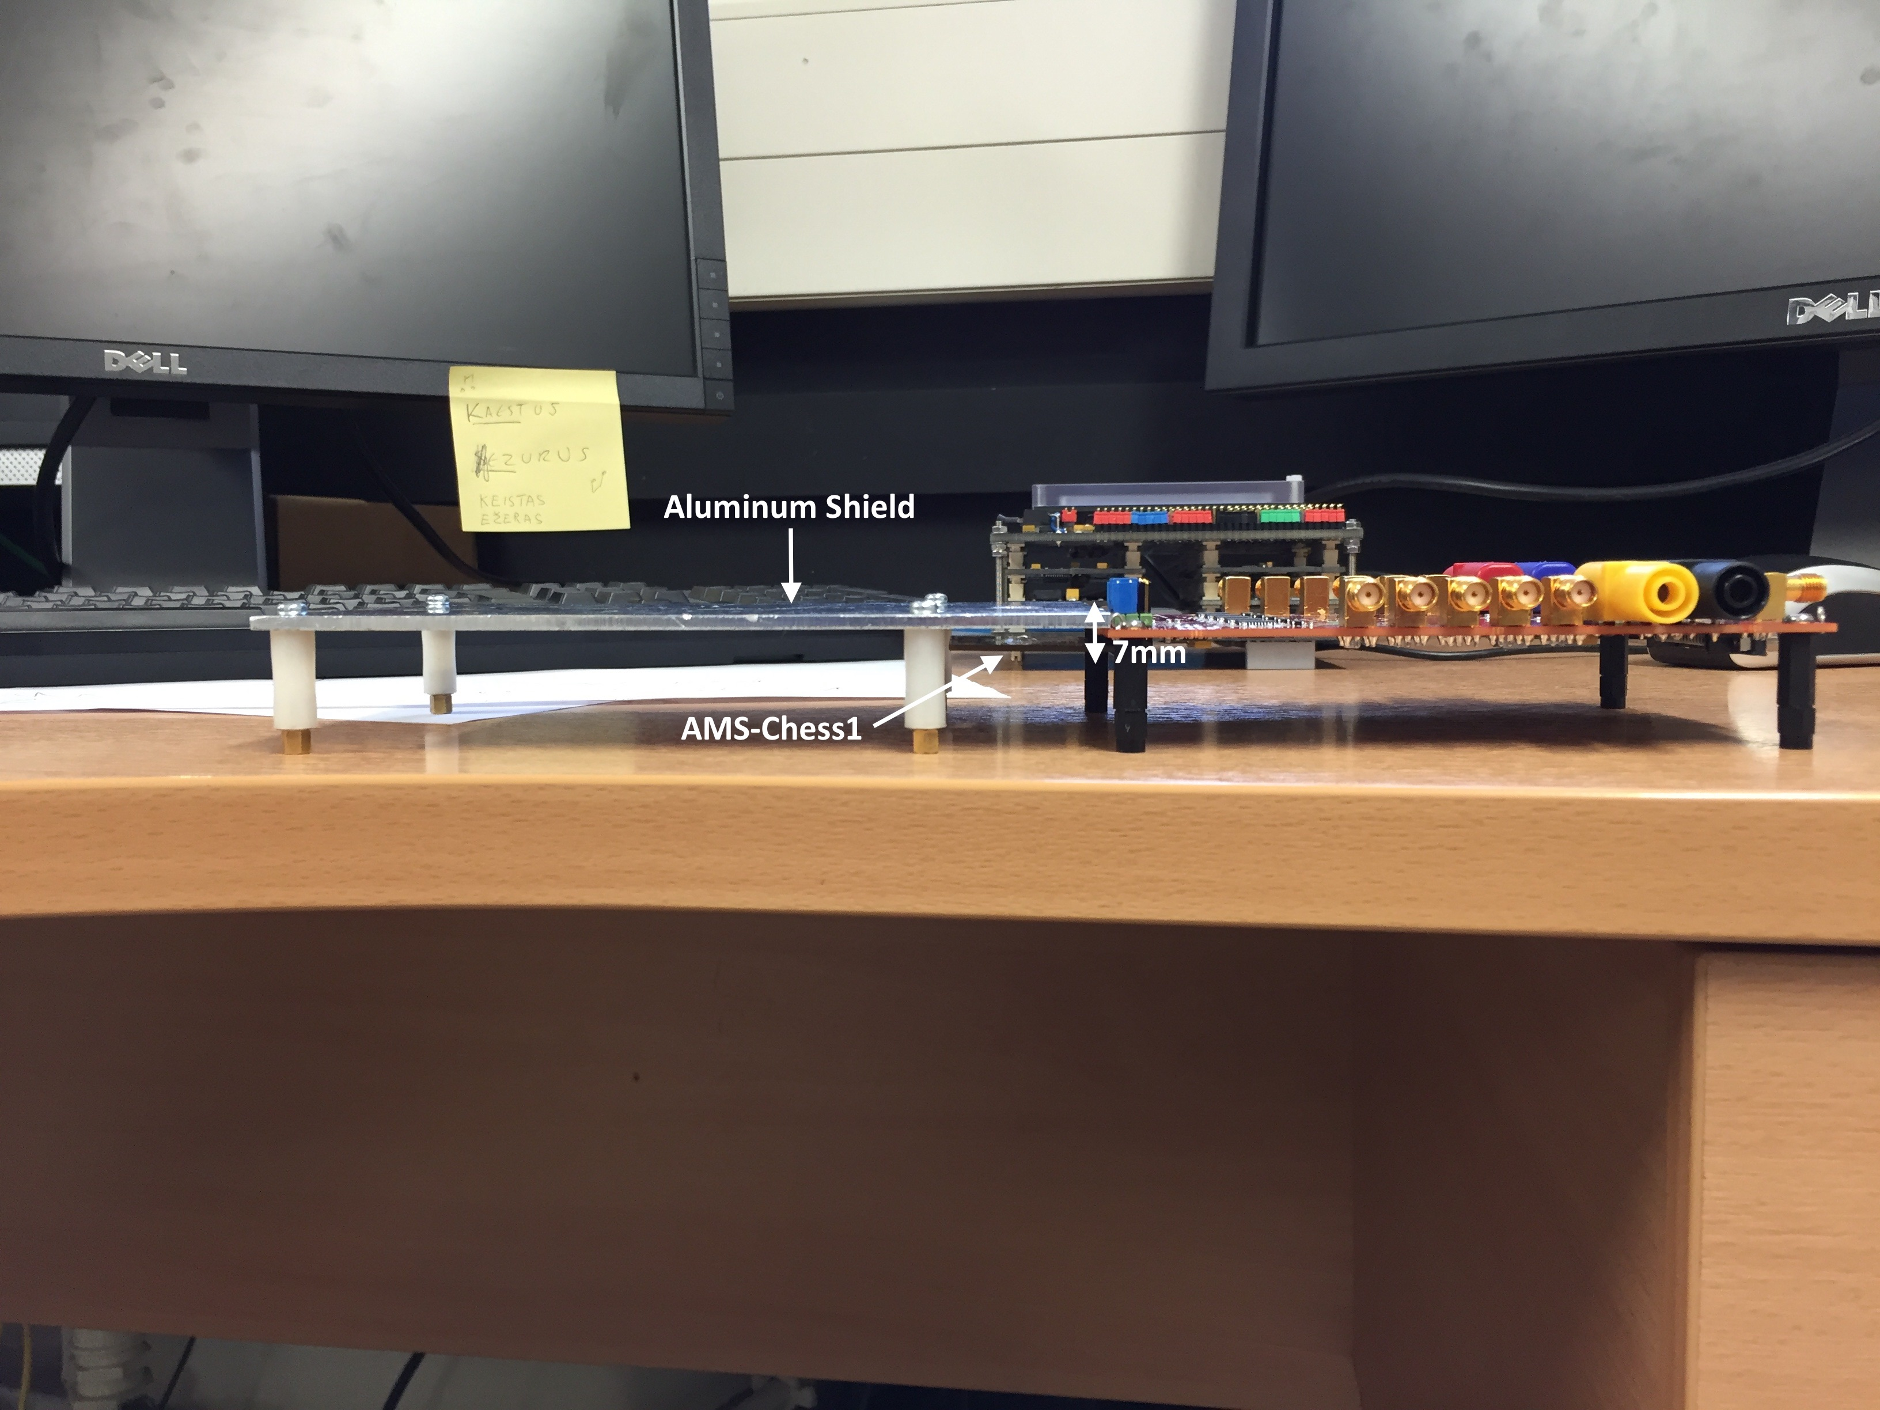
MIP Setup (2)
Source-Chip distance corresponded to ≈7mm
The measurements were done within 0-70V reverse bias range
1000 waveforms were recorded at each bias step
DAC settings
  VPLoad: 2100
  Casc: 2600
  iNSF: 750
  iN: 1000
  iNBias: 150
  iPFB: 2700

Slide 4
Previously…
X-Ray Measurement Summary
 | APA1_OUT5 | APA4_OUT5 | APA5_OUT5 | APA6_OUT5 | APA7_OUT5 | APA8_OUT5
Pixel size [um] | 45x100 | 45x200 | 45x400 | 45x400 | 45x800 | 45x800
Diode area [um^2] | 1350 | 4536 | 5400 | 9072 | 10800 | 18144
Noise [mV] | 3.6 | 4.0 | 4.3 | 4.0 | 4.1 | 3.8
Rise time @ Fe [nS] | 75 | 100 | 120 | 60 | 70 | 70
Gain [e/mV] | 51 | 38 | 31 | 57 | 113
Gain [mV/fC] | 123 | 164 | 202 | 110 | 55
Noise [e] = G [e/mV]*N[mV] | 184 | 152 | 133 | 228 | 463
MIP peak expected for APA5 structure ≈50mV assuming 20um depletion region

Slide 5
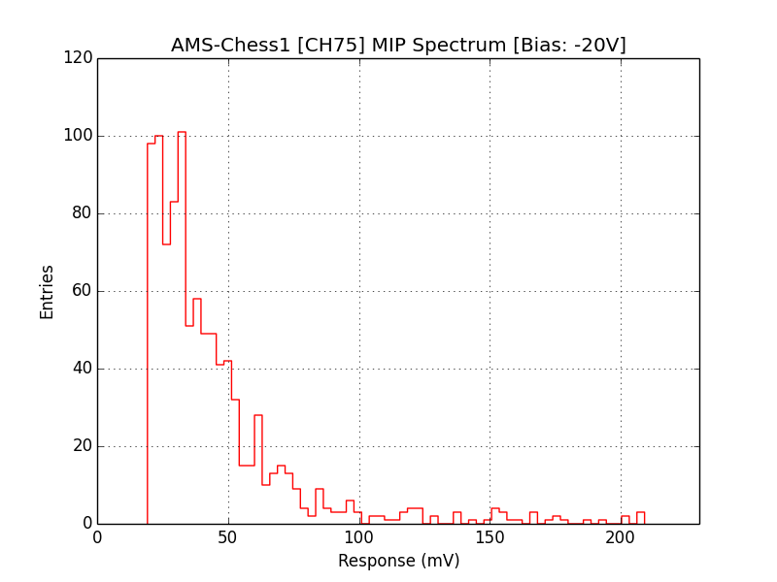
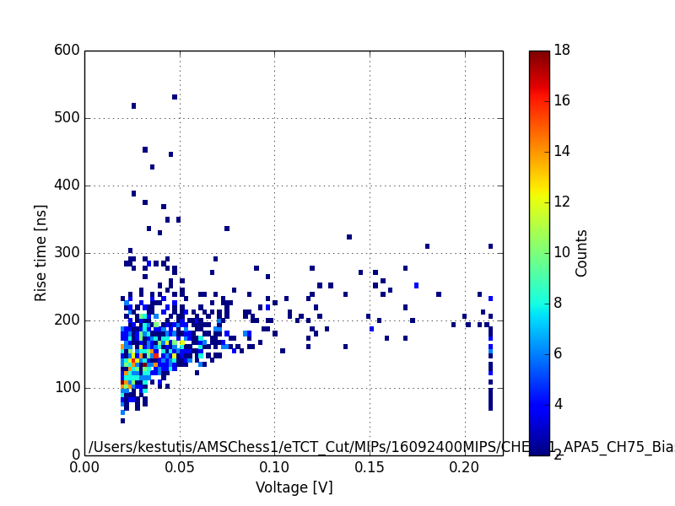
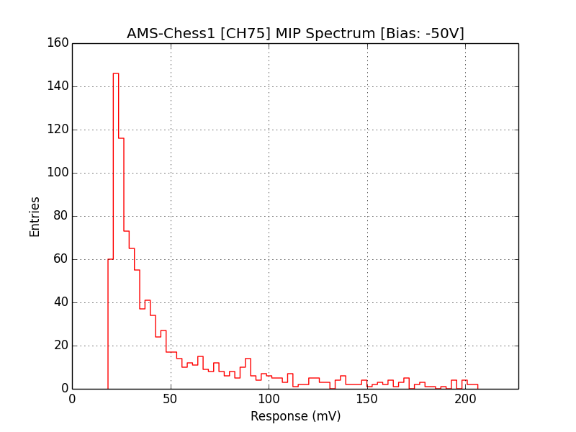
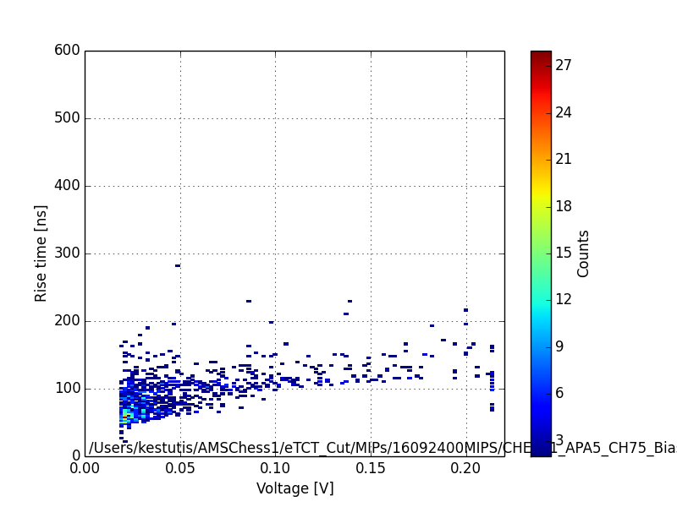
Results (APA5)
DAQ rate: 1.28Hz
DAQ rate: 0.64Hz

Slide 6
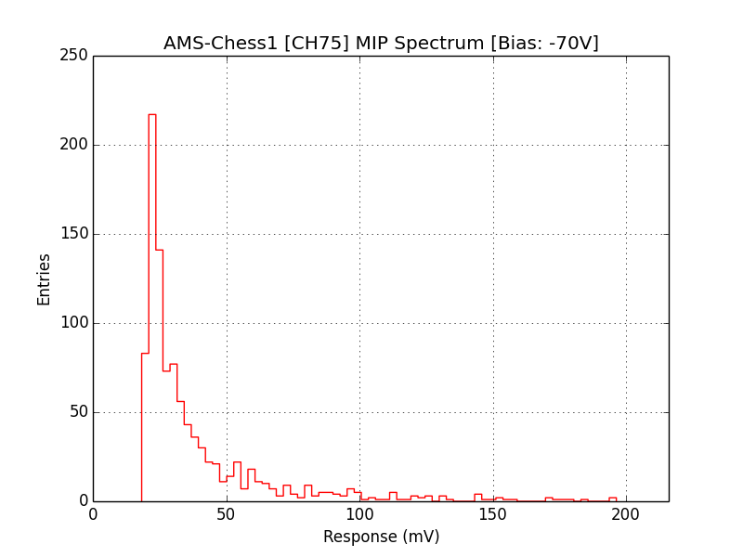
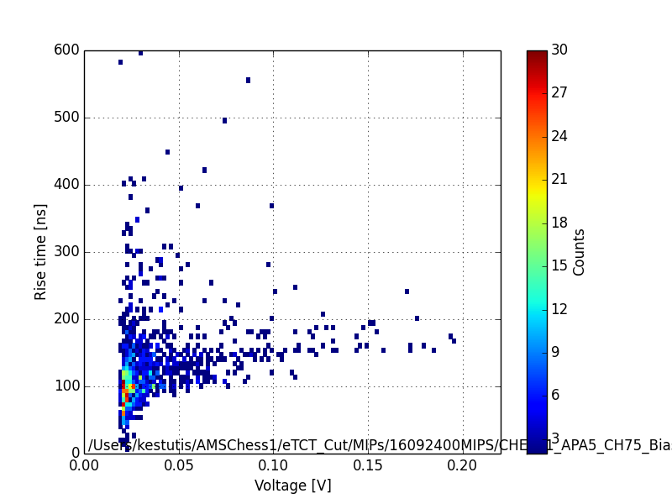
Results (APA5)
DAQ rate: 0.88Hz

Slide 7
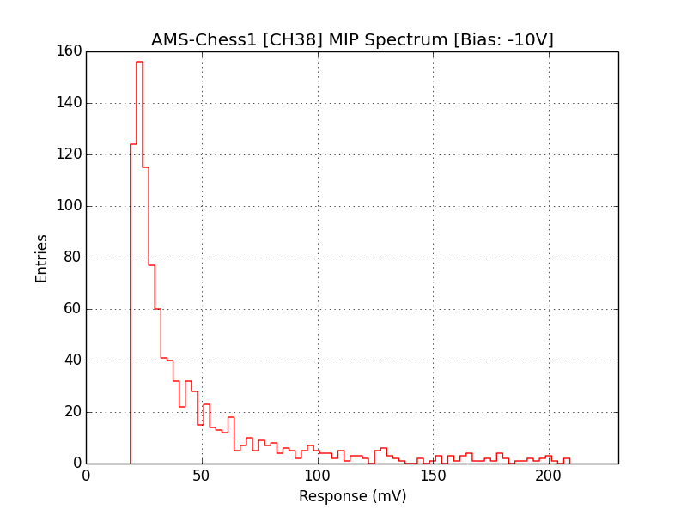
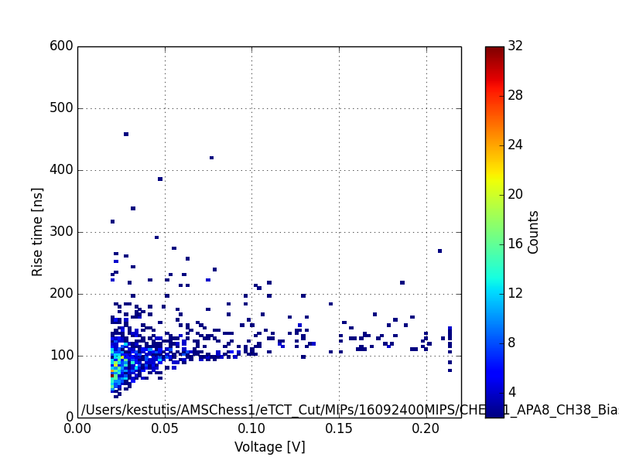
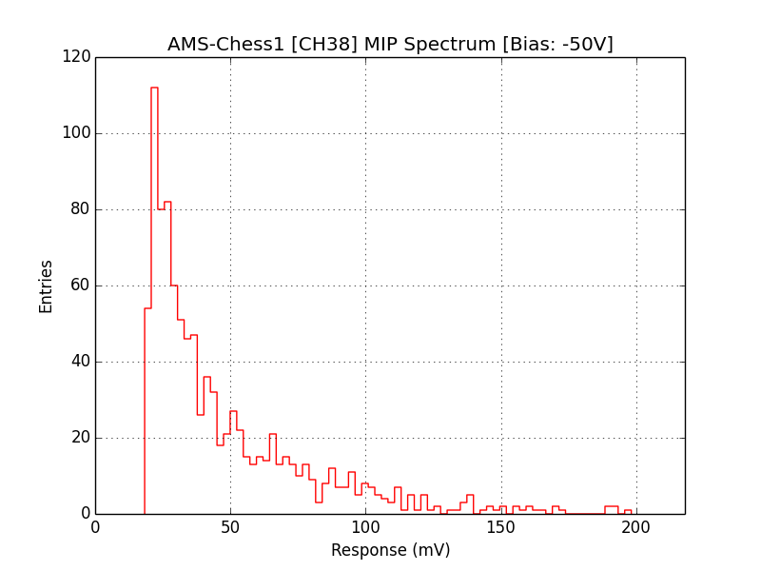
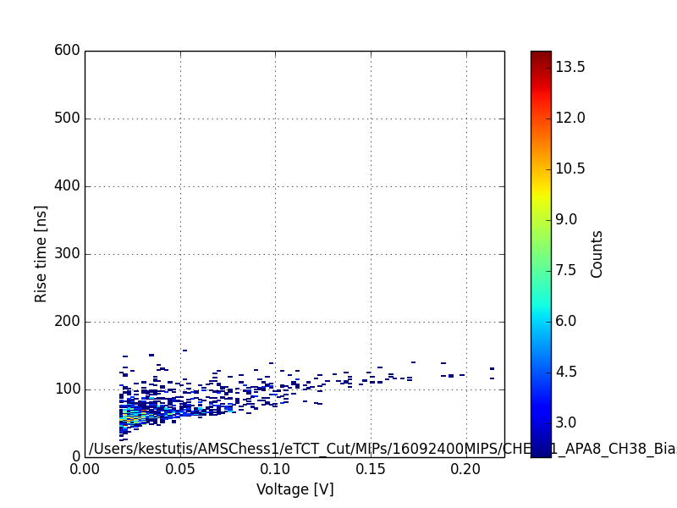
Results (APA8)
DAQ rate: 1.04Hz
DAQ rate: 0.88Hz

Slide 8
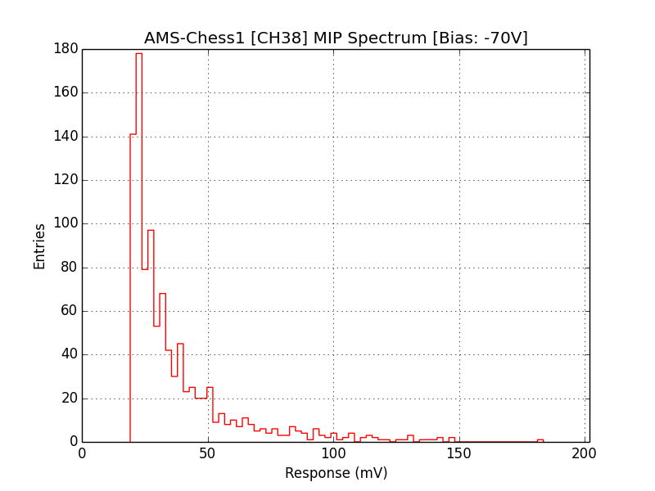
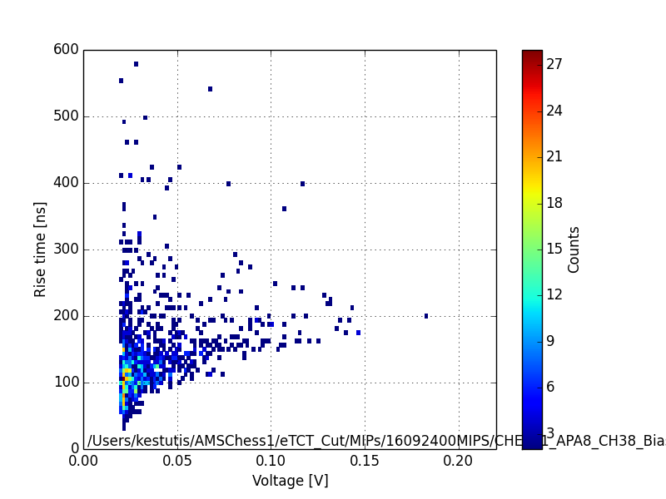
Results (APA8)
DAQ rate: 0.76Hz

Slide 9
Summary
No clear MIP peak was observed for APA5 and APA8 structures
Data indicates inconsistent variation of DAQ rate as a function of bias
MIP spectra shifts towards lower voltages with increasing reverse bias
Signal rise-time distribution also varies significantly with bias voltage

