Slide 1
Update: Analogue daughterboard and ABCN’
25 October 2016
J. J. John and T. Huffman
with help from many colleagues

Slide 2
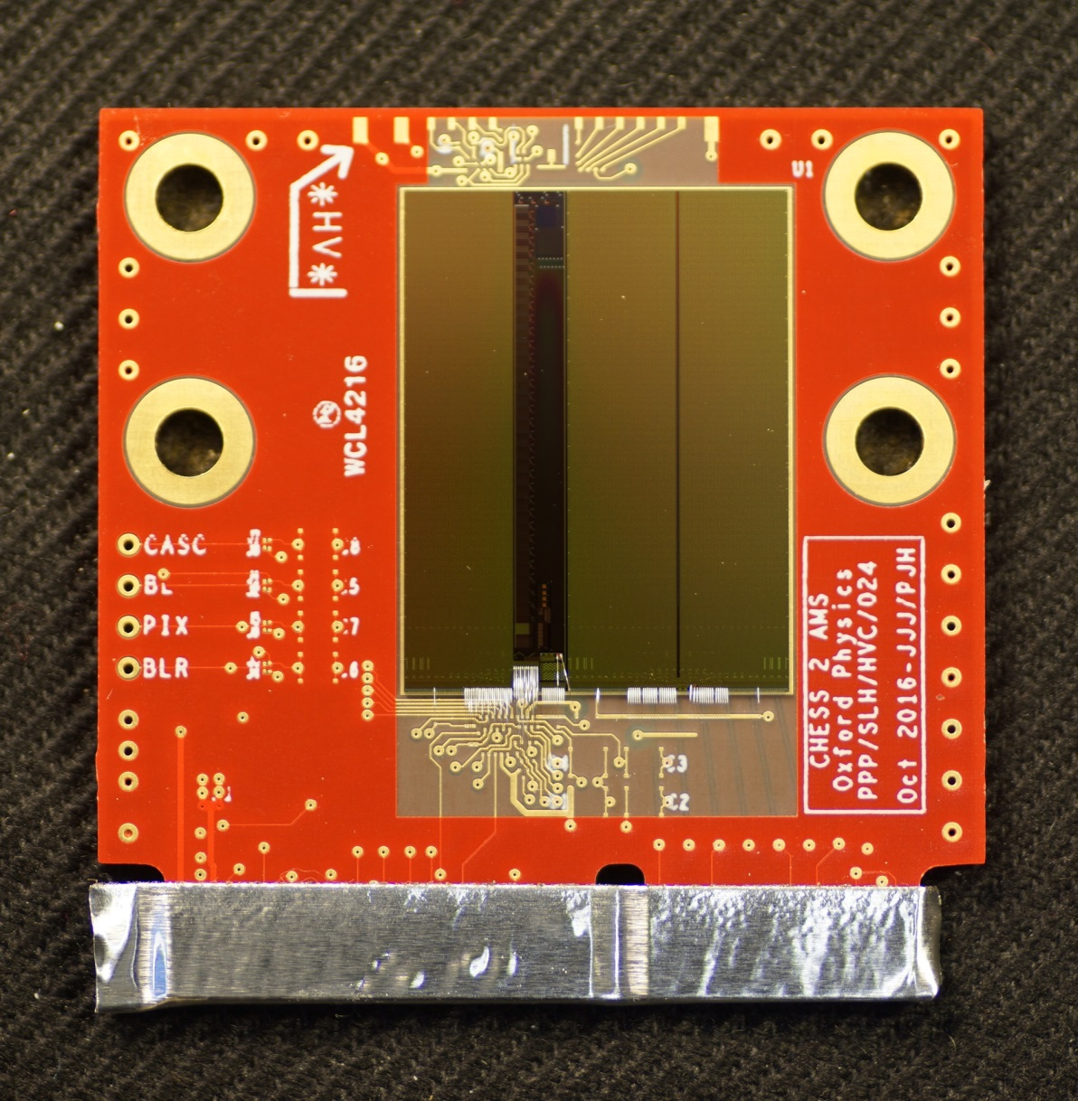
CHESS-2-AMS analogue daughterboard
Arrived – 100 daughterboards.
Since then, have been preparing for irradiation at PS (see later).
Many thanks to Paul Booker and
everyone at RAL for
wire-bonding these.
edge connector taped to short together all pads during proton irradiation

Slide 3
Final specs for analogue daughterboard
6 layers
pads for passive devices
bottom array: disable readout but enable SACI
It was not feasible to include 320 MHz readout of bottom array, in the end.
disable top and middle arrays
dual capacitor footprints:
wire-bondable on front, conventional on back
test array: configure and read out

Slide 4
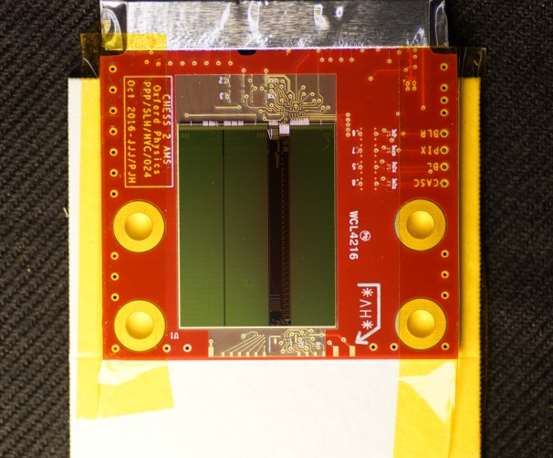
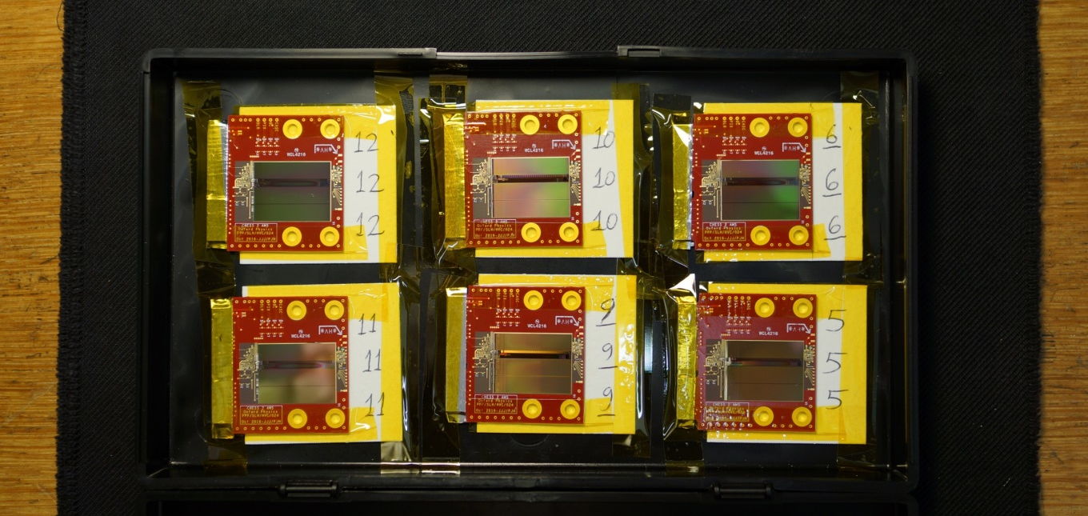
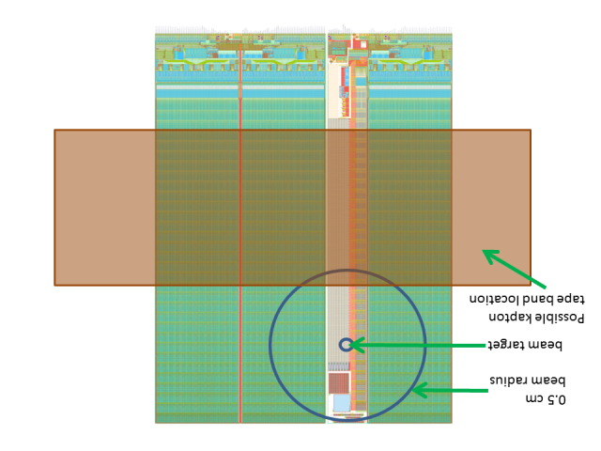
Irradiation at PS this week (starting Weds)
24 boards in all:
mounted on standard CERN cards
Daughterboard serial numbers | Wafer | Resistivity (Ω-cm) | Target dose
1 - 5 | w 1-2 | standard | 0.5 x 10¹⁵ n eq/cm²
6 - 10 | w 1-2 | standard | 1 x 10¹⁵ n eq/cm²
11- 15 | w 13-14 | 200-300 | 0.5 x 10¹⁵ n eq/cm²
16-20 | w 13-14 | 200-300 | 1 x 10¹⁵ n eq/cm²
21 - 22 | w 19-20 | 600-2000 | 0.5 x 10¹⁵ n eq/cm²
23 - 24 | w 19-20 | 600-2000 | 1 x 10¹⁵ n eq/cm²
Boards mounted on cards and packed
Thanks to Roy Wastie for preparing the cards.
beam centred as discussed:

Slide 5
Next steps for analogue work
Motherboards will need 1 IC changing (voltage reference, to be able to produce 3.6V from DACs).
    I am ordering these ICs for all institutes with CHESS-1 motherboards.
Ship analogue daughterboards and these ICs to institutes who requested analogue daughterboards.
        Will reconfirm people’s requests shortly.
Modify CHESS-1 motherboard, document steps -> TWiki
Add bonding diagrams and other documents -> TWiki
Update Atlys firmware for CHESS-2 including SACI – merge from UBC’s SACI code for ABCN’
Characterise

Slide 6
ABCN’ update
1) Data path:
UBC (Vancouver) have successfully completed the data path of the ABCN’
Tested via an FMC loopback cable on the Nexys Video FPGA board:
Emulated CHESS-2 data out of FPGA, across FMC loopback, back into FPGA, handled by ABCN’, read out by SCTDAQ software.
2) Next steps:
UBC is currently working on SACI code to talk to CHESS-2

Slide 7
CHESS-2 to FMC adaptor board
Status: design completed after many checks.
UBC is ordering 20 boards. Planning to assemble 10 boards to start.
ETA of boards ~2 weeks, then assembly.
Daughterboard connector
Adaptor board sketch:
HV
LV
4mm sockets
ground
regulators
and bias DAC
FMC connector
mounting holes
Key features:
Connects a CHESS-2 digital d/b to the Nexys Video via FMC connector
Allows the Nexys Video to read 1 of 3 strip arrays
Provides voltage supplies, HV connection and external bias DACs
FMC connector wired so that the other 2 strip arrays are connected to the High Pin Count pins
  Could be connected to various high pin count FMC evaluation boards if need be.

Slide 8
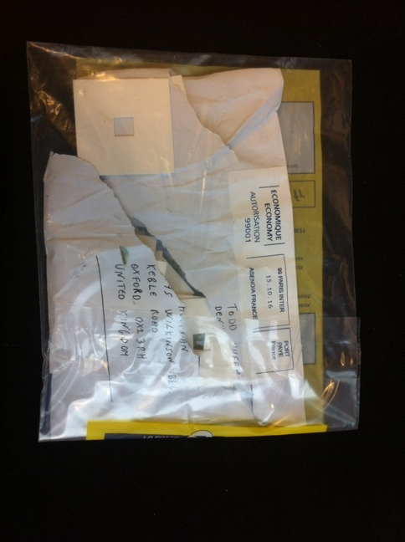
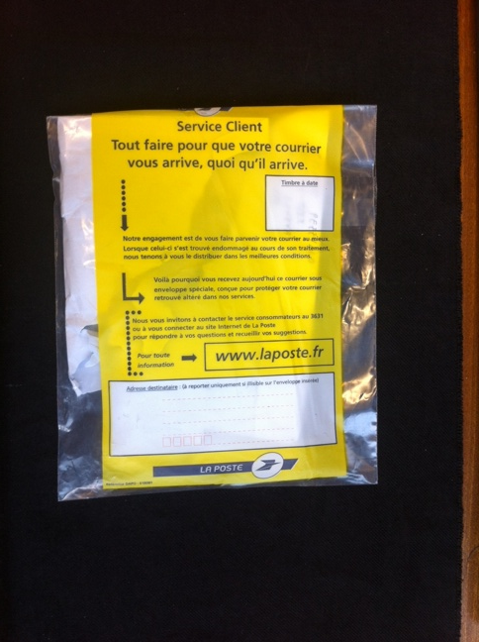
Things that happen along the way
The La Poste envelope reads: "customer service - doing everything so that your post arrives, no matter what happens."

