Slide 1
The Photon Commissioning Team
Harald Sinn
5.10.2016

Slide 2
Agenda
The photon commissioning team
Scheduling of shifts
Redmine ticket system for technical problems

Slide 3
The Photon Commissioning Team (PCT)
Basic idea and mission: Whenever photon beam components will be commissioned, two (or at least one) knowlegable people with X-ray experience should be in the DESY control room (BKR)
The two PCT members work seamlessly together with the DESY BKR team consisting of Machine Physicists and Operators
The BKR team works 24/7, the photon experts join about 3-4 days per week (excluding the ‘machine-only’ relevant shifts)
The PCT team will lead through the commissioning of all SASE X-ray beam transports, including an initial commissioning time for each instrument
For user experiments during operation and further commissioning tasks, new arrangements will be found (from Schenefeld control rooms)
To sustain a 3-shift operation for 3-4 days per week over a longer period (e.g. March17-Nov17), a team of currently 17 people is foreseen (some working only part-time for commissioning)

Slide 4
Commissioning team members (initial)
Harald Sinn: WP73
Liubov Samoylova WP73
Sergey Tomin: WP72
Naresh Kujala: WP74
Peter Zalden: WP81
Zuzana Konopkova: WP82
Thomas Roth: WP83
Marcin Sikorski: WP84
Markus Ilchen: WP85
Manuel Izquiredo: WP86
Associates (not working ‘full time’):
Yuhui Li (WP71 beam based alignment, undulator tuning)
Gianluca Geloni, Svitozar Serkez (WP72)
Natalia Gerasimova (WP73, max. 50%)
Andreas Koch (WP74, max 50%)
Karen Appel (WP82, max 50%)
Marc Messerschmidt (WP84)
from each scientific instrument one full time member
10 + 7 = 17 members

Slide 5
Tasks of commissioning team
Lead photon commissioning (plan, invite experts, guests etc.) and bring facility into operation on a fast track.
Documentation:
Gather technical documentation required for first commissioning
Document commissioning progress in BKR logbook
Communication
Progress should be made known to all members of the PCT
Meetings
Daily BKR meetings 7:00, 15:00, 23:00
Weekly BKR meeting Monday 15:00
To be defined: corresponding meetings in Schenefeld
Workshop with DESY on Nov. 24-25
Shift work (< 25% of annual working time)

Slide 6
Shift allocation rules for PCT (Matlab macro)
Allocated shifts: ‘Photon Systems’ +’Exp. Comm.’ (but not ‘Early User’ )
3 shifts per day:
Day shift 7:00 – 15:30
Swing shift 15:00 – 23:30
Owl shift 23:00 – 7:30
After one shift at least 2 shifts break (legal limit: 11 hours)
Two people on each shift (after June only one per owl shift)
Maximum 10 shifts per month
Maximum 5 shifts per week
Exclusion times (vacation, travel, .. )
Average: 48 shifts in 2017 (‘full time’ participant)
Shifts are otherwise randomly distributed (try to mix shift-partners)
Weight = (targeted shifts per year) / (already allocated shifts)

Slide 7
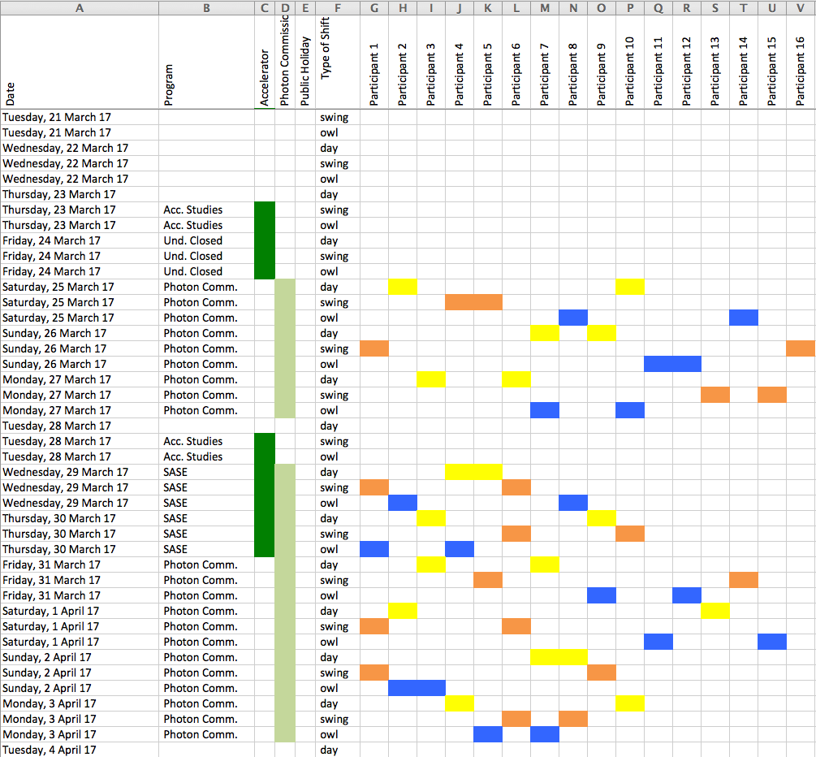

Slide 8
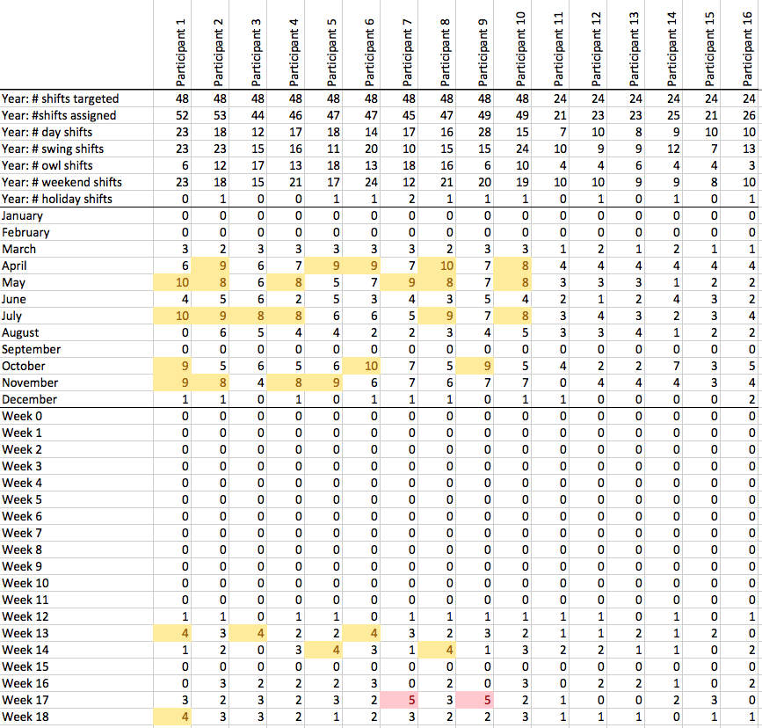

Slide 9
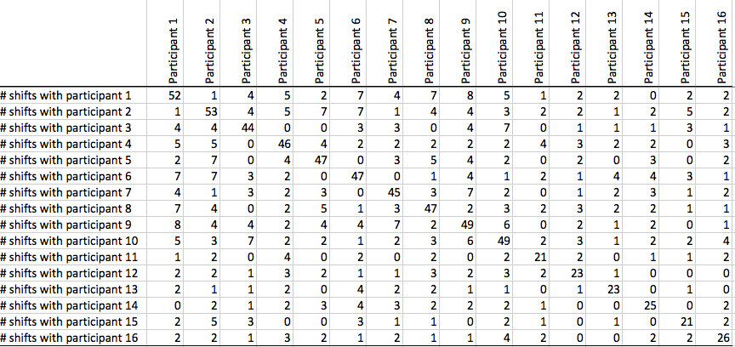
Shift partner correlation matrix

Slide 10
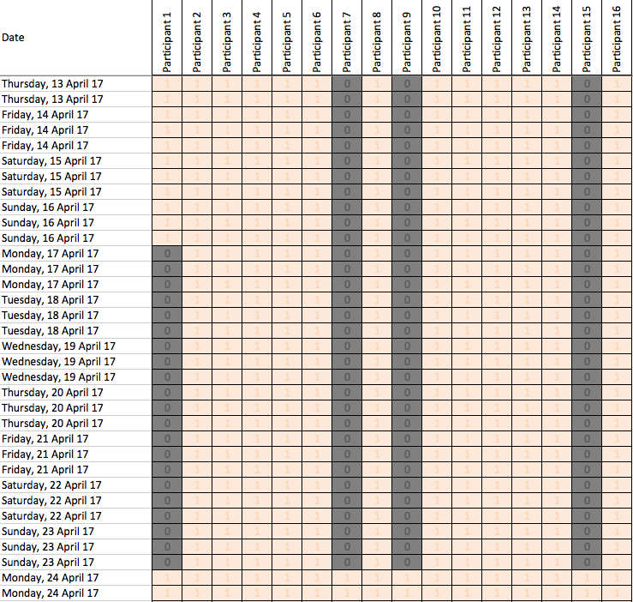
Input: Operation Plan + Vacation matrix (Excel)

Slide 11
Further comments shift allocation
Shift plan will be released 4 weeks (?) before (e.g. beginning of the month for following month)
Vacation/absence planning should be done as soon as possible
Swopping of individual shifts should be possible, but should go into the ‘official’ shift plan
Additional time spent in BKR will not be compensated
Some members may change after initial 3-4 month period
Some guests (SLAC) may join us for 2-4 week periods

Slide 12
Ticket system
Purposes:
Being able to point out technical problems that show up during BKR commissioning
Make (EXFEL) workpackage leader aware of it (automated emails will be sent)
Trace resonses/actions (max. 2 weeks)
Communicate in 15:00 BKR meeting
Communicate in daily EXFEL meeting
and not:
Micro-manage long-term work of others
Project planning and issue archive

Slide 13
Ticket system
Redmine Project under XFEL domain
Go to:
https://in.xfel.eu/redmine/
.. and login with your DESY password
(will not be required later for looking, but for placing and answering ticktes)

Slide 14
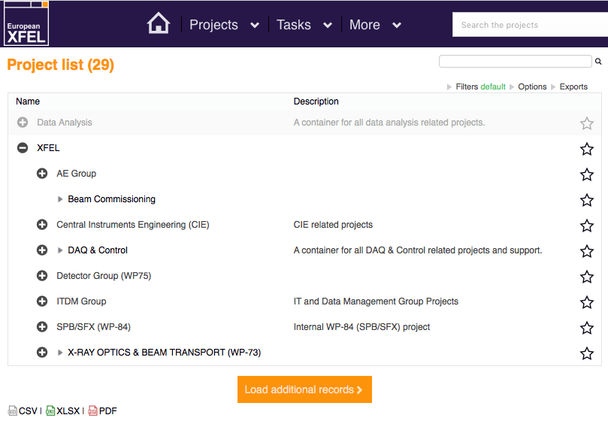

Slide 15
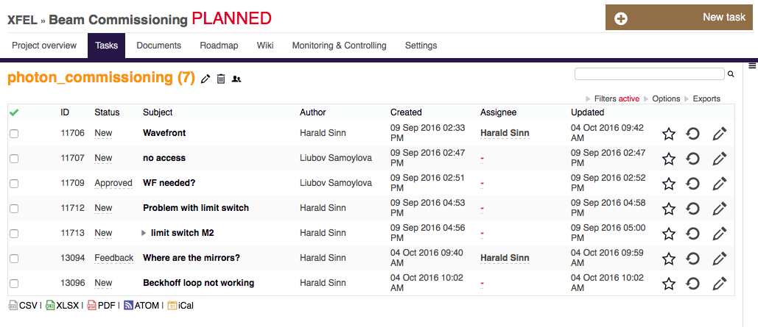
List of problems + responses

Slide 16
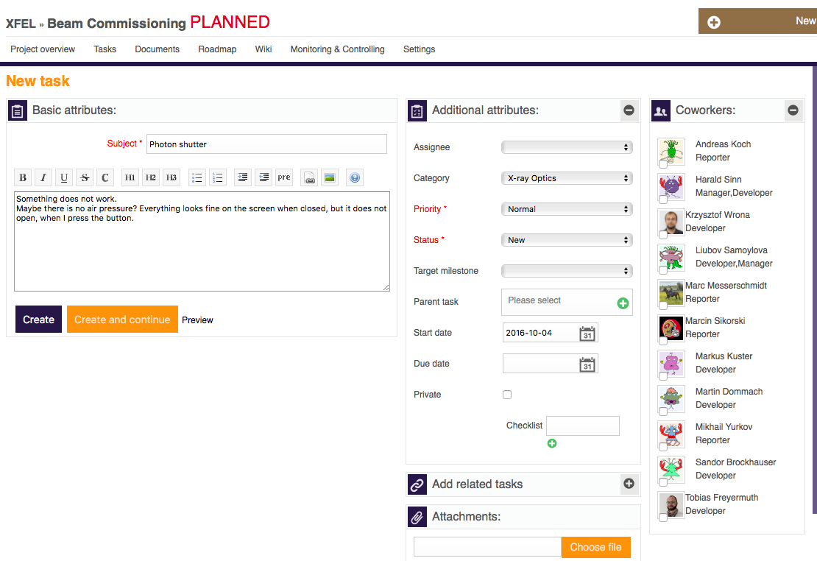
Enter a new ticket
Only write tickets for something that should (and can) be solved within max. 2 weeks!
Attributes are not so important (‘no category’ will go to me and will be assigned in meeting).

Slide 17
Concluding remarks
Redmine Ticket System:
For everybody, who is part of the commissioning team, please log in once in the Redmine system with your regular DESY/XFEL password. Only then I can assign a role.
At the moment the project ‘beam commissioning’ is in the ‘planned’ state, which means no messages are sent around.
It will become acrive next year (all old tickets will be erased then).
Shift planning:
Provide input on already known vacation/absence periods 2017 in Excel file (in Redmine ‘Documentation’ section).
Let me know, if you have more ideas and wishes on the shift distribution algorithm.

