Slide 1
Testing Goodness of Fit
Dr. Wolfgang Rolke
University of Puerto Rico - Mayaguez
Terascale Statistics School 2017
Hamburg - Germany

Slide 2
Table of Content
The Archetypical Statistics Problem
Example: Is the die fair?
Most Famous Answer: Pearson $X^{2}$
Pearson’s Reasoning
Hypothesis Testing Basics
Another Derivation of $X^{2}$
Mendel-Fisher Controversy
Monte Carlo Simulation
Fisherian Significance Testing vs Neyman-Pearson

Slide 3
Overfitting
Continuous Data
EDF Methods
Kolmogorov-Smirnov
$X^{2}$ vs K-S
Probability Plots
Smooth Tests
Multidimensional Data
Special Cases
2 Sample Problem
GOFer - Online Goodness-of-Fit Testing

Slide 4
The Archetypical Statistics Problem:
There is a theory
There is data from an experiment
Does the data agree with the theory?

Slide 5
Example: Is the die fair?
Theory: die is fair ($p_{i}=1/6$)
Experiment: roll die 1000 times
If die is fair one would expect 1000*1/6 = 167 1’s, 2’s and so on
Data:
Good fit?
1 | 2 | 3 | 4 | 5 | 6
187 | 168 | 161 | 147 | 176 | 161

Slide 6
Most Famous Answer: Pearson $X^{2}$
Sir Karl Pearson 1900,
“On the criterion that a given system of deviations from the probable in the case of correlated system of variables is such that it can be reasonably supposed to have arisen from random sampling”, Phil. Mag (5) 50, 157-175

Slide 7
Use as measure of deviations
$X^{2}$=$\sum{\frac{{(O−E)}^{2}}{E}}$
O: observed counts
E: expected counts
Agreement is bad if $X^{2}$ is large
But why $\sum{\frac{{(O−E)}^{2}}{E}}$, why not (say) $\sum{\frac{{(O−E)}^{2}}{O}}$ or $\sum{|O−E|}$ or $max\left\{\left|O−E\right|\right\}$ ?

Slide 8
 | 1 | 2 | 3 | 4 | 5 | 6
O | 187 | 168 | 161 | 147 | 176 | 161
E | 167 | 167 | 167 | 167 | 167 | 167
Is 5.72 “large”?
If die is fair and rolled 1000 times, how large would $X^{2}$ typically be?
$$X^{2}=\frac{{(187−167)}^{2}}{167}+..+\frac{{\left(161−167\right)}^{2}}{167}=5.72$$

Slide 9
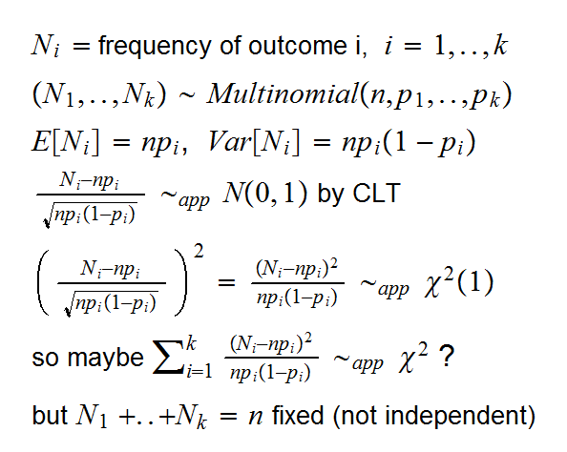
Pearson’s Reasoning

Slide 10
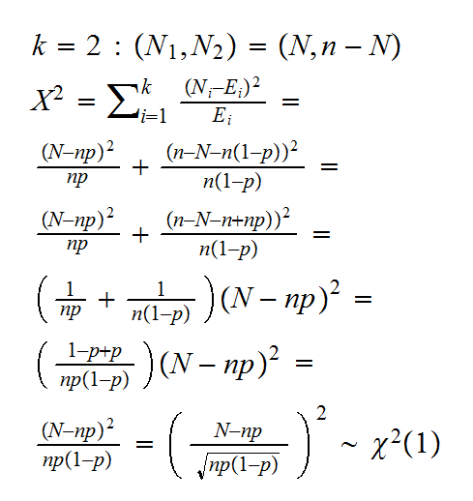

Slide 11
Pearson: $X^{2}$ has a chi square distribution with k-1 degrees of freedom (k=number of categories)
Here: mean of $χ^{2}\left(5\right)=5$
So our $X^{2}=5.72$ is not unusually large, die is fair.
In the derivation of the distribution of $X^{2}$ we used the CLT approximation, so this needs a sufficiently large sample size. But how large does it have to be?
Famous answer: $E≥5$
William G. Cochran The [chi-squared] test of goodness of fit. Annals of Mathematical Statistics 1952; 25:315–345.
Seems to have picked 5 for no particular reason. Later research showed this is quite conservative.

Slide 12
Hypothesis Testing Basics
Type I error: reject true null hypothesis
Type II error: fail to reject false null hypothesis
1: A HT has to have a true type I error probability no higher than the nominal one
2: The probability of committing the type II error should be as low as possible (subject to 1)
Historically 1 was achieved either by finding an exact test or having a large enough sample.

Slide 13
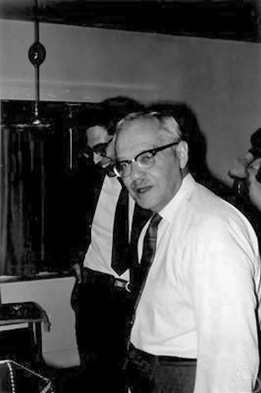
Another Derivation of $X^{2}$
Neyman, Jerzy; Pearson, Egon S. (1933). "On the Problem of the Most Efficient Tests of Statistical Hypotheses". Philosophical Transactions of the Royal Society A: Mathematical, Physical and Engineering Sciences. 231 (694–706):
In a test of a simple vs simple hypotheses likelihood ratio test is most powerful

Slide 14
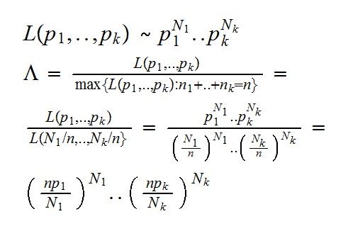

Slide 15
Samuel S. Wilks: “The Large-Sample Distribution of the Likelihood Ratio for Testing Composite Hypotheses”, The Annals of Mathematical Statistics, Vol. 9, No. 1 (Mar., 1938), pp. 60-62
$$−2logΛ\sim χ^{2}\left(k−1\right)$$

Slide 16
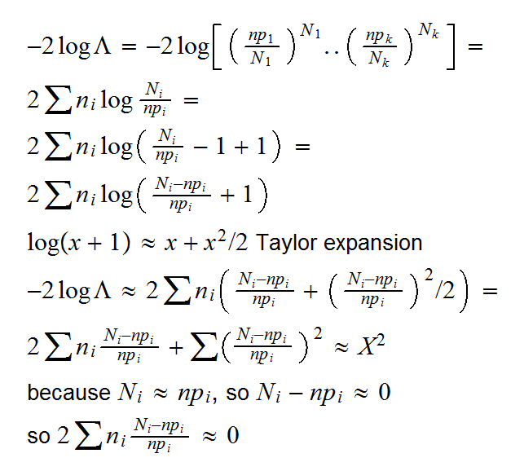

Slide 17
The Degree of Freedom Controversy
Not
$H_{0}:F=Normal(0,1)$ (simple hypothesis)
but
$H_{0}:F=Normal$ (composite hypothesis)
Idea: find estimates of parameters, use those.
Any change in test? Pearson said no.
In 1915 Greenwood and Yule publish an analysis of a 2x2 table and note that there is a problem.
In 1922, 1924 and 1926 Sir Karl Fisher published several papers showing that Pearson was wrong.

Slide 18
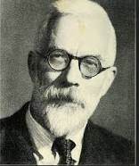
If m parameters are estimated
$$X^{2}\sim χ^{2}(k−1−m)$$
The 1922 paper is the first ever to use the term “degrees of freedom”.
In some ways this is an astonishing result: it does not seem to matter how well one can estimate the parameter (aka what sample size is used)
Does it matter what method of estimation is used? Yes, and it has to be minimum chisquare!
Except these days everyone is using maximum likelihood, and then this result can be wrong
Pearson didn’t acknowledge Fisher was right until 1935!

Slide 19
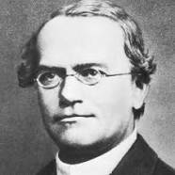
Mendel-Fisher Controversy
Mendel, J.G. (1866). "Versuche über Pflanzenhybriden", Verhandlungen des naturforschenden Vereines in Brünn, Bd. IV für das Jahr, 1865, Abhandlungen: 3–47
Discovery of Mendelian inheritance
Immediate impact on Science: ZERO!
Darwin could have used this when he wrote On The Origin of Species.
His cousin Francis Galton (inventor of regression!) could have told him.

Slide 20
Around 1900, Hugo de Vries and Carl Correns
first independently repeat some of Mendel’s
experiments and then rediscover Mendel's
writings and laws.
Finally Mendel becomes the “Father of Genetics”
Fisher, R.A. (1936). "Has Mendel's work been rediscovered?" . Annals of Science. 1 (2): 115–137.
Fisher re-analyzed Mendel’s data and applied the $X^{2}$ test to all of them together. He finds an (almost) perfect agreement. But inheritance is intrinsically random, the agreement should not be that good.
Fisher’s words: “to good to be true”

Slide 21
$X^{2}$ large (blue area)
→ difference between O and E to large
→ theory doesn’t agree with data
$X^{2}$ small (red area)
→ difference between O and E to small
→ Cheating!

Slide 22
More than 50 papers published since 1936 have tried to figure out what happened.
For a long time: it was the Gardener!
Another explanation, which seems to have gained momentum in recent years: It was early in the history of experimentation, modern ideas of how to avoid (even unconscious) biases were not yet developed.
Allan Franklin, A. W. F. Edwards, Daniel J. Fairbanks, Daniel L. Hartl and Teddy Seidenfeld. “Ending the Mendel-Fisher Controversy”, University of Pittsburgh Press, 2008.

Slide 23
Variations on $X^{2}$
Question used to be: which converges fastest to $χ^{2}$?
But these day null distribution can be found most easily using Monte Carlo simulation!

Slide 24
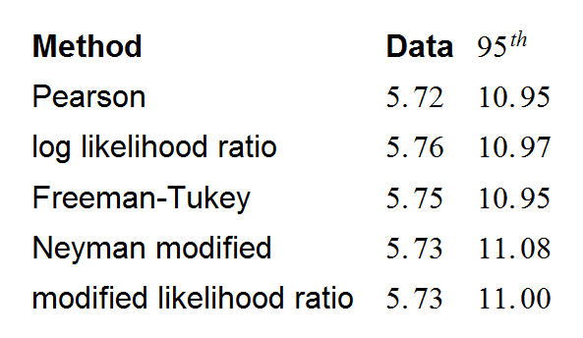
Monte Carlo Simulation
function(B=1e4) {
O<-c(187,168,161,147,176,161)
E<-rep(1,6)/6*1000
TS.Data<-rep(0,5)
TS.Data[1]<-sum( (O-E)^2/E)
TS.Data[2]<-2*sum(O*log(O/E))
TS.Data[3]<-4*sum( (sqrt(O)-sqrt(E))^2)
TS.Data[4]<-sum( (O-E)^2/O)
TS.Data[5]<-2*sum(E*log(E/O))
TS.Sim<-matrix(0,B,5)
for(i in 1:B) {
O<-table(sample(1:6,size=1000,replace=T))
TS.Sim[i,1]<-sum( (O-E)^2/E)
TS.Sim[i,2]<-2*sum(O*log(O/E))
TS.Sim[i,3]<-4*sum( (sqrt(O)-sqrt(E))^2)
TS.Sim[i,4]<-sum( (O-E)^2/O)
TS.Sim[i,5]<-2*sum(E*log(E/O))
}
list(TS.Data,apply(TS.Sim,2,quantile,0.95))
}

Slide 25
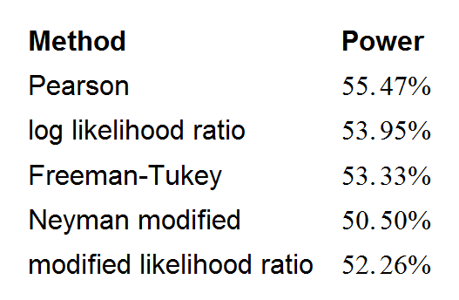
Question today: Which Method has highest Power?
function(B=1e4) {
crit95<-c(10.95, 10.97, 10.95, 11.08, 11.00)
E<-rep(1,6)/6*1000
TS.Sim<-matrix(0,B,5)
for(i in 1:B) {
O<-table(sample(1:6,size=1000,replace=T,
prob=c(1.25,1,1,1,1,1)))
TS.Sim[i,1]<-sum( (O-E)^2/E)
TS.Sim[i,2]<-2*sum(O*log(O/E))
TS.Sim[i,3]<-4*sum( (sqrt(O)-sqrt(E))^2)
TS.Sim[i,4]<-sum( (O-E)^2/O)
TS.Sim[i,5]<-2*sum(E*log(E/O))
}
power<-rep(0,5)
for(i in 1:5) power[i]<- s sum(TS.Sim[,i]>crit95[i])/B
power
}

Slide 26
Fisherian Significance Testing vs Neyman-Pearson
Fisher’s question: does data agree with theory?
Neyman-Pearson’s question: should one reject the null hypothesis in favor of some specific alternative?
Main advantage of Neyman-Pearson style test: can decide which method is better (aka has a higher power)
Today’s procedure is a hybrid of both
GOF testing much closer to Fisherian significance testing, except when we have a specific alternative in mind

Slide 27
George Box: All models are wrong, but some are useful
Probability models are theoretical constructs, one can not expect them to be perfect fits in real life (“there is no perfect circle in nature”)
→ how close an agreement between null and data is needed depends on context
→ related to choice of type I error probability ɑ, 5%? 1%? 5σ (I hope not!)

Slide 28
Overfitting
Usual question: is our theory a good enough model for the data?
We also should worry about: is our model better than it should be?
Overfitting!

Slide 29
Exponential Model - Good Fit?
$χ^{2}$ (6 bins): p value = 0.111
KS test: p value = 0.117

Slide 30
Typical procedure (especially for background fits):
Start with low degree polynomial
Add higher degrees until fit looks good
If GOF done by “visual inspection” quite likely leads to overfitting.
Additional problem: Version of “look-elsewhere effect” (aka simultaneous inference)

Slide 31
Continuous Data
Need to bin the data
In principle any binning is ok
Two Questions:
What kind of bins?
How many bins?

Slide 32
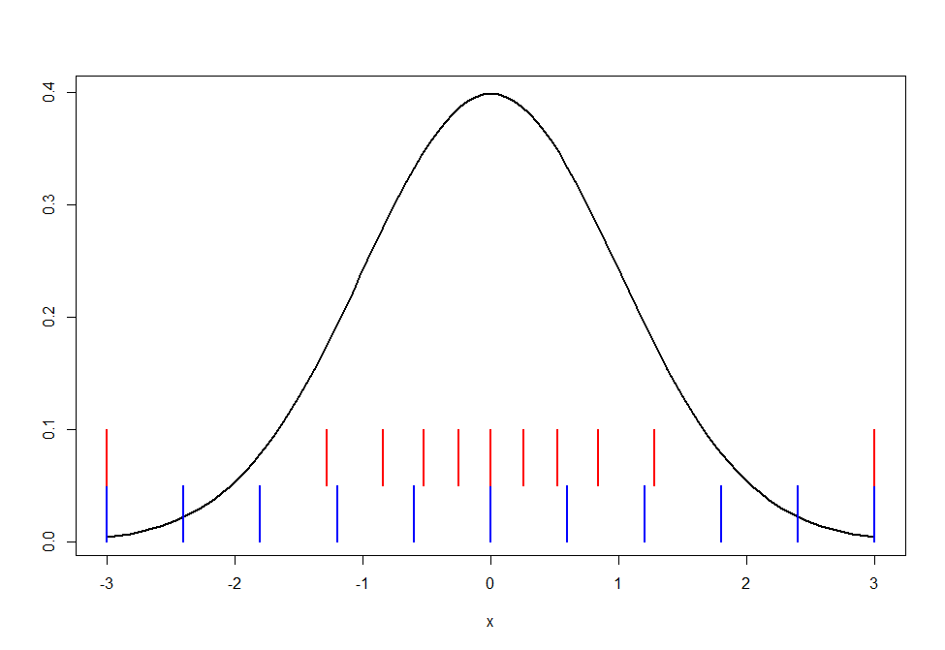
What kind of bins?
Equi-distant – Equi-probable

Slide 33
Most studies suggest equi-probable is better
One advantage: E=1/k >> 5 for all bins, no need to adjust binning
Major advantage: In general leads to tests with higher power
Bins can be found easily as quantiles of F or as quantiles of data

Slide 34
How many bins?
Textbook answer: $k=2n^{2/5}$
D’Agostini and Stephens (1986) “Goodness-of-Fit Techiques”
But: really depends on alternative
Example: $H_{0}:X\sim U\left[0,1\right] vs{ H}_{a}:X\sim Linear$
Optimal k: k=2!

Slide 35
EDF Methods
EDF: Empirical Distribution Function
$\hat{F}\left(x\right)→F\left(x\right)$ uniformly (Glivenko-Cantelli lemma)
so
$$D\{\hat{F}\left(x\right),F\left(x\right)\}$$
where D is some distance measure on function space can be used for goodness-of-fit test.

Slide 36
Theorem: (Probability Integral Transform)
Let X be a continuous random variable with distribution function F, then the random variable
Y = F(X) has a uniform (0,1) distribution.
Consequence: D is distribution free, aka does not depend on F.
One table to rule them all!
Except this does not work if parameters are estimated from data!

Slide 37
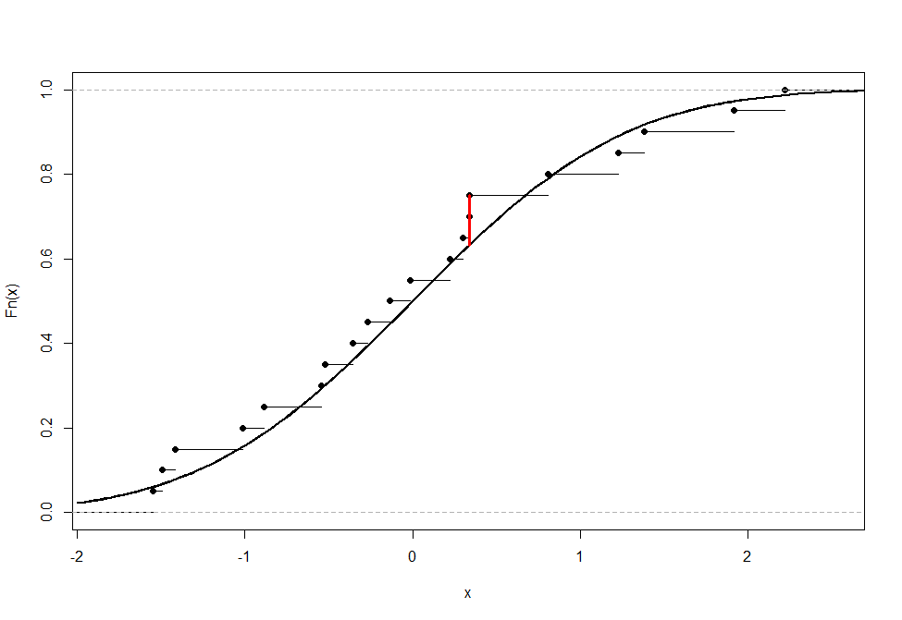
Kolmogorov-Smirnov
$$KS=max\left\{\left|\hat{F}\left(x\right)−F\left(x\right)\right|;x\right\}=$$
$$max\left\{\left|\frac{i}{n}−F\left(X_{(i)}\right)\right|,\left|F\left(X_{(i)}\right)−\frac{i−1}{n}\right|\right\}$$
Kolmogorov A (1933). "Sulla determinazione empirica di una legge di distribuzione". G. Ist. Ital. Attuari. 4: 83–91.
Smirnov N (1948). "Table for estimating the goodness of fit of empirical distributions". Annals of Mathematical Statistics. 19: 279–281

Slide 38
Alternatives
Anderson-Darling
Anderson, T. W.; Darling, D. A. (1952). "Asymptotic theory of certain "goodness-of-fit" criteria based on stochastic processes". Annals of Mathematical Statistics. 23: 193–212.
Cramer-vonMises
Cramér, H. (1928). "On the Composition of Elementary Errors". Scandinavian Actuarial Journal. 1928 (1): 13–74. doi:10.1080/03461238.1928.10416862.
von Mises, R. E. (1928). Wahrscheinlichkeit, Statistik und Wahrheit. Julius Springer.
And more…
Modern theory based on convergence of $\hat{F}$ to Gaussian process

Slide 39
None of these allows estimation of parameters except in some special cases:
$H_{0}:X\sim Normal$
Hubert Lilliefors (1967), "On the Kolmogorov–Smirnov test for normality with mean and variance unknown", Journal of the American Statistical Association, Vol. 62. pp. 399–402.
$H_{0}:X\sim Exponential$
Hubert Lilliefors (1969), "On the Kolmogorov–Smirnov test for the exponential distribution with mean unknown", Journal of the American Statistical Association, Vol. 64 . pp. 387–389.
But then again, just find null distribution via Monte Carlo!

Slide 40
R package KScorrect
Uses maximum likelihood to estimate parameters and Monte Carlo simulation to estimate null distribution
Example:
> x<-rexp(1000,1)
> LcKS(x,"pexp")$p.value
[1] 0.3998

Slide 41
Later I will show you another way to do GOF testing!

Slide 42
$X^{2}$ vs K-S
$H_{0}:F=Uniform\left[0,1\right]$
$$H_{a}: F = Linear [0,1]$$
Sample size: n=1000
$X^{2}$: 32 bins
(here Equi-distant = Equi-probable )

Slide 43
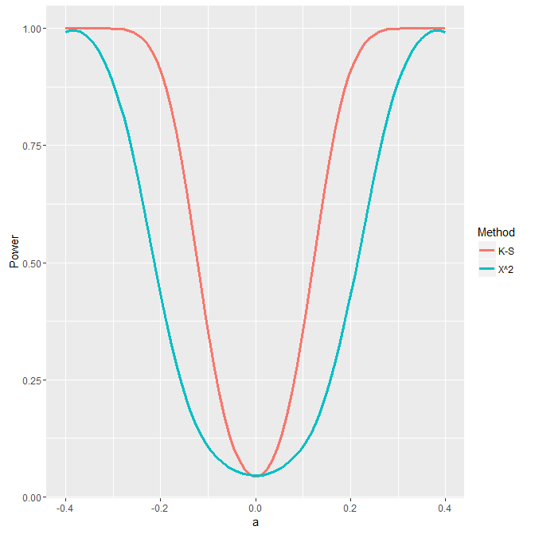

Slide 44
Probability Plots
Plot quantiles of F vs sample quantiles
If F is correct model, points form a straight line

Slide 45
Turn this into a formal test
Again Probability Integral Transform:
$X\sim F → F(X)\sim U[0,1]$
$\left(U_{1},..,U_{n}\right) iid U\left[0,1\right]$
Order Statistic $U_{(1)}<...<U_{(n)}$
$$U_{(k)}\sim Beta\left(k,n−k+1\right)$$
Find pointwise confidence intervals from quantiles of Beta distribution
Turn into simultaneous confidence band by adjusting nominal confidence level

Slide 46
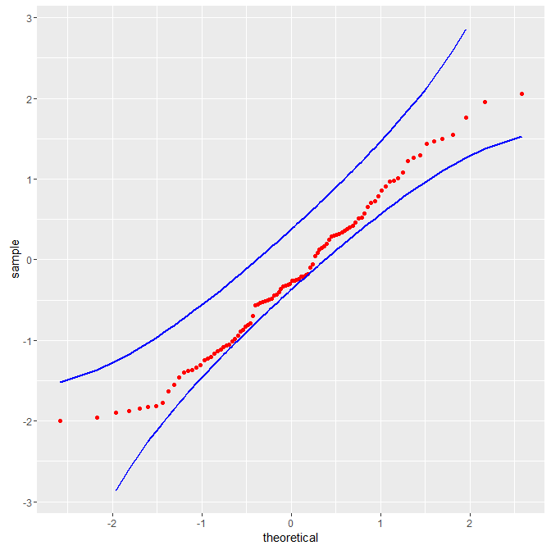
Sivan Aldor-Noima, Lawrence D. Brown, Andreas Buja , Robert A. Stine and Wolfgang Rolke, “The Power to See: A New Graphical Test of Normality”, The American Statistician (2013), Vol 67/4
Andreas Buja, Wolfgang Rolke “Calibration for Simultaneity: (Re) Sampling Methods for Simultaneous Inference with Applications to Function Estimation and Functional Data”, Technical Report, Wharton School of Business, Univ. of Pennsylvania
R routines: http://academic.uprm.edu/wrolke/research/publications.htm

Slide 47
Smooth Tests
Old idea – goes back to Neyman (1937) – but with some recent improvements.
Basic idea: embed density f in family of densities $\left\{g_{k}\right\}$ indexed by some parameter vector $Θ=(θ_{1},..,θ_{k})$ which includes true density for some k and such that
$H_{0}:true density is f↔$ $H_{0}: Θ=$0

Slide 48
$\left\{h_{j}\right\}$ should be orthonormal family of functions, i.e.
optimal choice of $\left\{h_{j}\right\}$ depends on f!

Slide 49
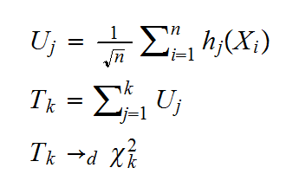
Typical choices for $\left\{h_{j}\right\}$:
Legendre Polynomials, Fourier series, $h_{j}$(x)=$\sqrt{2}\cos\left(jπx\right),$Haar functions, ….
Basics of the test:
Interesting feature: partial tests $\left(θ_{1},..,θ_{m}\right)=0$ for m<k can give insight into HOW null is wrong.

Slide 50
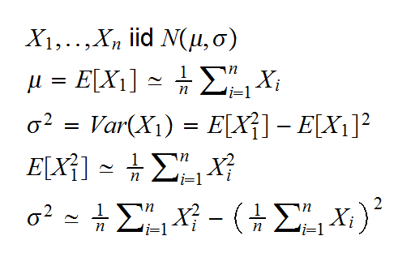
testing composite hypotheses is possible
Quite unusual: best method for estimating parameters: MoM (method of moments)
Example:

Slide 51
And many more…
Tests based on moments
Tests specific for a distribution (Normal: more than 20 tests)
A good place to start: “Comparing Distributions”, Olivier Thais, Springer

Slide 52
Multidimensional Data
$χ^{2}$ tests: Curse of Dimensionality (R. Bellman)
Example: ${H_{0}: (X}_{1},..,X_{d})\sim U[0,1]^{d}$
We want E$≥5$ and we want 10 bins in each dimension. What n do we need?
d=1: $E=n/{10}≅5→n≅$ 50
d=2: $E=n/{{10}^{2}}≅5→n≅$ 500
d=3: $E=n/{{10}^{3}}≅5→n≅$ 5000
…
d=10: $E=n/{{10}^{10}}≅5→n≅$ 50 billion

Slide 53
EDF Tests
EDF needs an ordering.
What comes first in $R^{2}:\left(0,1\right) or (1,0)$?
One can impose an ordering but in $R^{d}$ there are $2^{d}−1$ ways to do it!
Also, Probability Integral Transform no longer works, so KS test is no longer distribution free.
But one can always use MC to find null distribution.

Slide 54
GOF tests beyond 2 or 3 dimensions unlikely to be very useful.
At the very least will require gigantic data sets
Still a wide open problem!

Slide 55
Special Cases
Often data has special features that need to be taken into account
Example: High Energy Physics
Data is truncated
Sample size is random
Data is binned

Slide 56
Truncated Data
Data in High Energy Physics is always truncated to a finite interval.
Care needs to be taken with normalization (aka $\int_{−∞}^{∞}{f\left(x\right)dx}=1$)

Slide 57
Sample Size
In HEP experiments sample size is not fixed a-priori but is a consequence of the run time
n$\sim Poisson(λ)$
If n is fixed: $\left(N_{1},..,N_{k}\right)\sim Multinomial(n,p_{1},..,p_{k}$)
But if n is Poisson
$$N_{i}\sim Poisson(λ{p_{i}) and N}_{1},..,N_{k} independent!$$
(Theory of Marked Poisson processes)
Consequence: $X^{2}\sim χ^{2}(k)$ (not k-1)
Not an issue if null distribution is found via MC

Slide 58
Binned Data
Data in HEP is often already binned for various reasons, for example detector resolution
Still need to consider rebinning for chi square tests.
How about Kolmogorov-Smirnov?
$$KS=max\left\{\left|\frac{i}{n}−F\left(X_{(i)}\right)\right|,\left|F\left(X_{(i)}\right)−\frac{i−1}{n}\right|\right\}$$
But we only know ${b_{i}<X}_{(i)}<b_{i+1}$

Slide 59
Obvious answer: $x_{i}=\frac{b_{i}+b_{i+1}}{2}$ midpoint
Better answer: spread out $N_{i}$ points in ${(b}_{i},b_{i+1})$
according to F.
Can be quite slow (requires finding quantiles of F, solve many non-linear equations), in practise spreading them uniformly almost as good.

Slide 60
2-Sample Problem
Say we have
$X_{1}, .. ,X_{n}\sim F$ and $Y_{1}, .. ,Y_{m}\sim G$
and we want to test
$$H_{0}:F=G vs H_{0}:F≠G$$

Slide 61
At first this seems a very different problem, but fairly generally a method for one can be turned into a method for the other.
Example: Kolmogorov-Smirnov
GOF: $KS=max\left\{\left|\hat{F}\left(x\right)−F\left(x\right)\right|;x\right\}$
2-Sample: $KS=max\left\{\left|\hat{F}\left(x\right)−\hat{G}\left(x\right)\right|;x\right\}$

Slide 62
Permutation Tests
Under $H_{0}:F=G$
so
$$X_{1}, .. ,X_{n}, Y_{1}, .. ,Y_{m}\sim F$$
samples are independent, so any reordering is equally likely.
Basic permutation test:
Find random permutation of data, split in vectors of size n and m, calculate test statistic, repeat many times. Compare to actual data.

Slide 63
Power
$$F=N\left(0,1\right) G=N(μ,1)$$
in example: n=50
Compare to classic 2-sample t test:
$$TS=\frac{\overline{X}−\overline{Y}}{s_{p}\sqrt{\frac{1}{n}+\frac{1}{m}}} \sim t_{n+m−2,α/2}$$

Slide 65
GOFer Online Goodness-of-Fit Testing
No knowledge of R required
Can handle continuous or binned data
Can handle model specified via expression (density) or via bin probabilities
Model expressions can be specified via R or C++
Finds a variety of standard tests (Chisquare variants and EDF tests)
Allows for “optimal” binning

Slide 66
How to run App
App is online at https://drrolke.shinyapps.io/GOFer/
You can install all you need to run the app on your computer in less than 10 minutes. To see how go here http://academic.uprm.edu/wrolke/GOFer/
Page also has detailed explanations on how to use app.

Slide 67
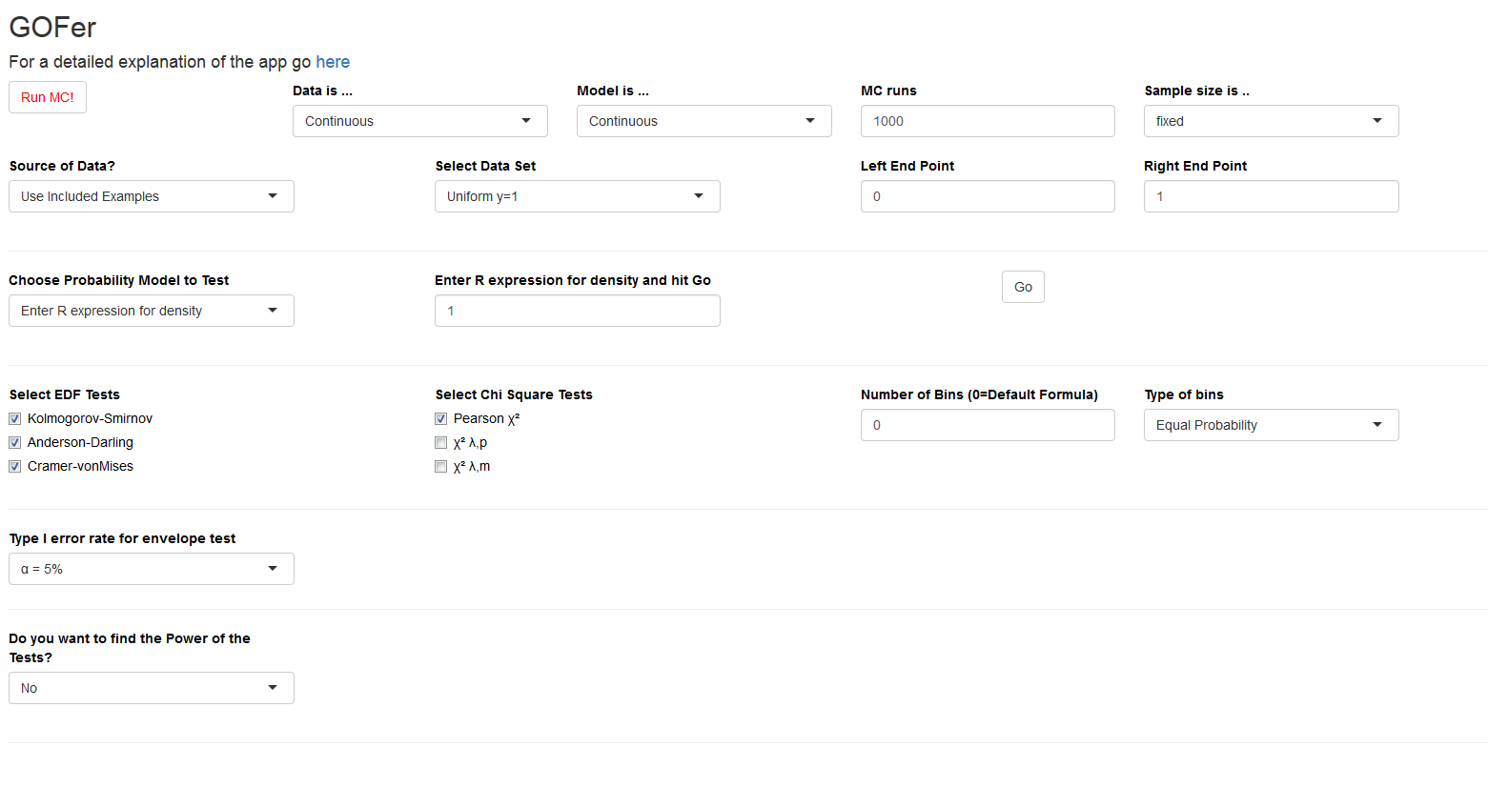

Slide 68
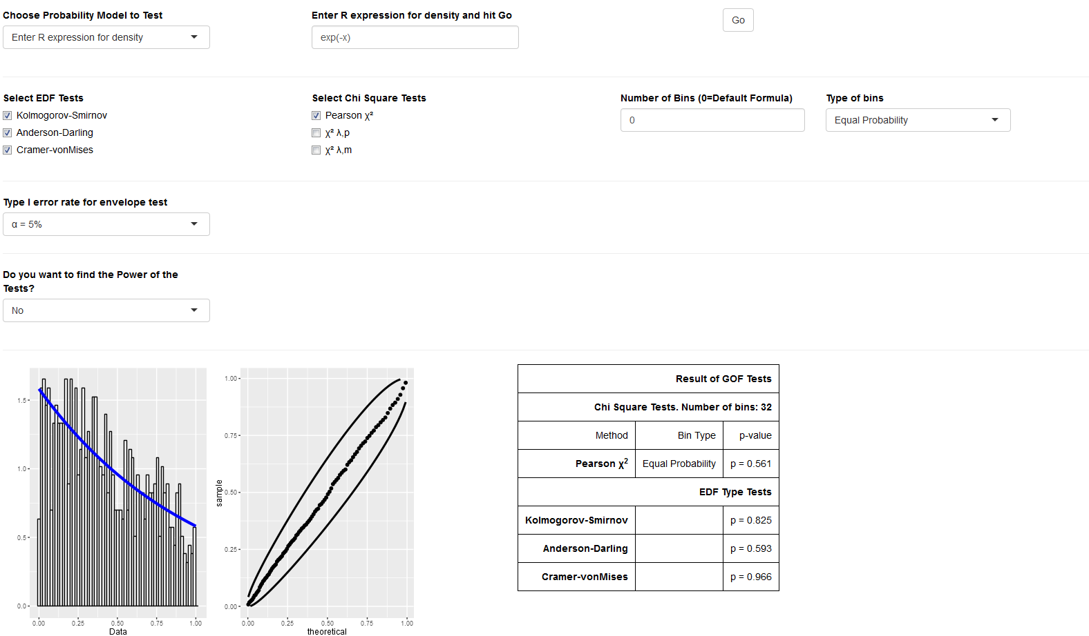

Slide 69
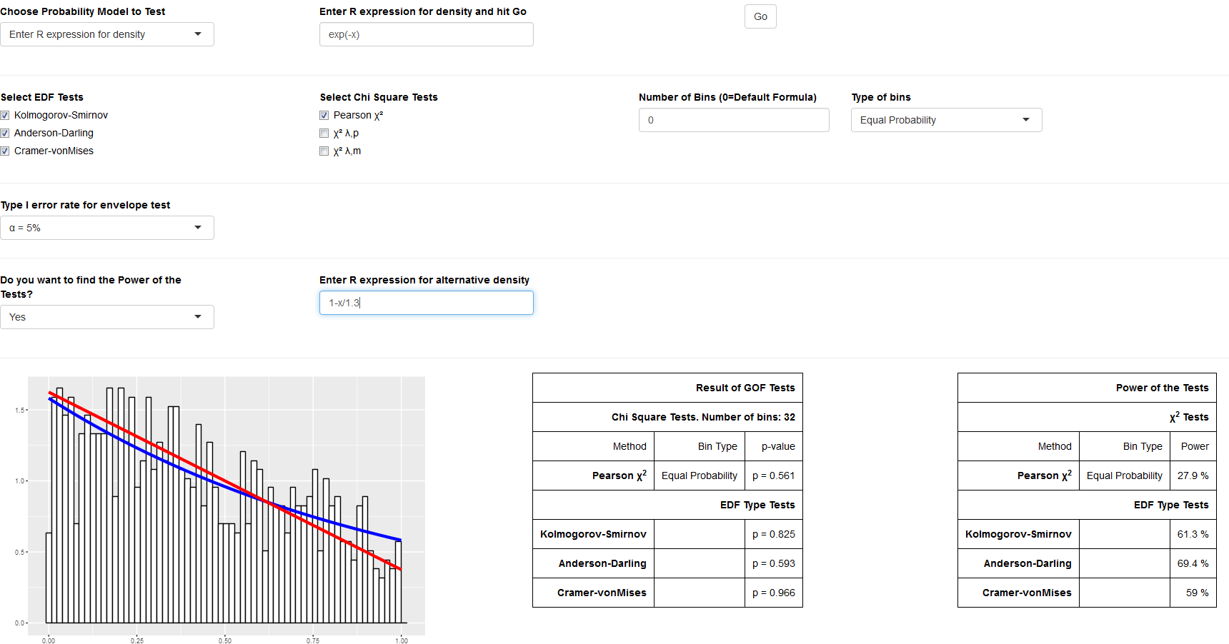

Slide 70
File Upload
R
C++
Density
exp(-param[1]*x)
Distribution
1-exp(-param[1]*x)
Alternative
1-x/5
Estimator
xbar<-mean(x)
new<-param[1]
repeat {
old<-new
new<-old-(1/old-xbar-exp(-old)/(1-exp(-old)))/(-1/old^2+exp(-old)/(1-exp(-old))^2)
if(abs(old-new)<0.0001) break
}
return(new)
Density
for(int i=0;i<n;++i) y[i] = exp(-param[0]*x[i]);
Distribution
for(int i=0;i<n;++i) y[i] = 1.0-exp(-param[0]*x[i]);
Alternative
for(int i=0;i<n;++i) y[i] = 1.0-x[i]/5.0;
Estimator
double pold,pnew,xbar;
xbar=0;
for(int i=0;i<n;++i) xbar+=x[i];
xbar=xbar/n;
pnew=param[0];
while(abs(pold-pnew)>0.0001) {
pold=pnew;
pnew=pold-(1.0/pold-xbar-exp(-pold)/(1.0-exp(-pold)))/(-1.0/(pold*pold)+exp(-pold)/(1.0-exp(-pold))/(1.0-exp(-pold)));
}
p[0]=pnew;

Slide 71
Thanks!

