Slide 1
67th Section Coordination Meeting XHEXP1
4.11.2016

Slide 2
Agenda
SASE1-3 Status Updates (G. Wellenreuther & A. Violante)
Critical task list (G. Wellenreuther)
Status of Beckhoff components (M. Areste)
Access rights to labs in E0 (S. Kozielski)

Slide 3
SASE1

Slide 4
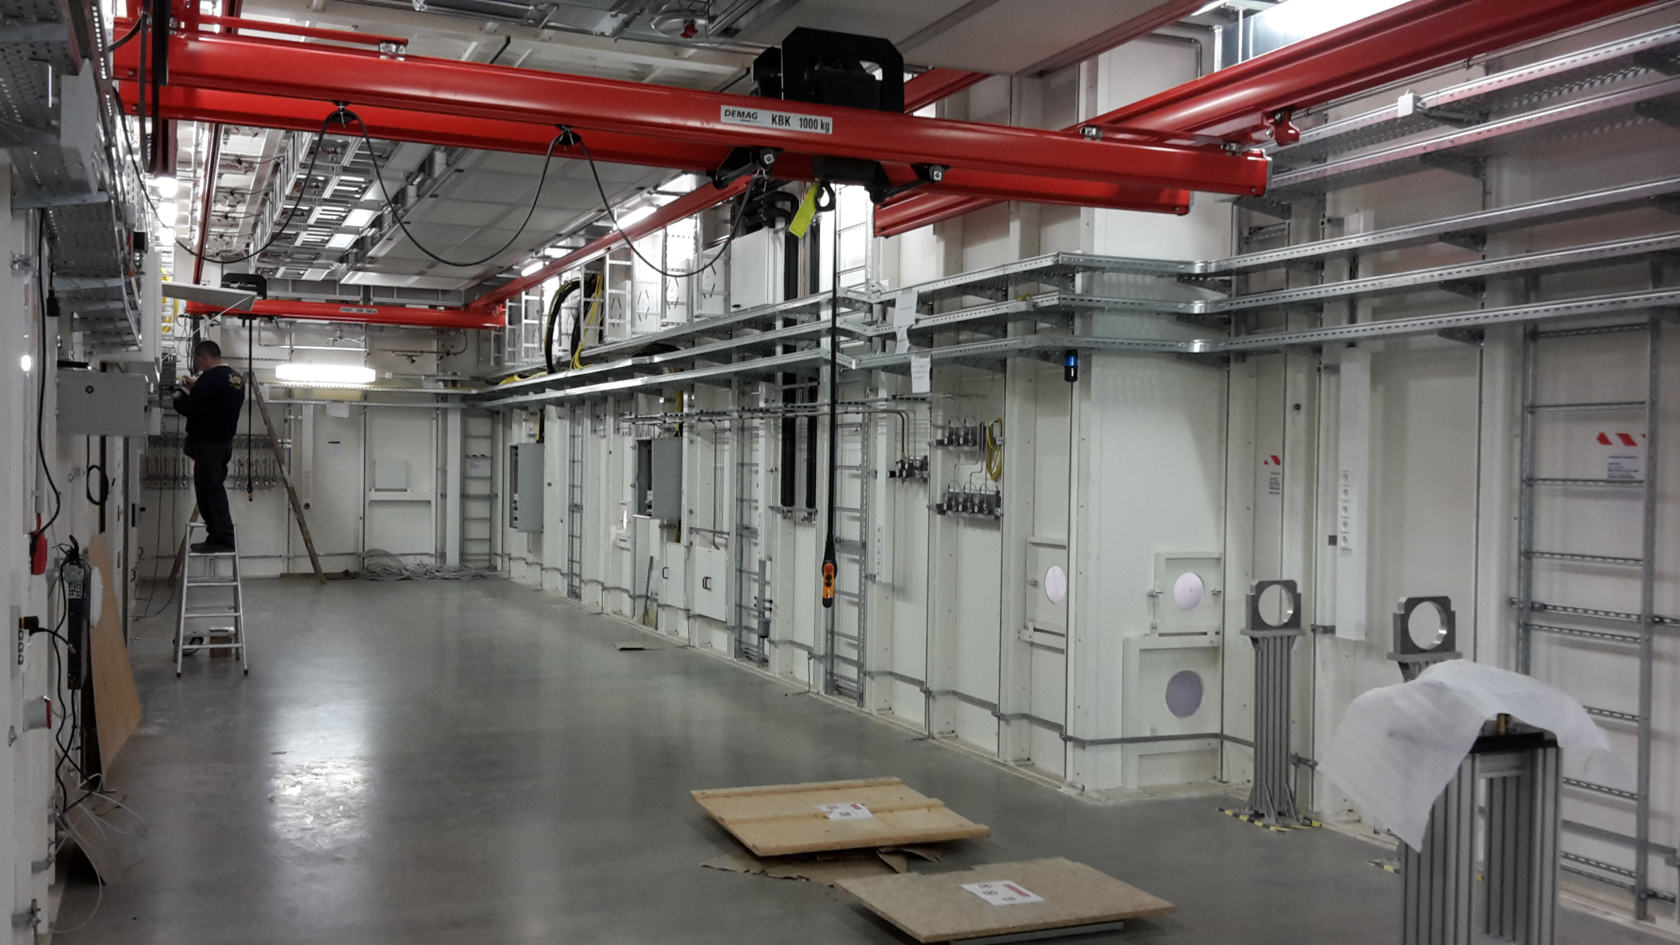
2.11. SPB/SFX-Experiment:

Slide 5
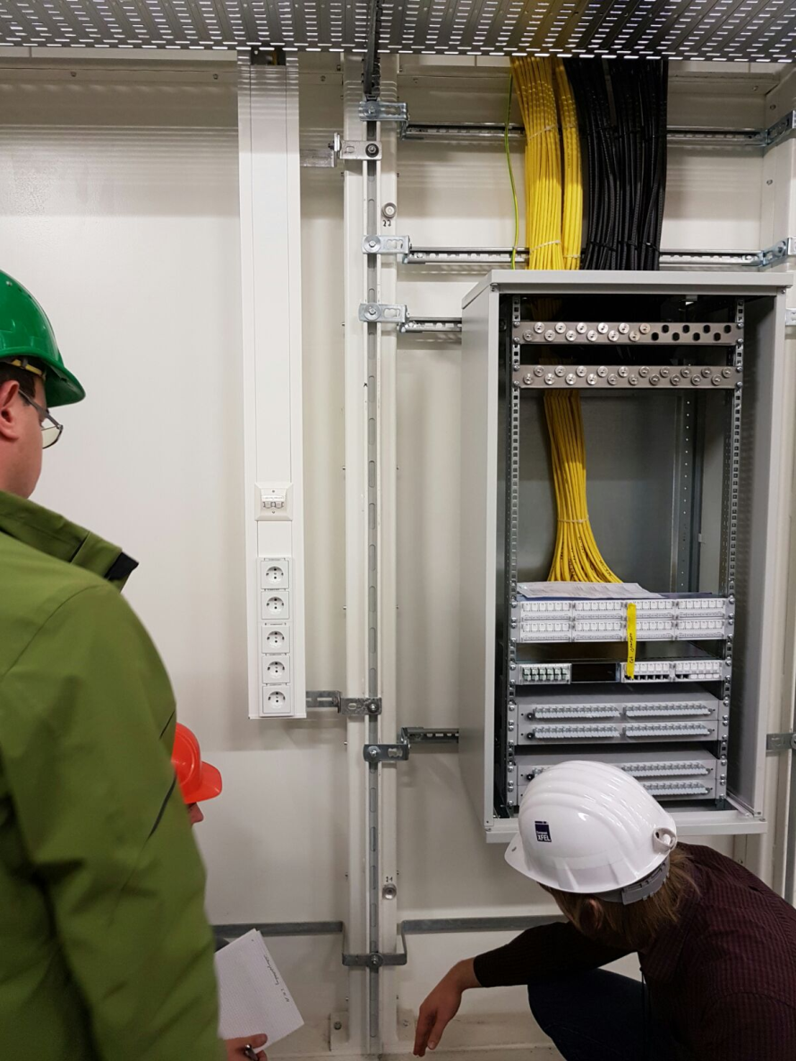
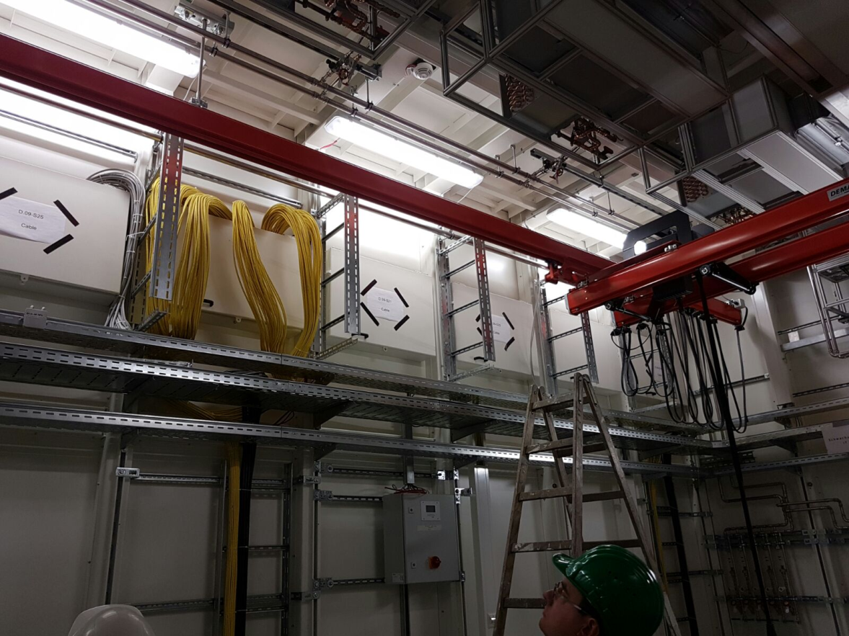
2.11.: Patchpanelgroup in D.09: Coax- + vertical cable tray installation almost done

Slide 6
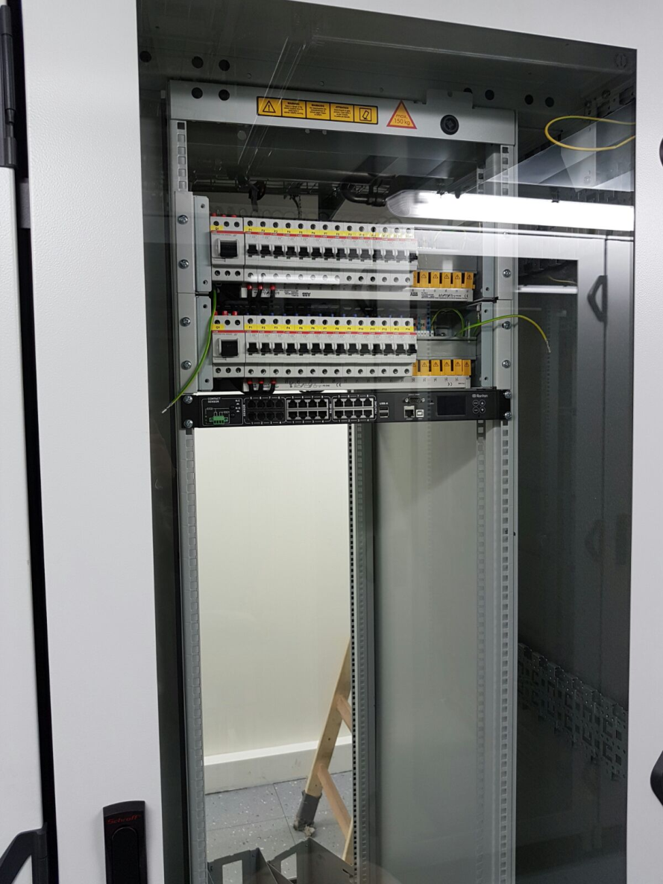
2.11.: D.22 Beckhoff rack with Schwenkrahmen
Temperature control has been installed

Slide 7
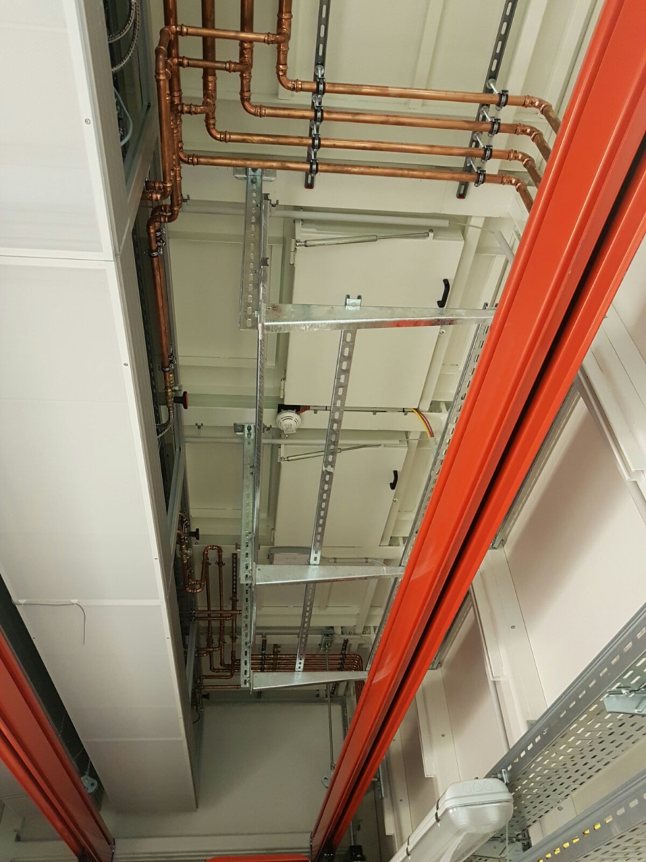
2.11.: D.05 cable supports for phase II cabling

Slide 8
SASE3

Slide 9
SASE2

Slide 10
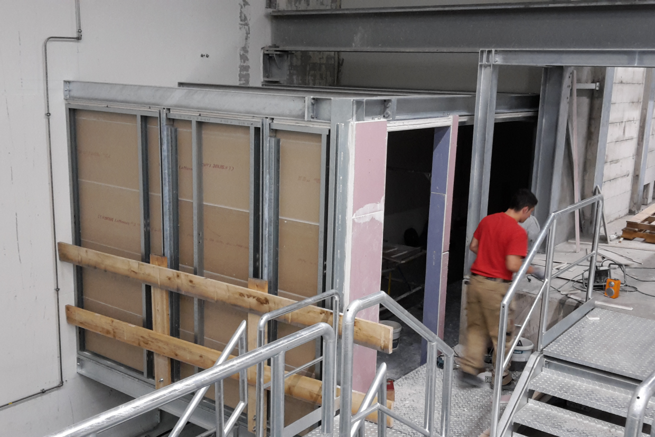
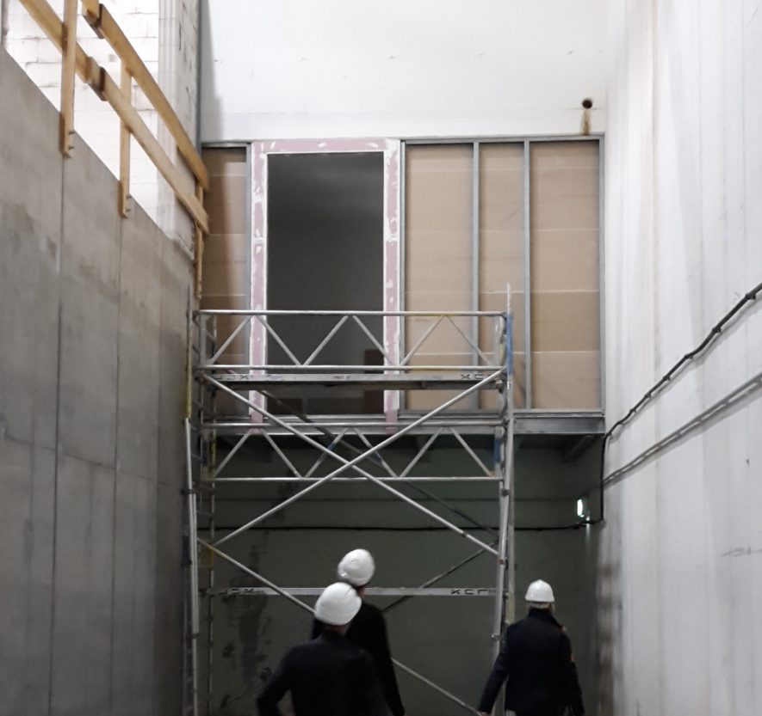
2.11.: Progress in SASE2 A.22

Slide 11
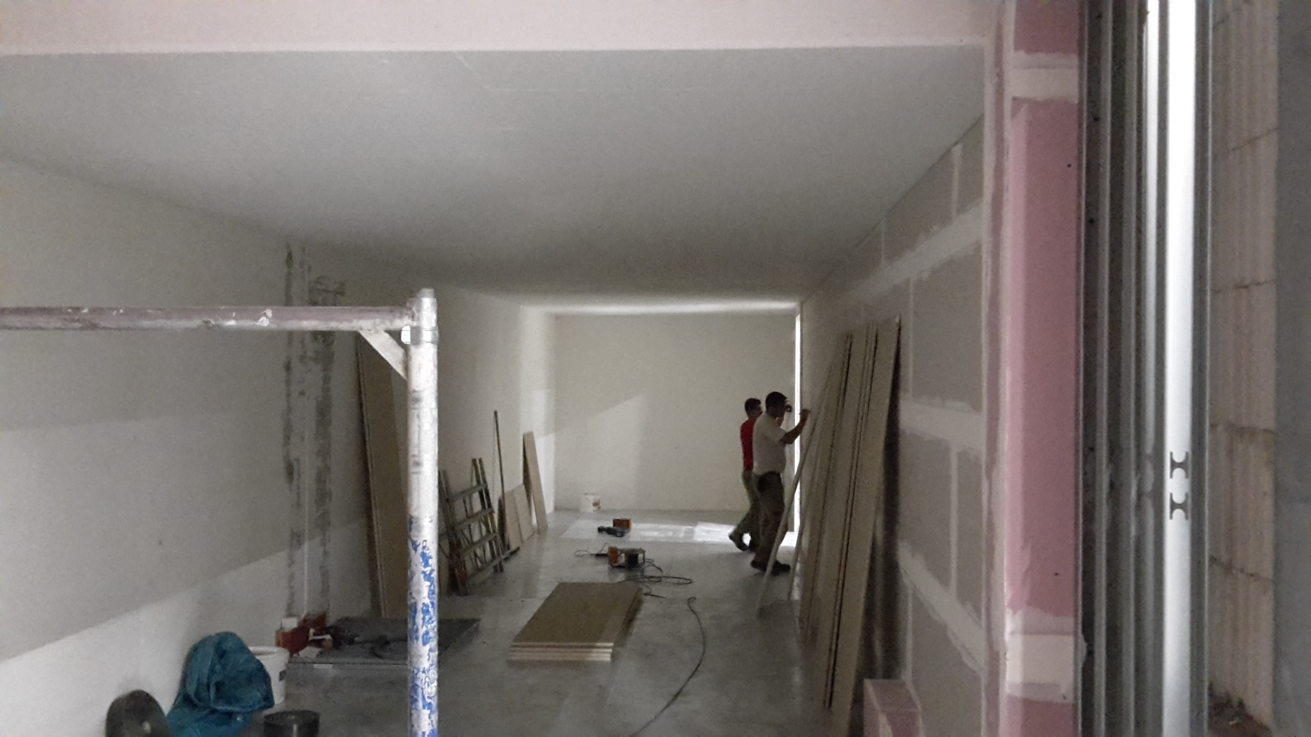
2.11.: Progress in SASE2 A.22

Slide 12
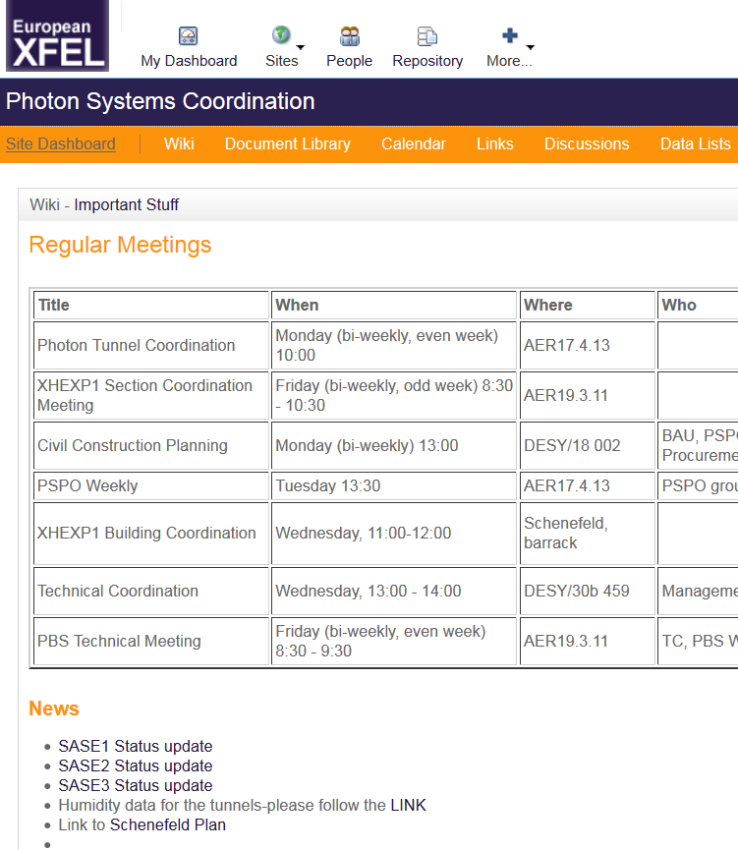
SASE1-3 status update
Summarize most recent and current time-critical tasks / dates for each SASE individually.
At least weekly updated.
In Alfresco:
Document Library/Planning
SASE1 Status update
SASE2 Status update
SASE3 Status update

Slide 13
Progress on critical task list
From Powerpoint ➔ Excel
Color coding ON TIME, DELAYED + WARNING added
Can be sorted by milestone, status, responsible, task category
Identified tasks have being discussed with most responsibles
„Actual“ timeline has been provided by many responsibles
  Part of the task can be directly linked to PSPO masterplan
„Planned“ timeline was established by GW, TH + HS
TH to establish CTL for tunnels, GW for XHEXP1
Link: Critical task lisk of XHEXP1 on Alfresco

