Slide 1

Progress and next steps
17 November 2016 this version is the minutes of the meeting
J. J. John on behalf of the team

Slide 2
Agenda
Discuss progress and steps for next week:
  ABCN’ emulator
  firmware - SACI
  readout software
  CHESS-2-to-FMC adaptor board
  components and preparations for assembly
  Other CHESS-2 hardware

Slide 3
ABCN’ firmware and software status
  1. ABCN’ firmware including SACI:
    Current status:
    Wojtek completed the SACI opcode handler for ITSDAQ.
    Kestutis and Jaya John wrote a test bench.
    All 3 of us simulated and debugged the SACI opcode block. We believe it’s working.
    Jaya John will run some additional test cases for completeness – see next slides.
  2. Software to read ABCN’
    Current status:
    .

Slide 4
Minutes – for firmware and software
  Actions:
    Jaya John to run remaining test cases.
    .

Slide 5
SACI test case coverage
Test case | Details and expected result | Result
Non-SACI opcode | Send another opcode. Handler should not process it. The simulation is expected to get stuck, as there is no other handler to respond. | PASS
SACI reset | Send a SACI opcode with the reset bit set. Expect saci_rst_L to go low. No SACI command is issued, only the reset. | PASS
SACI configuration command, no timeout | Send variants of SACI opcodes. | PASSING but need more tests
SACI timeout |  | PASS but retest in detail

Slide 6
Hardware status
  2. CHESS-2-to-FMC adaptor board
    Current status:
    Edge connectors are at TNT Vancouver right now. They tried to deliver them yesterday (Weds 16th) but somehow failed to find Physics and Astronomy (??).
    Other components:
    Assembly house:
    Actions:
      Colin or Wojtek to please contact TNT Canada (see e-mail of earlier today).
      .

Slide 7
Minutes
  3. Other CHESS-2 hardware
    For the digital hardware: no update since last week. Will have more news next Tuesday.
    For the analogue test system: Jaya John will port the SACI opcode block into the Atlys firmware for driving the CHESS-1 motherboards.

Slide 8
SACI simulations

Slide 9
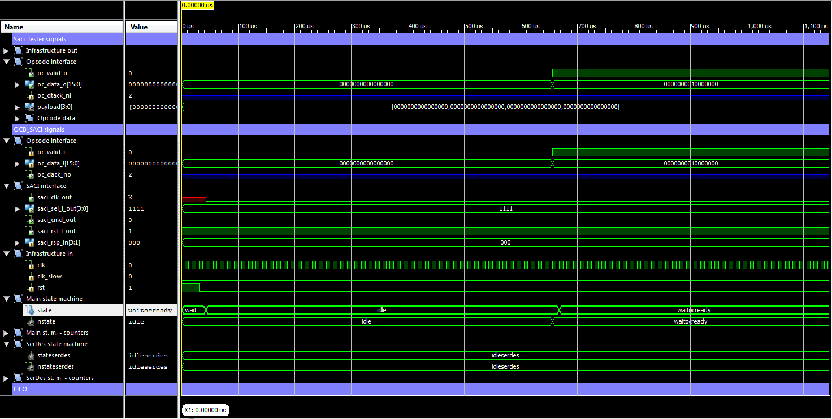
SACI simulations – non SACI opcode

Slide 10
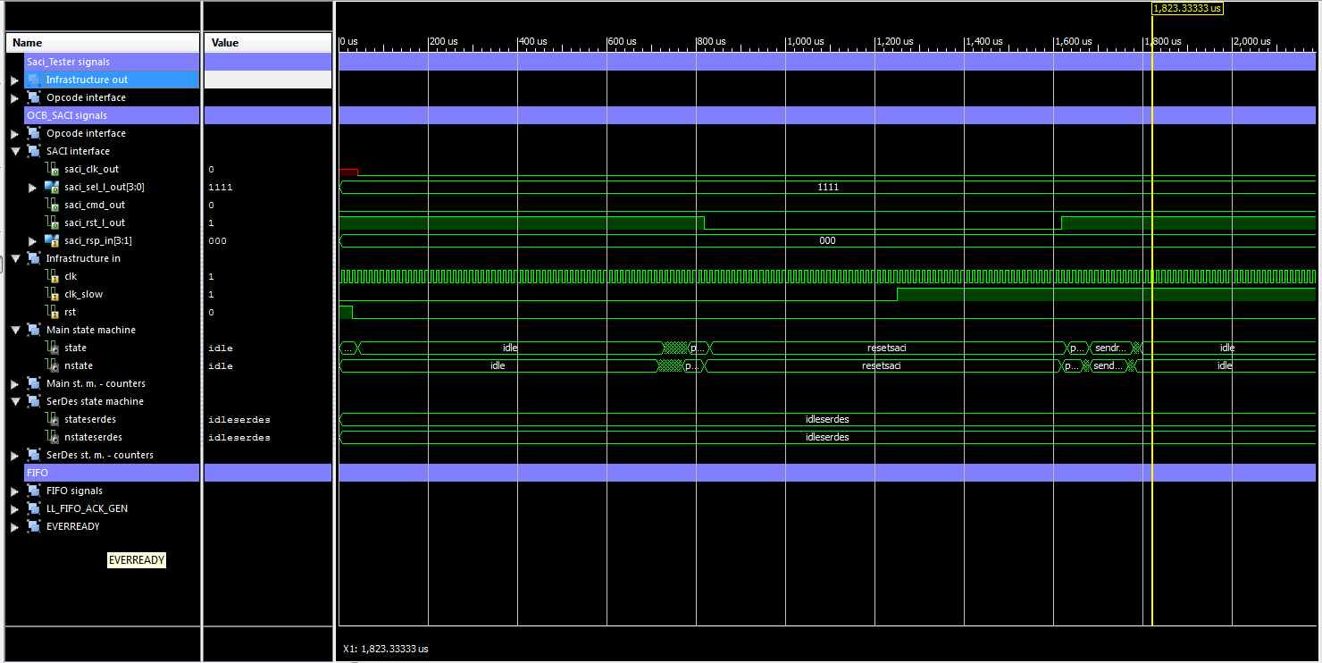
SACI reset – 1/4

Slide 11
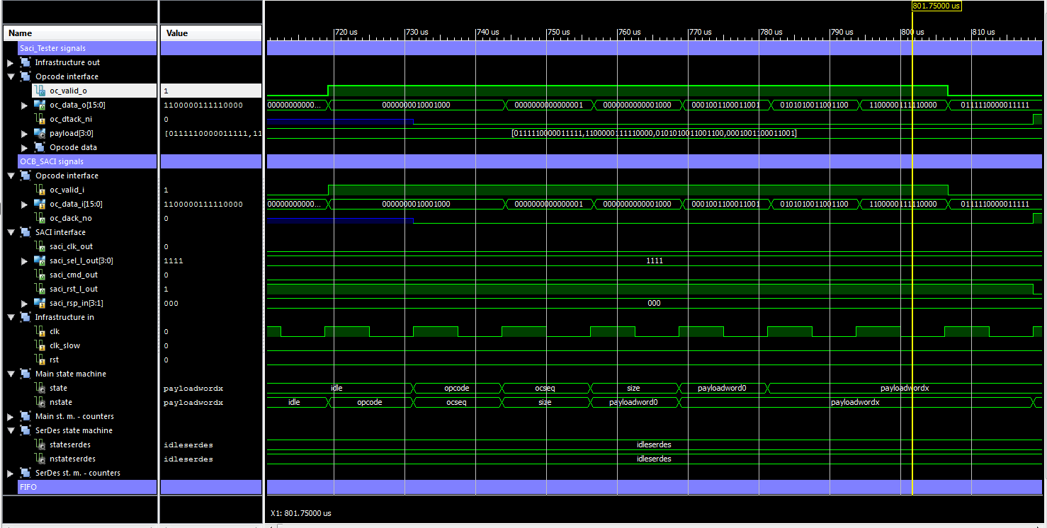
SACI reset – 2/4

Slide 12
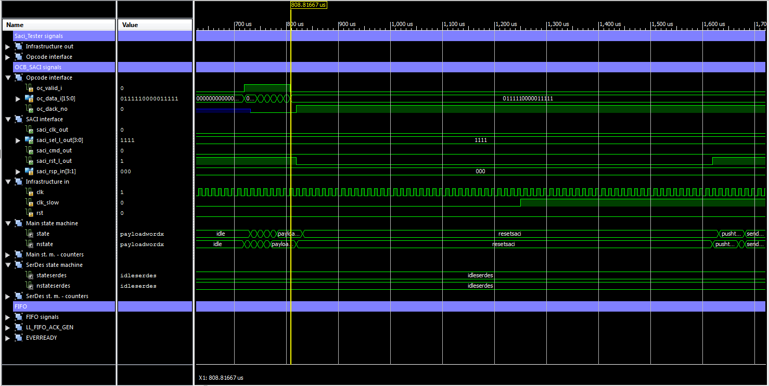
SACI reset – 3/4

Slide 13
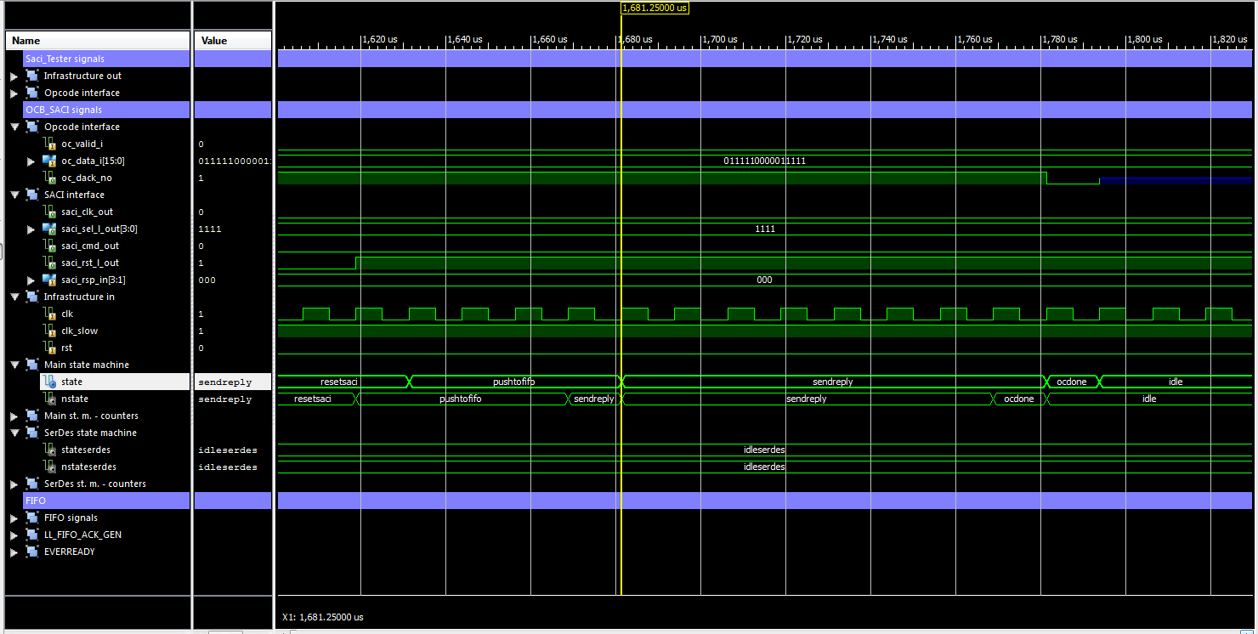
SACI reset – 4/4

