Slide 1

Progress and next steps
17 November 2016 this version is the minutes of the meeting
J. J. John on behalf of the team

Slide 2
Agenda
Discuss progress and steps for next week:
  ABCN’ emulator
  firmware - SACI
  readout software
  CHESS-2-to-FMC adaptor board
  components and preparations for assembly
  Other CHESS-2 hardware

Slide 3
ABCN’ firmware and software status
  1. ABCN’ firmware including SACI:
    Current status:
    Wojtek completed the SACI opcode handler for ITSDAQ.
    Kestutis and Jaya John wrote a test bench for the SACI opcode handler.
    All 3 of us simulated and debugged the SACI opcode block. We believe it’s working.
    Jaya John will run some additional test cases for completeness – see slide 5.
    Jaya John to include all test cases in one script for regression testing, for checking any later SACI code changes – see slide 5.
    Re-check units – using an 80MHz main clock in the test bench? Yes, clock half period is 6250ps => clock period 12.5ns => 80MHz.
    We discussed the COM-to-SACI bridge block for the ABCN’. This will still be implemented in future, but to get started, we have implemented this simpler SACI bus driver in the ITSDAQ firmware environment, which is controlled directly by commands from the SCTDAQ software.
    Next:
    Wojtek to include the SACI opcode handler in the Nexys Video ABCN’ firmware build.
    Jaya John to port to Atlys / CHESS-1 motherboard set-up. BUFR clock divider to be checked, may not work in Spartan-6.
    Need to check into CHESS-2 global reset pin on the adaptor board – tied to SACI reset? Or will we also need to control the global reset line from the Nexys Video?

Slide 4
Minutes – for firmware and software
  Software to read ABCN’
    Current status:
    Robin modified Kevin’s code to object-oriented. Nearly there with SACI configuration commands. Reset still to be added.
    Now working on parsing responses.
  Actions:
    All: share basic SACI configuration (sequence of commands) once anyone has a first version.

Slide 5
SACI test case coverage (updated to reflect discussion)
Test case | Details and expected result | Result
SACI reset | Send a SACI opcode with the reset bit set. Expect saci_rst_L to go low. No SACI command is issued, only the reset. | PASS
SACI configuration command, no timeout x 4 channels | Check each of the 4 channels and that the response goes on the correct response line. Check the response in more detail. | PASSING but test all channels
SACI timeout | Specify a short timeout in the opcode. Verify from states that the operation times out that that a timeout response is sent. | PASSING but retest with short timeout
Non-SACI opcode | Send another opcode. Handler should not process it. The simulation is expected to get stuck, as there is no other handler to respond. Put this last in the regression test set. | PASS
Multiple transactions / regression test | Check that state machines return to idle after opcodes handled. Put the non-SACI opcode last (since it hangs in current set-up, known behaviour). | To assemble

Slide 6
Hardware status
  2. CHESS-2-to-FMC adaptor board
    Current status:
    Edge connectors are at TNT Vancouver right now. Meant to arrive this morning at UBC (had issue on Wednesday). They were delivered to UBC later on Thursday 17 November.
    Other components: Wojtek will check with Pavel. FMC connectors were delayed (status from last week). Other components should be at UBC.
    Assembly house: Pavel has notified them to expect the incoming job.
    Actions:
      Wojtek to speak with Pavel to follow up FMC connectors.

Slide 7
Other hardware
  3. Other CHESS-2 hardware
    For the digital hardware: no update since last week. Will have more news next Tuesday and relay in next Thursday’s meeting.
    For the analogue test system: Jaya John will port the SACI opcode block into the Atlys firmware for driving the CHESS-1 motherboards.

Slide 8
SACI simulations

Slide 9
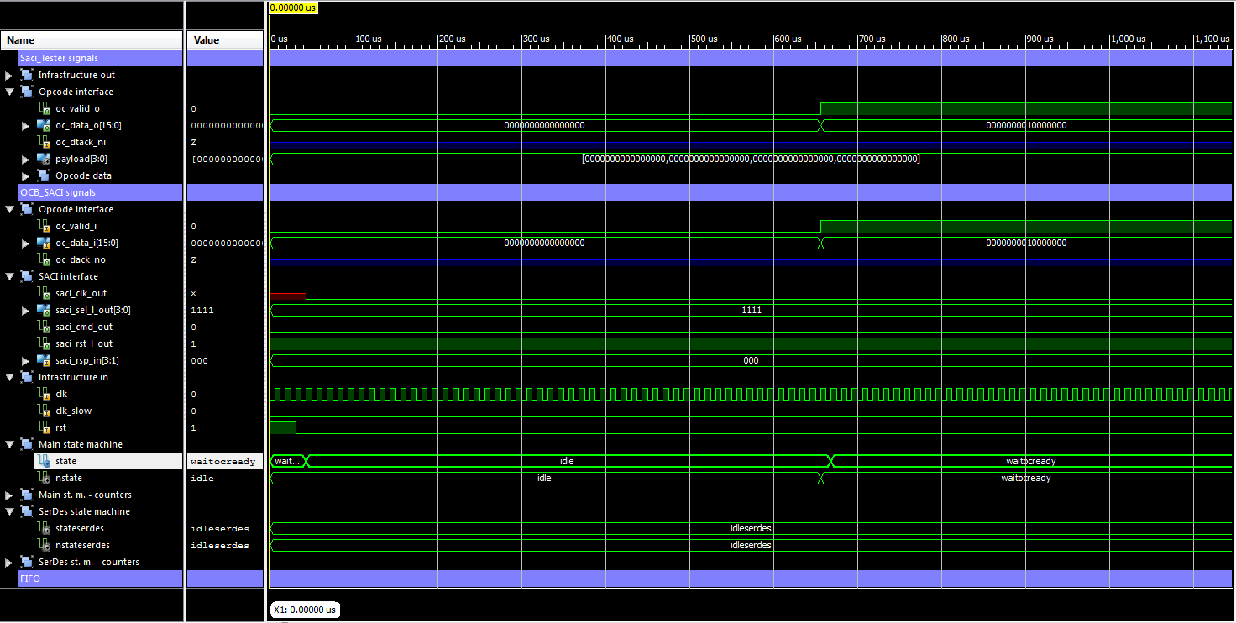
SACI simulations – non SACI opcode

Slide 10
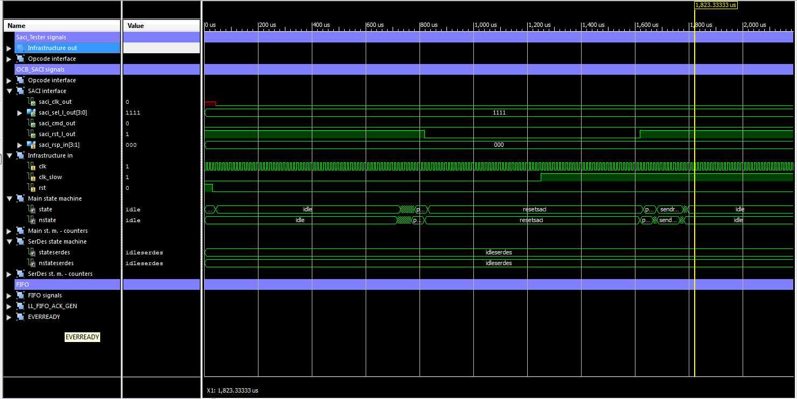
SACI reset – 1/4

Slide 11
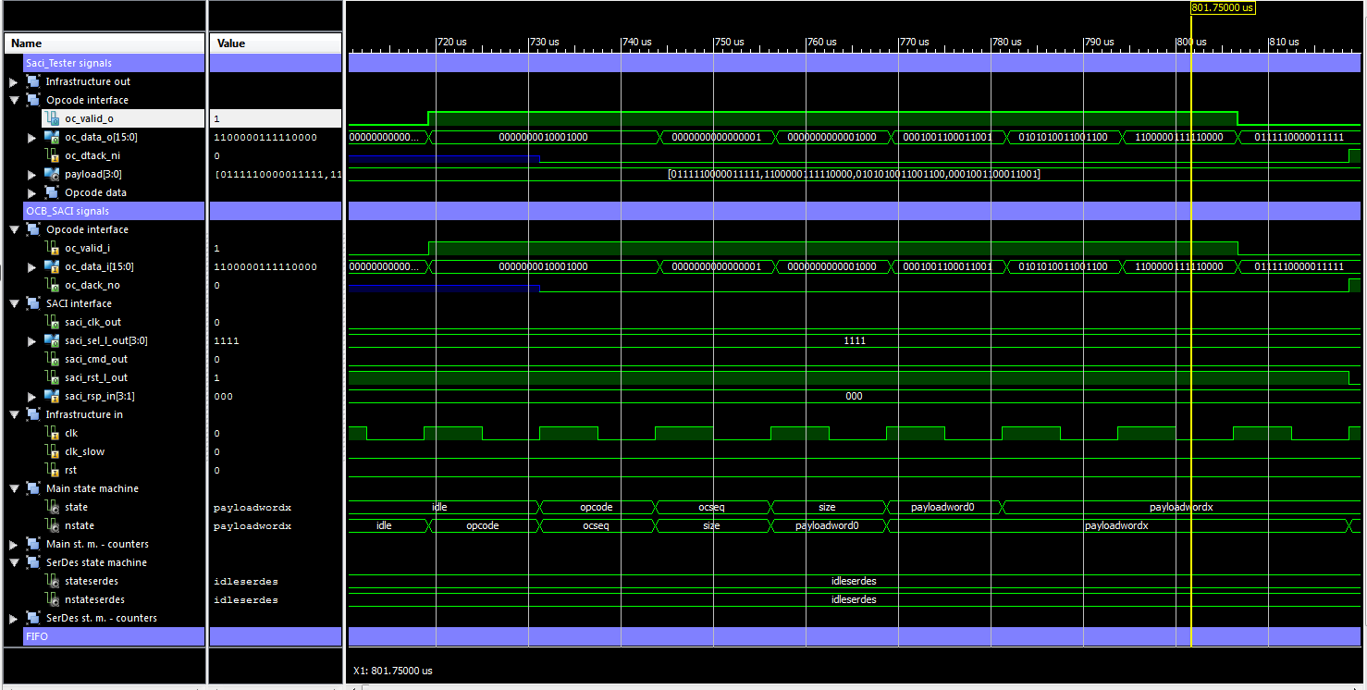
SACI reset – 2/4

Slide 12
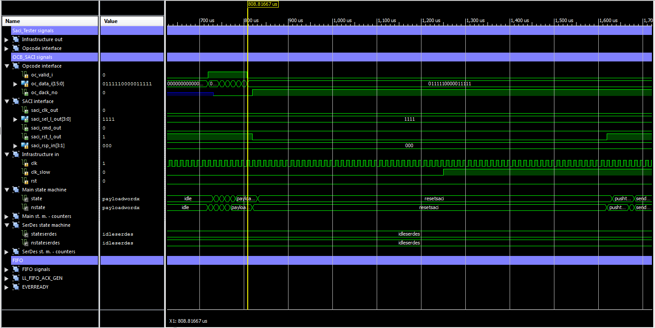
SACI reset – 3/4

Slide 13
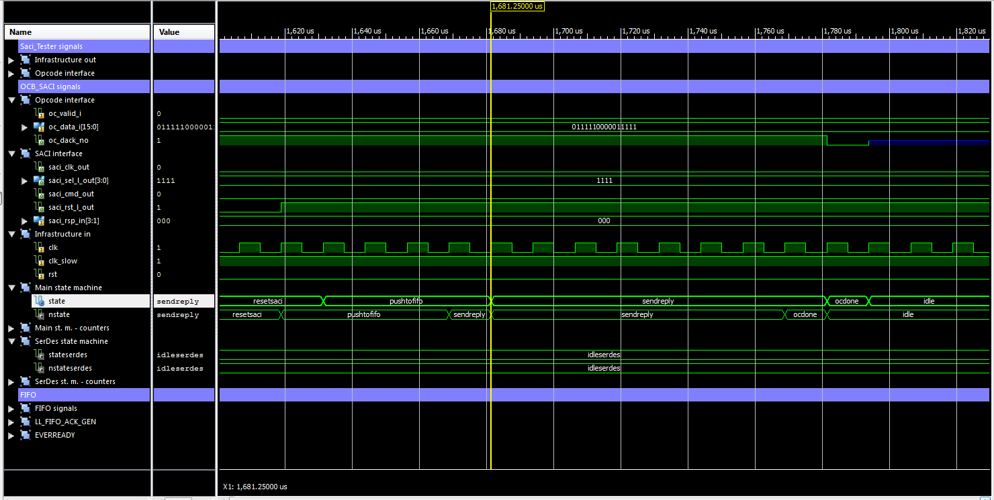
SACI reset – 4/4

