Slide 1

Progress and next steps
24 November 2016 this version is the minutes of the meeting
J. J. John on behalf of the team

Slide 2
Agenda
Discuss progress and steps for next week:
  TWiki page for CHESS-2 and related hardware
  ABCN’ emulator
  firmware - SACI
  readout software
  CHESS-2-to-FMC adaptor board
  Other CHESS-2 hardware
  Plans for mini-module

Slide 3
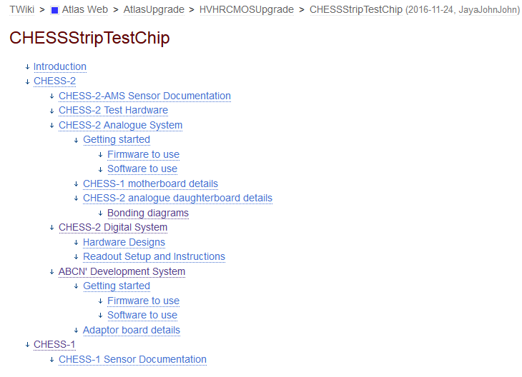
TWiki page for CHESS-2 and hardware
  I’ve been setting up this page to hold CHESS-2 information, including the 3 test systems:
  https://twiki.cern.ch/twiki/bin/view/Atlas/CHESSStripTestChip
  outline:
  proposed skeleton for ABCN’ and Adaptor Board info

Slide 4
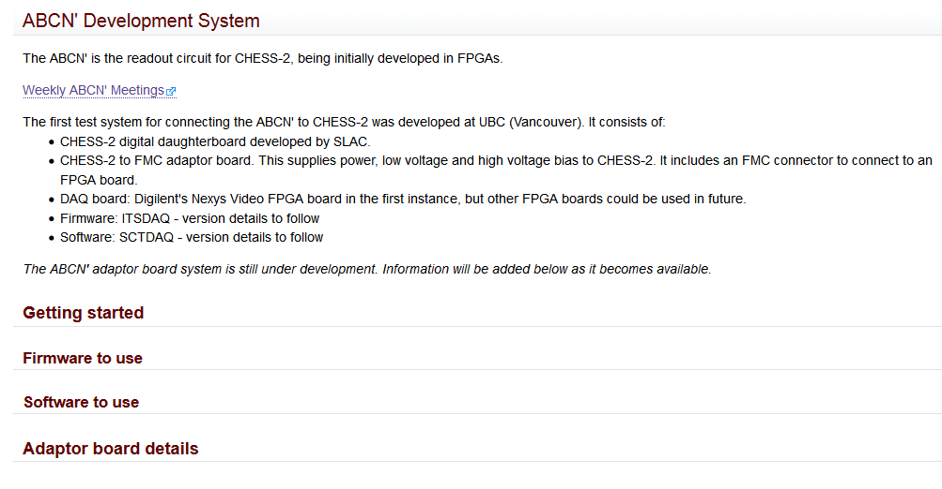
TWiki - ABCN’ and adaptor board section
  This is what I’ve drafted so far for the ABCN’ + adaptor board.
  Please edit and add freely, including improving the structure.
  We could add a linked page for the ABCN’ itself in the next while.
  suggest we supply basic instructions on working with the system
  schematics, layouts, possibly BOM…

Slide 5
ABCN’ firmware status
  We received good feedback from the CMOS Fortnightly meeting on our progress with SACI and the adaptor board.
  ABCN’ firmware including SACI:
    Current status:
    Jaya John still to run additional test cases for completeness and prepare the regression set of tests.
    .
    Next:
    Wojtek to include the SACI opcode handler in the Nexys Video ABCN’ firmware build.
    Jaya John to port to Atlys / CHESS-1 motherboard set-up. BUFR clock divider to be checked, may not work in Spartan-6.
    Need to check into CHESS-2 global reset pin on the adaptor board – tied to SACI reset? Or will we also need to control the global reset line from the Nexys Video?

Slide 6
ABCN’ software status
  Software to read ABCN’
    Current status:
    .
  Actions:
    All: share basic SACI configuration (sequence of commands) once anyone has a first version.

Slide 7
CHESS-2-to-FMC adaptor board status
  Current status:
  .
  .
  Actions:
    Wojtek to speak with Pavel to follow up FMC connectors.

Slide 8
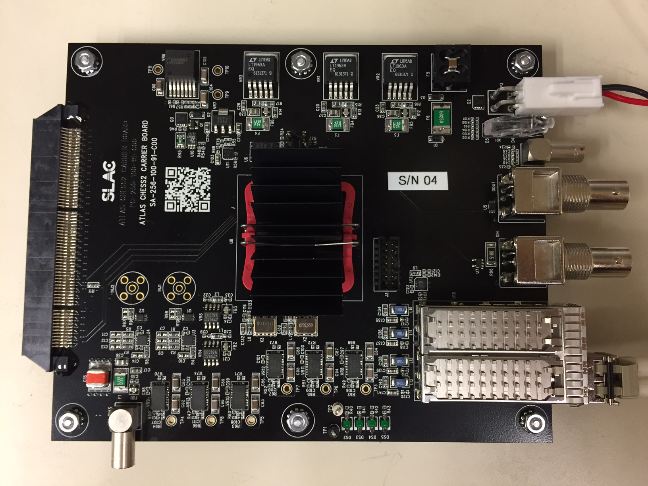
Other CHESS-2 hardware
  From the CMOS fortnightly meeting, Tuesday 22 November, from Su Dong and Larry Ruckman’s update (see presentation)
  Digital daughterboard:
    The BL/BLR-BR/BRL disconnect spotted by Wojtek is being addressed either by adding 2 wires (for boards not being irradiated) or 2 long wire-bonds.
    2 sent for wire-bonding (Amtech), others to Santa Cruz for loading and testing.
    Design will be revised for 2nd order.
  Carrier board:
    Received first few assembled boards.
    Sending 2 to UBC soon.
    Initial testing is going very well:
      power, JTAG, register
      read/writes via SFP port all fine
    Next steps: test SPI, triggering,
    external clock, data collection.
    Then, with asssembled
    daughterboards, ~next week:
    SACI, HV bias, LVDS tuning.
  Photo by SLAC

Slide 9
Looking ahead: the CHESS-2 mini-module
  Overall, we’re progressing well towards the goals for the CHESS programme review, expected in January.
  One gap in the programme is that we need to start on the mini-module very soon.
  Ideally we’d know how CHESS-2 is working before starting on the mini-module but then it would definitely be ready after January. It’s already tight to say the least.
  So it’s best to start now.

Slide 10
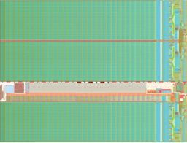
CHESS-2 mini-module concept
  A circuit board that “looks like a module” with a small number of tiled CHESS-2 devices.
  Sketch from ~March-April, updated for single board (keep it simple):
ABCN’
(FPGA)
ABCN’
(FPGA)
ABCN’
(FPGA)
ABCN’
(FPGA)
power
JTAG
SFP/Ethernet?
Clock
“usual module connector” ?

Slide 11
Mini-module, continued
  Su Dong said that SLAC may be able to help to design this board.
  In many ways it is an adaptation of the digital daughterboard and carrier board combined onto one board.
  Our job is to specify it. It would be helpful to work together on it to check and ensure it is complete and what is needed.

