Slide 1

Progress and next steps
24 November 2016 this version is the minutes of the meeting
J. J. John on behalf of the team

Slide 2
Agenda
Discuss progress and steps for next week:
  TWiki page for CHESS-2 and related hardware
  ABCN’ emulator
  firmware - SACI
  readout software
  CHESS-2-to-FMC adaptor board
  Other CHESS-2 hardware
  Plans for mini-module

Slide 3
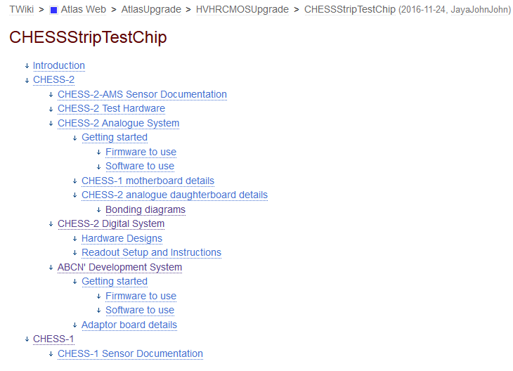
TWiki page for CHESS-2 and hardware
  I’ve been setting up this page to hold CHESS-2 information, including the 3 test systems:
  https://twiki.cern.ch/twiki/bin/view/Atlas/CHESSStripTestChip
  outline:
  proposed skeleton for ABCN’ and Adaptor Board info

Slide 4
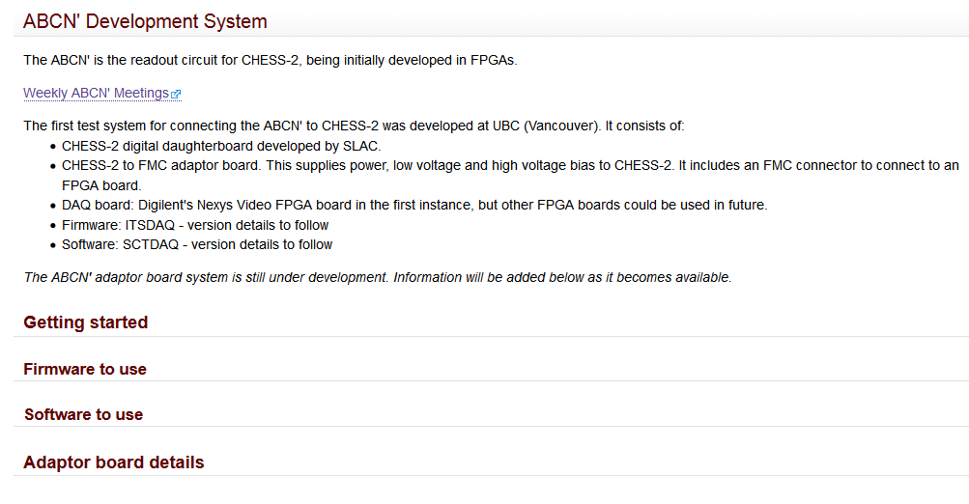
TWiki - ABCN’ and adaptor board section
  This is what I’ve drafted so far for the ABCN’ + adaptor board.
  Please edit and add freely, including improving the structure.
  We could add a linked page for the ABCN’ itself in the next while.
  suggest we supply basic instructions on working with the system
  schematics, layouts, possibly BOM…

Slide 5
ABCN’ firmware status
  We received good feedback from the CMOS Fortnightly meeting on our progress with SACI and the adaptor board.
  ABCN’ firmware including SACI:
    Jaya John still to run additional test cases for completeness and prepare the regression set of tests.
    Wojtek has merged the SACI handler to ITSDAQ, using an unused instance of the local link bus.
    Wojtek derived a new DIO block for the SACI signals, connected to the FMC.
    Also added needed single-ended signals like the 40MHz clock.
    Also added differential outputs of CHESS-2’s bottom array.
    Some timing violations but don’t seem to be SACI-specific, probably existing.
    Will check with IDC header with a scope, then try a loopback (with shift registers from test bench)
    SPI connections to DAC: didn’t find connections in code. Need to investigate and connect up to FMC. Use one of the 16-bit wide channels as the SPI channel. Has the extra lines needed.
    Wojtek added constants to package files for build type. Otherwise it is new files - Matt approves.
    Need to look at how best to fork or include this in the overall ITSDAQ variants.

Slide 6
ABCN’ firmware, continued…
  ABCN’ firmware including SACI:
    Jaya John to port to Atlys / CHESS-1 motherboard set-up. BUFR clock divider to be checked, may not work in Spartan-6.
    Need to check into CHESS-2 global reset pin on the adaptor board – tied to SACI reset? Or will we also need to control the global reset line from the Nexys Video?

Slide 7
ABCN’ software status
  Software to read ABCN’
    Current status:
    Packages written for sending.
    Now working on receiving and parsing, then DAC signalling.
    Working on Linux.
    Would like to use opcode sending and receiving calls from the SCTDAQ libraries/macros in due course.
    Need to point to useful examples of working with opcodes in SCTDAQ macros.
    Questions: global reset? 40MHz clock? any opcodes needed to control these?
      40MHz clock will be supplied by firmware, will not be gapped / does not need an opcode.
      SACI clock is gapped automatically by firmware, software does not need to worry about that.
  Actions:
    All: share basic SACI configuration (sequence of commands) once anyone has a first version.
    JJJ: examples

Slide 8
CHESS-2-to-FMC adaptor board status
  Current status:
  Components: all in.
  Bare boards: received, look fine. Probing at UBC looked fine.
  Boards needed a bit of milling because of a physical tab in the edge connectors - done.
  Boards and all components sent (yesterday or today).
  Turnaround is 1 week after the assembly house confirms they have checked all parts, which is probably some days.
  Call it 2 weeks all told (no customs involved).
  Enclosure spec is still pending – Wojtek will work on the spec next for the box.

Slide 9
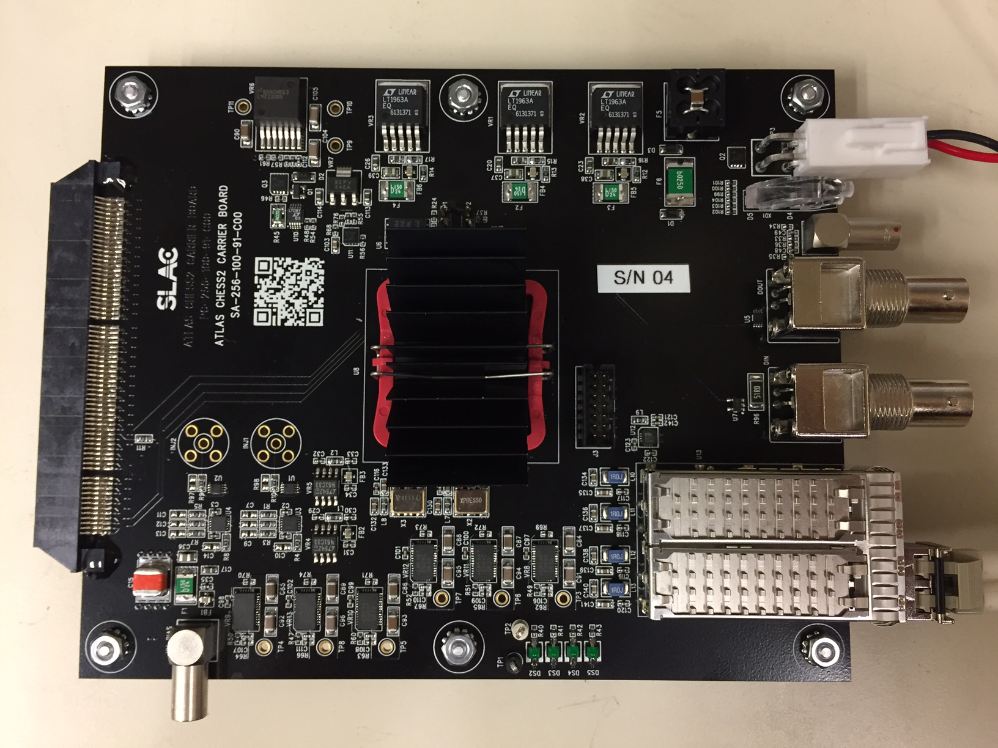
Other CHESS-2 hardware
  From the CMOS fortnightly meeting, Tuesday 22 November, from Su Dong and Larry Ruckman’s update (see presentation)
  Digital daughterboard:
    The BL/BLR-BR/BRL disconnect spotted by Wojtek is being addressed either by adding 2 wires (for boards not being irradiated) or 2 long wire-bonds.
    2 sent for wire-bonding (Amtech), others to Santa Cruz for loading and testing.
    Design will be revised for 2nd order.
  Carrier board:
    Received first few assembled boards.
    Sending 2 to UBC soon.
    Initial testing is going very well:
      power, JTAG, register
      read/writes via SFP port all fine
    Next steps: test SPI, triggering,
    external clock, data collection.
    Then, with assembled
    daughterboards, ~next week:
    SACI, HV bias, LVDS tuning.
  Photo by SLAC

Slide 10
Looking ahead: the CHESS-2 mini-module
  Overall, we’re progressing well towards the goals for the CHESS programme review, expected in January.
  One gap in the programme is that we need to start on the mini-module very soon.
  Ideally we’d know how CHESS-2 is working before starting on the mini-module but then it would definitely be ready after January. It’s already tight to say the least.
  So it’s best to start now.

Slide 11
CHESS-2 mini-module concept
  A circuit board that “looks like a module” with a small number of tiled CHESS-2 devices.
  Our first iteration sketch from ~March-April, updated a bit, looks like this:
    Simplify the proposal to just one circuit board
    In other word, no hybrids for now, keep it simple
    Want to see some tiling of devices to demonstrate mounting process

Slide 12
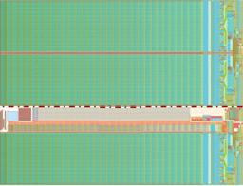
CHESS-2 mini-module concept
  A circuit board that “looks like a module” with a small number of tiled CHESS-2 devices.
  First iteration sketch from ~March-April:
ABCN’
(FPGA)
ABCN’
(FPGA)
ABCN’
(FPGA)
ABCN’
(FPGA)
power
JTAG
SFP/Ethernet?
Clock
“usual module connector” ?

Slide 13
After some discussion…
  Probably fewer FPGAs is better. Some favour just one. To be “more module-like”, two could be a good compromise.
  Could use cut sensors – top and middle arrays only – to avoid the big gap of the test structure areas.
ABCN’
(FPGA)
ABCN’
(FPGA)
power
JTAG
SFP/Ethernet?
Clock
“usual module connector” ?
  Matt: look at Ash’s new hybrid panel, same as electrical End-of-Stave. Updated connector with more ground pairs. This is the most helpful spec to meet. = 13 pairs. 50-pin connector.
  Need to look at number of pairs needed, also. Could still use older styles too, still supported.

Slide 14
Mini-module, continued
  Su Dong said that SLAC may be able to help to design this board.
  In many ways it is an adaptation of the digital daughterboard and carrier board combined onto one board.
  Our job is to specify it. It would be helpful to work together on it to check and ensure it is complete and what is needed.

