Slide 1

Progress and next steps
8 December 2016 this version is the minutes of the meeting
J. J. John on behalf of the team

Slide 2
Agenda
Discuss progress and steps for next week:
  ABCN’ emulator
  firmware - SACI
  readout software
  CHESS-2-to-FMC adaptor board
  Other CHESS-2 hardware
  Plans for mini-module
  + a reminder of the TWiki page for CHESS and its test hardware: https://twiki.cern.ch/twiki/bin/view/Atlas/CHESSStripTestChip

Slide 3
ABCN’ firmware status
  ABCN’ firmware including SACI:
    Jaya John to run additional test cases for completeness and prepare the regression set of tests.
      presently working on integrating SACI code into Atlys/CHESS-2 analogue system build.
    .

Slide 4
ABCN’ software status
  Software to read ABCN’
    Current status:
    .

Slide 5
CHESS-2-to-FMC adaptor board status
  Current status:
  Assembly house update:
  .
  Enclosure spec?

Slide 6
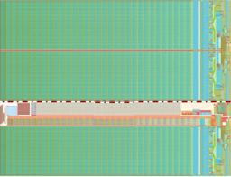
CHESS-2 mini-module concept
Feedback from Strip CMOS fortnightly meeting:
    on the right track.
    move connectors to avoid dead space at bottom of tiled array to avoid dead space.
JTAG
clock?
ABCN’
(FPGA)
ABCN’
(FPGA)
power
hybrid panel connector

