Slide 1

Progress and next steps
8 December 2016 this version is the minutes of the meeting
J. J. John on behalf of the team

Slide 2
Agenda
Discuss progress and steps for next week:
  ABCN’ emulator
  firmware - SACI
  readout software
  CHESS-2-to-FMC adaptor board
  Other CHESS-2 hardware
  Plans for mini-module
  + a reminder of the TWiki page for CHESS and its test hardware: https://twiki.cern.ch/twiki/bin/view/Atlas/CHESSStripTestChip

Slide 3
ABCN’ firmware and software status
  ABCN’ firmware including SACI:
    Jaya John to run additional test cases for completeness and prepare the regression set of tests.
      presently working on integrating SACI code into Atlys/CHESS-2 analogue system build. Thanks to Matt for his help.
  Software to read ABCN’ and SACI testing
    Current status:
    Wojtek and Robin could not attend this week’s meeting, so we’ll have an update next week.

Slide 4
CHESS-2-to-FMC adaptor board status
  Current status:
  Assembly house update: Colin will speak with Pavel to follow up the audit at the assembly house. A payment issue was resolved this week.

Slide 5
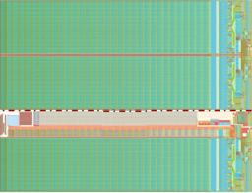
CHESS-2 mini-module
Feedback from Strip CMOS fortnightly meeting:
    People felt the design is on the right track.
    Move connectors to avoid dead space at bottom of tiled array, similar to this updated sketch.
    Next step: Jaya John to look at details of hybrid panel connector.
JTAG
clock?
ABCN’
(FPGA)
ABCN’
(FPGA)
power
hybrid panel connector

