Slide 1
DTS Fields of Interest POF IV 2020-2016
C.J. Schmidt 28.11.2016

Slide 2
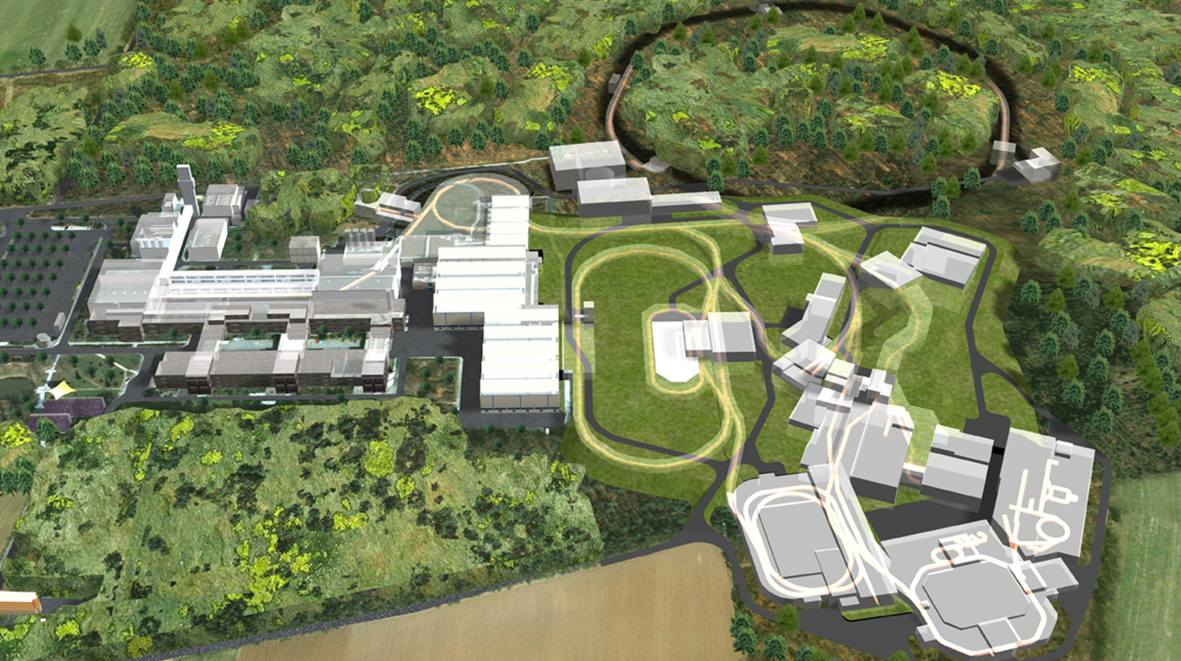
RESEARCH FIELD MATTER
We‘ll be back in PoF IV !

Slide 3
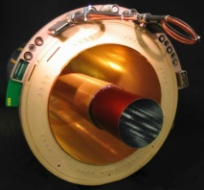
High resolution, high intensity, extreme dynamic range gaseous detectors
Tracks with Au beam
GEM-TPC prototype

Slide 4
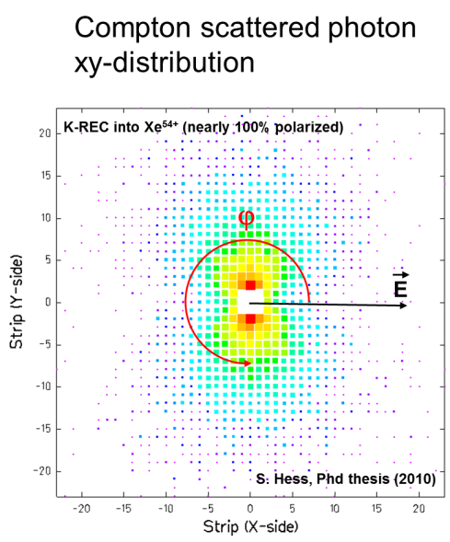
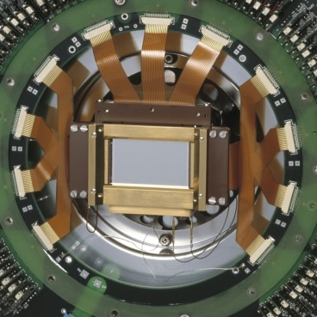
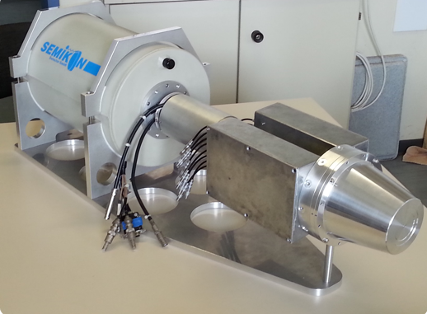
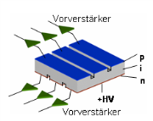
Si(Li)/Ge High Resolution Gamma and X-Ray Detectors
High resolution Semiconductor Detectors for Sparc and NUSTAR → Establish a Si/Ge Semiconductor Laboratory at GSI enhanced by FZJ IKP laboratory
→ application e.g. Compton Polarimeter
→ technological need: cryogenic ASICs
High resolution Ge detectors are essential for future gamma spectroscopy
and imaging in NUSTAR as well as for X-ray imaging and polarimetry in SPARC.

Slide 5
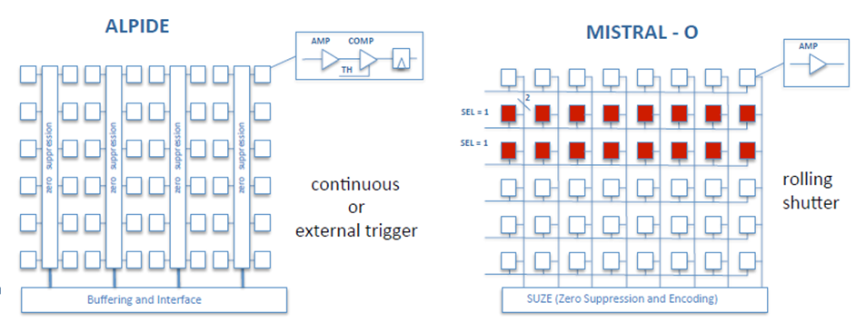
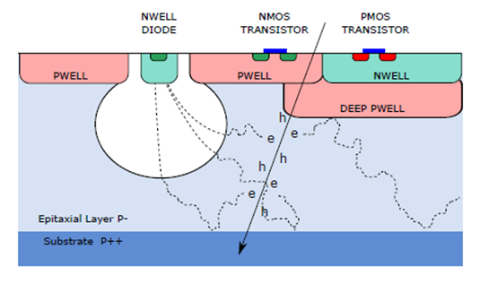
Silicon Trackers: Monolythic Active Pixel Detectors
CBM-STS upgrade preaparations
ALPIDE/MIMOSA technologies

Slide 6
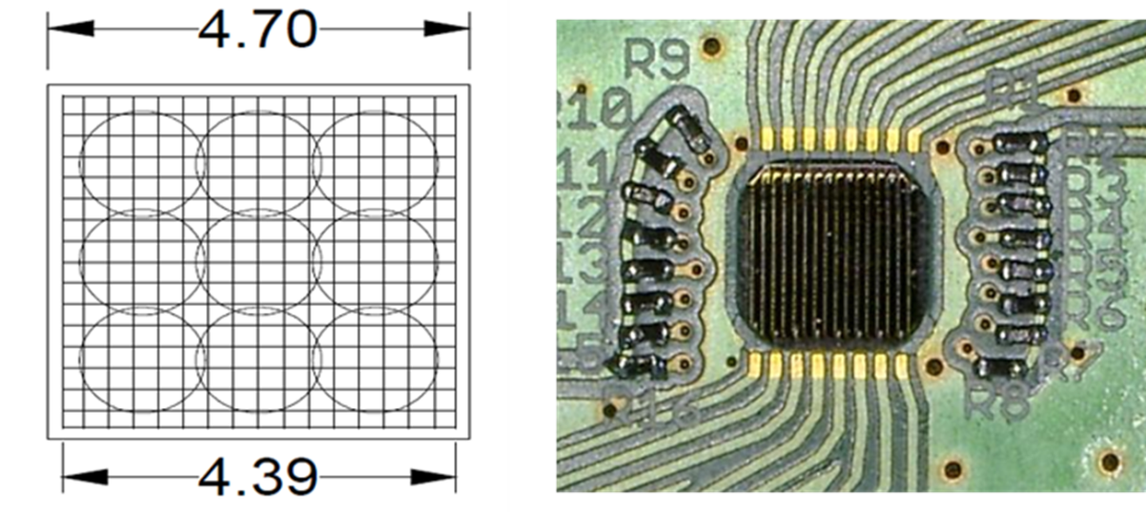
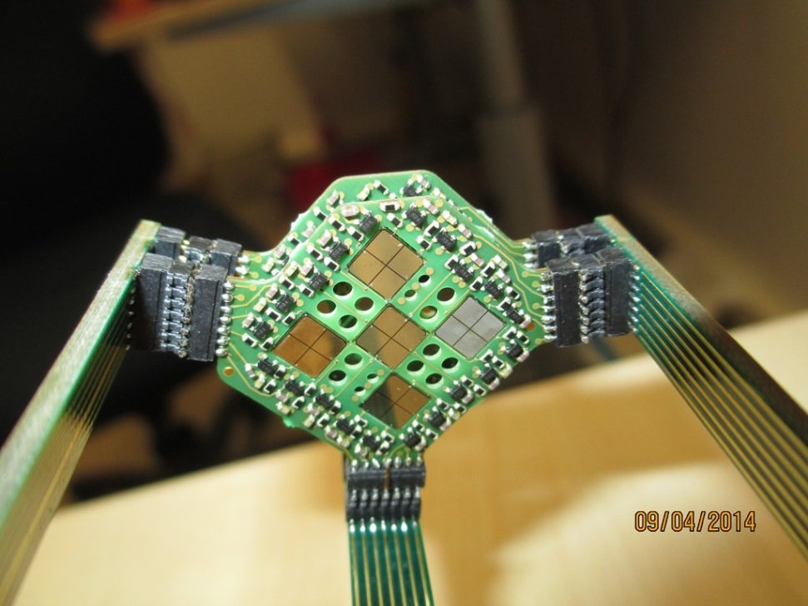
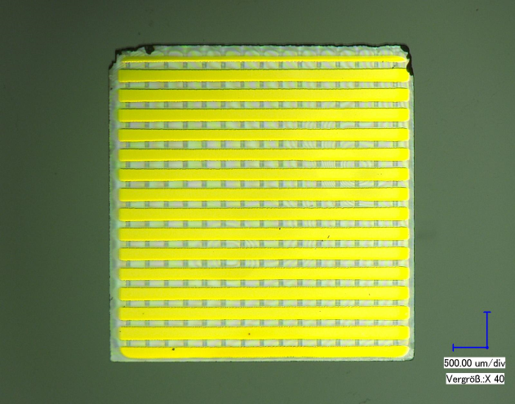
Diamond Detectors – push towards large areas add corresponding electronics TDC developments: towards ps resolution
Timing Detectors and Related Electronics
HADES Start Detector 15 x 15 mm²
Highly granular diamond
detectors for rad-hard timing

Slide 7
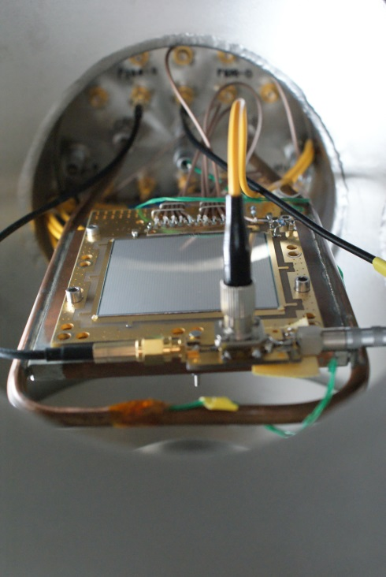
Si detectors for the heavy-ion TOF measurements
Super-FRS TOF beam diagnostics
Ion rate up to 5*10⁴ s⁻¹ per cm²
TOF resolution – 30-50 ps
Detector setups in vacuum
Si TOF detectors through waveform analysis
13ps resolution feasible
Synergy with EXPERT/Super-FRS project
O. Kiselev et al., GSI Scientific Report 2012, PHW-ENNA-EXP-42, p.172
C. Nociforo, JINST 9 (2014) C01022

Slide 8
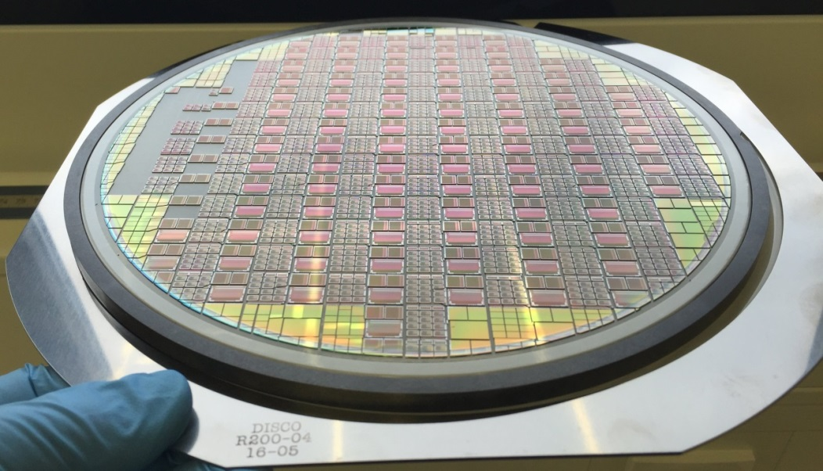
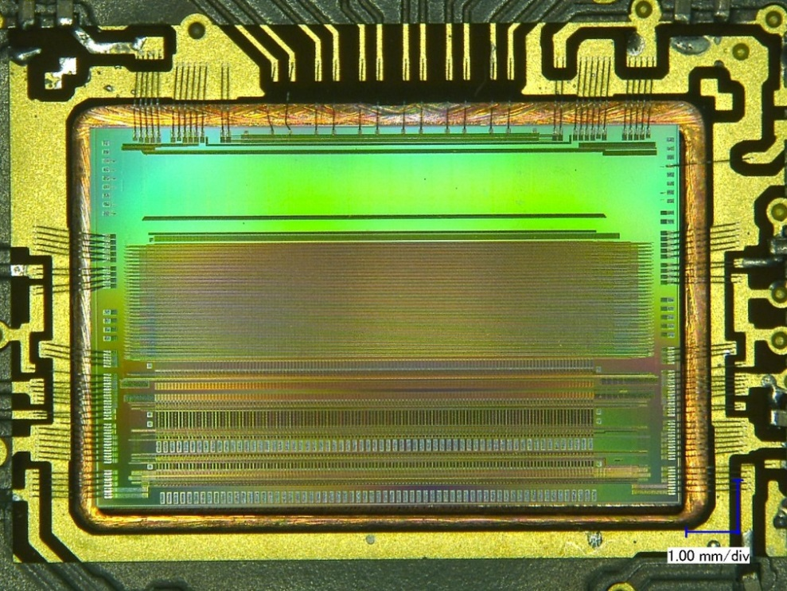
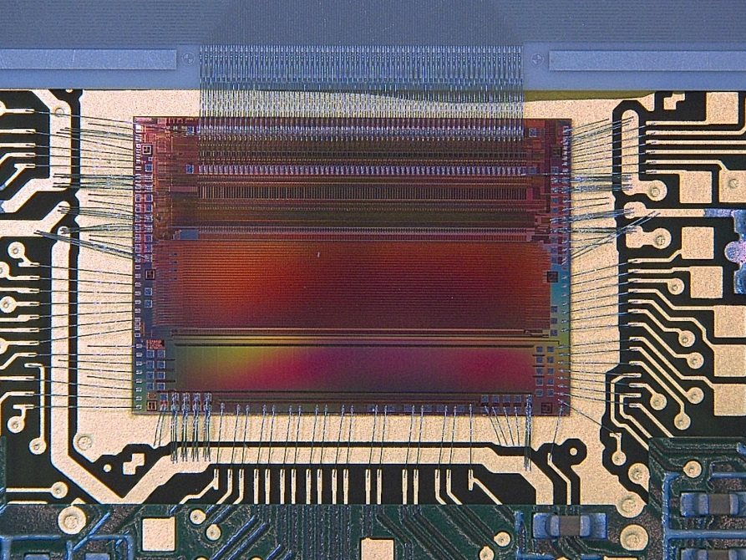
ASIC Detector Front-End Design & Integration
multi-channel pre-amps
monolithic pixel detectors
mixed signal designs
hybrid technologies

Slide 9
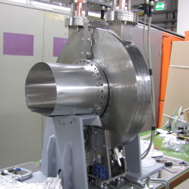
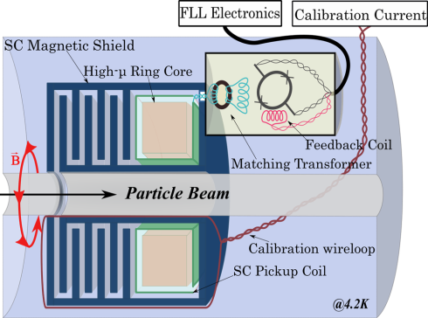
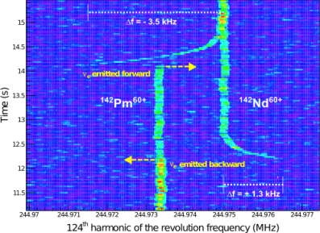
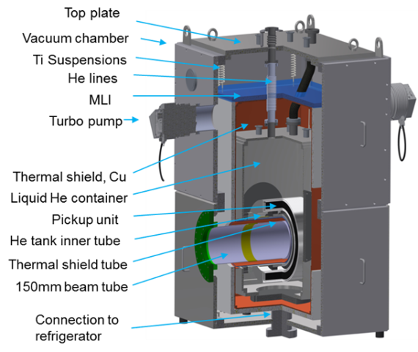
Cryogenic Detectors
Micro Calorimeters
cryogenic detectors and low temperature readout ASICs
highly granular cryogenic detector arrays and their readout
Beam Diagnostics: Non-Destructive In-Ring Particle Detection
Single particle sensitivity (Schottky)
absolut current values (Cryogenic Current Comparators) using dc-SQUIDs (device, cryostat, magn. shielding, electronics)

Slide 10
Radiation Hard Scintillating as well as Cherenkov Detectors through active materials in the liquid phase
Solid Scintillators cannot cope with future radiation levels
Radiation Scintillators to turn opaque and blind

Slide 11
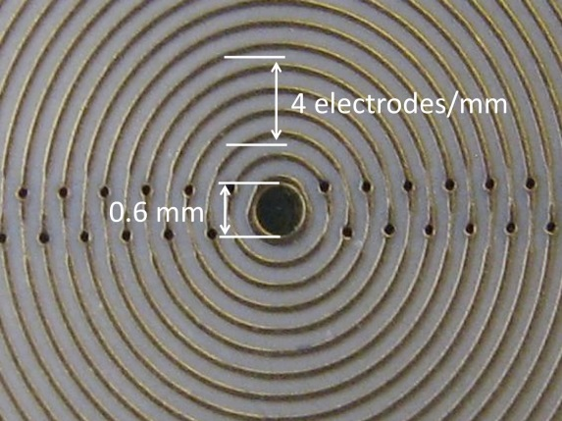
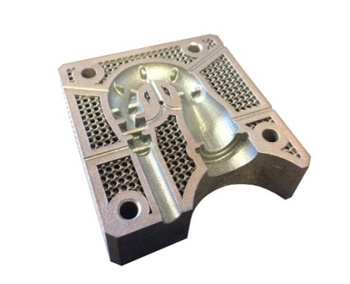
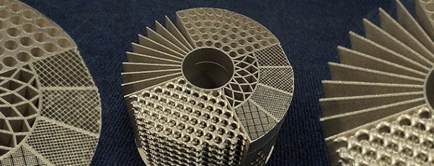
3D-Printed Detectors Modern Materials, Modern 3D Structuring Technologies (GSI proposal for distributed detector lab)
3D-Printing-oriented Engineering
ultra lightweight structures
combined functionality
modern power management
Complex metallic capillary cooling structures
Integration of optical and conductive data interconnect
RF carpets to stop
relativistic fragment ions
Stopping power ~ Structure³

