Slide 1
CHESS2 Digital Readout
Larry Ruckman, Su Dong

Slide 2
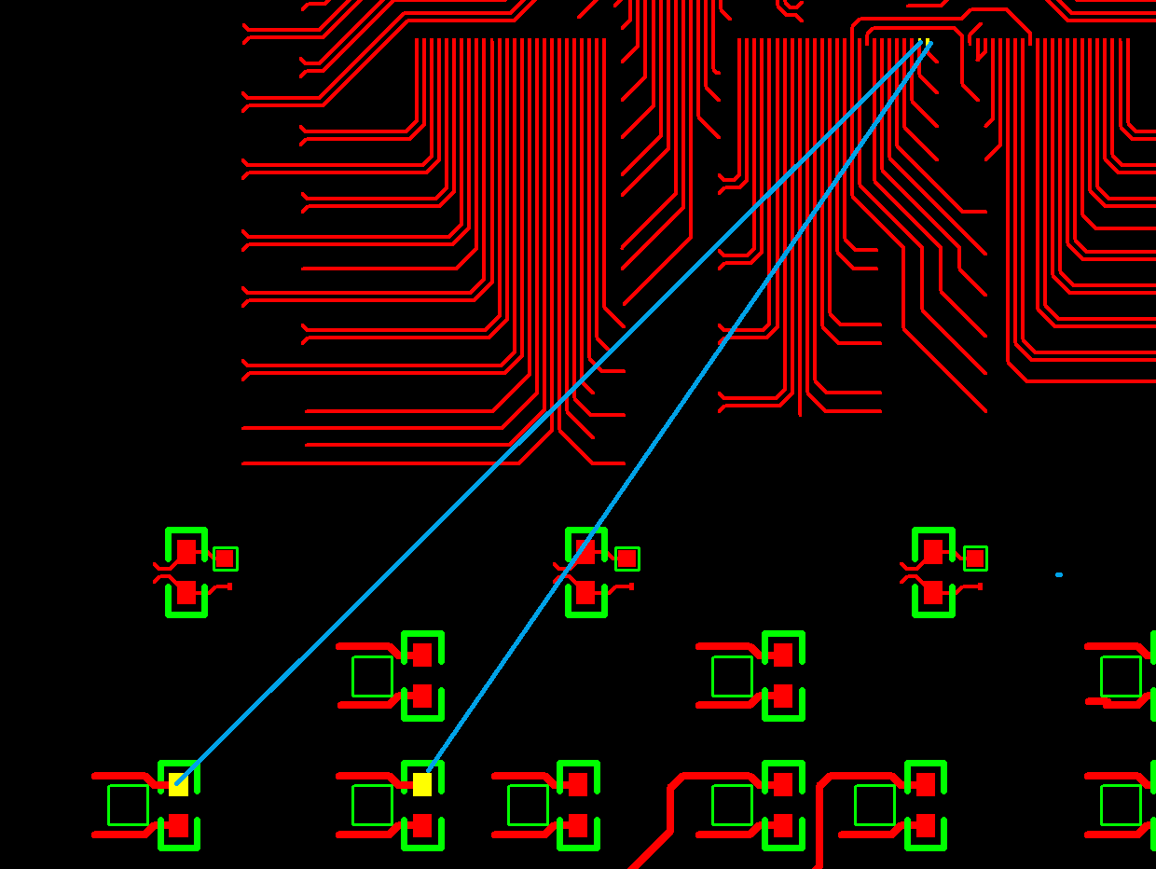
Digital Test Daughter Board
First panel of 10 at SLAC
One bug spotted by Wojciech Fedorko: BL/BLR mislabelled on SamTec connector as BR/BRL caused no connect at layout.
Two regular wire soldering patch on daughter card
Carrier board still OK
Two patched daughter boards went to Amtech for wire bonding
Sending a few to UCSC to load for further checks
Design details for daughter + carrier are documented (including wire bond diagrams) at:
https://confluence.slac.stanford.edu/display/AIRTRACK/ATLAS%3A+CHESS2

Slide 3
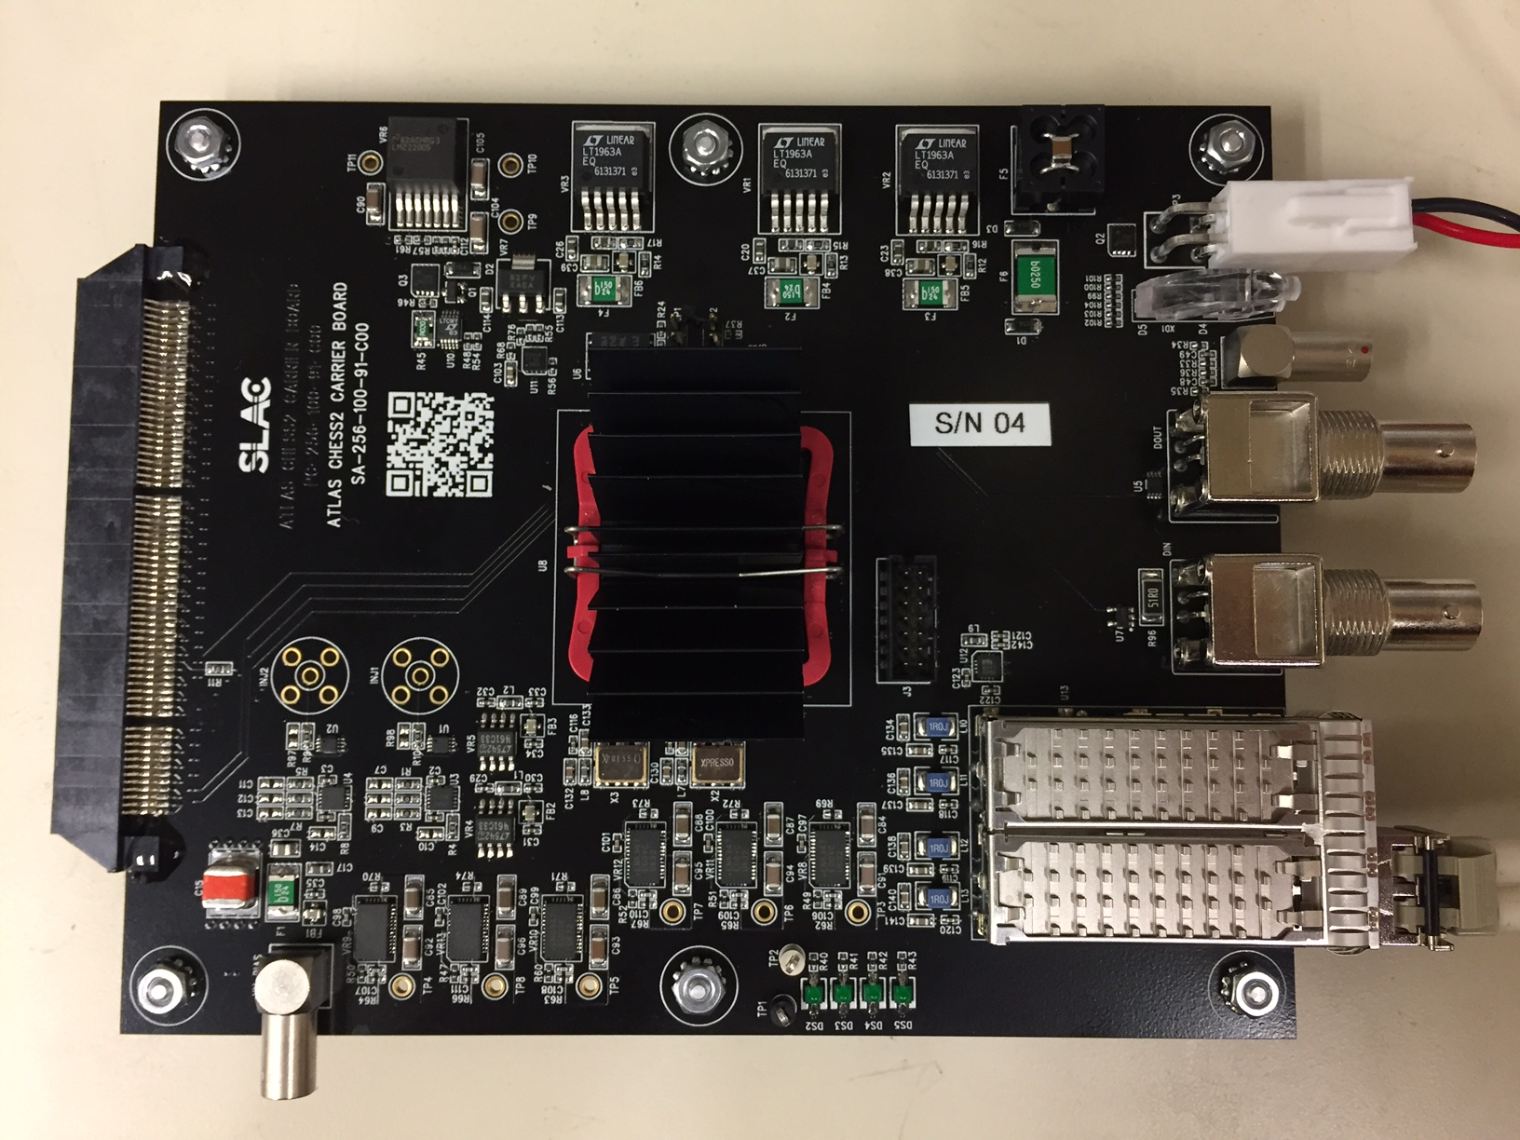
Digital Carrier Board
First few loaded boards at SLAC
Checks by Larry so far:
  Power regulation OK
  Can program FPGA and PROM with J-tag. PROM booting OK.
  Can R/W registers via SFP port with PGP link.
More standalone tests to come:
  SPI DAC
  Triggering
  External clock
  Data collection
Further tests requires loaded daughter board:
  SACI interface
  HV bias
  ASIC’s parallel LVDS data tuning

Slide 4
Status and Next
Full digital chain test ~ next week with patched daughter boards.
A few more boards to be loaded at UCSC to further check for potential problems.
Sending two carrier boards to UBC for ABCN’ test stand
Continue loading rest of the digital boards.
Launch revised daughter board fab after first check.
Distribute bare (or partial loaded) daughter boards and carrier boards.
Documentation collection started at:
https://twiki.cern.ch/twiki/bin/view/Atlas/CHESSStripTestChip

