Slide 1
Update: Analogue test system and ABCN’
22 November 2016
J. J. John
with help from many colleagues

Slide 2
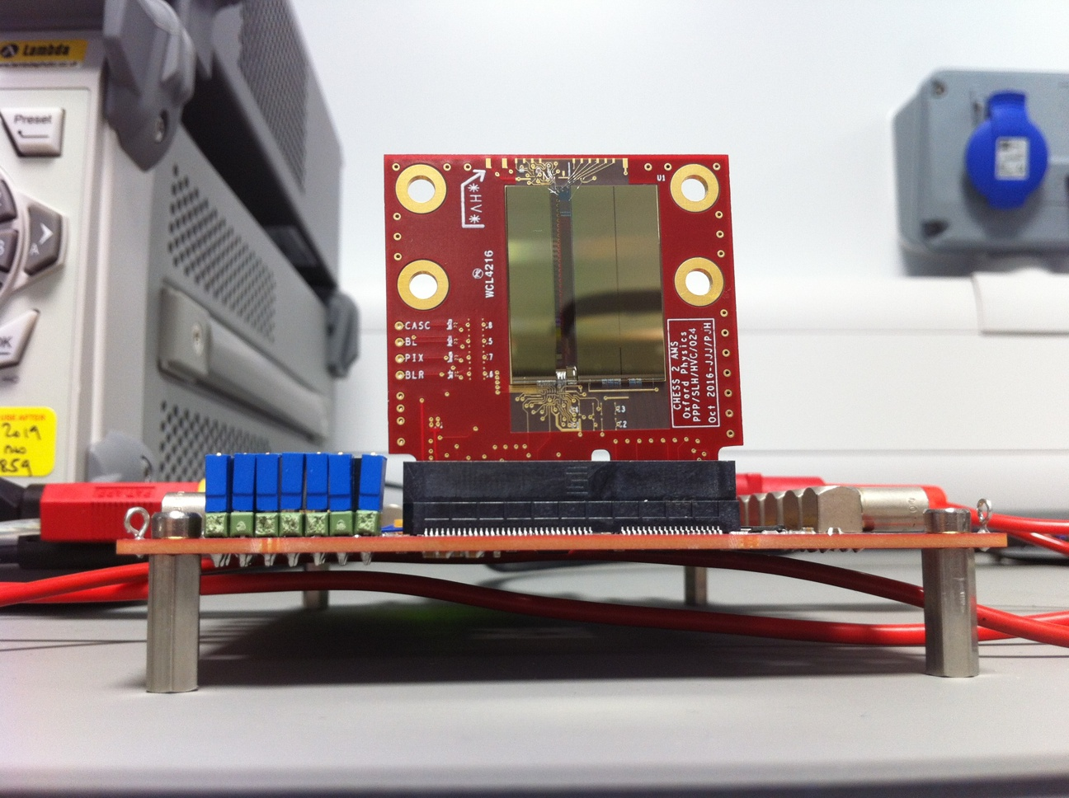
Analogue test system

Slide 3
Analogue test system - status
Distribution
Edge TCT cut-outs done last week
Delivered: Argonne, DESY, Santa Cruz, Glasgow
In transit: Ljubljana (x10 edge TCT) – posted today. RAL’s at Oxford, QMUL’s at Glasgow.
Documentation
Have extended our CHESS TWiki page for CHESS-2 work:
https://twiki.cern.ch/twiki/bin/view/Atlas/CHESSStripTestChip
including a structure to describe the 3 test systems – analogue, digital and ABCN’
Info will continue to be added over time.
Will post bonding diagrams and motherboard changes by tomorrow and e-mail institutes.
Firmware
Have SACI firmware – need to merge to Atlys next + add 40MHz clock.
Probably 2-3 days of work.
Software
Kestutis has updated this for running the motherboard’s DACs for CHESS-2.
Next: add changes for SACI.

Slide 4
ABCN’ update
1) SACI:
Wojtek at UBC (Vancouver) completed the SACI driver for the ITSDAQ firmware environment. Jaya John, Kestutis and Wojtek simulated and debugged it.
2) Adaptor board:
Boards and most components received (as of last Thursday).
Boards expected to go out for assembly this week.
3) Next steps:
Wojtek (UBC) is currently merging the SACI code into the Nexys Video firmware base. Robin (UBC) is preparing the software extensions to SCTDAQ.
Jaya John is running some more test cases and preparing a regression test set.

