Slide 1
CHESS-2 Analogue test system, proton irradiated CHESS-2 and ABCN’
6 December 2016
J. J. John and T. Huffman
with help from many colleagues

Slide 2
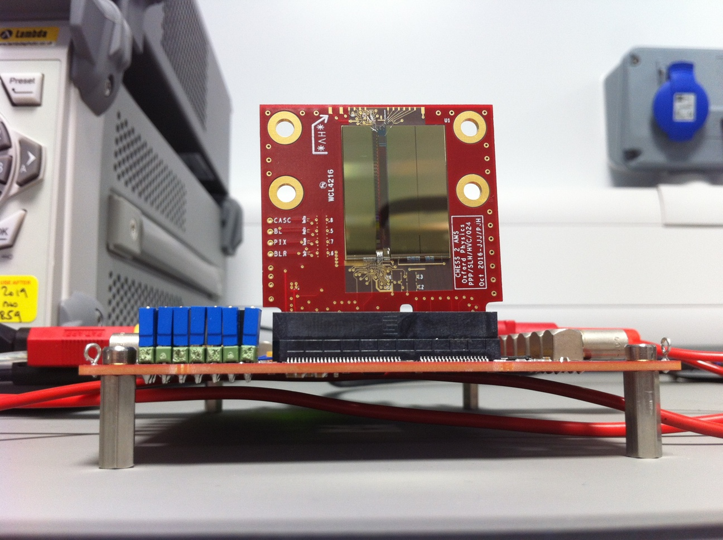
Analogue test system

Slide 3
Analogue test system - status
Documentation
Still extending our CHESS TWiki page for CHESS-2 work:
https://twiki.cern.ch/twiki/bin/view/Atlas/CHESSStripTestChip
Analogue test system: hardware information added since last meeting.
See next slides for details.
Hardware
Have distributed instructions for modifying CHESS-1 motherboards for CHESS-2 work.
Link: instructions
Firmware
Working on this at the moment, probably 1-2 days left. Aiming to test in lab with Todd this week. Will e-mail groups once set.
Software
Adding macros to the “CMOSDAQ” root environment for CHESS-2 work (e.g. SACI commands, CHESS-2 reset).
CHESS-2 DAQ commands tested earlier with Kestutis.

Slide 4
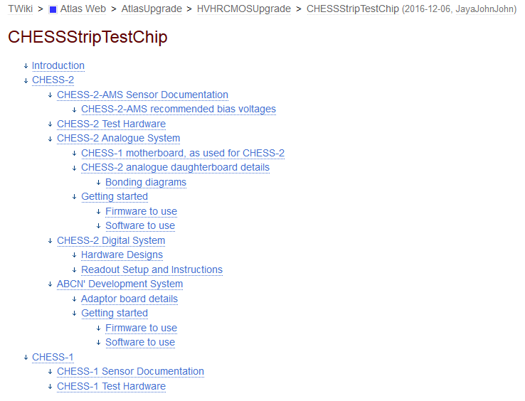
CHESS TWiki – outline
CHESS-2 sensor specs and info
CHESS-2 test systems:
analogue
-- quite a bit added this week
digital
ABCN’ readout
all CHESS-1 info

Slide 5
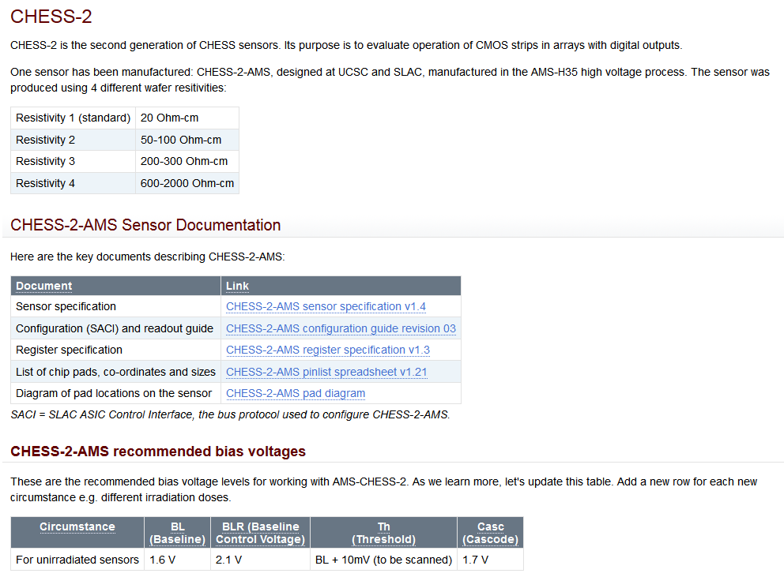
CHESS-2 TWiki info
reminder of resistivities
CHESS-2 sensor specs
current best knowledge about bias levels
- let’s update as we learn

Slide 6
CHESS-2 boards irradiated at PS - update
Status – from Federico Ravotti (CERN)
It is now possible to ship the boards to us – though January is recommended.
  Dose rates at contact: 7uSv/hr (3 boxes) and 3-4uSv/hr (3 boxes)
The final received doses are being summarised at the moment for 2016 runs, should have soon.
Reminder – what we irradiated:
10 of 20 Ω-cm (resistivity 1)
  5 at target dose 0.5 x 10¹⁵ n eq/cm²
  5 at target dose 1 x 10¹⁵ n eq/cm²
10 of 200-300 Ω-cm (resistivity 2)
  5 at target dose 0.5 x 10¹⁵ n eq/cm²
  5 at target dose 1 x 10¹⁵ n eq/cm²
4 of 600-2000 Ω-cm (resistivity 4)
  2 at target dose 0.5 x 10¹⁵ n eq/cm²
  2 at target dose 1 x 10¹⁵ n eq/cm²

Slide 7
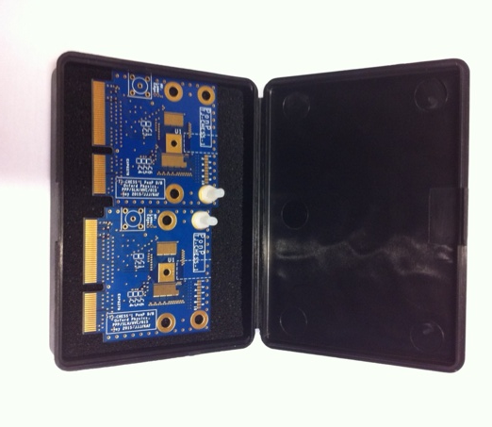
Proposal for proton-irradiated boards
Todd suggests as a starting point:
Let us know who is interested to work with these
Each group could have say a pair of a lower resistivity (res 1 or 2)
  1 of 0.5 x 10¹⁵ n eq/cm²
  1 of 1 x 10¹⁵ n eq/cm²
Then work out who would also like resistivity 4 boards
Federico will help us ship from CERN but need a team account to bill to
We don’t yet know about logistics of shipping cold or costs, to be seen
Proposed shipping box mock-up

Slide 8
ABCN’ update
1) SACI:
Wojtek and Robin testing on the lab bench this week.
Jaya John integrating SACI block into Atlys for CHESS-1 motherboard this week.
2) Adaptor board:
Boards and components at assembly house.
They are auditing the parts – one error to fix – so it seems we may have them just before Christmas.
3) Mini-module:
Discussing actively – see next slide.

Slide 9
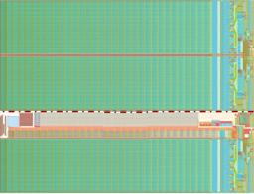
Mini-module – after discussion in ABCN’ group
  Fewer FPGAs seems better. Some favour just one. To be “more module-like”, two could be a good compromise.
  Could use cut sensors – top and middle arrays only – to avoid the big gap of the test structure areas.
ABCN’
(FPGA)
ABCN’
(FPGA)
power
JTAG
Clock
“usual module connector” ?
  For connection to the SCTDAQ software, looking at the connector on Ashley Greenall’s new hybrid panel, same as electrical End-of-Stave.
  Evaluating this at the moment = main item to specify now.

