Slide 1
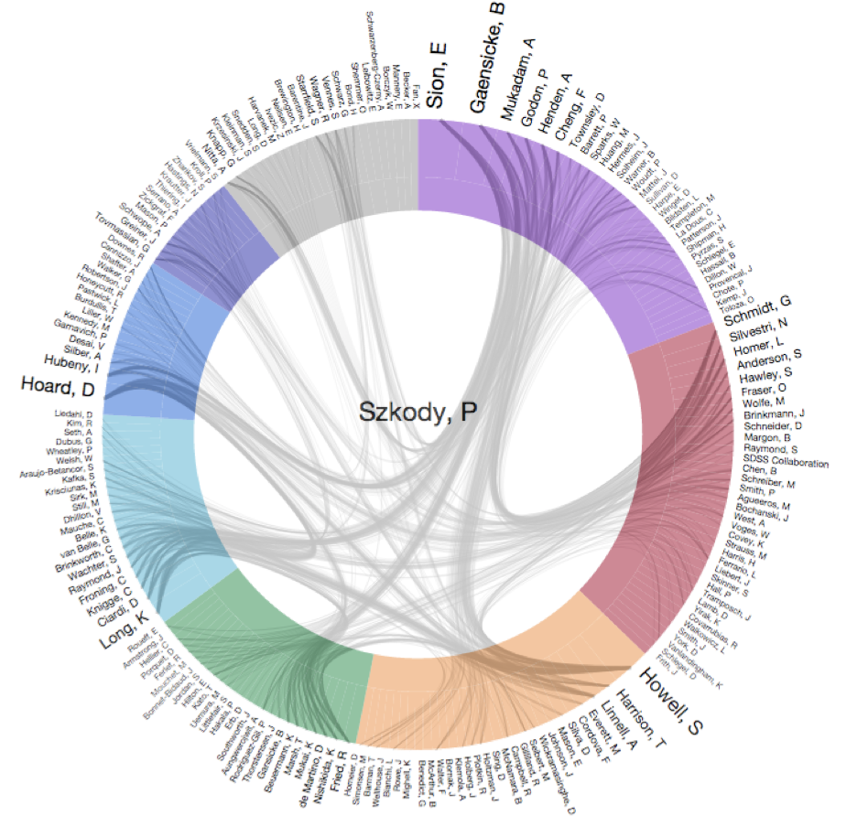
Metrics & Visualizations
with the NASA Astrophysics Data System
Edwin Henneken
Smithsonian Astrophysical Observatory

Slide 2
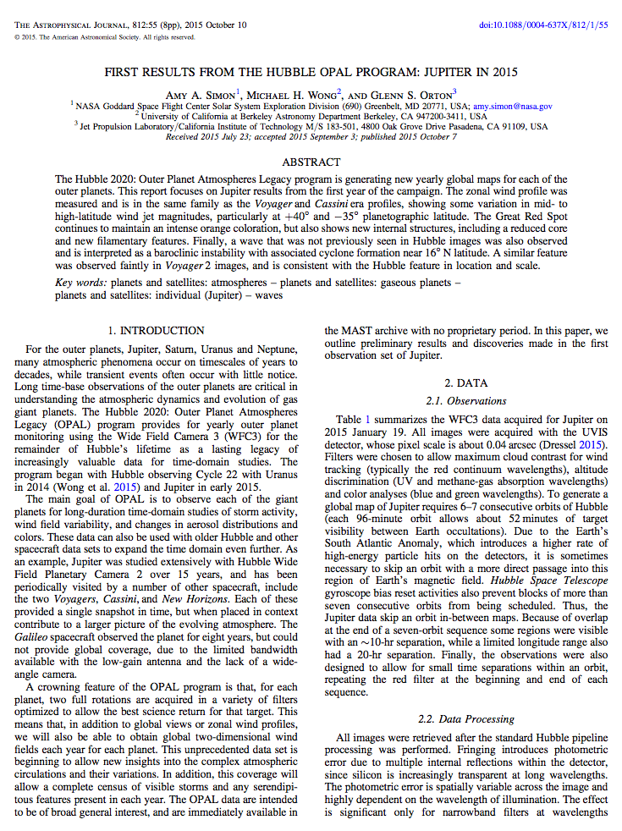
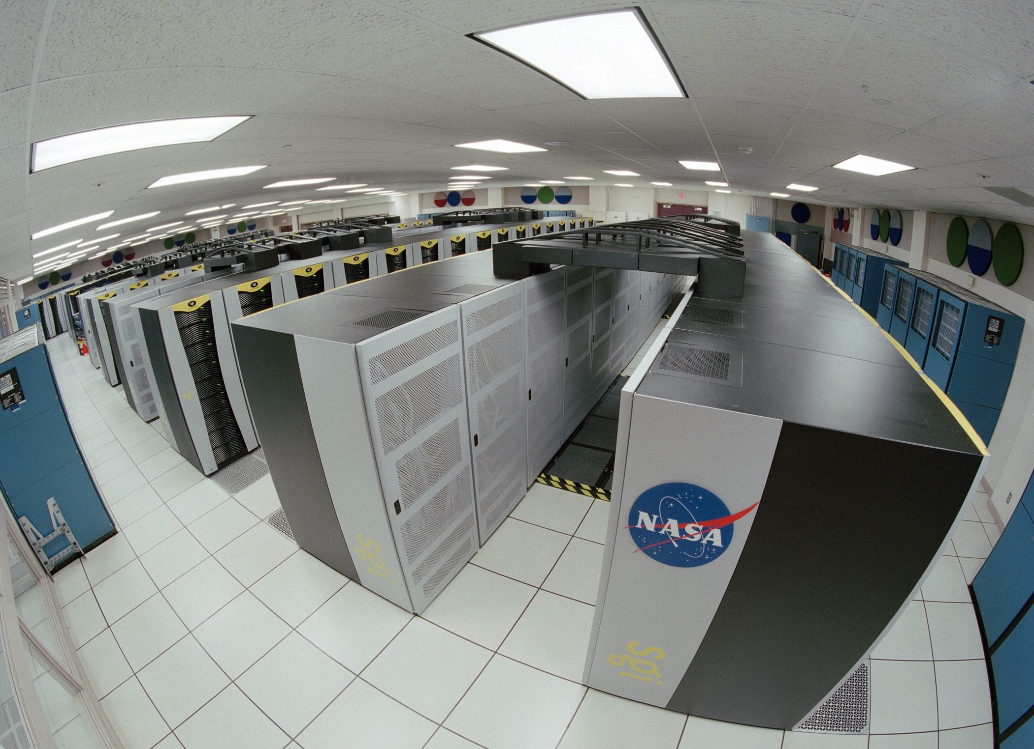
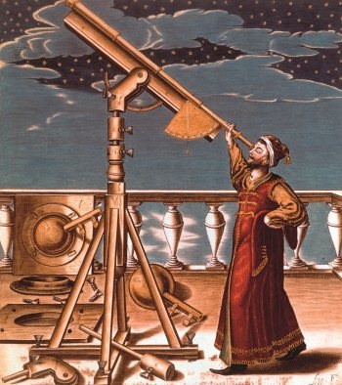
impact
society
academia
Impact of Scientific Research
products
publications
data
software
research
scientists
instruments
missions
grants
Notes:
Hi, I am Edwin Henneken. I work as IT Specialist for the NASA Astrophysics Data System, at the Smithsonian Astrophysical Observatory.
Among many things, scientific research produces publications, data and the software used to create or process the data. You can view these products as having been created in various settings: that of individual scientists, particular instruments, a mission or as the result of one or more grants. When these products are released, they have a certain amount of impact. Publications, data products and software receive citations in the scholarly literature. Another example is people using social media to write about science. Why would you care about this impact? Assuming you can measure this impact, you can use this to evaluate a scientist, an instrument, a mission or a grant. This is often done when it is time to apply for a new grant or, for example, to apply for a job. Roughly, impact falls into two classes: societal and scholarly impact. Here I will just talk about scholarly impact. How do you measure scholarly impact?

Slide 3
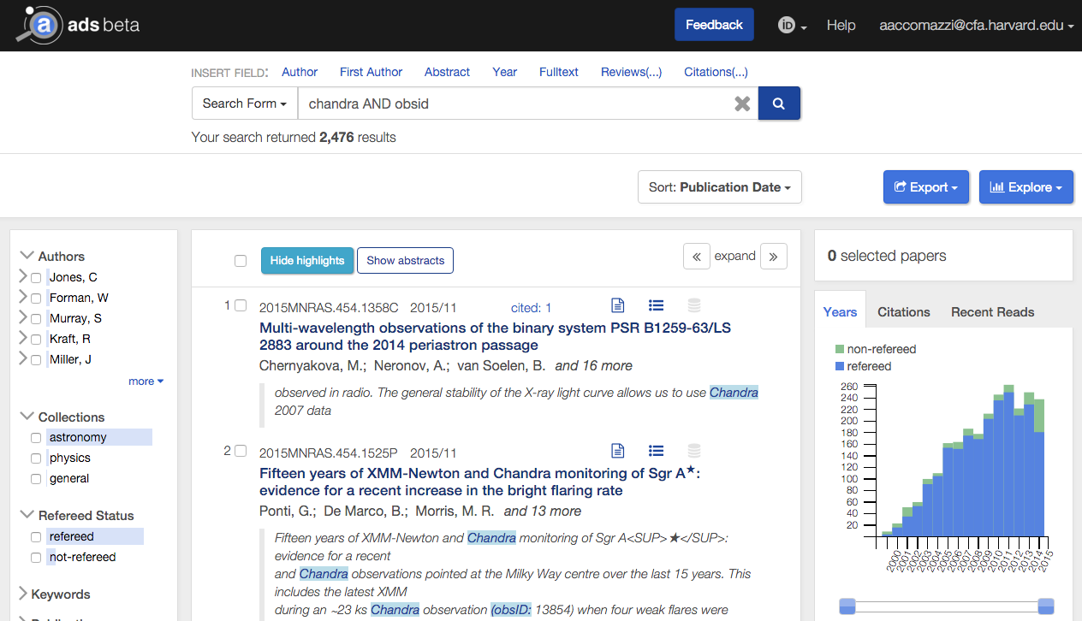
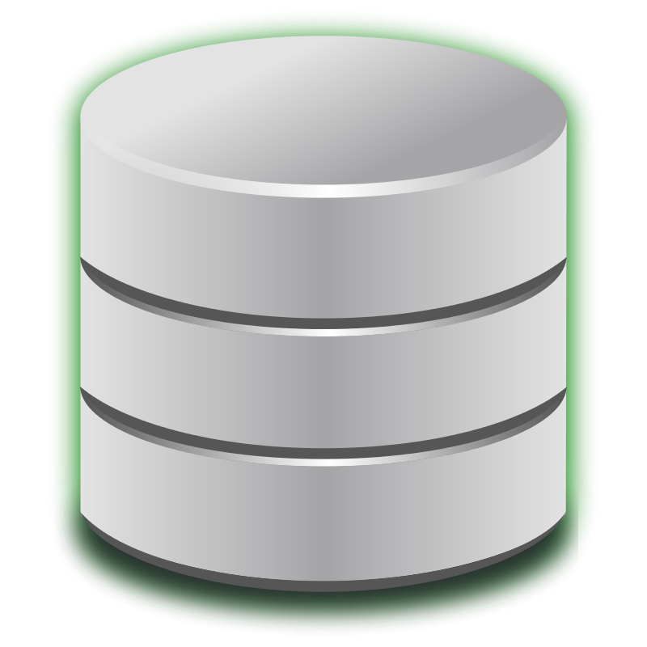
NASA Astrophysics Data System
METRICS
VISUALIZATIONS
expose
enrich
citations
ADS
downloads
aggregate
ORCiD
metadata
publishers
repositories
products
publications
data
software
Notes:
This is where the NASA Astrophysics Data System comes in. We are a digital library portal used by all professional astronomers, planetary scientists and many physicists on a daily basis. We aggregate the metadata associated with those products I mentioned earlier. Article metadata from publishers and data and software metadata from various repositories. We enrich this metadata with citation and download statistics. So, when somebody uses our service to find publications, we can use the data that we have aggregated and enriched to generate measures of impact for this set of publications. For example, this could be the set of publications generated by a certain mission. One such measure is the overview of publication metrics.

Slide 4
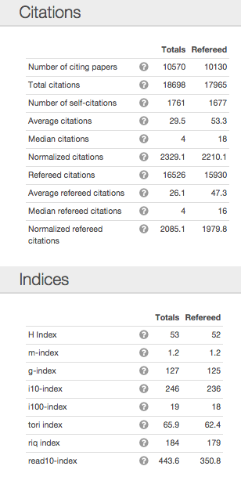
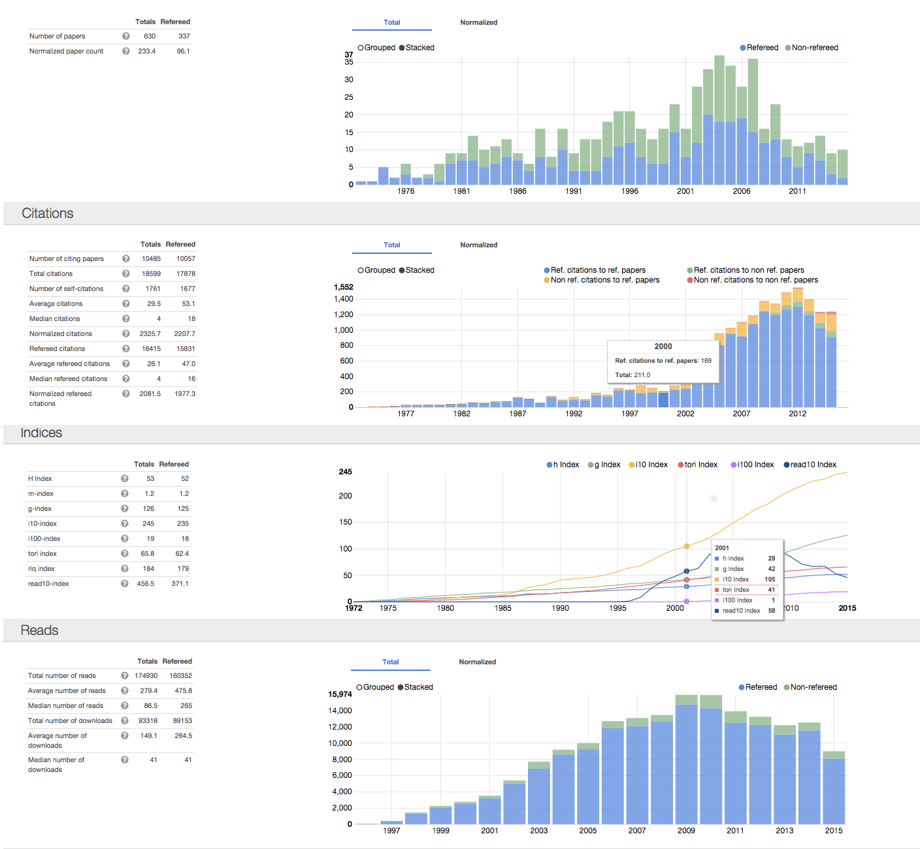
Publication Metrics
Notes:
After have searched the ADS for publications (represented by the image in upper left), you can generate a “Citation Metrics” overview from the Explore menu on the page with search results. These can be the papers generated using data from a certain instrument. This overview(shown in the center) consists of basic citation and download statistics and histograms, to indicate how some of these measures have changed over time. It also contains more sophisticated statistics in the form of indicators like the Hirsch index. This overview is a summary of impact, reduced to numbers. Great for a resume or an annual report.

Slide 5
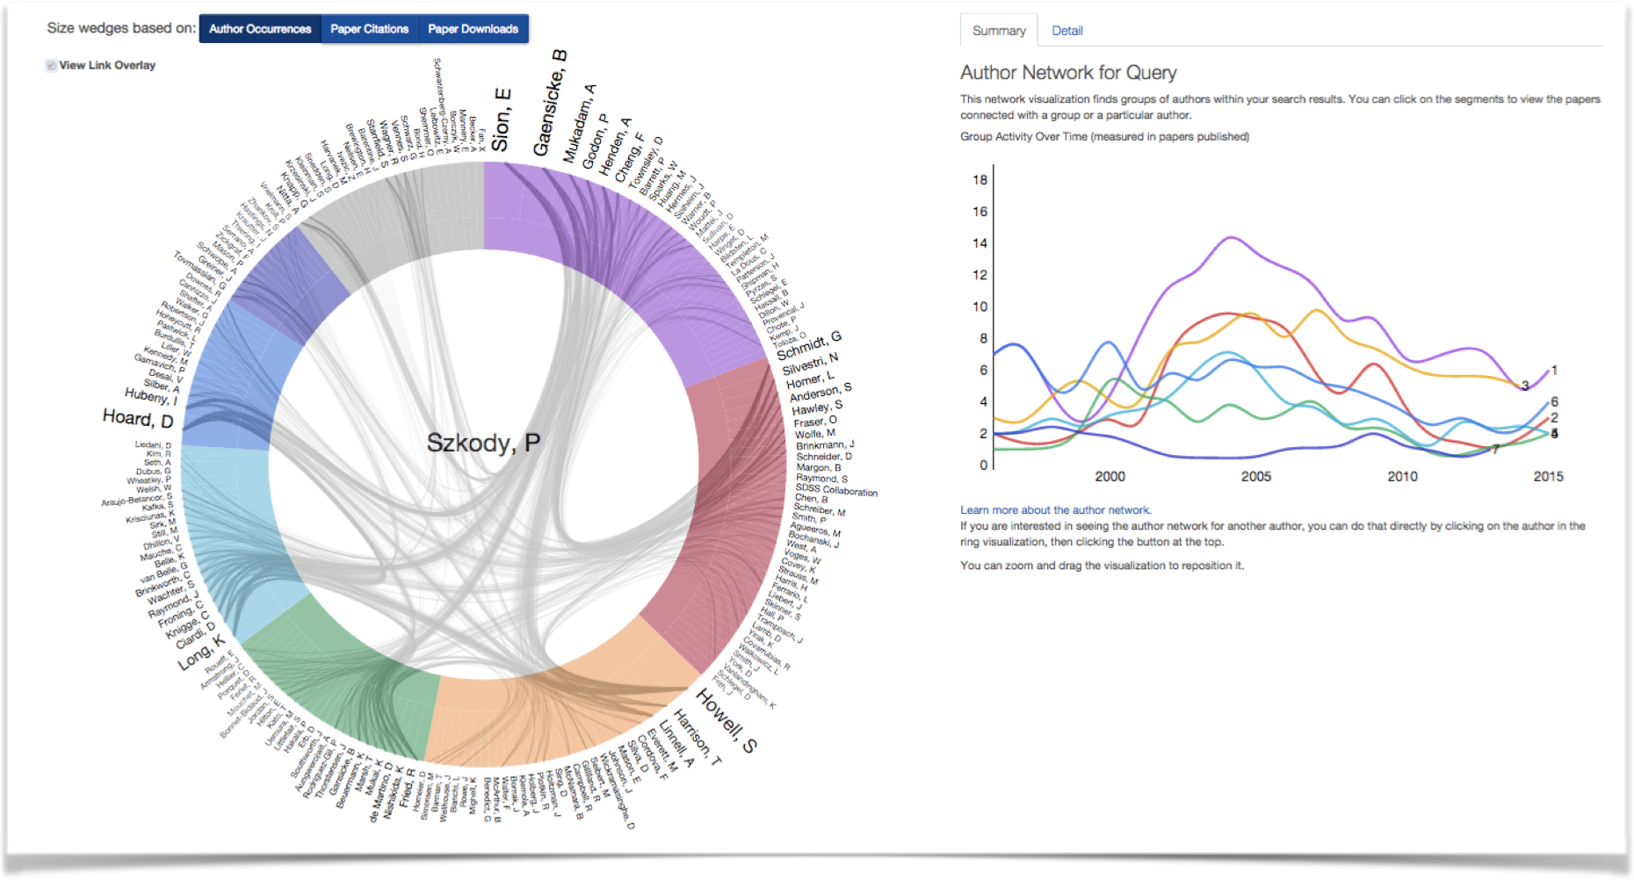
Visualization: Author Network
Edwin Henneken, Smithsonian Astrophysical Observatory
ehenneken@cfa.harvard.edu
The ADS is operated by the Smithsonian Astrophysical Observatory under NASA Grant NNX12AG54G
http://ui.adsabs.harvard.edu
@adsabs
Notes:
From the generated list of publications, you can also choose to create visualizations. The visualizations are a different way of illustrating impact. Here you look at the relationships in the set of publications. The center image is an example of the Author Network, which illustrates collaborations. These collaborations, represented by the various colors, are the result of a clustering algorithm applied to the co-author network. The graph on the right indicates how active each of these collaborations is. With both the metrics overview and the visualizations we feel we give back to the community, by making it easier to do impact studies and to help people answer questions they did not know they had.
The metrics and visualizations shown here, are part of the new ADS, code-named Bumblebee. Please stop by at our table for a test drive! You can access Bumblebee at the URL shown here, you can follow us on Twitter and feel free to email me with questions at this email address.
Thank you!

