Slide 1
Data and software sharing – a publisher’s perspective
AAHEP9, Hamburg 4th May 2017
Iain Hrynaszkiewicz

Slide 2
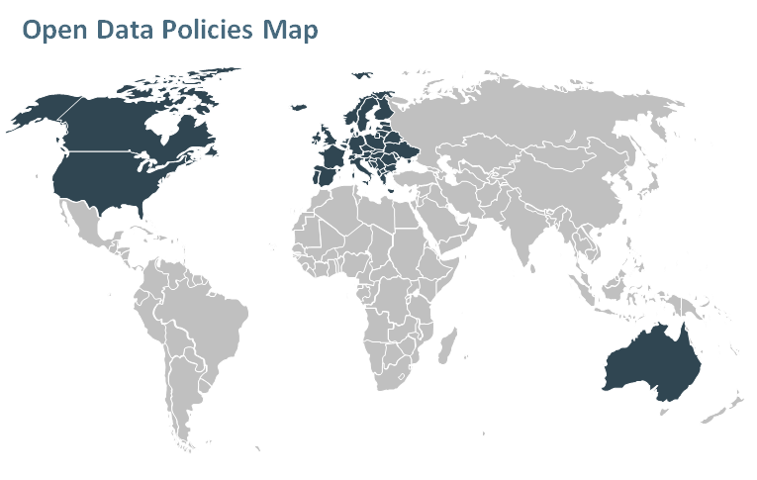
Research funders’ policies (on data, at least)
More than 40 research funders globally have policies or mandates that require data archiving as a condition of grants (1), including:
National Science Foundation (NSF)
National Institutes of Health (NIH)
Wellcome Trust
Bill and Melinda Gates Foundation
Research Councils UK
European Commission H2020
Some of these require data to be linked to publications including:
Engineering and Physical Sciences Research Council (EPSRC)
(1) Hahnel, M: Global funders who require data archiving as a condition of grants. figshare.
https://dx.doi.org/10.6084/m9.figshare.1281141.v1 (2015)

Slide 3
Data and software are “1st class” research objects
HEFCE and the REF: http://blog.hefce.ac.uk/2015/09/01/opening-up-research-data/ “Via the REF, we fully recognise data as an equally valid form of research output, and, through our open access policy for the next REF, we plan to reward research environments that deliver open access to a wider set of outputs than just journal articles and conference papers.”
National Science Foundation (US) “For all new grant applications from 14 January, the US National Science Foundation (NSF) asks a principal investigator to list his or her research “products” rather than “publications” in the biographical sketch section. This means that, according to the NSF, a scientist’s worth is not dependent solely on publications. Data sets, software and other non-traditional research products will count too.” http://www.nature.com/nature/journal/v493/n7431/full/493159a.html

Slide 4
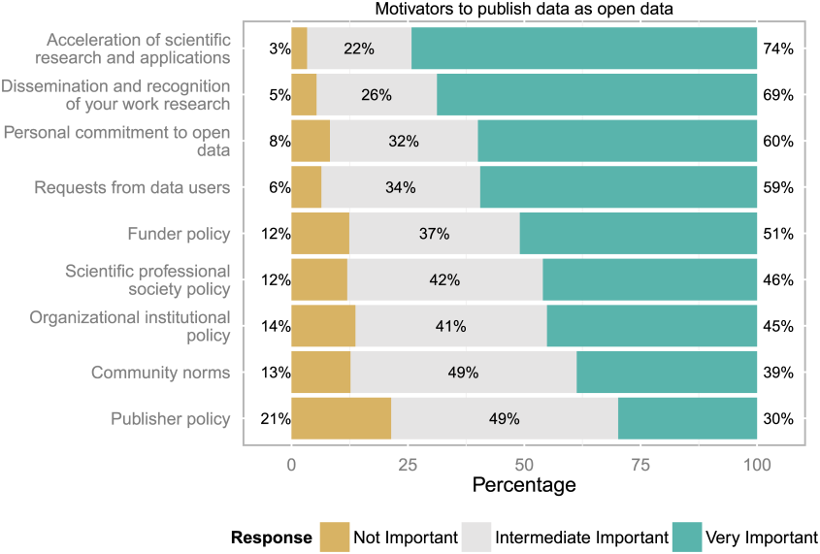
What motivates researchers to share (data)?
97% - to accelerate research and its applications¹
96% - increased visibility and discovery of their research data^{1,2}
95% - increased usability of their research data²
>90% - credit mechanism for deposit of data^{1,2}
88% - to comply with funder policy¹
Schmidt et al. (2016). PLoS ONE 11(1): e0146695. doi:10.1371/journal.pone.0146695 (n=1248) (& image credit, CC BY)
Nature Publishing Group (2014): Data publication survey - raw data. figshare. http://dx.doi.org/10.6084/ m9.figshare.1234052 (n=387)
Notes:
What else do they want?

Slide 5
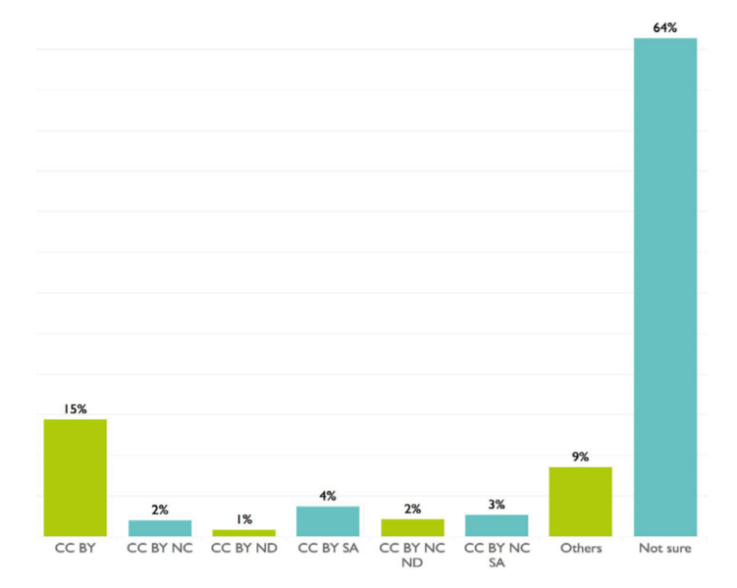
What challenges do researchers face (in data sharing)?
64% unsure about open licensing of research data¹
56% do not use a metadata standard²
54% would like more guidance complying with funder policies¹
54% do not have enough time to make data available¹
45% unaware of a repository for some of their data³
39% uncertain about meeting costs of making data open^{1,2}
Treadway et al. (2016). figshare. https://dx.doi.org/10.6084/m9.figshare.4036398.v1 (n= 2061) (& image credit CC BY)
Tenopir et al. (2011). PLoS ONE 6(6): e21101. doi:10.1371/journal.pone.0021101 (n=1315)
Nature Publishing Group (2014). figshare. http://dx.doi.org/10.6084/ m9.figshare.1234052 (n=387)
Notes:
Main findings:
Researchers do share and use one another’s data but lack places to put it.
They would value a high quality data publication

Slide 6
What are publishers doing about data and software sharing?
Content types e.g. data/software articles and journals
Credit and incentives e.g. data and software citation
Encouraging reuse e.g. open licenses
Data quality e.g. peer review of data and code
Data & code discoverability e.g. linking data & code to publications; supporting repositories
Raising awareness e.g. editorials, outreach
Guidance and policy e.g. information for authors, policy harmonization
Technology e.g. platform developments, repository integration and other partnerships

Slide 7
What are publishers doing about data and software sharing?
Content types e.g. data/software articles and journals
Credit and incentives e.g. data and software citation
Encouraging reuse e.g. open licenses
Data quality e.g. peer review of data and code
Data & code discoverability e.g. linking data and code to publications; supporting repositories
Raising awareness e.g. editorials, outreach
Guidance and policy e.g. information for authors, policy harmonization
Technology e.g. platform developments, repository integration and other partnerships

Slide 8
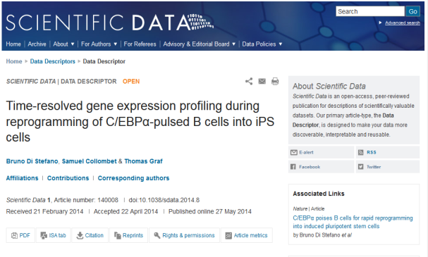
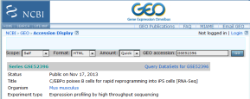
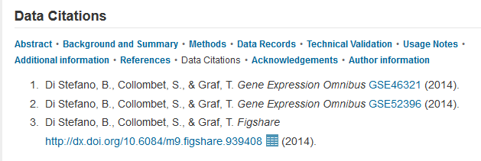
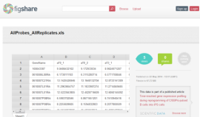
The data descriptor article at Scientific Data
Associated Nature Article
Data at figshare & NCBI GEO
Integrated figshare data viewer
Notes:
We now have several examples of data descriptors derived from different sources and linking data to publications in various/multiple ways.
Following up on the previous publication at Nature, the authors provide a richer description and release of valuable gene expression data from an iPS cell reprogramming time-course, including data from four early time points, not analyzed or released in the original publication (figshare data).

Slide 9
What are publishers doing about data and software sharing?
Content types e.g. data/software articles and journals
Credit and incentives e.g. data and software citation
Encouraging reuse e.g. open licenses
Data quality e.g. peer review of data and code
Data & code discoverability e.g. linking data and code to publications; supporting repositories
Raising awareness e.g. editorials, outreach
Guidance and policy e.g. information for authors, policy harmonization
Technology e.g. platform developments, repository integration and other partnerships
SoftwareX

Slide 10
What are publishers doing about data and software sharing?
Content types e.g. data/software articles and journals
Credit and incentives e.g. data and software citation
Encouraging reuse e.g. open licenses
Data quality e.g. peer review of data and code
Data & code discoverability e.g. linking data and code to publications; supporting repositories
Raising awareness e.g. editorials, outreach
Guidance and policy e.g. information for authors, policy harmonization
Technology e.g. platform developments, repository integration and other partnerships

Slide 11
What is a data citation?
A reference made to data in the same way as researchers routinely provide a bibliographic reference to journal articles and books
When public datasets have Digital Object Identifiers (DOIs), very similar to citing a journal article
Include the minimum information recommended by DataCite and follow Nature style i.e.
authors, title, publisher (repository name), identifier, year
Creator (author)
Title
Publisher (repository name)
Identifier (DOI)
Publication year

Slide 12
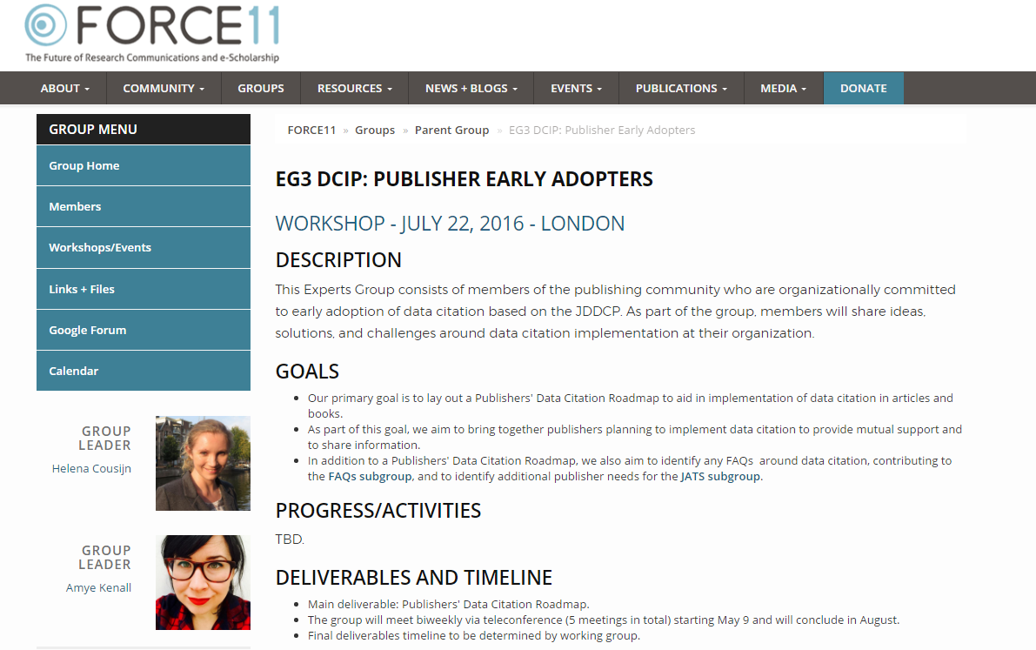
A Data Citation Roadmap Publishers
Primary goal is to lay out a Publishers' Data Citation Roadmap to aid in implementation of data citation in articles and books.
Key part of roadmap is data policy and how these are presented to researchers/readers at publisher and/or journal level
Data citation is a key part of publisher (and all?) data policies
https://www.force11.org/group/dcip/eg3publisherearlyadopters
Reference:
A Data Citation Roadmap for Scientific Publishers. Helena Cousijn, Amye Kenall, Emma Ganley, Melissa Harrison, David Kernohan, Fiona Murphy, Patrick Polischuk, Maryann Martone, Timothy Clark
bioRxiv 100784; doi: https://doi.org/10.1101/100784

Slide 13
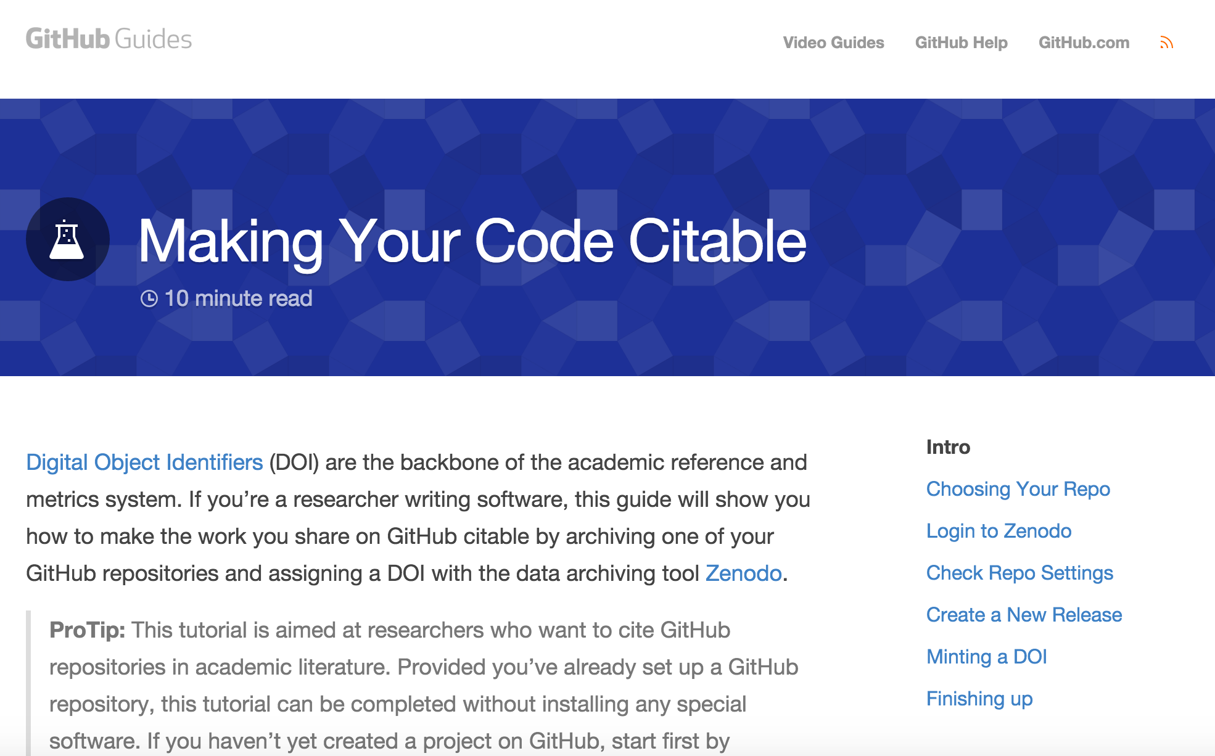
Software citation
https://guides.github.com/activities/citable-code/
http://blog.apastyle.org/apastyle/2015/01/how-to-cite-software-in-apa-style.html
https://www.software.ac.uk/how-cite-and-describe-software
https://blog.datacite.org/software-citation-workflows/
Notes:
Open citations e.g. Springer Nature

Slide 14
What are publishers doing about data and software sharing?
Content types e.g. data/software articles and journals
Credit and incentives e.g. data and software citation
Encouraging reuse e.g. open licenses
Data quality e.g. peer review of data and code
Data & code discoverability e.g. linking data & code to publications; supporting repositories
Raising awareness e.g. editorials, outreach
Guidance and policy e.g. information for authors, policy harmonization
Technology e.g. platform developments, repository integration and other partnerships

Slide 15
Helping researchers find the right repository
Springer Nature recommended repositories list (>80 repositories; available CC BY & reused by e.g. PLOS)
http://www.springernature.com/gp/group/data-policy/repositories
http://www.re3data.org/ (<1,800 repositories listed)
What makes a good (data) repository?
Data repositories for data supporting peer-reviewed publications generally should:
Ensure long-term persistence and preservation of datasets
Be recognized by a research community or research institution
Provide deposited datasets with stable and persistent identifiers, such as Digital Object Identifiers (DOIs)
Allow access to data without unnecessary restrictions
Provide a clear license or terms of use for deposited datasets

Slide 16
What are journals & publishers doing about it?
Content types e.g. data articles and journals
Credit and incentives e.g. data citation and data articles
Encouraging reuse e.g. open licenses
Data quality e.g. data peer review
Data discoverability e.g. linking data to publications; supporting repositories
Raising awareness e.g. editorials, outreach
Guidance and policy e.g. information for authors, policy harmonization
Technology e.g. platform developments, repository integration and other partnerships

Slide 17
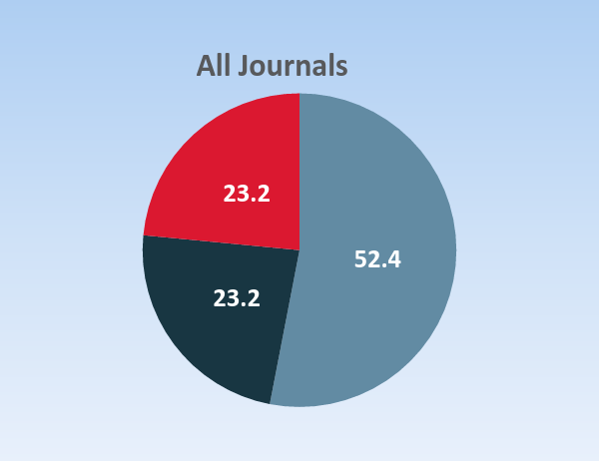
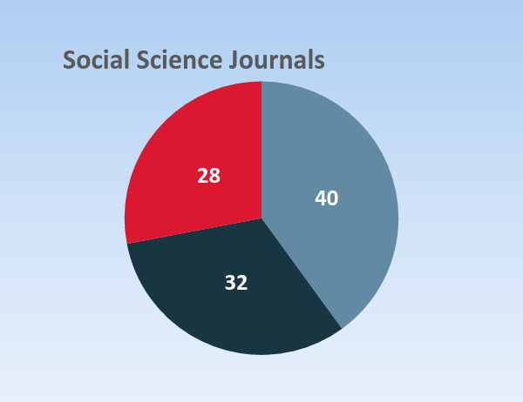
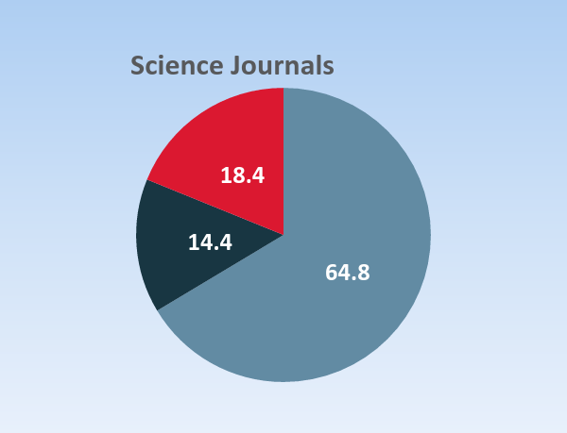
How many journals have a research data policy?
Full Policy
Partial Policy
No Policy
Data source: Linda Naughton, JISC Journal Research Data Policy Bank project presentation (n = 250)
“The evidence shows that the current research data policy ecosystem is in critical need of standardization and harmonization”
-- Naughton, L. & Kernohan, D., (2016). Making sense of journal research data policies. Insights. 29(1), pp.84–89. DOI: http://doi.org/10.1629/uksg.284

Slide 18
Research data policy initiative: motivations
Helping our authors and journals, books and proceedings publish better research
Improving author, editor and reader service
Encourage more readership and reuse of research
Promote use of data repositories
Understand costs and benefits of research data policies
www.springernature.com/gp/group/data-policy

Slide 19
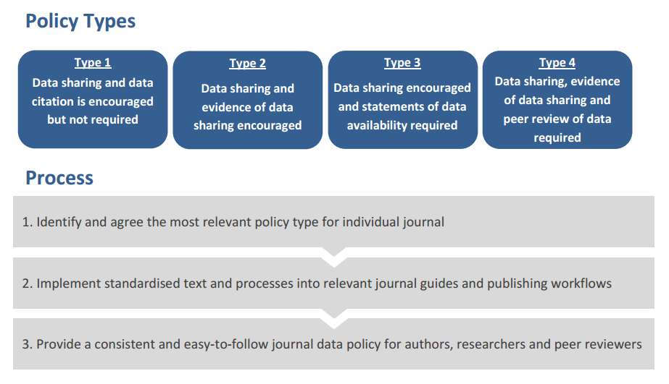
http://www.springernature.com/gp/group/data-policy

Slide 20
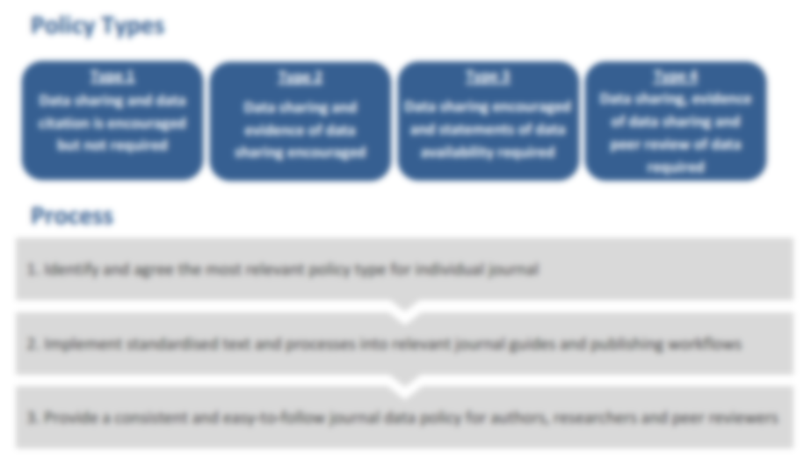
All policy types:
Preference sharing of data via repositories (rather than ESM/SI)
Allow citation of public datasets in reference lists/bibliographies
Encourage use of publisher helpdesk to ensure compliance with funder mandates
http://www.springernature.com/gp/group/data-policy/helpdesk

Slide 21
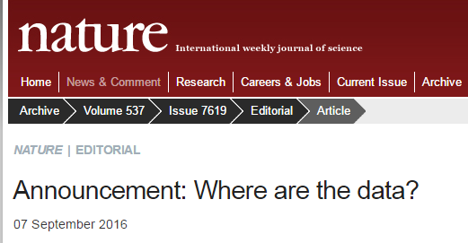
Policy implementation progress – 27th April 2017
964 (~40%) Springer Nature journals have adopted a standard policy – so far
Includes all Nature and BioMed Central journals; Springer Research Group journals being added weekly
~6000 data policy website visits per month
Policies released CC BY to enable wider policy adoption and development
~5 helpdesk enquiries per week
http://www.springernature.com/gp/group/media/press-releases/over-600-journals-springer-nature-journals-commit-to-new-data-sharing-policies/11111248

Slide 22
What is a data availability statement (DAS)?
A statement about where data supporting the results reported in the article can be found
The datasets generated during and/or analysed during the current study are available in the [NAME] repository, [PERSISTENT WEB LINK TO DATASETS].
The datasets generated during and/or analysed during the current study are available from the corresponding author on reasonable request.
All data generated or analysed during this study are included in this published article (and its supplementary information files).
Required by many journals/publishers e.g. PLOS, Royal Society, Nature, BioMed Central, BMJ, Hindawi

Slide 23
Data availability statements
Guidance on and published examples of data availability statements http://www.springernature.com/gp/group/data-policy/data-availability-statements
Data generated at a central, large scale facility – common practice in some physical sciences | Raw data were generated at the [facility name] large-scale facility. Derived data supporting the findings of this study are available from the corresponding author upon request | Nature Physics

Slide 24
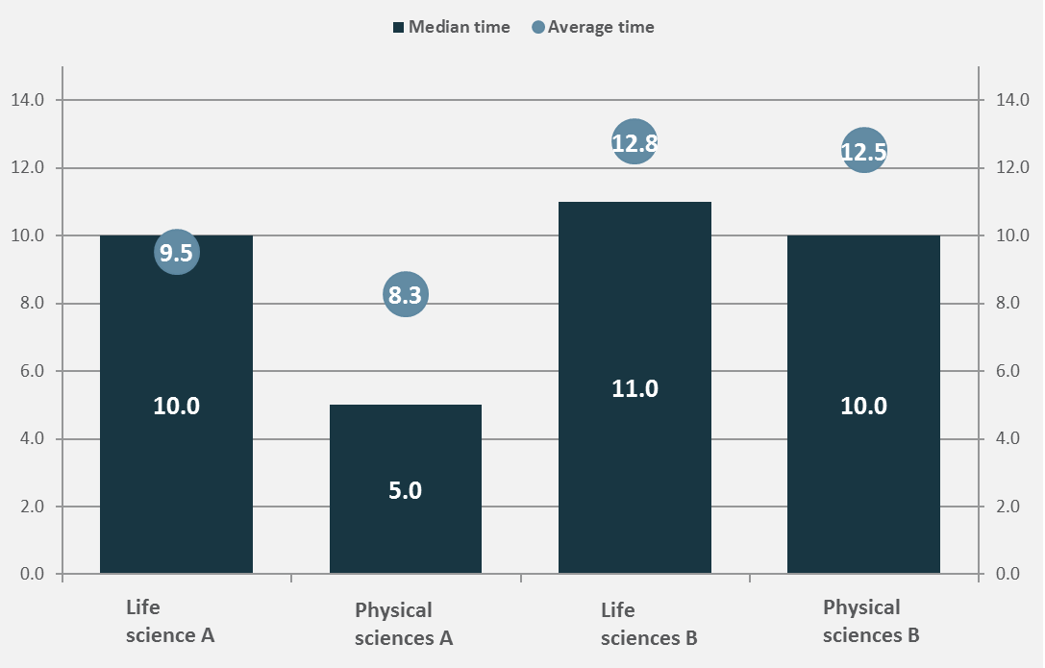
Median editor time to add DAS by journal (minutes)
n= 82

Slide 25
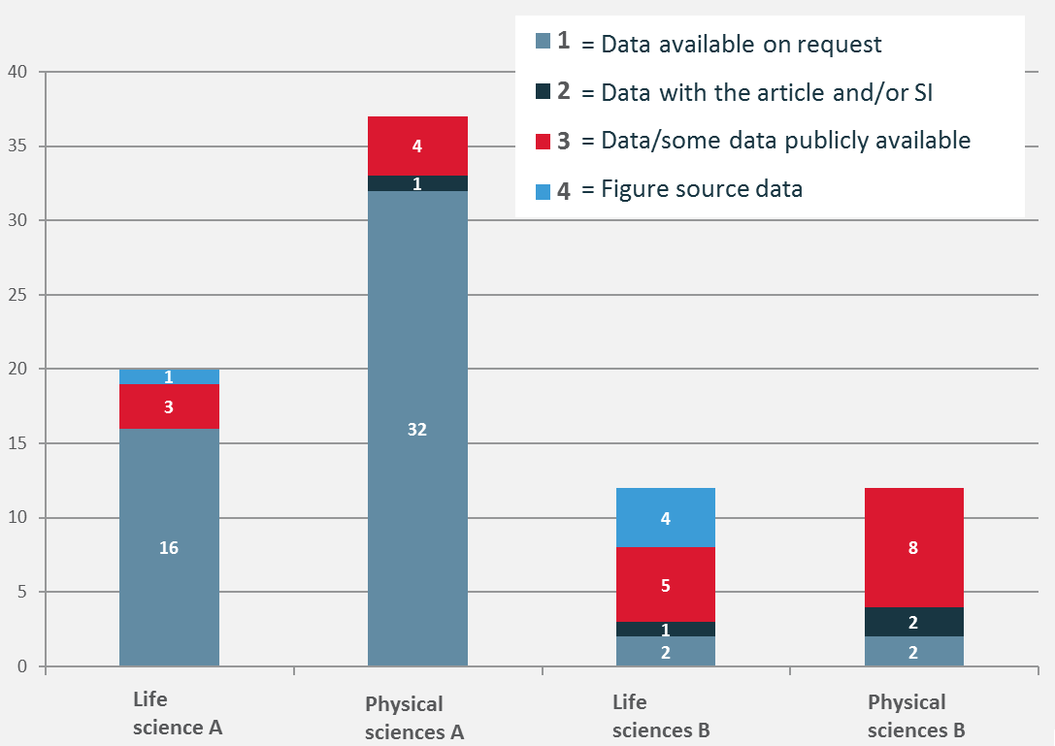
Statement types by journal
n= 82
= Data available on request
= Data with the article and/or SI
= Data/some data publicly available
= Figure source data

Slide 26
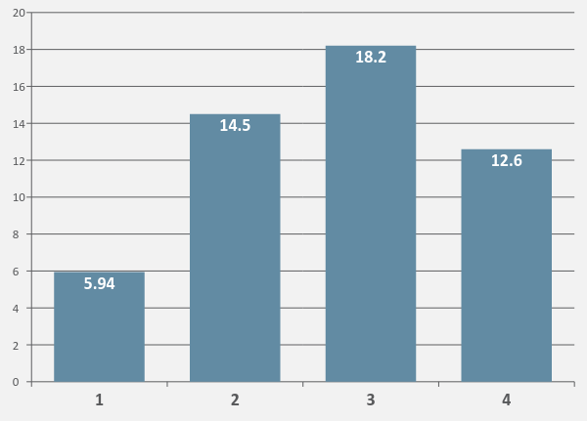
Average time by statement type (minutes)
n= 82
1 = Data available on request
2 = Data with the article and/or SI
3 = Data/some data publicly available
4 = Figure source data

Slide 27
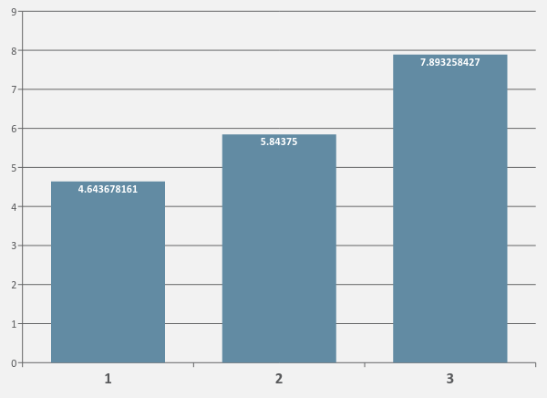
Average time by statement type (minutes)
1 = Data available on request
2 = Data with the article and/or SI
3 = Data/some data publicly available
n= 185

Slide 28
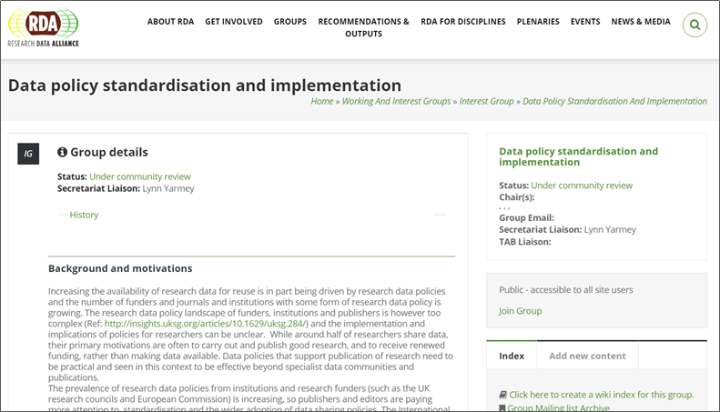
Research Data Alliance (RDA) data policy group

Slide 29
Chemistry Data Publishing Policies
Slide credit: Ian Bruno, CCDC
Discussion of policies for publishing chemistry took place last month at the Spring American Chemical Society meeting, San Francisco
Starting point is a review of policies for a selection of chemistry journals
Data Types
crystallography (single crystal, powder)
spectroscopy (NMR, IR, UV-vis, Mass)
chromatography (GC, HPLC)
physical properties
kinetic, magnetic, computational etc.
chemical structures
Policy categorisations
required/optional
with/without validation
in repository/with manuscript
Aim is to generate a comprehensive spreadsheet of journal requirements for chemistry data – and identify opportunities to improve current practice
Initiative being led by Vin Scalfani, University of Alabama
Initiated at a RDA-US/IUPAC Chemistry Data Workshop, July 2016
Supported by the RDA Chemistry Research Data Interest Group

Slide 30
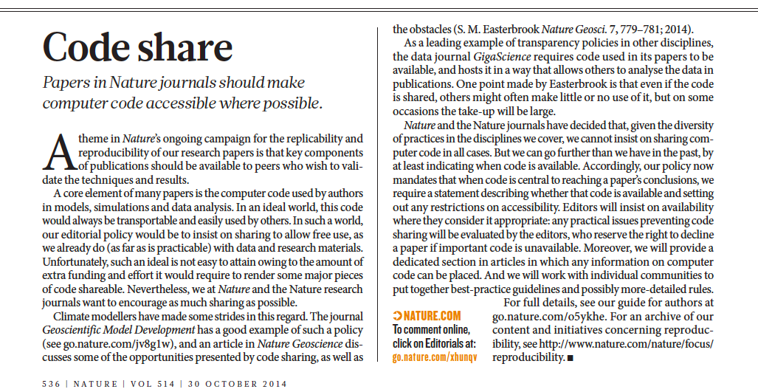
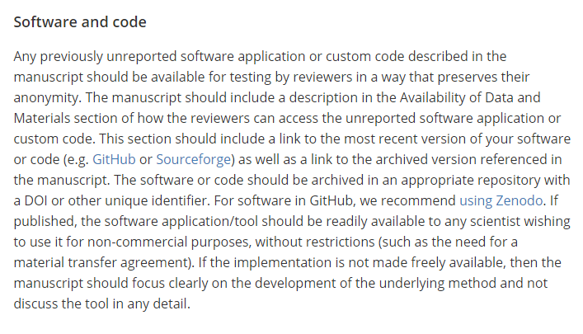
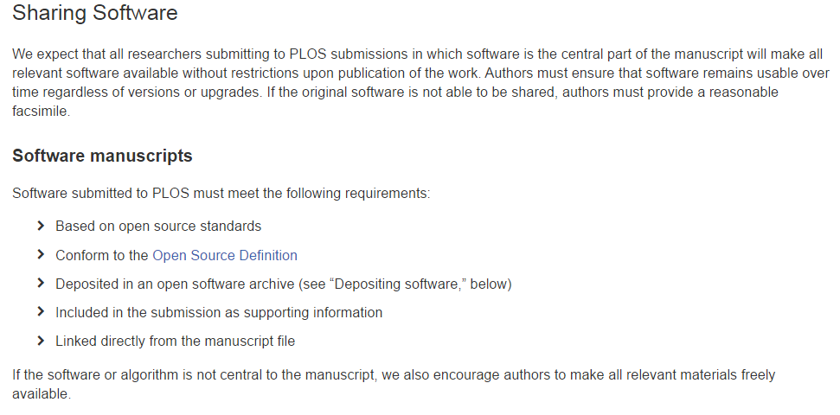
Policies on code

Slide 31
Reproducible research policies
https://academic.oup.com/biostatistics/pages/General_Instructions
Reproducible Research
Our reproducible research policy is for papers in the journal to be kite-marked D if the data on which they are based are freely available, C if the authors’ code is freely available, and R if both data and code are available, and our Associate Editor for Reproducibility is able to use these to reproduce the results in the paper. Data and code are published electronically on the journal’s website as Supplementary Materials.
Code Availability
Authors are strongly encouraged to submit code supporting their publications. Authors should submit a link to a Github repository and to a specific example of the code on a code archiving service such as Figshare or Zenodo.

Slide 32
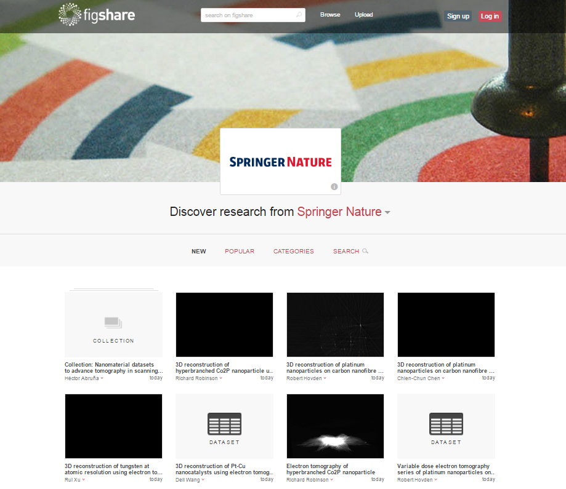
Technological partners & developments to enable sharing
https://springernature.figshare.com/

Slide 33
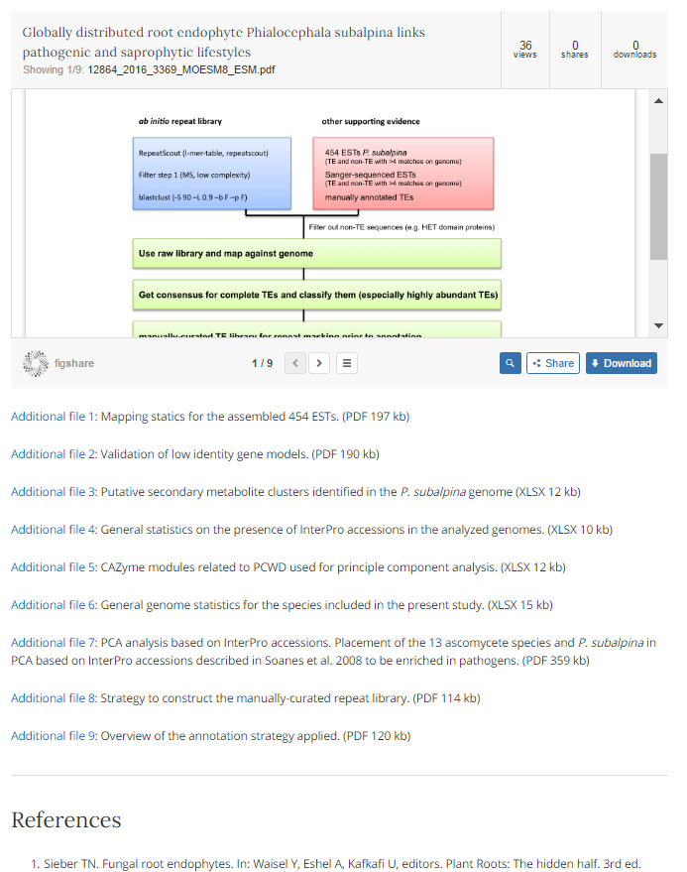
Figshare “widget” on BMC & SpringerOpen journals
http://bmcgenomics.biomedcentral.com/articles/10.1186/s12864-016-3369-8

Slide 34
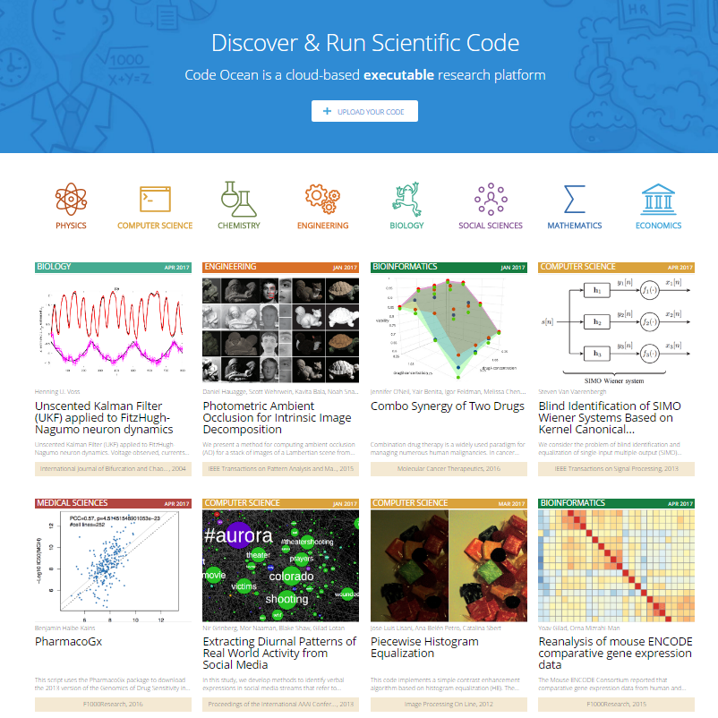
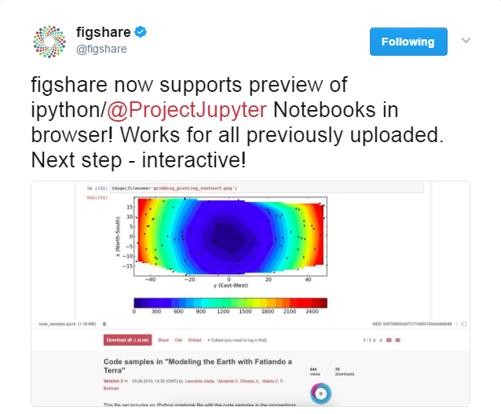
New tools/services available to publishers to support code sharing

Slide 35
Springer Nature Data Support Services pilot
To help Springer Nature authors and journals follow good practice in sharing and archiving of research data, we’re piloting optional data deposition and curation services.
Build on our Research Data Support helpdesk and will further help authors comply with funder policies, prepare their data for deposition in a repository and enhance their peer-reviewed publications.
The services provide secure and private submission of data files, which are then curated and managed by the Springer Nature Research Data team for public release.
http://www.springernature.com/gb/group/data-policy/data-support-services

Slide 36
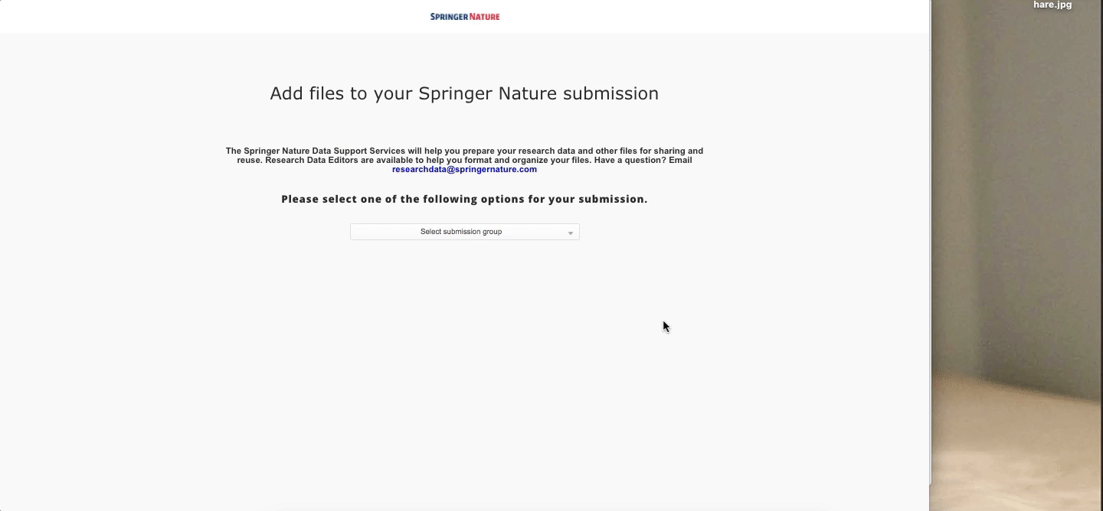
Uploading to Data Support Services

Slide 37
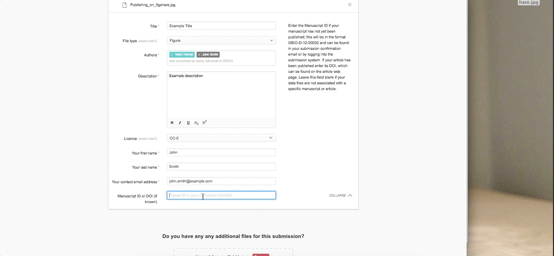
Submitting to Data Support Services

Slide 38
Acknowledgements
Springer Nature Data Policy Project Group:
Amye Kenall, Sowmya Swaminathan, Ralf Gerstner & Alex Birukou, Mathias Astell, Grace Baynes, Wim van der Stelt
Further acknowledgements: Varsha Khodiyar & Andrew Hufton (Scientific Data journal) Graham Smith (Research Data team @Springer Nature) Andreas Vogel & Astrid Huizer (Springer Nature operations) Mimi Keshani & Megan Hardeman (figshare)

Slide 39
Thank you
iain.hrynaszkiewicz@nature.com
researchdata@springernature.com @iainh_z

