Slide 1
Unique conference identifiers and CrossMark for proceedings
Aliaksandr Birukou,
Executive Editor, Computer Science
4 May 2017

Slide 2
Role of conference proceedings in CS
Computer science publishes a significant portion of its research outputs as conference proceedings
conference papers constitute 20-70% of references in journals
More reviewers, faster publication
Acceptance rate for top conferences is often 8-15%
Higher visibility and greater impact, direct contact with your peers

Slide 3
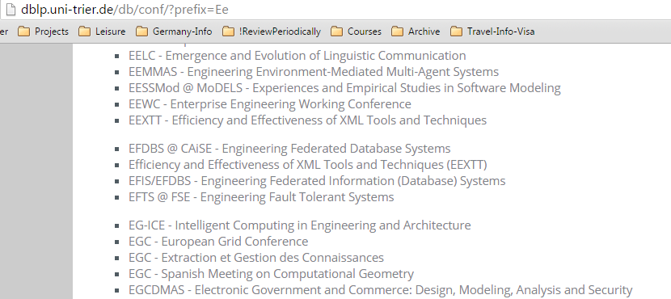
Acronyms are not unique

Slide 4
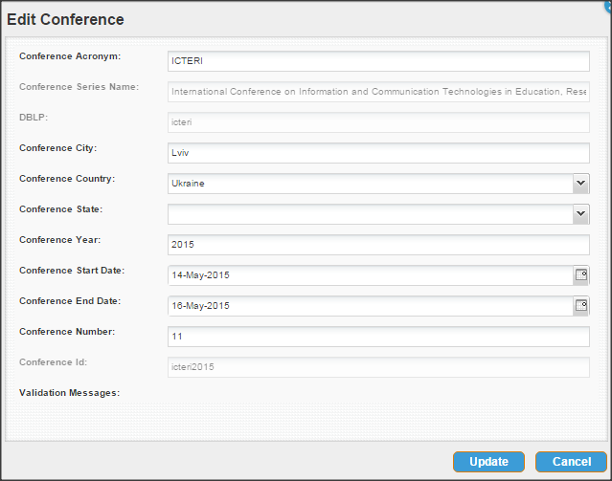
Unique Conference Series ID – ORCID for conferences
Unique ConfSeriesID

Slide 5
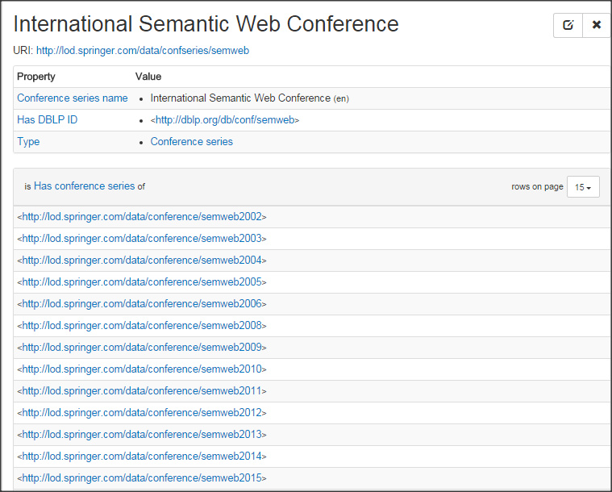
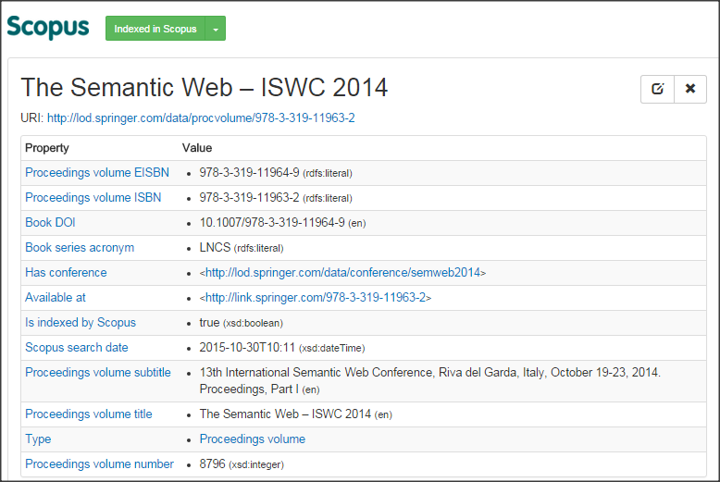
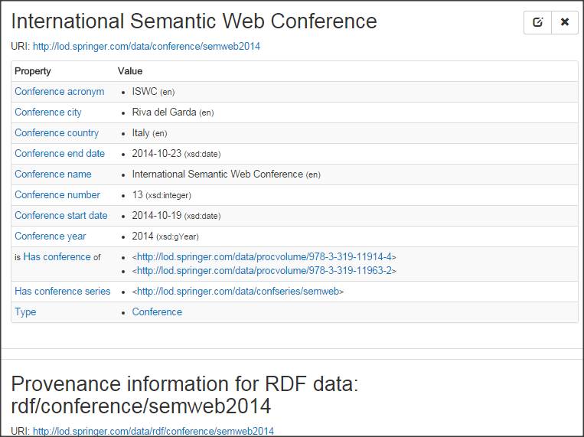
LOD Portal
Each resource is identified via a Persistent URI (resolves to the resource and remains valid over years)
Provides useful info, understandable for machines using open standards (RDF and SPARQL)
Can be linked to other resources in the LOD cloud (DBLP, ACM, IEEE)

Slide 6
Creating a dataset about peer review processes of the conferences
In cooperation with PEERE project – mission on creating a dataset of peer review in computer science conferences published by Springer
Text mining of ~10,000 prefaces from the 5 CS proceedings series (LNCS+)
Text mined fields conference chairs use:
peer review type,
num submitted / accepted papers , acceptance rate
num reviewers / paper ...
additionally learnt
do they use additional reviewers?
which submission systems do they use? (EasyChair, CMT, OCS, ...)
Mario Malicki
University of Split

Slide 7
Proceedings of IFIPTM 2008: Joint iTrust and PST Conferences on Privacy, Trust Management and Security, June 18-20, 2008, Trondheim, Norway

Slide 8
CrossMark for peer review process of a conference
This is in cooperation with PEERE project. The fields have been mined from 10,000 conference prefaces.
The fields will be discussed within the CrossRef working group. Such info will be provided by conference organizers.
Label | Meaning | Example
peerReviewType | single-blind, double-blind, open, other | single blind
confManagementSystem | EasyChair, CMT, etc. | OCS
submissionsSentForReview | The number of papers sent for peer review. Does not include straightforward rejects by the PC chairs due to out-of-scope or other reasons | 100
fullPapersAccepted | The number of full papers accepted. | 30
shortPapersAccepted | The number of short papers accepted. | 15
accRateFullPapersPerc | The number of full papers/The number of submissions sent for review * 100 | 30
avgNumReviewsPerPaper | The number of reviews / the number of submissions sent for review. | 3.25
avgNumPapersPerReviewer | The number of papers each reviewer has to review on average. | 5.5
extReviewersInvolved | Were external reviewers involved? | yes
additionalInfoOnReviewProcess | Any additional information provided about the peer review process by the organizers. | "Short papers underwent shepherding process and 5 out of 10 were accepted as full papers."

Slide 9
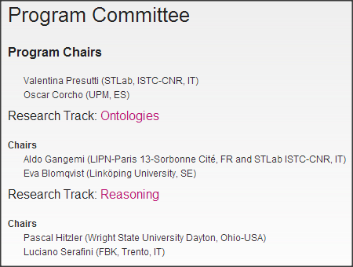
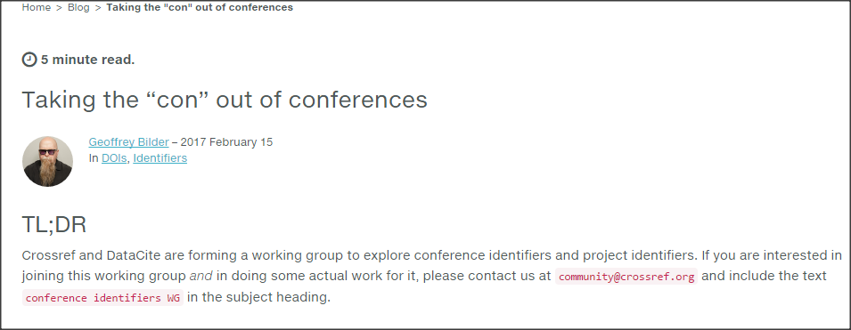
CrossRef working group
Scope of the group:
(1) Unique Conference IDs
(2) Metadata on peer-review process
(3) machine-processable data about PCs?
Important note: we need to make clear that this is
about sharing open reliable metadata (transparency)
not about creating a conference quality metric
Participants:
Aliaksandr Birukou, Springer Nature
Martin Fenner, DataCite
Geoffrey Bilder, CrossRef
Marcel R. Ackermann, DBLP
Nhora Cortes-Comerer, ASME
Philip DiVietro, ASME
Christina Hoppermann, Springer Nature
Bethan Keall, Elsevier
Anna Lacson, ACM
Andres Mori, Digital Science
Craig Rodkin, ACM
Sweitze Roffel, Elsevier
Judith Salk, Elsevier
Kruna Vukmirovic, The IET
Notes:
Crossref board meeting was held in November 2016. The idea of a unique cross-publisher ConferenceSeriesID and a CrossMark for proceedings was well received. Crossref will build a technical working group.

Slide 10
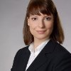
Thank you
Special thanks to
LOD project team and KG team
Project sponsors
Volha Bryl
Kai Eckert
Henning
Schoenenberger
Mirjam Kessler
Markus Kaindl
Alfred Hofmann
Andrey Gromyko

Slide 11
Number of conference proceedings in CS (and engineering)
IEEE
6,887 conferences published since 1951 in IEEEXplore
more than 1,400 conference proceedings per year
Scope: electrical engineering, computer science, and related fields
Springer
11,000 conferences published since 1973 in SpringerLink
more than 1,200 conference proceedings per year: 800 (CS) + 400 (rest)
Scope: computer science, engineering, math, business and economics, any other field
ACM conference proceedings
around 8,000 conferences
ACM International Conference Proceeding Series (ICPS)
established in 2002
26,223 papers from 821 conferences till end 2014
sources: http://www.acm.org/publications/ICPS_DL_Flyer.pdf, http://dl.acm.org/proceedings.cfm, http://dl.acm.org/events.cfm.
All stats – end 2016

Slide 12
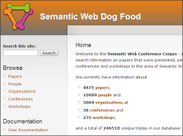
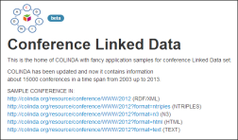
More info about the LOD portal – 25.04.2017
9,749 proceedings volumes
48
8,702 conferences
15,000
2001-now
1973-now
2003-2013
11th Extended Semantic Web Conference
10th Extended Semantic Web Conference
...
1,566 conference series
Published in:
Extended Semantic Web Conference
International Semantic Web Conference
...
since late 2016: not only CS!

Slide 13
Main principles
High-quality data provided directly by the publisher, integral part of existing workflows
Uniqueness of conference ID is guaranteed by design
The data is open – provided under CC0 1.0 (Public Domain dedication)
researchers are welcome to analyze, link to, etc.
Providing conference info as Linked Data, as a part of the Web of Data enables:
easier access for indexing services, libraries, conf. management systems, research evaluation agencies
SpringerNature is the first publisher providing metadata about conferences in a structured way
Can we make science more
accessible and transparent?

Slide 14
Plans for 2017 (as of April)
Done in 2016 – early 2017
Adding conferences from other disciplines (engineering, math) for new proceedings
Indexing checks for EI COMPENDEX
Added books (not all, only rather recent) to the portal
Added chapter-level data, including authors, affiliations
Integration with Bookmetrix
Ongoing
Indexing checks for ISI Conference Proceedings index
Adding ERA, CCF, GII-GRIN and QUALIS rankings
Adding data about ~2000 conferences published only several times
Uploading information about peer review processes
Linking to DBLP and Bookmetrix
Planned
Adding data about Elsevier conferences
Indexing checks for ISI

