Slide 1
Karabo 2.0 Workshop: From Configuration to Data Acquisition
Steffen Hauf for CAS
Hamburg, 24.01.17

Slide 2
Overview
System Configuration
States
Alarms
Control Data Logging
Run Configuration
Run Management – presented by Djelloul Boukhelef

Slide 3
Overview in Terms of Topology: Broker messaging
GUI Clients
Run Configurator
Run Config Group
Run Config Group
Central Broker
Device
Device
GuiServer
DataLogger
DataLogger
ProjectManager
Project Database
DataLogger Manager

Slide 4
Overview in Terms of Topology: GUI Communication
GUI Clients
Run Configurator
Run Config Group
Run Config Group
Central Broker
Device
Device
p2p
GuiServer
DataLogger
DataLogger
ProjectManager
Project Database
DataLogger Manager

Slide 5
Overview in Terms of Topology: Logger Communication
GUI Clients
Run Configurator
Run Config Group
Run Config Group
Central Broker
Device
Device
p2p
GuiServer
p2p
p2p
DataLogger
DataLogger
ProjectManager
Project Database
DataLogger Manager

Slide 6
Overview in Terms of Topology: What can be run locally
GUI Clients
Run Configurator
Run Config Group
Run Config Group
Central Broker
Device
Device
p2p
GuiServer
p2p
p2p
DataLogger
DataLogger
ProjectManager
Project Database
DataLogger Manager

Slide 7
Overview in Terms of Topology: This presentation
GUI Clients
Run Configurator
Run Config Group
Run Config Group
Central Broker
Device
Device
p2p
GuiServer
p2p
p2p
DataLogger
DataLogger
ProjectManager
Project Database
DataLogger Manager

Slide 8
Overview in Terms of Topology: Following Sessions
GUI Clients
Run Configurator
Run Config Group
Run Config Group
Central Broker
Device
Device
p2p
GuiServer
p2p
p2p
DataLogger
DataLogger
ProjectManager
Project Database
DataLogger Manager

Slide 9
Overview in Terms of Topology: Production environment
ITDM provided DAQ and Data management
GUI Clients
Run Configurator
Run Config Group
Run Config Group
Central Broker
Device
Device
p2p
GuiServer
p2p
p2p
DataLogger
DataLogger
ProjectManager
Project Database
DataLogger Manager

Slide 10
Overview in Terms of Topology: Production environment
ITDM provided local DAQ solution
GUI Clients
Run Configurator
Run Config Group
Run Config Group
Central Broker
Device
Device
p2p
GuiServer
p2p
p2p
DataLogger
DataLogger
ProjectManager
Project Database
DataLogger Manager

Slide 11
Concepts: Configuration
A Karabo installation is customizable on different configuration levels:
Device classes in use: determined at install time, extensible at run-time by installing more plugins and reconfiguring servers to host more devices.
Device instances: determines the number of devices actually running in the system
For pipelined-processing the relation of these devices is also configurable, i.e. processing pipelines as directed graphs.
Device configuration: configures each individual device instance
Run configuration: configures which data is recorded from devices for later analysis. Goes into the archive, accessible via a meta-data catalogue

Slide 12
Concepts: Configuration
A Karabo Installation is customizable on different configuration levels:
Devices in use: determined at install time, extensible at run-time by installing more plugins and reconfiguring servers to host more devices.
Device instances: determines the number of devices actually running in the system
For pipelined-processing the relation of these devices is also configurable, i.e. processing pipelines as directed graphs.
Device configuration: configures each individual device
Run configuration: configures which data is recorded from devices for later analysis. Goes into the archive, accessible via a meta-data catalogue

Slide 13
Concepts: Configuration
A Karabo Installation is customizable on different configuration levels:
Devices in use: determined at install time, extensible at run-time by installing more plugins and reconfiguring servers to host more devices.
Device instances: determines the number of devices actually running in the system
For pipelined-processing the relation of these devices is also configurable, i.e. processing pipelines as directed graphs.
Device configuration: configures each individual device
Run configuration: configures which data is recorded from devices for later analysis. Goes into the archive, accessible via a meta-data catalogue – D. Boukhelef will present DAQ and DM details

Slide 14
Configurations: How its done in Karabo
Configurations

Slide 15
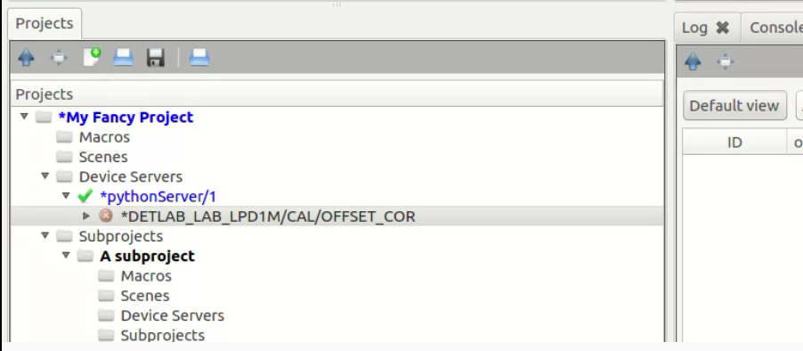
Configurations: How its done in Karabo
Server and device configurations are created through the same interface: the project panel of the Karabo GUI
For servers the host can be selected → a daemon will then deploy to servers in the distributed system in the future
For devices an initial configuration is created. Part of this configuration is the server they are hosted upon
All configurations are versioned as part of so called “Projects”. A project bundles servers, device configuraitons, GUI scenes, Macros and subprojects into a versioned entitiy.
Versions are easily identifyable by “aliases”, which adds more descriptive information to version numbers.
All information is stored in centralized database. User-specific access rights will be supported in the future.

Slide 16
Configurations: How its done in Karabo
Server and device configurations are created through the same interface: the project panel of the Karabo GUI
For servers the host can be selected → a daemon will then deploy to servers in the distributed system in the future
For devices an initial configuration is created. Part of this configuration is the server they are hosted upon
All configurations are versioned as part of so called “Projects”. A project bundles servers, device configuraitons, GUI scenes, Macros and subprojects into a versioned entitiy.
Versions are easily identifyable by “aliases”, which adds more descriptive information to version numbers.
All information is stored in centralized database. User-specific access rights will be supported in the future.

Slide 17
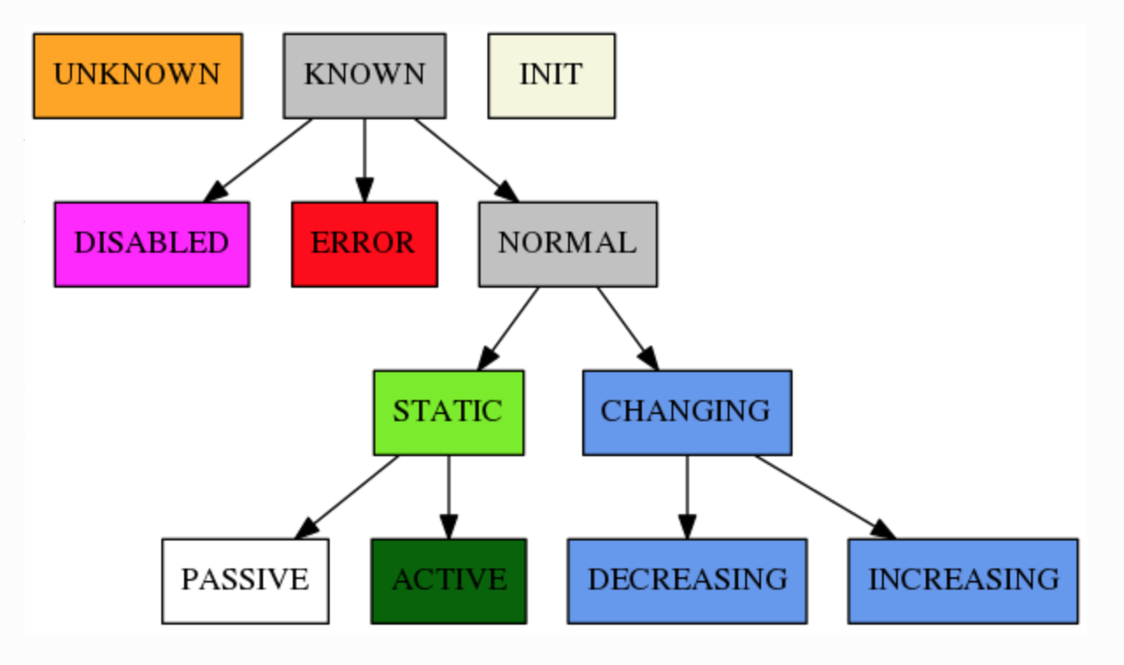
Concepts : Device States
Within Karabo states are “unified”: there is a fixed set of states
States are assembled into a hierarchy, deriving for a small set of base-states.
By doing so each state can be automatically identified by the system:
Identify error states and make users aware
Assign a distinct color to each state
Be able to automatically evaluated relations between states, e.g. the most significant out of an ensemble of states.

Slide 18
States: How its done in Karabo
States

Slide 19
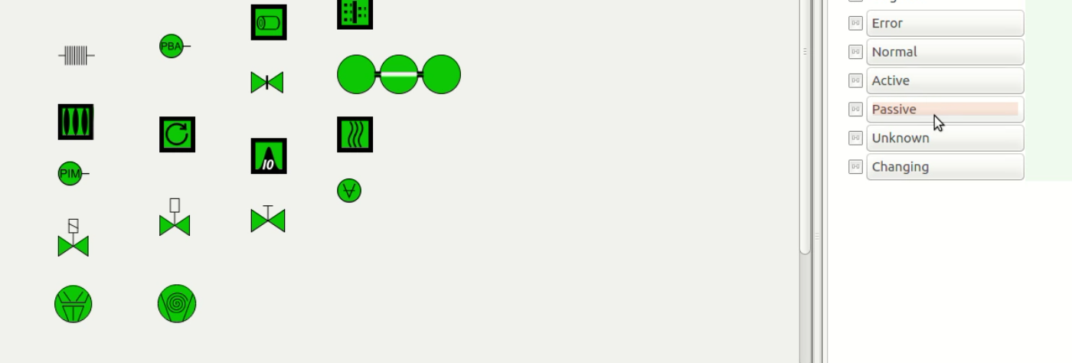
States: How its done in Karabo
Unified states lead to the concept of standard icons which are state-aware.
These icons are from a standardized, to be used facility-wide
Each icons changes color according to state. Red and orange indicate errors and are reserved colors throughout Karabo
Additional indicators in the navigation views signify errors
Karabo states are used to signify the state of a device or hardware, they are not used to indicate alarms:
UNKNOWN state signifies that no connection to hardware is established, we thus don’t know its state
ERROR signifies an error on the hardware
All other behavior places the device in one of the NORMAL states

Slide 20
States: How its done in Karabo
Unified states lead to the concept of standard icons which are state-aware.
These icons are from a standardized, to be used facility-wide
Each icons changes color according to state. Red and orange indicate errors and are reserved colors throughout Karabo
Additional indicators in the navigation views signify errors
Karabo states are used to signify the state of a device or hardware, they are not used to indicate alarms:
UNKNOWN state signifies that no connection to hardware is established, we thus don’t know its state
ERROR signifies an error on the hardware
All other behavior places the device in one of the NORMAL states

Slide 21
Concept: Alarms in a Control System
In Karabo Alarms and Warning indicate that an operator should give attention to either a specific value, or a device
Alarms are not related with a device state. In fact: a device capable of asserting alarm conditions, should be in a NORMAL state.
We have lower and upper limit alarms, as well as variance based alarms. The latter is evaluated in a rolling window fashion
Alarms are centrally managed in an Alarm Service. They may either silently disappear when the condition triggering them passes, or need to be acknowledged.

Slide 22
Alarms: How its done in Karabo
Alarms

Slide 23
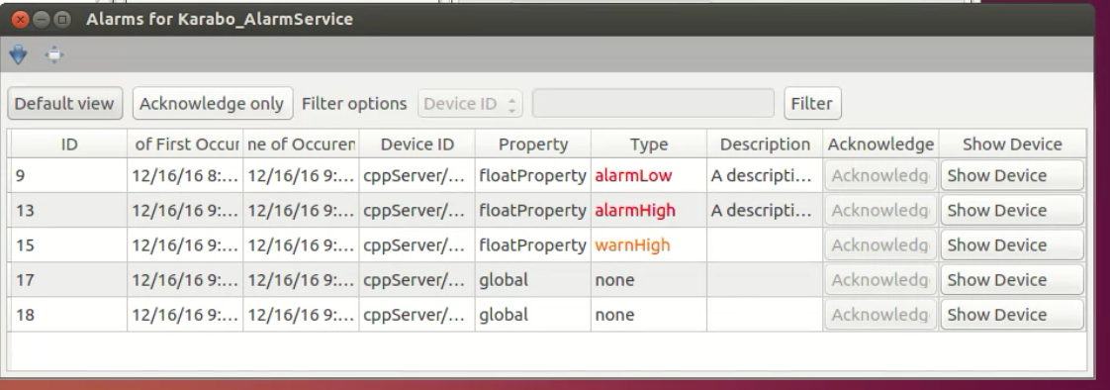
Alarms: How its done in Karabo
All alarms in the system are indicated in the central alarm widget.
They do not change the state of the device the occur on
Acknowledging happens through the alarm service and is only possible if the alarm condition has passed.
The alarm service additionally provides direct access to the device configuration for a device in alarm condition.
The alarm service allows for filtering by alarm type
Alarms may have additional descriptions associated with them.
If an alarm occurs multiple times, i.e. a transient condition, it will appear once in the alarm list. The time of last occurrence is updated for each new alarm on the same device and property and of the same type

Slide 24
Alarms: How its done in Karabo
All alarms in the system are indicated in the central alarm widget.
They do not change the state of the device the occur on
Acknowledging happens through the alarm service and is only possible if the alarm condition has passed.
The alarm service additionally provides direct access to the device configuration for a device in alarm condition.
The alarm service allows for filtering by alarm type
Alarms may have additional descriptions associated with them.
If an alarm occurs multiple times, i.e. a transient condition, it will appear once in the alarm list. The time of last occurrence is updated for each new alarm on the same device and property and of the same type

Slide 25
Concept: Run Configuration
Run configuration determines which data sources are stored in the ITDM provided Data Management (DM) and Data Acquisition (DAQ) system
A data source is a device. Pipelined processing outputs on devices, e.g. for cameras a seen as separate data source
Data sources are grouped into “run configuration groups”. Examples are e.g. the LPD detector group, sample injection group, …
In the run configurator theses groups are selected or deselected by the users. If selected alls data sources of a group will be included in DM and DAQ for a run

Slide 26
Run Configuration: How its done in Karabo
Run Configuration

Slide 27
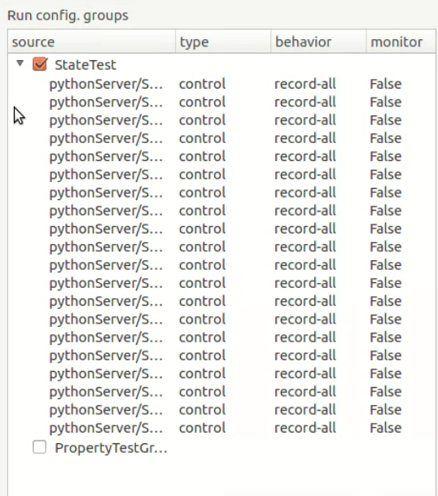
Run Configuration: How its done in Karabo
The run configurator device has a special configuration panel for run configuration. It is however a normal device, so its configuration changes can be stored and versioned in the database
Run configuration groups have a configuration option for user and expert sources. Expert sources cannot be altered by normal users, and can for instance contain data that should always be present (housekeeping info)
Each source can have a behavior configured on what is recorded: init, read-only and record-all.
If a source appears in user and expert fields, or in multiple run configuration groups the most-inclusive behavior is chosen
Sources can be configured to output to the online streams

Slide 28
Summary
Karabo is a SCADA system “that is batteries included”:
In-build data logging
In-build run management
Close integration into DAQ
In-build alarm system
In-build state-awareness
Integrated GUI-builder
In-build pipelined processing using generic exchange format
Bundled with essential dependencies
Support of both native C++ and Python Programming APIs

