Slide 1
Photon beamlines
Harald Sinn
Commissioning Workshop
Jork, 24-25.11.2016

Slide 2
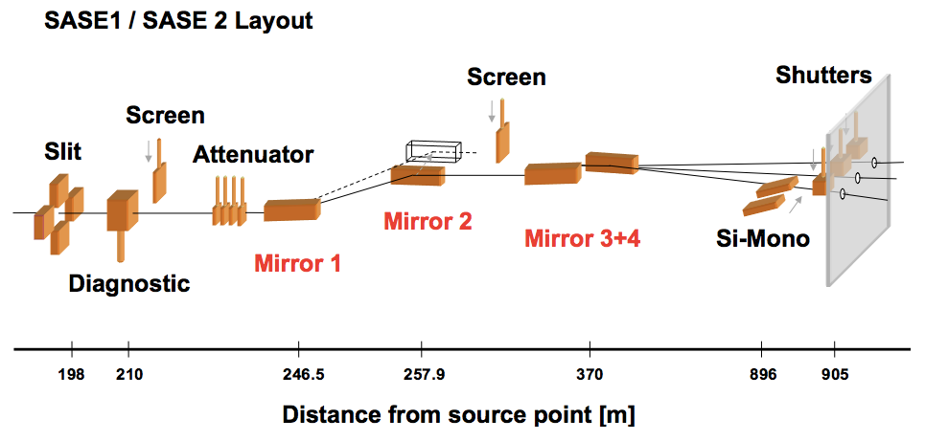
Beamline design
So far only two branches are being built

Slide 3
Overview
TR
Imager
SR
Imager
Solid Attenuator
2D Imager
Filter
SRA
K-Mono
XGM
CRL1
Beam loss monitor
Pop-in monitor
Shutter XS3
Beam loss monitor
Pop-in monitor
M1
M2
MCP
Hirex
M3
Beam loss monitor
Spectrum Analyzer
Pop-in monitor
Shutter FXE
Mono 1
Mono 2
Beam loss monitor
Pulse picker
Pop-in monitor
Shutter SPB
grey tabs switch to
sub-screens
XGM
Attenuator
CRL2
Equipment Protection
Motion
Vacuum
Tunnel SASE 1
Motion
switch to other screen
indicators of problems

Slide 4
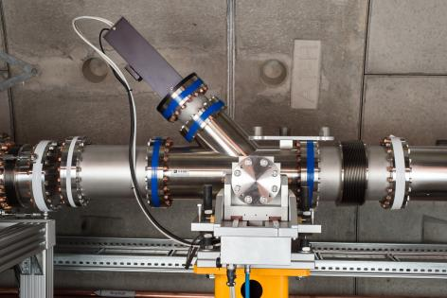
Imagers
SASE1 Pop-in Monitor XTD2
on off
CAM
LED
beam
0.03
out
in
0.00
Can accept only one pulse per train (exception: attentuator in)
Moves YAG in with step motor
In EPS, MPS systems
Calibration of screen positions (through software)
LED light to see some signal (and calibration marks?)
Different types differ in size of YAG and resolution
SR-Imager has photodiode
on off
screen
(Proposed software panels are shown, real ones will be a bit different)
Responsible: Andreaas Koch/ Photon Diagnostics

Slide 5
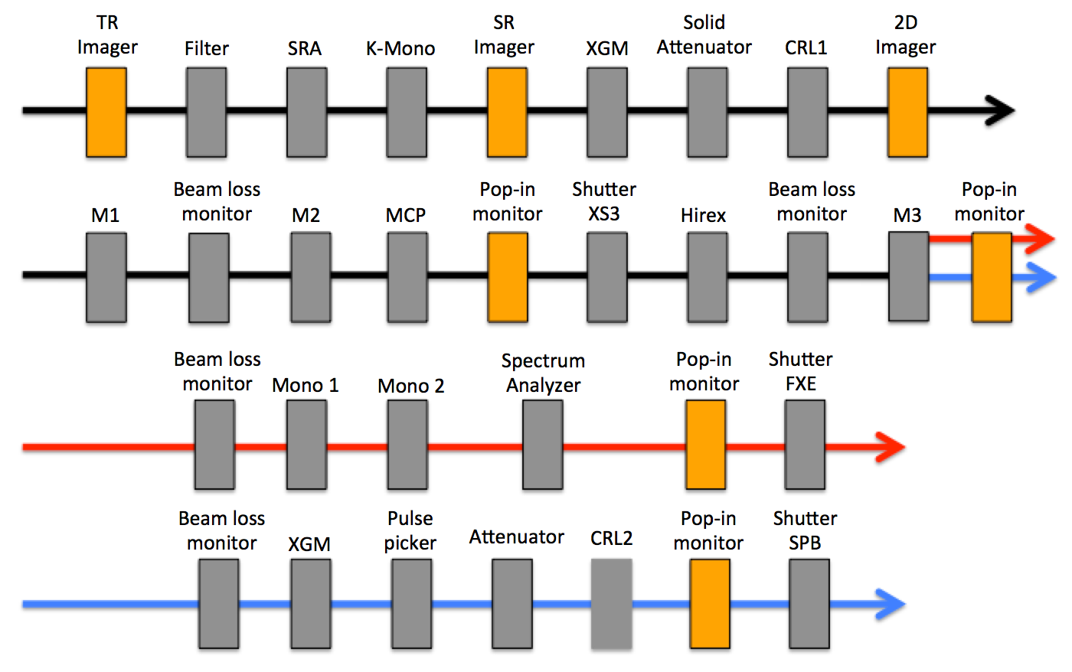
Imagers
(Transmissive, 2D, Pop-in Monitors IMPG 1+2)
Responsible: Andreaas Koch/ Photon Diagnostics

Slide 6
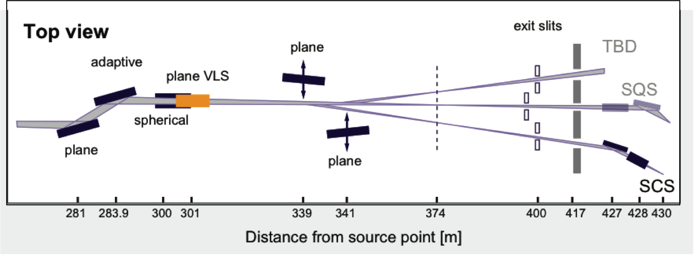
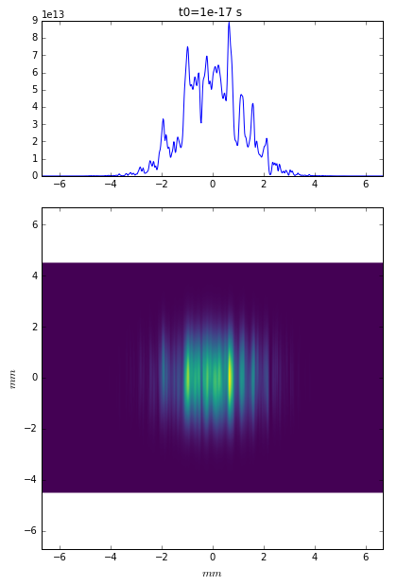
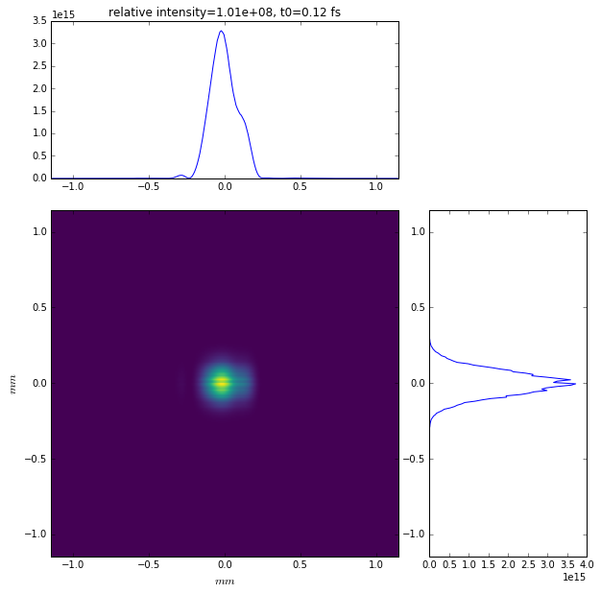
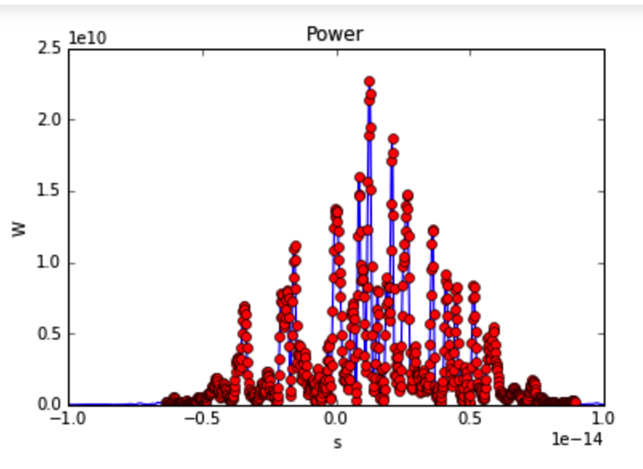
Simulation of Imager Views
from data base XPD:
Liubov Samoylova (X-ray Optics)

Slide 7
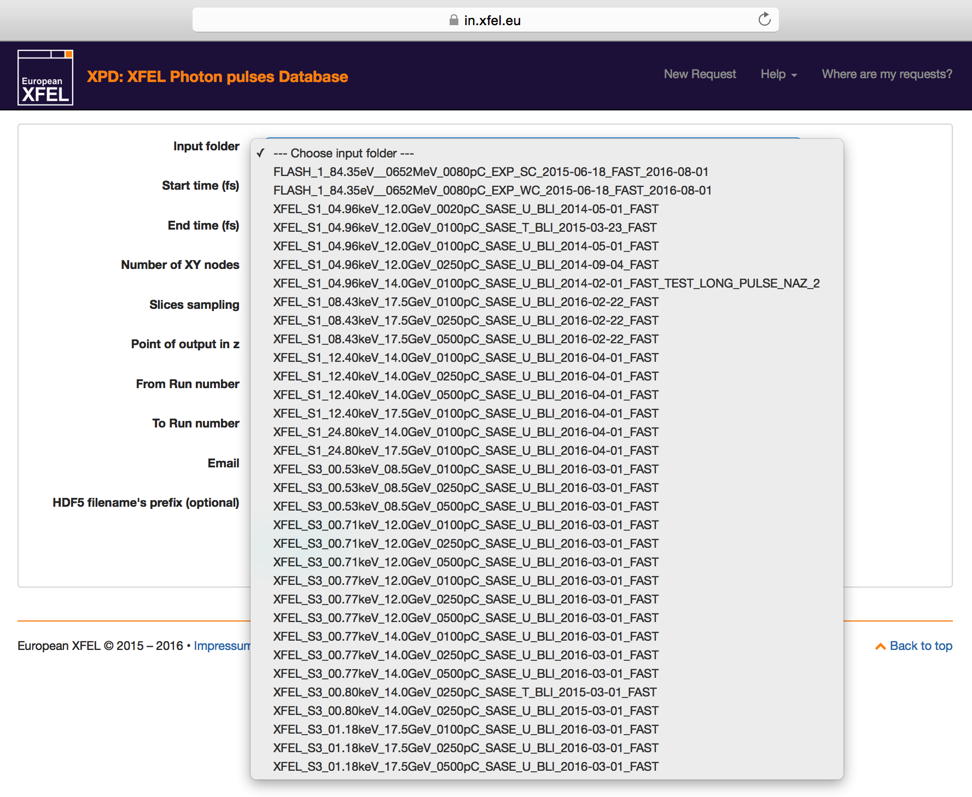

Get FEL simulation data for commissioning: web access to FAST code (M.Yurkov, E. Schneidmiller) results
in.xfel.eu
commissioning parameters
Liubov Samoylova (X-ray Optics)

Slide 8
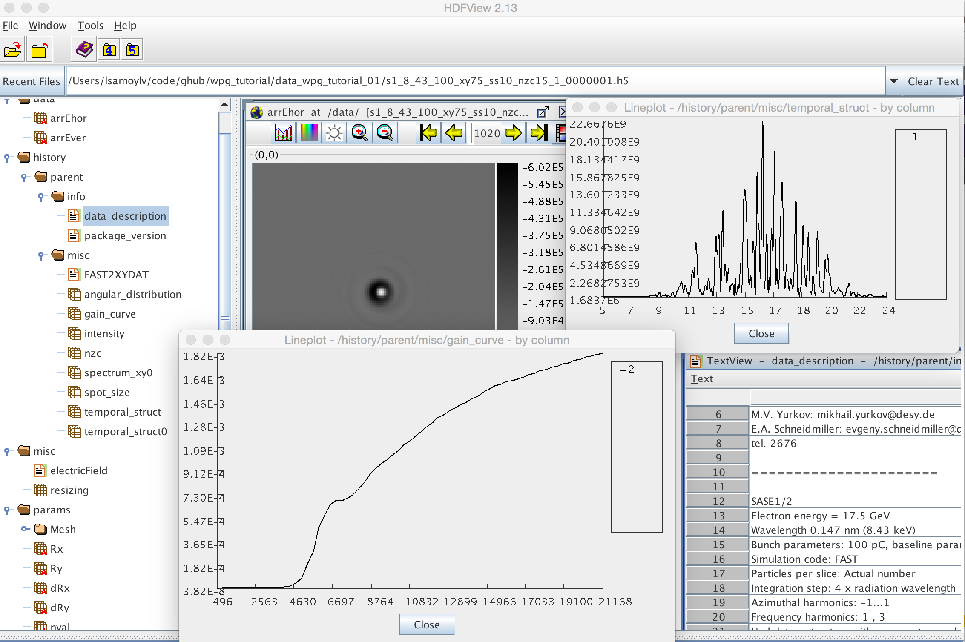
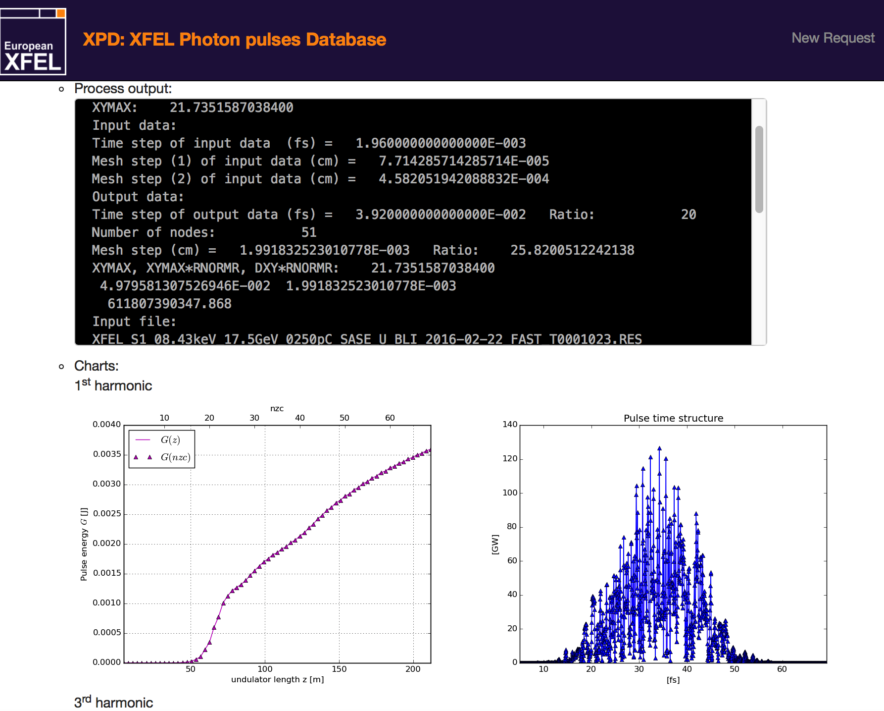
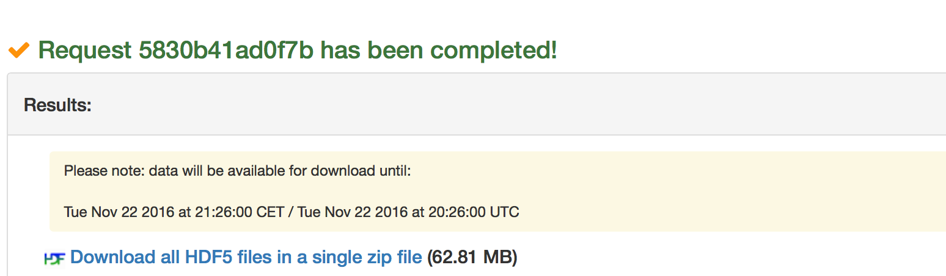
Pick up the selected pulse data in hdf5 format
data available for download for 72 h
Structured HDF5 files contain all information about FEL simulation including input parameters and post-processing data
Liubov Samoylova (X-ray Optics)

Slide 9
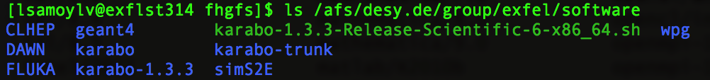
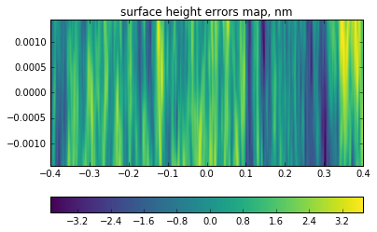
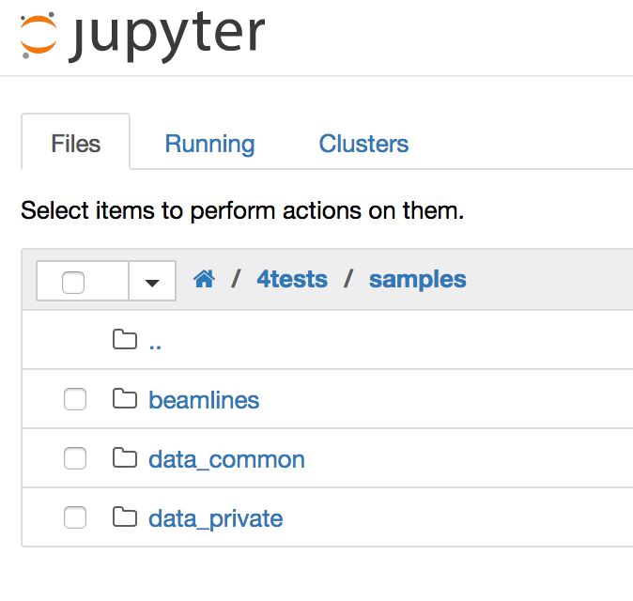
Propagate wavefront hdf5 data using WPG wave optics software
WPG software package on /afs/desy
Special commissioning folder, containing
  metrology data for the mirrors
  python scripts with layouts including
  all optical beamline components
  scripts can be run as Jupyter notebooks
  (interactive interface running in web browser)
  Can be used ‘real time’ by commissioning team
Liubov Samoylova (X-ray Optics)

Slide 10
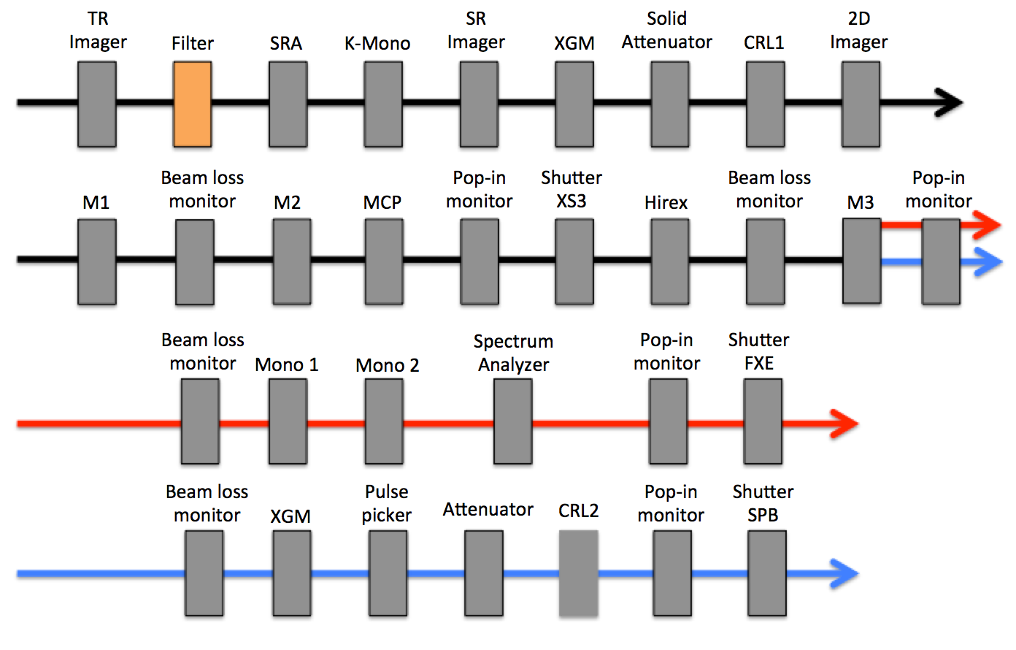
Filter

Slide 11
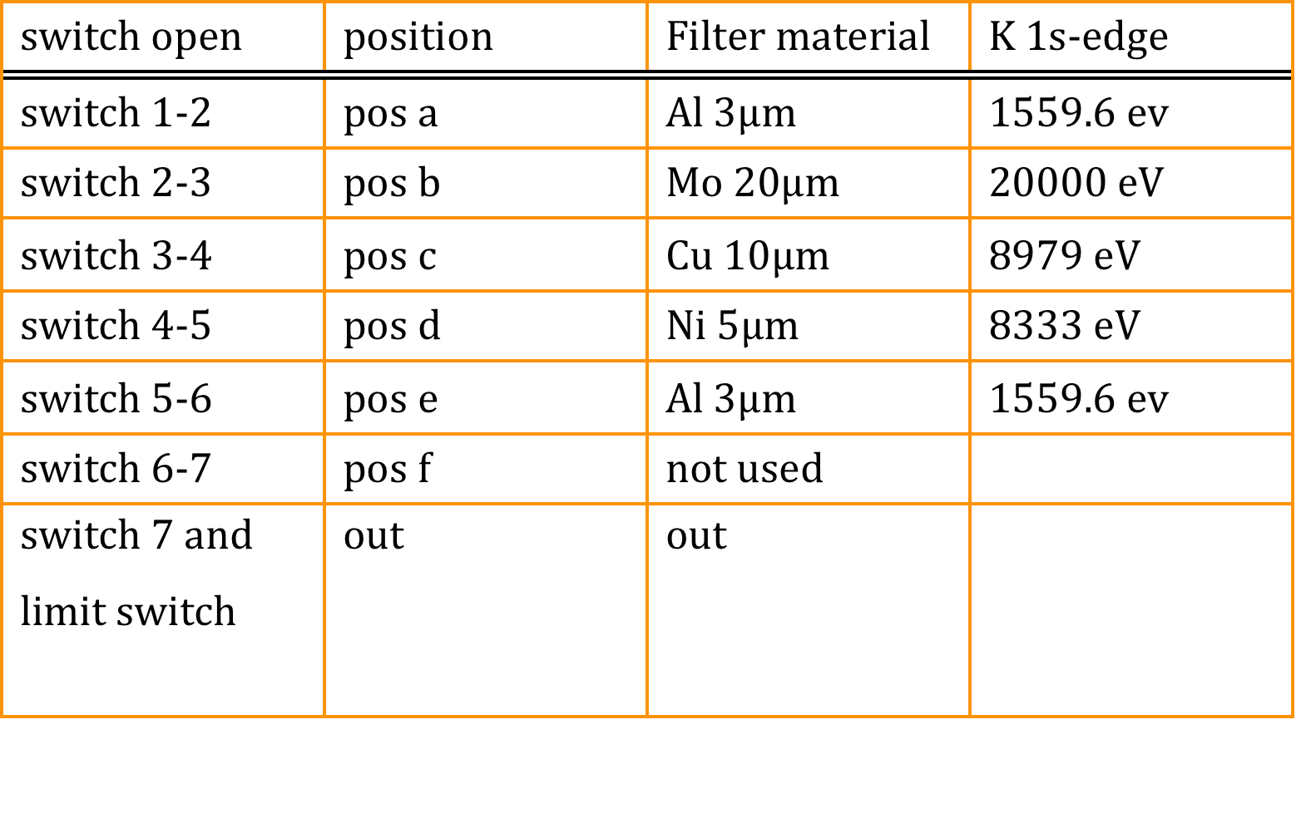
Filter
beam
out position
empty
Al
Ni
Cu
Mo
Al
only 1 pulse/train or spontaneous radiation!
requires detector (diode in SR imager, XGM)
ideally also intensity monitor before
can calibrate photon enery to 1 eV precision
Responsible: Wolfgang Freund/ Photon Diagnostics

Slide 12
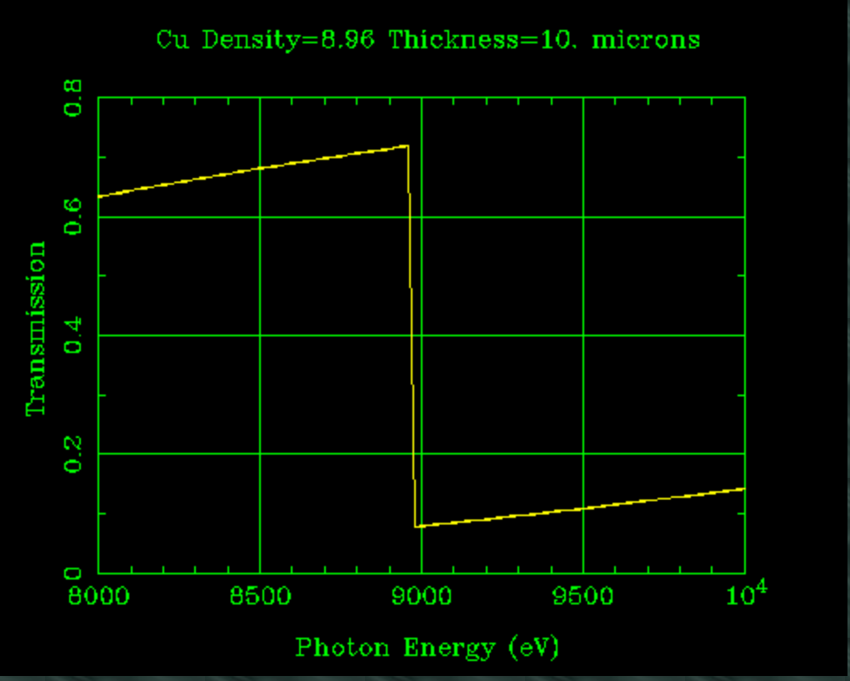
Cu- Filter around 9 keV can be used for wavelength calibration
8979 eV +- 0.5 eV
Nickel foil:
8333 eV
scan of undulator gap or electron energy
source: CRXO website http://henke.lbl.gov

Slide 13
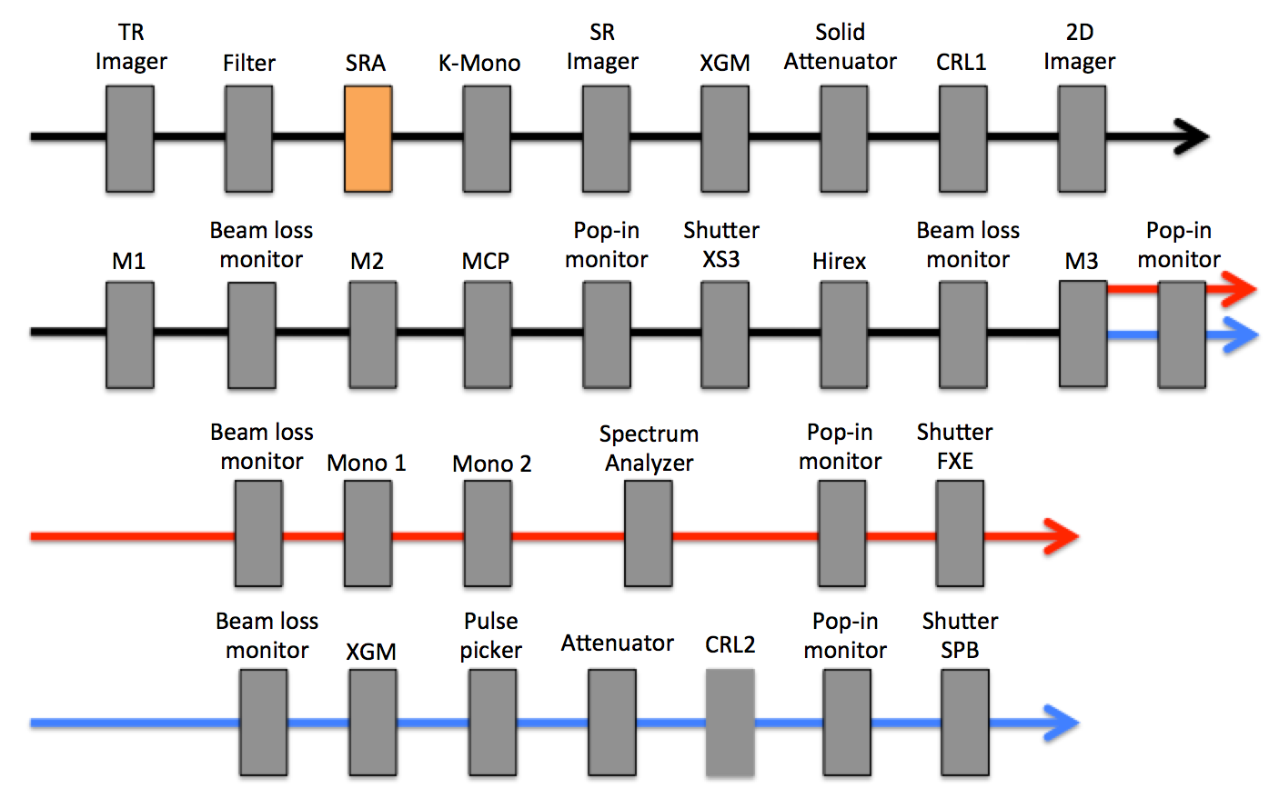
SRA

Slide 14
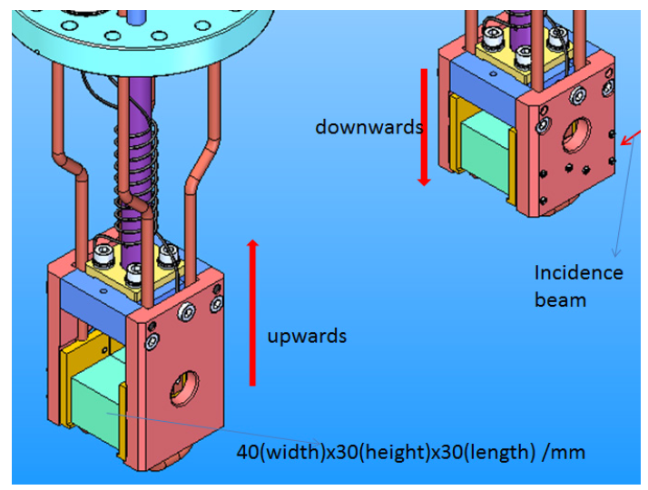
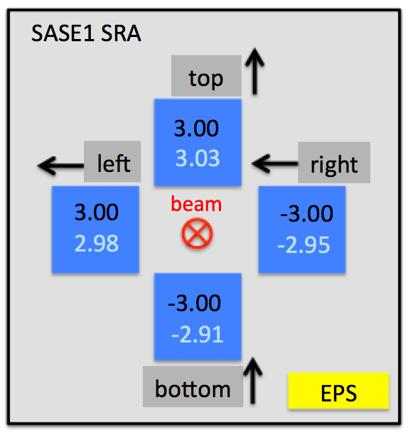
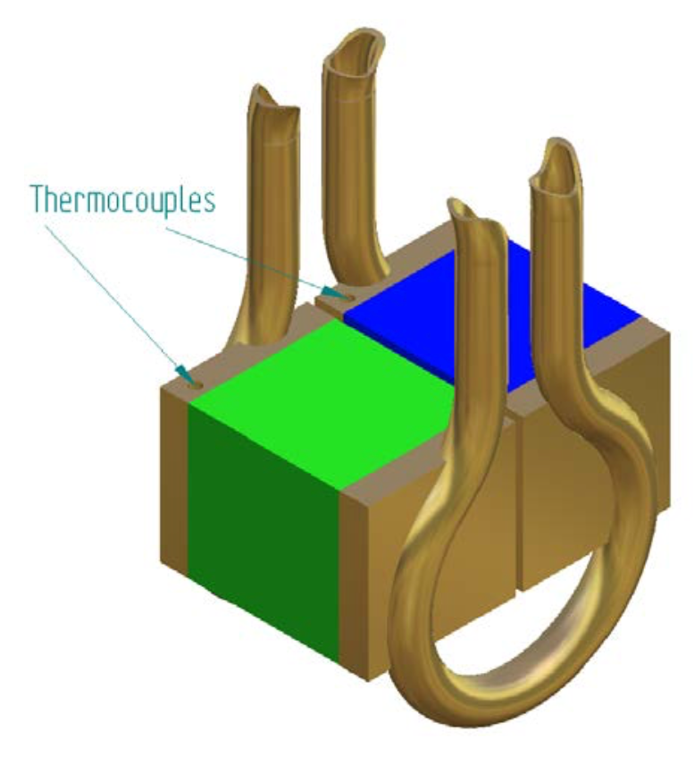
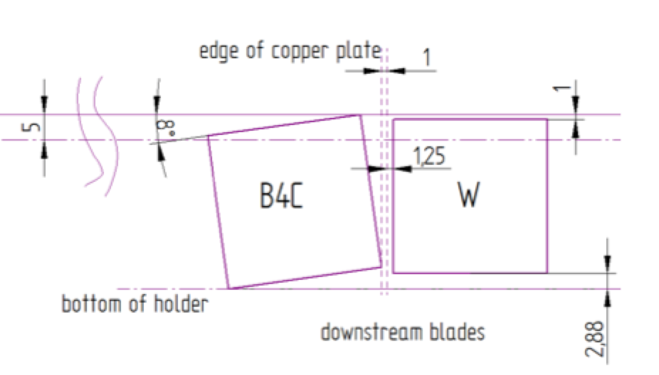
Spontaneous Radiation Aperture (SRA): The only slit in SASE1 tunnels
beam
responsible: Xiaohao Dong, X-ray Optics

Slide 15
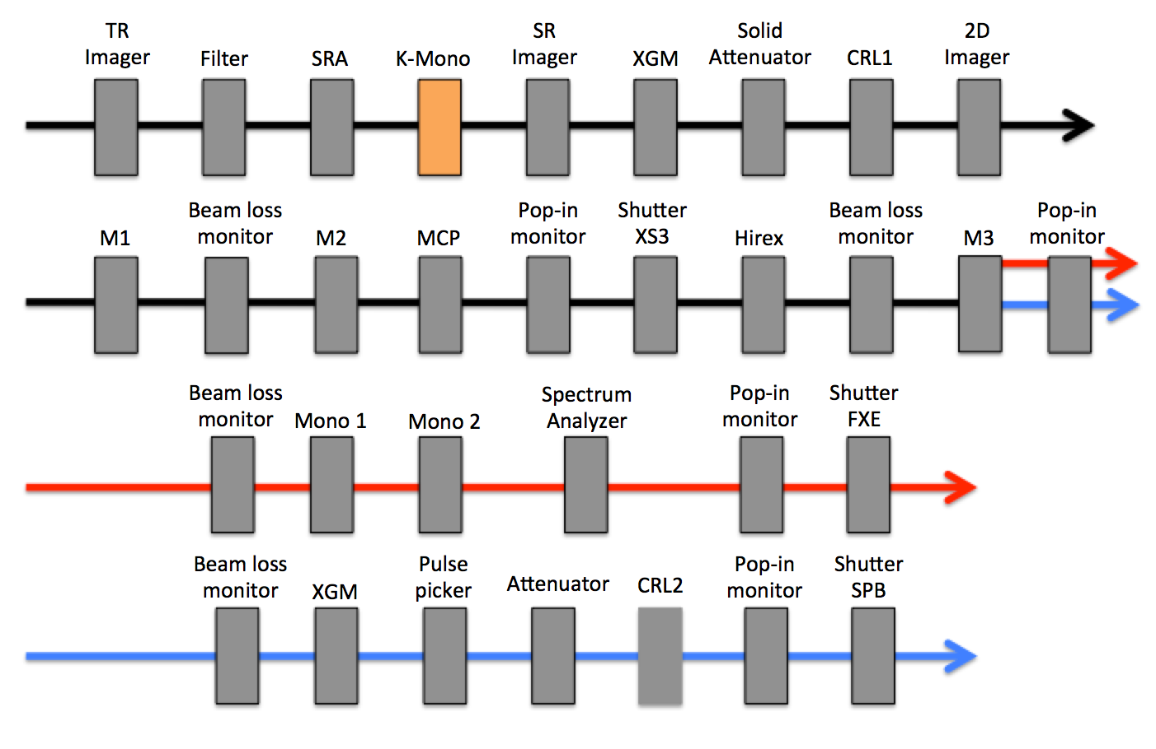
K-mono (‘K’ from undulator-k)

Slide 16
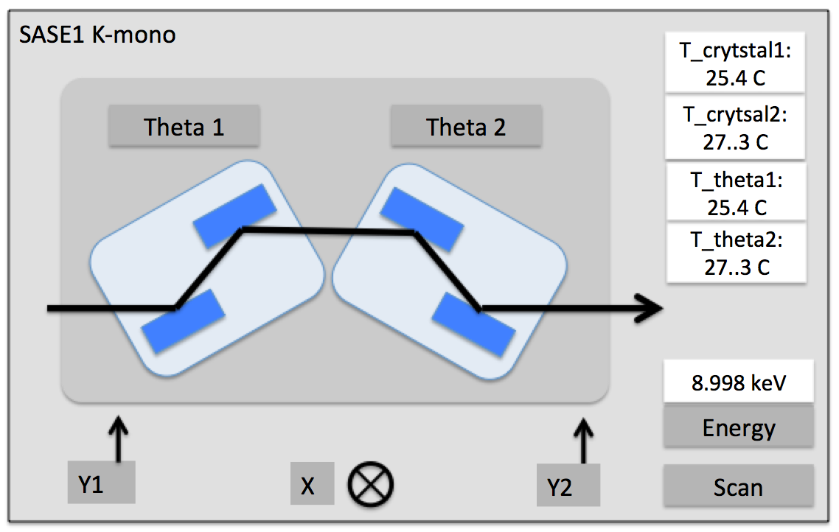
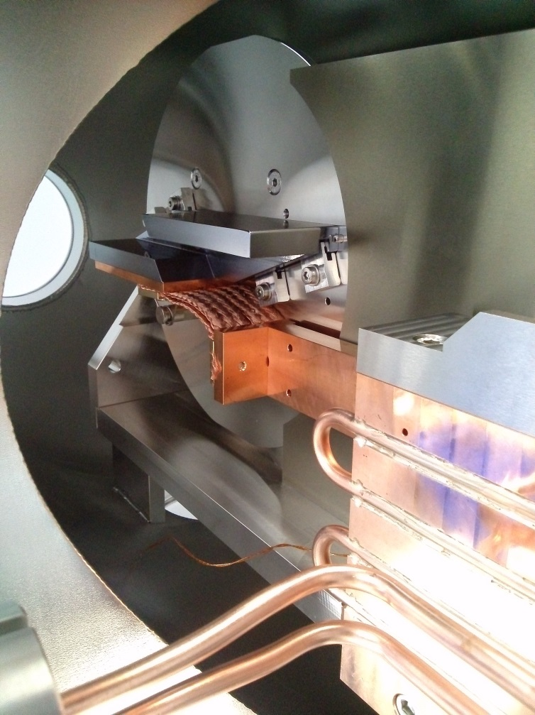
K-mono
View inside the SASE3 unit
Responsible: Wolfgang Freund/ Photon Diagnostics

Slide 17
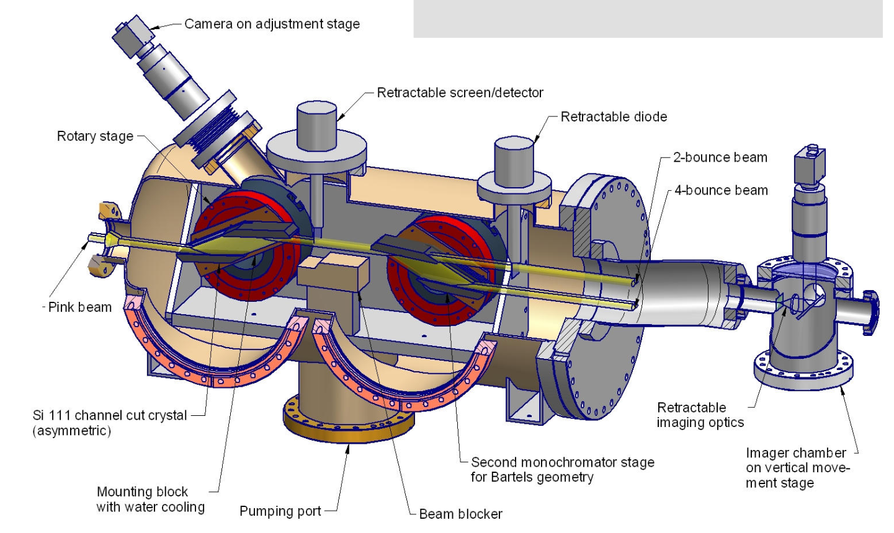
K-mono (2011 design)

Slide 18
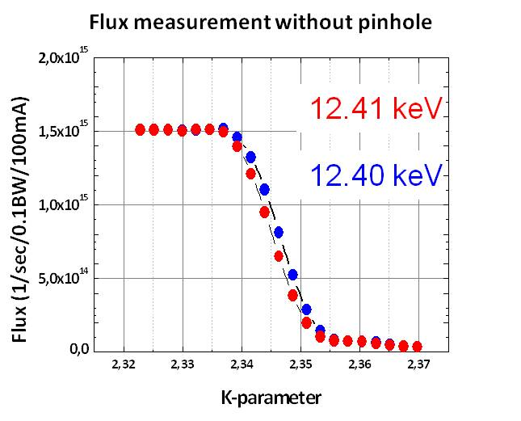
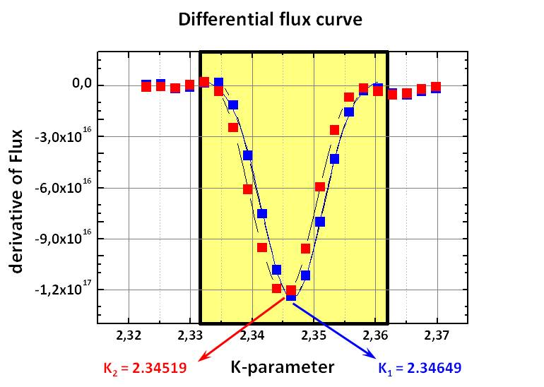
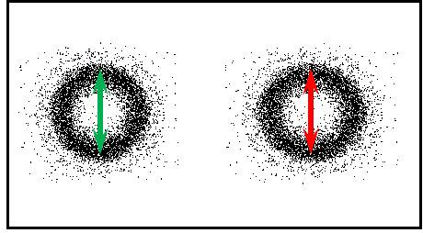
K-mono in action
scan of Kmono closing one or the other undulator segement (spont. rad)
two undulator segments
data acquisition faster, but
requires bump in electron trajectory

Slide 19
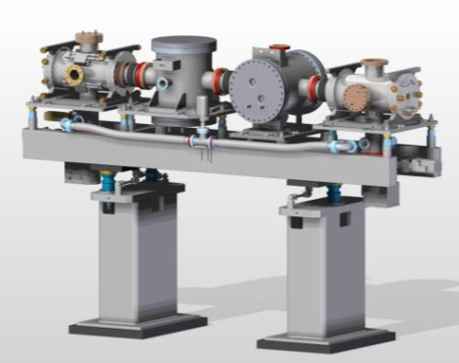
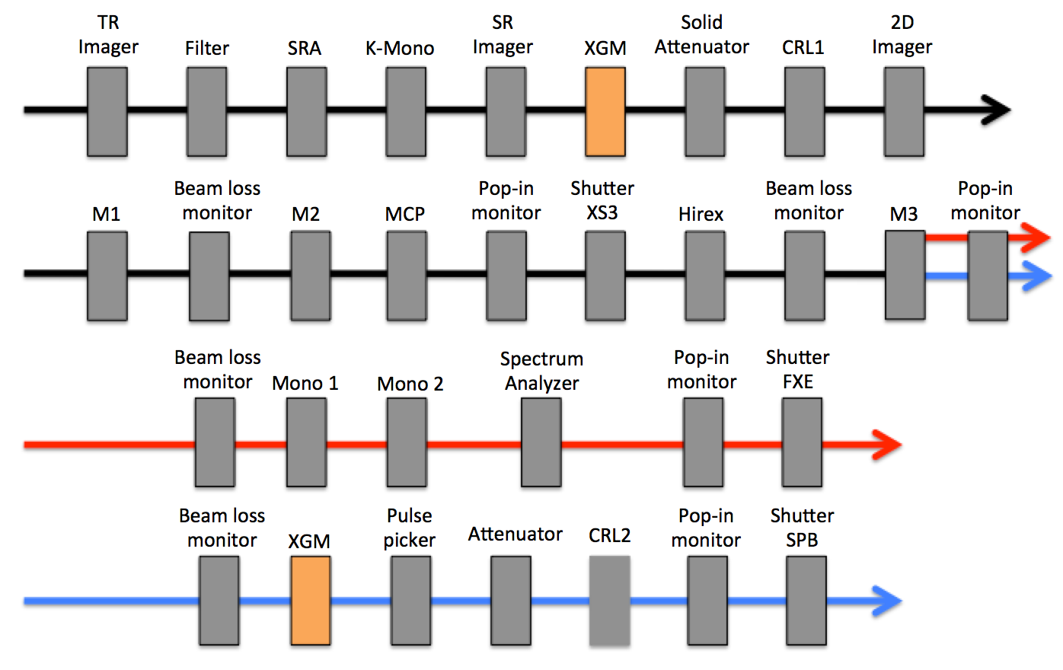
XGMs
Intensity + beam position
Only two for cost reasons
No motions
DOOCS controled
Jan Grünert (WP74) + Kai Tiedtke group (DESY)

Slide 20
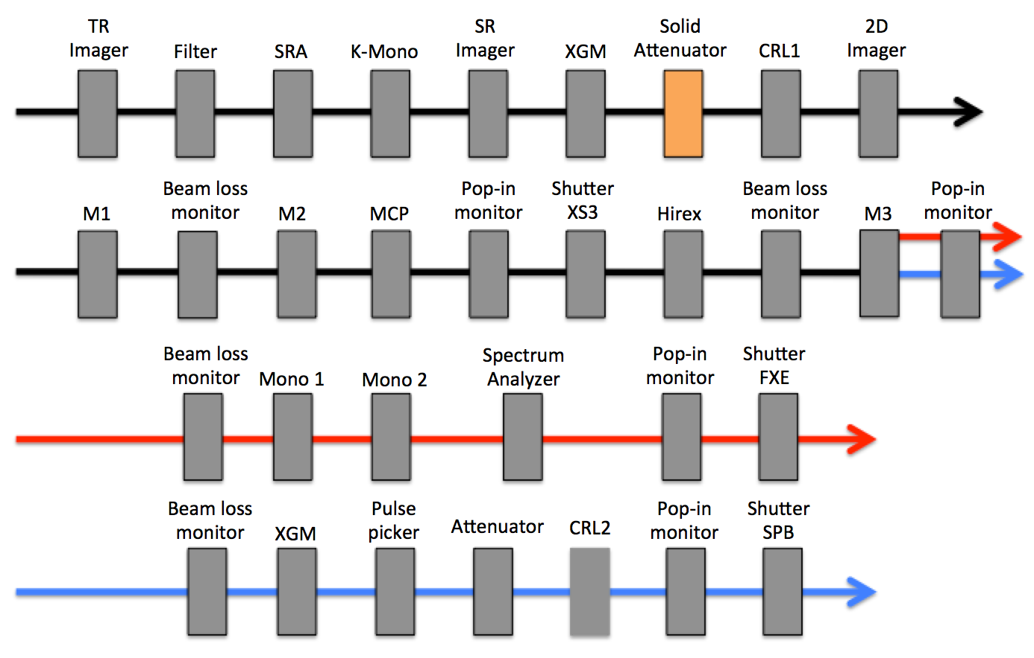
Solid Attenuators
protects downstream components
Different design, similar functionality for instrument alignment
Responsible: Harald Sinn, WP73

Slide 21
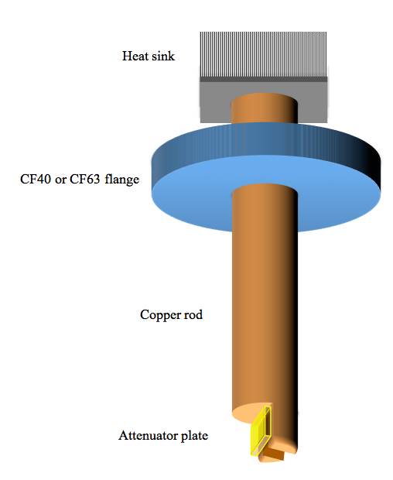
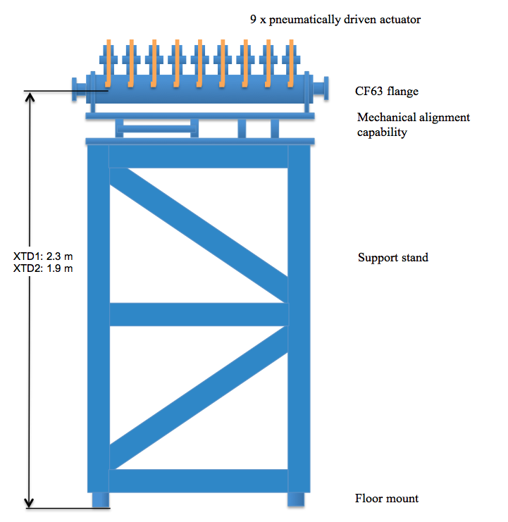
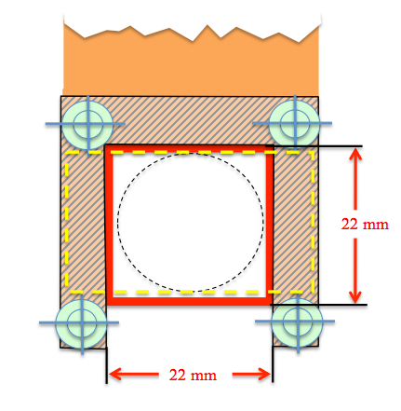
Solid Attenuator

Slide 22
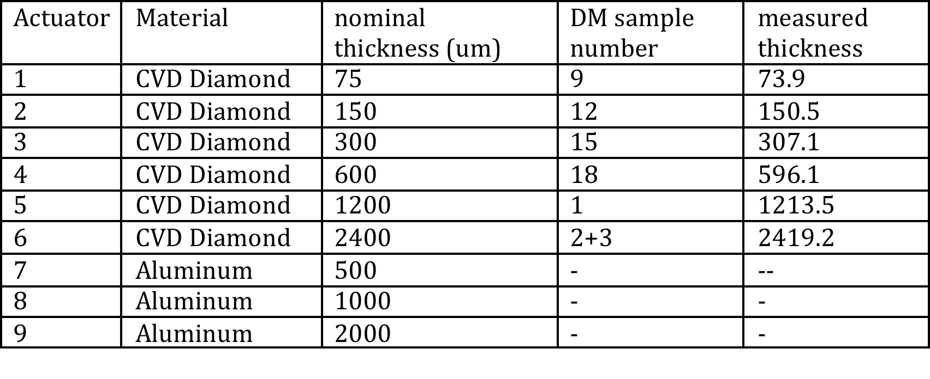
Attenuator plates mounted
In beam direction (downstream) order (SASE1)
(Feb 2015 )

Slide 23
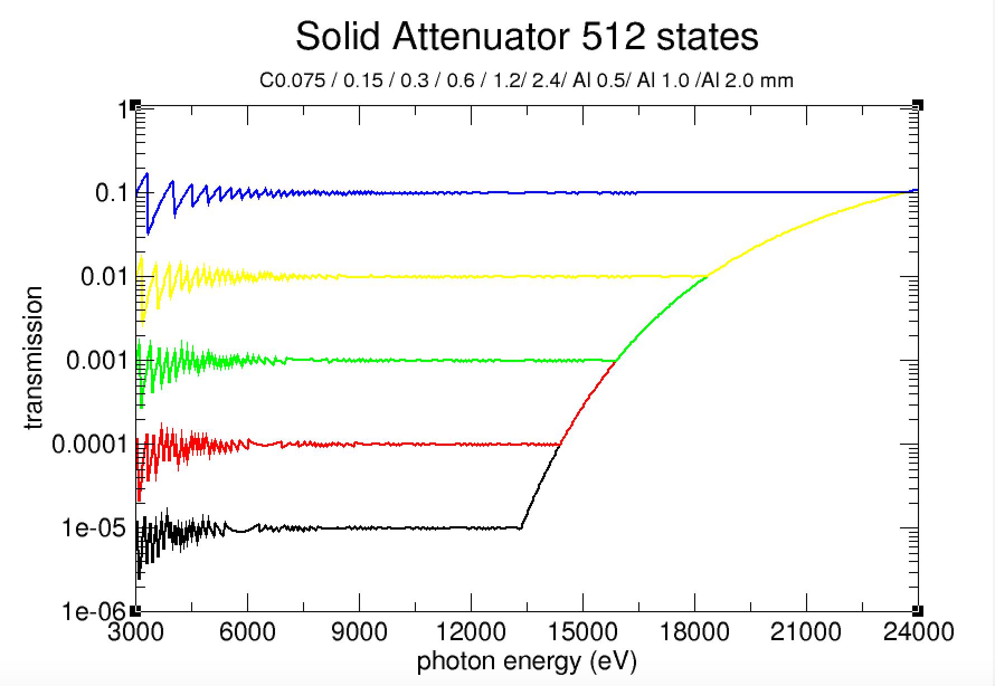

Slide 24
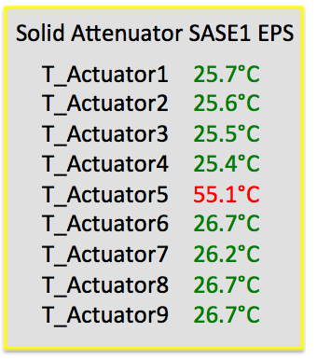
Solid Attenuator panel
SASE1 Solid Attenuator
Full beam
10⁻¹
10⁻²
10⁻³
A1
A2
A3
A4
A5
A6
A7
A8
A9
6.3 keV
S5
3.1 10⁻¹
EPS

Slide 25
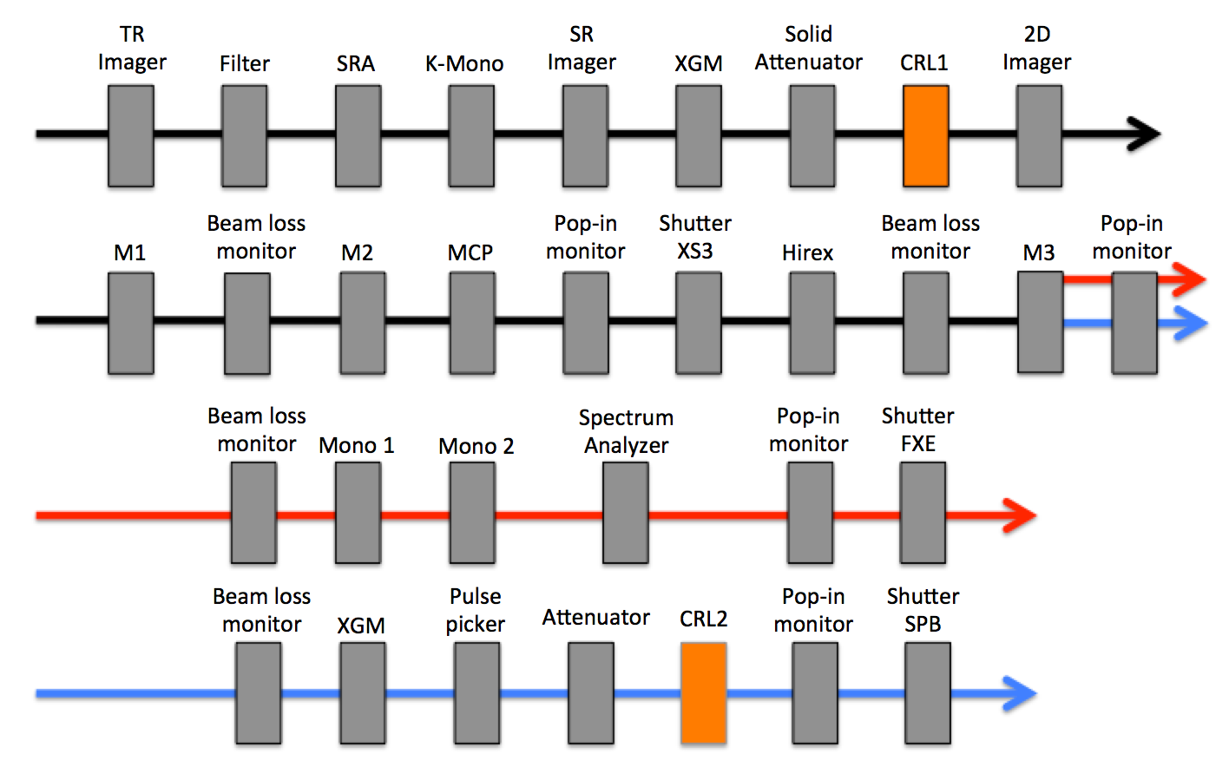
Compound Refractive Lenses (CRLs)
Collimation + weak focusing (similar M2 bender)
tight focusing, backup for SPB KB mirrors

Slide 26
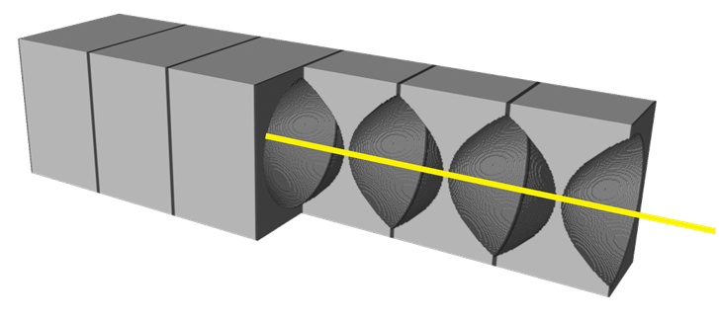
Compound Refractive Lenses (CRLs)
n=1
about 100 m !
n=0.999999
Beryllium
Equivalent: Optical diverging lens

Slide 27
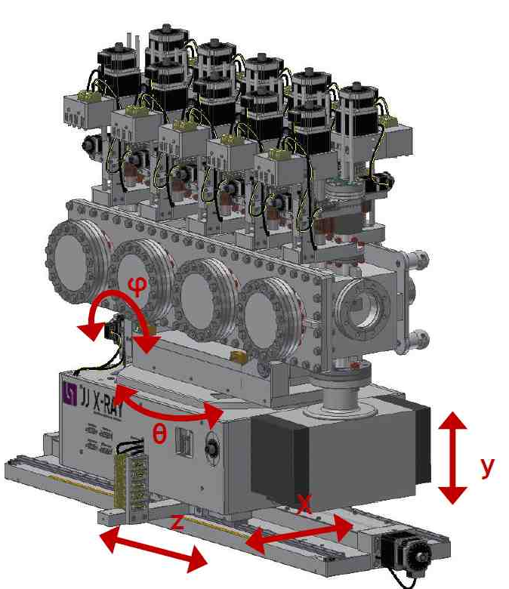
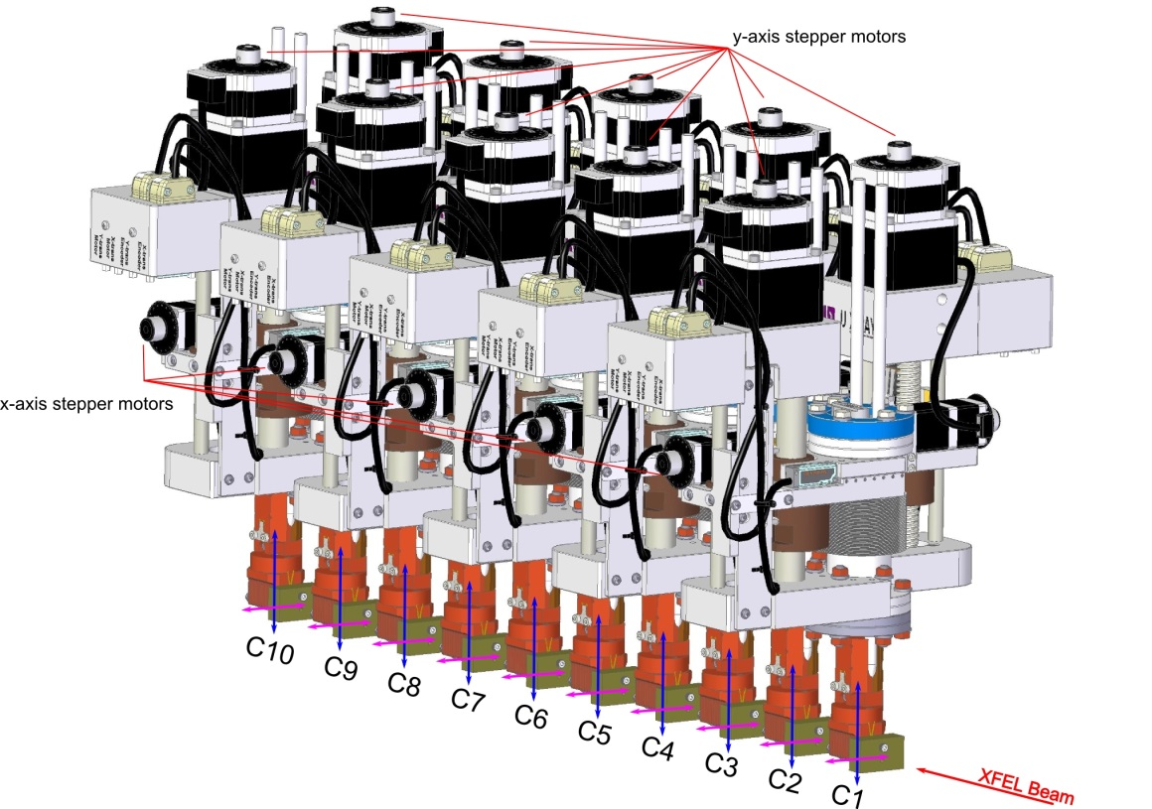
CRLs in XTD2+9
Entire vessel 5-dim adjustable
Each arm x-y adjustabe
B4C apertures on each arm
Thermometers
Can be damaged > 60 pulses
Can damage beam pipes + shutters
Not needed in phase 1
Lewis Batchelor, CIE

Slide 28
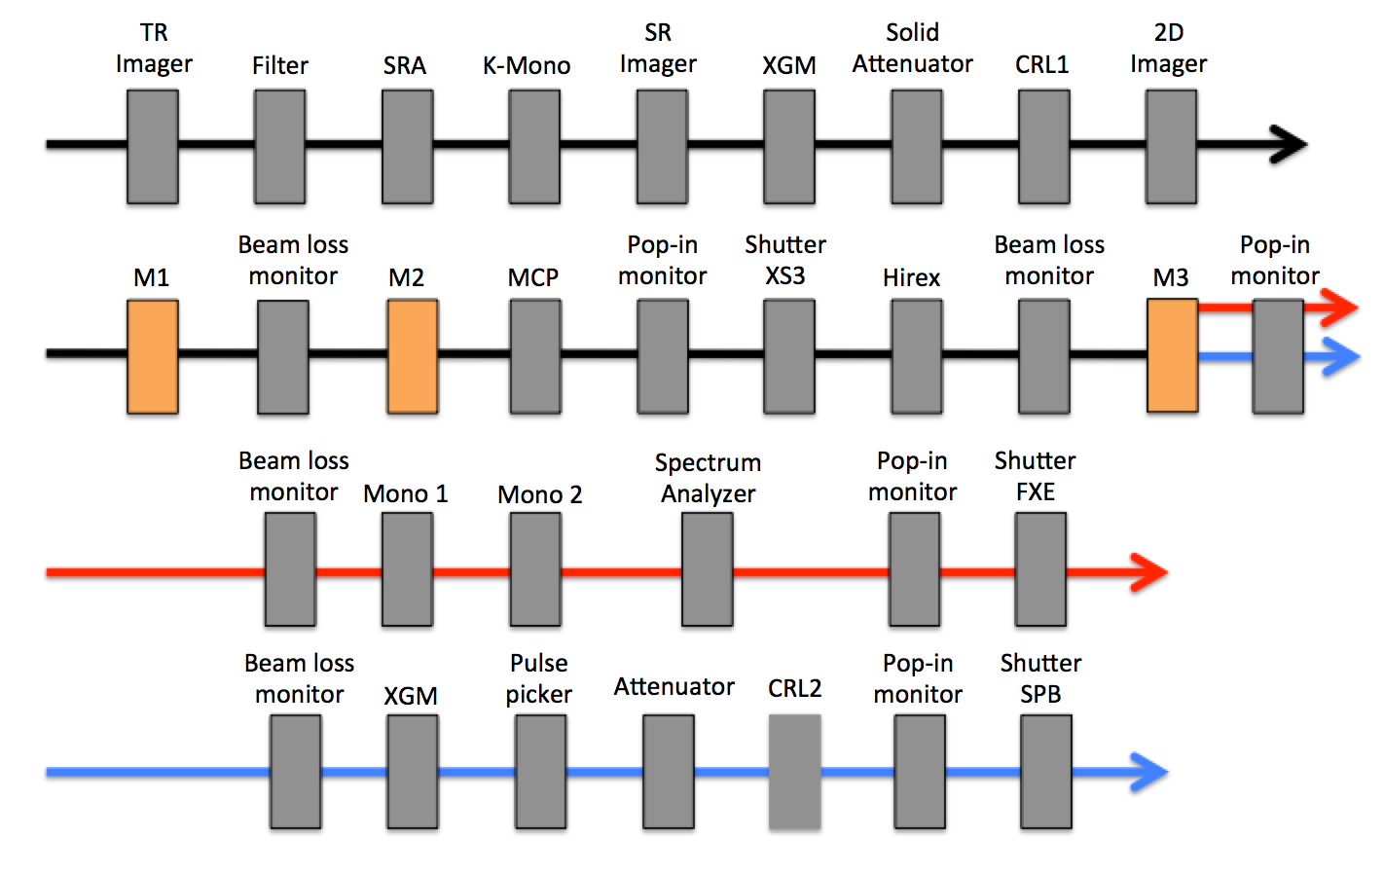
Mirrors

Slide 29
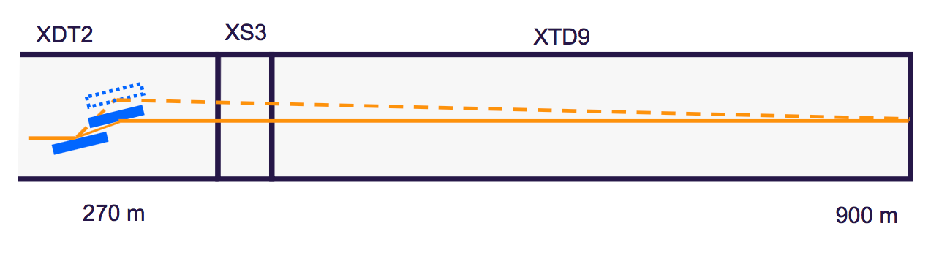
Mirror M1 + M2 (offset mirrors)
Tungsten beam stop
M1+M2 are photon beam chicane for safety reasons
Chicane is defined by collimators (ColA1: 12.5x20 mm before M1)
Variable incidence angle used to adjust to varying beam size
Incidence angle 1.1 mrad .. 3.6 mrad
Offset 25 mm .. 85 mm
Beam is steered back over tunnel length

Slide 30
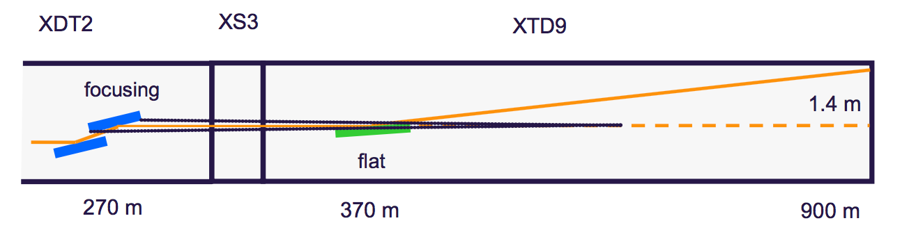
Mirror M3 (distribution mirror)
430 m
Incidence angle 1.35 mrad defined by distance to tunnel end
‘No-clipping’ condition at M3 achieved by intermediate focus (in particular needed for low energies)
M2 has therefore adjustabe radius (∞ - 50 km)
Only 1D intermediate focus (much less damaging than CRLs)
With constant intermediate focus position same beamsize as natural beam in experiment hall

Slide 31
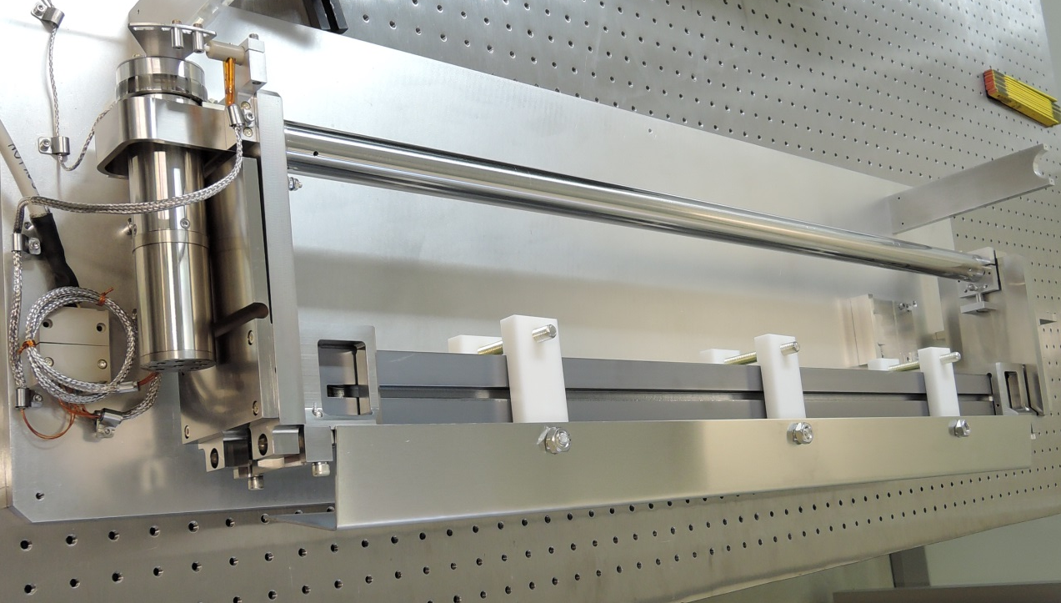
Mirrors: Technical realisation
Bending mechanism prototype

Slide 32
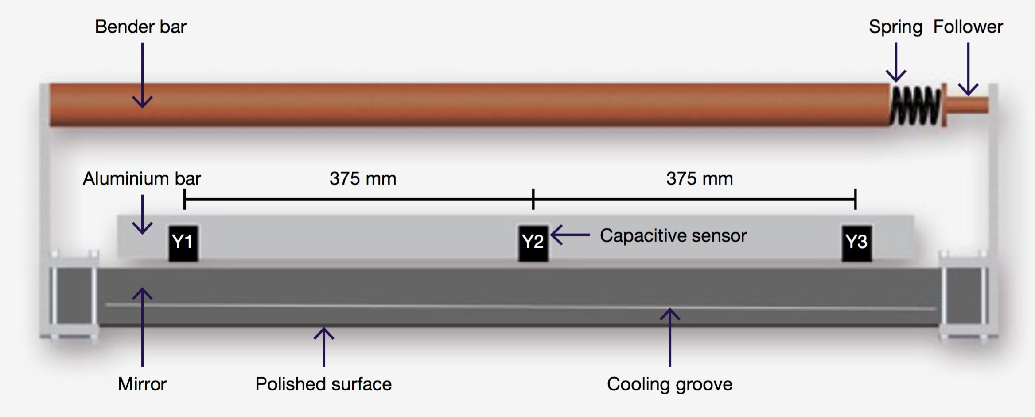
Temperature drift of bender
capacitive sensors
Temperature
Fizeau Interferometer
Stability on 10 nm level during
0.3 °C drift in mechanical bender !
Capacitive Sensors

Slide 33
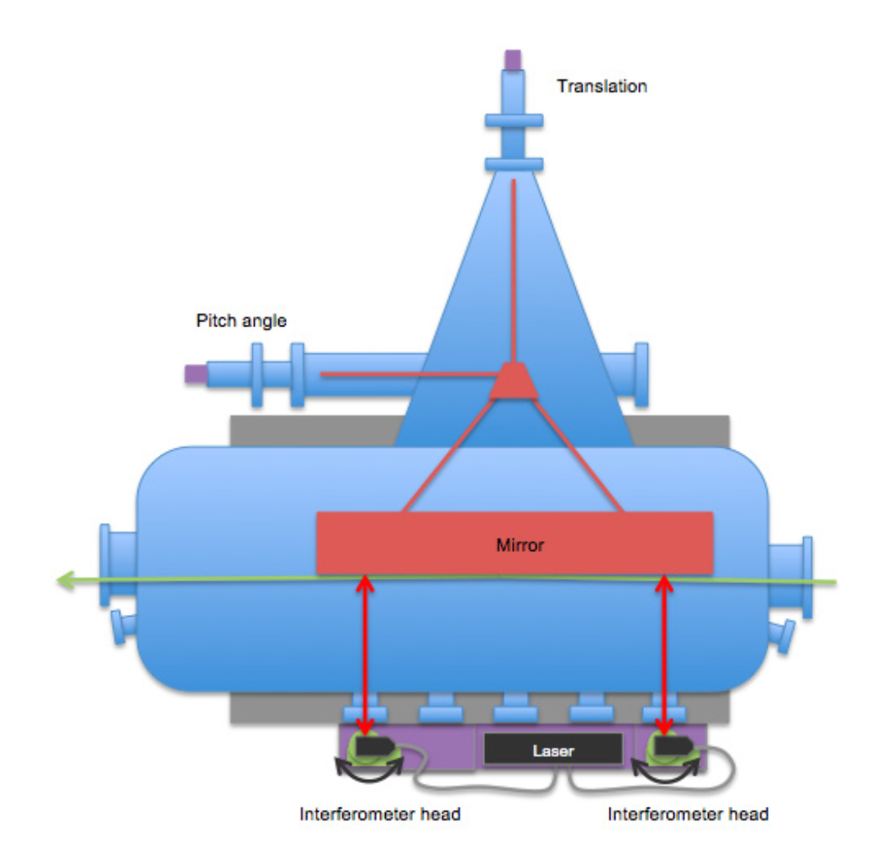
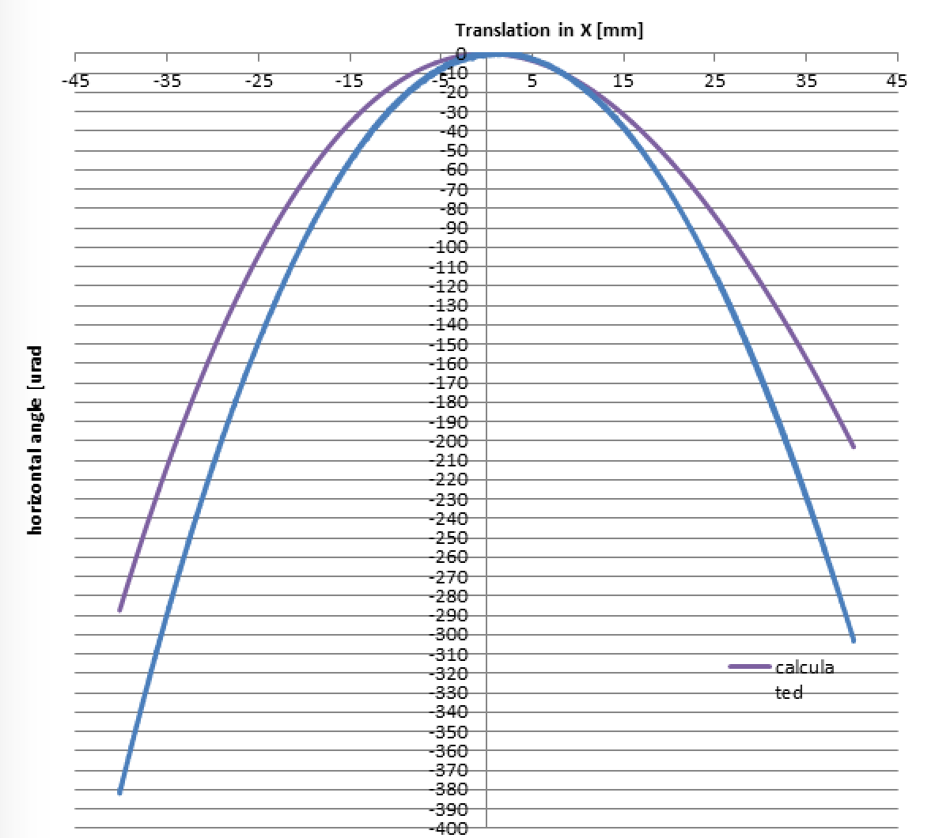
Mirror chambers
No translation slides, probably close to 10 nrad reproducibility, but:
Parasitic motion: ≈10 µrad /mm
However: 1 mm translation of M2 changes 40 µrad reflection angle anyway
Responsible: Antje Trapp, X-ray Optics

Slide 34
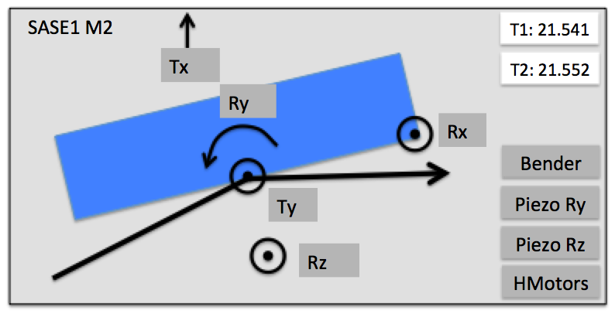

Mirror (‘CHOMs’) panels
(= Chamber for horizontal offset mirrors)
Responsible: Antje Trapp, X-ray Optics

Slide 35

Caution: Liquid Metal Cooling!

Slide 36

Photon beam loss monitor
responsible: Natalia Gerasimova, X-ray optics

Slide 37

Fast shutdown of beam:
The Photon Beam Loss Monitor concept
Connects directly to E-machine MPS, shuts down beam after 30-50 pulses
MPS
responsible: Natalia Gerasimova, X-ray optics

Slide 38

PBLM after every beam steering element
after horizontal mirrors
at the end of beamlines
responsible: Natalia Gerasimova, X-ray optics

Slide 39


PBLM panel
mechanical motions + cameras in Karabo
PMT (photomultiplier) readout and seetings through DOOCS
direct connections to MPS
responsible: Natalia Gerasimova, X-ray optics

Slide 40


MCP
MCPs + Diodes for SASE search and optimization
Can work in direct beam or in beam through M1+M2
Single shot sensitive!
responsible: Jan Grünert, X-ray diagnostics

Slide 41

Hirex
responsible: Naresh Kujala, X-ray diagnostics

Slide 42

Hirex spectrometer
Can provide spectrum from single pulse measurement
Semi-transparent
Can stand 1-50 pulses/train
Useful for laser tuning (shows bandwidth of X-rays)
responsible: Naresh Kujala, X-ray diagnostics

Slide 43

Hirex spectrometer
responsible: Naresh Kujala, X-ray diagnostics

Slide 44

500 m empty pipe

Slide 45

500 m empty pipe

Slide 46
beampipe (100 mm diameter)
end of pipe
SASE beam
upstream collimator (Shutter in XS3)

Slide 47
Alignment of beam transport
SASE1
screens
13 m
5 m
1.4 m
113 m
530 m
mirrors
Alignment accuracy philosophy:
1 mm / 5 m = 100 mm / 500 m

Slide 48

Can we damage anything during first photon beam commissioning ?
melting of beam pipes
Yes, we can!
B4C shutters etc

Slide 49


Further help:
Ray tracing plots (Alfresco WP73)

Slide 50

Mono 1+2
responsible: Xiaohao Dong, X-ray Optics

Slide 51

Monochromator

Slide 52
Mono 1
SASE1 Mono 1
T0: 95.4 K
Pico Roll
Heater 0
Piezo Pitch
T1: 105.4 K
Pico Pitch
Heater 1
T2: 107.3 K
Heater 2
Ty
Tx
8.998 keV
Energy
ACCM_pitch
Scan
responsible: Xiaohao Dong + Liuba Samoylova X-ray Optics

Slide 53
Mono 2
SASE1 Mono 2
T0: 95.4 K
Piezo Pitch
Heater 0
Pico Roll
Pico Pitch
T1: 105.4 K
Heater 1
T2: 107.3 K
Heater 2
Ty
Tx
8.998 keV
Energy
ACCM_pitch
Scan

Slide 54

SPB devices (CRL, Pulse picker, Attenuator)

Slide 55


Pulse picker
10 Hz operation
B4C disk + Tantalum
Should be able to survive 60 pulses, but rotor gets warm over time.
Will be tied to MPS to reduce beam mode
Responsible: Lewis Batchelor, CIE

Slide 56


Attenuator (SPB)
Materials: Diamond, B4C, Silicon
Double thickness when going to next arm
Attention: Cu+Fe+H₂O crosses beam! (need interlock based on encoder at some point)

Slide 57

Shutters
Responsible: Fan Yang , X-ray Optics

Slide 58

Shutter
Will be controlled primarily through DESY MPS group software
Can stand up to about 300 pulses/train (Mode 3)
Power absorbers always closes before tungsten shutter
Can be damaged by CRL focus
Fan Yang/X-ray Optics

Slide 59
Finish!

