Slide 1


European XFEL Accelerator
Winni Decking
(with slides from C. Gerth, D. Noelle, H. Weise, S. Choroba, M. Omet, J. Branlard, …)
Joint Accelerator & Photon Systems Commissioning Seminar
24.11.2016
Notes:
How to edit the title slide
Upper area: Title of your talk, max. 2 rows of the defined size (55 pt)
Lower area (subtitle): Conference/meeting/workshop, location, date,
your name and affiliation,
max. 4 rows of the defined size (32 pt)
Change the partner logos or add others in the last row.

Slide 2
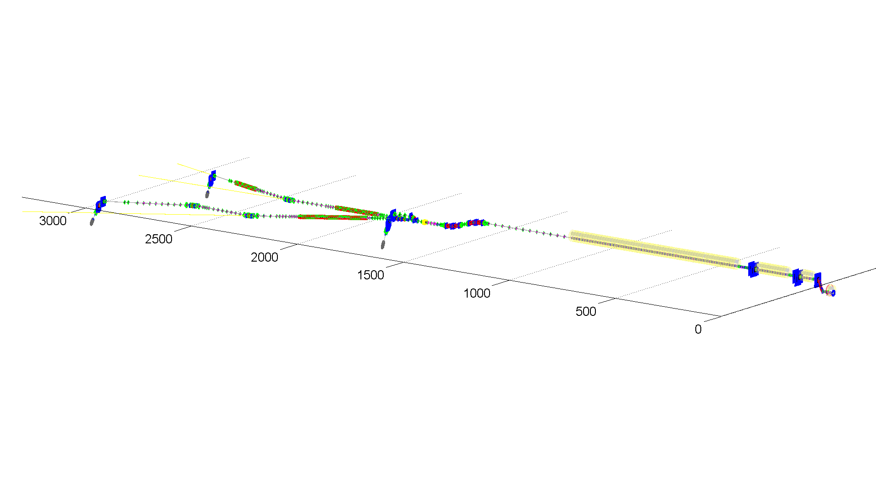
Accelerator Overview
North Branch
SASE1, SASE3, T4D Dump
L2
BC2 Dump
Injector
South Branch
SASE2, T5D Dump
L3
TLD Dump
L1
BC1 Dump
1 km of superconducting linac
3.3 km warm electron beam line
450 m undulator
…
Notes:
How to edit the title slide
Upper area: Title of your talk, max. 2 rows of the defined size (55 pt)
Lower area (subtitle): Conference/meeting/workshop, location, date,
your name and affiliation,
max. 4 rows of the defined size (32 pt)
Change the partner logos or add others in the last row.

Slide 3
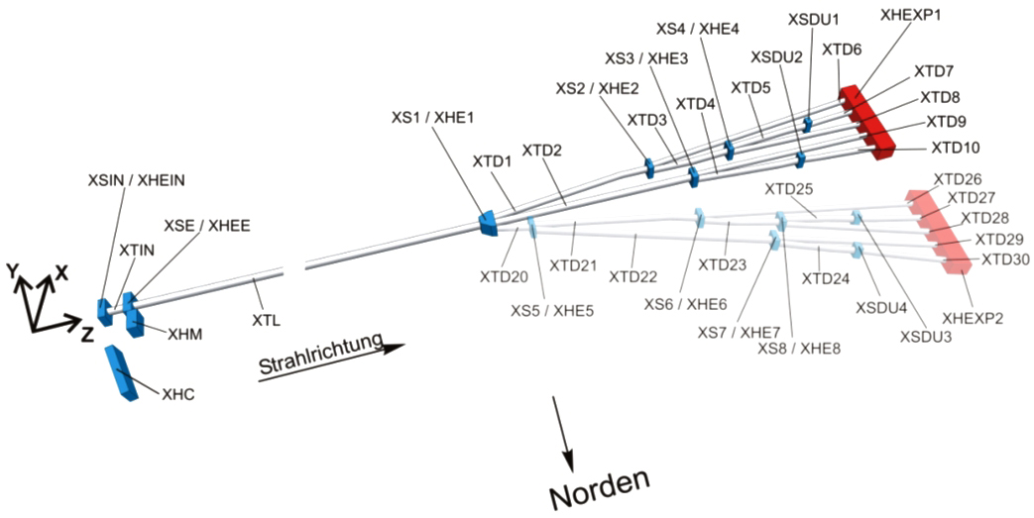
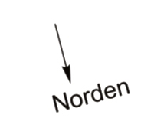
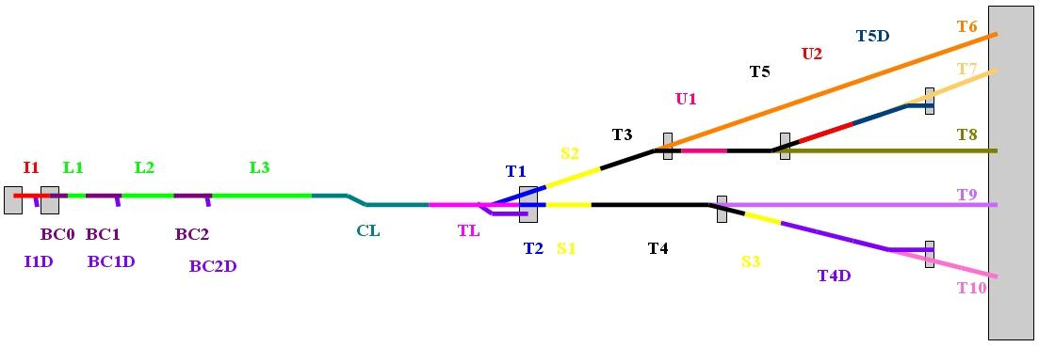
Nomenclature
Notes:
Before you start editing the slides of your talk change to the Master Slide view:
Menu button “View”, Master, Slide Master:
Edit the following 2 items in the 1st slide:
1) 1st row in the violet header:
Delete the existent text and write the title of your talk into this text field
2) The 2 rows in the footer area: Delete the text and write the information
regarding your talk (same as on the Title Slide) into this text field.
If you want to use more partner logos position them left
beside the DESY logo in the footer area
Close Master View

Slide 4
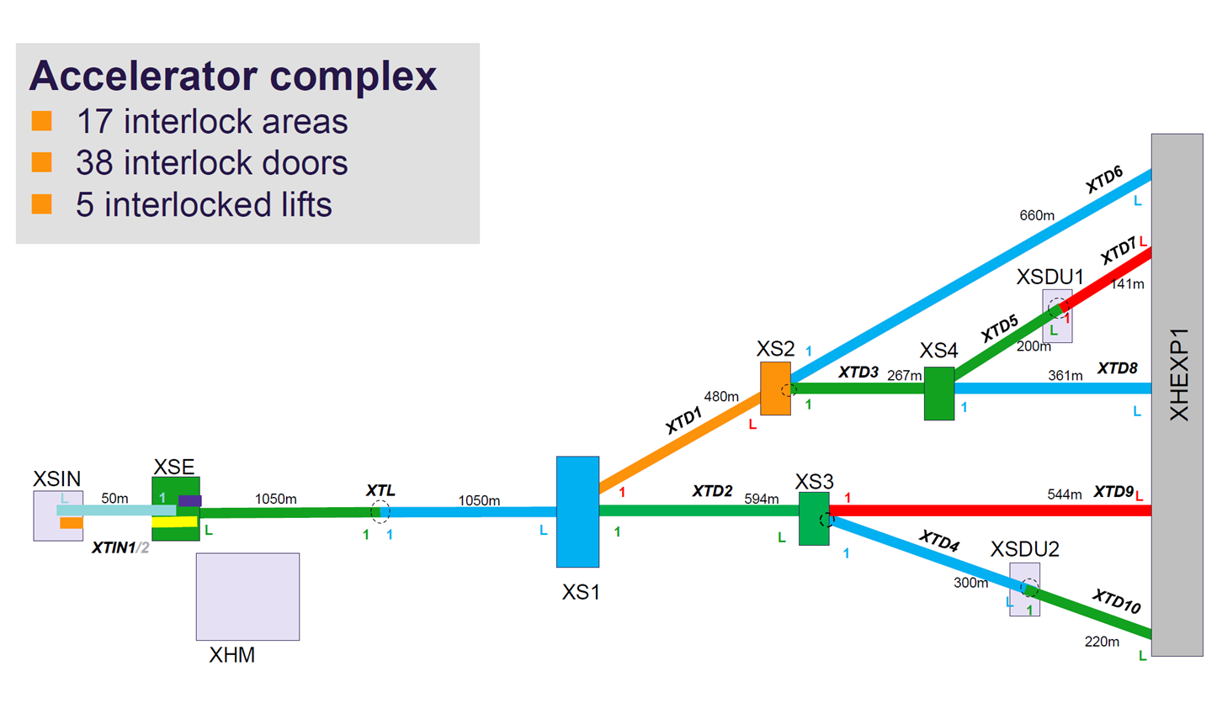
Interlock Areas

Slide 5
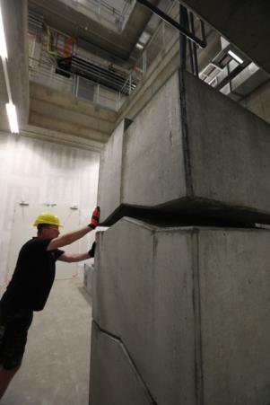
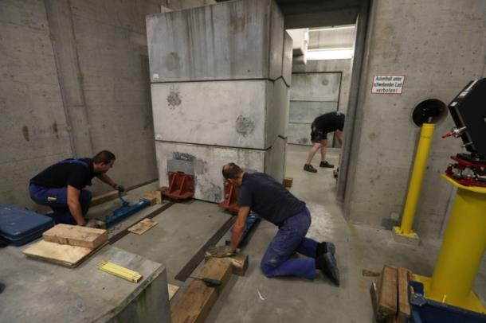
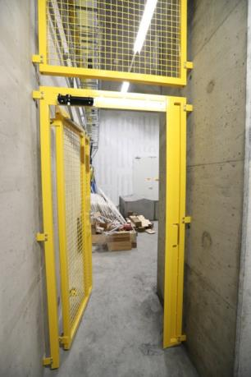
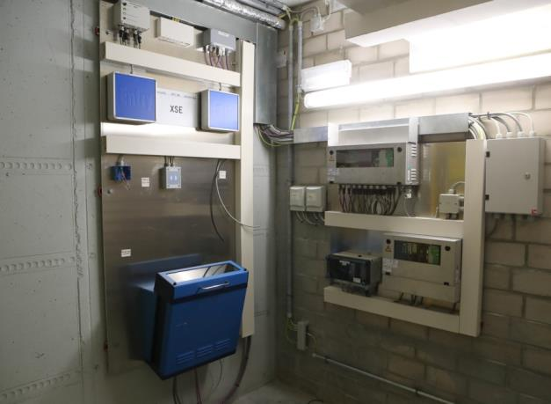
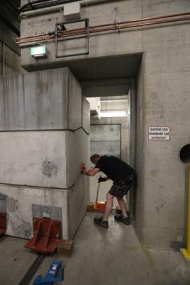
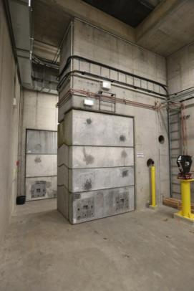
Shielding and Personnel Interlock

Slide 6
Interlock Areas
Interlocked sections for first lasing

Slide 7
Not covered
MKK Infrastructure – Climate, Water, Racks
Cryogenic System
Control System – Network, DAQ, …
Laser systems – Photoinjector, Laser Heater, Laser based synchronisation
Injector

Slide 8
Resonance Condition
1- 9
40-68 mm
1x10⁻¹⁰ m
European XFEL aims at 0.25 to 25 keV
Soft X-rays
SASE 3 (68 mm)
0.25 – ≥ 3 keV
Hard X-rays
SASE 1&2 (40 mm)
3.0 – ~25 keV
17.5
14.0
12.0
8.5
Electron
Energy [GeV]
200
1
2
10
20
Photon Energy [keV]

Slide 9
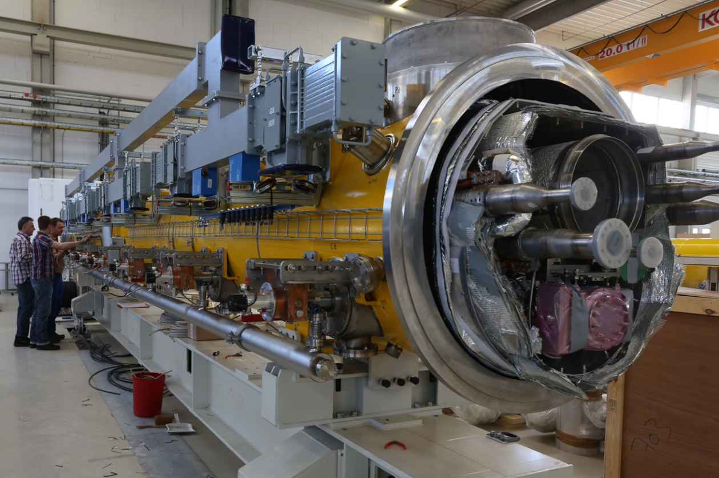
Linear Accelerator

Slide 10
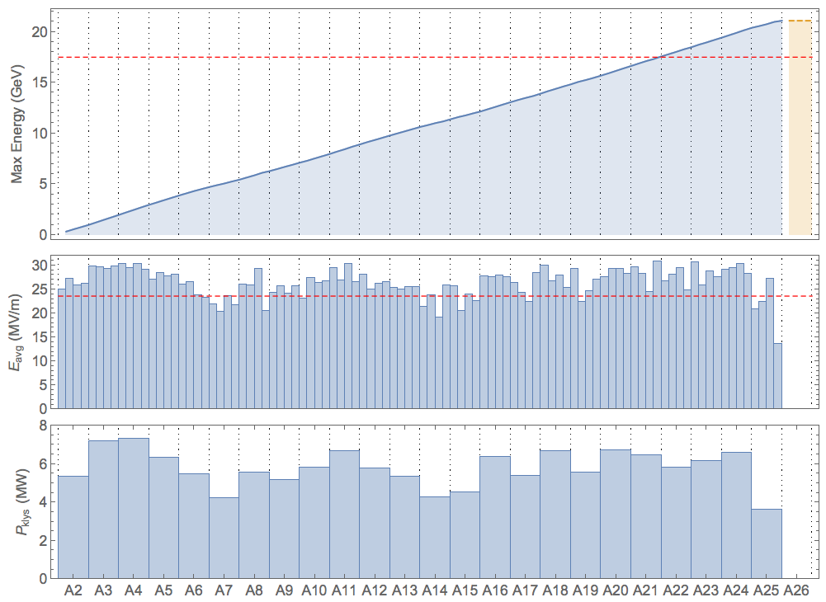
Energy Reach of European XFEL Modules
maximum energy reach
  after tunnel installation and
  according to accelerator module test
the maximum energy during FEL operation needs to respect the bunch compressor (BC) working points
  2.4 GeV nominal BC2 energy
  leads to approx. 19.5 GeV
  higher BC2 energy (e.g. 3.3 GeV)
  allows for > 20 GeV
increased max. energy assures higher availability
17.5 GeV
23.6 MV/m
1
CS2
CS3
CS4
CS5
CS6
CS7
CS8
CS9
BC1
BC2
2.4 GeV 15.1 17.9 19.5

Slide 11
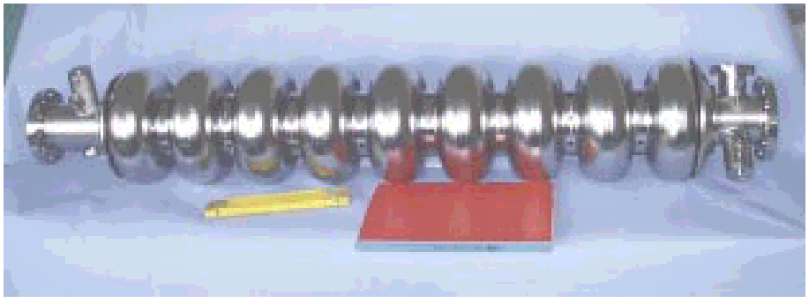
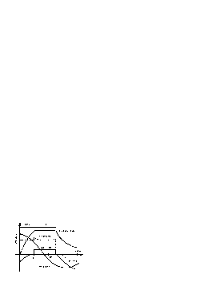
XFEL High Power RF - Overview
Number of sc cavities: 800 total for 17.5GeV
Power per cavity: 122 kW
Gradient at 17.5GeV: 23.6 MV/m
Power per 32 cavities
(4 cryo modules): 3.9MW
Power per RF station: 5.2MW (including 10% losses and 15% regulation reserve)
Number of RF stations: 26(orig. 27), active 25
Macro beam pulse duration: 650μs
RF pulse duration: 1.38ms
Repetition rate: 10Hz (25Hz)
Average RF power per station: 72kW (150kW)

Slide 12
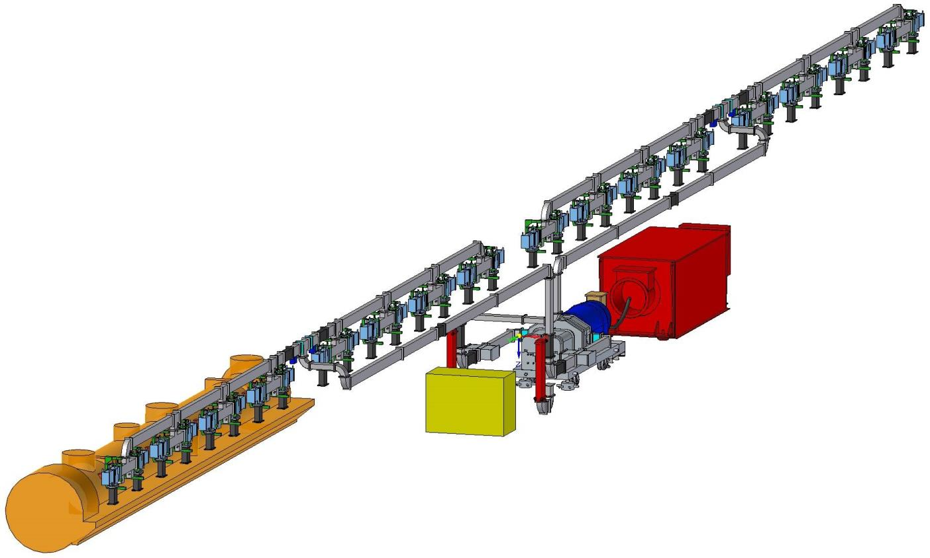
XTL RF Station Overview
HV Pulse
Cable
RF Waveguide
Distribution
HV Modulator
HV Pulse Cable
Modulator Hall XHM
Pulse Transformer
Klystron
XFEL Tunnel XTL
Racks and Water Distribution

Slide 13
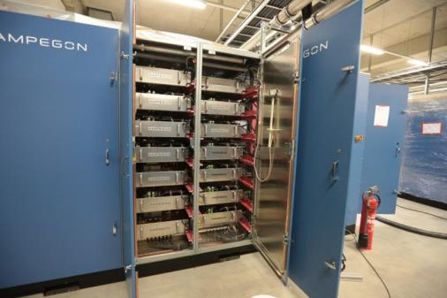
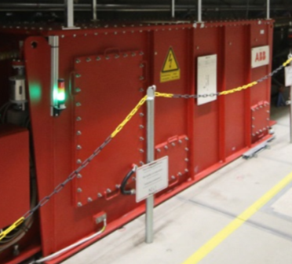
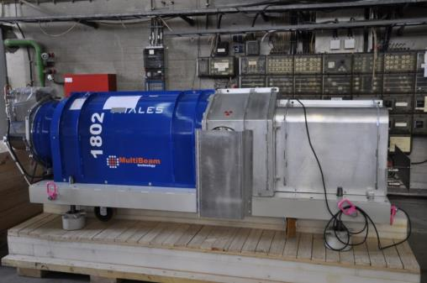
HV Pulse Modulator
Pulse Step Modulator
Multi Beam Klystron
Pulse Transformer
Gun Voltage | 132kV
Gun Current | 150A
RF Pulse Duration | 1.57 ms
RF Peak Power | 10 MW
Pulse Repetition Rate | 10Hz
RF Average Power | 150 kW
Efficiency | 63%
Pulse Voltage | 12kV
Pulse Current | 1.8kA
High Voltage Pulse Duration (70% to 70%) | 1.57ms
High Voltage Flat Top (99% to 99%) | 1.37ms
Pulse Repetition Rate | 10Hz
Pulse Transformer Ratio | 1 :12
Ratio | 1 :12

Slide 14
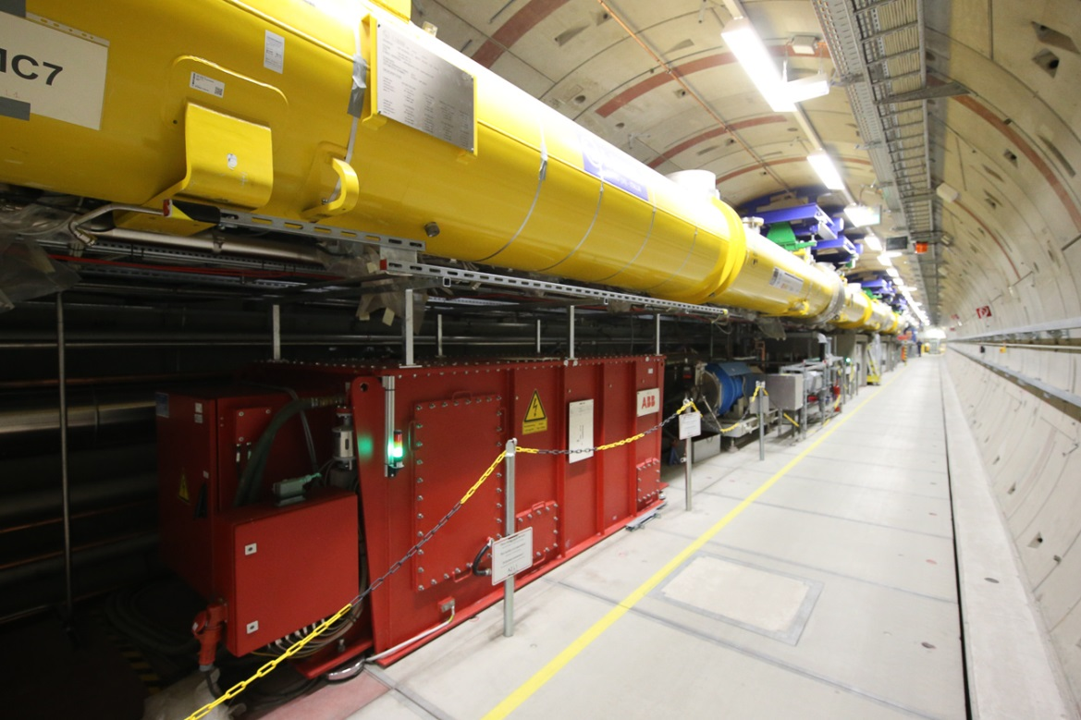
RF Station in XTL

Slide 15
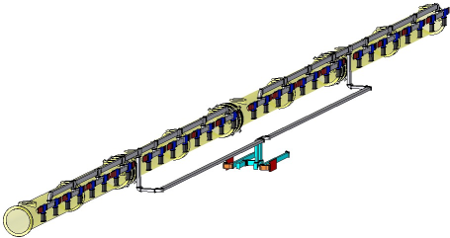
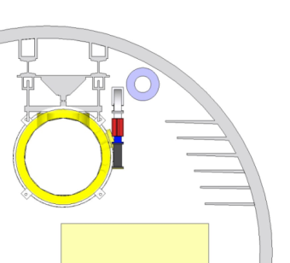
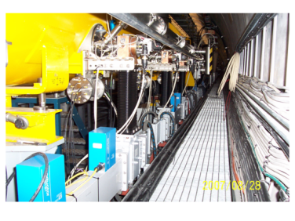
RF Power Distribution
Distribution of klystron output power to the superconducting cavities
Protection of the klystron from reflected power
Control of phase

Slide 16
Module Waveguide Distribution (equal power)
Shunt tee
Fixed phase shifters
Asymmetric shunt tee 3.0 dB, 4.77 dB, 6.0 dB
Shunt tees with integrated phase shifters
Waveguide Bellow
350kW Ferrite Load
350kW Circulator

Slide 17
Module Waveguide Distribution (individual cavities and modules)
Shunt tee
Asymmetric shunt tees with individual coupling factors
Fixed phase shifters
Asymmetric shunt tees 3.0 dB, 4.77 dB, 6.0 dB
Shunt tees with integrated phase shifters
Waveguide Bellow
350kW Ferrite Load
350kW Circulator
Asymmetric shunt tees with individual coupling factors (induct. + cap. posts)
Asymmetric shunt tee with individual coupling factor

Slide 18
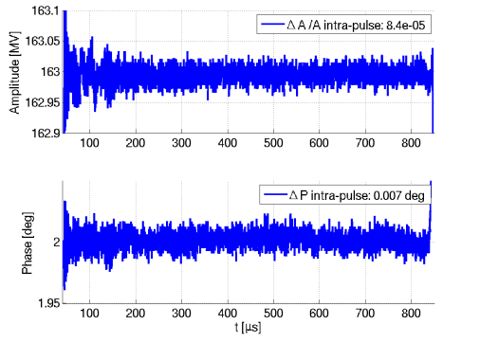
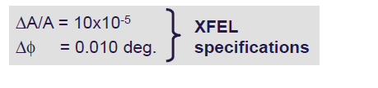
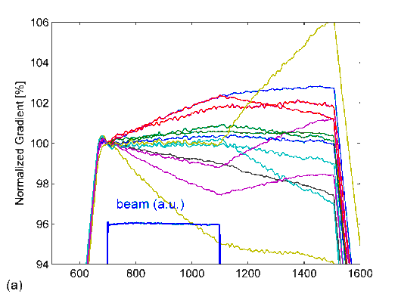
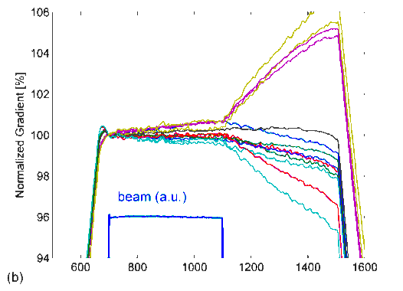
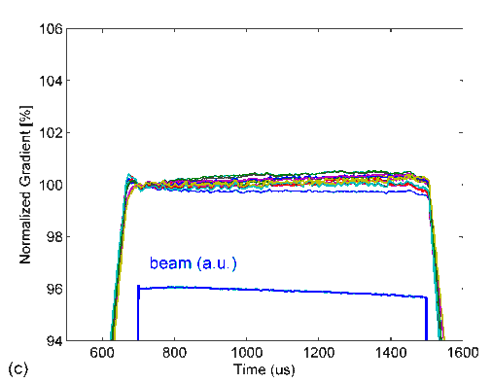
LLRF Tasks
Provide stable acceleration
  Within pulse
  Pulse to pulse
  Optimize cavity and module performance
Beam 4.5 mA
Beam 4.5 mA
Beam 4.5 mA

Slide 19
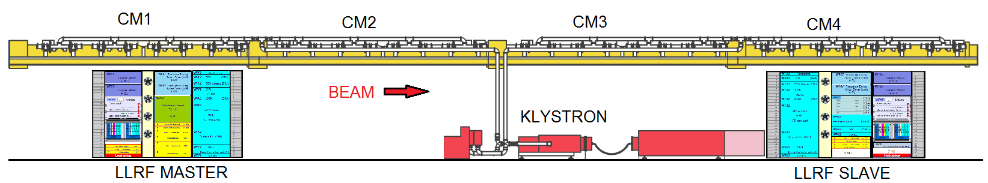
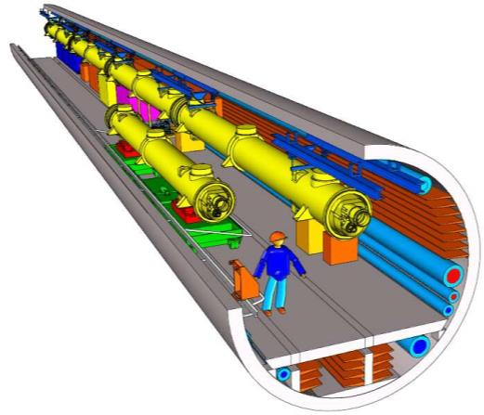
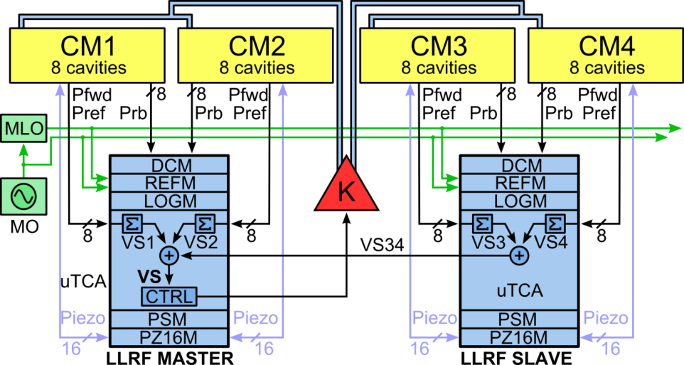
LLRF System Description
RF station: semi-distributed LLRF system
Section | Rack space | Redundancy
Gun, I1, 3H1 | 16U | Full
Linac 1 | 28U | Full
Linac 2 | 28U | No
Linac 3 | 28U | No

Slide 20
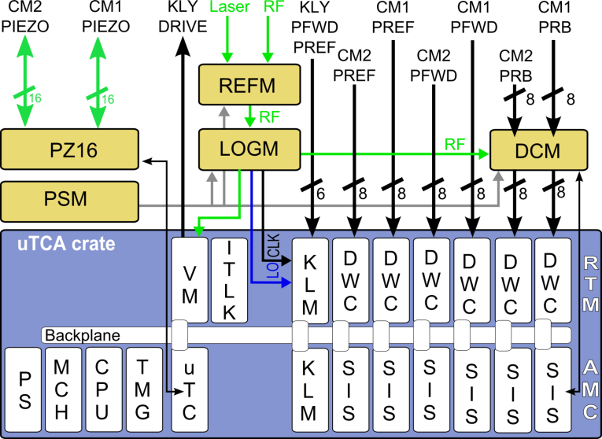



LLRF System Description
REFM
RF Reference Module
LOGM
Local Oscillator
Generation Module
DCM
Drift Compensation
Module
PZ16M
Piezo Driver Module
PSM
Power Supply Module
CPIM
Coupler Processing
interlock Module
uPS Power Supply
MCH Management and
Control Hub
CPU Computing Unit
TMG Timing
uTC Control board
uDS800 Fast ADC
uDAQ Digitizer board
uVM Vector Modulator
ITLK Interlock
KLM Klystron Lifetime
Management
uDWC Down converter
MTCA.4 crate
D
D
D
D
D
D
D
S
A
A
A
A
A
A
800
Q
Q
Q
Q
Q
Q
EXTERNAL MODULES
MTCA.4 MODULES
RTM Rear Transition Module
AMC Advanced Mezzanine Card

Slide 21
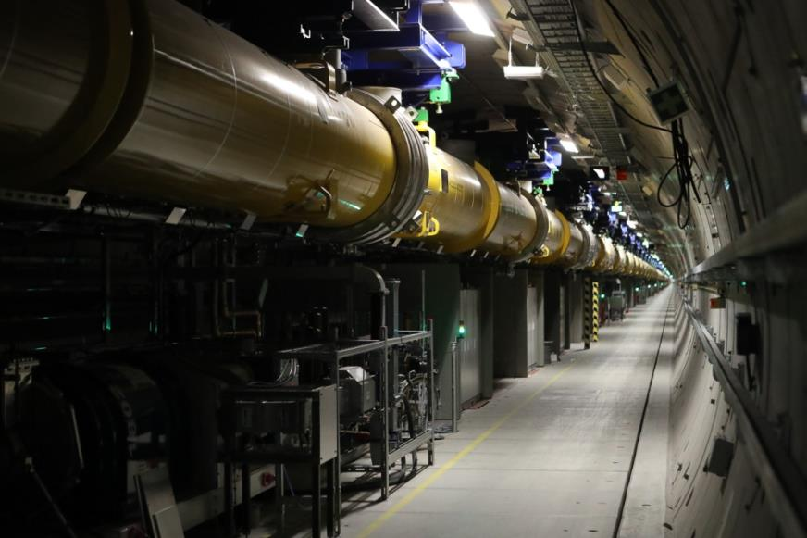
Linac Commissioning – ‚Warm‘
‘Warm’ technical commissioning of RF stations - in parallel with ongoing tunnel installation
Making RF in the tunnel for the first time
First full system integration (personnel protection, timing, MPS, RF reference, servers, communication)
Warm conditioning of couplers
Exercise components, calibrate signals
Operation of RF station from control room
16 out of 24 XTL RF stations are tested
Test of remaining 8 according to installation status
Notes:
Before you start editing the slides of your talk change to the Master Slide view:
Menu button “View”, Master, Slide Master:
Edit the following 2 items in the 1st slide:
1) 1st row in the violet header:
Delete the existent text and write the title of your talk into this text field
2) The 2 rows in the footer area: Delete the text and write the information
regarding your talk (same as on the Title Slide) into this text field.
If you want to use more partner logos position them left
beside the DESY logo in the footer area
Close Master View

Slide 22
Linac Commissioning – ‘Cold’
General approach (holds for all RF stations)
Start with RF only, no beam $, right after cold coupler conditioning
Start with low forward power ~ 80 dBm at klystron
1 Hz repetition rate, short pulse length (100-200 usec) possible, longer is more interesting
Tune cavities, 1-4 module at a time
Adjust couplers QL = 4.6e6
RF station configuration: gradients, timing, limiters, detuning, etc…
Reach nominal gradient
$: Upstream sections continue to be commissioned/operated with beam

Slide 23
Linac Commissioning – ‘Cold’
General approach (holds for all RF stations)
After reaching final gradient:
Beam on : 30 bunches, 1 nC, 4.5 MHz
Phasing (phase shifters fine tuning) + probe calibration (MV/m)
Ready for beam transport to next section

Slide 24
Linac Commissioning – ‘Cold’
Sequential commissioning of RF and beam lines
Recommission Injector at 130 MeV (2 wks)
Pass beam to BC1 beam dump after L1 (1 wk)
Commissioning of L1
  E_{final}=600 MeV, 1 RF stations, 15 MV/m (2 wks)
Pass beam to BC2 beam dump after L2 (2 dys)
Commissioning of L2
  E_{final} = 2.4 GeV, 3 RF stations, 20 MV/m (2 wks)
In parallel:
Commissioning of cold PS from L1 to L3 (5.5 wks)
Cold conditioning of couplers from L1 to L3 (3 wks)

Slide 25
Linac Commissioning – ‘Cold’
L3 commissioning of up to 20 RF stations
Pass 2.4 GeV beam to XS1 beam dump,
about 600 m after L3 ( 1wk)
LLRF commissioning of 1 cryo-string (3 RF stations) at a time,
adding about 2.5 GeV per cryo-string (1-2 wks)
Quantity | Value
electron energy | 2.5 – 17.5 GeV
macro pulse repetition rate | 1 Hz
RF pulse length (flat top) | >100 μs
bunch number per pulse | 30
bunch repetition frequency within pulse | 4.5 MHz
bunch charge | 1 nC
beam power | 1 – 7 kW

Slide 26
Overview of XFEL Cryogenic Equipment
AMTF
Cryo Plant
Warm
He-Pumps
(Building 54)
SC
SC
SC
SC
SC
SC
XRTL
SC
SC
Contributions
LINDE
DEMACO
BINP
Distribution Box
DB54
Shaft
Purifier
Purifier
Cold Compressors
CB44
Coldbox 41
Coldbox 43
Distribution Box
XLVB
Distribution Box
XLVB
Distribution Box
XLVB
Linac
Injector
Distribution Box
XIVB
XLTL2
XLTL3
Main Linac
FB
XLTL1
EC
3,9 GHz
FC
FC
CMS
EC
FC
CMS
EC
FC
CMS
SCB
SCB
CMS
EC
CM
FB
EC
3,9 GHz
FC
CM

Slide 27
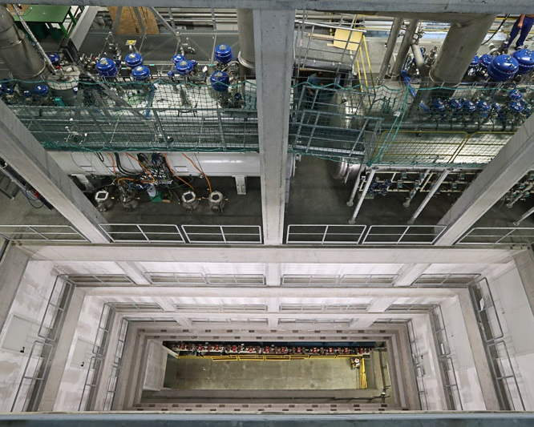
Cold Box and Valve Box in XSE

Slide 28
RF pulse length
RF flat-top (nominal 600 μs) defines dynamic cryo-load (up to 50% of 2K system load)
  Sudden changes in RF power lead to instabilities in cryo system
  Might stop cold compressors with long start-up time
Reduce RF flat-top to decrease impact
Commission He heaters (in all SCBs) and Cryo/RF interplay
Remark: Short RF flat-top also reduced dark-current

Slide 29
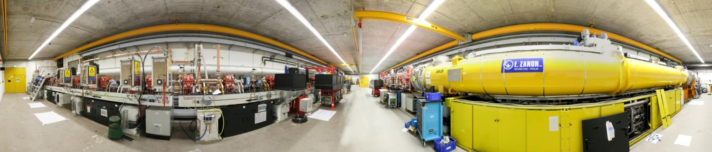
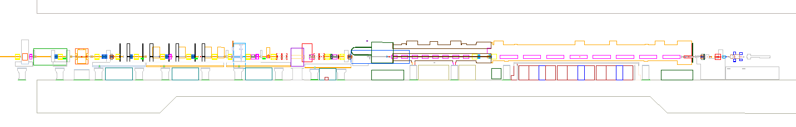
Complete Injector
Dump Transverse Deflecting Structure
Spectrometer Diagnostic Section Laser Heater 3.9 GHz Module 1.3 GHz Module Gun

Slide 30
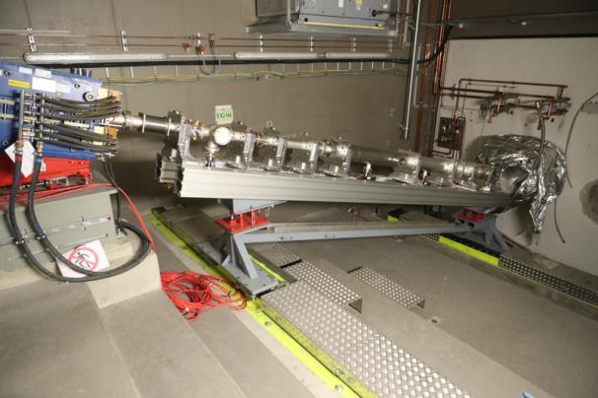
Beam Dumps
bunch compressor diagnostic dumps
0.5 and 2.5 GeV
small fraction of max. beam power
injector dumps
130 MeV
P_{ave}= 12 kW
max. beam power
main beam dumps
up to 20 GeV
P_{ave}= 300 kW
1/2 max beam power
beam magnified
slow sweep to distribute heat

Slide 31
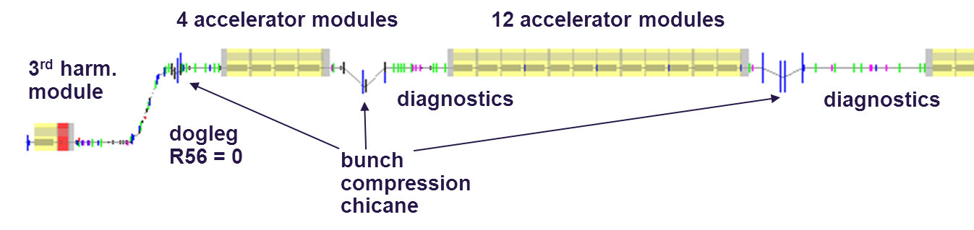
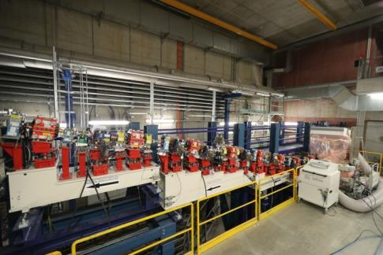
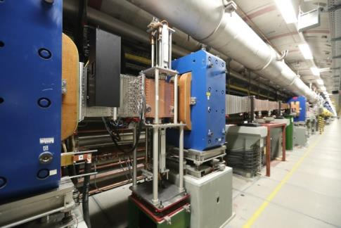
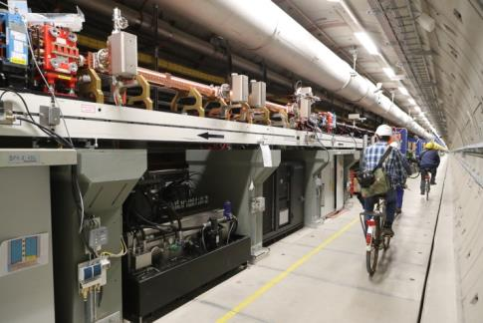
3 Stage Bunch Compression
R56=60-120mm
R56=
60-120mm
R56=30-100mm
= 40 mm

Slide 32


Bunch Compressor BC1

Slide 33
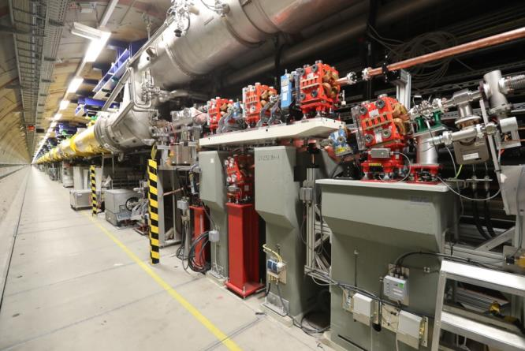
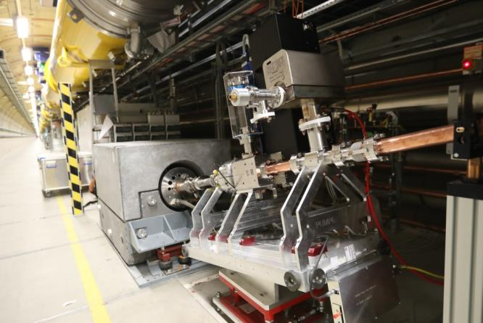
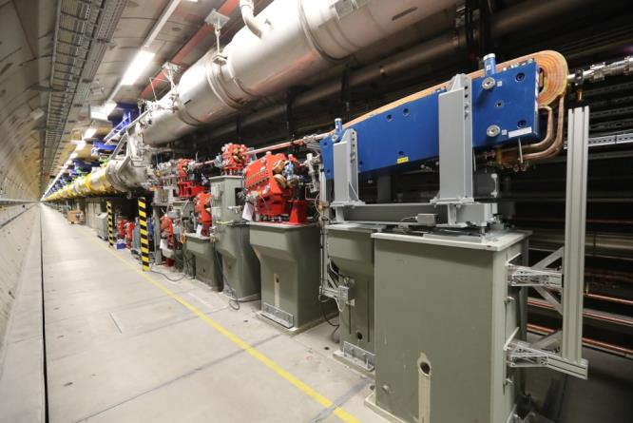
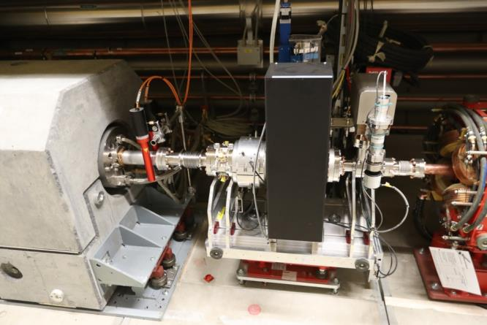
Both Bunch Compressors BC1 / BC2 include Commissioning Beam Dumps

Slide 34
3 Stage Bunch Compression
R56=60-120mm
R56=
60-120mm
R56=30-100mm
= 40 mm
Energy | 130MeV | 600MeV | 2.5GeV | 17.5GeV
20pC | 4.53ps | 1.46ps | 185fs | 5.23fs
100pC | 4.80ps | 1.55ps | 197fs | 11.6fs
250pC | 5.27ps | 1.70ps | 223fs | 25.4fs
500pC | 6.00ps | 1.96ps | 259fs | 43.0fs
1000pC | 6.77ps | 2.23ps | 303fs | 84.0fs
Bunch length change (x 100) after bunch compressors: BC0, BC1, BC3
Collective effects (CSR) lead to changes of the bunch profile
Bunch arrival time may change after dispersive sections: BC0, BC1, BC3

Slide 35
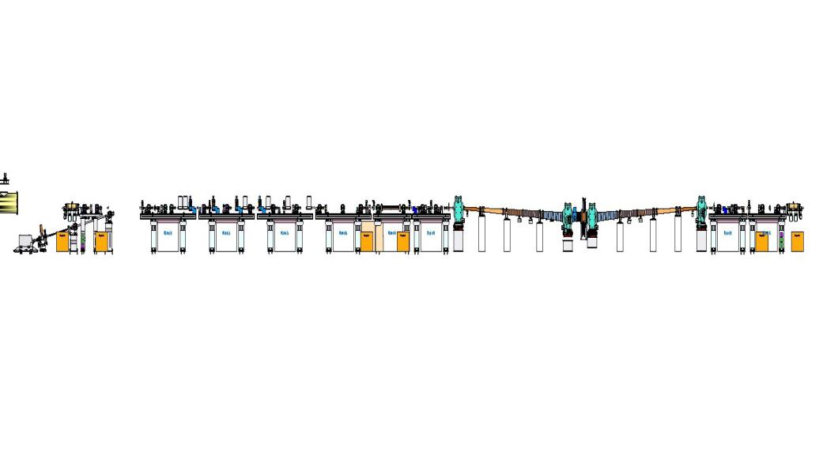
Layout of Diagnostic Section (BC1)
Diagnostic Sections:
Bunch Compression (BCM)
Bunch-Arrival Time (BAM)
Long. Bunch Profile (EOD)
BC1
Matching Section:
FODO Lattice
Slice Emittance (TDS)
Long. Bunch Profile (TDS)
e-spectrometer:
Energy
Long. PS
BC chicane:
Energy (EBPM)
Energy spread (SRM)
BC0
Matching into chicane
Beam direction
L2
L1
BCM
EBPM
BCM
BAM
BAM
Controller
Beam Based FB
REFM
Experimental Hall:
SLO
~ 3.5km
Pump-Probe Laser 1
Links
x 24
MLO
MO
Pump-Probe Laser n
* MLO/SLO: master/slave laser oscillator
WP-02 LLRF

Slide 36
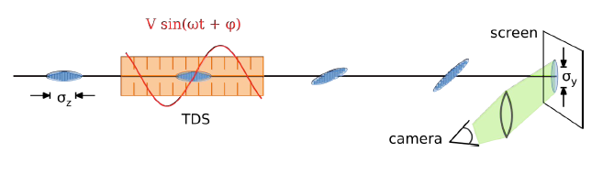
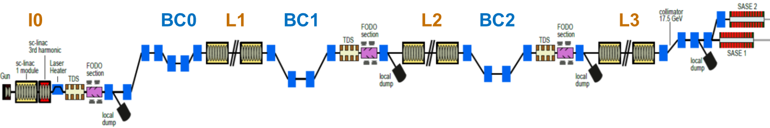
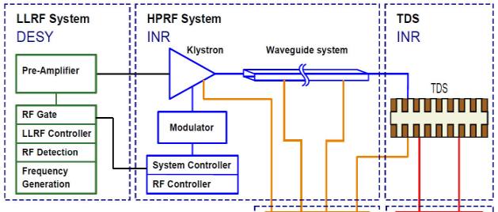
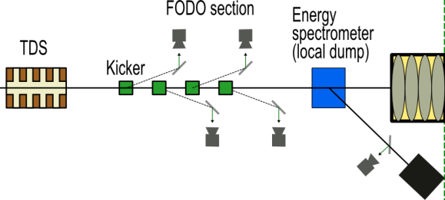
TDS Systems Overview
Notes:
Before you start editing the slides of your talk change to the Master Slide view:
Menu button “View”, Master, Slide Master:
Edit the following 2 items in the 1st slide:
1) 1st row in the violet header:
Delete the existent text and write the title of the EoI for WPnumber
2) The row in the footer area: write the institute name
Close Master View

Slide 37



Transverse Deflection System in Bunch Compressor BC2
The BC2 TDS RF station is installed and successfully commissioned.
TDS structure commissioning is next.
  Water cooling / temperature stabilization / RF.

Slide 38
Summary - Longitudinal Diagnostics
TDS
TDS
TDS
EOD
EOD
EOD
BAM
BAM
BAM
BAM
EBPM
EBPM
EBPM
CRD
SRM
SRM
BCM
BCM
BCM
BCM
Notes:
Before you start editing the slides of your talk change to the Master Slide view:
Menu button “View”, Master, Slide Master:
Edit the following 2 items in the 1st slide:
1) 1st row in the violet header:
Delete the existent text and write the title of the EoI for WPnumber
2) The row in the footer area: write the institute name
Close Master View

Slide 39





Beam Diagnostics
Beam Loss Monitor
(input for Machine Protection System)
Dosimetry
(equipment protection)
Current Monitor
(also MPS)
Dark Current Monitor
(also very sensitive charge monitor)
Beam Position Monitor

Slide 40



Beam Size Measurement: Hot Spots
Emittance Measurements
3 or 4 stations with known phase advance
Section | Screen | Screen Off Axis | Wire-scanners (WS)
Injector | 5 | 4 | 0
BC1 | 3 | 4 | 0
BC2 | 6 | 4 | 0
Collimator | 7 |  | 3
Beam Distribution | 5
Undulator Lines | 11 |  | 3 x 3
Chicanes | 3
Dump | 6
Photon | 3
Total | 49 | 12 | 12
Dot Grid Target(spot Ø .50mm)
200µm thick LYSO Screen (ON-Axis)
2 half 200µm thick LYSO Screens (OFF-Axis)

Slide 41


Beam Collimation and Distribution
Beam distribution after main collimation system runs three beam lines in parallel (Dump, North – SASE1&SASE3, South – SASE2)
Kicker-Septa combinations allow flexible distribution to all beam lines
For the beginning straight beam pass to SASE1&SASE3, no fast elements

Slide 42

Reminder: Special Time Structure
10 RF pulses per second
Each pulse with up to 2700 bunches

Slide 43
Bunch Repetition
Linac will be operated with several tens of bunches (not single bunch) as fast as possible
RF pulse length can be varied
Initially possible repetition rates (injector laser)
n | bunch repetition frequency [MHz] (=1.3GHz/(n*144) with n>=2 and even) | bunch spacing [ns] | max # of bunches in 600 μs train
2 | 4.514 | 222 | 2700
8 | 1.128 | 886 | 670
90 | 0.1003 | 10000 | 60
- | - | - | 1

Slide 44




Beam Distribution
Flexible kicker scheme allows to distribute bunches individually to experiments within the 600 μs long bunch train
Three experiments can operate simultaenesouly
MID
HED
SPB
FXE
SQS
SCS

Slide 45



Installation on Top of XS1 Dump Cave
Access to the XS1 shaft allowed finishing of mechanical installations.

Slide 46


Undulator System Commissioning
Undulator final technical commissioning after final alignment to straight line reference
First lasing:
  Electron BBA based on dispersion-free steering (‘LCLS method’)
  Undulator and phase shifter settings based on magnetic measurements
  Photon based methods
Clima hutch open
Clima hutch closed

Slide 47


Undulator
SASE 1/2 photon energy vs. gap
Installation
Representative measurement results

Slide 48
E-beam parameters
Quantity | Value
electron energy | 8/12.5/14/17.5 GeV
macro pulse repetition rate | 10 Hz
RF pulse length (flat top) | 600 μs
bunch train length | 600 μs
bunch repetition frequency within pulse | 4.5 MHz
bunch charge | 0.02 – 1 nC
electron bunch length after compression (FWHM) | 2 – 180 fs
Slice emittance | 0.4 - 1.0 mm mrad
beam power | 500 kW
Variable undulator gap | 10-20 mm
Simultaneously operated SASE undulators | 3

Slide 49
Initial E-beam parameters
Quantity | Value
electron energy | 8/12.5/14/17.5 GeV
macro pulse repetition rate | 10 Hz
RF pulse length (flat top) | 600 μs
bunch train length | 70 μs
bunch repetition frequency within pulse | 4.5 MHz 1.1 MHz
bunch charge | 0.02 – 1 nC 0.5 nC
electron bunch length after compression (FWHM) | 2 – 180 fs 90 fs
Slice emittance | 0.4 - 1.0 mm mrad
beam power | 500 kW 5 kW
Variable undulator gap | 10-20 mm 14 mm
Simultaneously operated SASE undulators | 3 1

Slide 50




Group Work
Develop the commissioning plan for the accelerator from restart of the injector up to beam in the XSDU2 dump
Present the sequence and timeline
  What are the major challenges?
  How can we mitigate risks?
  What tools/diagnostics/components/skills are needed?
Who's plan is more efficient (= faster)? Or
Notes:
Before you start editing the slides of your talk change to the Master Slide view:
Menu button “View”, Master, Slide Master:
Edit the following 2 items in the 1st slide:
1) 1st row in the violet header:
Delete the existent text and write the title of your talk into this text field
2) The 2 rows in the footer area: Delete the text and write the information
regarding your talk (same as on the Title Slide) into this text field.
If you want to use more partner logos position them left
beside the DESY logo in the footer area
Close Master View

