Slide 1
DOOCS Undulator controls
Olaf Hensler – MCS
With the help of :
Suren Abeghyan - XFEL
Suren Karabekyan - XFEL

Slide 2
DOOCS Undulator Controls One SASE string
Displays
Ubuntu/Linux computer running :
Wavelength Server
from O.Hensler
HLC QuadMover
from O.Hensler
DOOCS – Beckhoff Server
from S. Abeghyan
Ethernet/ZMQ
Beckhoff Computer
(Windows)
Beckhoff Plc
Beckhoff Plc
SASEx/Undu1
SASEx/UnduX

Slide 3
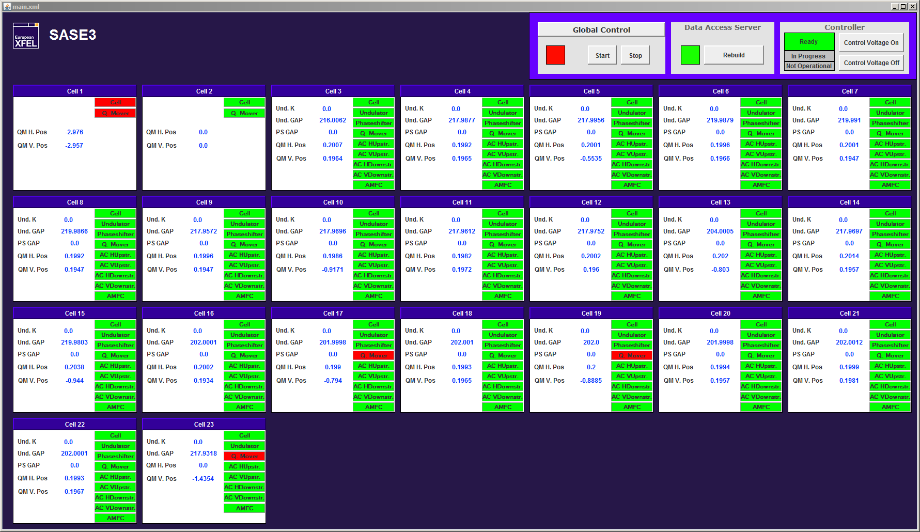
DOOCS Undulator Controls
Middle Layer Server Control / User Server control switch foreseen
Courtesy: Suren Abeghyan

Slide 4
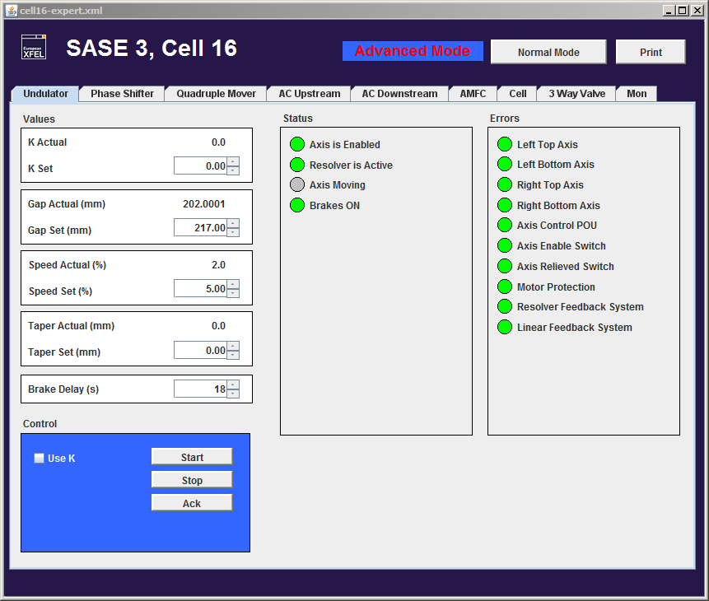
DOOCS Undulator Controls one Undulator
Control of one undulator module
All details available
Courtesy: Suren Abeghyan
Notes:
Advanced mode and Normal mode

Slide 5
DOOCS Undulator Controls FLASH example
Wavelength Control Server
Controls all undulator together
User chooses the wavelength
Gaps are calculated and applied
Taper groups are possible
Linear or quadratic taper
Interface to FEL user ?!

Slide 6
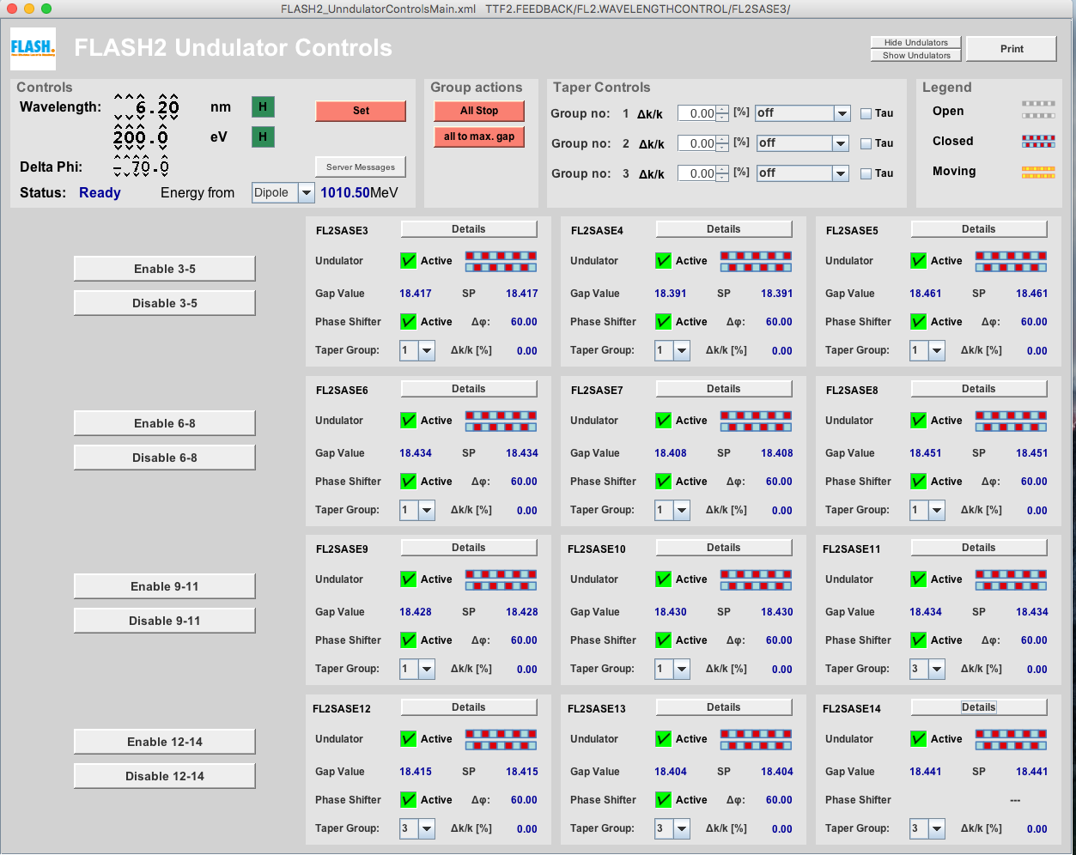
DOOCS Undulator Controls FLASH example

Slide 7
DOOCS Undulator Controls Quadrupole MiddleLayer
Converts beam kick [rad] into quad movement [mm]
Uses generalized kick from Magnet MiddleLayer
Calculates Min/Max kick from Min/Max position of quads
Used for beam-base alignment

