Slide 1
Of DAQs, XGMs and data flows
or how to access accelerator data

Slide 2
The DAQ System
at XFEL will mainly serve as data synchronization instance
there will be (initially) 2 instances (diag, llrf)
many essential processes will attach here
e.g. collecting trajectory data, slow FB loops, …
XGM data can be accessed here
so how does it look like?

Slide 3
The DAQ System
Courtesy: T. Wilksen (DESY)

Slide 4
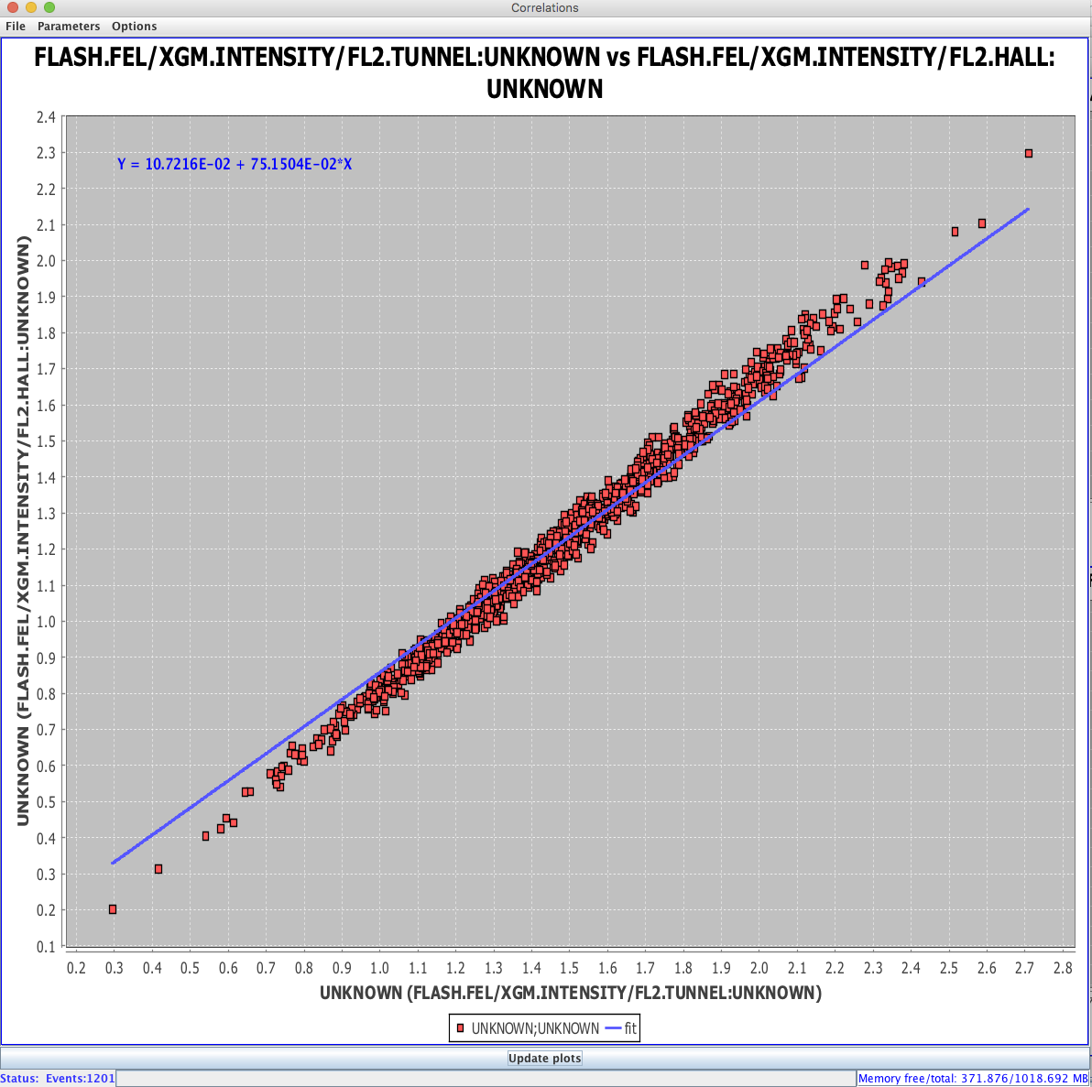
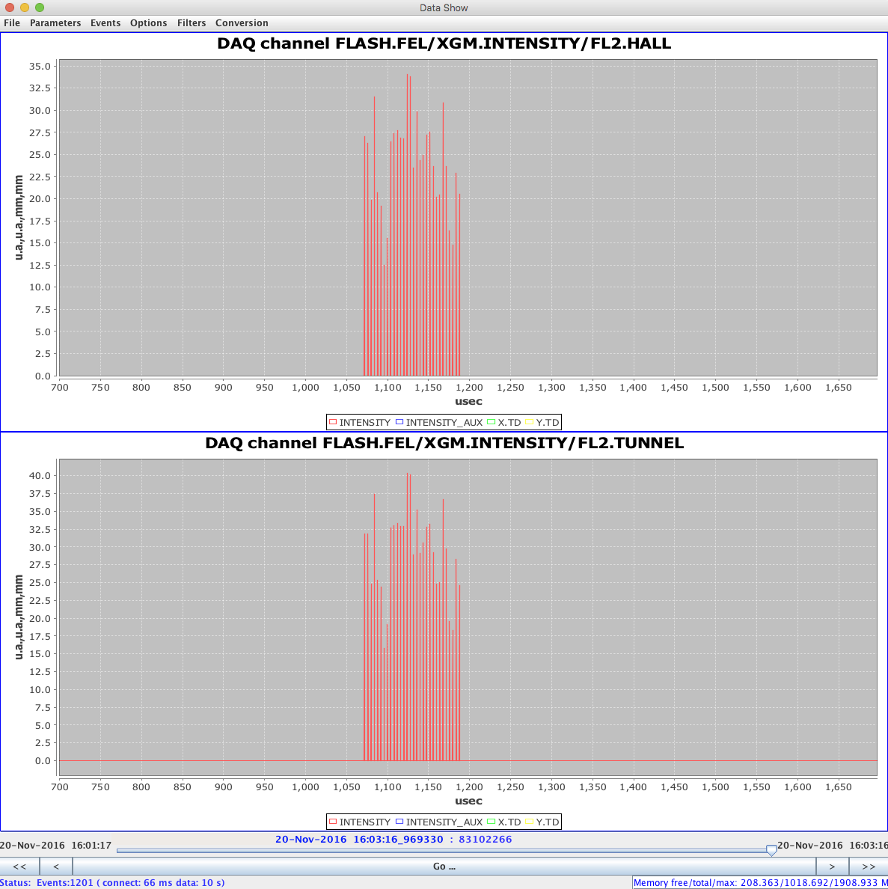
The DAQ System

Slide 5
How to get XGM Data?
2012

Slide 6
How to get XGM Data?
A full running implementation of all XGM relevant infrastructure can be found at FLASH2
There are two XGMs installed and available in DOOCS under the FLASH.FEL facility
to get electron intensity via DOOCS one could use:
FLASH.FEL/SASE_STATISTICS/FLASH2/DET1.TD
same will be set up for XFEL:
Context | Server/Device | Beam-line | Detector
XFEL.FEL | SASE_STATISTICS | SA1 | DET1.TD
FLASH.FEL | SASE_STATISTICS | FLASH2 | DET1.TD

Slide 7
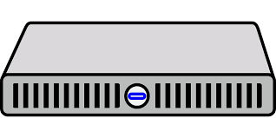
How to get XGM Data?
RPC
karabo
RPC
X
RPC
xfeldaq1
multicast
XGM
Bahrenfeld
multicast
Schenefeld

Slide 8
How to get XGM Data?
DOOCS-NAME DOOCS-SERVER PHYSICAL-DEVICES
-----------------------------------------------------------------------
XGM.CURRENT keithely_server K2700 + 2x K6514
XGM.GAS_SUPPLY gasmix_server Gas-Supply-SPS
XGM.GAS_DOSING rvc300_server Pfeiffer RVC300
XGM.PRESSURE srg2cepress_server Spining-Rotor-Gauge
XGM.TEMP adam_server adam pt100
XGM.POSMON gmdposmon_server >keithley
XGM.PHOTONFLUX xgmdflux_server >all other
SPDEVDMA spdevicedma_server ADQ412
XGM.PREPROCESSING xgmdpreproc_server >spdevdma
XGM.BPM xgmd_server >preproc
XGM.INTENSITY xgmd_server >preproc
Courtesy: S. Grunewald (DESY)

