Slide 1
High Level Software
XFEL Commissioning Workshop, Jork
Lars Fröhlich, 2016-11-23
Notes:
How to edit the title slide
Upper area: Title of your talk, max. 2 rows of the defined size (55 pt)
Lower area (subtitle): Conference/meeting/workshop, location, date, your name and affiliation, max. 4 rows of the defined size (32 pt)
Change the partner logos or add others in the last row.

Slide 2
A Heterogeneous Environment
jddd / Karabo-GUI
Generic user interface builders/engines
jddd: Java
Karabo-GUI: Python 3.4 / QT
Applications
Matlab
Java
Python 3.4 / QT
Control Systems / Protocols
DOOCS, TINE, EPICS, Karabo
Middle Layer Servers
C++
Frontend Servers
C++

Slide 3
jddd: Java Doocs Data Display

Slide 4
jddd Editor

Slide 5
Java: Sequencer

Slide 6
Matlab
hlcr/hlcw: “High Level Controls” read/write
doocs_read/doocs_write: DOOCS low-level
xcomm: TINE low-level

Slide 7
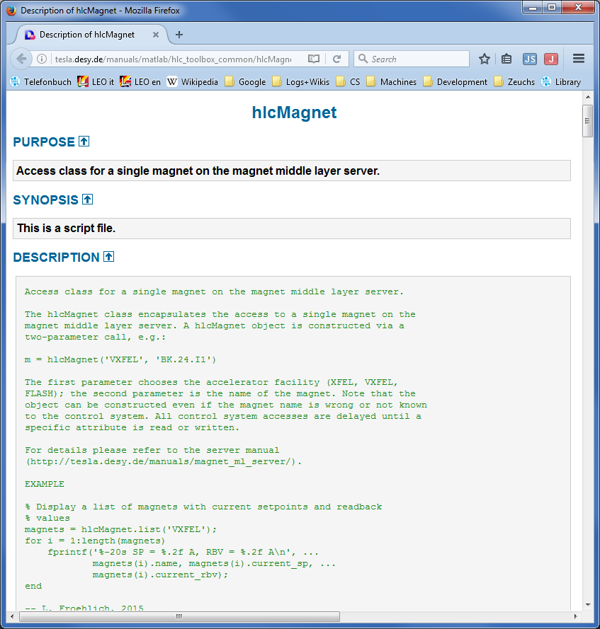
Matlab: Toolboxes

Slide 8
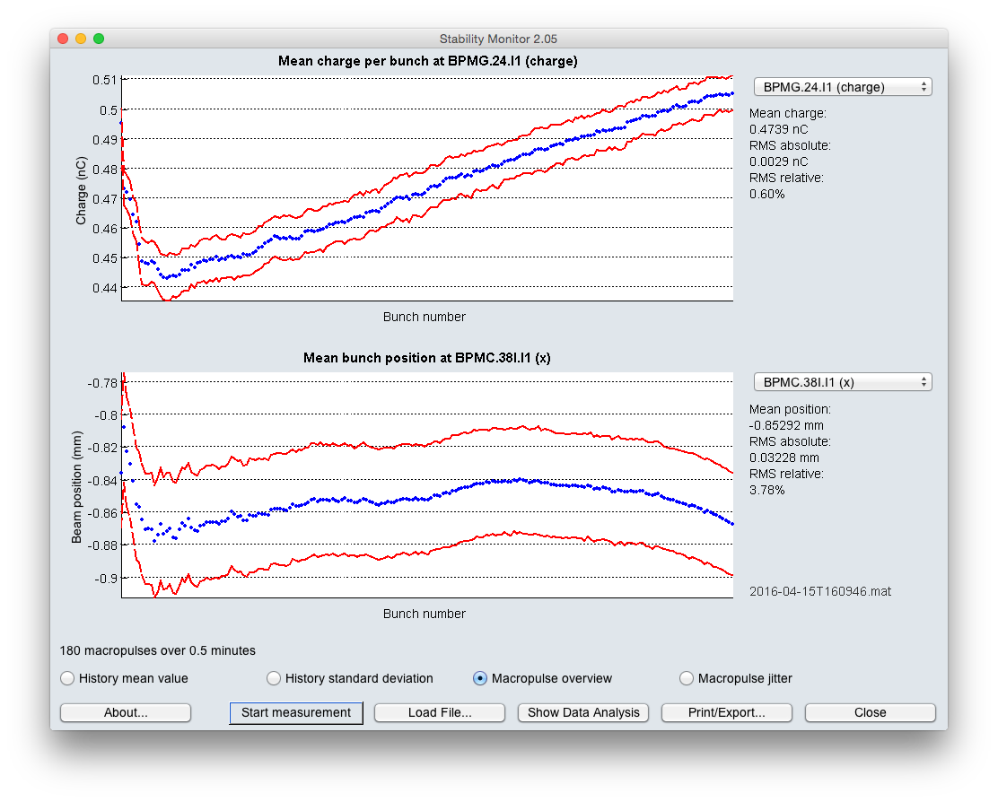
Matlab: Multi-Purpose Tools
Configurable tools to automate common tasks/measurements
Data recording
Scans
Checks

Slide 9
Python
Anaconda (Python 3.4+Libraries)
PyTINE: TINE interface module
PyDOOCS: DOOCS interface module
QT4: Graphical user interfaces

Slide 10
Python: Examples
Magnet Energizer:
Adjust magnets to beam energy
IntelliPhase:
Find “on-crest/anti-crest” phase
Measure feedback action while beam energy/arrival time is kept constant by feedbacks
Alternatively: operate without feedback

Slide 11
Karabo – DOOCS

Slide 12
Karabo Interfaces (1/3): Native Python Bindings
Direct Karabo integration for Python tools
Complete support for all Karabo features
Coexists with PyDOOCS, PyTINE interfaces
Control room demo: Not yet, to be scheduled soon.
Python Tool
Karabo Bindings
Karabo
Photon Beamlines

Slide 13
Karabo Interfaces (2/3): C++ Client Library
Under development
Can be integrated into DOOCS C++ client library
Provides Karabo access for
DOOCS middle layer servers
Matlab tools (via Matlab DOOCS interface)
Python tools (via PyDOOCS interface)
Initial tests successful, but experimental code, not in standard build yet.
Matlab Tool
Python Tool
DOOCS Matlab Bindings
PyDOOCS
DOOCS Client Lib w/ Karabo
DOOCS Client Lib w/ Karabo
DOOCS ML Server
DOOCS Client Lib w/ Karabo
Karabo
Photon Beamlines

Slide 14
Karabo Interfaces (3/3): jddd / Java
jddd uses Java jDOOCS instead of DOOCS C++ ClientLib
Java bindings for Karabo: Only conceptual implementation available, to be evaluated
Alternative: Create DOOCS middle layer servers
jddd
jDOOCS Library
DOOCS ML Server
DOOCS Client Lib w/ Karabo
Karabo
Photon Beamlines

