Slide 1
Shift scheduling, tickets
Harald Sinn
25.11.2016

Slide 2
Commissioning team members (update)
Harald Sinn: WP73
Liubov Samoylova WP73
Sergey Tomin: WP72
Naresh Kujala: WP74
Peter Zalden: WP81
Zuzana Konopkova: WP82
Ulrike Bösenberg: WP83
Marcin Sikorski: WP84
Markus Ilchen: WP85
Manuel Izquiredo: WP86
Associates (not working ‘full time’):
Yuhui Li (WP71 beam based alignment, undulator tuning)
Gianluca Geloni, Svitozar Serkez (WP72)
Natalia Gerasimova (WP73, max. 50%)
Andreas Koch (WP74, max 50%)
Karen Appel (WP82, max 50%)
Marc Messerschmidt (WP84)
from each scientific instrument one full time member
10 + 7 = 17 members

Slide 3
Tasks of commissioning team
Lead photon commissioning (plan, invite experts, guests etc.) and bring facility into operation on a fast track.
Documentation:
Gather technical documentation required for first commissioning
Document commissioning progress in BKR logbook
Communication
Progress should be made known to all members of the PCT
Meetings
Daily BKR meetings 7:00, 15:00, 23:00
Weekly BKR meeting Monday 15:00
To be defined: corresponding meetings in Schenefeld
Workshop with DESY on Nov. 24-25
Shift work (< 25% of annual working time)

Slide 4
Shift allocation rules for PCT (Matlab macro)
Allocated shifts: ‘Photon Systems’ +’Exp. Comm.’ (but not ‘Early User’ )
3 shifts per day:
Day shift 7:00 – 15:30
Swing shift 15:00 – 23:30
Owl shift 23:00 – 7:30
After one shift at least 2 shifts break (legal limit: 11 hours)
Two people on each shift (after June only one per owl shift)
Maximum 10 shifts per month
Maximum 5 shifts per week
Exclusion times (vacation, travel, .. )
Average: 48 shifts in 2017 (‘full time’ participant)
Shifts are otherwise randomly distributed (try to mix shift-partners)
Weight = (targeted shifts per year) / (already allocated shifts)

Slide 5
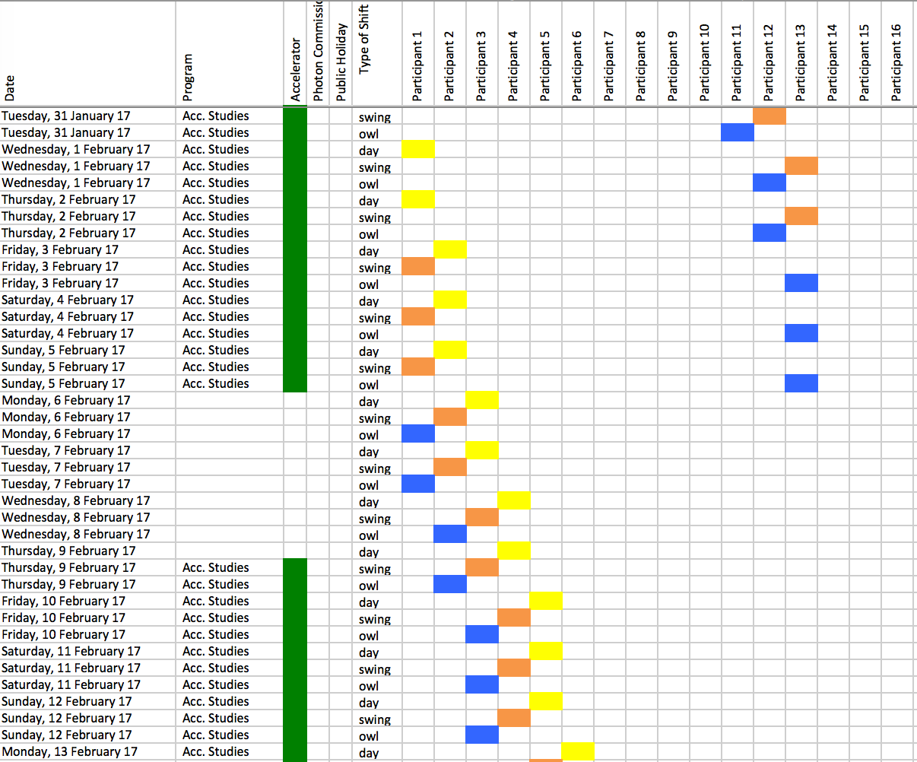
DESY shift schedule:
11x7 shifts

Slide 6
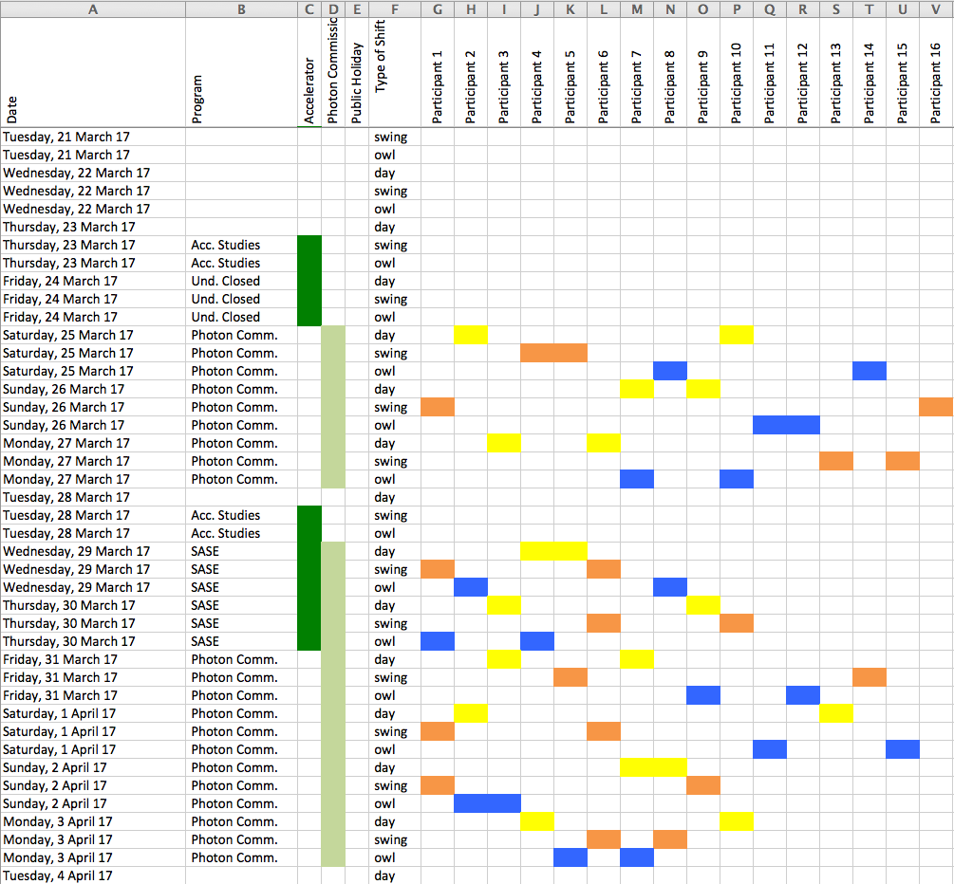
XFEL initial proposal

Slide 7
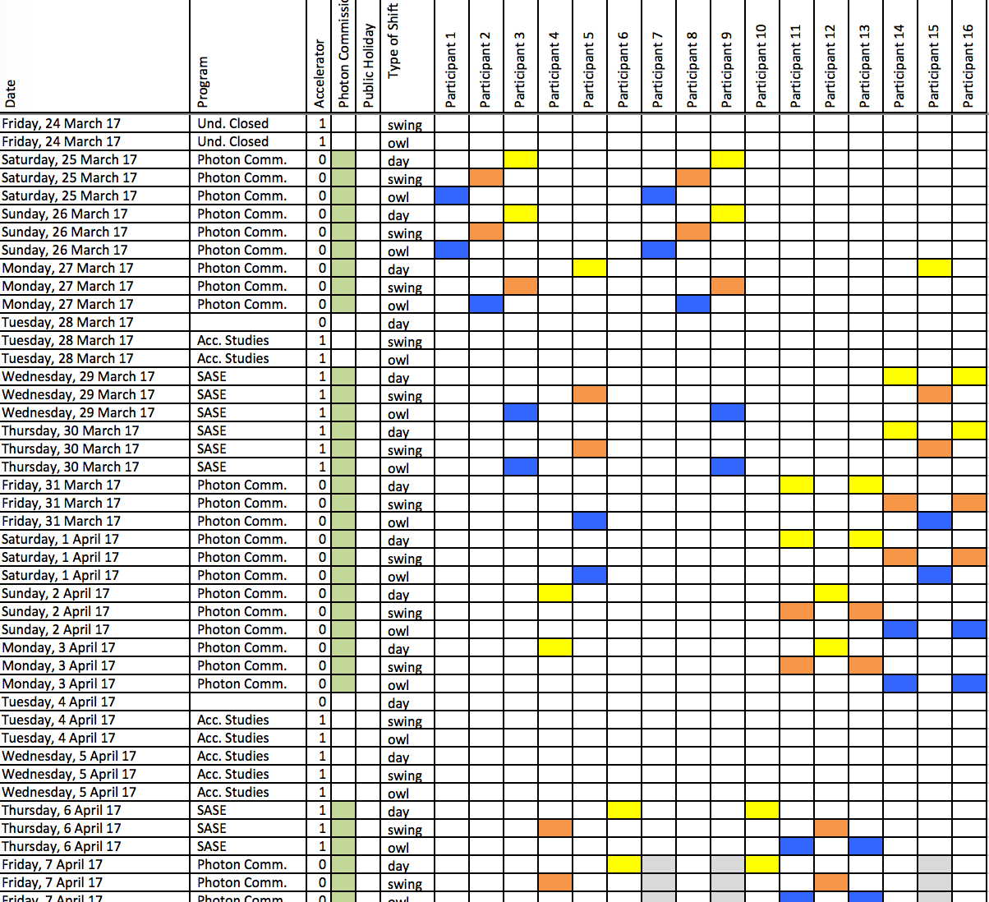
XFEL current discussions (with HR+works council)

Slide 8
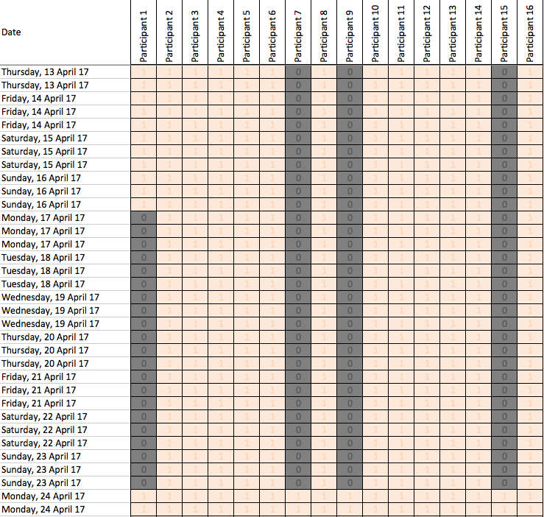
Input: Operation Plan + Vacation matrix (Excel)

Slide 9
Other issues
Two from photon team (Yuhui and Sergey) will work from January on in BRK (with DESY shift schedule)
Shift compensation scheme at XFEL under discussion. Similar to DESY scheme, but will be based on on hours on shift (month by month)
XFEL team needs to collect vacation + absence information

Slide 10
Ticket system
Purposes:
Being able to point out technical problems that show up during BKR commissioning
Make (EXFEL) workpackage leader aware of it (automated emails will be sent)
Trace resonses/actions (max. 2 weeks)
Communicate in 15:00 BKR meeting
Communicate in daily EXFEL meeting
and not:
Micro-manage long-term work of others
Project planning and issue archive

Slide 11
Ticket system
Redmine Project under XFEL domain
Go to:
https://in.xfel.eu/redmine/
.. and login with your DESY password
(will not be required later for looking, but for placing and answering ticktes)

Slide 12
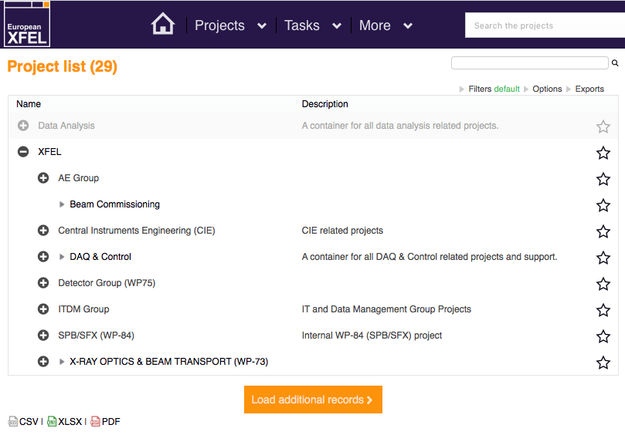

Slide 13
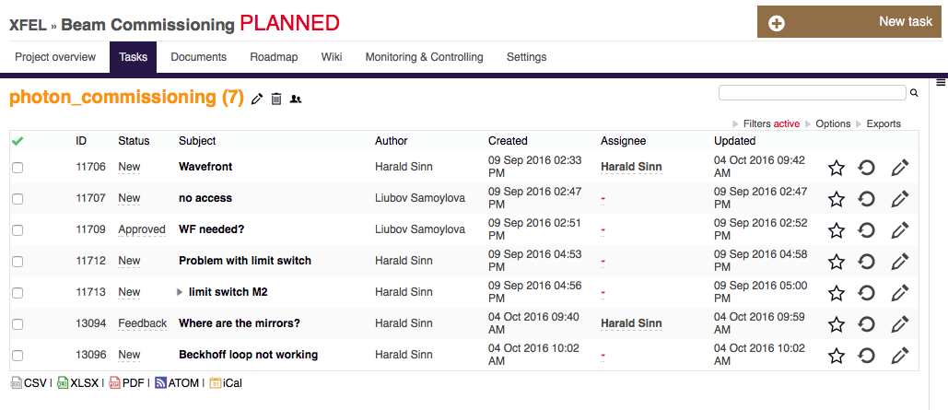
List of problems + responses

Slide 14
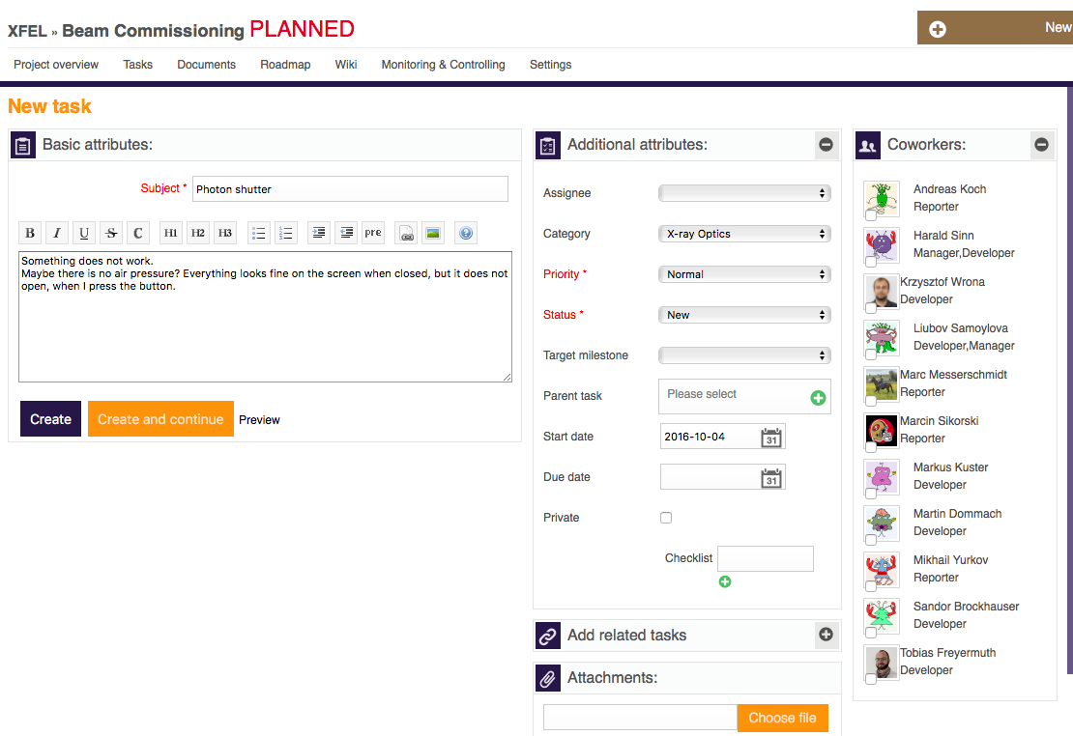
Enter a new ticket
Only write tickets for something that should (and can) be solved within max. 2 weeks!
Attributes are not so important (‘no category’ will go to me and will be assigned in meeting).

Slide 15
Concluding remarks
Redmine Ticket System:
For everybody, who is part of the commissioning team, please log in once in the Redmine system with your regular DESY/XFEL password. Only then I can assign a role.
At the moment the project ‘beam commissioning’ is in the ‘planned’ state, which means no messages are sent around.
It will become acrive next year (all old tickets will be erased then).
Shift planning:
Provide input on already known vacation/absence periods 2017 in Excel file (in Redmine ‘Documentation’ section).
Let me know, if you have more ideas and wishes on the shift distribution algorithm.

