Slide 1

Progress and next steps
15 December 2016 this version is the minutes of the meeting
J. J. John on behalf of the team

Slide 2
Agenda
Discuss progress and steps for next week:
  ABCN’ emulator
  firmware - SACI
  readout software
  CHESS-2-to-FMC adaptor board
  Other CHESS-2 hardware
  CHESS-2 mini-module
  Next meeting: will be Thursday 5 January.
  No meeting on Thursday 22 December.
  A reminder of the TWiki page for CHESS and its test hardware: https://twiki.cern.ch/twiki/bin/view/Atlas/CHESSStripTestChip

Slide 3
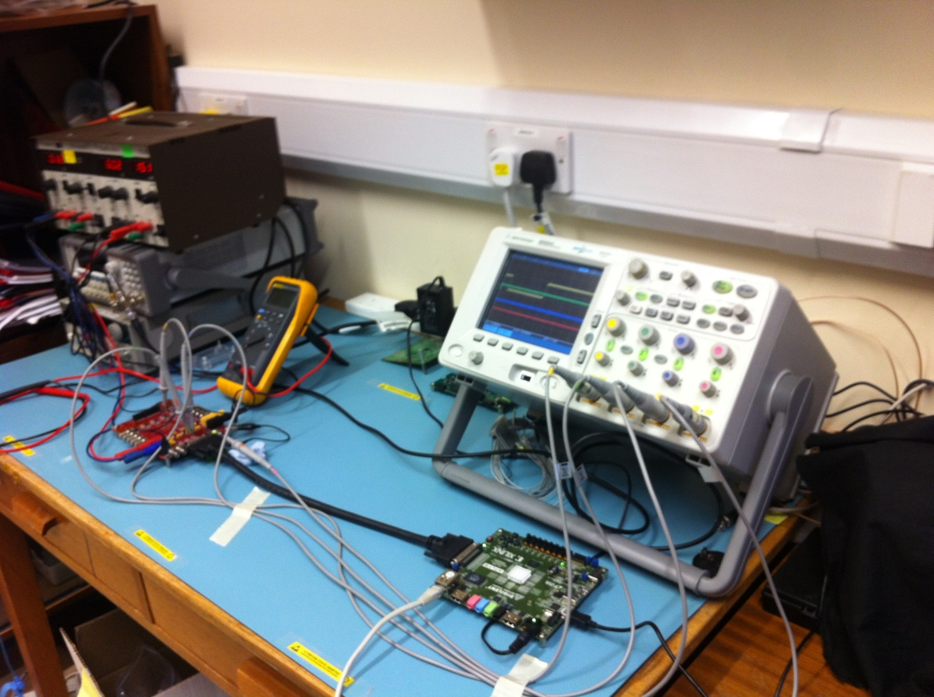
ABCN’ firmware status
  Current status:
  Jaya John to run additional test cases for completeness and prepare the regression set of tests.
    Matt integrated Wojtek’s SACI opcode block into the Atlys/CHESS-2 analogue system build – many thanks. This has been added to the ITSDAQ repository.
    Along the way, Matt updated the SACI opcode block to use a slow clock enable instead of the second clock, since the clock buffer isn’t available for the Spartan-6 on the Atlys.
    Jaya John is now running first tests of the SACI commands on the Atlys – debugging his software inputs to the SACI block.
    If there are any issues getting the expected SACI signalling out of the Atlys, then Jaya John will re-run the simulation test bench on the updated SACI opcode block code.
    Jaya John to send an update to Wojtek, Matt and Robin about how it goes with updated SACI opcode block and software, to save time all around.

Slide 4
ABCN’ software status
  Current status:
  Robin is away for the break but could well be coming back earlier.
  Once debugged, Jaya John to send his software code for running SACI commands to Robin, in case useful for comparison.

Slide 5
CHESS-2-to-FMC adaptor board status
  Current status:
  Assembly update: no news.
  Wojtek will check with Pavel whether the assembly house signed off the audit and if there is an updated delivery date.

Slide 6
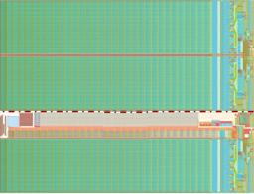
CHESS-2 mini-module
Updated sketch:
    Feedback from CMOS fortnightly meeting: move connectors to avoid dead space at bottom of tiled array.
    Next step: Jaya John to look at details of hybrid panel connector (still pending – was concentrating on SACI firmware for CHESS-2 analogue test set-up)
JTAG
clock?
ABCN’
(FPGA)
ABCN’
(FPGA)
power
hybrid panel connector

