Slide 1

Progress and next steps
5 January 2017 this version is the minutes of the meeting
J. J. John on behalf of the team

Slide 2
Agenda
Discuss progress and steps for next week:
  ABCN’ emulator
  firmware - SACI
  readout software
  CHESS-2-to-FMC adaptor board
  Other CHESS-2 hardware
  CHESS-2 mini-module
  TWiki page for CHESS and its test hardware: https://twiki.cern.ch/twiki/bin/view/Atlas/CHESSStripTestChip

Slide 3
ABCN’ firmware status
  Current status:
  Atlys firmware for CHESS-2/SACI up and running.
  Thanks to Wojtek for designing and coding it and to Matt for helping to integrate and finalise it.
  Will continue basic tests in Oxford and start working with CHESS-2 this week.

Slide 4
ABCN’ software status
  Current status:
  .
  [Done] Once debugged, Jaya John to send his software code for running SACI commands to Robin, in case useful for comparison.

Slide 5
CHESS-2-to-FMC adaptor board status
  Current status:
  .
CHESS-2 other hardware
  Current status:
  Pietro at SLAC has successfully tested the SACI interface using the digital CHESS-2 system.
  Hardware testing is well advanced. During testing, Larry identified some fixes on the carrier board and digital daughterboard which will be implemented in the next order of the boards.

Slide 6
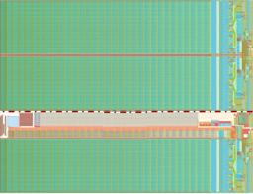
CHESS-2 mini-module
Current status: (same as last time)
    Next step: Jaya John to look at details of hybrid panel connector.
JTAG
clock?
ABCN’
(FPGA)
ABCN’
(FPGA)
power
hybrid panel connector

