Slide 1

Progress and next steps
12 January 2017 this version is the minutes of the meeting
J. J. John on behalf of the team

Slide 2
Agenda
Discuss progress and steps for next week:
  ABCN’ emulator
  firmware - SACI
  readout software
  CHESS-2-to-FMC adaptor board
  Other CHESS-2 hardware
  CHESS-2 mini-module
  TWiki page for CHESS and its test hardware: https://twiki.cern.ch/twiki/bin/view/Atlas/CHESSStripTestChip

Slide 3
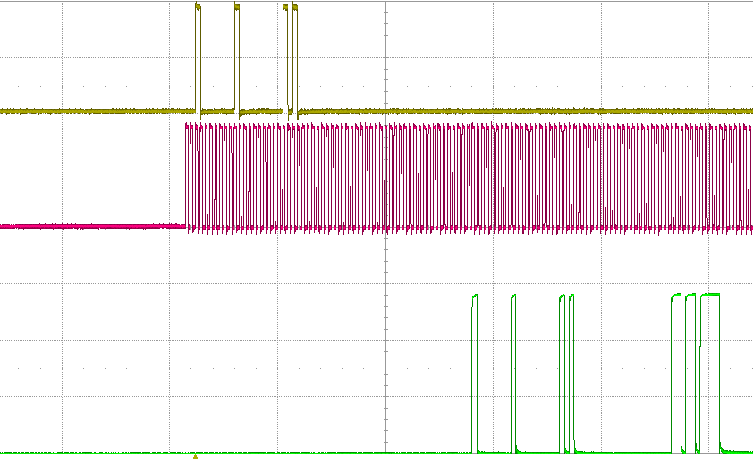
ABCN’ firmware status
  Current status:
  The Atlys firmware for SACI/CHESS-2 is fully working (version va113).
  Currently working with CHESS-2 in Oxford, Glasgow and Santa Cruz. So far we have read and written registers in the test array. We are working on charge injection now.
  So far, looking at SACI response on scope. We will later enhance software to report back the responses.
start
cmd 1
addr 5
SACI command
= read global register 5
SACI clock
data 0xebc
= power-up contents
cmd 1
addr 5
start
SACI response from CHESS-2
(test array)

Slide 4
ABCN’ firmware status, continued
  Current status:
  Nexys Video:
ABCN’ software status
  Current status:
  Robin working on the testing in the lab – looking at the sending of commands from software using a breakout board.

Slide 5
CHESS-2-to-FMC adaptor board status
  Current status:
  .
CHESS-2 other hardware
  Current status:
  Testing is continuing at SLAC, working towards a second build to distribute.
  From the TWiki page, the plans to run the carrier board in standalone mode (connecting to a PC over Ethernet without an HSIO-2) have been brought forward.

Slide 6
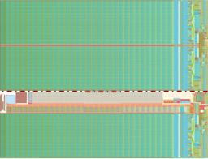
CHESS-2 mini-module
Current status: (same as last time)
    Next step: Jaya John to look at details of hybrid panel connector.
JTAG
clock?
ABCN’
(FPGA)
ABCN’
(FPGA)
power
hybrid panel connector

