Slide 1

Progress and next steps
26 January 2017 this version is the minutes of the meeting
J. J. John on behalf of the team

Slide 2
Agenda
Discuss progress and steps for next week:
  ABCN’ emulator
  firmware - SACI
  readout software
  CHESS-2-to-FMC adaptor board
  Other CHESS-2 hardware
  CHESS-2 mini-module
  TWiki page for CHESS and its test hardware: https://twiki.cern.ch/twiki/bin/view/Atlas/CHESSStripTestChip

Slide 3
ABCN’ firmware status
  Atlys firmware / CHESS-2 analogue test status:
  Very similar status to last week: still using Atlys firmware version va113.
  Still working on charge injection. SLAC is also working on this on the digital system, giving an independent check.
  We have resolved some motherboard issues (some changes made at Santa Cruz for CHESS-1 tripped up this phase a bit). We are seeing a daughterboard issue in Oxford seen on one board so far, DAC voltages seemingly dragged down, not seen at Santa Cruz.

Slide 4
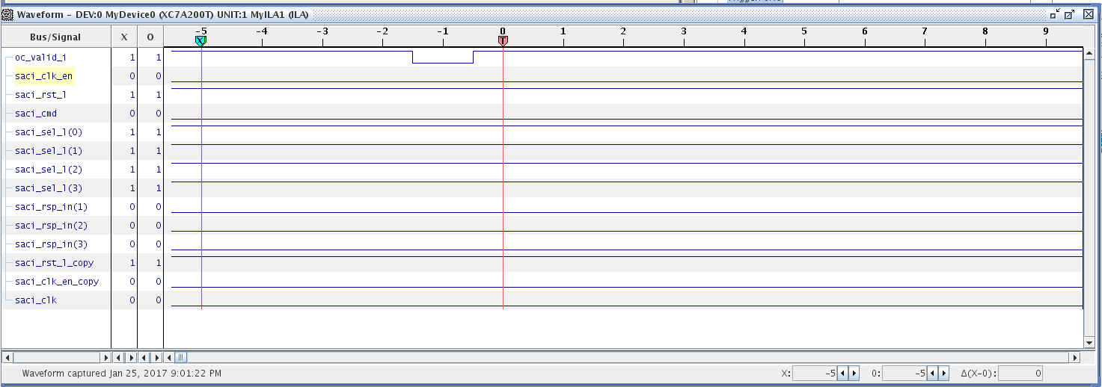
ABCN’ firmware status
  Nexys Video firmware and software status:
  A reminder to check these preset lines in itsdaq_top.vhd: (since minutes just posted)
    vadj_en <= '1';
    set_vadj <= "10"; -- 2.5V
  Currently debugging signals with ChipScope, screenshot below.
  The expected static signals are being sent out of the SACI module but do not seem to be making it to the FMC – not seen when probing the breakout board.

Slide 5
ABC130* developments
  (included here to summarise last week’s discussion, as minutes were just sent out)
  Keeping track:
  Matt and Weiguo will keep an eye on ABC130* changes and suggest when it would be good to resynchronise the ABCN’ codebase.
  For now it makes sense to carry on with our present code, but we should revisit this after a couple of months.
  Recent changes:
  The ABC130* team is working on a new control protocol. Ultimately the ABCN’ should use the same protocol.
  L0ID becomes L0Tag, for example.
  The new code will include test benches in svn.

Slide 6
CHESS-2-to-FMC adaptor board status
  Current status:
  Boards received at UBC!
  Pavel is doing initial low-level checks on the regulators and level shifters.
CHESS-2 other hardware
  Current status:
  Larry is working on the charge injection at the moment.
  SLAC is close to being able to send boards to UBC.
  They would like to see whether any further board modifications are needed related to charge injection, before sending.

Slide 7
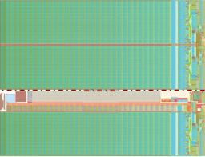
CHESS-2 mini-module
Current status:
    Now have hybrid panel connector pinout.
JTAG
clock?
ABCN’
(FPGA)
ABCN’
(FPGA)
power
hybrid panel connector

