Slide 1

Progress and next steps
26 January 2017 this version is the minutes of the meeting
J. J. John on behalf of the team

Slide 2
Agenda
Discuss progress and steps for next week:
  ABCN’ emulator
  firmware - SACI
  readout software
  CHESS-2-to-FMC adaptor board
  Other CHESS-2 hardware
  CHESS-2 mini-module
  TWiki page for CHESS and its test hardware: https://twiki.cern.ch/twiki/bin/view/Atlas/CHESSStripTestChip

Slide 3
ABCN’ firmware status
  Atlys firmware / CHESS-2 analogue test status:
  Very similar status to last week: still using Atlys firmware version va113.
  Still working on charge injection. SLAC is also working on this on the digital system, giving an independent check.
  We have resolved some motherboard issues at Santa Cruz: some changes made at only at Santa Cruz for CHESS-1 needed to be undone for CHESS-2 work.
  We are seeing a daughterboard issue in Oxford seen on one board so far, with 2 of the 4 DAC voltages from the motherboard getting dragged down on the daughterboard. This is not seen at Santa Cruz so seems to be with this particular daughterboard.

Slide 4
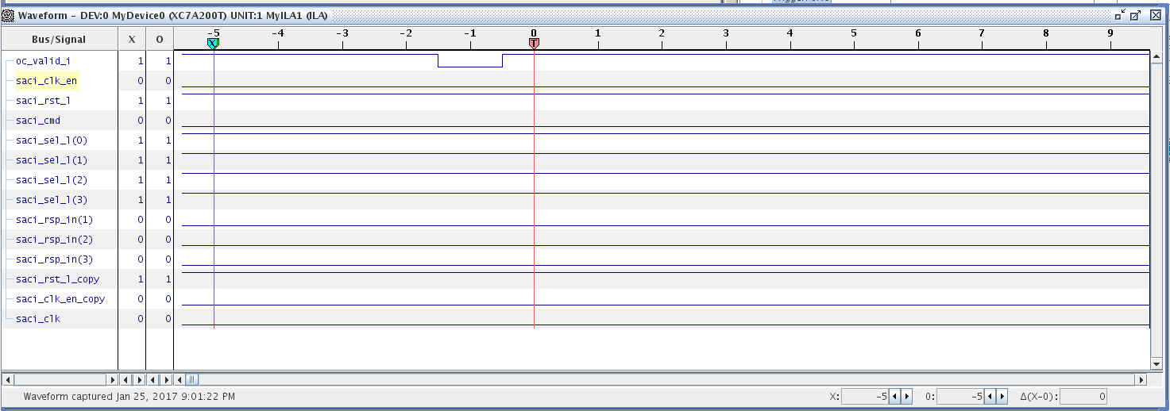
ABCN’ firmware status, continued
  Nexys Video firmware and software status:
  Robin and Wojtek are currently debugging signals with ChipScope, screenshot below.
  The VADJ adjustable bank voltage controls were checked and are as expected.
  The expected static signals are being sent out of the SACI module but do not seem to be making it to the FMC – not seen when probing the breakout board.

Slide 5
ABCN’ firmware status, continued
  Nexys Video firmware debugging suggestions:
  One possibility is that ISE optimised away some connections.
    Under Synthesize, look at View Technology Schematics. This shows what circuitry is left after optimisation, so you’d see if the SACI outputs reach the FPGA pins.
  For the SACI clock issue:
    In the latest ocb_saci.vhd from Matt (in ITSDAQ svn), saci_clk comes from:
      saci_clk <= not(tog_saci_clk_i) and saci_clk_en;
    tog_saci_clk_i is connected to tog_i(T_4MHz), ultimately from ticks_gen.vhd. You could check that this line is toggling.
    saci_clk_en is generated by the main state machine prc_async_machine. In the usual sequence, it becomes ‘1’ in state PayloadWordX (and remains ‘1’ until SendReply is reached).
    So it could help to monitor the current and next state of both the main state machine and the serialiser-deserialiser state machine with ChipScope . Perhaps the state machines are not starting up, or never reaching PayloadWordX in any case.
    If the expected states aren’t reached, can then look at the inputs to see why.

Slide 6
ABC130* developments
  (included here to summarise last week’s discussion, as minutes were just sent out)
  Keeping track:
  Matt and Weiguo will keep an eye on ABC130* changes and suggest when it would be good to resynchronise the ABCN’ codebase.
  For now it makes sense to carry on with our present code, but we should revisit this after a couple of months.
  Recent changes:
  The ABC130* team is working on a new control protocol. Ultimately the ABCN’ should use the same protocol.
  L0ID becomes L0Tag, for example.
  The new code is expected to include at least some test benches in subversion.

Slide 7
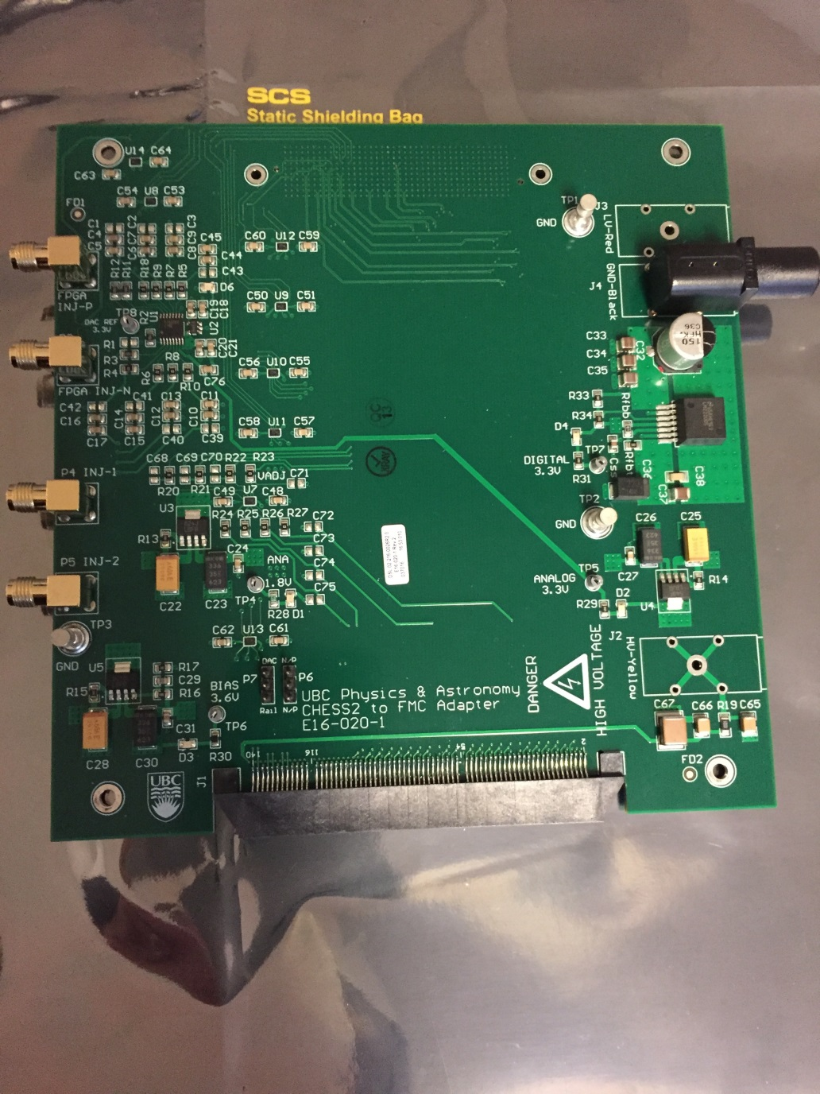
CHESS-2-to-FMC adaptor board status
  Current status:
  Boards received at UBC! The assembly looks good.
  Pavel is doing initial low-level checks on the regulators and level shifters, some completed already.
  He’ll next test the DACs with a microcontroller (for SPI).
  The power connectors are on their way (yellow and red not available in Canada for some reason)
  The footprint is asymmetrical, unusually, so the connectors need some adapting to fit.
  UBC will complete basic testing and then look at sending to other institutes.
  Colin will let us know about finances – perhaps via team accounts at CERN.

Slide 8
CHESS-2 other hardware
  Current status:
  Larry is working on the charge injection at the moment.
  SLAC is close to being able to send boards to UBC.
  They would like to see whether any further board modifications are needed related to charge injection, before sending.
CHESS-2 mini-module
Current status:
    Received 50-pin hybrid panel connector pinout from Ashley Greenall (Liverpool).
    The connector is the ITSDAQ standard 0.05" Samtec connector FTSH-125-01-F-DV
    This is organised as 13 signal pairs and 12 ground pairs, alternating, for constant impedance and to minimise cross-talk. The signal pairs are:
      1 x bunch crossing clock BCO
      1 x command COM
      1 x request line L1R
      8 x data
      2 x spare lines
    Next: go over data out requirements.

